Slide 1
Professional Software Development
Clare Macrae, CCDC
19th May 2017

Slide 2
Terms
“Professional” here means “good enough quality”
not just “programming for money”
lots of this applies to both open and closed source projects
lots of this applies to both small and large projects
plenty that you’ll be able to apply during your studies
“Good enough quality”
Nothing is ever perfect
Imperative not to spend ages on everything – need to be pragmatic
In some areas, I’ll mention terms with no detail – for later Googling, if interested
Notes:
If you can implement these principles in your studies, you’ll do well in your course/project, and they’ll stand you in good stead when job-hunting

Slide 3
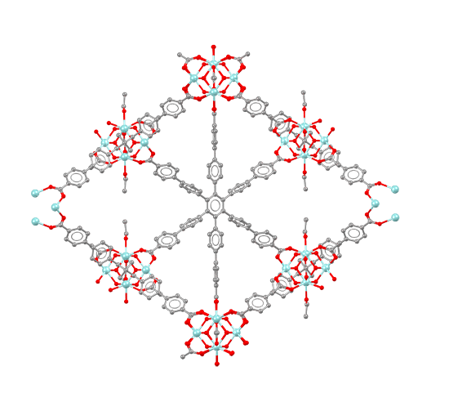
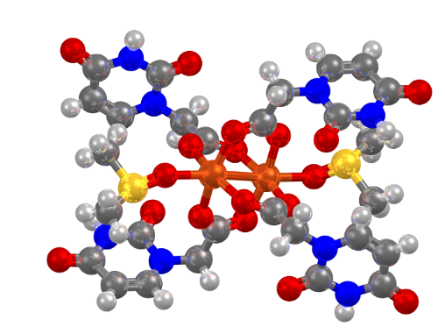
About CCDC and the CSD
Cambridge Crystallographic Data Centre
Around 70 staff in Cambridge, UK and Piscataway, New Jersey, USA
Non-profit company and registered charity
Cambridge Structural Database
Comprehensive, up-to-date database of crystal structures
Small-molecule organic and metal-organic crystal structures
Established 1965, > 50 years old!
Over 876,000 fully curated entries
Notes:
The CSD’s 800,000th entry TUWMOP: Ref: Khaled Hassanein, Oscar Castillo, Carlos J. Gómez-García, Félix Zamora, Pilar Amo-Ochoa, Crystal Growth and Design, 2015, DOI: 10.1021/acs.cgd.5b01110
The zirconium metal-organic framework, with pbz topology (CSD refcode: IXETEM, DOI: 10.5517/ccdc.csd.cc1m8m8s)

Slide 4
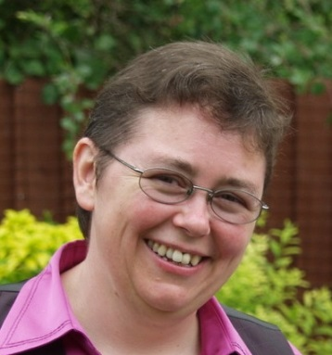
About Me
Been interested in programming since school days
Chemistry Degree from Brasenose College, Oxford
Part II in Prof Graham Richards’ group, 1986-87
Then to work on the Cambridge Structural Database – highlights:
Original author of Mercury crystal structure visualisation tool
https://www.ccdc.cam.ac.uk/solutions/csd-system/components/mercury/
CSD-Xpedite – total, radical over-haul of database systems
Biggest programming interests
C++, Qt, Python
Automation, automation, automation
macrae@ccdc.cam.ac.uk

Slide 5
What I love about software development
Helping people
Help solve their real-world problems
Save them time
Make them happy/happier
Continually learning
New techniques and, less so, new technologies
Detective work – sometimes challenging problems

Slide 6
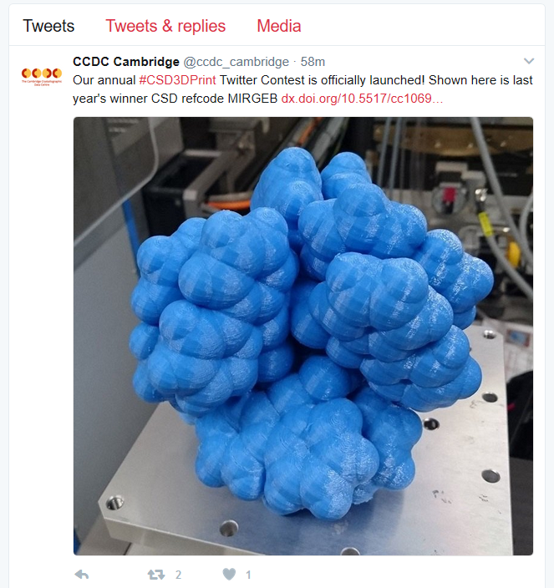
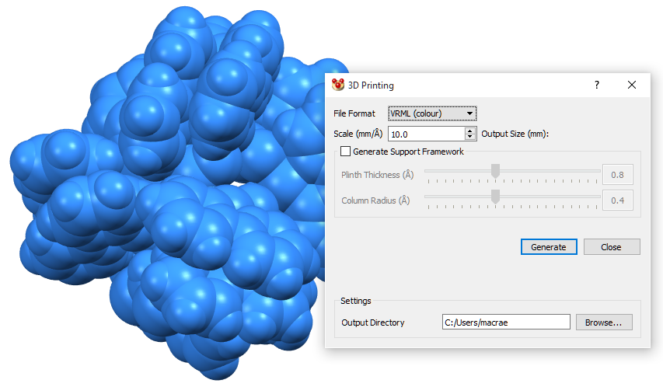
About Mercury
CCDC’s freely available Crystal Structure Visualisation Tool
Now with added 3D Printing!

Slide 7
Software development at CCDC over the decades
From:
One developer per product, working alone (often) for years
Much re-inventing of wheels
Not much re-using of code
User testing done close to release – harder to fix bugs
To:
Teams working together on shared goals
Pair programming
Testsuite
Testing done as each small feature is completed

Slide 8
Motivation: Actually solving problems!
At CCDC we write software to solve problems
mostly for other people (users, colleagues)
sometimes for ourselves
Our work has no real value until it is actually used to solve problems
What follows talks a lot about quality, sustainability, testability and so-on
These are not the goals, however…
The goal is actually releasing software and helping people
These tools and techniques just happen to make it easier to do that
Notes:
Some people talk about software that has been written but not released as being like manufactured items in a factory which are just inventory, gathering dust – the company has spent money on raw materials and staff and building costs, but is not getting any money back for those investments.

Slide 9
Challenges

Slide 10
How is this relevant to you?
These principles span from individual use through to managing massive projects
Modern scientists need to be able to script well – and there will be plenty of practical tips for you

Slide 11
Challenges: Long time-scales
Legacy Code
(For now), we still depend on a little Fortran77 code written in the 1980s, if not earlier
We have C++ code going back to 1999
We still have the history of all code written since 1992 – and seeing that history is still valuable
Wide range of languages
Some of which only 1 or 2 people here know at all
The original programmer’s left!
You can’t ask for help
Or maybe you wrote it a long time ago, and don’t remember!
Sometimes a few months feels like “a long time”
Notes:
Think about what life will be like in 2035 – only 20 years away, and it’ll be here before we know it – so help out your future self by using these techniques now!

Slide 12
Challenges: Large code-bases
Currently (May 2017) over 2.8 million lines of C++ code for us to maintain
including nearly 0.5 millions lines of tests
including comments
it’s mostly well-structured in re-usable/re-used libraries
we also depend on millions of lines of 3rd-party C++ libraries (e.g. Qt, Boost)
Lots of code shared between multiple projects
Pitfalls
No-one can be totally familiar with that volume of code
Can’t know all consequences of changing any code
Hard to spot existing code to re-use
Correctness and usability matters more than speed, for many applications

Slide 13
Challenges: Mistakes – and unintended behaviour
Many sources of bugs
Simple error – it never worked
Misunderstanding of requirements – it does the wrong thing
It used to work, and now it doesn’t:
A change in our underlying code affects higher-level code
A change in a 3rd-party library affects our code
For scientific research based on code, it’s important to know that the software is doing the right thing

Slide 14
Challenges: Too much to test
With very small programs, it can be fine to manually test every route through the program
As each later change and addition runs the risk of breaking earlier features, testing gets combinatorially more time-consuming

Slide 15
Challenges: Too much to do
No program is ever finished
Unless it’s being binned, never to be used again!
Deciding where to spend time
Given where we are now, what’s the best use of time?

Slide 16
Challenges: Temptation to rush
To work long hours, get tired and make mistakes
become less productive over time
To cut corners on implementation (building up “technical debt”)
and slow down later changes
https://en.wikipedia.org/wiki/Technical_debt
Vicious circle: this creates expectation of delivery at certain rate – and pressure to keep going

Slide 17
Challenges: Lots to learn and memorise
Switching between different languages
Switching between different projects

Slide 18
Any Questions?

Slide 19
Solutions

Slide 20
This really is what we do!
Everything I mention here…
is done by at least one team at CCDC
and often most or all teams
and often for many years
they are things that we have found have genuinely speeded up our work, and our releases
we didn’t invent the techniques – they are in widespread use in industry and open source projects
feedback we get from interview candidates and new recruits is that we do better, overall, than many other companies they have worked with

Slide 21
Solution: Version control
Use a tool to keep track of all changes to all ingredients of your program
source code
build and distribution scripts
Provides free time travel
what has changed
show me the code as it was on such-and-such date…
delete the edits I just made, that broke my program!

Slide 22
Solution: Version control
You can do this
There are many such tools, and free public services
git – available e.g. from github, bitbucket
mercurial – available from bitbucket
we have used mercurial very successfully for several years
You can also use version control systems on your local machine

Slide 23
Solution: Version control - Issues
Only as good as the comments used when committing files
Much more effective when each revision represents one change
When you release a version, give it a named tag – helps with support

Slide 24
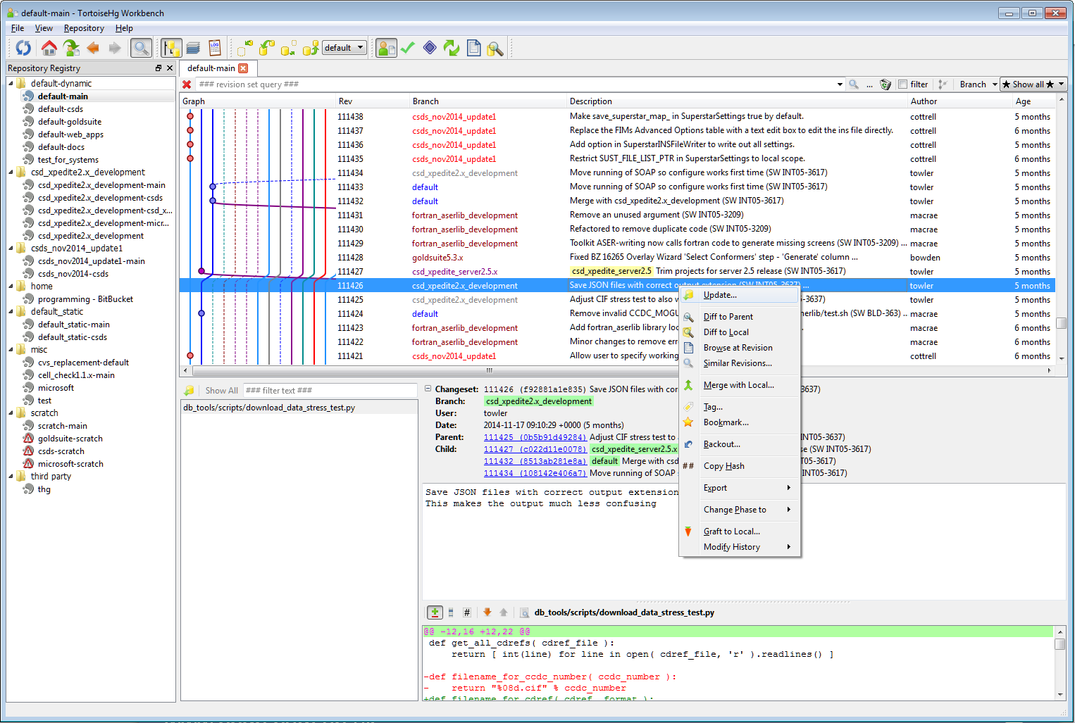

Slide 25
Solution: Work sustainably
We have mini-deadlines every two weeks, rather than massive deadlines every few months
Avoid working long hours – just get more tired and less effective
You can do this!
Notes:
We look for variety in our work
Take a step back

Slide 26
Solution: Emphasize Code Quality
From user perspective:
High reliability
Few bugs
From developer perspective:
Easy to read
Easy to add and modify code
Easy to re-use
There are formal measurements – all have limitations, however
Code can be great from user’s perspective, but not from developer’s
Equally, beautiful code is no use if it doesn’t help the user!

Slide 27
Solution: Emphasize Code Quality
You can do this:
Read up on good programming principles
#1: DRY – “Don’t Repeat Yourself”
https://en.wikipedia.org/wiki/Don%27t_repeat_yourself
#2: Single responsibility principle
https://en.wikipedia.org/wiki/Single_responsibility_principle

Slide 28
Solution: Unit Tests
Each area of code includes a special program – “testsuite” – to test that components behave correctly
These are run by:
developers when changing code
automated build systems
They give developers freedom and confidence to change and improve code
Make a change (and add a test for it)
Run the existing tests
Know that it’s good
Issues:
It takes effort to learn to write good, effective, fast tests
Badly written tests can give the illusion of safety, but just waste time needing to be maintained

Slide 29
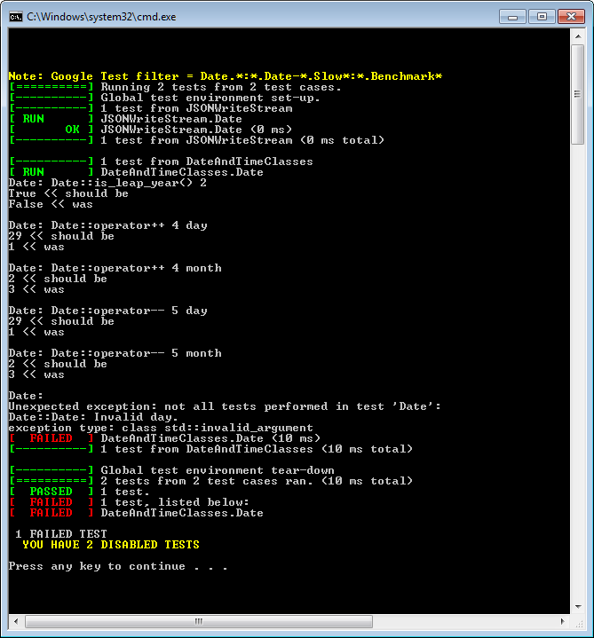

Slide 30
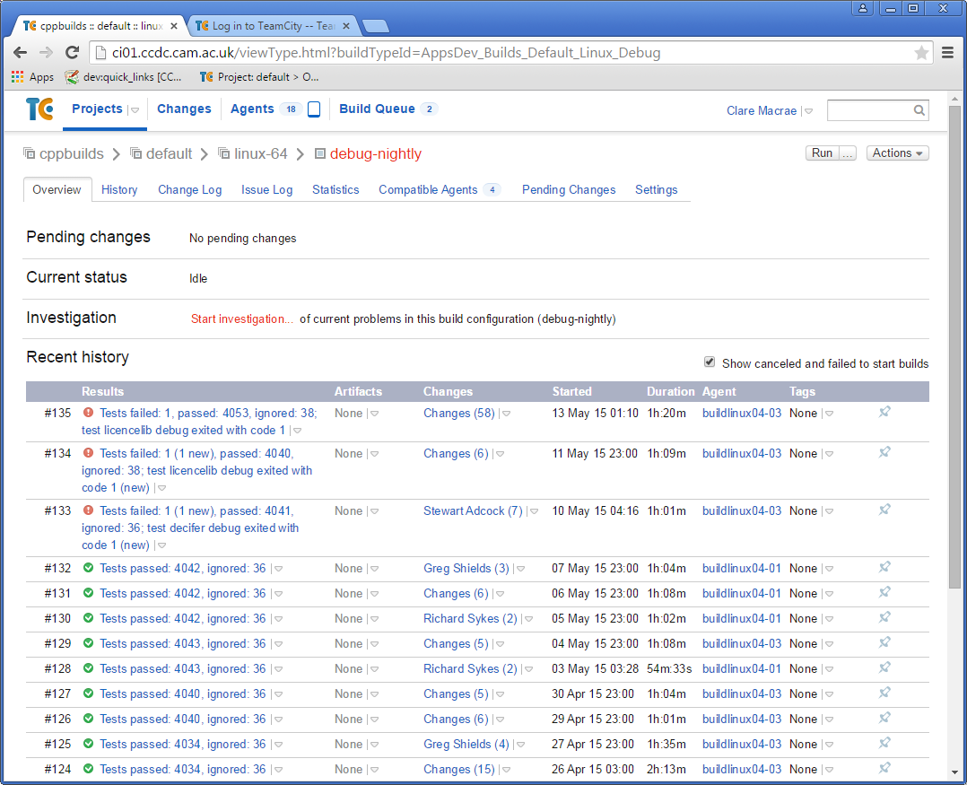
Notes:
This is the TeamCity build server we use at CCDC – with an example screenshot, showing a sequence of builds where the tests all passed, and then 3 most recent builds, where 1 test failed.
This allows new problems to be found and fixed very quickly.

Slide 31
Solution: Unit Tests
You can do this:
Learn about a testing framework in your language (e.g. PyUnit)
Write tests for your code
And run the tests every time you make a change
Big bonus points!
Look for “Continuous Integration” tools that work with your version control system and your language(s)
https://en.wikipedia.org/wiki/Continuous_integration
And use these to build and test your software, every time you make a change, e.g. for Python
https://docs.travis-ci.com/user/languages/python/
https://travis-ci.org/simplejson/simplejson

Slide 32
Solution: Testing by humans
In the past, we have tended to only focus on testing before major releases
Time-consuming, inefficient, not very effective (as so much to test)
Code is long-forgotten by the time bugs are reported
Now, as each new feature is implemented, someone tests and gives feedback
Usually within 1 day
We still do some more general testing before releases
Trying to minimise this

Slide 33
Solution: Testing by humans
You can do this:
Test each other’s projects
Deliberately try breaking things (“exploratory testing”)
https://en.wikipedia.org/wiki/Exploratory_testing
Do you understand how to use it?
Testing is a useful skill
Also useful to learn how to give critical feedback in a supportive way!

Slide 34
Solution: Use tools to save you time
For example, many use simple text editor to edit Python
Instead, pick a tool that is aware of the language, and saves time – less typing, and less memorising
Example: PyCharm – helps you find errors as soon as you make them!
https://www.jetbrains.com/pycharm/
Use a debugger
when the code isn’t behaving correctly
and to understand existing code

Slide 35
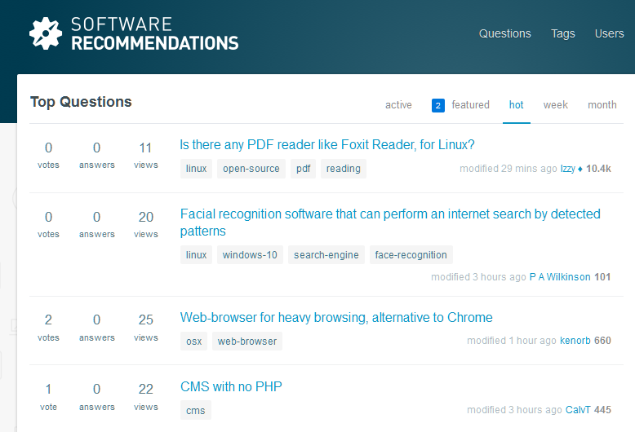
Solution: Use tools to save you time
You can do this!
Search websites like StackOverflow to find recommendations for tools in the languages you’re using
Also “Software Recommendations” http://softwarerecs.stackexchange.com/

Slide 36
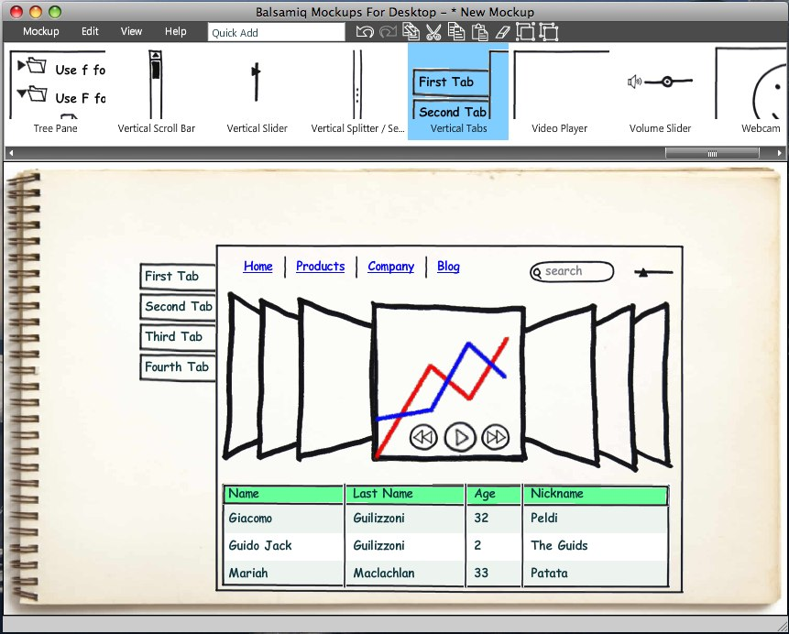
Solution: Do paper tests of software first
https://www.flickr.com/photos/doglotion/2715361146/
The tool used here is Balsamiq: https://balsamiq.com/
Notes:
Sketch out how the software will work/look – and talk to users to see if it makes sense, or they can suggest ways to improve it.
This is *much* cheaper than implementing it, and then finding it could have been better, or had real problems.

Slide 37
Solution: Agile software development
Definition: Any set of tactics that enable a prioritised stream of useful results, in spite of a changing environment (Tom Gilb)
Culture of continuous improvement
Works best in trusting environments
Equally, the transparency and visibility helps with building trust
Doing experiments to learn:
About technology
About ways of implementing needs of users

Slide 38
Agile at CCDC
Multiple “SCRUM” teams
https://en.wikipedia.org/wiki/Scrum_(software_development)
Each working on defined areas and technologies
Each with a “Product Owner”
dedicated person who understands user group’s needs and area of work
acts as conduit between development team and users
Above that, four “Product Managers” who set the long-term vision, and short-term direction, of what we should deliver

Slide 39
Conclusions

Slide 40
Summary
These practices really do result in happier developers and happier users!
They can require a strong culture of improvement to adopt them, but it is worth it!
You can do this!
Do try out some of these ideas and tools
Keep looking for ways to improve what you do – and share tips and tricks with each other!

Slide 41
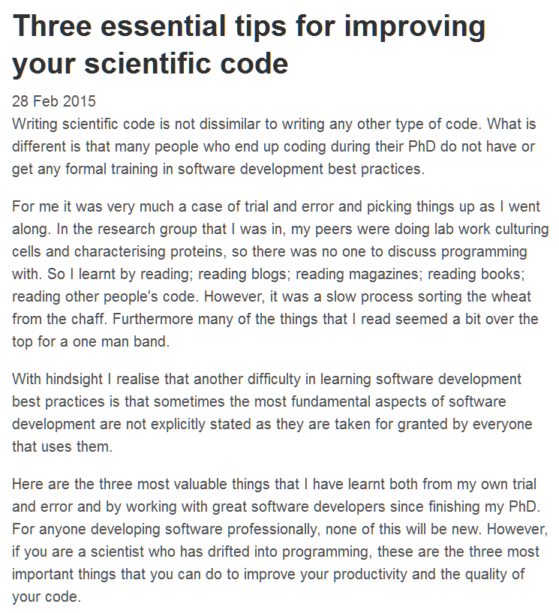
References and Resources
Blog: http://tjelvarolsson.com/posts/
http://tjelvarolsson.com/blog/three-essential-tips-for-improving-your-scientific-code/

Slide 42

https://pragprog.com/the-pragmatic-programmer

Slide 43
Any Questions?

