Slide 1
Langdon Winner, “Do Artifacts Have Politics?”

Slide 2
Artifact = ?

Slide 3
Artifact = human-made object with a creator
Technological artifact = artifact made to be used for some purpose or function
Meant to exclude:
Objects with a function but not a (human) creator
Byproducts
Waste products
Some works of art

Slide 4
Politics = “arrangements of power and authority in human associations as well as the activities that take place within those arrangements”
What does it mean to say that an artifact “has politics”?

Slide 5
“Obvious” claim
“Technical systems of various kinds are deeply interwoven in the conditions of modern politics. The physical arrangements of industrial production, warfare, communications, and the like have fundamentally changed the exercise of power and the experience of citizenship” (122)
Examples?
Notes:
Factories – conversion of the economy from feudalism to industrial capitalism to the more service-based economy we have today
Television – massive effect on political campaigns
Development of atomic weapons – changed the way wars are fought

Slide 6
Technologies as politically neutral
”But to go beyond this obvious fact and to argue that certain technologies in themselves have political properties seems, at first glance, completely mistaken. We all know that people have politics, not things. … Blaming the hardware appears even more foolish than blaming the victims when it comes to judging conditions of public life” (122).

Slide 7
“The issues that divide or unite people in society are settled not only in the institutes and practices of politics proper, but also, and less obviously, in tangible arrangements of steal and concrete, wires and transistors, nuts and bolts.” (p. 128)

Slide 8
“By far the greatest latitude of choice exists the very first time a particular instrument, system or technique is introduced … since choices tend to become strongly fixed in material equipment, economic investment, and social habit.” (p. 127)
Notes:
Once the relevant political issues are settled (partly by technology), they can be difficult to reverse, because they have been embedded in technical arrangements that are difficult to reverse

Slide 9
Technologies as having politics built in
Technical Arrangements as “Forms of Order” = “instances in which the invention, design, or arrangement of a specific technical device or system becomes a way of settling an issue in a particular community” (123)
“Inherently Political” Technologies = “man-made systems that appear to require, or to be strongly compatible with, particular kinds of political relationships”
Notes:
Two ways to interpret the claim that technologies “have politics”
What does he mean by a “technical arrangement”

Slide 10
Technologies as having politics built in
Technical Arrangements as “Forms of Order” = “instances in which the invention, design, or arrangement of a specific technical device or system becomes a way of settling an issue in a particular community” (123)
“Inherently Political” Technologies = “man-made systems that appear to require, or to be strongly compatible with, particular kinds of political relationships”
Notes:
Two ways to interpret the claim that technologies “have politics”

Slide 11
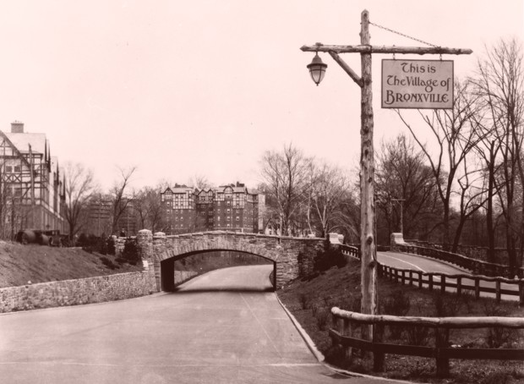
Notes:
Robert Moses’ Parkways on Long Island – early 20th century
* What political issue is being settled by the way Moses designed the bridges on the parkways in Long Island?
“This summer, as New Yorkers head out to Long Island’s beach towns and parks on the Southern State Parkway, they’ll pass beneath a series of overpass bridges made infamous in Robert A. Caro’s monumental 1974 biography of Robert Moses, The Power Broker.
In one of the book's most memorable passages, Caro reveals that Moses ordered his engineers to build the bridges low over the parkway to keep buses from the city away from Jones Beach—buses presumably filled with the poor blacks and Puerto Ricans Moses despised. The story was told to Caro by Sidney M. Shapiro, a close Moses associate and former chief engineer and general manager of the Long Island State Park Commission.”
“The parkway was just that—a way through a park. It was designed to both literally and figuratively remove you from the city, a Central Park for the motorist. Berms and lush plantings screened off-site views disruptive of the reverie, creating an almost cinematic impression of driving through a vast pastoral landscape.”

Slide 12
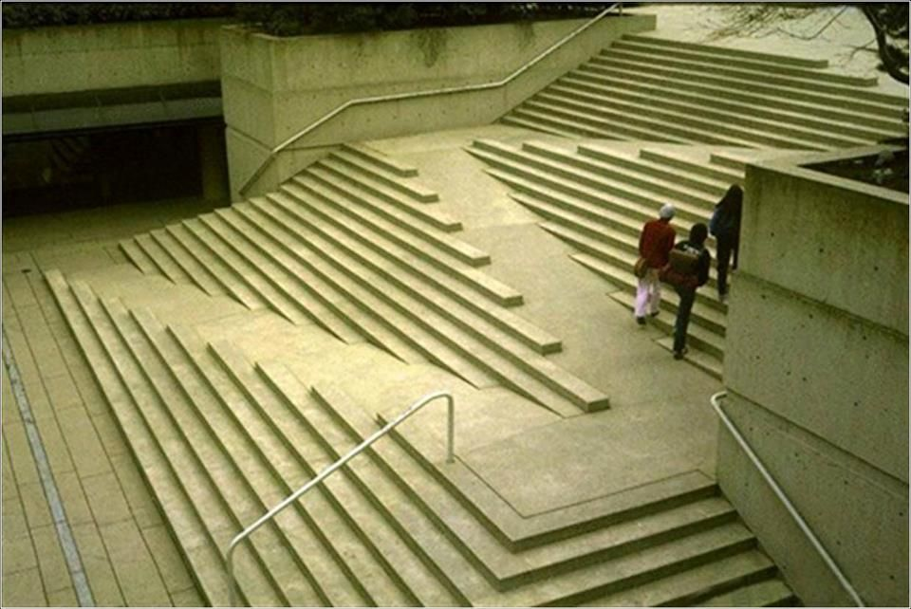
Notes:
What political issue is being settled?

Slide 13
“The organized movement of handicapped people in the United States during the 1970s pointed out the countless ways in which machines, instruments, and structures of common use – buses, buildings, sidewalks, plumbing fixtures, and so forth – made it impossible for many handicapped persons to move about freely, a condition that systematically excluded them from public life. It is safe to say that designs unsuited for the handicapped arose more from long-standing neglect than from anyone’s active inattention.” (125)
Notes:
What political issue is being settled?

Slide 14

Notes:
What political issue is being settled?

Slide 15
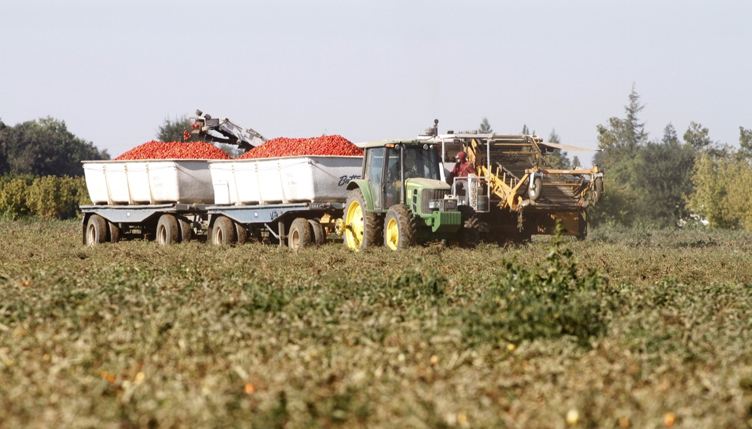
Hell
Notes:
What political issue is being settled?

Slide 16
foreseen political effect, w/political intention

Slide 17
foreseen political effect, w/political intention
unforeseen political effect, w/o political intention

Slide 18

foreseen political effect, w/political intention
unforeseen political effect, w/o political intention
foreseen political effect, w/o political intention

Slide 19
“By far the greatest latitude of choice exists the very first time a particular instrument, system or technique is introduced … since choices tend to become strongly fixed in material equipment, economic investment, and social habit.”
“A second range of choices, equally critical in many instances, has to do with specific features in the design or arrangement of a technical system after the decision to go ahead with it has already been made”
Notes:
Two ways in which designers of technologies help settle political issues

Slide 20
“The issues that divide or unite people in society are settled not only in the institutes and practices of politics proper, but also, and less obviously, in tangible arrangements of steal and concrete, wires and transistors, nuts and bolts.” (p. 128)
Do the points Winner makes about physical artifacts apply to algorithms as well? Why or why not?

Slide 21
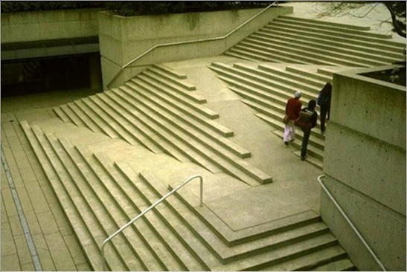
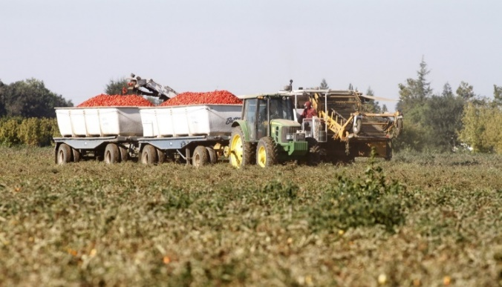
“TECHNICAL ARRANGEMENTS AS FORMS OF ORDER”

Slide 22
“TECHNICAL ARRANGEMENTS AS FORMS OF ORDER”
“INHERENTLY POLITICAL TECHNOLOGIES”
?

Slide 23
Technologies as having politics built in
Technical Arrangements as “Forms of Order” = “instances in which the invention, design, or arrangement of a specific technical device or system becomes a way of settling an issue in a particular community” (123)
“Inherently Political” Technologies = “man-made systems that appear to require, or to be strongly compatible with, particular kinds of political relationships”
Notes:
Two possibilities here:
Technology requires particular kinds of political relationships
Technology is strongly compatible with certain kinds of political relationships

Slide 24
Inherently political technologies
Technologies that require a certain power structure

Slide 25
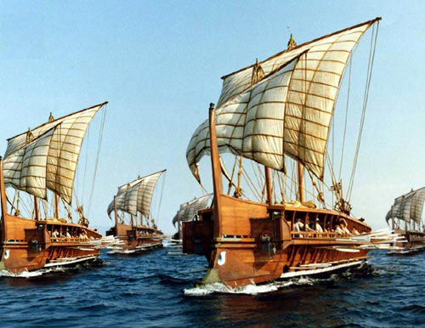
Notes:
Trireme – Greek ship from Plato’s time
The total complement (plērōma) of the ship was about 200.^{[35][36]} These were divided into the 170 rowers (eretai), who provided the ship's motive power, the deck crew headed by the trierarch and a marine detachment. For the crew of Athenian triremes, the ships were an extension of their democratic beliefs. Rich and poor rowed alongside each other. Victor Davis Hanson argues that this "served the larger civic interest of acculturating thousands as they worked together in cramped conditions and under dire circumstances."^{[37]}

Slide 26
“As long as [the atom bomb] exists, its lethal properties demand that it be controlled by a centralized, rigidly hierarchical chain of command closed to all influences that might make its workings unpredictable” (p. 131)

Slide 27
The internal social system of the bomb must be authoritarian; there is no other way. (p. 131)

Slide 28
Inherently political technologies
Technologies that require a certain power structure
Technologies that strongly facilitate a certain power structure
VS.

Slide 29
Are there technologies that require a certain power structure by their very nature?
Notes:
Sailing ships?
Atomic weapons?
Other examples?

Slide 30
Are there technologies that strongly facilitate certain power structures by their very nature?
Notes:
We’ll talk about a specific example – on the next slide

Slide 31
“I think if we turn our back on China and isolate China things will get worse. Imagine if the Internet took hold in China. Imagine how freedom would spread. Our greatest export to the world has been, is and always will be the incredible freedom we understand in America.” George W. Bush

Slide 32
foreseen political effect, w/political intention
unforeseen political effect, w/o political intention
foreseen political effect, w/o political intention
A
B
C
In groups, identify a novel example in each category, starting with the category assigned to your group

