Slide 1

Rockbuster Stealth LLC
Data Analysis in support of 2020 company strategy
David Griesel

Slide 2




Objective
Provide data-driven insights derived from the existing database to address business questions posed by Management.
Tableau Dashboard

Slide 3
Key Questions
1. Which movies contributed the most / least to revenue gain?
2. What was the average rental duration for all videos?
3. Which countries are Rockbuster customers based in?
4. Where are customers with a high lifetime value based?
5. Do sales figures vary between geographic regions?

Slide 4
Existing Catalogue
958 Films
16 Categories
5 Ratings
1 Release Year (2006)
1 Language (English)

Slide 5
Existing Client Base
599 Customers
108 Countries
597 Cities

Slide 6
The Analysis Question 1: Which movies contributed the most / least to revenue gain?

Slide 7
The Analysis Question 2: What was the average rental duration for all videos?
Rental Duration (days) | Number of Transactions | Min Actual Duration | Max Actual Duration | Average Actual Duration
3 | 3 366 | 0 | 10 | 5
4 | 3 213 | 0 | 10 | 5
5 | 3 132 | 0 | 10 | 5
6 | 3 352 | 0 | 10 | 5
7 | 2 798 | 0 | 10 | 5
All | 15 861 | 0 | 10 | 5

Slide 8
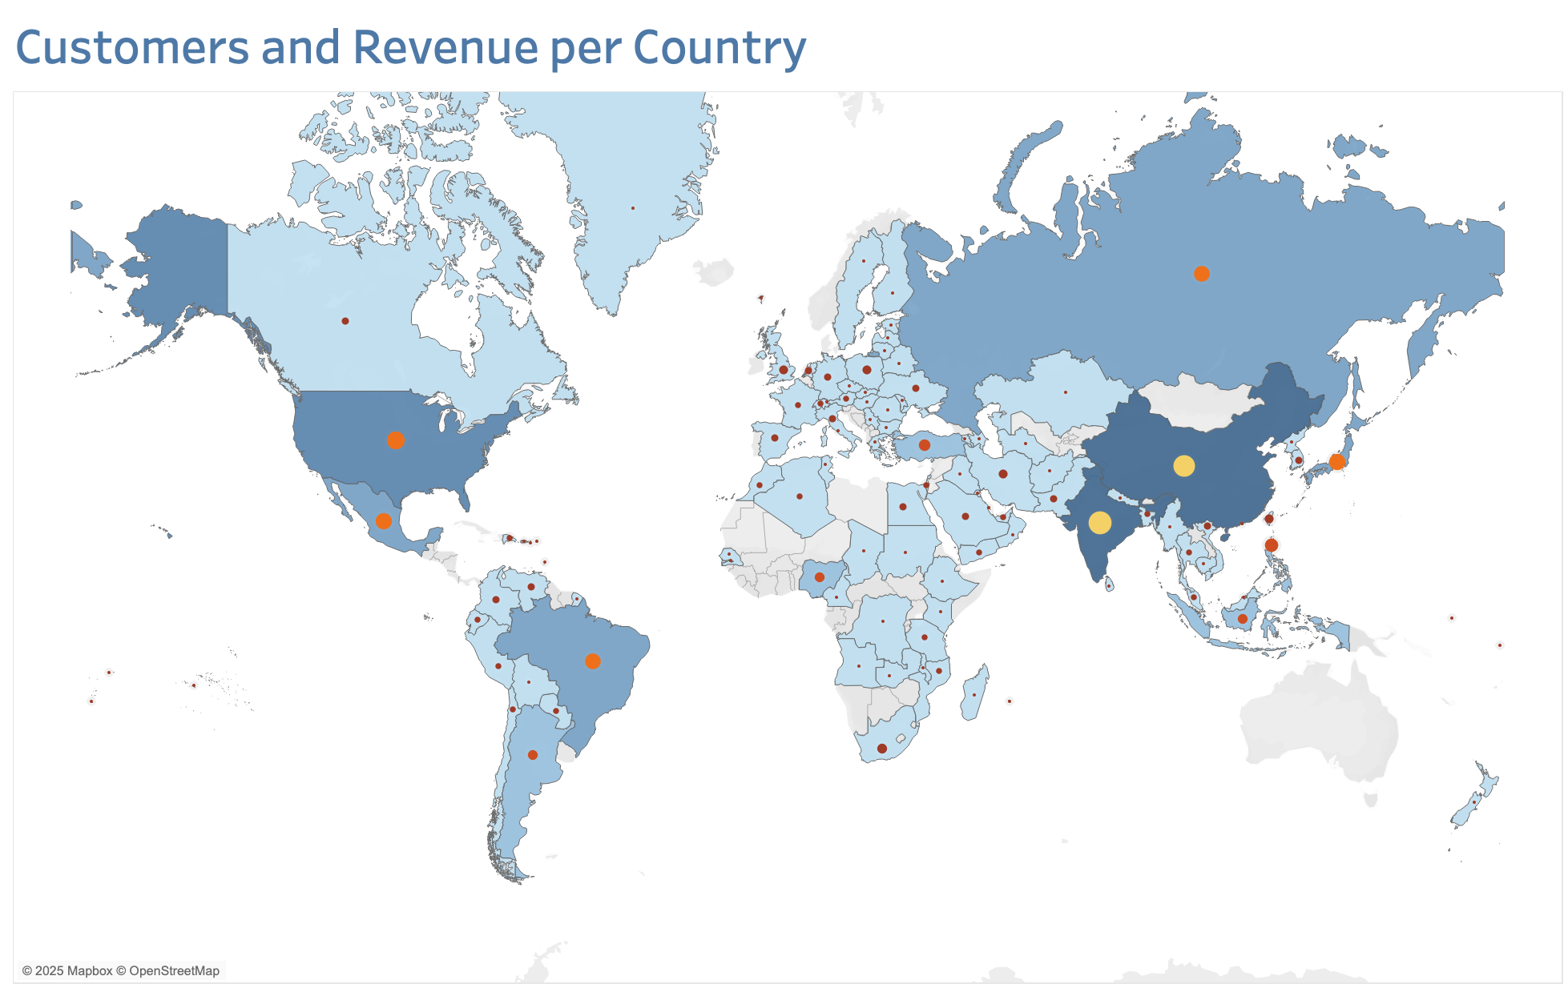
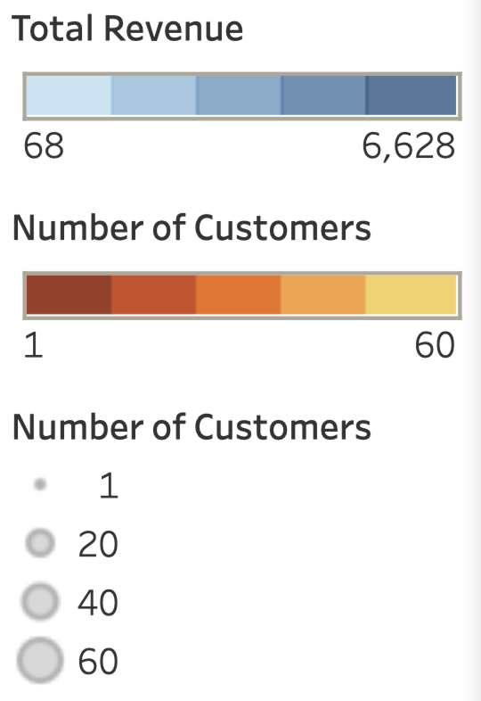
The Analysis Question 3: Which countries are Rockbuster customers based in?
Rank | Top 10 Countries | Number of Customers
1 | India | 60
2 | China | 53
3 | United States | 36
4 | Japan | 31
5 | Mexico | 30
6 | Brazil | 28
7 | Russian Federation | 28
8 | Philippines | 20
9 | Turkey | 15
10 | Indonesia | 14
Rank | Top 10 Countries | Total Revenue (¤)
1 | India | 6 628
2 | China | 5 799
3 | United States | 4 110
4 | Japan | 3 471
5 | Mexico | 3 307
6 | Brazil | 3 201
7 | Russian Federation | 3 046
8 | Philippines | 2 381
9 | Turkey | 1 662
10 | Indonesia | 1 510

Slide 9
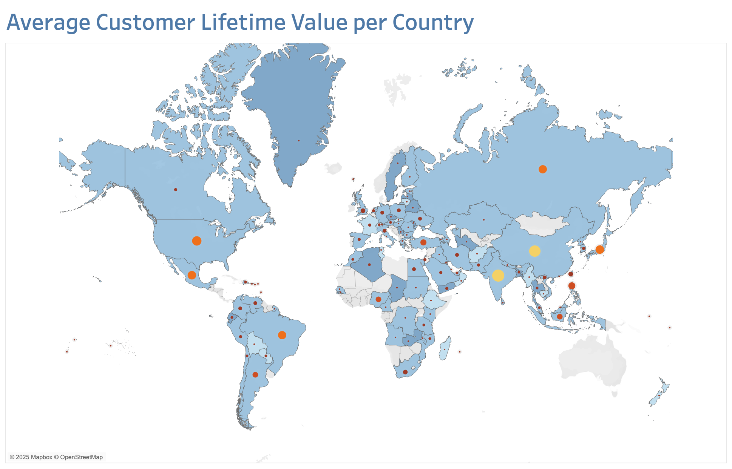
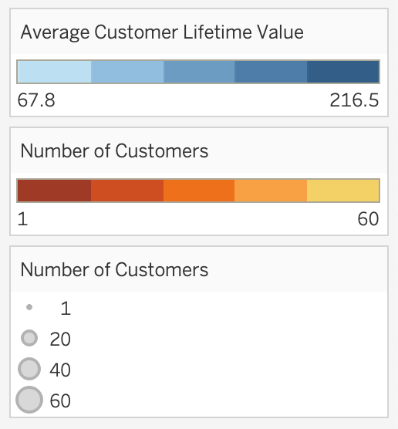
Country | Number of Customers | Average CLV
Réunion | 1 | 216.54
Vatican City | 1 | 152.66
Nauru | 1 | 148.69
Sweden | 1 | 144.66
Hong Kong | 1 | 142.70
Thailand | 3 | 139.68
Belarus | 2 | 138.67
Greenland | 1 | 137.66
Turkmenistan | 1 | 136.73
Chad | 1 | 135.68
The Analysis Question 4: Where are customers with a high lifetime value based?

Slide 10
The Analysis Question 5: Do sales figures vary between geographic regions?

Slide 11
Summary
The catalogue features 958 titles across 16 genres and 5 ratings, all in English and released in 2006.
The customer base comprises 599 customers across 108 countries and 597 cities.
The top 5 revenue-generating films earned between ¤205 and ¤232, while 7 films shared the bottom five positions, generating between ¤6 and ¤8.
Rental durations across all terms ranged from same-day returns to a maximum of 10, with an average duration of 5 days.
Total revenue by country varied from ¤68 to ¤6,628, with customer counts between 1 and 60. India led in both customer numbers and total revenue, followed closely by China, and the United States.
Average customer lifetime value (CLV) varied between ¤68 to ¤217, with Réunion having the highest CLV, followed by Vatican City and Nauru.
The Asia-Pacific region emerged as the clear leader ¤26 468 in sales and 235 customers, while Latin America performed the worst selling ¤8 096 from 73 customers.

