Slide 1

Rockbuster Stealth LLC
Data Analysis in support of 2020 company strategy
David Griesel
Tableau Dashboard

Slide 2




Overview
Customer Base
Customers | 599
Countries | 108
Cities | 597
Film Catalogue
Titles in Inventory | 958
Categories | 16
Ratings | 5
Languages | 1 (English)
Release Years | 1 (2006)
Revenue Earned | Amount (¤)
Paid | 60 785
Accrued | 6 103
Total | 66 888

Slide 3
Key Questions
1. Which movies contributed the most / least to revenue gain?
2. What was the average rental duration for all videos?
3. Which countries are customers based in?
4. Where are customers with a high lifetime value based?
5. Do sales figures vary between geographic regions?

Slide 4
Question 1 Which movies contributed the most / least to revenue gain?
The distribution of revenue was highly uneven with the top five highest-grossing titles each earning over ¤200, while the lowest performers brought in less than ¤8 each.

Slide 5
Question 2 What was the average rental duration for all videos?
Summary Statistics - Actual Rental Duration per Rental Term
Rental Term (Days) | Number of Transactions | Minimum Actual Duration | Maximum Actual Duration | Average Actual Duration
3 Days | 3 366 | 0 | 10 | 5
4 Days | 3 213 | 0 | 10 | 5
5 Days | 3 132 | 0 | 10 | 5
6 Days | 3 352 | 0 | 10 | 5
7 Days | 2 798 | 0 | 10 | 5
All Terms | 15 861 | 0 | 10 | 5
While each film was assigned a fixed rental term between 3 and 7 days, actual return behaviour showed little variation, ranging from same-day returns to as long as 10 days, with an average of 5 days.
Transaction Distribution - Actual Rental Duration per Rental Term
Rental Term | Actual Duration
 | 0 Days | 1 Days | 2 Days | 3 Days | 4 Days | 5 Days | 6 Days | 7 Days | 8 Days | 9 Days | 10 Days
3 Days | 18 | 356 | 370 | 371 | 358 | 400 | 366 | 357 | 385 | 360 | 25
4 Days | 22 | 309 | 361 | 369 | 339 | 337 | 401 | 358 | 363 | 335 | 19
5 Days | 26 | 336 | 375 | 337 | 327 | 331 | 344 | 361 | 346 | 335 | 14
6 Days | 22 | 342 | 371 | 354 | 356 | 383 | 372 | 430 | 355 | 345 | 22
7 Days | 17 | 301 | 318 | 283 | 301 | 310 | 300 | 315 | 313 | 316 | 24
All Terms | 105 | 1644 | 1795 | 1714 | 1681 | 1761 | 1783 | 1821 | 1762 | 1691 | 104
Most returns were evenly distributed between 1 and 9 days regardless of the assigned duration, with notably fewer same-day and 10-day returns, suggesting that assigned terms had limited influence on actual return behaviour.

Slide 6
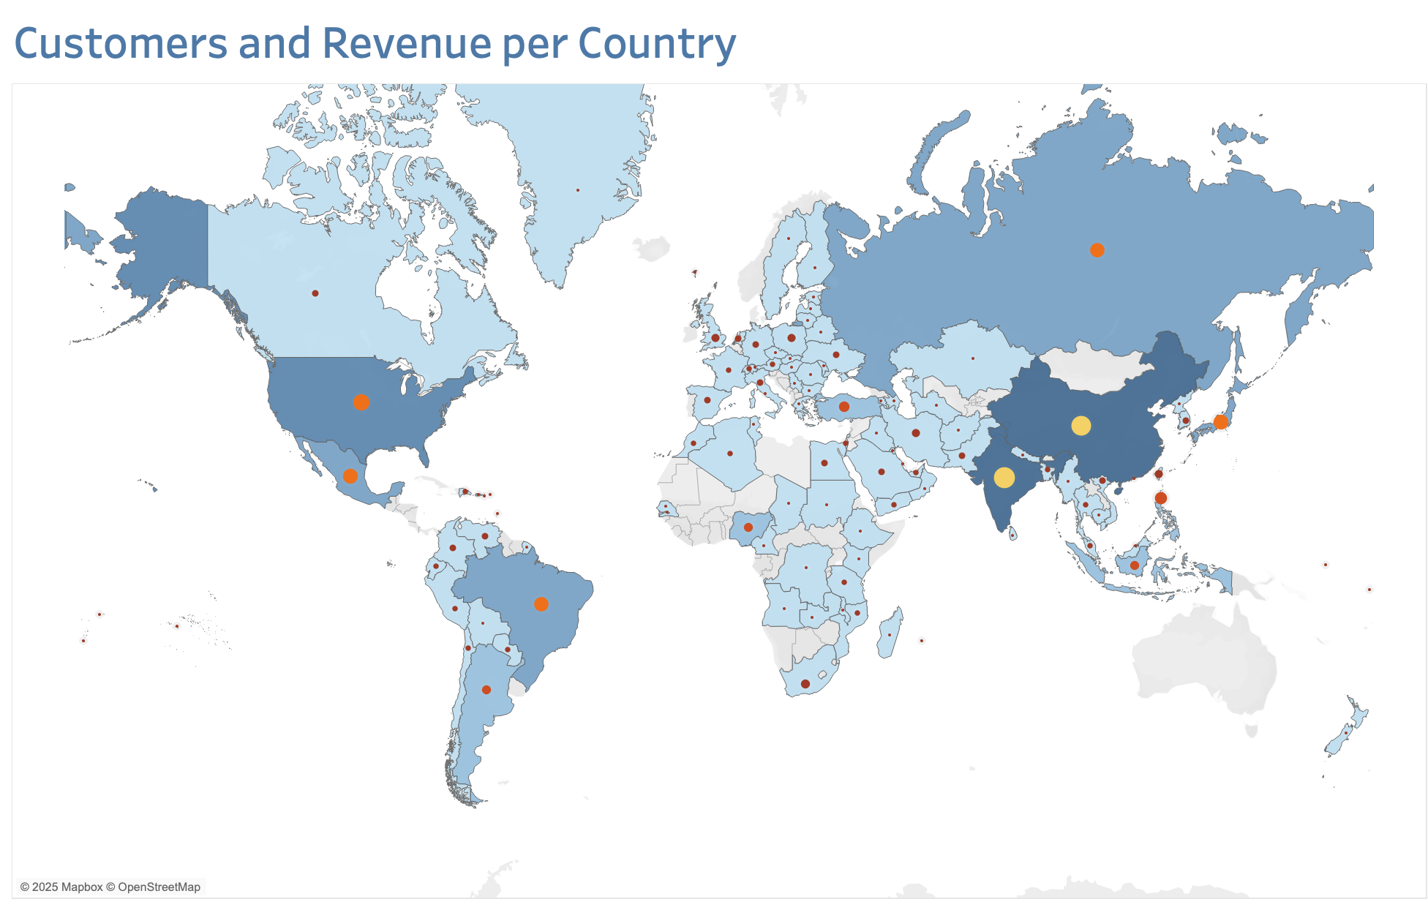
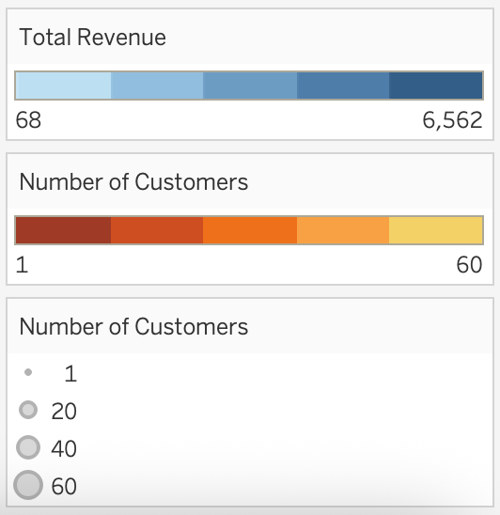
Question 3 Which countries are customers based in?
Rank | Top 10 Countries | Number of Customers | Total Revenue (¤)
1 | India | 60 | 6 562
2 | China | 53 | 5 758
3 | United States | 36 | 4 081
4 | Japan | 31 | 3 448
5 | Mexico | 30 | 3 293
6 | Brazil | 28 | 3 178
7 | Russian Federation | 28 | 3 038
8 | Philippines | 20 | 2 355
9 | Turkey | 15 | 1 651
10 | Indonesia | 14 | 1 504
Total |  | 315 | 34 868
Customer activity was highly concentrated, with just 10 out of 108 countries accounting for 53% of all customers (315 of 599) and 51% of total revenue (¤35 155 of ¤66 888).
Notably, the 10 countries with the most customers were also the 10 highest revenue-generating markets in identical order, indicating a strong alignment between customer volume and sales contribution.

Slide 7
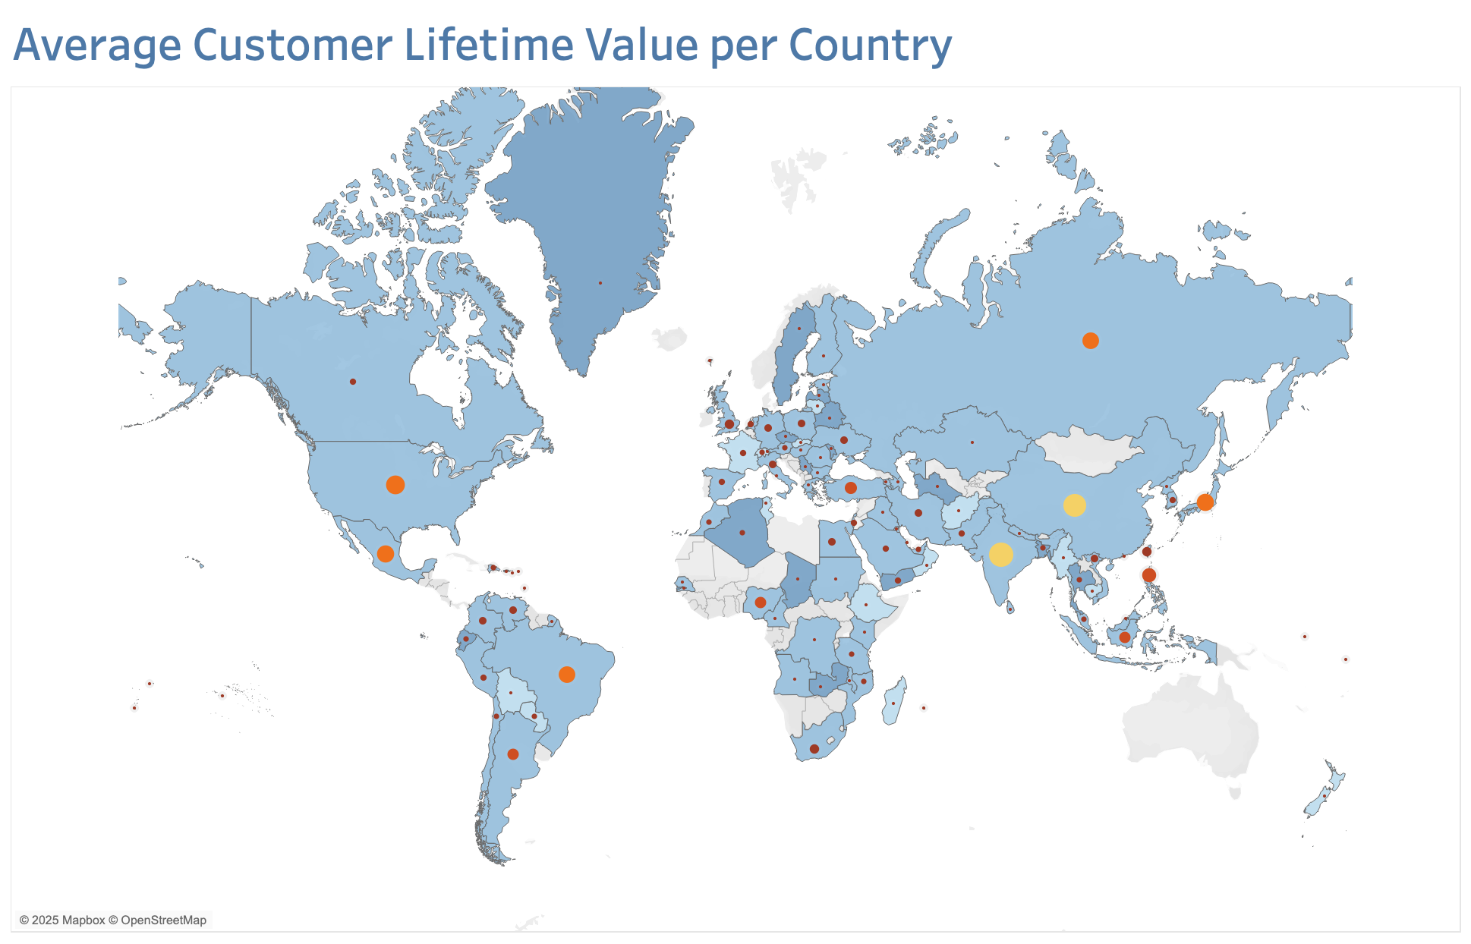
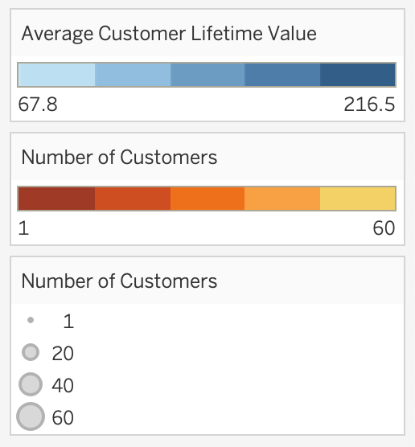
Question 4 Where are customers with a high lifetime value based?
Rank | Top 10 Customers | Country | Total Revenue
1 | 526 | United States | 221,55
2 | 148 | Réunion | 216,54
3 | 144 | Belarus | 195,58
4 | 137 | Netherlands | 194,61
5 | 178 | Brazil | 189,62
6 | 459 | Iran | 186,62
7 | 469 | Spain | 177,6
8 | 468 | India | 175,61
9 | 236 | Philippines | 174,59
10 | 176 | Algeria | 173,63
Rank | Top 10 Countries (CLV) | No of Customers | Total Revenue | Average CLV
1 | Réunion | 1 | 216,54 | 216,54
2 | Vatican City | 1 | 152,66 | 152,66
3 | Nauru | 1 | 148,69 | 148,69
4 | Sweden | 1 | 144,66 | 144,66
5 | Hong Kong | 1 | 142,7 | 142,7
6 | Thailand | 3 | 413,06 | 137,69
7 | Belarus | 2 | 137,66 | 137,66
8 | Greenland | 1 | 274,35 | 137,18
9 | Turkmenistan | 1 | 135,68 | 135,68
10 | Chad | 1 | 133,74 | 133,74
While large markets like India, China and the United States lead in total revenue due to high customer numbers, the highest customer lifetime values are seen in

Slide 8
Country | Number of Customers | Average CLV
Réunion | 1 | 216.54
Vatican City | 1 | 152.66
Nauru | 1 | 148.69
Sweden | 1 | 144.66
Hong Kong | 1 | 142.70
Thailand | 3 | 139.68
Belarus | 2 | 138.67
Greenland | 1 | 137.66
Turkmenistan | 1 | 136.73
Chad | 1 | 135.68
The Analysis Question 4: Where are customers with a high lifetime value based?

Slide 9
The Analysis Question 5: Do sales figures vary between geographic regions?

Slide 10
Summary
The catalogue features 958 titles across 16 genres and 5 ratings, all in English and released in 2006.
The customer base comprises 599 customers across 108 countries and 597 cities.
The top 5 revenue-generating films earned between ¤205 and ¤232, while 7 films shared the bottom five positions, generating between ¤6 and ¤8.
Rental durations across all terms ranged from same-day returns to a maximum of 10, with an average duration of 5 days.
Total revenue by country varied from ¤68 to ¤6,628, with customer counts between 1 and 60. India led in both customer numbers and total revenue, followed closely by China, and the United States.
Average customer lifetime value (CLV) varied between ¤68 to ¤217, with Réunion having the highest CLV, followed by Vatican City and Nauru.
The Asia-Pacific region emerged as the clear leader ¤26 468 in sales and 235 customers, while Latin America performed the worst selling ¤8 096 from 73 customers.

