Slide 1

Streaming Service Launch Strategy
Revenue and customer insights
David Griesel

Slide 2




Key Questions
1. Which movies contributed the most / least to revenue gain?
2. What was the average rental duration for all videos?
3. Which countries are customers based in?
4. Where are customers that spend the most located?
5. Do sales figures vary between geographic regions?

Slide 3
Question 1 Which movies contributed the most / least to revenue gain?
Film Catalogue
Titles (Registered) | 1000
Titles (Inventory) | 958
Categories | 16
Ratings | 5
Languages | 1 (English)
Release Years | 1 (2006)
Revenue Earned per Film (¤)
Minimum | 5,94
Maximum | 231,73
Average | 69,82
Total | 66 888,39
Of the 1,000 titles registered in the system, only 958 were held in inventory, generating ¤66,888.39 in total revenue. Film-level earnings varied significantly, with the top five titles — led by Telegraph Voyage and Wife Turn — generating between ¤204.72 and ¤231.73. At the other end of the spectrum, seven films occupied the bottom five positions, all earning less than ¤8.00, with Texas Watch and Oklahoma Jumanji tied for last place at just ¤5.94 each.

Slide 4
Question 2 What was the average rental duration for all videos?
Summary Statistics - Actual Rental Duration per Rental Term
Rental Term (Days) | Number of Transactions | Minimum Actual Duration | Maximum Actual Duration | Average Actual Duration
3 Days | 3 366 | 0 | 10 | 5
4 Days | 3 213 | 0 | 10 | 5
5 Days | 3 132 | 0 | 10 | 5
6 Days | 3 352 | 0 | 10 | 5
7 Days | 2 798 | 0 | 10 | 5
All Terms | 15 861 | 0 | 10 | 5
While each film was assigned a fixed rental term between 3 and 7 days, actual return behaviour showed no variation, ranging from same-day returns to as long as 10 days, with an average of 5 days.
Rental Term | Number of Transactions - Actual Rental Duration
 | 0 Days | 1 Days | 2 Days | 3 Days | 4 Days | 5 Days | 6 Days | 7 Days | 8 Days | 9 Days | 10 Days
3 Days | 18 | 356 | 370 | 371 | 358 | 400 | 366 | 357 | 385 | 360 | 25
4 Days | 22 | 309 | 361 | 369 | 339 | 337 | 401 | 358 | 363 | 335 | 19
5 Days | 26 | 336 | 375 | 337 | 327 | 331 | 344 | 361 | 346 | 335 | 14
6 Days | 22 | 342 | 371 | 354 | 356 | 383 | 372 | 430 | 355 | 345 | 22
7 Days | 17 | 301 | 318 | 283 | 301 | 310 | 300 | 315 | 313 | 316 | 24
All Terms | 105 | 1644 | 1795 | 1714 | 1681 | 1761 | 1783 | 1821 | 1762 | 1691 | 104
Returns were also evenly distributed between 1 and 9 days regardless of the assigned duration, with notably fewer same-day and 10-day returns, suggesting that specified terms had limited influence on actual return behaviour.

Slide 5
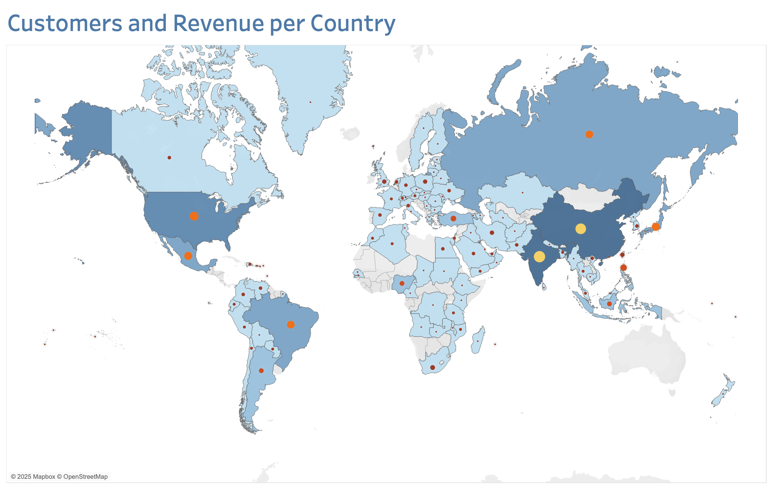
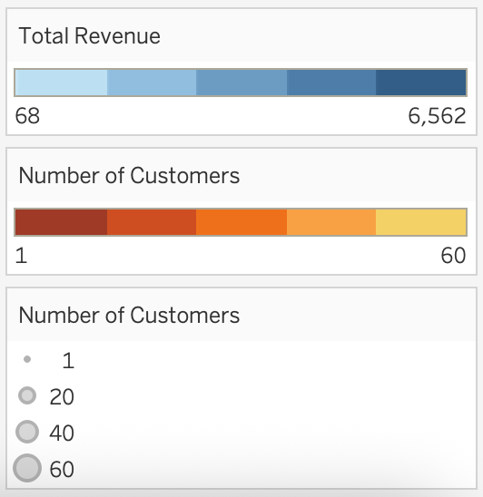
Question 3 Which countries are customers based in?
Rank | Top 10 Countries | Customers | Revenue (¤)
1 | India | 60 | 6 561,52
2 | China | 53 | 5 757,87
3 | United States | 36 | 4 081,43
4 | Japan | 31 | 3 447,84
5 | Mexico | 30 | 3 293,10
6 | Brazil | 28 | 3 177,59
7 | Russian Federation | 28 | 3 037,91
8 | Philippines | 20 | 2 355,42
9 | Turkey | 15 | 1 651,15
10 | Indonesia | 14 | 1 504,35
Total |  | 315 | 34 868,18
Customers per Country
Minimum | 1
Maximum | 60
Average | 6
Total | 599
Revenue per Country (¤)
Minimum | 67,82
Maximum | 6 561,52
Average | 619,34
Total | 66 888,39
There were 599 customers based in 108 countries, but activity was concentrated in a small number of high-volume markets. The top 10 countries accounted for 315 customers (53% of 599) and ¤34,868 in revenue (52% of ¤66,888).
These countries also ranked identically in both metrics, indicating a strong alignment between customer volume and revenue contribution.

Slide 6
Question 4 Where are customers that spend the most located?
Top 10 Customers
Rank | Customer ID | Country | Total Spent
1 | 526 | United States | 221,55
2 | 148 | Réunion | 216,54
3 | 144 | Belarus | 195,58
4 | 137 | Netherlands | 194,61
5 | 178 | Brazil | 189,62
6 | 459 | Iran | 186,62
7 | 469 | Spain | 177,60
8 | 468 | India | 175,61
9 | 236 | Philippines | 174,59
10 | 176 | Algeria | 173,63
Total |  |  | 1 905,95
Top-spending customers were not limited to high-volume markets. They came from a diverse mix of countries, including major markets such as the United States and India, as well as smaller ones like Réunion and Belarus.
Despite their high individual spending, the combined contribution of the top 10 customers amounted to just ¤1 906 (3% of the ¤66 888 total revenue).
Revenue per Customer (¤)
Minimum | 50,85
Maximum | 221,55
Average | 111,67
Total | 66 888,39

Slide 7
Question 5 Do sales figures vary between geographic regions?
Sales figures varied significantly by region, largely mirroring customer distribution. Asia-Pacific had the highest customer count and revenue, followed by Europe and the Middle East & Africa with similar volumes. North America and Latin America contributed the least.
Region | Customer Count | Total Revenue | Average per Customer
Asia-Pacific | 235 | 26 233,24 | 112
Europe | 109 | 12 182,34 | 112
Middle East & Africa | 106 | 11 911,99 | 112
North America | 76 | 8 543,66 | 112
South America | 73 | 8 017,16 | 111
Total |  | 66 888,39 | 599
Despite differences in scale, average revenue per customer was consistent across all regions.

Slide 8
Summary
Catalogue performance was uneven, with a small number of titles generating disproportionately high revenue and many earning very little.
Return behaviour showed little correlation with assigned rental terms, suggesting customer habits were independent of predefined rental policies.
Customer activity was highly concentrated, with just 10 countries responsible for over half of global revenue and customer volume.
Top spenders were globally dispersed, but their individual impact on total revenue was limited.
Asia-Pacific led all regions in both customer count and revenue, followed by Europe and the Middle East & Africa.

