Slide 1

Rockbuster Stealth LLC
Data Analysis in support of 2020 company strategy
David Griesel
Tableau Public

Slide 2




Overview
Objective
To derive data-driven insights from the existing database in response to business questions posed by Management.
Strategic Importance
To leverage existing movie licenses and transition from a physical rental model to an online platform that can compete with other existing streaming services.

Slide 3
Key Questions
1. Which movies contributed the most / least to revenue gain?
2. What was the average rental duration for all videos?
3. Which countries are Rockbuster customers based in?
4. Where are customers with a high lifetime value based?
5. Do sales figures vary between geographic regions?

Slide 4
Existing Catalogue
1000 Films
1 Language (English)
1 Release Year (2006)
17 Categories
5 Ratings

Slide 5
Existing Client Base
599 Customers
108 Countries
597 Cities

Slide 6
The Analysis Question 1: Which movies contributed the most / least to revenue gain?

Slide 7
The Analysis Question 2: What was the average rental duration for all videos?
Metric (Overall) | Rental Duration (Days)
Minimum | 3.00
Maximum | 7.00
Average | 4.99
Rating | Average Rental Duration (Days)
G | 4.84
PG | 5.08
PG-13 | 5.05
R | 4.77
NC-17 | 5.14

Slide 8
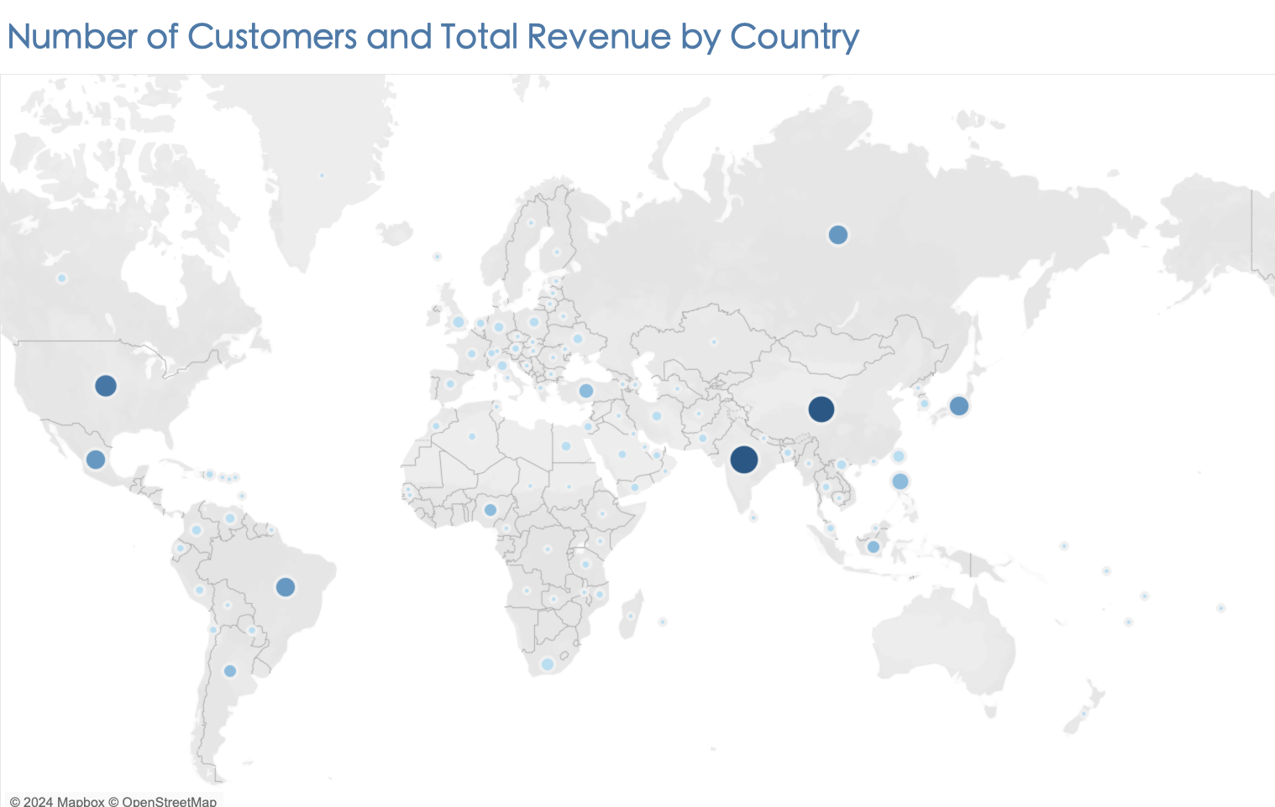
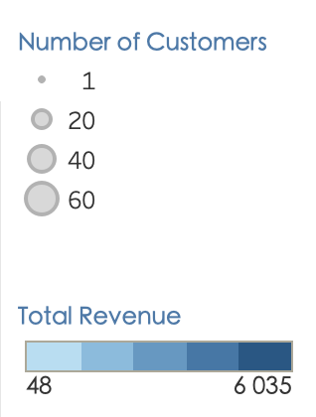
The Analysis Question 3: Which countries are Rockbuster customers based in?
Rank | Top 10 Countries | Number of Customers
1 | India | 60
2 | China | 53
3 | United States | 36
4 | Japan | 31
5 | Mexico | 30
6 | Brazil | 28
7 | Russian Federation | 28
8 | Philippines | 20
9 | Turkey | 15
10 | Indonesia | 14
Rank | Top 10 Countries | Total Revenue (EUR)
1 | India | 6034.78
2 | China | 5251.03
3 | United States | 3685.31
4 | Japan | 3122.51
5 | Mexico | 2984.82
6 | Brazil | 2919.19
7 | Russian Federation | 2765.62
8 | Philippines | 2219.70
9 | Turkey | 1498.49
10 | Indonesia | 1352.69

Slide 9
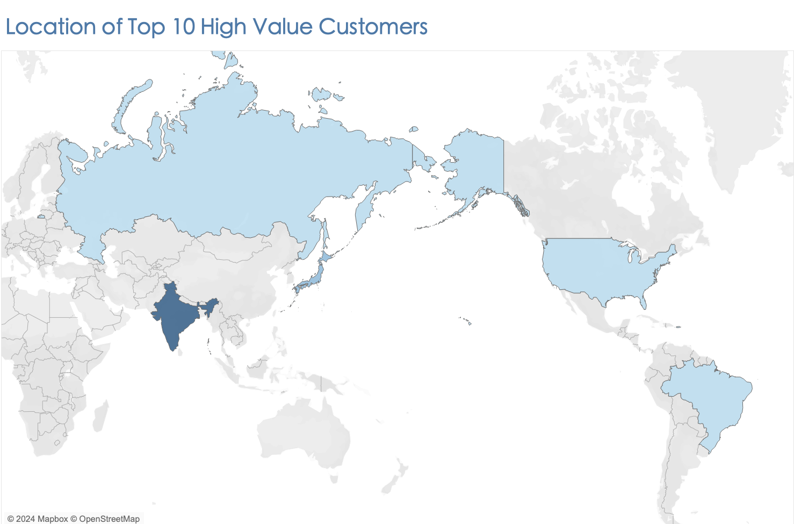
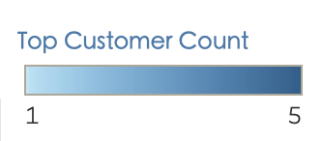
Country | Number of Customers
India | 5
United States | 1
Japan | 2
Brazil | 1
Russian Federation | 1
The Analysis Question 4: Where are customers with a high lifetime value based?

Slide 10
The Analysis Question 5: Do sales figures vary between geographic regions?

Slide 11
Recommendations
Geographic performance
Asia is the best performing region and further investment in this region should yield substantial returns.
Oceania is the worst performing and strategies should be explored for expansion in this region.
Catalogue Offering
The catalogue currently only offers English language films and should be expanded to include more localised content.
CUSTOMER LOYALTY
Development of a rewards program for loyal customers to encourage repeat rentals.

