Slide 1
Learning Python 3
Week 1: Getting setup and running your very first programS.

Slide 2
What is Python ?
Python is a programming language. Other famous programming languages include “Java”, “Javascript”, “C”, “Ruby” and “PHP”.
Python is a major programming language which has been used to build sites and services such as :-
Dropbox (who employ the engineer who first made Python).
Youtube (who use Python to build the Youtube webpages).
Instragram
The Large Hardron Colider
Lucasfilm (who used Python to control the special effects on the recent Star Wars movies).

Slide 3
What version of Python ?
There are two main versions of Python in use today, which are very similar but not 100% compatible.
Python 2: Was originally released in 2000. The last version of Python 2 will be released in 2020 and then the language will get no further support.
Python 3: The first version was released in 2008, and support will continue.
We will be learning Python 3 exclusively.
KEY FACT: Be careful what examples you find on the internet. Make sure they are for Python 3 or they might not work !

Slide 4
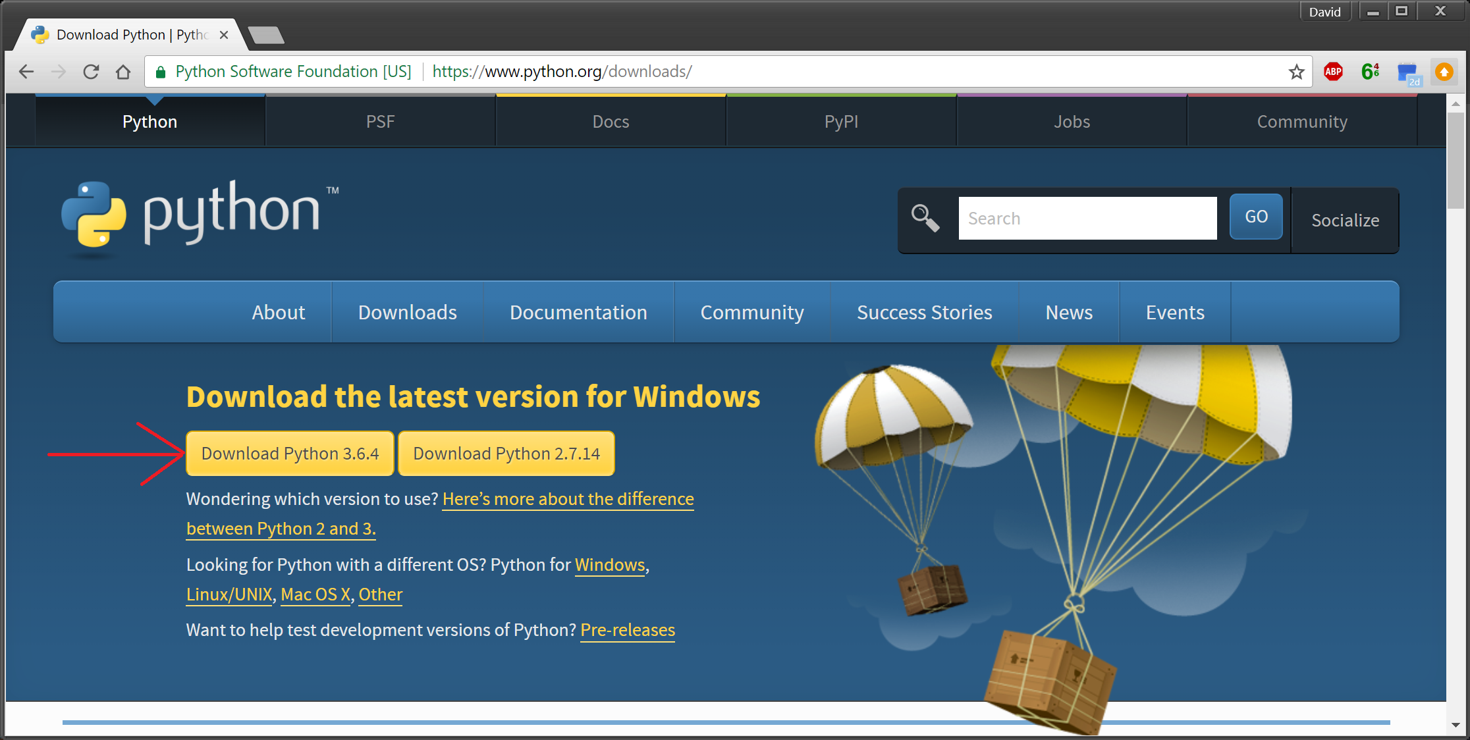
Getting Python 3
On Windows, you should install Python3 from :-
https://www.python.org/downloads/
ACTION: Visit this webpage, download Python and install it.

Slide 5
Hello World !
Computer programmers traditionally use “Hello World” as the first program they write in any programming language.
It simply prints “Hello World” on the screen.
It proves several things :-
You can write, save, and run a simple program.
You have installed Python correctly.

Slide 6
What tools to use to write programs.
You can write programs with any text editor.
Later you will get a better tool, but this will show you that you don’t need anything fancy to write a program (but it can help make it easier !).
We will write our first program using notepad that comes with Windows.
ACTION: Run notepad by pressing the windows key, typing “notepad” and pressing enter. You should get an empty notepad window you can type things into.

Slide 7
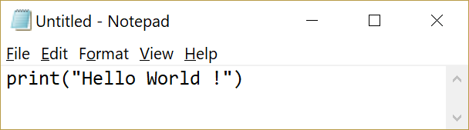
Your first program.
The first program is just the line listed on the right.
Your notepad window should look like the example on the right when you are finished.
It is very important when programming to be precise. The computer cares about the case (capital letters vs normal letters), the exact types of brackets and the exact types of quotes.
For example, (, { and [ are all different and using the wrong types of brackets will cause your program to not work !
Action: Type the program into the notepad window.

Slide 8
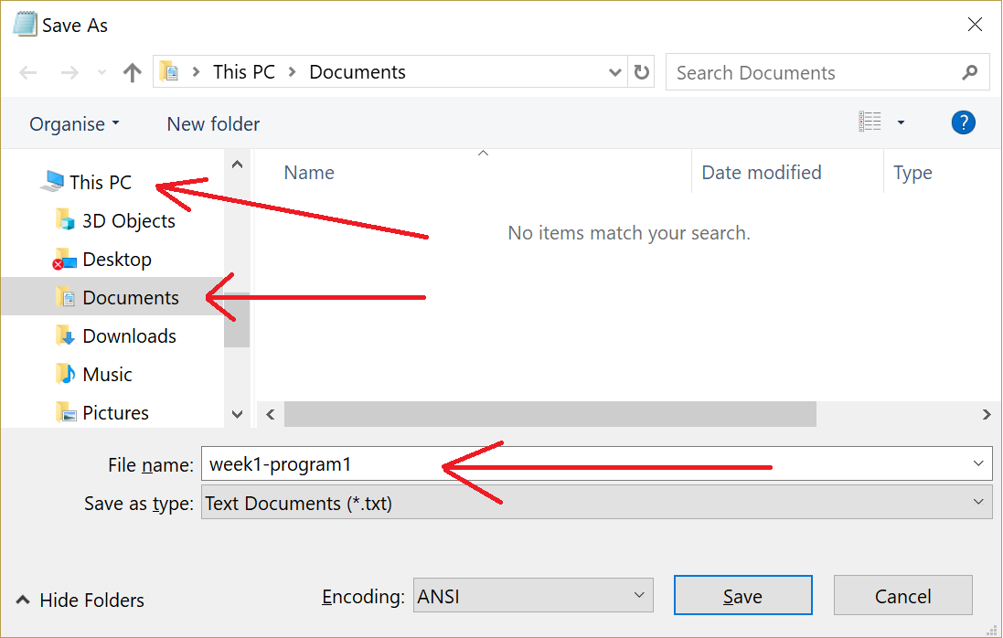
Saving your program.
Now you need to save the program.
Like with other things, use the “File” → “Save” option to save the file.
We will need to give the program a name. This can be anything you want.
You should save it in “This PC” -> “Documents”.
Action: Save the program. Remember what you called it !

Slide 9
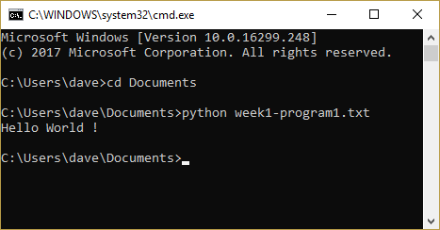
Running your program
You can use the command prompt to run Python programs.
The command prompt has many other uses – and later in this course we will find other uses.
ACTION: Copy the commands shown in the command prompt on the right.
CHECK: You should see the result “Hello World !”

Slide 10

Well done !
You wrote and ran your first computer program, congratulations !

Slide 11
Making it easier (with better tools) !
You can get tools to do all this in one program though.
I recommend a tool called “PyCharm”.
You can get it from
https://www.jetbrains.com/pycharm/download
You should pick the community edition.
ACTION: Install PyCharm on your computer.

Slide 12
FIXME: Do you need to do anything else to install and have Pycharm run on a fresh install ?

Slide 13
What is PyCharm
PyCharm is an example of an IDE (Integrated Development Environment).
It puts all the tools you need to create, run and debug programs in once place.
It helps you to write code with a large variety of features.
As we continue this course, you will learn about several of these features.

Slide 14
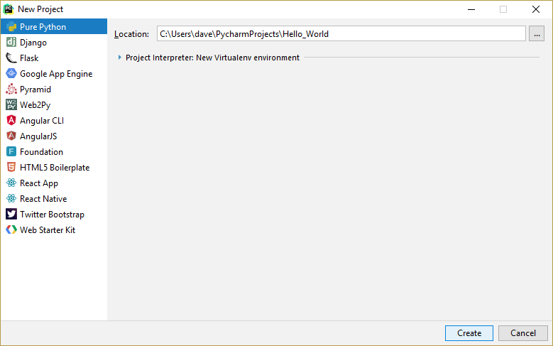
Making a Hello World Project.
ACTIONS:
Load PyCharm.
Use File -> New Project.
Call the project “Hello_World”, like in the screenshot.
KEY POINT:
This is how we will create all projects in the future. So remember this !

Slide 15
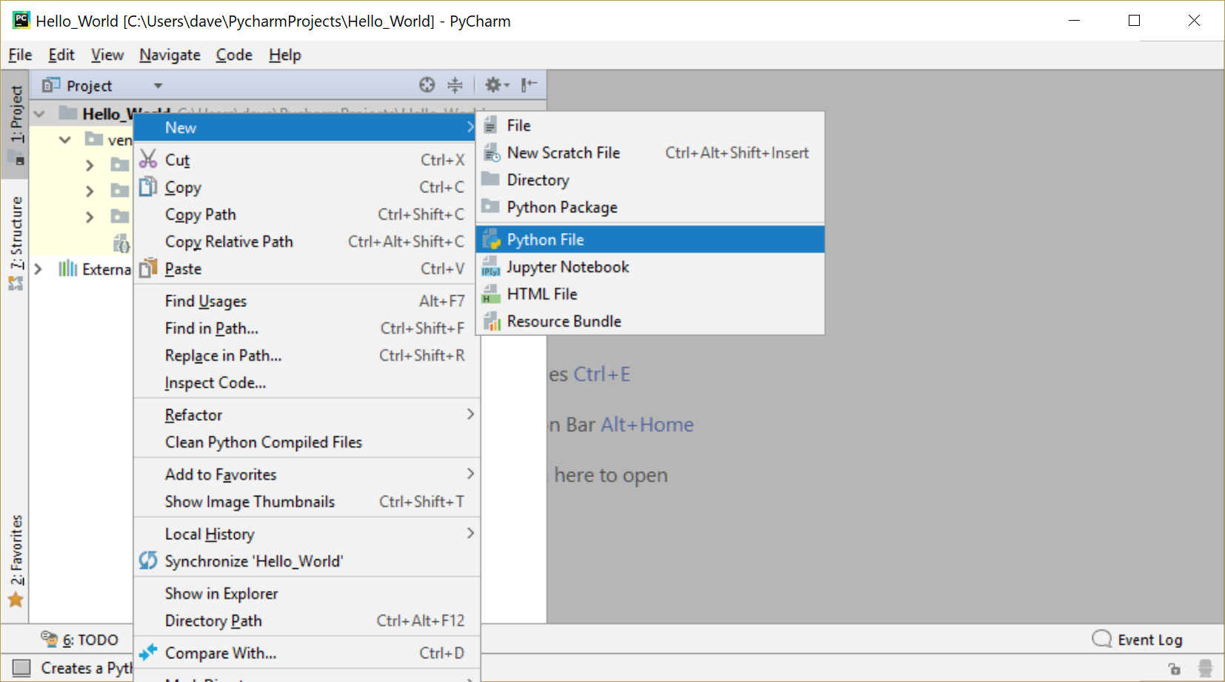
Creating the Hello World File.
This will have created a folder on your PC for your new Hello World project.
To create a file in it, you should right click the main folder on the right, and create a Python file.
Action: Create a file called “Hello_World”

Slide 16
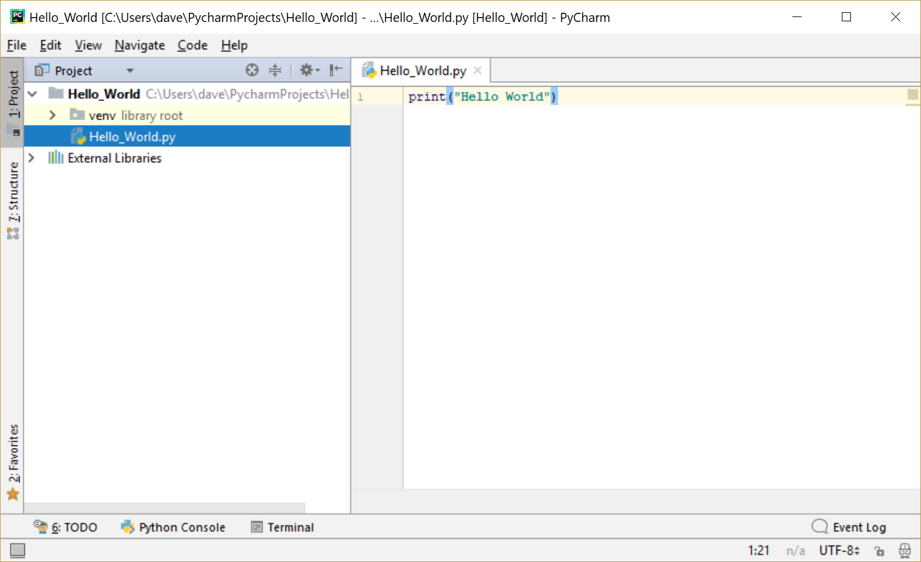
Writing Hello World in PyCharm.
ACTION: Write the same Hello World program you wrote before in the right hand window.
Note: You will see PyCharm colours things in for you. These colours are useful and you will learn what they mean later.

Slide 17
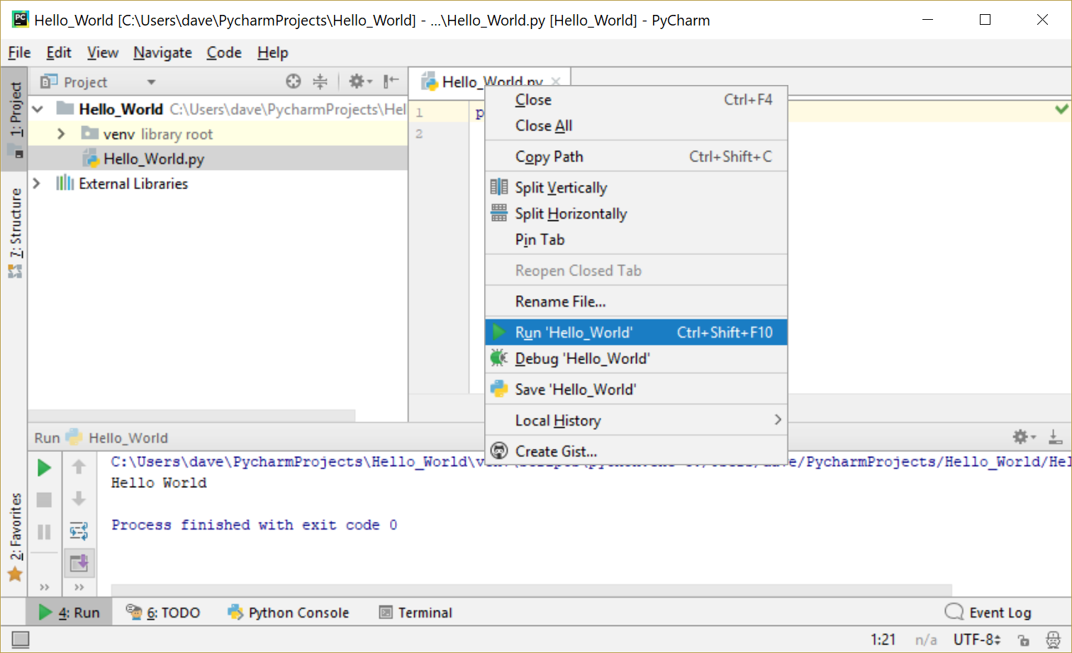
Run the Program.
ACTION: Use PyCharm to run the program. Right click on the tab with the file in it, and select “Run”.
CHECK: Confirm you have the “Hello World” output in the new bottom tab.
SHORTCUT: Now you can press the green “play” button to run the program again.

Slide 18
Homework ☹
This weeks homework is quite easy.
Project1: “Hello Universe”.
Write a program like the one that said hello to the world, but instead says hello to the entire universe instead.
Project2: “1 to 10”.
Write a program, which prints the numbers 1 to 10, each on a separate line.
Expected Output Project 1
Hello Universe !
Project 2
1
2
3
4
5
6
7
8
9
10

Slide 19
What we will learn next week !
We will learn how to ask the person running the program questions, and use the answers they give in running the program.
We will learn a much better way to write the 1 to 10 program.
We will learn how to easily make it count to a million !
We will learn how to make decisions and to do different things.

