Slide 1
Learning Python 3
Week 6: PYPY MODULES AND GRAPHICS

Slide 2
Goals of this week.
This week we will learn about.
Installing modules that don't come with Python.
Working with graphics and images.
Working with multiple files in a directory.

Slide 3
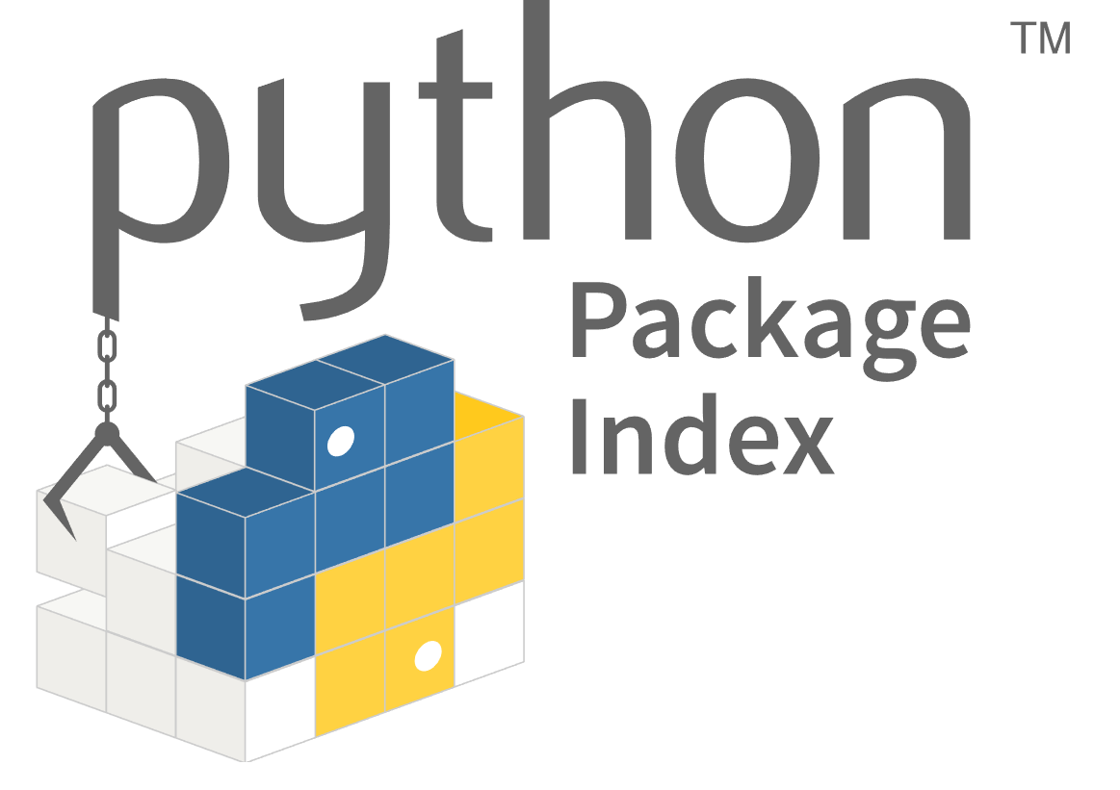
Using PyPy Modules.

Slide 4
Standard Library vs PyPi
Last week we used the "random" module from the standard library.
The standard library is a set of modules that come with Python.
But you need to import them before you can use them in programs.
You can find the full reference to the standard library at https://docs.python.org/3/library/index.html
We will introduce more of the standard library in later weeks.

Slide 5
Python Package Index
Although the standard library has a lot of modules, it doesn't do everything.
Additionally, you can get modules from the Python Package Index (PyPi).
Anyone can contribute modules to PyPi, you don't need to be a Python developer.
This means that PyPi modules can vary in quality.
It also means you can find old PyPi modules that don't work.
Working out which PyPi modules are good, and which ones are bad, takes time and skill.

Slide 6
How to find good PyPi modules.
The best ways are :-
Ask an experienced Python programmer, telling them what you want the module to do.
Use Google to find popular packages for the task you want to perform.
Often one package becomes the "winner" in a particular area.
For example, if you want to use the web, you will almost always want to use the requests package.
Or, if like in this weeks lesson, you want to work with images and graphics, you will use the pillow package.

Slide 7
Modules not installed.
You can always import standard library modules. They come with Python.
If you try and import a PyPi module without installing it, your program will fail.
You haven't installed the pillow module.
# Week6, Program1
print("No modules are imported")
import random
print("I've imported the random module")
print(f"And rolled a die and got a {random.randint(1,6)}")
import PIL
print("I've imported the PIL (Pillow) module")
Task: Type this program in and run it.
What do you think will happen ?
Is that what happened ?

Slide 8
Installing PyPi modules
There are multiple ways to install PyPi modules.
I will show you the recommended method, that uses PyCharm and Virtualenv's.
Exactly what Virtualenv's mean is complicated, and we will cover it much later.

Slide 9
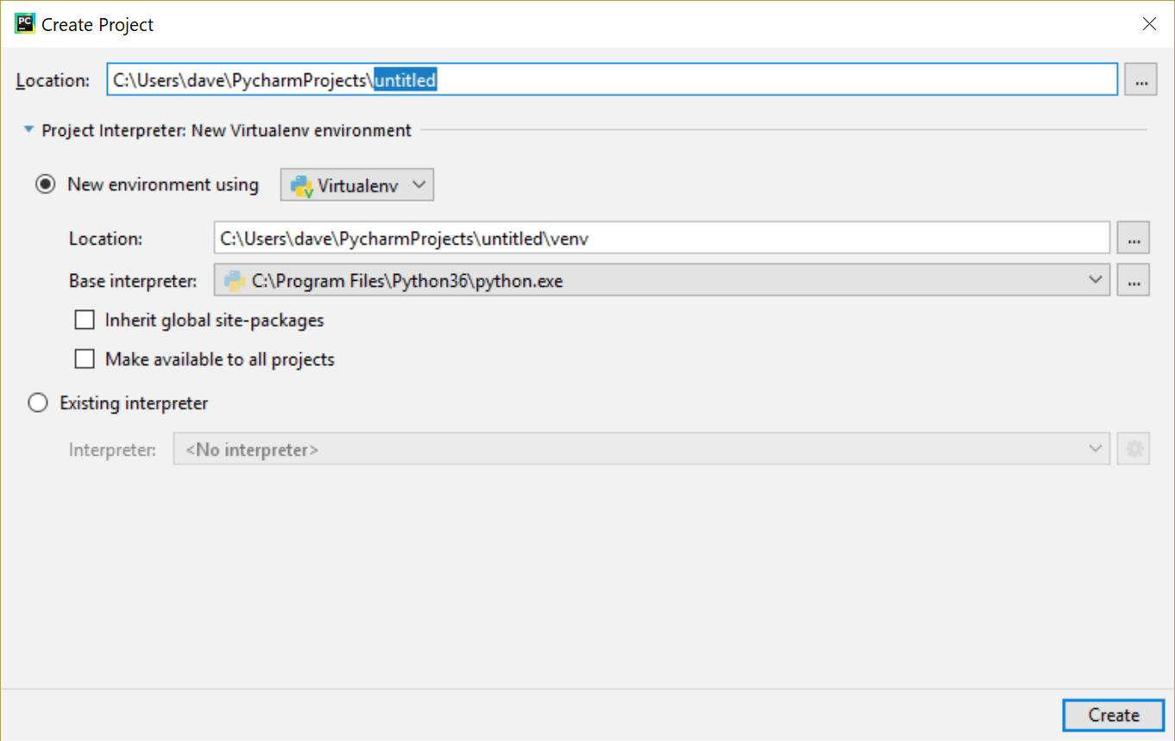
Creating a new PyCharm Project
In PyCharm, from the menus select File → New Project.
Expand the "Project Interpreter" tab and make sure it is setup the way it is in the image.
Here you are creating a new VirtualEnv for this project.
Any packages you install will only be installed for this project.
Keeping packages separate in projects like this is useful.
Task: Do this. Call your project Week6

Slide 10
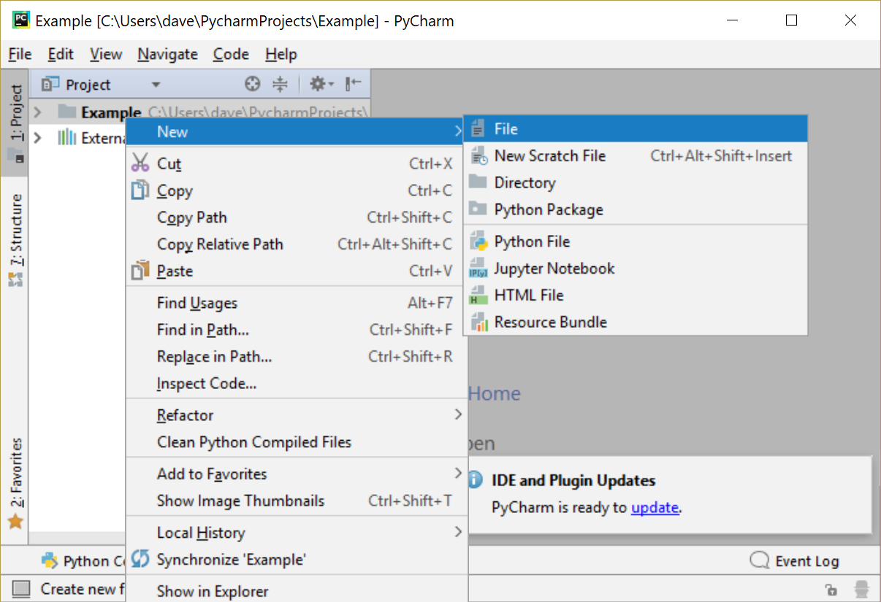
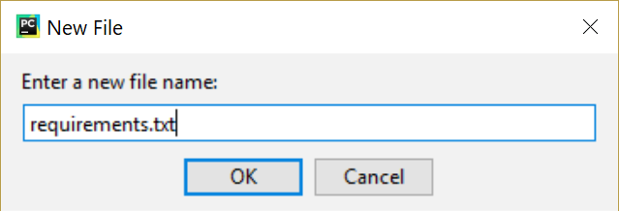
Creating a requirements file.
In your new project, create a text file called "requirements.txt".
You can do it by right clicking on top directory in your project and selecting New → File.
When the New File dialog box appears, type in the name "requirements.txt".
Task: Do this.

Slide 11
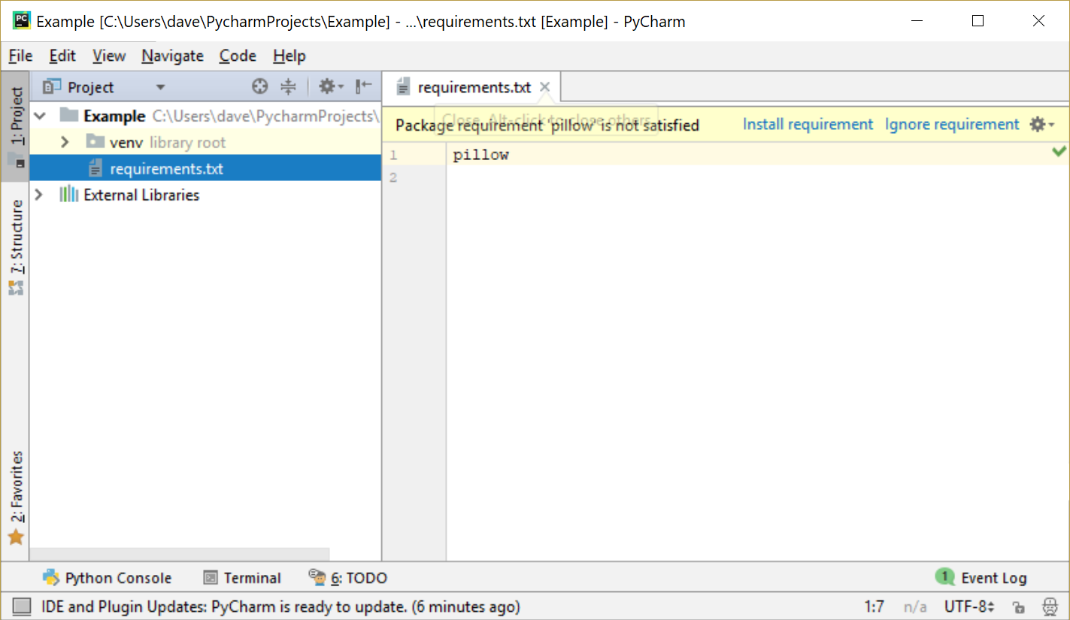
Installing the requirement.
Type in the name of the module.
In our example, this is going to be "pillow".
When you do this, a yellow bar will appear telling you that your requirements aren't satisfied.
Click the "Install Requirement" button.
Task: Do this.

Slide 12
Repeating the import.
This program should look familiar. It is exactly the same as Program1.
Now you have made a project and installed the pillow project, does it work ?
# Week6, Program2
print("No modules are imported")
import random
print("I've imported the random module")
print(f"And rolled a die and got a {random.randint(1,6)}")
import PIL
print("I've imported the PIL (Pillow) module")
Task: Type this program in and run it.
What do you think will happen ?
Is that what happened ?

Slide 13
Importing Part of a Module
Some modules are very big, and pillow is one of them.
For these modules, sometimes you will want to import a part of them.
You do this like :-
from <module_name> import <thing>,<otherthing>
You will see examples of this in our upcoming programs.
How to work out what these things are we will come to in a later week.

Slide 14
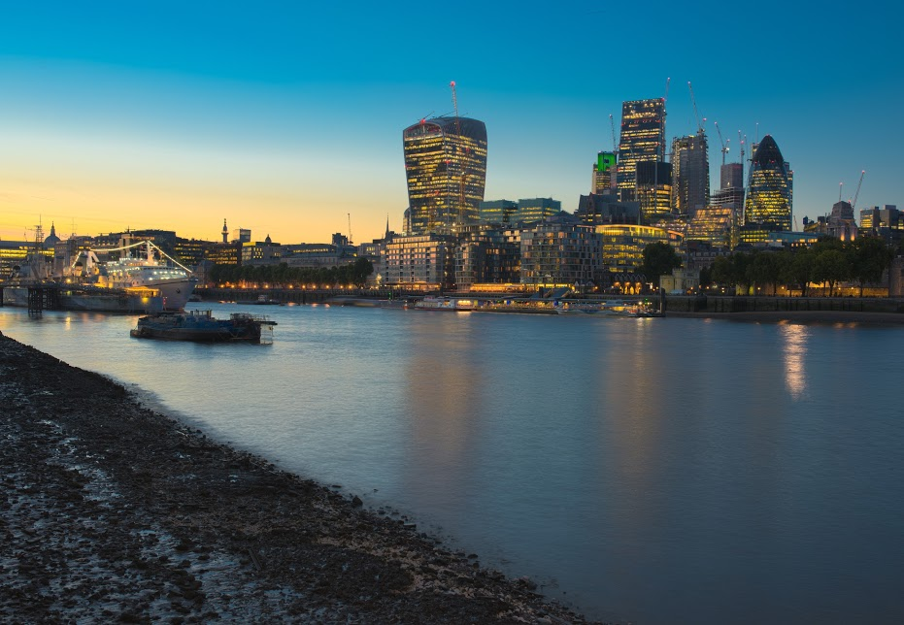
Getting the image.
Before we can play with editing an image, we will need an image to play with.
Lets use this one.
Download it from https://github.com/davidgroves/DGM_Tutorials/raw/master/week6/examples/london.jpg and put it in the same directory as your Week6 project.
If you need help doing this, ask for it.
Task: Get the file.

Slide 15
A simple image program.
This program imports the PIL/pillow module, which lets Python work on images.
Then it just displays it.
# Week6, Program3
from PIL import Image
myimage = Image.open("london.jpg")
myimage.show()
Task: Read this program and try and work out what it will do.
Type it in and run it. Is that what happened ?

Slide 16
Loading the image.
This program imports the PIL/pillow module, which lets Python work on images.
Then it manipulates the image.
Can you work out what the manipulation is going to be ?
# Week6, Program4
from PIL import Image
myimage = Image.open("london.jpg")
turned_image = myimage.rotate(180)
turned_image.show()
Task: Read this program and try and work out what it will do.
Type it in and run it. Is that what happened ?

Slide 17
Manipulating the image mode.
This program is similar to the previous one.
Instead of rotating the image, we convert it to greyscale (black, white and shades of grey only).
If you want to learn about other modes, look it up at https://pillow.readthedocs.io/en/3.1.x/reference/Image.html#PIL.Image.Image.convert
# Week6, Program5
from PIL import Image
myimage = Image.open("london.jpg")
greyscale_image = myimage.convert('L')
greyscale_image.show()
Task: Read this program and try and work out what it will do.
Type it in and run it. Is that what happened ?

Slide 18
Printing Information About An Image.
Pillow can tell you things about your image.
This program shows some examples.
# Week6, Program6
from PIL import Image, ImageDraw
myimage = Image.open("london.jpg")
print(f"This image is {myimage.width} pixels wide")
print(f"This image is {myimage.height} pixels tall")
print(f"This image is in the {myimage.format} format")
Task: Read this program and try and work out what it will do.
Type it in and run it. Is that what happened ?

Slide 19
Drawing on an image.
If you want to draw on the image, we need to add a "drawing layer".
We then draw on this, and Pillow puts everything together.
Try and work out what this program will do.
# Week6, Program7
from PIL import Image, ImageDraw
# Load the image from disk.
myimage = Image.open("london.jpg")
# Create the drawing layer so we can draw on it.
draw = ImageDraw.Draw(myimage)
# Draw two lines
draw.line([0, 0, myimage.width, myimage.height], width=10)
draw.line([0, myimage.height, myimage.width, 0], width=10)
myimage.show()
Task: Read this program and try and work out what it will do.
Type it in and run it. Is that what happened ?

Slide 20
Writing on an Image.
You can write on an image.
To do this you need.
To import the ImageFont and ImageDraw modules.
Create a Drawing layer.
Draw text at specific coordinates.
# Week6, Program8
from PIL import Image, ImageDraw, ImageFont
# Load the image.
myimage = Image.open("london.jpg")
# Load a font (The arial font from Windows)
myfont = ImageFont.truetype("arial.ttf", size=24)
# Get a drawing layer to draw on London
dl = ImageDraw.Draw(myimage)
# Draw text in the bottom left.
dl.text([10, myimage.height – 50], "London, England",
font=myfont)
# Show the image
myimage.show()
Task: Read this program and try and work out what it will do.
Type it in and run it. Is that what happened ?

Slide 21
Building an image from scratch.
This program makes a new 5x5 image.
Then it colours in some pixels.
Finally it makes it larger (500x500) so you can see it.
# Week6, Program9
from PIL import Image, ImageDraw
# Make a new image.
# It uses Red/Green/Blue colouring.
# It is 5x5 pixels in size.
image = Image.new("RGB", (5,5))
# Make a drawing layer
draw = ImageDraw.Draw(image)
# Draw the red pixels with the list of pairs of x,y locations
draw.point([(0,0), (1,0), (2,0), (3,0)], fill=(255,0,0))
draw.point([(4,0), (4,1), (4,2), (4,3)], fill=(255,0,0))
# Draw the green pixels
draw.point([(1,1), (1,2), (1,3)], fill=(0,255,0))
draw.point([(2,1), (2,2), (2,3)], fill=(0,255,0))
draw.point([(3,1), (3,2), (3,3)], fill=(0,255,0))
# Draw the blue pixels
draw.point([(0,1), (0,2), (0,3), (0,4)], fill=(0,0,255))
draw.point([(1,4), (2,4), (3,4), (4,4)], fill=(0,0,255))
# Scale the image to be 500x500 pixels instead of 5x5.
# as otherwise it will be too small to see.
scaled_image = image.resize((500,500))
scaled_image.show()
Task: On pen and paper, try and work out what the pattern will look like when this program is run.
Then type it in and run it.
Is the pattern what you expected ?

Slide 22
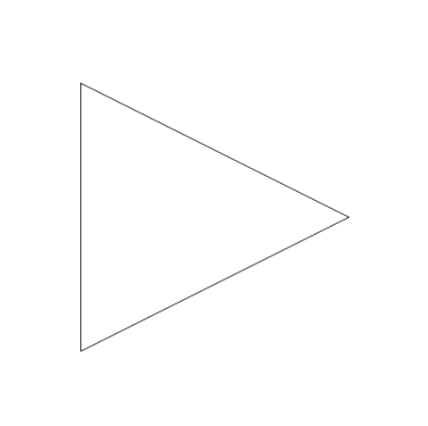
Homework 1
On a 500 x 500 pixel canvas.
Create this "play" button.

Slide 23
Homework 2
Watch this youtube video.
https://www.youtube.com/watch?v=IGlGvSXkRGI
Create a program which implements the first image in the video.
(The one with the triangle).
This is significantly harder than earlier homework assignments, so do your best but don't be afraid to ask for help !

Slide 24
Homework 3
Using Homework2 as a base.
Draw 10,000 "dots".
Every 500 dots, write a file called imageX.png, where X is the number of dots drawn so far.
Look at the images you have produced to see the pattern developing.

Slide 25
Extra Credit
Investigate the polygon feature of PIL.
Start by reading: https://pillow.readthedocs.io/en/3.0.x/reference/ImageDraw.html#PIL.ImageDraw.PIL.ImageDraw.Draw.polygon
Use this to draw a flag.
My answer is the French Flag.
Try and draw the French flag without looking at my code.
If you can't, then read that first, then have something that makes another flag (the German flag would be a good option).
For super extra credit, draw the Union Flag !

