Slide 1
Learning Python 3
Week 11: Loading and saving data

Slide 2
Goals of this week.
Learn about saving and loading data.
Learn about different representations for that data.
Python Pickle Files
JSON
YAML

Slide 3
Recapping loading and saving text files.

Slide 4
Recap on Saving Files
Earlier we learned how to load and save text files.
To do that, we used code like this.
Type this in.
What do you think the output will be ?
Do you expect any other files to be produced ?
Were you correct ?
# Week11, Example1
mywritefile = open("myfile.txt", "w")
mywritefile.write("Hello File !")
mywritefile.close()
myreadfile = open("myfile.txt", "r")
print(myreadfile.read())

Slide 5
Text Only
This is great for loading and saving textual data.
You could use it to load or save numbers as well, but you would have to interpret them as numbers.
This example shows you having to handle numbers.
Type this in.
Does it do what you think it does ?
Do you agree with my comments that it is ugly ?
# Week11, Example2
write_number_file = open("my_numbers_file.txt", "w")
for i in range(10):
# Note how ugly this is.
write_number_file.write(f"{str(i)}\n")
write_number_file.close()
read_number_file = open("my_numbers_file.txt", "r")
for i in read_number_file.readlines():
# Note we get a string with a newline on the end
# that we need to strip.
print(f"{i.strip()} is of type {type(i)}")
# And this is ugly again, casting to an int
print(f" 2 x {i.strip()} = {2 * int(i)}")

Slide 6
Manually saving and loading classes.

Slide 7
Saving Classes
Here we will write a “load” and “save” method for an example class.
The class will hold four values about a person.
This is similar to the person classes we built when learning about classes.
Firstname: string
Surname: string
Date of Birth: date class from the datetime module.
Phone Number: integer
We will implement this in two stages.
First, we will build the example class.
Secondly, we will write the load and save methods and use them.

Slide 8
The person example class.
We build the class.
We create bruce as an instance of that class.
We make a representation method so we can print the class.
Type this in.
Predict the output.
Were you correct ?
# Week11, Example3
import datetime
class Person:
def __init__(self, **kwargs):
self.firstname = kwargs['firstname']
self.surname = kwargs['surname']
self.dob = kwargs['dob']
self.phone = kwargs['phone']
def __repr__(self):
return f"{self.firstname} {self.surname} was born \
{self.dob}, and has phone number {self.phone}"
bruce = Person(firstname = "Bruce",
surname = "Almighty",
dob = datetime.date(year=1,month=12,day=25),
phone = 5550123)
print(bruce)

Slide 9
Adding a save method.
# Week11, Example4
import datetime
class Person:
def __init__(self, **kwargs):
self.firstname = kwargs['firstname']
self.surname = kwargs['surname']
self.dob = kwargs['dob']
self.phone = kwargs['phone']
def __repr__(self):
return f"{self.firstname} {self.surname} was born {self.dob}, and has phone number {self.phone}"
def save(self, filename):
f = open(filename, "w")
f.write(f"{self.firstname},{self.surname},{self.dob},{self.phone}")
f.close()
bruce = Person(firstname = "Bruce",
surname = "Almighty",
dob = datetime.date(year=1,month=12,day=25),
phone = 5550123)
bruce.save("bruce.txt")
Building on example3, we add a save method.
This accepts a filename and writes the class to a file with that name.
Type this in.
What file will be created ?
What will be in it ?

Slide 10
Add a load function
# Week11, Example5
import datetime
class Person:
def __init__(self, **kwargs):
self.firstname = kwargs['firstname']
self.surname = kwargs['surname']
self.dob = kwargs['dob']
self.phone = kwargs['phone']
def __repr__(self):
return f"{self.firstname} {self.surname} was born {self.dob}, and has phone number {self.phone}"
def save(self, filename):
f = open(filename, "w")
f.write(f"{self.firstname},{self.surname},{self.dob},{self.phone}")
f.close()
def load_person(filename):
f = open(filename, "r")
# Read the text line in.
line = f.readline()
# Split the line on ,
splitline = line.split(",")
firstname = splitline[0]
surname = splitline[1]
# strftime takes a string and turns it into a datetime object
# following a format spec. The next line might look a bit "magical" (sorry !)
dob = datetime.datetime.strptime(splitline[2], "%Y-%m-%d").date()
phone = int(splitline[3])
return(Person(firstname = firstname,
surname = surname,
dob = dob,
phone = phone))
bruce = load_person("bruce.txt")
print(bruce)
And now we write a load function, that can take the file we just made and give us a class back.
Does this do what you expected ?
Do you think it is neat ?
Would it be easy to extend ?

Slide 11
Recap
Hopefully you agree with me that this is less than ideal.
You would have to write load functions and save methods for every class.
If you ever add an attribute to a class, you would have to update those methods.
If you added or removed an attribute, your saved classes wouldn’t load anymore.
There must be a better way, right ?

Slide 12
Alternatives - Pickles

Slide 13
Recap
Hopefully you agree with me that this is less than ideal.
You would have to write load functions and save methods for every class.
If you ever add an attribute to a class, you would have to update those methods.
If you added or removed an attribute, your saved classes wouldn’t load anymore.
There must be a better way, right ?

Slide 14
Pickles
Python has a built in library called pickle.
It lets you just save and load objects.
It works for almost any Python objects.
Only for very rare cases will you need to help pickle do the right thing.
We will have an example, using pickle to save and load an object.

Slide 15
A Pickle Example
# Week11, Example6
import datetime
import pickle
class Person:
def __init__(self, **kwargs):
self.firstname = kwargs['firstname']
self.surname = kwargs['surname']
self.dob = kwargs['dob']
self.phone = kwargs['phone']
def __repr__(self):
return f"{self.firstname} {self.surname} was born {self.dob}, and has phone number {self.phone}"
bruce = Person(firstname = "Bruce",
surname = "Almighty",
dob = datetime.date(year=1,month=12,day=25),
phone = 5550123)
# Save bruce to a file
output_file = open("bruce.pickle", "wb")
pickle.dump(bruce, output_file)
output_file.close()
# Load new bruce from the file
input_file = open("bruce.pickle", "rb")
new_bruce = pickle.load(input_file)
print(new_bruce)
Type this in.
Can you predict what it does ?
Were you correct ?

Slide 16
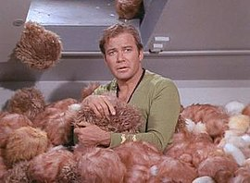
The problems with pickles.
Pickles stores files as binary data.
It isn’t readable by humans.
You can’t really edit it outside of Python.
Pickles is Python specific. Other programming languages or tools can’t work with it.
If you change the code of a program and load a pickled object saved with a different version, there are ways you can make that operation fail. More on this later.
The problem with pickles made me think of the trouble with tribbles.

Slide 17
Alternatives – JSON (theory)

Slide 18
JSON (JavaScript Object Notation).
JavaScript is another programming language.
In some ways it is similar to Python, but in other ways it is quite different.
It is the only language that is built into web browsers.
Because of this, and the need to have websites work with backend services, JavaScript Object Notation has become a very common way of exchanging data between different programs.
It is almost a “lingua franca” of structured data on the internet.
Read more about JSON here: https://en.wikipedia.org/wiki/JSON
The formal specification is here: http://www.ecma-international.org/publications/files/ECMA-ST/ECMA-404.pdf (this is likely to be quite hard to read !)

Slide 19
Types in JSON.
Just like Python has different types like strings, integers, Booleans, dictionaries and others, JSON does as well.
JSON has less types than Python does however.
JSON has these types :-
String: The same as a string in Python, but must always be enclosed in double quotes (“), never single quotes (‘).
Number: All numbers act like floats.
Object: Very similar to a dictionary in Python.
Array: Very similar to a list in Python,.
Boolean: Like Booleans in Python, but written with lowercase. Python would have True/False, but JSON has true/false.
Null: The same as None in Python, written as “null”.

Slide 20
An empty JSON document.
All JSON documents need to be contained in curly braces
{ and }.
Therefore, an empty JSON document can look like this :-
{
}

Slide 21
Example JSON arrays (lists).
Lists (called arrays in JSON) are represented almost exactly the same as they are in Python.
One exception, is while you can use either type of quote (“ or ‘) in Python, you can ONLY use double quotes (“) in JSON.
Here are two documents. One a list of names and one a list of mixed types.
{
["Alice", "Bob", "Eve"]
} {
["Pi", 3.1415, "Dozen", "12"]
}

Slide 22
JSON Objects (Dictionaries).
These are examples of objects in JSON, which are similar to dictionaries in Python.
Unlike in Python, keys can only be strings, although values can be of multiple types.
{
"Firstname": "Alan",
"Surname": "Turing",
"Year_Of_Birth": 1912
}
{
"Firstname": "Barack",
"Surname": "Obama",
"Age": 57,
"Start_Of_Presidency": 2009
"End_Of_Presidency": 2017
}

Slide 23
Nesting in JSON.
Objects in JSON can contain other objects.
So, another way of storing the Barack Obama example, which also shows he was a two term US president would be :-
Terms is am array (list) containing two objects (dictionaries), which have the start and end years of the presidents terms.
{
"Firstname":"Barack",
"Surname":"Obama",
"Age":57,
"Terms":[
{
"Start":2009,
"End":2013
},
{
"Start":2013,
"End":2017
}
]
}

Slide 24
JSON is Pedantic
JSON is pedantic.
Even a single quote, comma or bracket of the wrong type or in the wrong place will make your document invalid.
Writing JSON by hand is hard and painful.
Sometimes when you get JSON from somewhere, it will also come as a single line.
This makes it hard to see any structure in it. (See example on right)
{"Firstname":"Barack","Surname":"Obama","Age":57,"Terms":[{"Start":2009,"End":2013},{"Start":2013,"End":2017}]}

Slide 25
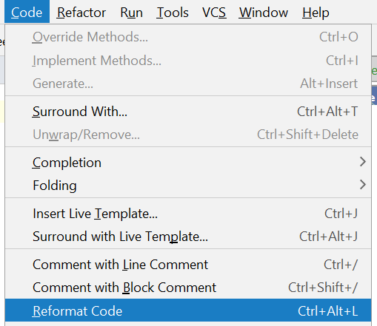
Tools to help (1/2).
If you name a file as .json in Pycharm, it will provide syntax highlighting and error handling via the red underlining.
Type in the JSON on the right. Be very careful to get all the quotes and punctuation correct.
Use the Syntax Highlighting to find a missing , and put it in.
In the Pycharm Menu, use the Code -> Reformat Code options in the menu to make the JSON look pretty.
{"Firstname":"Bill","Surname":"Clinton","Age":71,"Terms":[{"Start":1993,"End":1997}{"Start":1997,"End":2001}]}

Slide 26
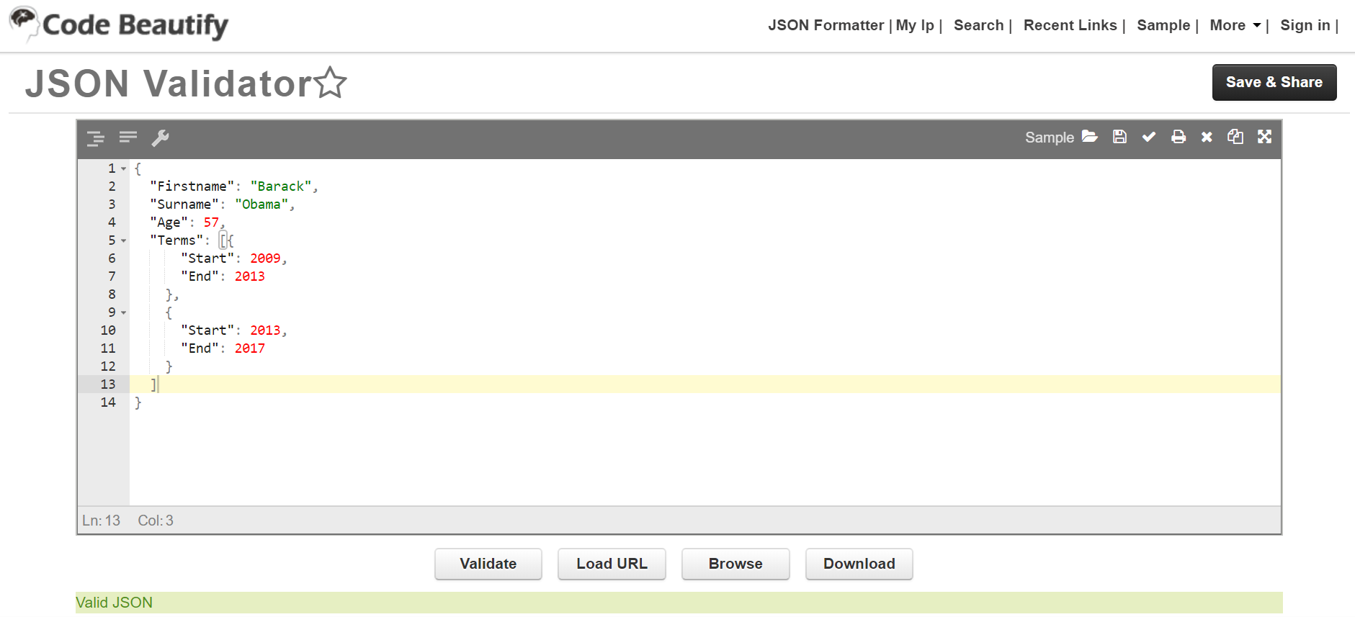
Tools to help (2/2).
There are also web based tools that can help.
I recommend https://codebeautify.org/jsonvalidator

Slide 27
Alternatives – JSON (practical)

Slide 28
Loading Objects from JSON.
Create a file with the contents on the right called “week11_example8.json”
{
"Firstname": "Ronald",
"Surname": "Reagan",
"Terms": [
{
"Start": 1981,
"End": 1985
},
{
"Start": 1985,
"End": 1989
}
]
}

Slide 29
Python code to load it.
Python has a json module in the standard library.
You can use it to work on strings that are in the JSON format, or files that contain JSON formatted text.
You can use it both read and write JSON, and do various automatic operations with converting Python structures to JSON and vice versa.
By default, JSON is loaded as a dictionary.
On the next slide, we will load the JSON we just wrote.

Slide 30
Loading – Example.
# Week11, Example8
import json
with open("week11_example8.json") as jf:
president = json.load(jf)
print(type(president))
print(f"This presidents first name is {president['Firstname']}")
termcount = len(president["Terms"])
print(f"This president served {termcount} terms")
Type in the code.
Can you predict what it will do ?
Particularly, what Python type will this be ?

Slide 31
Converting Python To JSON
While the built in Python library is easy to use to READ JSON, it is much harder to save python datastructures to JSON.
This is because not all Python data structures convert neatly to JSON.
For example, if you tried to save a dictionary containing data about a person, where the persons date of birth was represented by a date object from the datetime standard library, how would you represent this within the JSON types ?

Slide 32
An example of the type problem.
Try this program.
Do you expect it to work ?
Did it do what you expected ?
# Week11, Example9
import json
import datetime
person = {
"name": "Albert Einstien",
"dob": datetime.date(year=1879, month=3, day=14)
}
print(json.dumps(person))

Slide 33
The Error.
File "C:\Program Files\Python37\lib\json\encoder.py", line 179, in default
raise TypeError(f'Object of type {o.__class__.__name__} '
TypeError: Object of type date is not JSON serializable
Here we are told the Python library doesn’t know how to “serialise” dates.
(Serialise is term for turning the object into a serial format, like JSON).
We know this is because of the date type.

Slide 34
Fixing This.
To understand this approach we need to do three steps.
Decide, within the types supported by JSON, how we wish to represent the Python data.
Create a special class, which can be passed to the JSON encoder functions (dump or dumps typically), which tells it what to do with these types it doesn’t naturally understand what to do.
Create a special class, which can be passed to the JSON decoder functions (load or loads typically), which tells it how to translate the JSON type back into the Python type.

Slide 35
Step 1: Deciding on our format.
We can literally pick anything we want, but some things will obviously make more sense than others.
For example, we could decide to translate
Type date: datetime.date(year=1879, month=3, day=14)
Into
Type string: “The 14th day of the 3rd month of 1879”.
However, this makes more sense.
String: 1879-03-14

Slide 36
Step 1: Why I picked that format.
Why did I pick YYYY-MM-DD rather than DD-MM-YYYY or something else ?
For two reasons.
1.) If you sort those strings, as strings, into order, they come out in date order as well. This makes this format popular in computer science.
2.) It is an ISO standard, the ISO standard date format. Python’s datetime library has a function that returns this format out the box.
# Week11, Example10
import json
import datetime
person = {
"name": "Albert Einstien",
"dob": datetime.date(year=1879, month=3, day=14)
}
print(person["dob"].isoformat())

Slide 37
Step 2: Making an encoder.
# Week11, Example11
import json
import datetime
# Create a class, which is a subclass of JSONEncoder.
class PersonEncoder(json.JSONEncoder):
# Modify the default behaviour. This function is called
# on each element in the object being encoded, in this
# case it is being called twice, once for the name string,
# and then again for the dob date.
def default(self, obj):
# If the thing is a date, do something custom !
if isinstance(obj, datetime.date):
# Return a dictionary.
return {
# This is so our Decoder knows what to do.
# It is customary to start metadata like this
# with an underscore.
"_type": "date",
"value": obj.isoformat()
}
# And if this isn't a date, just return what
# we would do without this custom encoder.
else:
return super(PersonEncoder, self).default(obj)
person = {
"name": "Albert Einstien",
"dob": datetime.date(year=1879, month=3, day=14)
}
# Print this to the screen, and save it to albert.txt
print(json.dumps(person, cls=PersonEncoder))
with open("albert.txt", "w") as outfile:
json.dump(person, outfile, cls=PersonEncoder)
This code is quite complicated, and I’ve commented it inline.
Please feel free to ask questions about this.

Slide 38
A new problem !
One problem now, is we can’t just save it and then load it like we could earlier in example 4 and 5, like we did with Bruce.
This is because we will get the data with the metadata _type, and the thing as a string and not a Python date.
We need to fix this with a custom Decoder !

Slide 39
Step 3: Making a decoder.
Since I’ve added to the previous example, the code is now too long to put on the slide.
Go check the example from the repo.
The comments are still inline.
The program should

