Slide 1
Learning Python 3
Week 9: Simulating Snakes and Ladders

Slide 2
Goals of this week.
Working out the average number of turns it takes to play a game of snakes and ladders.
Today we will work through this together.

Slide 3
Analysis of the problem.
A game of snakes and ladders consists of a player:-
Rolling a dice.
Moving forward that many squares.
If they land at the bottom of a ladder, they climb it.
If they land at the head of a snake, they slide down it.

Slide 4
Rules of the Game.
There are several variations in the rules of Snakes and Ladders.
To start with, we shall use these rules :-
You don't get another turn if you roll a 6.
If you would move past the last square on the board, you win the game.
(You don't need to exactly land on 30).
We shall use the board shown on the next stage.

Slide 5
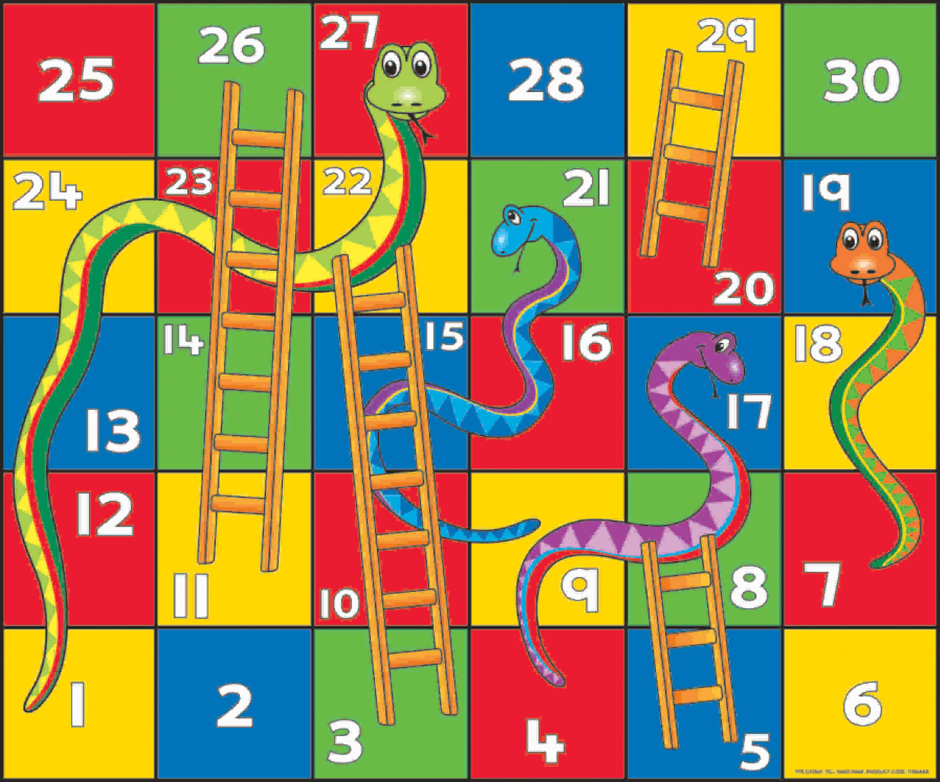
Board

Slide 6
How should we roll a dice ?
What library can we import that will allow us to simulate rolling a die ?
Import that library.
Write a function which takes no arguments and returns a simulation of a single 6 sided die roll.

Slide 7
Example 1.
# Week9, Example1
import random
def roll_die():
return(random.randint(1,6))
You should have something like this.

Slide 8
Representing the board.
Most of the time a player lands on a square, they remain on the square.
Sometimes though, they go up a ladder or down a snake.
Model this as a dictionary, with the key being the square they land on after the roll, and the value being :-
The same if they don't slide.
The top of the ladder if they climb one.
The bottom of the snake if they slide down one.

Slide 9
Hint.
Instead of writing all 30 squares :-
Fill in 1 to 30 with the same number.
Then replace the keys for the snakes and the ladders.

Slide 10
Example 2.
# Week9, Example2
import random
def roll_die():
return(random.randint(1,6))
end_position = {}
# Fill in 1 to 30 with the same position.
# This would be like a board with no snakes or ladders.
for i in range(1,31):
end_position[i] = i
# Ladders
end_position[3] = 22
end_position[5] = 8
end_position[11] = 26
end_position[20] = 29
# Snakes
end_position[17] = 4
end_position[19] = 7
end_position[21] = 9
end_position[27] = 1
You should have something like this.
This is all one program, it starts on the left and continues on the right. Enter the code on the left, then underneath it the code on the right.

Slide 11
Playing the game.
At the start of the game, a player is on square 1.
The player rolls a die and moves forward that many squares.
Add one to the number of turns the player has taken.
If the player would be on square 30 or past square 30, they win !
When they win, print how many turns it took.
If they haven't won, they climb ladders or slide down snakes.
They take another turn.
Write code to implement this.
Compare it to example3.

Slide 12
Changing how the game ends.
Lets modify the rules of the game.
Starting with my version of example3, add functionality so.
The player must land exactly on 30 to win the game.
If the player rolls past 30, they don't move at all.
Compare what you have written against my example4.

Slide 13
A different end to the game.
Another way snakes and ladders can be played.
If you land on 30 you win.
If you would go past 30, you "bounce off".
You are on 29 and roll a 2. You end up back on 29 after "bouncing".
You are on 29 and roll a 4. You end up back on 27 after "bouncing". Then you slide down the snake.
Starting with example4, implement this.
Compare this with my example5. week9_example4.py

Slide 14
Starting to Get Statistics.
Playing the game once isn't that interesting.
Restructure example5 so it plays the game ten thousand times
At the end, output the
Shortest game (in number of turns).
Longest game (in number of turns).
Average game length (in number of turns).
There are many ways to do it.
Compare what you produce with mine in example6.

Slide 15
A more advanced example.
I've reworked the version in example 6 and made example 7.
This program uses techniques and libraries you haven't seen, so I wouldn't expect you to be able to make it on your own.
You will need to make sure the matplotlib library is installed.
Review it, and use the internet to research the things you don't understand.
Comment the code.
Send me the commented code so I can review it and give you feedback.

Slide 16

Homework

Slide 17
Homework 1
Start with the last example.
Add a rule that requires you to you to roll a 6 before you can start to play the game.
Count each attempt to roll a 6 as a "turn"
Once you roll a 6, you don't move that turn. Instead, you CAN move the next turn.
So the minimum game length would now be something like rolling
6, 2, 6, 2
Run the program and see how it changes how long the game takes (on average) to complete.

Slide 18
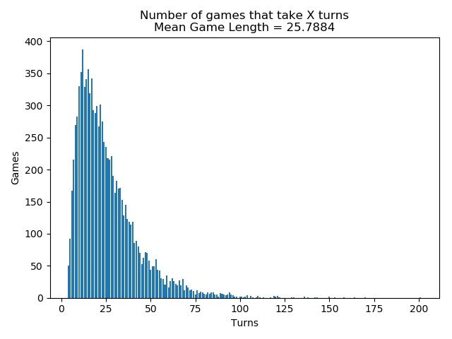
Homework 2
Start with the previous Homework, or with my version.
Add to the title of the graph the average (mean) number of turns to play a game.
Output should look something like the example on the right.

Slide 19
Homework 3
Read my version of homework 3.
What does it use that you haven't yet used ?
Where would you find documentation on that feature ?
Add comments explaining parts of the code to it, and send them to me for review.

