Slide 1
Learning Python 3
Week 10: Test Driven Development.

Slide 2
Goals of this week.
Learn about software testing.
Learn about test driven development as a methodology.
Implement it using pytest

Slide 3
Ad-Hoc Testing.
So far, you have no doubt "tested" your programs.
You have done so using a technique known as "ad-hoc" testing.
As the name suggests, it is when testing consists of running the program and checking that it works the way you want.
This works well for smaller programs, and less important programs, but it has some problems with it.

Slide 4
The problems with Ad-Hoc Testing.
You know something works when you tested it, but do you keep testing things when you change the program ?
If someone else worked on your program, did they break something you had working ?
You might change a function or a method. Does something that uses it still work as you expected ?

Slide 5
Introducing Test Driven Development.
Test driven development is writing code to test other bits of code.
You can keep running the tests every time you change something.
This cuts out a lot of the problems with ad-hoc testing.

Slide 6
Manual Testing and Asserts.
Examine this simple example program.
Assert will throw an error if the condition you give it isn't true.
Do you expect this program to work ?
Type it in and find out.
# Week10, Example1
def add(x,y):
return x + y
assert add(2,2) == 4

Slide 7
Manual Testing and Asserts (pt2).
This is the same program with a small change.
Do you expect this program to work ?
If not, what do you expect to happen ?
Type it in and find out what does.
# Week10, Example2
def add(x,y):
return x + y
assert add(2,2) == 5

Slide 8
Putting testing in functions.
# Week10, Example3
def add(x,y):
return x + y
def test_add_works():
assert add(2,2) == 4
def test_add_fails():
assert add(2,3) == 4
test_add_works()
print("The test we expected to work did !")
test_add_fails()
print("The test we expected to fail did !")
Here we have put the testing in dedicated functions.
These functions are called test_something().
We will see why this is particularly useful on the next slide.
What do you expect this program to do ?
Type it in and see if you are correct ?

Slide 9
Running Tests with pytest.
pytest (also known as py.test) is a framework you can use to run tests and see results.
To use it you need to do three main things.
Configure PyCharm to use pytest for your project.
Name your test functions test_<SOMETHING>.
Use PyCharm to run your tests.

Slide 10
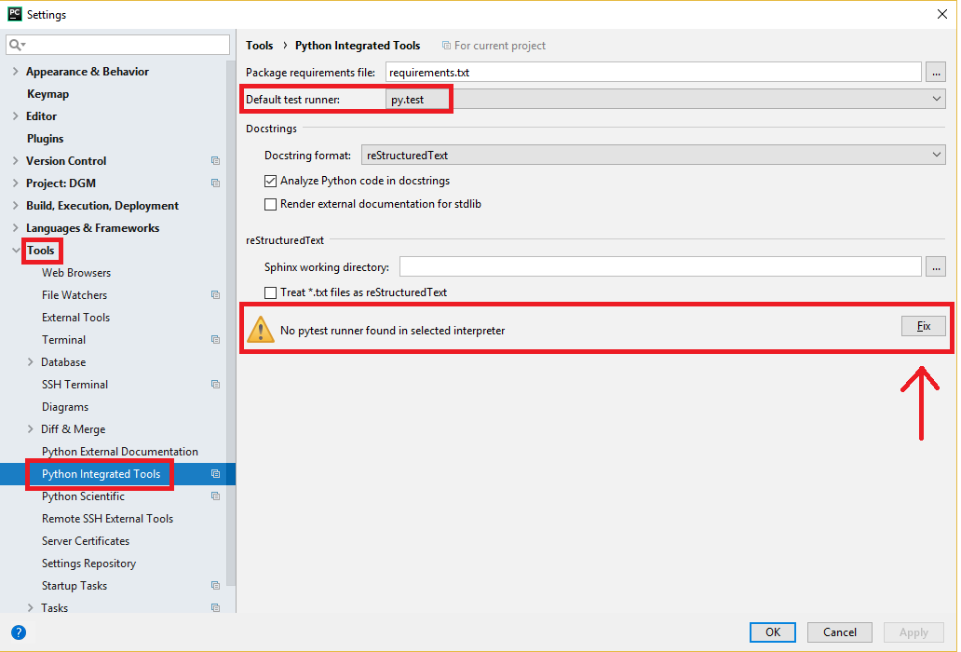
Step1: Setting up PyCharm.
In PyCharm.
Go to the File menu, and pick Settings.
Select Tools -> Python Integrated Tools.
Set the Default Test Runner to "py.test".
Pycharm will tell you py.test installed installed, and offer a "Fix" button. Click it.

Slide 11
Step2: Writing test_ functions.
You already wrote a program in example3 that did this, but we are going to write a new one.
Note this program doesn't do anything !
It is just functions and tests.
Type it in.
Then run the tests in it as explained in the previous slides.
# Week10, Example4
def add(x,y):
return x + y
def multiply(x,y):
return x * y
def test_add_works():
assert add(2,2) == 4
def test_add_fails():
assert add(2,3) == 4
def test_multiply_works():
assert multiply(2,2) == 4
def test_multiply_fails():
assert multiply(2,3) == 4

Slide 12
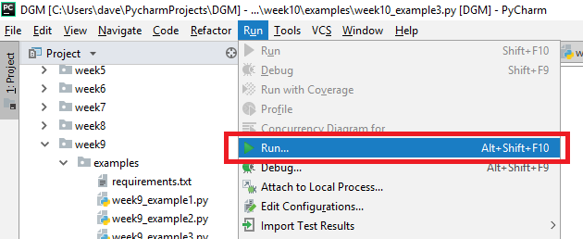
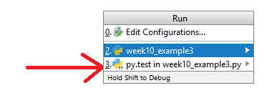
Step3: Running it with Pycharm.
With your program selected, select Run → Run… on the menu.
The menu that pops up will have two options.
The first (week10_example3) here will run the program normally.
The second (py.test in week10_example3) will run all the tests in your program.

Slide 13
Understanding the output.
Skip to the "FAILURES" section.
It shows each test that failed.
It also shows the reason the test failed.
Here we see test_add_fails() failed because we tried to assert 5 == 4, which it doesn't.
We also see test_multiplay_fails() failed because we tried to assert 6 == 4, which it doesn't.
Finally, it shows the total number of tests that failed and tests that passed.
================================== FAILURES ===================================
_______________________________ test_add_fails ________________________________
def test_add_fails():
> assert add(2,3) == 4
E assert 5 == 4
E + where 5 = add(2, 3)
week10_example4.py:13: AssertionError
_____________________________ test_multiply_fails _____________________________
def test_multiply_fails():
> assert multiply(2,3) == 4
E assert 6 == 4
E + where 6 = multiply(2, 3)
week10_example4.py:19: AssertionError
===================== 2 failed, 2 passed in 0.10 seconds ======================

Slide 14
Removing the deliberate failures.
Nobody likes to fail !
But without failures, you wouldn't have been able to see how this works.
So now lets remove the deliberate failures from the last program and repeat the tests.
# Week10, Example5
def add(x,y):
return x + y
def multiply(x,y):
return x * y
def test_add():
assert add(2,2) == 4
def test_multiply():
assert multiply(2,2) == 4

Slide 15
Understanding the no failure output.
Here there is no "FAILURES" section.
Here we just get to see all two tests passed, and it took 0.03 seconds to do it.
=========== test session starts =======
platform win32 -- Python 3.6.3, pytest-3.6.2, py-1.5.4, pluggy-0.6.0
rootdir: C:\Users\dave\PycharmProjects\DGM\week10\examples, inifile:collected 2 items
week10_example5.py .. [100%]
========= 2 passed in 0.03 seconds ======

Slide 16

Coverage.

Slide 17
What is coverage ?
Coverage is the idea of how much of your program is covered by tests.
Ideally you want 100% coverage, but that isn't always possible or practical.
Coverage requires another python module installed, called (unsurprisingly), coverage.
Add coverage to your requirements.txt file and make sure it is installed, like you did in previous weeks.
Then, lets see how it works.

Slide 18
An example program with incomplete coverage.
This program has tests for add() and subtract()
But not for multiply()
Type it in, and we will run coverage on it on the next slide.
# Week10, Example6
def add(x,y):
return x + y
def multiply(x,y):
return x * y
def subtract(x,y):
return x - y
def test_add():
assert add(2,2) == 4
def test_multiply():
assert multiply(2,2) == 4

Slide 19
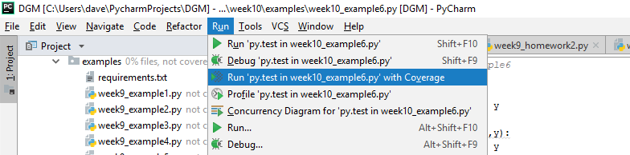
An incomplete coverage example.
This program has incomplete coverage.
add() and multiply() have tests, but subtract() does not.
If you select "Run with Coverage", as in the screenshot, you can get help from PyCharm with coverage.

Slide 20
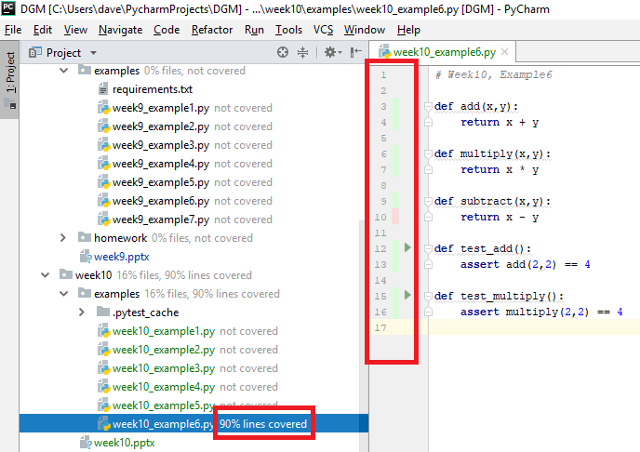
Understanding the Output.
It ran the tests as normal, but PyCharm now has two extra things.
These are highlighted on the screenshot.
We can see in the list of files in our project that our example program has 90% coverage.
And, on the right, we can see green marks for lines covered by tests (or that are tests), and red lines for uncovered statements.

Slide 21
Adding Full Coverage.
# Week10, Example7
def add(x,y):
return x + y
def multiply(x,y):
return x * y
def subtract(x,y):
return x - y
def test_add():
assert add(2,2) == 4
def test_multiply():
assert multiply(2,2) == 4
def test_subtract():
assert subtract(4,2) == 2
Here we have written a test for subtraction.
This program should have 100% coverage !
Try running coverage against it to see.

Slide 22
Changing How Something Works / Running Individual Tests.
Although right now the tests don't take long to run, when you are working on bigger projects, running the full test suite may take a while.
When you are working, often you are editing something that only needs you to run a single test to see if it has worked.
For example, the next program changes the multiplication process to a less efficient one (but one that still works).
This shows you an advantage of test driven development. You can change HOW something is implemented, and check nothing else has broken as a result.

Slide 23
Changing Multiplication.
Multiplication here is changed.
But because of our tests, we know it still works !
Type this in and run the tests.
Check the tests pass.
Check the program has full coverage.
# Week10, Example8
def add(x,y):
return x + y
def multiply(x,y):
i = 1
answer = x
while i < y:
answer += x
i += 1
return answer
def subtract(x,y):
return x - y
def test_add():
assert add(2,2) == 4
def test_multiply():
assert multiply(2,2) == 4
assert multiply(2,5) == 10
assert multiply(8,8) == 64
def test_subtract():
assert subtract(4,2) == 2

Slide 24
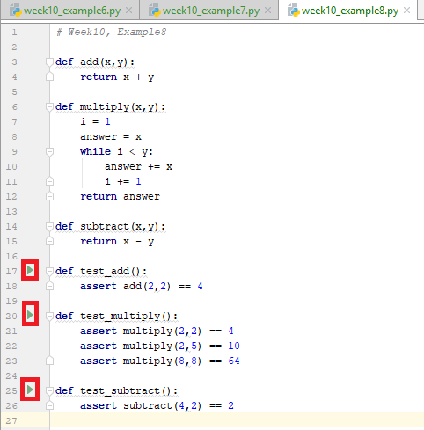
Running Single Tests.
If you only want to change multiply, PyCharm provides a small "test" button by the function.
By clicking it, you only run that set of tests.
Try this with multiply.
Then break the multiply function and try again.

Slide 25

Homework !

Slide 26
Homework.
Two types of homework this week.
The first type, I have provided the tests, but I want you to provide the implementations.
The second type, I have provided the implementations, and I want you to provide tests.

Slide 27
Homework 1.
# Week10, Homework1, Question
# Returns the arithmetic mean (average) of a list of numbers.
def mean(list_of_numbers):
# Replace this with your answer.n
pass
def test_mean():
assert mean([1,2,3,4,5]) == 3
assert mean([1,3,5,7,9]) == 5
assert mean([1,2,3,4,5,6]) == 3.5
assert mean([1.5, 2.5, 3.5, 4.5, 5.5, 6.5]) == 4

Slide 28
Homework 2.
# Week10, Homework2, Question
# Take a length of time in days, mins and hours
# and return how long it takes in seconds.
def time_in_seconds(days=0, hours=0, mins=0):
# Replace this with your answer.
pass
def test_time_in_seconds():
assert time_in_seconds(days=1, hours=0, mins=0) == 86400
assert time_in_seconds(days=1, hours=15, mins=35) == 142500
assert time_in_seconds(days=2, hours=3, mins=11) == 184260

Slide 29
Homework 3.
You don't always need to understand the code to be able to write tests for it.
You just need to understand what the outputs should be.
Replace test_is_prime() with your tests.
Make sure you have 100% coverage when you have completed.
There are many correct answers. Mine is just an example.
# Week10, Homework3, Question
import math
def is_prime(n):
if n == 2:
return True
if n % 2 == 0 or n <= 1:
return False
sqr = int(math.sqrt(n)) + 1
for divisor in range(3, sqr, 2):
if n % divisor == 0:
return False
return True
def test_is_prime():
# Add your tests here.
pass

Slide 30
Homework 4.
You don't always need to understand the code to be able to write tests for it.
You just need to understand what the outputs should be.
Replace test_day_of_week() with your tests.
Make sure you have 100% coverage when you have completed.
There are many correct answers. Mine is just an example.
# Week10, Homework4, Question
import datetime
def day_of_week(day, month, year):
day_list = ["Monday", "Tuesday", "Wednesday", "Thursday",
"Friday", "Saturday", "Sunday"]
day = datetime.date(day=day, month=month, year=year)
return(day_list[day.weekday()])
def test_day_of_week():
# Put your tests here.
pass

Slide 31
Homework 5.
This program has two implementations of letter_of_alphabet().
This function takes the number of a letter of the alphabet (for example 3 would be c), and returns that letter.
letter_of_alphabet1() is "home made". letter_of_alphabet2() uses the string module.
Although we run the same tests against both functions, and we should expect the same results, we don't get them.
Find the bugs in letter_of_alphabet1.
# Week10, Homework5
import string
def letter_of_alphabet1(number):
letters = ["a", "b", "x", "d", "e", "f", "g",
"h", "i", "j", "k", "l", "m", "n",
"o", "p", "q", "r", "s", "t", "u",
"v", "v", "w", "x", "y", "z"]
return letters[number - 1]
def letter_of_alphabet2(number):
return string.ascii_lowercase[number - 1]
def test_letter_of_alphabet1():
assert "a" == letter_of_alphabet1(1)
assert "c" == letter_of_alphabet1(3)
assert "z" == letter_of_alphabet1(26)
def test_letter_of_alphabet2():
assert "a" == letter_of_alphabet2(1)
assert "c" == letter_of_alphabet2(3)
assert "z" == letter_of_alphabet2(26)

