Slide 1
Learning Python 3
Week 5: Modules, Dictionaries, Randomness and Files

Slide 2
Goals of this week.
This week we will learn about.
Importing modules.
Specifically the "random" module.
Using random numbers in a program.
Using the new data type, the "dictionary".
Reading and Writing from files on the disk.
We will also get to work with palindromes.

Slide 3
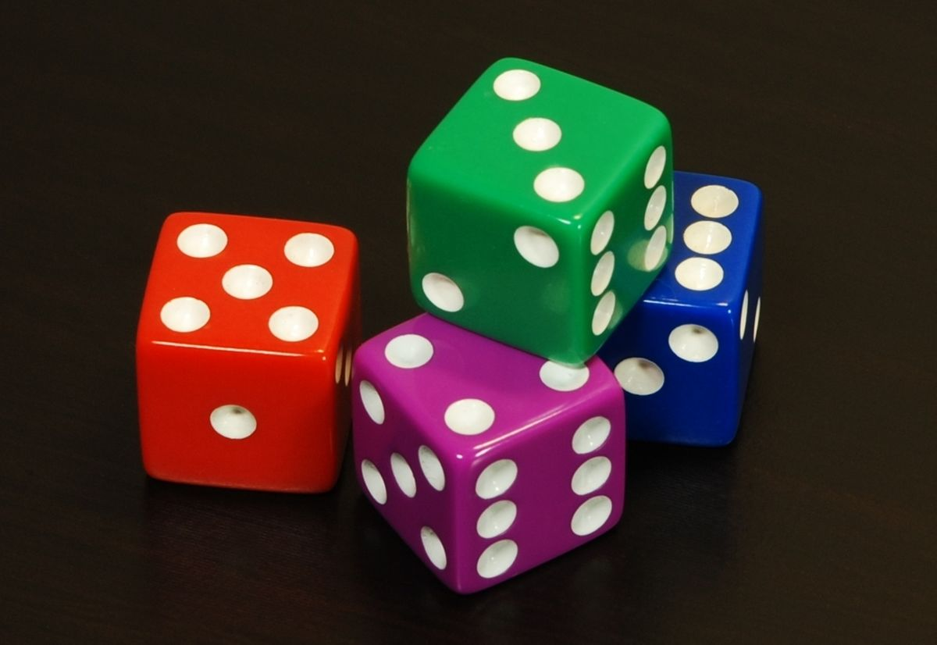
Modules, and the random module.

Slide 4
What are modules ?
So far, everything we have done is with the basic Python programming language.
We will eventually learn all these basic language features.
But there is more !
You can import modules, and modules come in two main types.
Standard Library modules come with Python, and add additional features that are commonly needed in programs.
Python Package Index (PyPi) modules, which you need to download from the internet to use.
This week, we will use modules in the Standard Library. We will come back to PyPi modules later.

Slide 5
How do I use a module.
First you need to import it.
You can do this anywhere in a program, but it is normal to import modules at the start of the program.
Once the module is imported, you can use it and functions it contains by using module_name.function
We will learn exactly what a function is next week.
This week, we will be using the randint function.
You use it like random.randint(a,b), where a and b are integers.
It gets you a random integer between those two numbers.

Slide 6
Example – Importing and Using Random.
This program imports the random module.
Then it uses it to roll a 6 sided die.
Unlike previous programs you have run, you cannot predict what this one will do !
Task: Type in this program and run it several times. Does it do what you expected ?
# Week5, Program1
import random
die1 = random.randint(1,6)
print(f"I rolled a die and got {die1}")
die2 = random.randint(1,6)
print(f"I rolled another die and got {die2}")
print(f"Together I got {die1 + die2}")

Slide 7
More Random Examples.
# Week5, Program2
import random
prime_ministers = ['Tony Blair', 'Gordon Brown', 'David Cameron', 'Theresa May']
print("A random 21st century prime minister :-")
print(prime_ministers[random.randint(0,3)])
print("======================================")
print(f"Google the year {random.randint(1900,1999)}")
print("Find something that happened in that year")
Task: Type in this program and run it several times. Does it do what you expected ?
Extra Credit: Look up the history and find an important event.

Slide 8
More about the Random module.
There is more to the random module than just random.randint
Another function of the random module is random.choice
You pass it a list, and it returns a random item from that list.
Look at this new example, which does the same random prime minister choice as the last program.
# Week5, Program3
import random
prime_ministers = ['Tony Blair', 'Gordon Brown', 'David Cameron', 'Theresa May']
print("A random 21st century prime minister :-")
print(random.choice(prime_ministers))
Task: Type in this program and run it several times. Does it do what you expected ?
Extra Credit: Look up the history and find an important event.

Slide 9
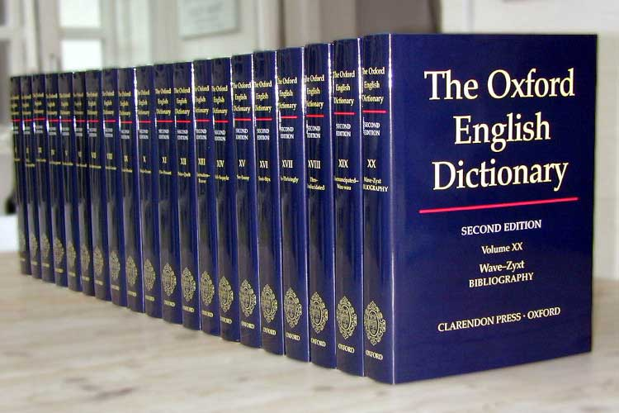
Dictionaries.

Slide 10
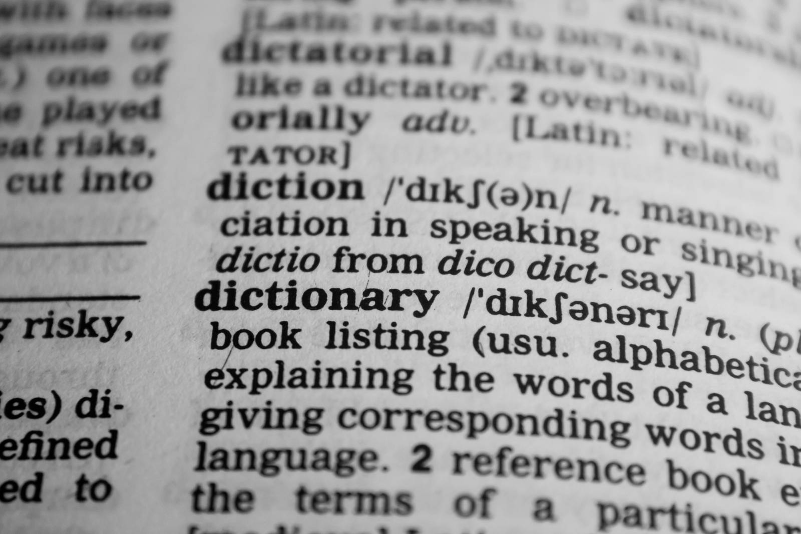
Dictionaries.
Dictionaries are a type of thing in Python.
Other types we have seen so far are Integers, Strings and Lists.
Dictionaries in Python have a key and a value
Think of the key like a word in the dictionary, and the value like the definition.
Keys can be strings and integers (and other types).
Values can be any type.

Slide 11
Defining and accessing a dictionary.
Just like we can use [] for an empty list.
We can use {} for an empty dictionary.
To store something in a dictionary, we do
dict_name["key"] = value
To access the value of a key, we do
dict_name["key"]

Slide 12
Dictionary Examples
# Week5, Program4
pm = {} # Make an empty dictionary.
pm["Tony"] = "Blair"
pm["Gordon"] = "Brown"
pm["David"] = "Cameron"
pm["Theresa"] = "May"
print(pm["Gordon"])
print(pm["Theresa"])
print(pm["Tony"])
Here is an example of using a dictionary.
Again, we will use the list of 21st century prime ministers in our example.
Task: Type in this program and run it several times. Does it do what you expected ?
Extra Credit: Look up the history and find an important event.

Slide 13
Dictionaries: Integer Keys.
# Week5, Program5
year = {} # An empty dictionary.
year[2018] = ["Theresa May"]
year[2017] = ["Theresa May"]
year[2016] = ["David Cameron", "Theresa May"]
i = 2011
while i <= 2015:
year[i] = ["David Cameron"]
i = i + 1
year[2010] = ["Gordon Brown", "David Cameron"]
for i in [2008,2009]:
year[i] = ["Gordon Brown"]
for i in [2000,2001,2002,2003,2004,2005,2006]:
year[i] = ["Tony Blair"]
year[2007] = ["Tony Blair", "Gordon Brown"]
print(f"Year 2003: {year[2003]}")
print(f"Year 2007: {year[2007]}")
print(f"Year 2010: {year[2010]}")
print(f"Year 2016: {year[2016]}")
We can also use integers as keys.
We are doing that in this program.
Task: Type in this program and run it. Does it do what you expected ?
Extra Credit: Do you know why the results are what they are (in terms of history).

Slide 14
Iterating Over Dictionaries.
You can iterate over dictionary keys, values or both.
If you are going to do a lot of this, you should ask yourself the question:
Should this be a dictionary, or a list ?
Sometimes however you want a dictionary that you do iterate over.
To do so, use
dictionary_name.keys() to get all the keys.
dictionary_name.values()to get all the values.
dictionary_names.items()to get both as pairs.
You can also define a dictionary, and set some keys and values in the one line.
You do so with dictionary_name = {"Key1": "Value1", "Key2": "Value2"}
Lets look at some examples on the next slide.

Slide 15
Iterating Over Dictionaries: Examples
# Week5, Program6
alphabet = {1: "A", 2: "B", 3: "C", 4: "D", 5: "E"}
for n in alphabet.keys():
print(n)
for l in alphabet.values():
print(l)
for n, l in alphabet.items():
print(n,l)
Task: Type in this program and run it. Does it do what you expected ?

Slide 16
Keys are Unique
Keys are unique.
If you try and add something to a dictionary and the key already exists, you replace it.
You can also modify the values of existing keys.
# Week5, Program7
moons = {"Earth": "Luna", "Mars": ["Phobos", "Deimos"]}
print(f"The moons of Earth are {moons['Earth']}")
print(f"The moons of Mars are {moons['Mars']}")
print("Advanced Space Aliens move Charon from Pluto to Mars !")
moons["Mars"].append("Charon")
print(f"The moons of Earth are {moons['Earth']}")
print(f"The moons of Mars are {moons['Mars']}")
print("Evil space aliens destroy Earth's moon !")
moons["Earth"] = None
print(f"The moons of Earth are {moons['Earth']}")
print(f"The moons of Mars are {moons['Mars']}")
Task: Type in this program and run it. Does it do what you expected ?

Slide 17

Working with Files.

Slide 18
Writing Files.
First, we will show you how to write text to a file.
To do this, we need to do these things.
1.) We need to open the file. This causes Python to make a file if it doesn't exist, and be ready to write to it.
We need to know the filename we want to open.
We need to say what mode we are opening the file in.
The table on the right explains the modes.
2.) We use the .write() method to write to the file.
3.) Once we are finished with the file, we need to use the .close() method to be finished with it.
Commonly Used Modes.
Code | What it does
w | Write to the file. Overwrite the file totally if it already exists.
a | Append to the file. If the file already exists, things you write to it get added to the bottom.
r | Read from the file. Use this if you want to get the contents of the file into your program.
x | Create a new file for writing. This will fail with an error if the file already exists.

Slide 19
Writing File – An example.
This program will open a file and write to it.
The file will be in the same location as your python program.
You should see it appear in the project list on the left of PyCharm after you run it.
# Week5, Program8
# Open a new file for writing.
yourfile = open("helloworld.txt", "x")
# Write to it.
yourfile.write("Hello World !")
# Close the file
yourfile.close()
Task: Type in this program and run it. Does it do what you expected ?
What happens if you run it again ?

Slide 20
Overwriting a File.
This program will overwrite a file that already exists.
# Week5, Program9
# Replace or open a file for writing.
yourfile = open("helloworld.txt", "w")
# Write to it.
yourfile.write("Bonjour monde !")
# Close the file
yourfile.close()
Task: Type in this program and run it. Does it do what you expected ?
What happens if you run it again ?

Slide 21
Appending to a file.
This program will append (add to) an existing file.
# Week5, Program10
# Open a file for appending.
yourfile = open("helloworld.txt", "a")
# Write to it.
yourfile.write("Hola mundo !")
# Close the file
yourfile.close()
Task: Type in this program and run it. Does it do what you expected ?
What happens if you run it again ?

Slide 22
Reading from a file
# Week5, Program11
yourfile = open("helloworld.txt", "r")
# Read each line into a list (with newline characters).
contents = yourfile.readlines()
print(contents)
yourfile.close()
yourfile = open("helloworld.txt", "r")
# Read each line into a list.
contents = yourfile.read().splitlines()
print(contents)
yourfile.close()
yourfile = open("helloworld.txt", "r")
# Read each line, one at a time using a for loop.
for line in yourfile:
# rstrip removes the extra newline.
print(line.rstrip())
yourfile.close()
This is similar to what you have just been doing, but also a little different.
You still open the file like before.
But you read from it in one of several ways.
The example on the right shows multiple ways of achieving similar things.
Tip: There are some tradeoffs using each of these methods, but they only really matter with giant files.
Task: Type in this program and run it. Does it do what you expected ?
What happens if you run it again ?

Slide 23
The newline character.
You will have noticed the last example had a newline character.
This is indicated with "\n". It is a special code meaning move to a newline (like when you press enter).
You can use this in print, as in this example.
# Week5, Program12
print("Line1\nLine2\n")
print("\nYou\nCan\nUse\nMore\nThan\nOne\n\n\nOf\nThese !")
Task: Type in this program and run it. Does it do what you expected ?

Slide 24

Homework.

Slide 25
Homework
This week, the homework is going to be a little different.
To start with, we will have similar things to previous weeks.
Then we will write a program that simulates rolling multiple dice, and shows which numbers are the most common when rolling them.
Finally, we will write a program which prints all the palindromes in the English language.

Slide 26
Homework 1
Import the random module.
Simulate rolling a 20 sided dice and print the result.
Repeat this 10 times by using a while loop.
Create a list with the 4 constituent countries of the United Kingdom.
Use random.choice() to select a random country and print it.
Repeat this 10 times by using a while loop.

Slide 27
Homework 2
Create a dictionary which has the keys as the names of the constituent countries of the United Kingdom, and the values as the names of the capital cities of those countries.
By referring the dictionary, print the capital of England.
Using a for loop, print "The capital of _____ is ____" for each country in the UK.

Slide 28
Homework 3
Look up the names of the last 5 monarchs (starting with Queen Elizabeth II) of the United Kingdom, and the year they came to the throne.
Store the names as a string if only one monarch came to the throne in a year.
Store the names as a list of strings if more than one did.
Make a dictionary with the keys as the years of ascension, and the values as the name of the Monarch.
Print who came to the throne in 1901.
Print who came to the throne in 1910.
Print who came to the throne in 1936.

Slide 29
Homework 4
Simulate rolling a normal 6 sided die 500 times.
Write the results of each of these rolls to a file, with each roll on a different line.
Tips:
You can only write strings to files. You can use format strings in file.write() just like you can in print()
Remember how to add new lines.

Slide 30
Homework 5: Rolling 2 million dice !
This is a little more complicated than previous homework assignments.
There are multiple ways to do this.
Don't be afraid to ask for help if you are struggling, but show what you have already done and try and ask specific questions about what you need help with rather than just "how do I do it ?".

Slide 31
Homework 5: Rolling 2 million dice !
Create a dictionary with keys from 2 to 12, and values set to 0 for all these things.
Simulate rolling 2 normal six sided dice.
Add the results together to get a number between 2 and 12.
Add 1 to the value of the dictionary which has the key.
Repeat the above 1 million times !
Finally, print how many of each number you got.
Extra Credit: Do the results surprise you. Repeat it. Can you explain why the pattern is the way it is ?

Slide 32
Homework 6: Finding the Palindromes
To complete this task, you will need an English wordlist.
You can download words.txt from this link: https://bit.ly/2FmZ4PN
Remember to download this file into the same directory you have your program in. Get help with this if you need it.
Tip: Remember to strip off the newline !
Your task is to find all the palindromes in that word list.
If you don't know what a palindrome is, look it up on the internet or in a dictionary.

Slide 33

Next Week.

Slide 34
Next Week.
We will learn to install libraries from the internet.
We will learn to make simple images.
We will implement the Chaos game (Sierpinski triangles).
Watch this video to learn more.
https://www.youtube.com/watch?v=kbKtFN71Lfs

