Slide 1
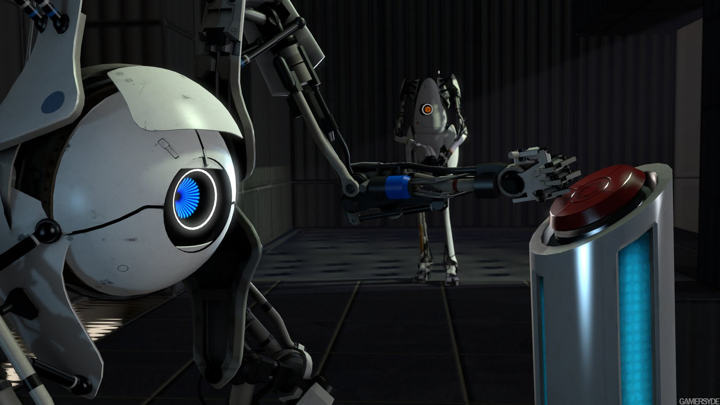
Games AI
Lecture 6.1
Automated Game Testing

Slide 2
Automated Game Testing
Last lecture we talked about Procedural Content Generation
  A PCG algorithm has a generative space of content that it can create
  We want our content to be functional and aesthetic.
  Among the other features we wanted from our generater were:
    Reliability
    Controllability
    Diversity
    Creativity

Slide 3
Automated Game Testing
Iteration is important in developing good PCG
  But how do we iterate?
    Generate some content
    Look at it
    Tweak the generator
    Repeat

Slide 4
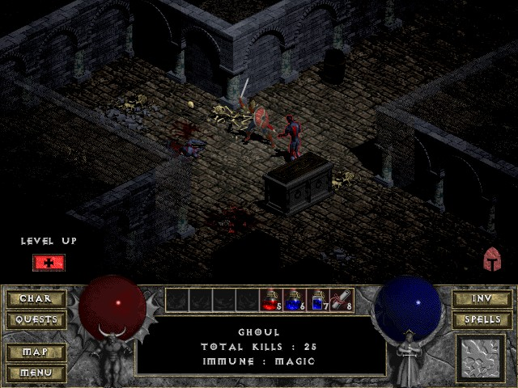
Automated Game Testing
Look at it
  But what if that takes too long?

Slide 5
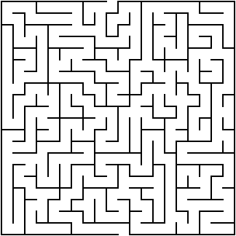
Automated Game Testing
Look at it – with AI
  Is this maze passable?
  How could we check automatically?

Slide 6
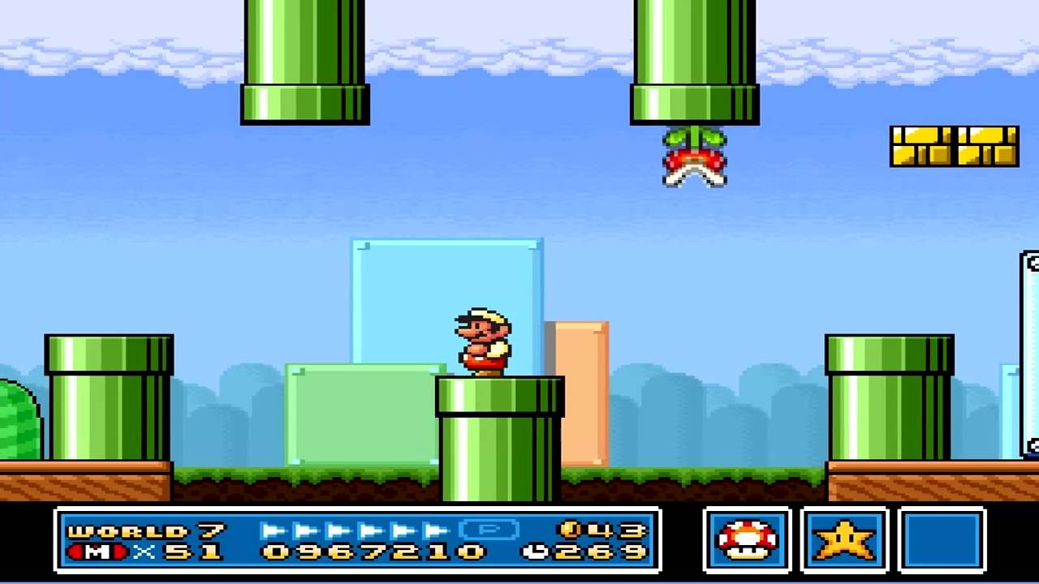
Automated Game Testing
More challenging...
  Is this level passable?
  How could we check automatically?

Slide 7
Automated Game Testing
Iteration (2)
  Generate some content
  AI gives it a score
  Tweak the generator
  Repeat

Slide 8
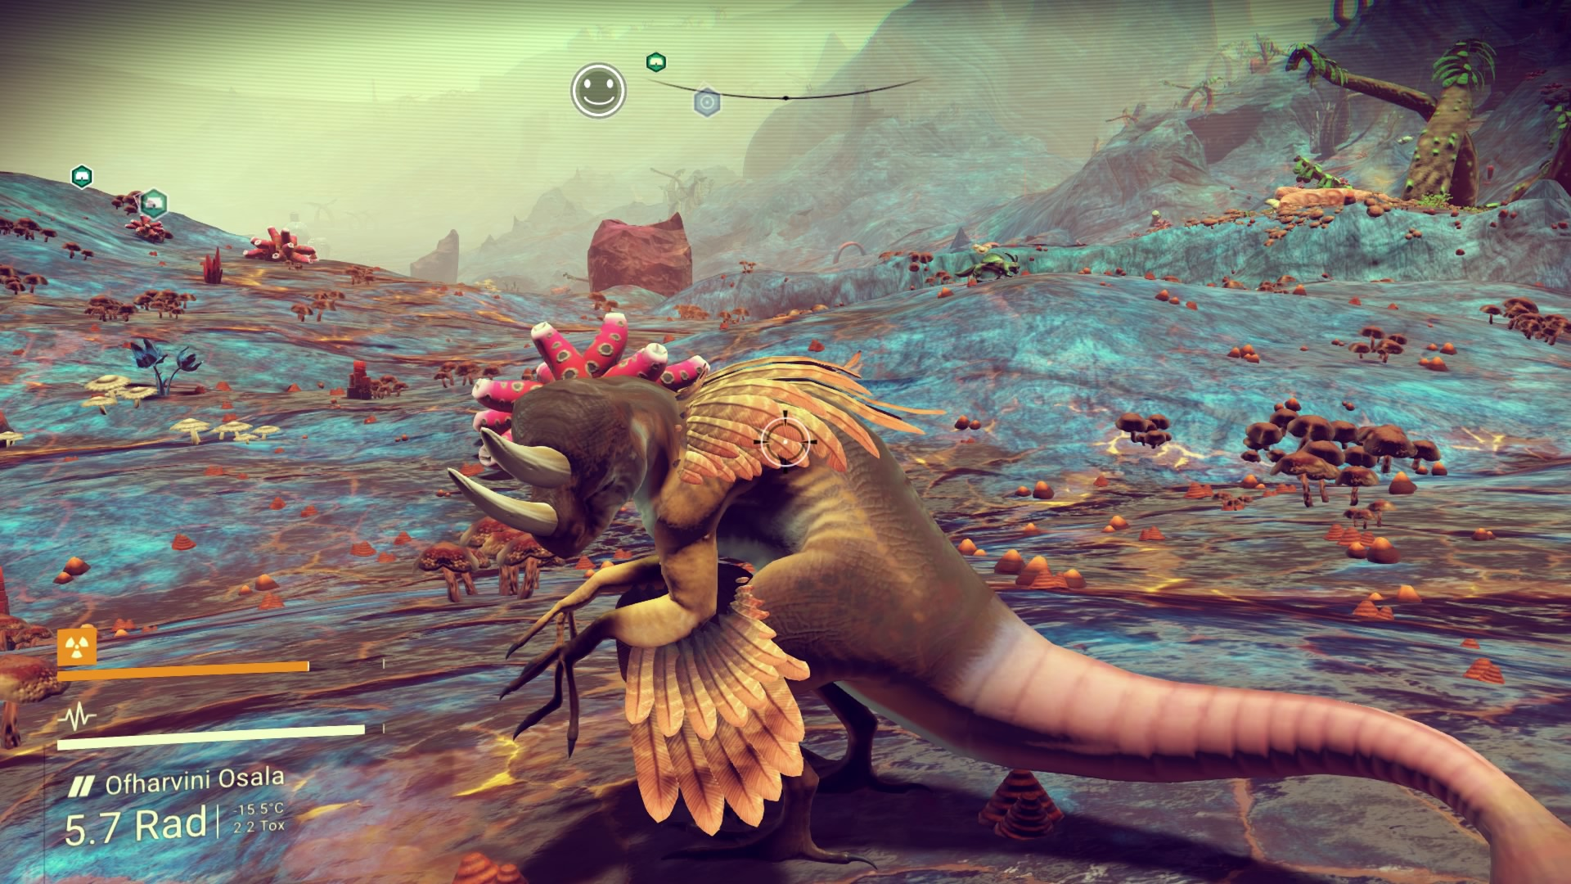
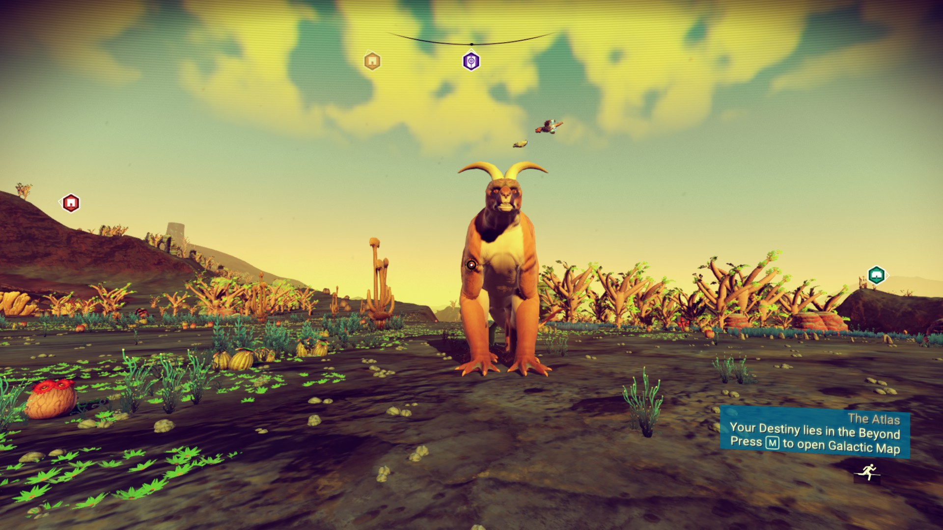
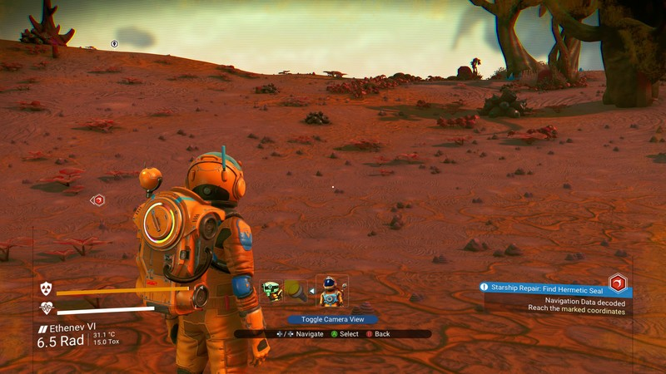
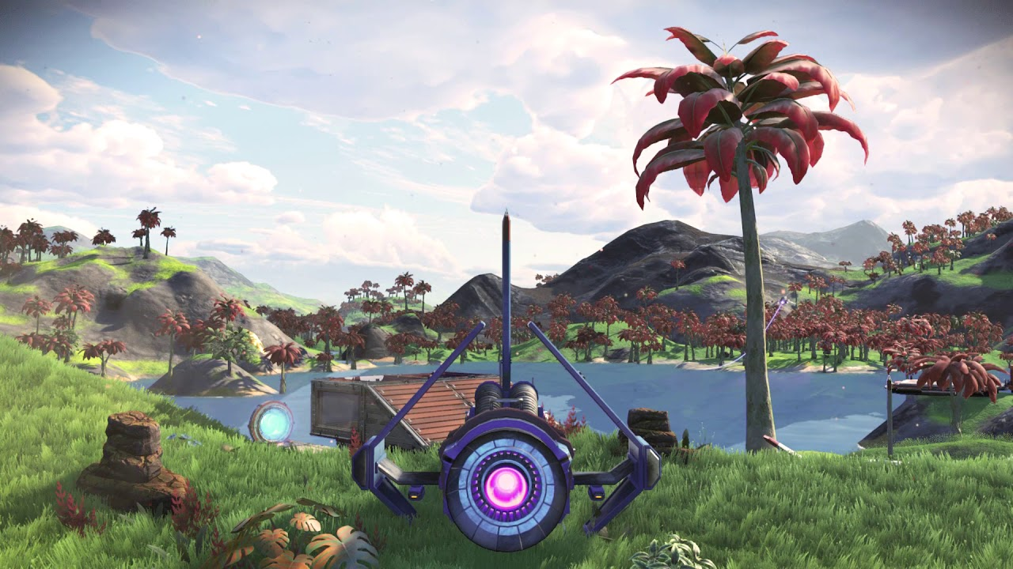
Automated Game Testing
AI gives it a score
  But what if we want a particular aesthetic?
  How do we give this a score?

Slide 9
Automated Game Testing
Iteration (3)
  Generate some content
  Designer (efficiently) gives it a score
  Tweak the generator
  Repeat

Slide 10
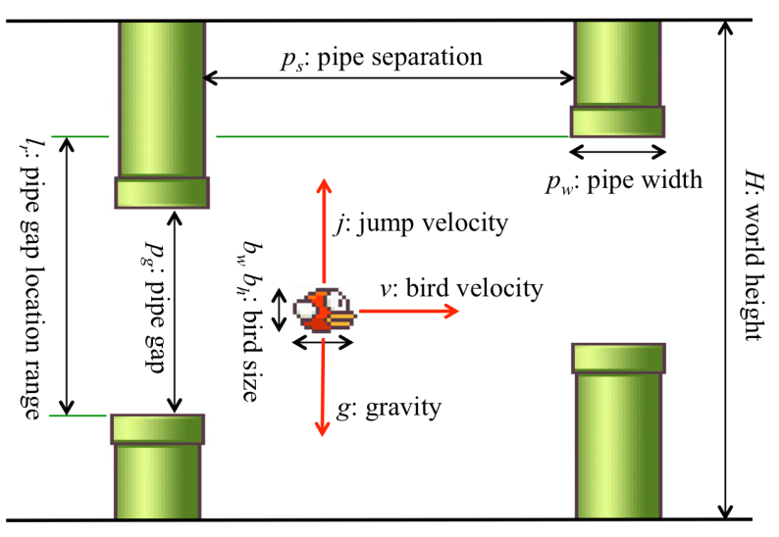
Automated Game Testing
More difficult...
  But what if we want a particular aesthetic of play
  e.g. how do we score difficulty?
https://game.engineering.nyu.edu/projects/exploring-game-space/

Slide 11
Automated Game Testing
Iteration (4)
  Generate some content / Build a version of the game
  AI or Designer (efficiently) gives it a score
  Tweak the generator / develop the next version of the game
  Repeat

Slide 12
Automated Game Testing
We also wanted our PCG to have:
  Reliability
  Controlability
  Diversity
  Creativity
If we can devise a statistical measure for these, then we can evaluate them automatically

Slide 13
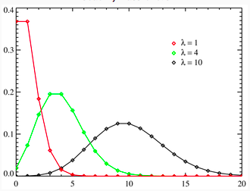
Automated Game Testing
How would we generate a statistic for:
  Reliability?

Slide 14
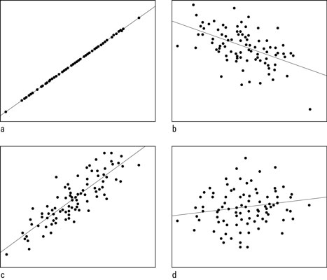
Automated Game Testing
How would we generate a statistic for:
  Controllability?

Slide 15
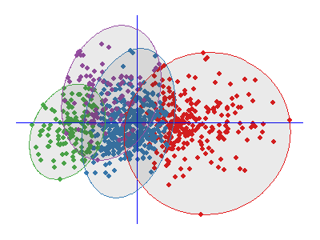
Automated Game Testing
How would we generate a statistic for:
  Diversity?

Slide 16
Automated Game Testing
Iteration (4)
  Generate some content
  Score it
  Tweak the generator based on that score
  Repeat
Still requires human intervention

Slide 17
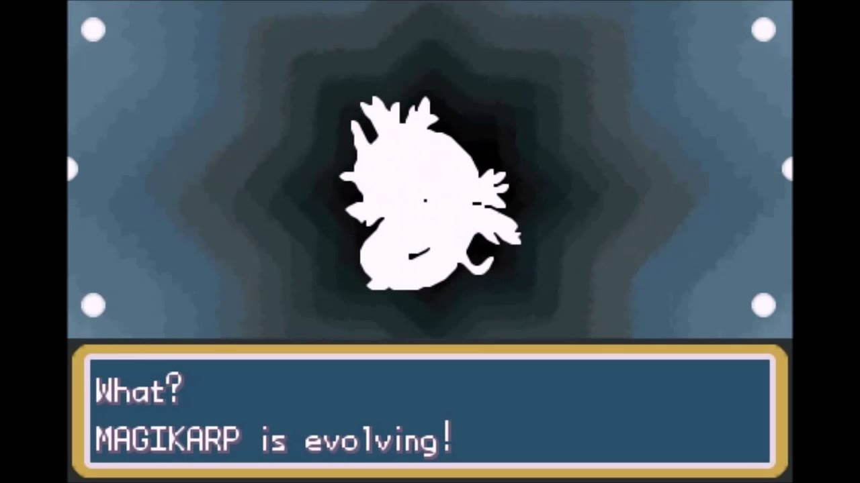
Automated Game Testing
To iterate fastest, we need the AI to re-program the generator
We need the generator to… evolve!

