Slide 1
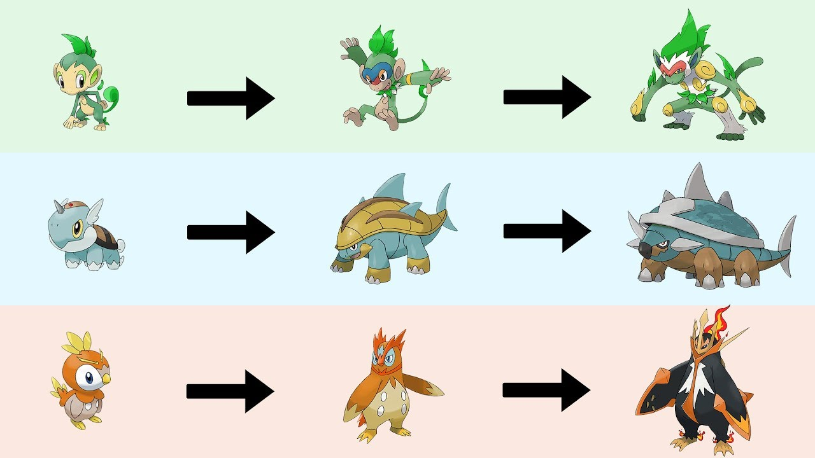
Games AI
Lecture 6.2
Evolutionary Algorithms

Slide 2
Introduction
Last lecture we described PCG as a search problem
  You have a generative space defined by your algorithm
  Sometimes this space includes both good and bad content.
  If you can score how “good” content is with an evaluation function then you can search for high-scoring content.
    This is an optimisation problem

Slide 3
Introduction
Why evolution?
  Engineers often copy solutions in nature
  What is the best problem solver in nature?
    The evolutionary process

Slide 4
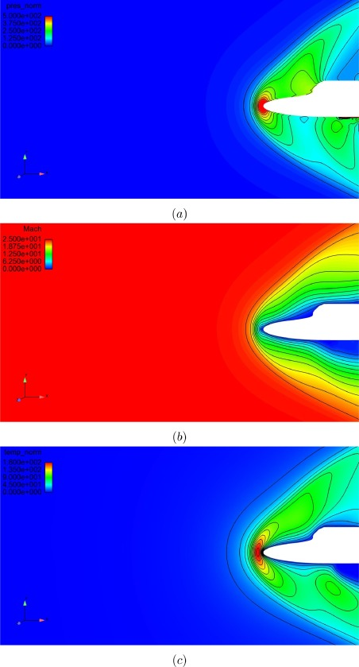
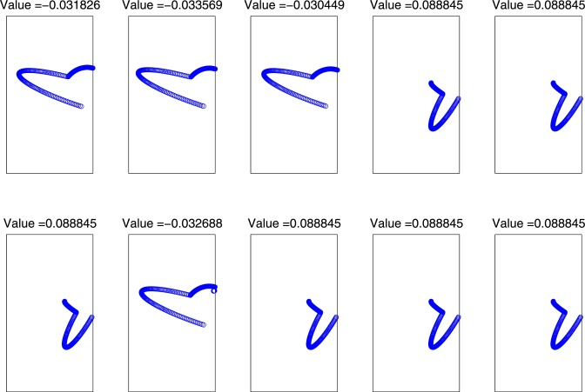
Introduction
So you can… find the optimal design for hypersonic re-entry vehicle nosecone
Evans, B., Walton, S., Evans, B., Walton, S. 2017 Aerodynamic optimisation of a hypersonic
reentry vehicle based on solution of the Boltzmann–BGK equation and evolutionary optimisation
Applied Mathematical Modelling 52 215 240 doi: 10.1016/j.apm.2017.07.024

Slide 5
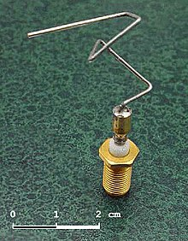
Introduction
Or... evolve a more efficient antenna for an unusual purpose

Slide 6
Introduction
Or... tune parameters for rules and FSMs
  if (enemy.distance <= 5)
    attackWithKnife()
  else if (enemy.distance > 5 AND enemy.distance <=30)
    attackWithSubmachineGun()
  else attackWithRifle()

Slide 7
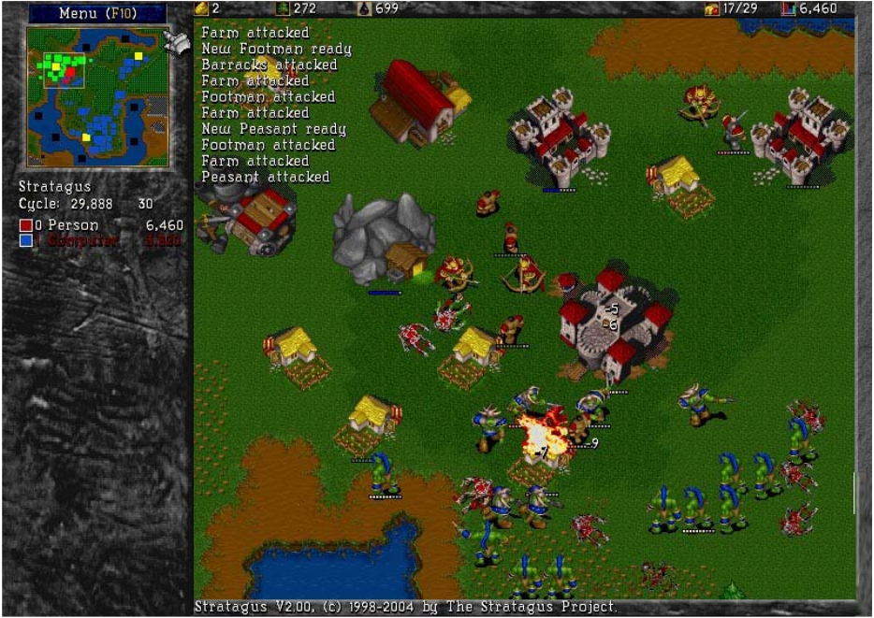
Introduction
Or... tune parameters that define AI personality (e.g. unit preference, scientific advance preference, offense vs. defense, etc.)
Ponsen, Marc, and Pieter Spronck. Improving adaptive game AI with evolutionary learning. Diss. Masters Thesis, Delft University of Technology, 2004. http://citeseerx.ist.psu.edu/viewdoc/download?doi=10.1.1.109.6055&rep=rep1&type=pdf

Slide 8
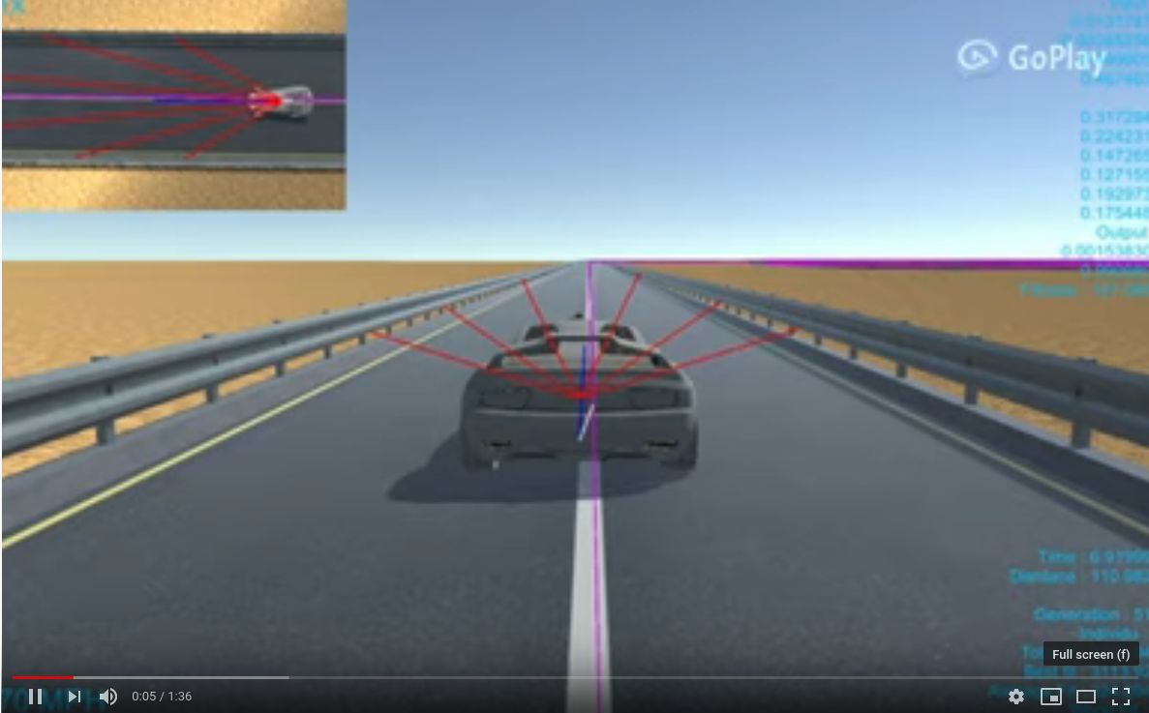
Introduction
Or... evolve agents using e.g neuroevolution (evolution of neural networks)
  https://youtu.be/_1TOKKgAock

Slide 9
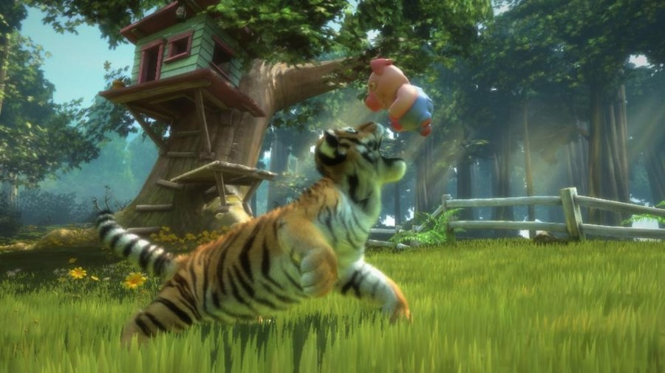
Natural evolution

Slide 10
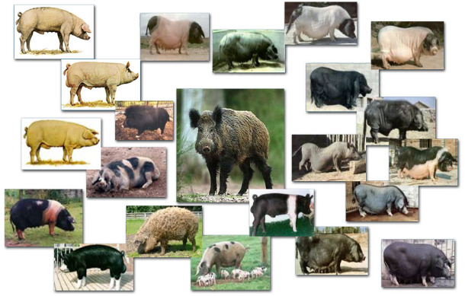
Natural evolution
Darwinian natural selection:
  Competition-based selection
  Phenotypic variation
    Behavioural and physical traits that affect an individual’s fitness

Slide 11
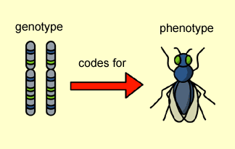
Natural evolution
Success in survival and reproduction is determined by phenotypical properties
Phenotypic variations are always caused by genotypic variations
Phenotypes never influence genetic information
  No learning within individuals

Slide 12
Natural evolution
Change happens through reproduction by the mechanisms of:
  Mutation
  Recombination

Slide 13
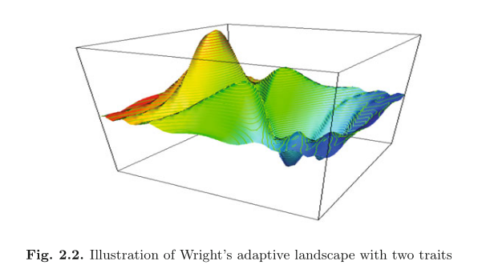
Natural evolution
Adaptive landscape
  Metaphor of a space where height corresponds to fitness
    Global Optimum = best
    Local Optimum = better than neighbours
https://dantelore.com/posts/evolutionary-algorithm-playable-demo/

Slide 14
Natural evolution
Each individual is a sample of the space of all possible living things
  Produced by forces of variation
  Evaluated by forces of selection
    Prove viable to live
    Prove viable to reproduce
In algorithmic terms this is a “generate and test” method.

Slide 15
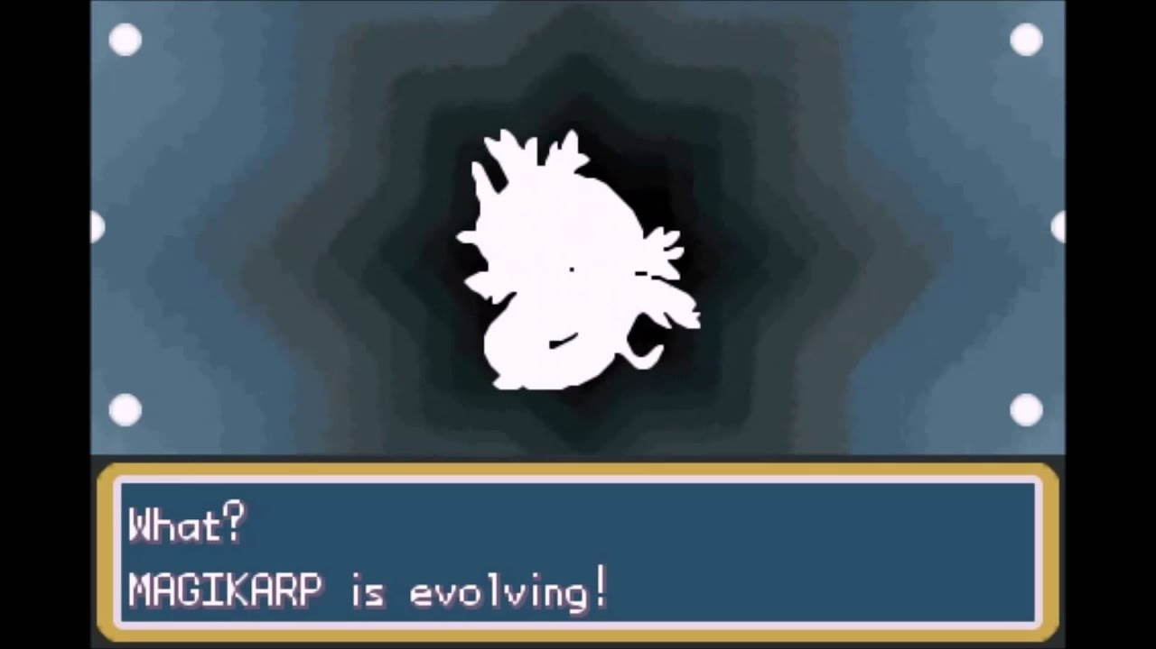
Intro to Evolutionary Algorithms

Slide 16
Intro to EAs
In an Evolutionary Algorithm, a solution is described by a genotype
  This might be a string, enum[], number[]...
  e.g. parameter values for a PCG algorithm
  e.g. weights for a neural network
This data (genotype) is interpreted to create the phenotype (e.g. level map, AI behaviour, game audio)

Slide 17
Intro to EAs
Evolutionary Algorithms (EAs) are:
  Population based
    (You keep hold of a bunch of possible solutions at the same time)
  Stochastic
    (Involves randomness)
  Most use recombination
    (You mix together different solutions to try and find a better one)

Slide 18
Intro to EAs
Why EAs work
  Variation (recombination and mutation) create diverity and novelty
  Selection acts as a force to increase the mean quality of solutions

Slide 19
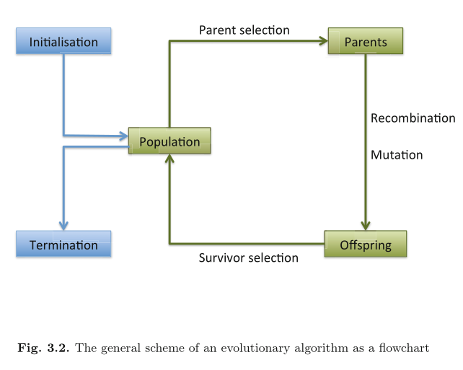
Intro to EAs

Slide 20
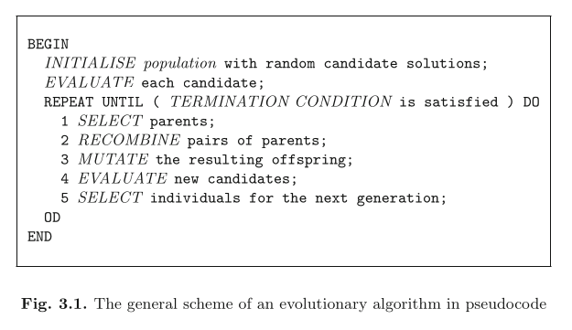
Intro to EAs

Slide 21
Intro to EAs
Components of EAs
  representation (definition of individuals)
  evaluation function (or fitness function)
  population
  parent selection mechanism
  variation operators, recombination and mutation
  survivor selection mechanism (replacement)
  termination condition

Slide 22
Intro to EAs
Components of EAs
  representation (definition of individuals)
  evaluation function (or fitness function)
  population
  parent selection mechanism
  variation operators, recombination and mutation
  survivor selection mechanism (replacement)
  termination condition

Slide 23
Intro to EAs
Representation: What is your genome?
  Strings in a finite alphabet (genetic algorithms)
  Real-valued vectors (evolution strategies)
  Finite state machines (classical evolutionary programming)
  Trees (genetic programming)
Different approaches may suit different problems better depending on the natural way to encode the candidate solutions

Slide 24
Intro to EAs
Components of EAs
  representation (definition of individuals)
  evaluation function (or fitness function)
  population
  parent selection mechanism
  variation operators, recombination and mutation
  survivor selection mechanism (replacement)
  termination condition

Slide 25
Intro to EAs
Evaluation Function
  Function that assigns quality measure to genotypes
    Evaluate phenotype for quality.
  Represent requirements that population should adapt to meet (i.e. defines what improvement means)

Slide 26
Intro to EAs
Components of EAs
  representation (definition of individuals)
  evaluation function (or fitness function)
  population
  parent selection mechanism
  variation operators, recombination and mutation
  survivor selection mechanism (replacement)
  termination condition

Slide 27
Intro to EAs
Population
  holds possible solution
    A multiset of genotypes (almost always a constant size)
  Individuals do not change or adapt, population does
  Selection operators work at the population level
    Best individual of a given population is selected

Slide 28
Intro to EAs
Components of EAs
  representation (definition of individuals)
  evaluation function (or fitness function)
  population
  parent selection mechanism
  variation operators, recombination and mutation
  survivor selection mechanism (replacement)
  termination condition

Slide 29
Intro to EAs
Parent selection / mate selection
  Distinguish among individuals based on quality
  Allow better individuals to become parents of next generation
  Probabilistic – fitter individuals more likely to be selected as parents
    Often still give low-fitness individuals a small chance, otherwise search becomes too greedy and gets stuck in local optima.

Slide 30
Intro to EAs
Components of EAs
  representation (definition of individuals)
  evaluation function (or fitness function)
  population
  parent selection mechanism
  variation operators, recombination and mutation
  survivor selection mechanism (replacement)
  termination condition

Slide 31
Intro to EAs
Variation operators
  Create new individuals from old ones
  The “generate” in “generate and test”
  Mutation and Crossover (recombination)

Slide 32
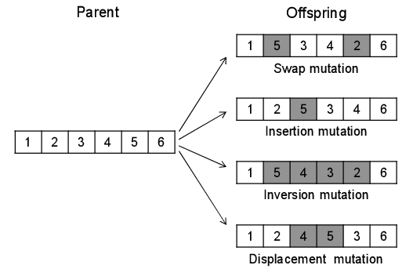
Intro to EAs
Mutation
  Randomly change part of the genotype
  Stochastic
  Unbiased
  Provides the gene-pool with “fresh blood”

Slide 33
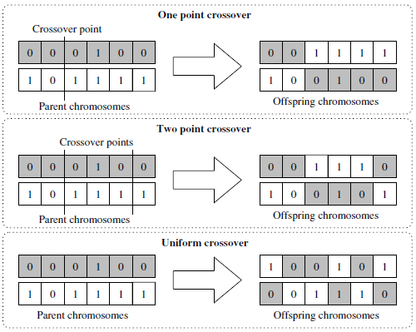
Intro to EAs
Crossover
  Merges information in two or more parents
  Random recombinations
  Hopefully take good qualities of each parent

Slide 34
Intro to EAs
Components of EAs
  representation (definition of individuals)
  evaluation function (or fitness function)
  population
  parent selection mechanism
  variation operators, recombination and mutation
  survivor selection mechanism (replacement)
  termination condition

Slide 35
Intro to EAs
Survivior selection / replacement strategy
  Decide which of older generations to keep
  Based on fitness values
    e.g. keep top % of new and old generation combined
  Or based on age
    e.g. only keep newest generation

Slide 36
Intro to EAs
Components of EAs
  representation (definition of individuals)
  evaluation function (or fitness function)
  population
  parent selection mechanism
  variation operators, recombination and mutation
  survivor selection mechanism (replacement)
  termination condition

Slide 37
Intro to EAs
Termination condition
  Stop when we find optimum fitness (if you guarantee reaching it)
  Otherwise
    Limit CPU time
    Limit total number of fitness evaluations
    Check if fitness improvement remains low for a given period of time (i.e. for a number of generations or fitness evaluations)
    Check if the population diversity drops below a given threshold

Slide 38
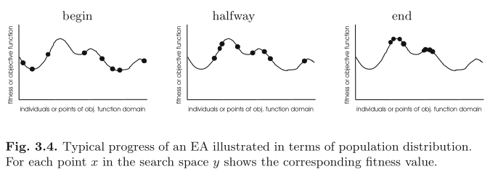
  How do EAs behaive?

Slide 39
EA behaviour
  Exploration: generation of individuals in untested space
  Exploitation: concentrating in vicinity of known good solutions
  Premature convergence: losing population diversity too quickly and getting stuck in a local optimum.

Slide 40
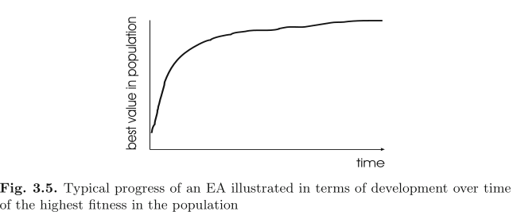
EA behaviour
  EAs are anytime
    You can interrupt them at... any time
    Get the best solution so far, even if suboptimal

Slide 41
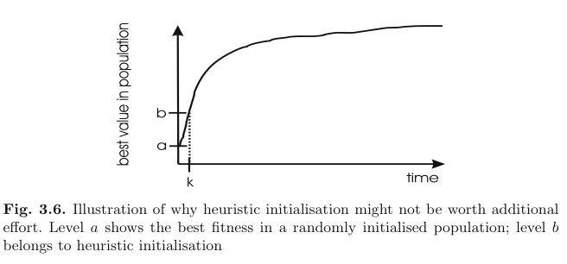
EA behaviour
  Improvement is often rapid at start
  You can initialise your population with heuristics, but it might not be worth the effort

Slide 42
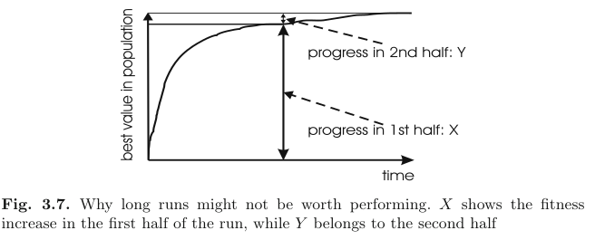
EA behaviour
  Improvement slows down, so long runs may be not worth i t

Slide 43
EA behaviour
  Designing and tuning EAs is an art:
    Population size
    Number of generations
    Fitness function
    Representation
    Mutation rate
    Crossover operations
    Selection procedure
    Number of solutions to keep

Slide 44
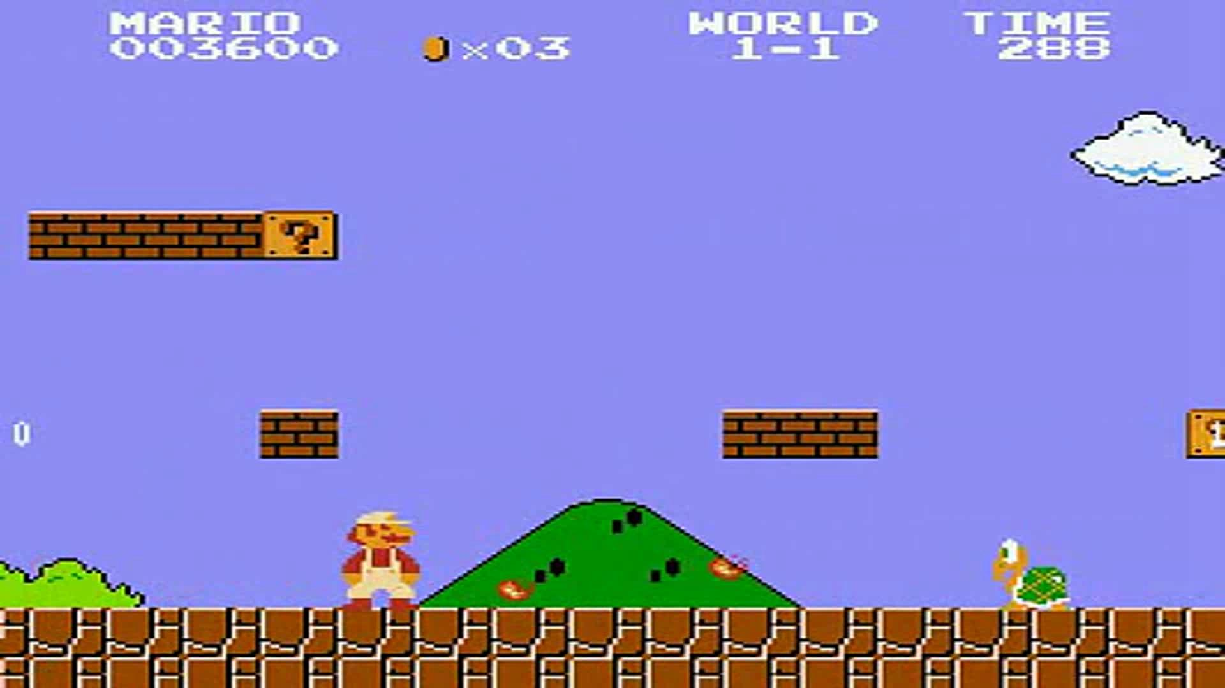
  Mario Map Generation
Steve Dahlskog and Julian Togelius:
Patterns as Objectives for Level
Generation: PCG Workshop 2013

Slide 45
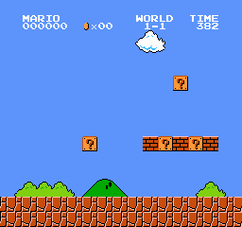
Mario map generation
Representation attempt 1
  2D grid of integers storing value for each grid cell
    Direct mapping to phenotype
    But “good” space is tiny proportion of search space

Slide 46
Mario map generation
Representation attempt 2
  A range of integers, each representing the height of an obstacle
    0 = hole in the ground
    10 = maximum height of obstacle
  But most obstacles in SMB are close to the ground.

Slide 47
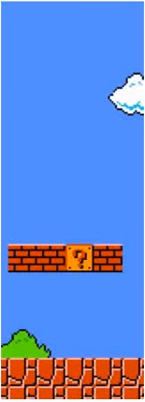
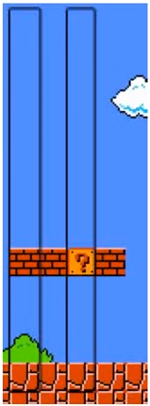
Mario map generation
Representation attempt 3
  Represent mario level as string of symbols, each symbol corresponds to a column of blocks that existed in the original SMB

Slide 48
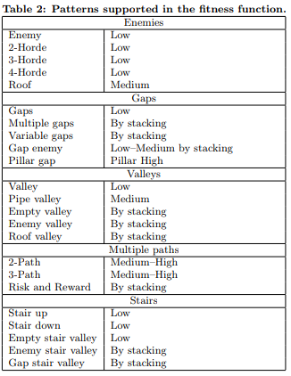
Mario map generation
Fitness function
  Look for level design patterns in the output that match patterns in the original SMB

Slide 49
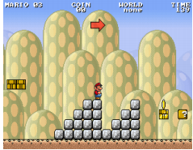
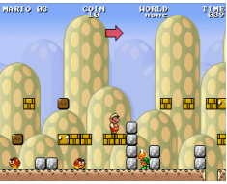
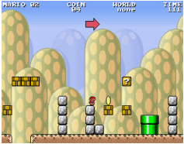
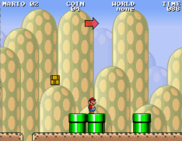
Mario map generation
Population of 200 (randomly initialised)
Rank by fitness, top 50% kept
One point crossover between pairs in rank order (best breeds with second best)
Mutation: inject a random character in a random position
10,000 generations

Slide 50
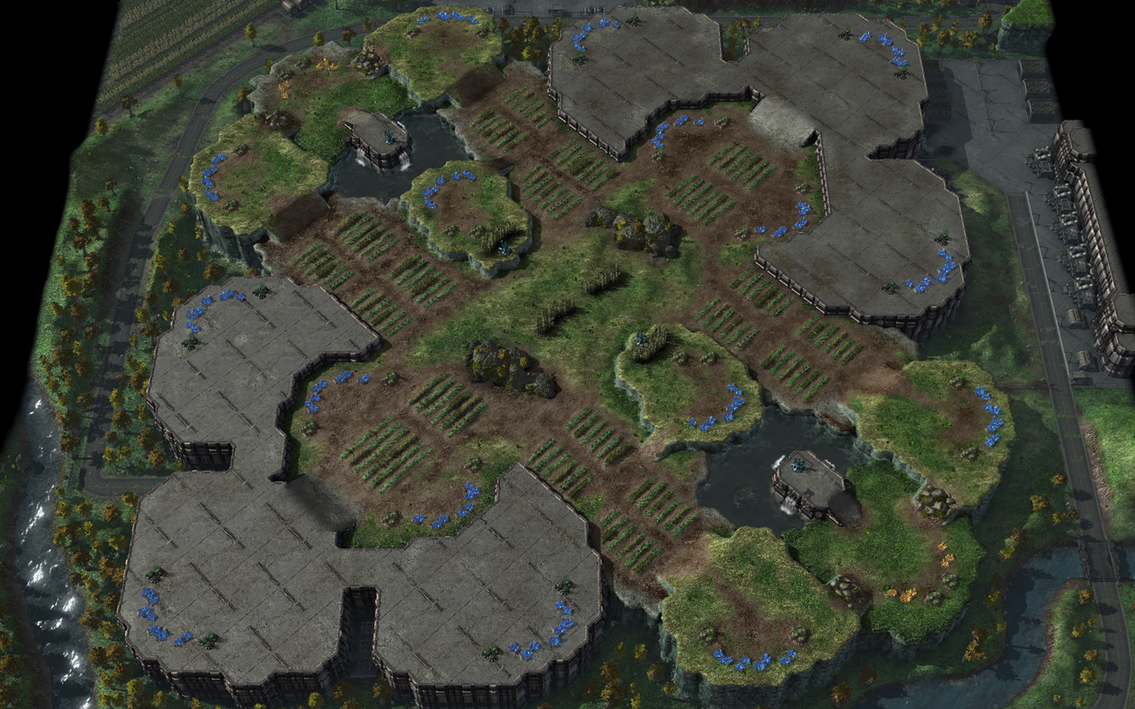
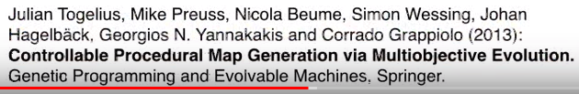
  Starcraft Map Generation

Slide 51
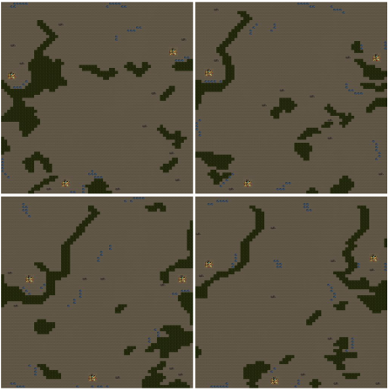
Starcraft map generation
Evolution of RTS maps
  Desirable
    Playability
    Fairness
    Skill differentiation
    Interestingness

Slide 52
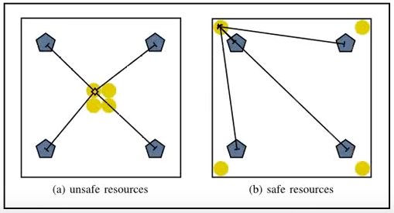
Starcraft map generation
Fairness fitness function
  Distance from base to closest resource
  Resource ownership
  Resource safety
  Resource fairness

Slide 53
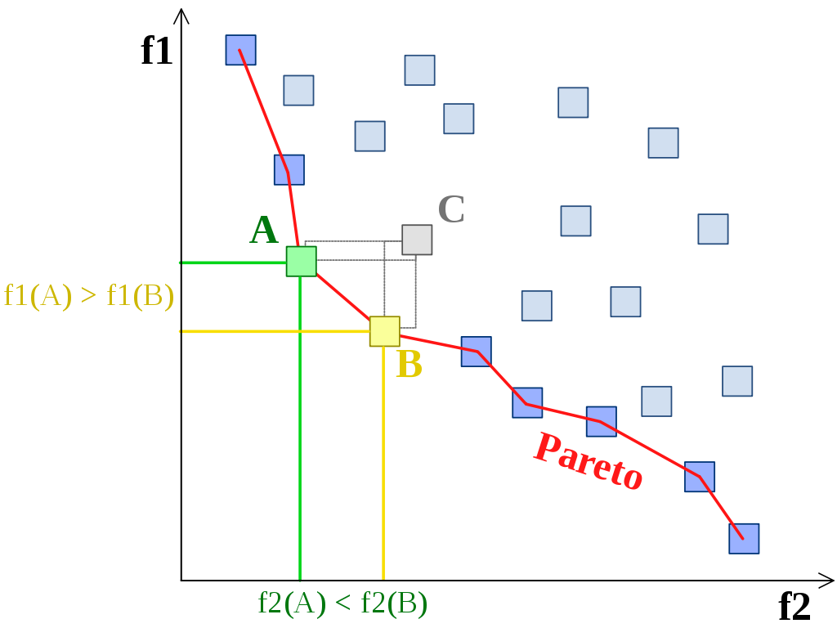
Starcraft map generation
Multiobjective EAs have multiple objectives
  Pareto front between them
  The point at which increasing one objective will decrease another
  Not always desirable – sometimes you want to look for solutions that are good for any of the objectives

Slide 54
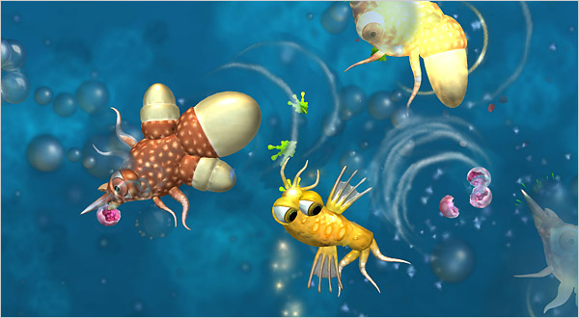
PCG iteration as evolution
  Generate some content (phenotype) from parameters (genotype)
  Score it using designer/AI (fitness)
  Evolve a new set of parameters
  Repeat

Slide 55
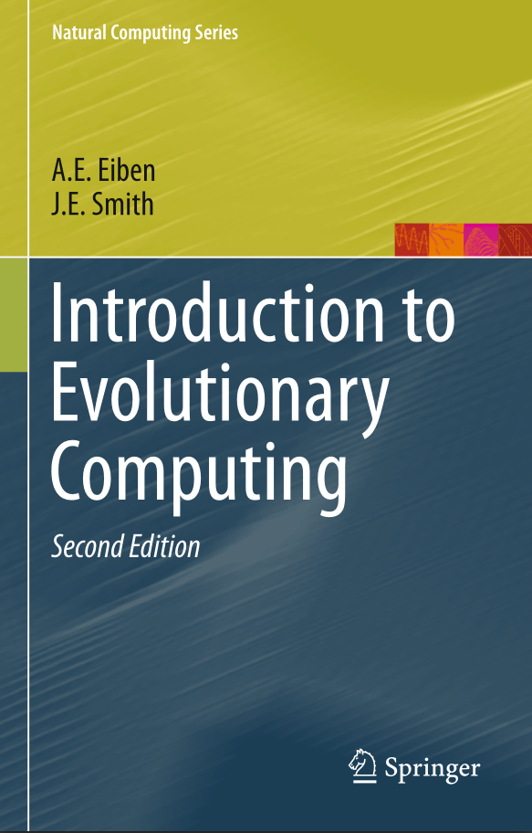
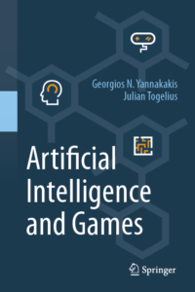
Further reading
Eiben & Smith, 2015. Introduction to Evolutionary Computing (Second Edition) Springer
Yannakakis and Togelius, 2018. Artificial Intelligence and Games. Springer
...and the links throughout the slides

