Slide 1

Games AI
Lecture 8.1
Neural Networks

Slide 2
Overview
Neural Networks
  Learn functions that map an input to an output
x
f(x)

Slide 3

Overview
Supreme Commander 2
  Input: 17 ratios between statistics for friendly and enemy units in given radius
    # units, unit health, damage/sec, …
  Outputs: utility of possible actions
    Attack weakest, attack closest, attack, generator, attack shield, …

Slide 4
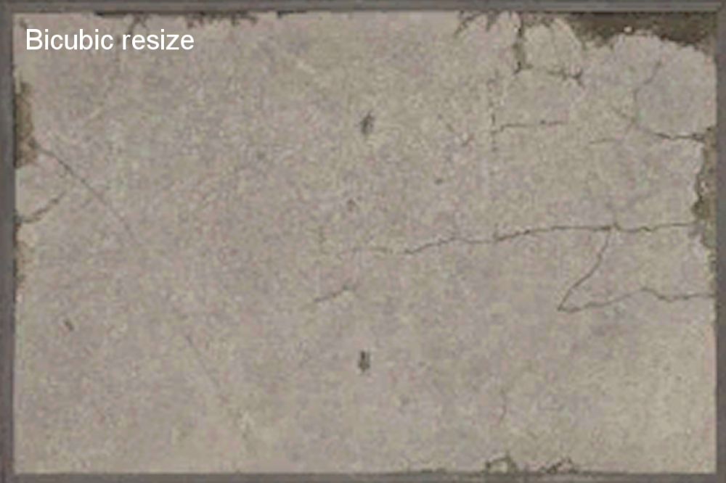
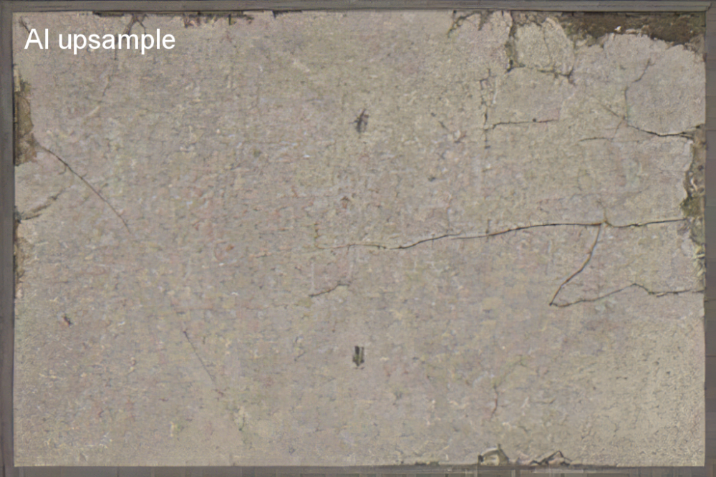
Overview
PCG
  Input = low-res texture
  Output = high-res texture
Images: https://www.leadwerks.com/community/blogs/entry/2487-upsampling-textures-with-ai/

Slide 5



Overview
Game remakes and up-scaling
http://forums.qhimm.com/index.php?topic=18553.msg261290#msg261290

Slide 6
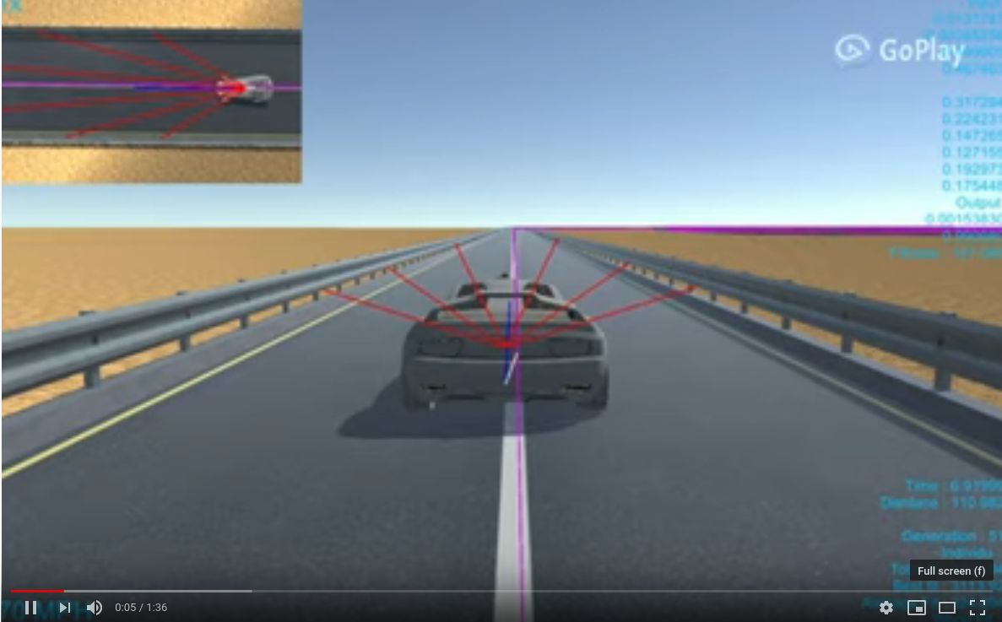
Overview
Neural-network controlled agents, e.g. using neuroevolution
  https://youtu.be/_1TOKKgAock

Slide 7
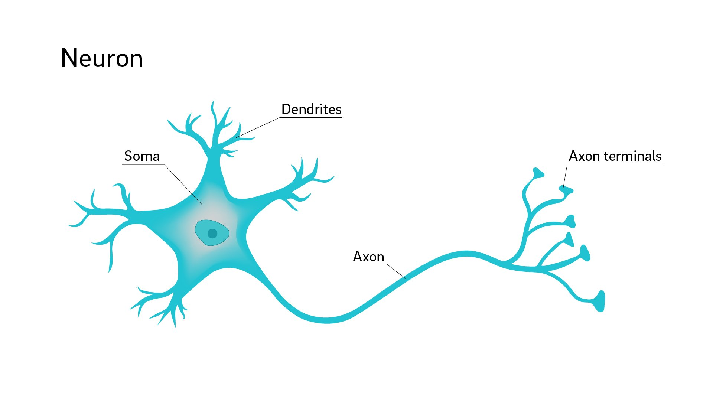
Overview
Neurons
  Dendrites
  Cell body
  Axon
Take inputs from dendrites
Combine them to produce output
Send output along axon

Slide 8

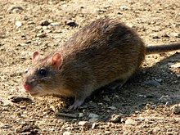
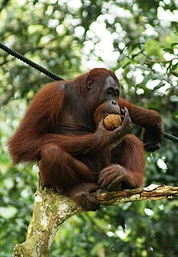
Overview
Jellyfish* | 5,600
Brown rat | 31,000,000
Orangutan | 8,900,000,000
Human | 16,340,000,000
*Whole nervous system

Slide 9
Overview
Each neuron is connected to potentially thousands of others.
  10¹⁰ neurons in the human brain
  10¹³ neuron connections
Each neuron is slow (millisecond+)
Massive parallel processing

Slide 10
Overview
b
x_{w1}
x₁
x_{w2}
Σ
σ
x₂
y
x_{w3}
x₃
Input
vector x
Weight
vector w
Weighted
sum + bias
Activation
function σ
Output
activation
y

Slide 11
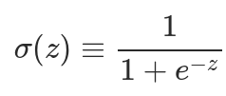
Overview
b
2.2
x
0.1
0.5
0.2
0.7
w
5
2
-2
1
4
0.98
Input
vector x
Weight
vector w
Weighted
sum + bias
Activation
function σ
Output
activation
y
(∑= 1.8)

Slide 12
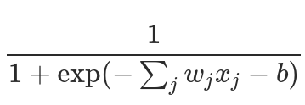
Overview
Calculate the weighted sum of inputs (x_{1..n}) with weights (w_{1...n})
    ∑_{j}w_{j}x_{j}
Add the bias b
    ∑_{j}w_{j}x_{j} + b
Pass it into our activation function σ
    σ(∑_{j}w_{j}x_{j} + b)
And put it all together, and the activation of a neuron is:
We can also write ∑_{j}w_{j}x_{j} as a dot product: w⋅x

Slide 13
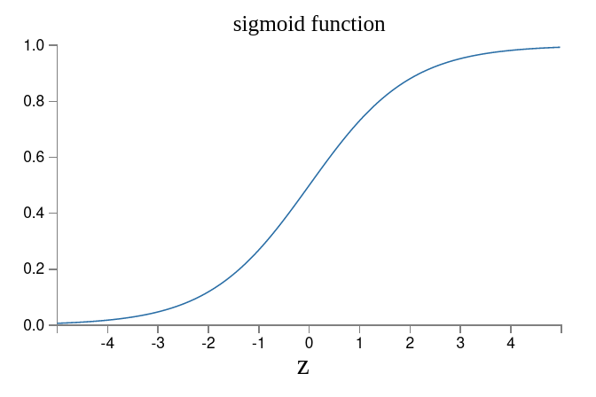
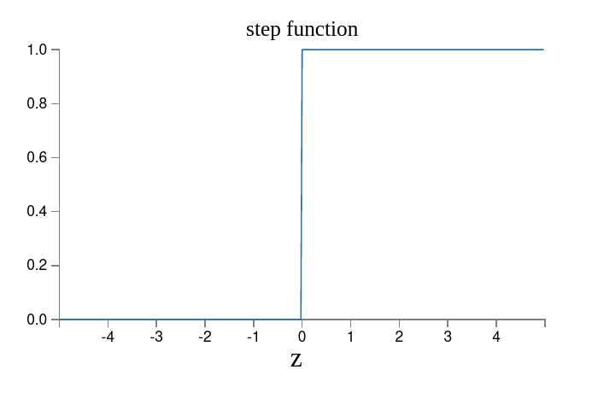
Overview
σ is a non-linear function e.g. logisitic sigmoid or step function
  Most of the time you will use sigmoid functions

Slide 14
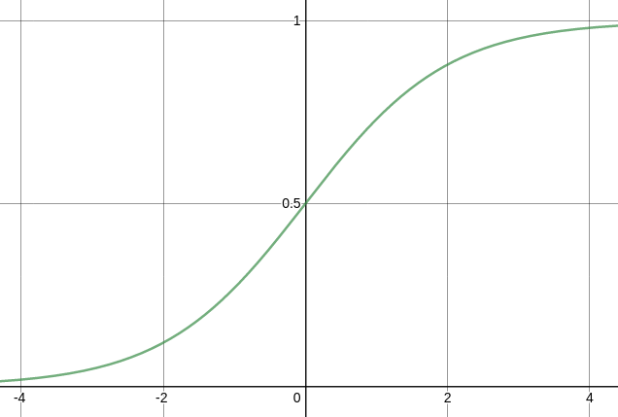
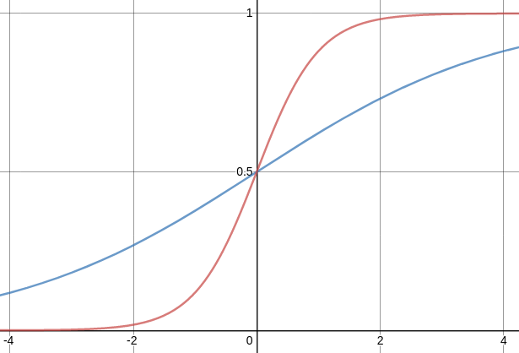
Overview
Weights effectively change the steepness of the sigmoid
σ(x)
σ(x)
σ(2x)
σ(0.5x)

Slide 15
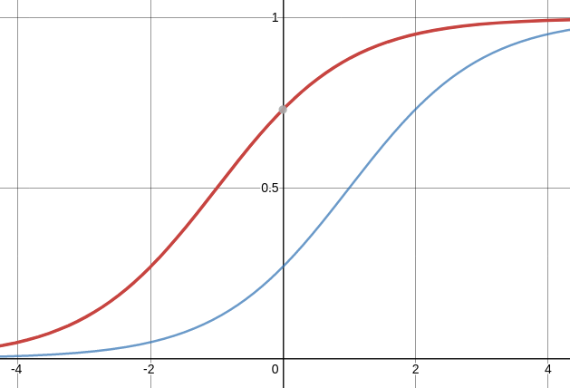
Overview
Bias is a constant that effectively shifts the activation function left/right
σ(x)
σ(x)
σ(x-1)
σ(x+1)

Slide 16
Overview
High activation
You can think of bias as how easy it is to activate the neuron
  A big positive bias means that the “step” between 0 and 1 will happen at really small input values
  A big negative bias means that the “step” will happen at really big input values
+ve bias
-ve bias
Low activation

Slide 17
Overview
Each neuron is making a decision just like a logic gate
  And logic gates can be used to build computers
  If we use the step function…
false
true

Slide 18
Overview
2) Because the sigmoid function has a smooth step, it can be more or less true or false
    Which can also be more or less confident of being true/false
    Which allows it to be trained, so the computer redesigns itself!
false?
true?

Slide 19
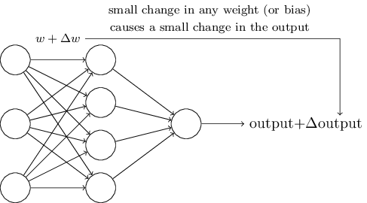
Overview
To train the network, a small change in the weights must correspond to a small change in the output
  Because of the sigmoid function, this is the case
  Why is this not the case for the step function?

Slide 20

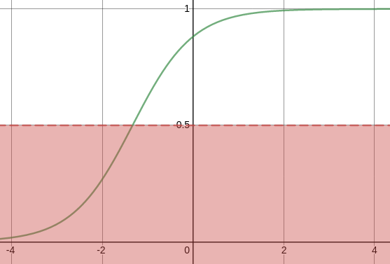

Overview
To use the network once it is trained, e.g. to classify inputs into categories, we usually round the output to 0 or 1.

Slide 21

Architecture

Slide 22
Architecture
The Single Layer Perceptron is the simplest ANN
x₁
x₂
f(x)
x₃
Input layer
Output layer

Slide 23
Architecture
Input nodes are special.
  They have no inputs from other nodes
  Their output is whatever value they are inputing into the network is.

Slide 24
Architecture
Nodes only have a single output, but that output can be used as the input to multiple nodes, hence the multiple arrows in diagrams
x₁
y₁
x₂
y₂
x₃
Input layer
Output layer

Slide 25
Architecture
Multi-layer Perceptrons have additional hidden layers
  (a MLP is a fully-connected network)
x₁
y₁
x₂
y₂
x₃
y₃
Input layer
Hidden layer
Output layer

Slide 26
Architecture
The more neurons you have in a layer, the more different properties that layer can process
  i.e. the more different ways that layer is processing the inputs
  or the more derived properties that layer is calculating

Slide 27
Architecture
You can have any number of such hidden layers (if you have enough computation power)
x₁
x₂
f(x)
x₃
Input layer
Hidden layers
Output layer

Slide 28
Architecture
Each hidden layer allows the network to work with higher levels of abstraction
  The first hidden layer derives properties from the input values
  Then the second hidden layer derives properties from these
  Then the third hidden layer…

Slide 29
Architecture
When you have deep networks, you often want connections that skip layers, so properties available at one layer can influence later layers
  i.e. the data flows better
  Another impact of this is that networks can be more resiliant when parts of the network are changed or disabled.

Slide 30
Architecture
Recurrant Neural Networks have loops so can store state
  Good for processing temporal streams of data e.g. speech
x₁
x₂
f(x)
Hidden Layer
x₃
Input layer
Output layer
Context units

Slide 31
Architecture
Autoencoders are used to learn ways to compress data by having small hidden layer
Input layer
Hidden layers
Output layer

Slide 32
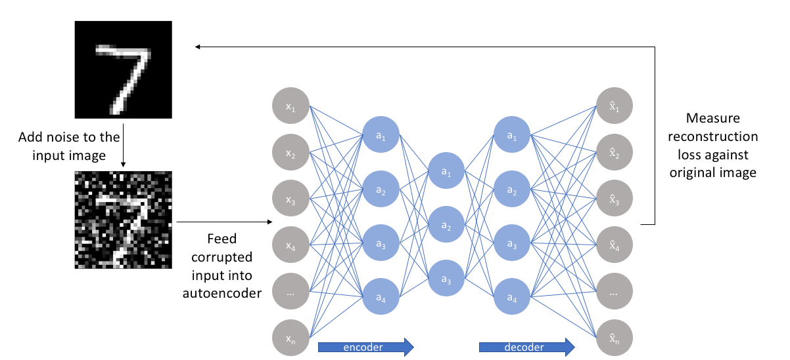
Architecture
Autoencoders can be used to de-noise images too!
Image: https://www.jeremyjordan.me/autoencoders/

Slide 33
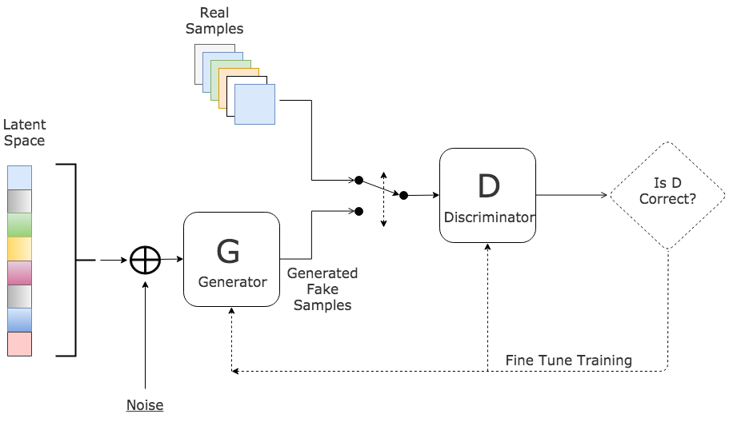
Architecture
Generative Adversarial Networks are pairs of neural networks that generate content that is very similar to a set of samples

Slide 34

Training

Slide 35
Training
ANNs are usually* a form of supervised learning
  Your training data is pre-labelled with the correct output
  e.g.
→ “cat”
*Other than autoencoders, which learn an encoding in an unsupervised manner

Slide 36

Training
Lets say we’re categorising animal images as either: cat, dog, or t-rex
  We would have 3 output nodes, that give us a 3-dimensional vector
  We would define each category as a unit vectors
= [1,0,0]
= [0,1,0]
*
= [0,0,1]
*that’s T-Rex, the band

Slide 37

Training
At first, it’ll produce results that are pretty much random, e.g.
But if this is in our training dataset, we can compare this output to the known value, in this case [0,0,1] (t-rex)
This lets us work out the training error
→ [0.4, 0.9, 0.6]

Slide 38
Training
The training error can be calculated per output neuron i for input x
  (e_{i} = error for neuron i, y(x) = target value, a = actual value)
  e_{i} = y(x)_{i} – a_{i}
You usually actually use the Quadratic Error
  ( y(x)_{i} – a_{i} )²
And if we do this for the all outputs as a vector, y(x) and a are vectors (e.g. [0, 0, 1] and [0.4, 0.9, 0.6] it becomes
  || y(x) – a ||²
    (Where || v || is the length function of the vector, which coverts it into a scalar)

Slide 39
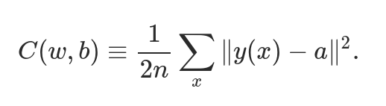
Training
We could calculate the mean squared error (MSE) over our entire test dataset.
  We could describe a function that gives us this value.
    Its called a cost function (or error function)
  This is a function over w and b which are vectors of the weights and biases in the network
    Basically for given weights and biases, what is the MSE for our test data?
Ideally we want C(w,b) ≈ 0 (i.e. basically no error)
(The ½ is just a constant to make things easier in the maths later)

Slide 40
Training
Cost function / error function
  Idea behind training: Want to minimise the cost function
  As w and b might be very large vectors, analytic approaches too difficult – (calculus with 1,000,000s of variables!)

Slide 41
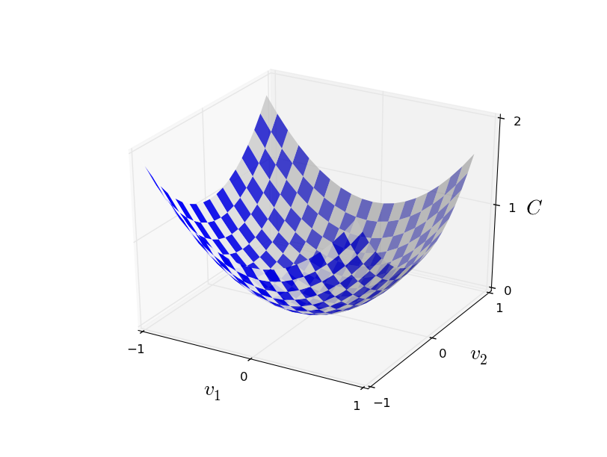
Training
Imagine we only had one weight and one bias
  C(w,b) would be 2 dimensional and our cost function would by a surface in 3d space
    (Very much like an adaptive landscape in evolutionary algorithms)
  We want to find the lowest point (global minima) on that 2d surface

Slide 42
Training
Gradient Descent:
  Start from a random point
    (i.e. randomly-assigned weights/biases)
  Calculate the gradient of your cost function at that point
  Move downhill until you get to a local minima

Slide 43

Backpropagation

Slide 44
Backpropagation
Backpropagation* is a way to optimise the weights of a (feed-forward) neural network
How to actually perform gradient descent in an efficient manner
  Works backwards from the last layer in the network towards the first
*Comes from: “Backwards propagation of errors”

Slide 45
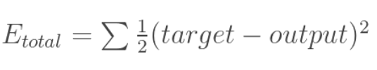
Backpropagation
We can work out our total error for our network (for a single input) as we saw before
  Here we find the squared error of each node and sum over all output nodes*
*Again, ½ is just a constant for the maths

Slide 46
Backpropagation
Backpropagation works by calculating how much each weight contributes to the total error
  And then reducing that weight proportionally to its contribution
  We do this in a sequence of steps using the chain rule
w₅
o₁
out₁
w₆
o₂
out₂

Slide 47
Backpropagation
Starting with a weight on an output node:
  We work out the how sensitive the total error is to changes in the output of o₁
  Then how sensitive the output of o₁ is to changes in the total net input of o₁
  Then how sensitive the total net input of o₁ is to changes in w₅
With the chain rule, this will tells us how much w₅ impacts total error
w₅
Total Error
net
out
w₆

Slide 48
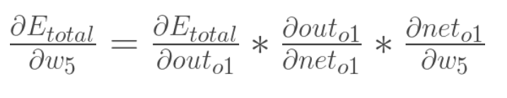
Backpropagation
We can formally express the chain rule here as the following:
  The sensitivity of the total error to changes in w₅ is equal to the three other sensitivities we mentioned multiplied together
  We calculate what these are using partial derivatives from calculus
    (Which I’m not going to go through here)

Slide 49
Backpropagation
Once we have found we multiply it my our learning rate, η (eta) (a small positive number)
  We’re going to then change our weight by minus this amount (because we want to reduce our error)
  The size of our step is proportional to the sensitivity of the error to the weight w₅
    So we adjust the important weights faster than the unimportant ones

Slide 50
Backpropagation
We then repeat the process for all the weights on the output layer, storing the new values
We then repeat more or less the same the process for the previous layer
Finally, we apply the updated weights

Slide 51
Backpropagation
After enough iterations with our training data, the error decreases to a local minima.
  And our network is ready to use

Slide 52
Further Reading
There’s obviously a lot more to neural networks and how to train them
  For a well-written introduction, chapter 1 of:
    http://neuralnetworksanddeeplearning.com
  An excelent tool for understanding what is going on inside a neural network:
    https://playground.tensorflow.org/
  Another helpful tool for understanding, if you can get it to work properly:
    http://neurovis.mitchcrowe.com/
  A helpful video on understanding backpropagation
    https://www.youtube.com/watch?v=6BMwisTZFr4
  And a worked example of backpropagation
  https://mattmazur.com/2015/03/17/a-step-by-step-backpropagation-example/

