Slide 1
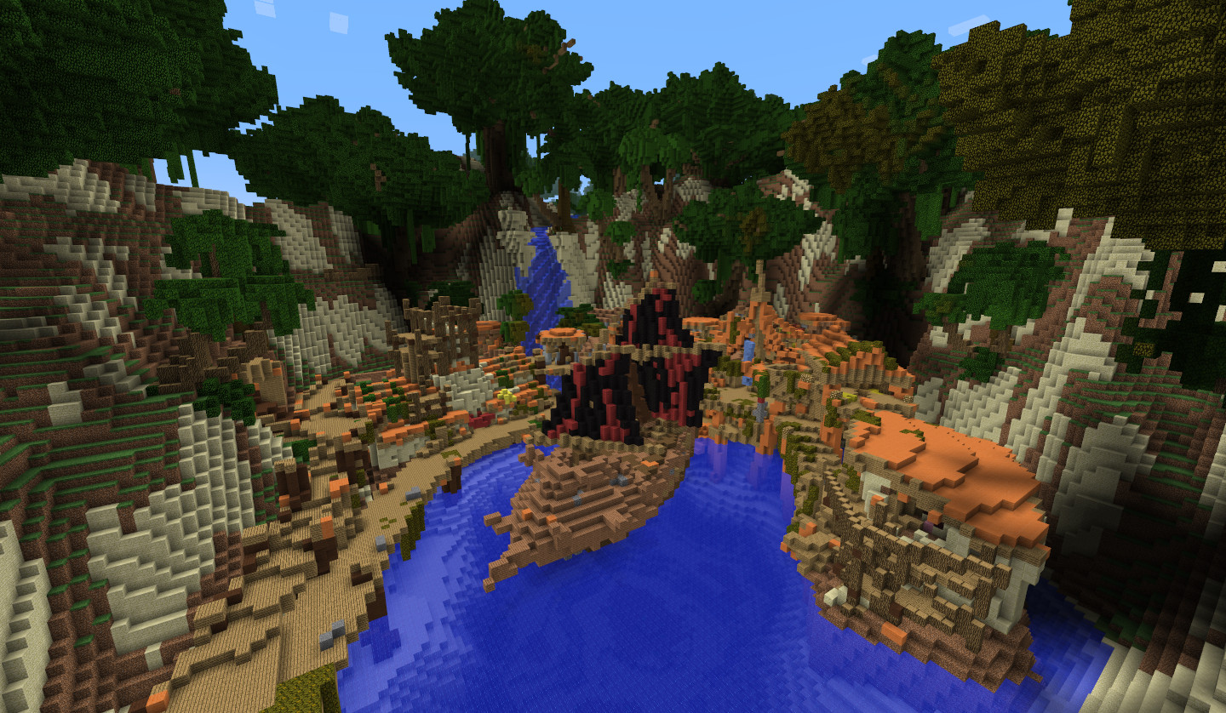
Games AI
Lecture 5.1
Procedural Content Generation

Slide 2
Overview
What can be generated?
  Levels and maps
  Visuals
  Audio
  Narrative
  Rules and mechanics
  Games

Slide 3
Overview
Why generate content?
  Replayability
  Cost saving
  New types of game
  As a tool for artists/designers

Slide 4
Overview
How do you generate it?
  Tiles
  Grammars
  Distribution
  Parametric
  Interpretive
  Simulations

Slide 5
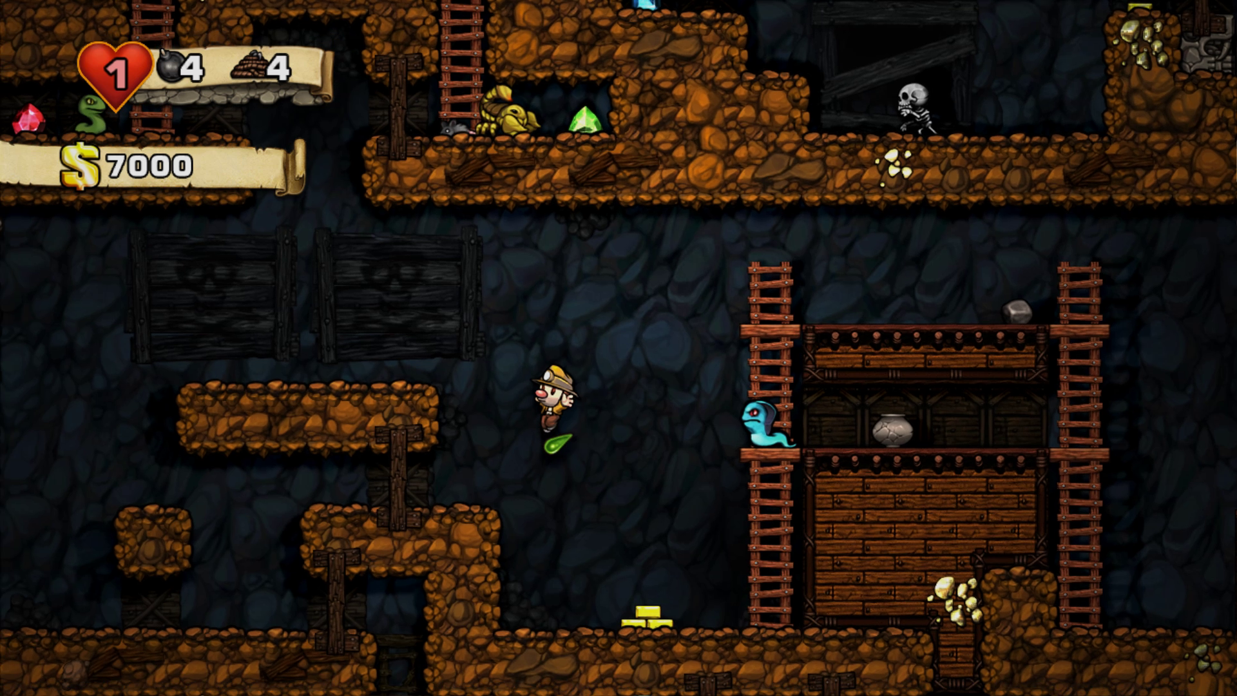
Tiles

Slide 6
Tiles
Tiles
  When you have
    Equal sized blocks of content that can be placed anywhere
    Not a lot of constraints on how tiles can be arranged
    Variation in placement leads to interesting variation
  Tiles can be large or small, and have more or less internal structure
  e.g. tile maps, solitare boards, tarrot, …

Slide 7
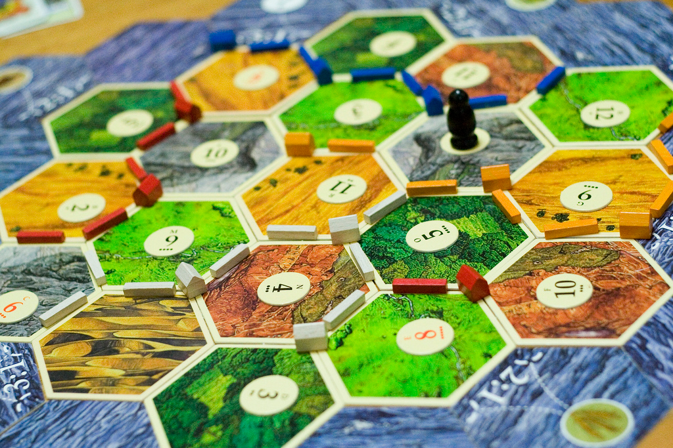
Tiles
Settlers of Catan
  Shuffling cards gives random placement of terrain
  Minimal placement constraints
  Players adapt strategy to level

Slide 8
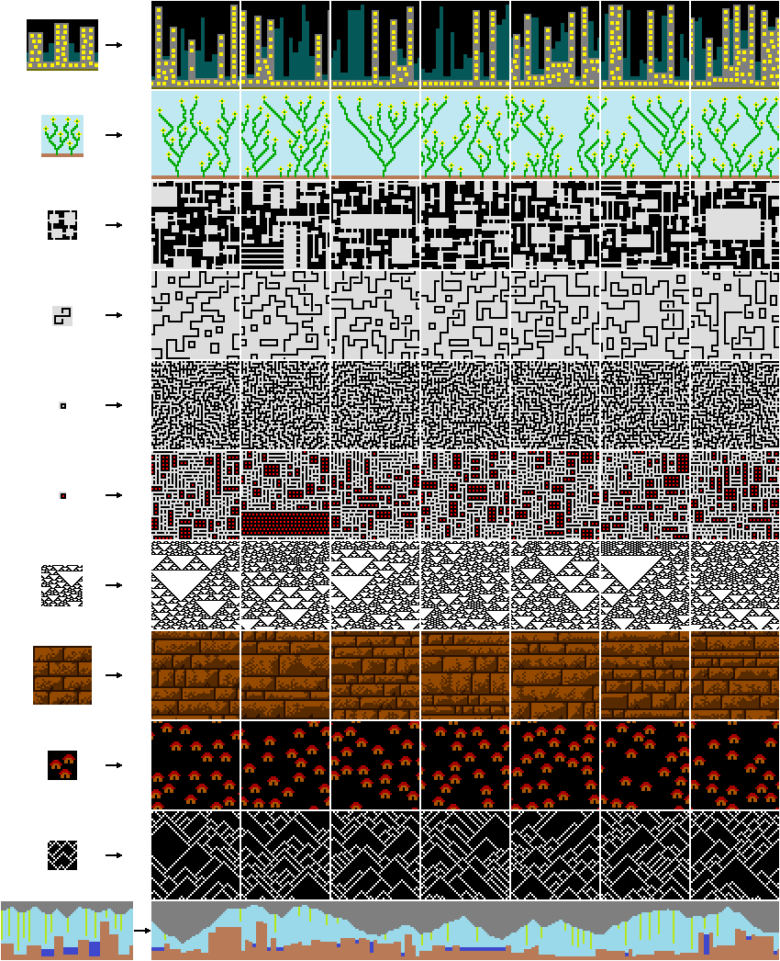
Tiles
Statistical Methods
  Exploit statistical relationships in a sample input
  e.g. Wave Function Collapse, inspired by quantum mechanics
  Generates images that are similar to a small sample
  https://github.com/mxgmn/WaveFunctionCollapse
  https://www.youtube.com/watch?v=1yvNv2Kaz4A

Slide 9
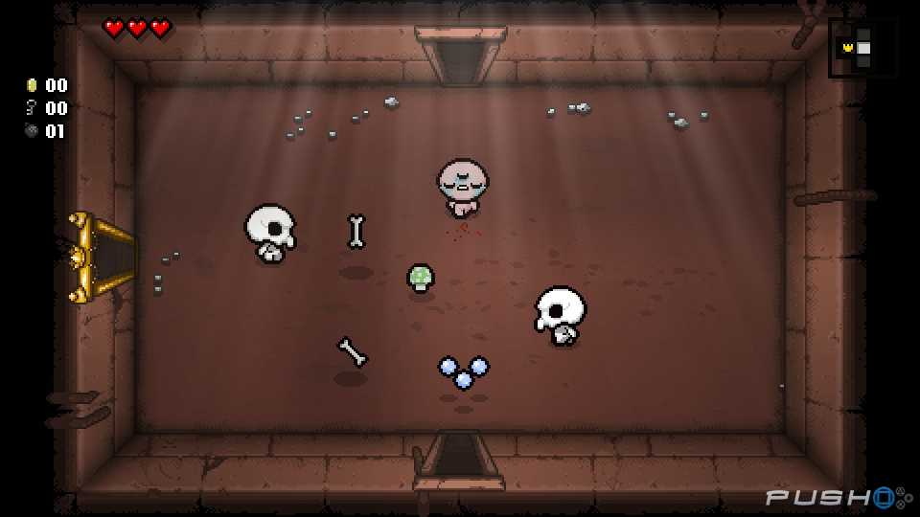
Tiles
Binding of Isaac
  Top down roguelike shooter
  Explore dungeon, find items, kill boss
https://bindingofisaacrebirth.fandom.com/wiki/Level_Generation

Slide 10
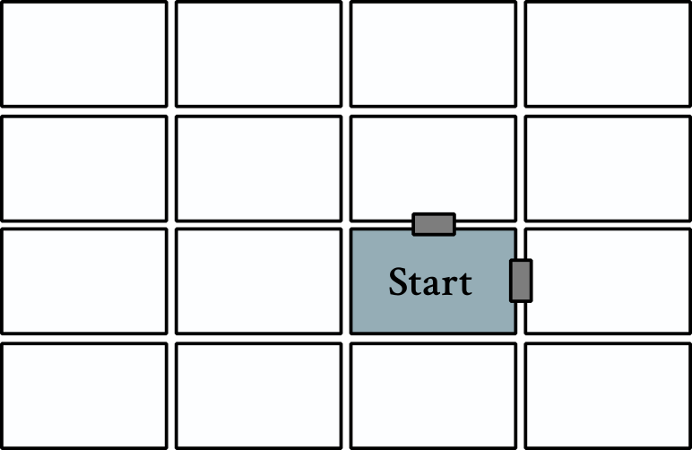
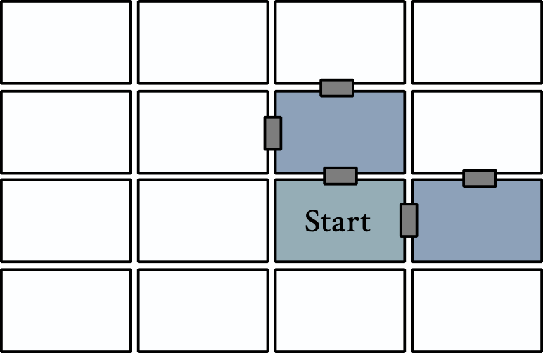
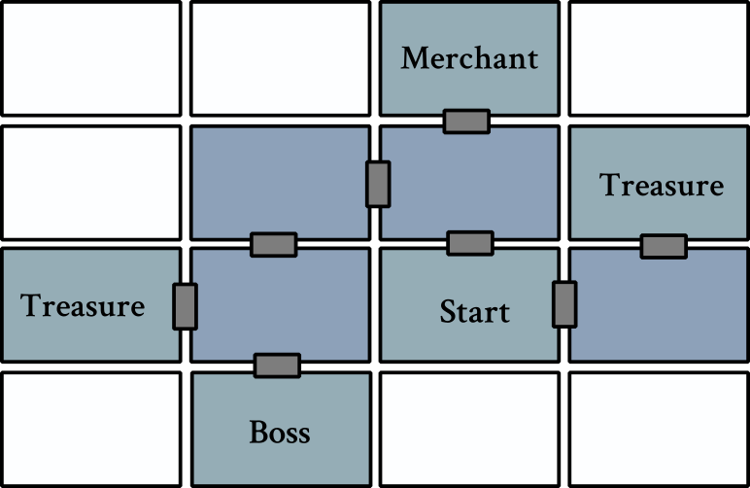
Tiles
Step 1:
  Build layout
Step 2:
  Pick template rooms based on connectivity

Slide 11
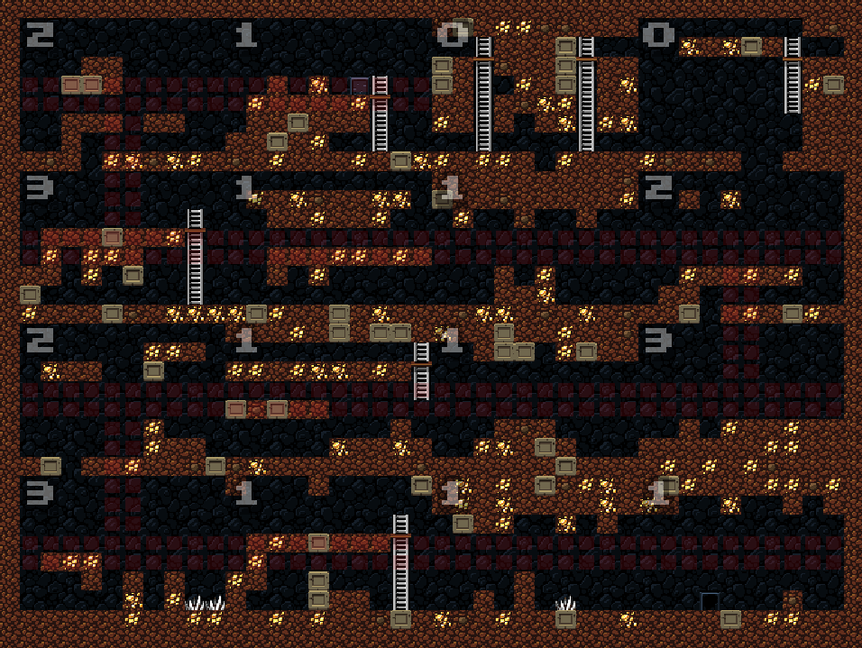
Tiles
Spelunky Level Generation
  Template-based
  Walks a path through a 4x4 grid
  http://tinysubversions.com/spelunkyGen/

Slide 12
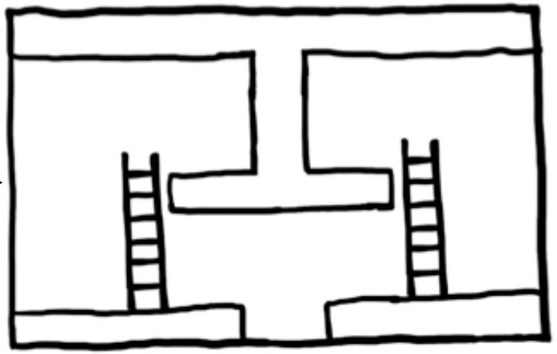
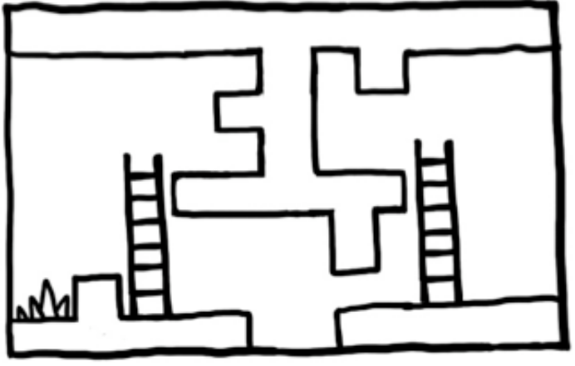
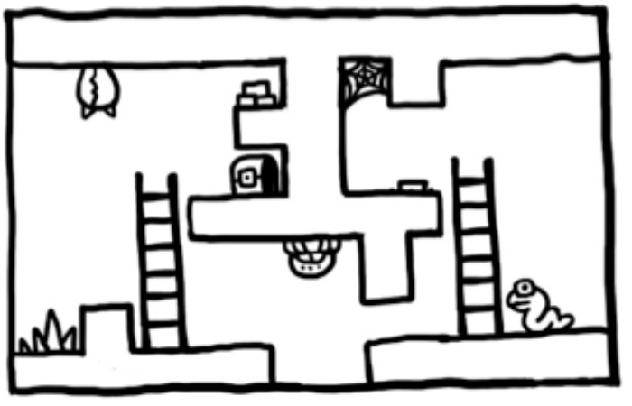
Tiles
Spelunky
  Room templates include limited random elements
  Always passable

Slide 13
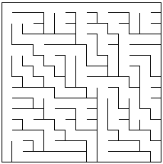
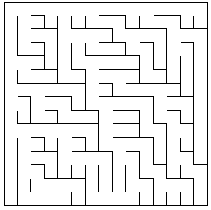
Tiles
Binary Tree Maze Algorithm
  For each cell, randomly dig a path north or west*. Simple!
  Shaped like a binary branching tree
  Problems
    Long corridors at edge
    Strong north-west bias
*Or any other adjacent directions, so long as you’re consistent
http://weblog.jamisbuck.org/2011/2/1/maze-generation-binary-tree-algorithm

Slide 14
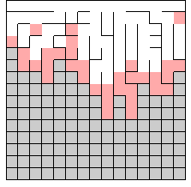
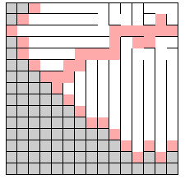
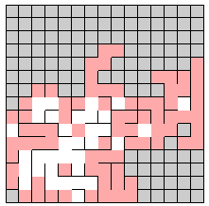
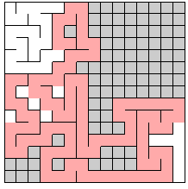
Tiles
Growing Tree Maze Algorithm
  Create a list of cells, add starting cell
  Choose a cell in list
    Newest? Random?
    How you choose affects style of maze
  Carve path to any unvisited neighbour
  Repeat until list is empty
http://weblog.jamisbuck.org/2011/1/27/maze-generation-growing-tree-algorithm

Slide 15
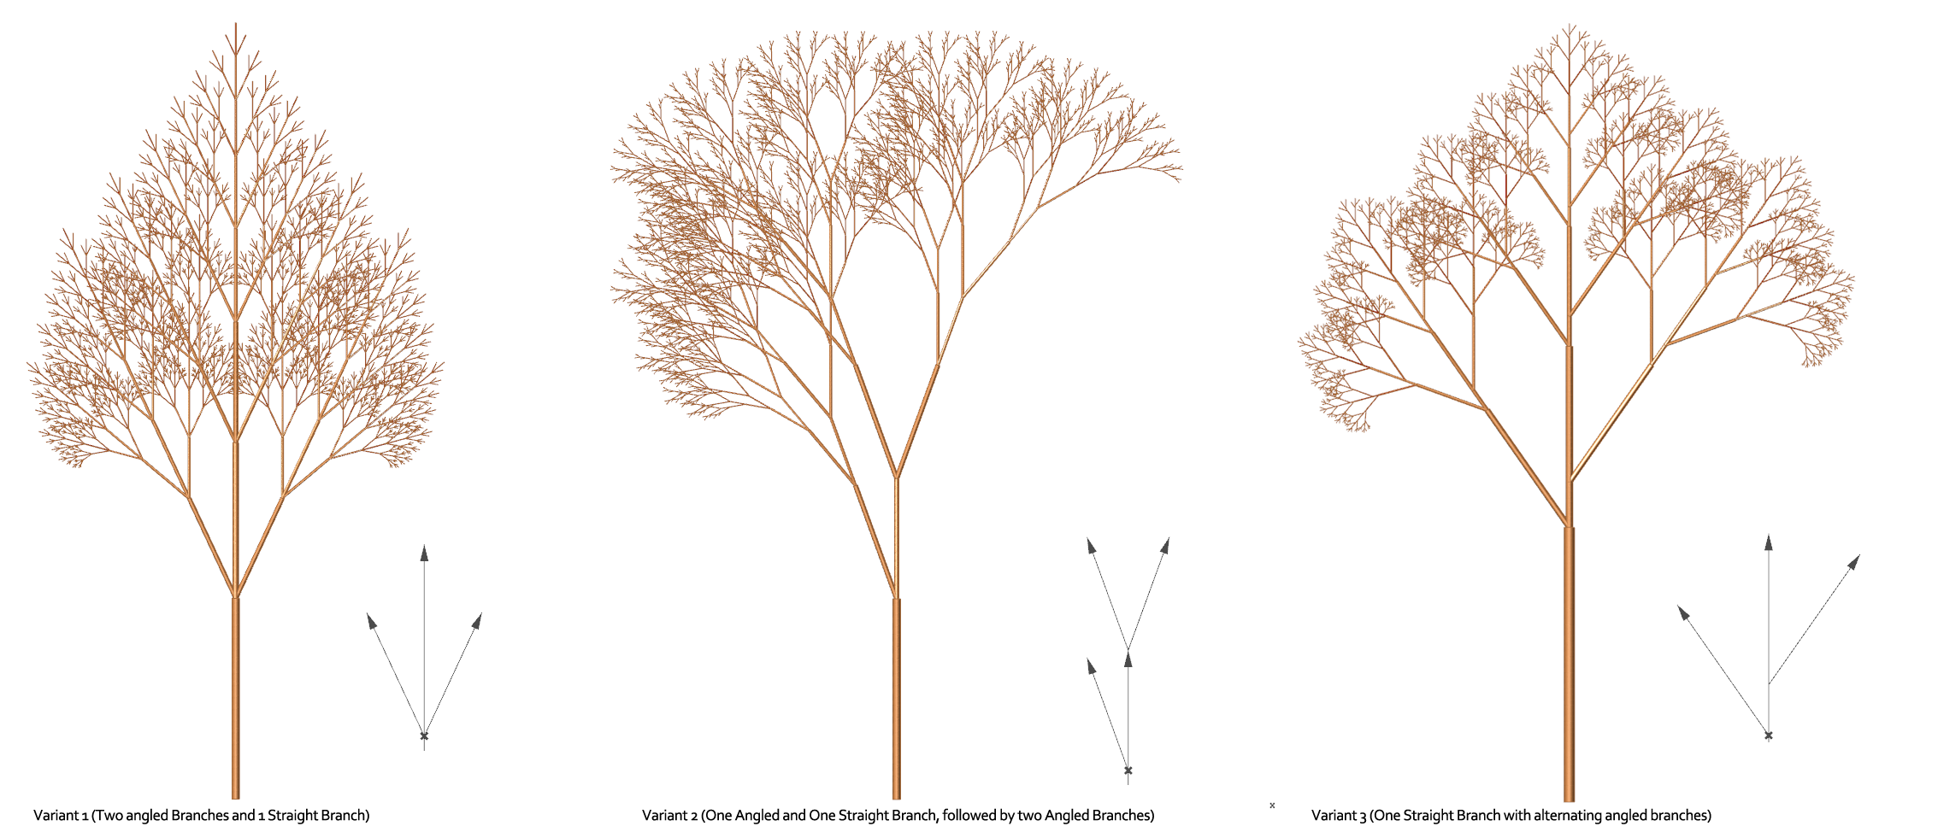
Grammars

Slide 16
Grammars
Grammars
  A grammar is a system of string-rewriting rules, such as
    A → a
    A → A B
    B → b
  These generate recursive structures and are good at generating language
  Grammars are formally defined by their complexity
  Good at generating stuff that’s defined as combinations of other stuff
  Sub-generators can be reused

Slide 17
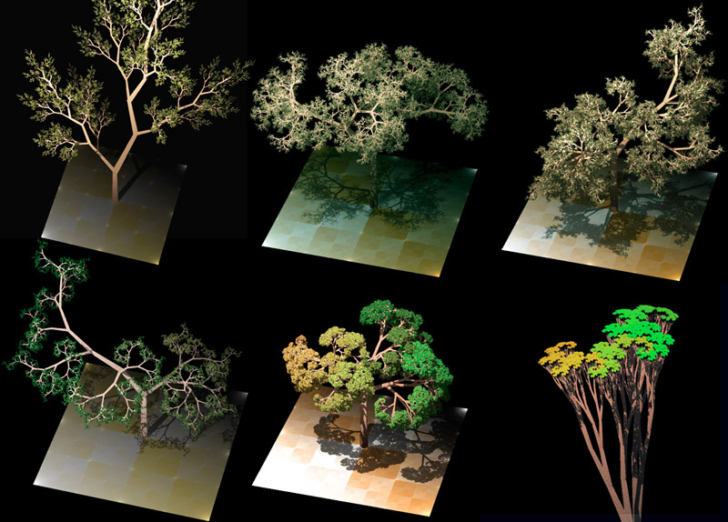
Grammars
L Systems
  Parallel string rewriting grammar
  Developed to model growth of algae and plants
  Organic forms, plants, fractals

Slide 18
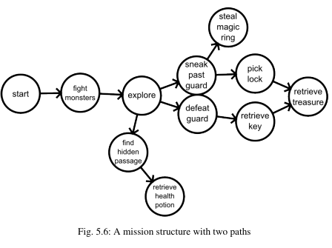
Grammars
Graph Grammars
  Rules define how to re-write sub-parts of the graph
  Start with trivial graph and grow complexity
Image from http://pcgbook.com/

Slide 19
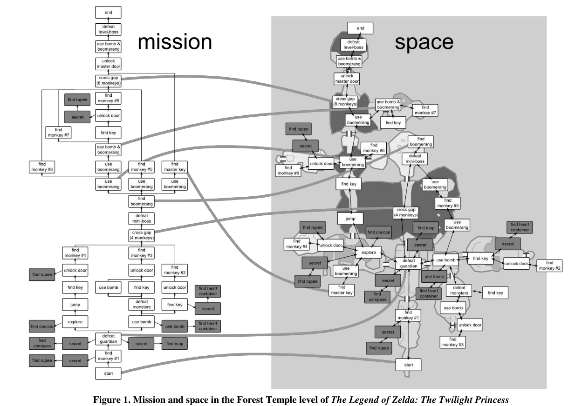
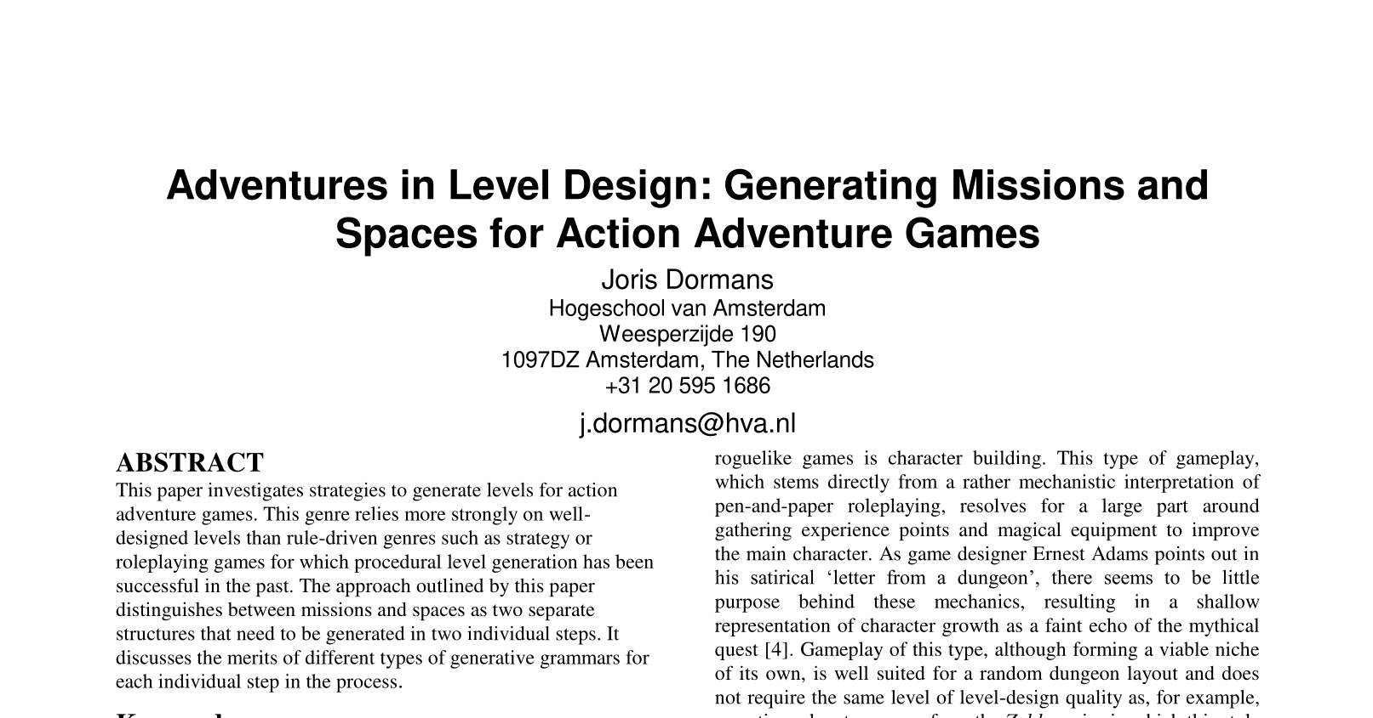
Grammars

Slide 20
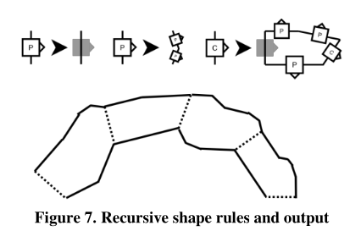
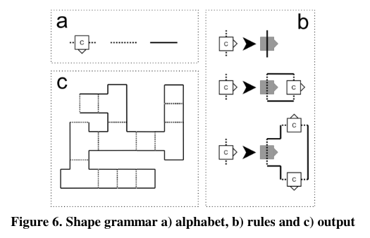
Grammars
Shape Grammar

Slide 21
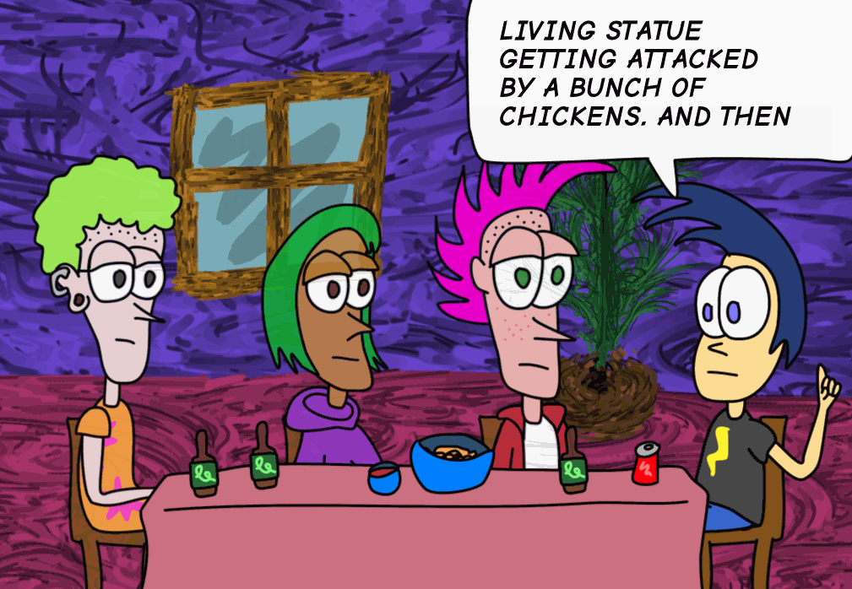
Grammars
Tracery
  Text/string generator
  Context-free grammar-based with some extra bits
  Adds ability to set variables
  http://tracery.io/

Slide 22
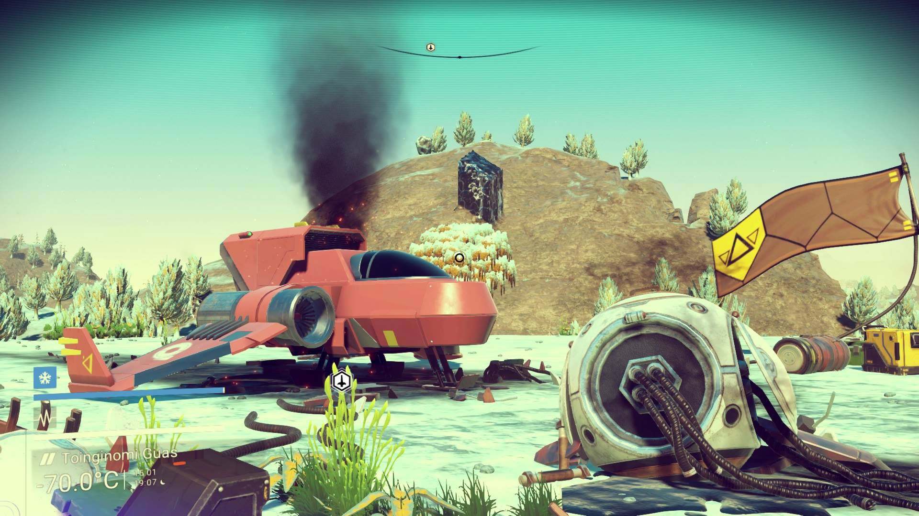
Distribution

Slide 23
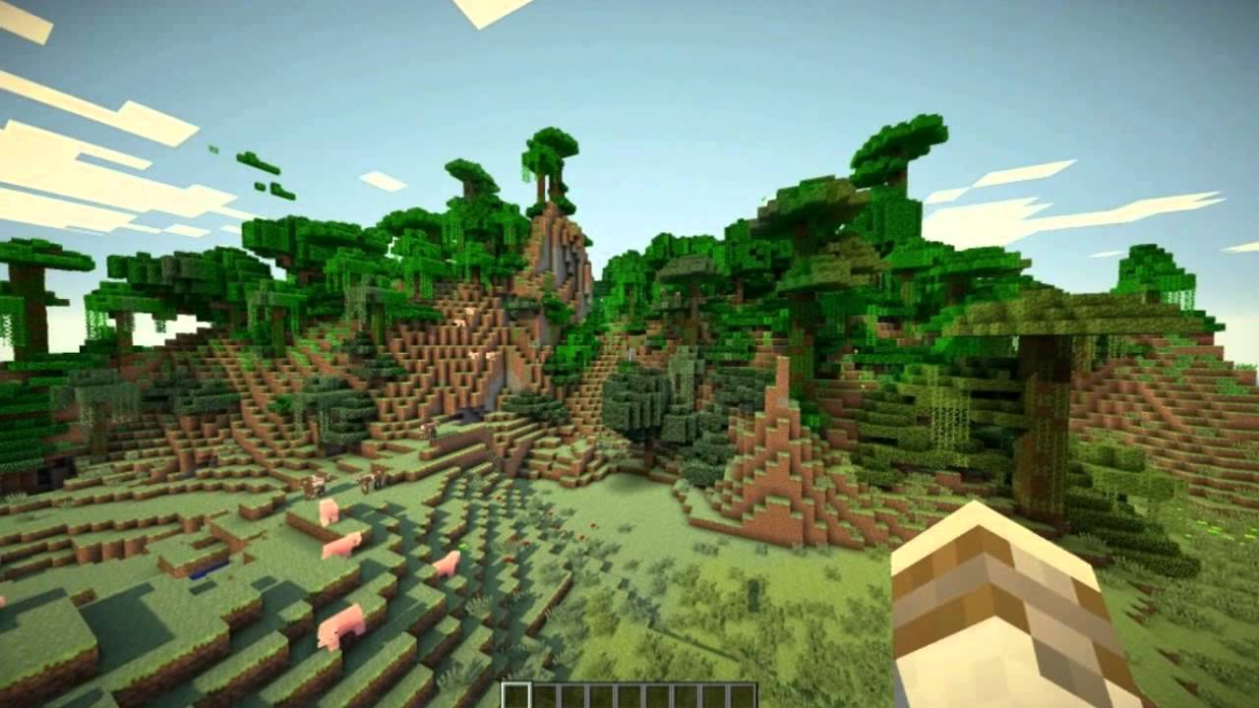
Distribution
Distribution
  Putting stuff in the world
  Pure randomness is unrealistic
  Don’t require much structure

Slide 24
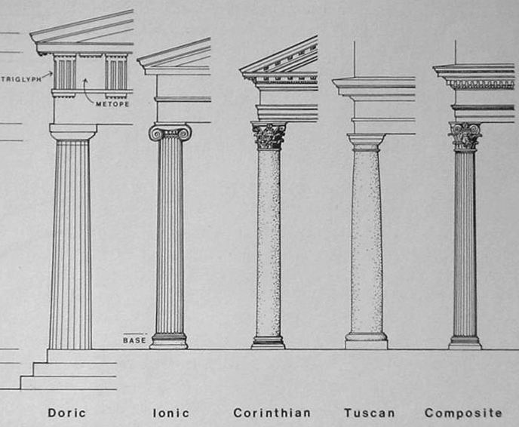
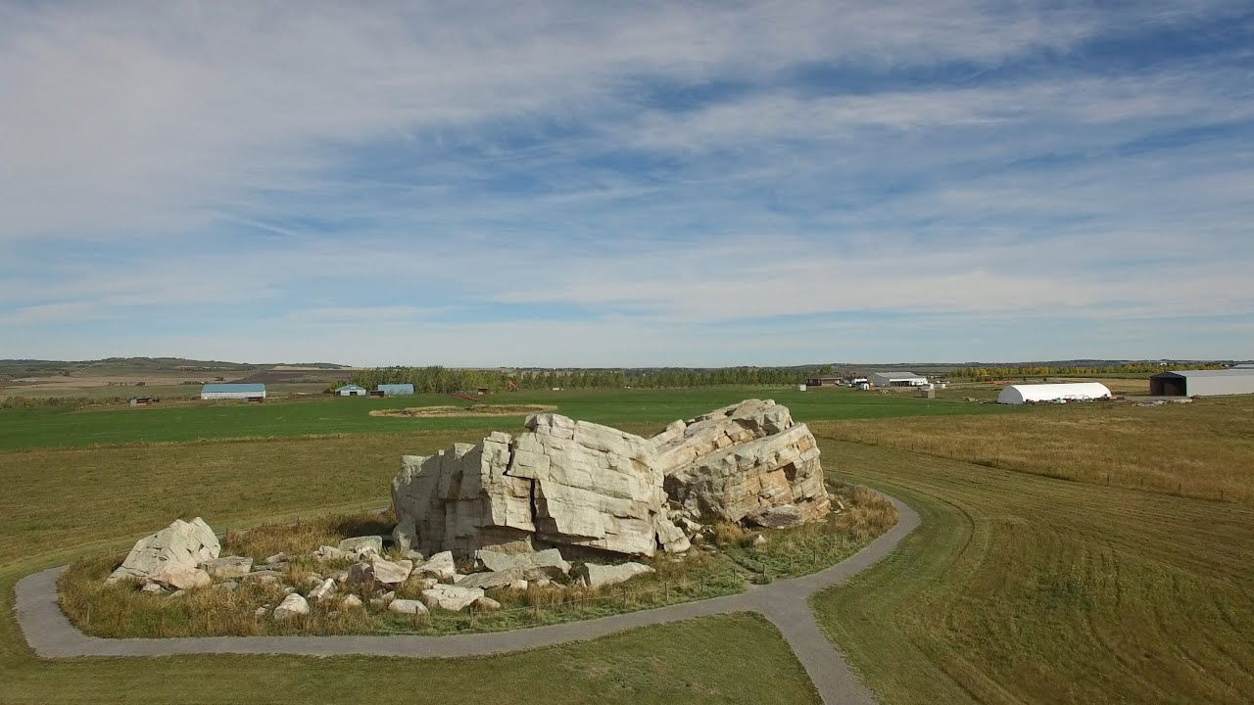
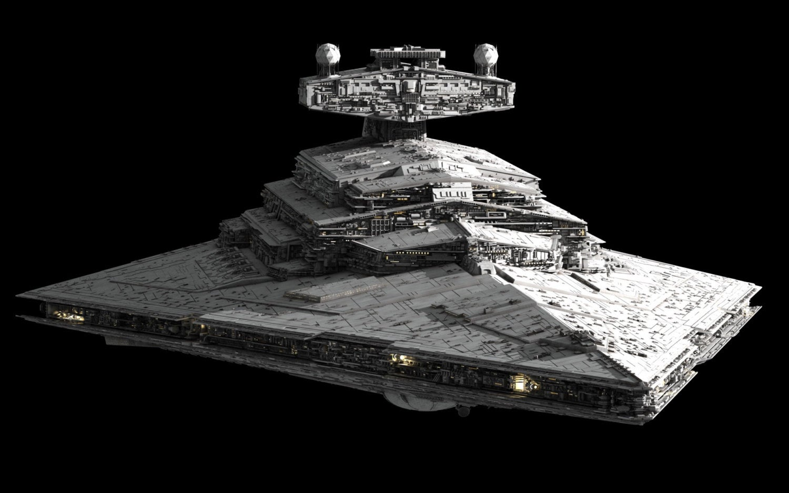
Distribution
Clustering / clumping
  Barnacling
  Footing
  Greebling

Slide 25
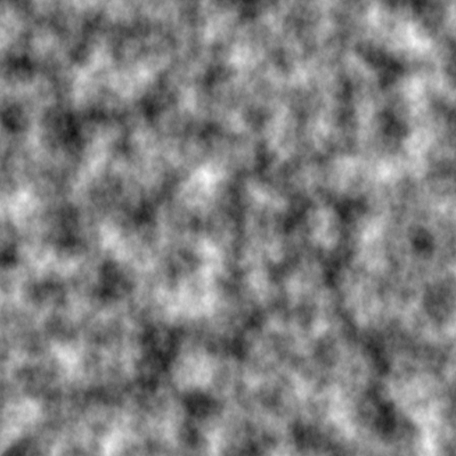
Distribution
Perlin noise
  (Very!) Widely used
  Other noises exist such as Simplex

Slide 26
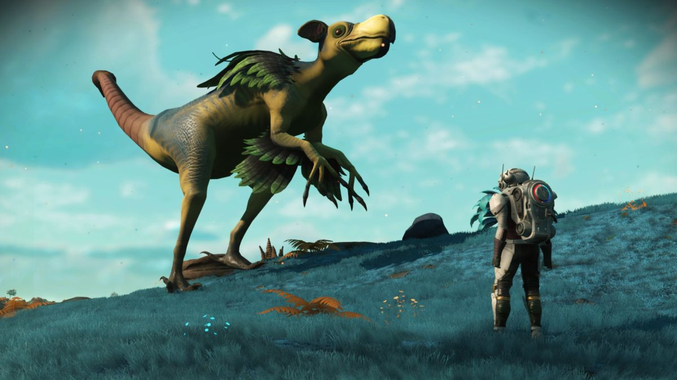
Parametric

Slide 27
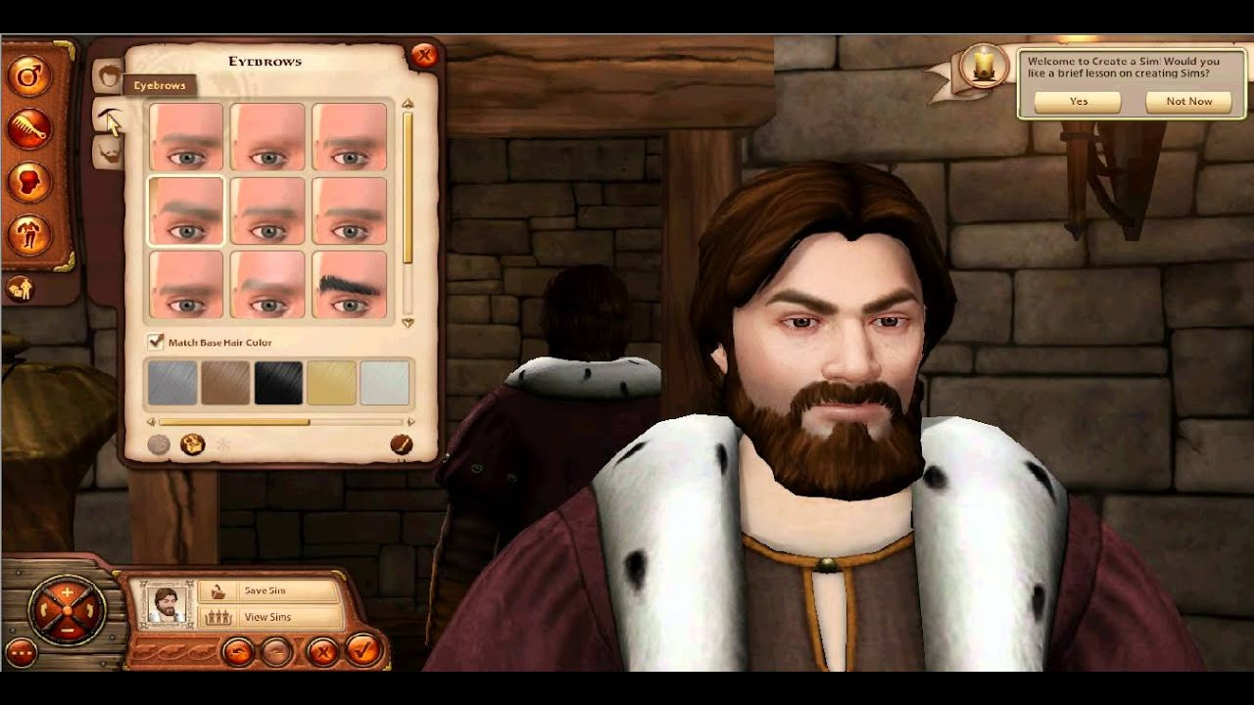
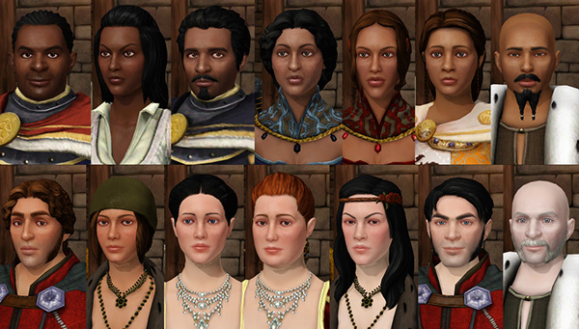
Parametric
Parametric
  Define a multidimensional possibility space, defined by parameters
  Structure of content is defined, but can vary on a number of dimensions

Slide 28
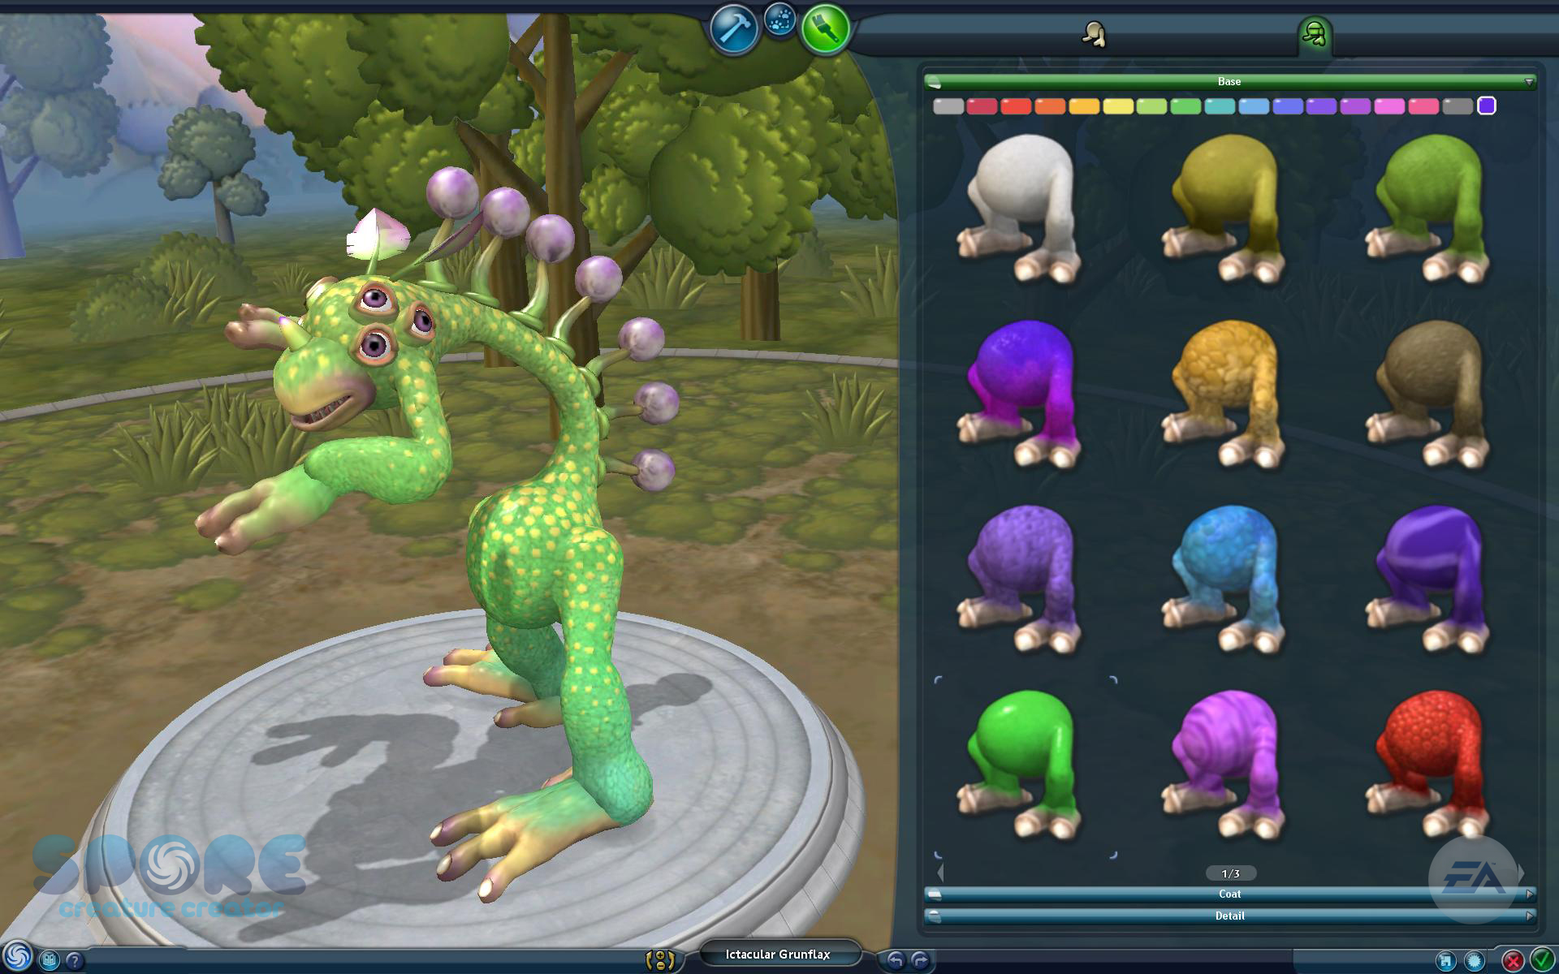
Interpretive

Slide 29
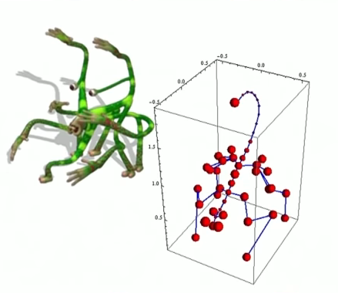
Interpretive
Interpretive
  Take input data in one format and process it into another format
  Exploit the underlying structure in data
  Take a simple structure and make it more complex

Slide 30
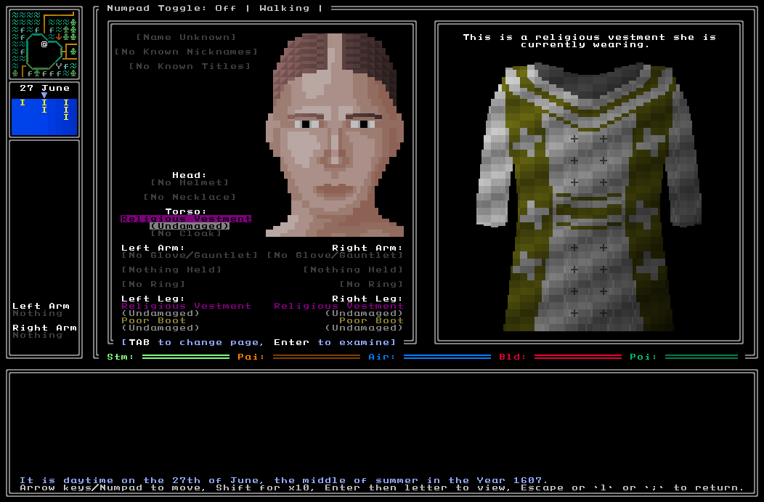
Overview
Simulations

Slide 31
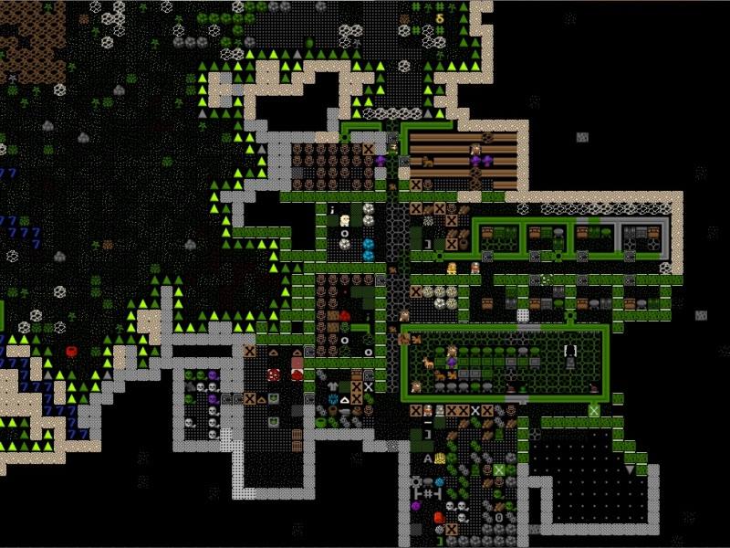
Simulations
Agent-based Simulations
  Generate content based on actions of in-world agents
  Agents can be vary complex...
    e.g. in Dwarf Fortress
  Or basic...
    Particle trails
    Flocking

Slide 32
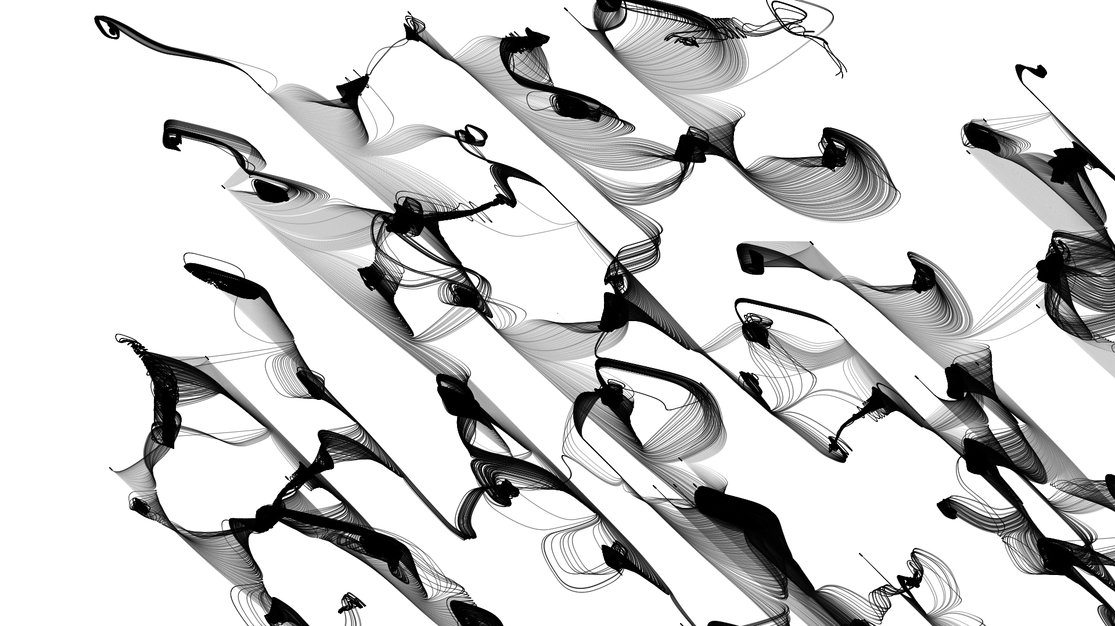

Slide 33
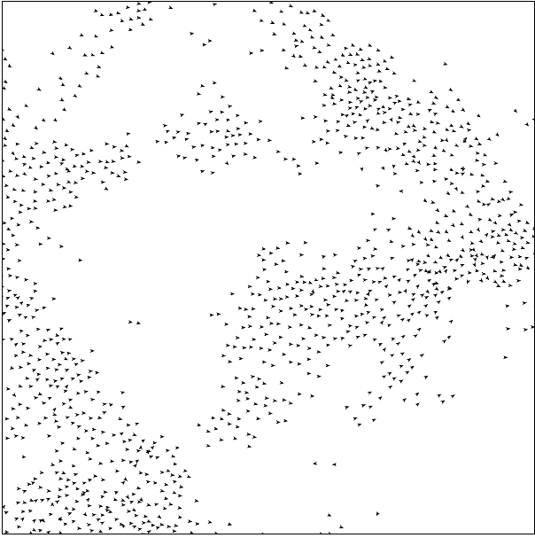
Interpretive
Boids (Bird-like Objects)
  Bird-like flocking behaviour
  Result of each agent following three rules

Slide 34
Interpretive
Avoid
  Steer away from nearby boids
Align
  Steer toward heading of nearby boids
Approach
  Steer toward centre of flock
https://www.harmendeweerd.nl/boids/

Slide 35
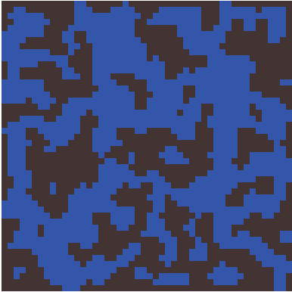
Simulations
Cellular Autometa
  Simulate state of cells based on states of neighbours
  For natural-looking forms such as caves, islands, etc.

Slide 36
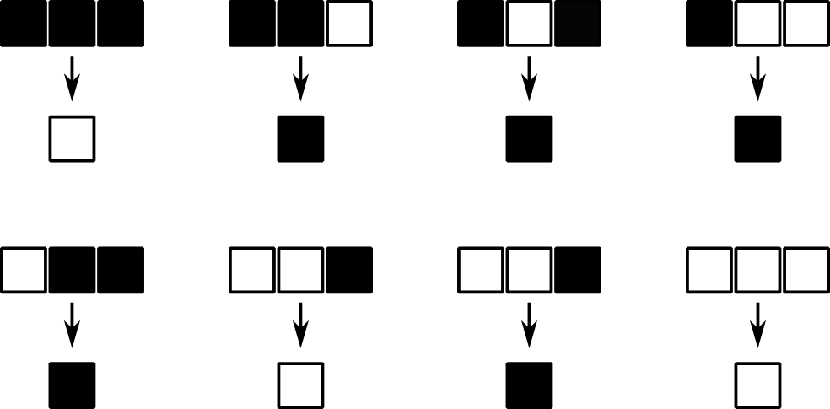
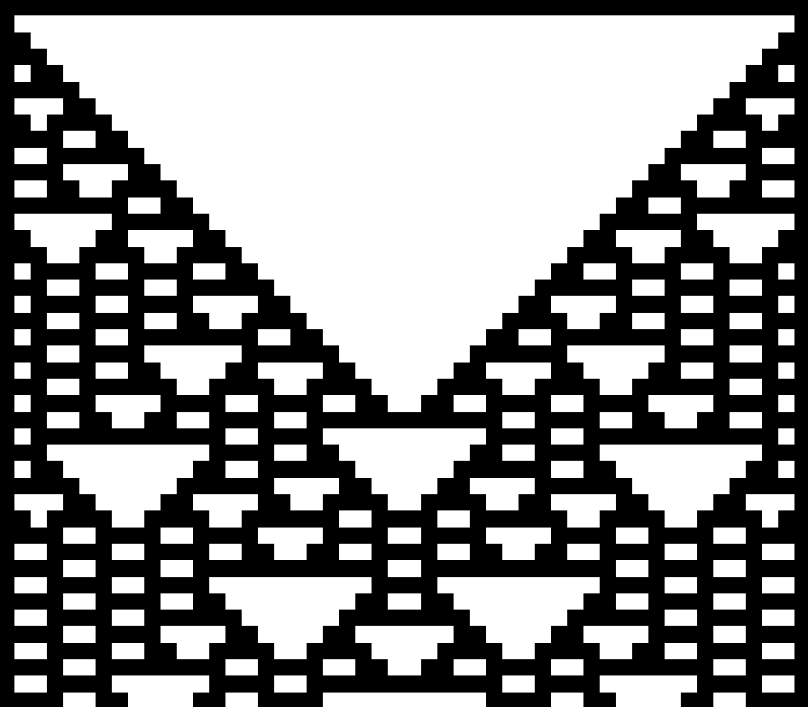
1D Cellular Autometa
  Each cell is determined by the cells above it

Slide 37
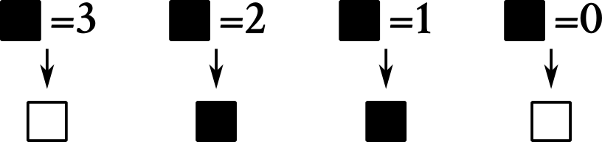

Slide 57
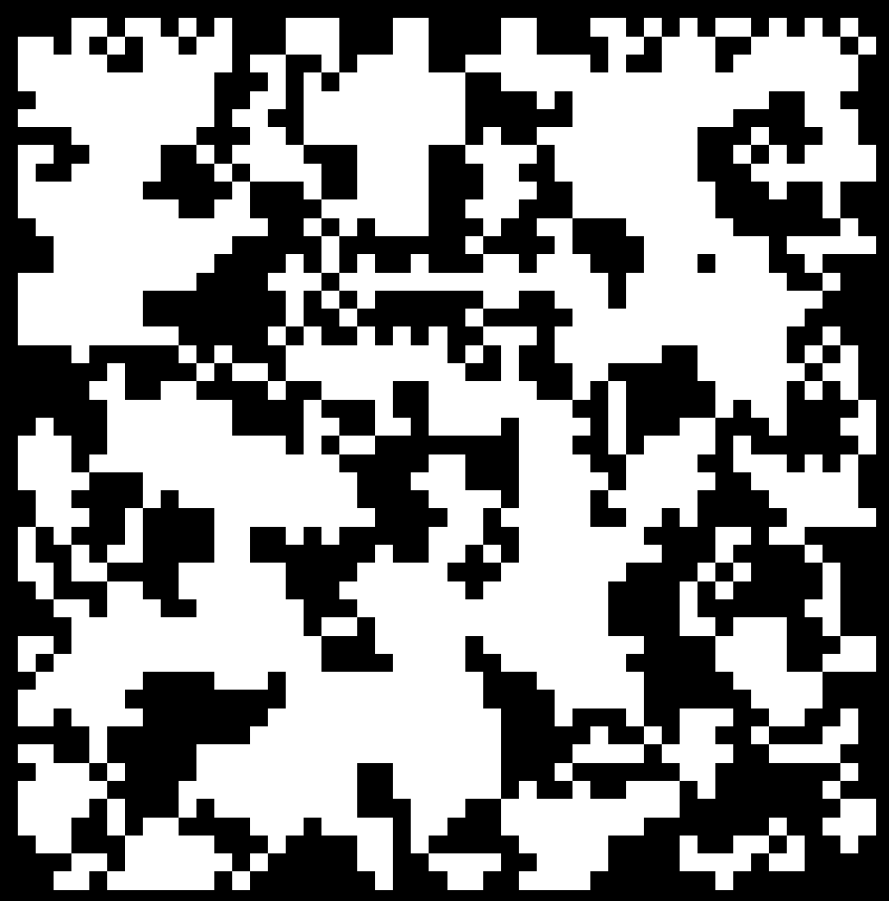
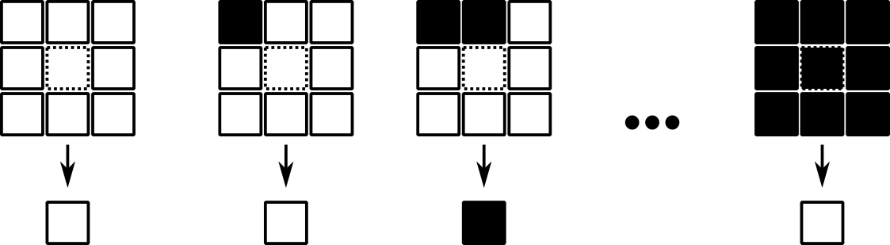
Simulations
2D Cellular Autometa
  Each cell is determined by the cells around it (it’s “neighbourhood”)

Slide 58
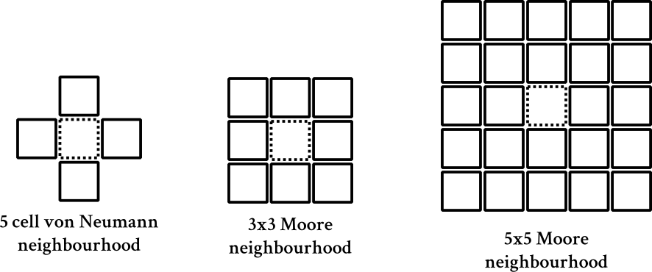
Simulations

Slide 59
Simulations
2D Cellular Autometa
  Each cell is determined by the cells around it (it’s “neighbourhood”)

Slide 60
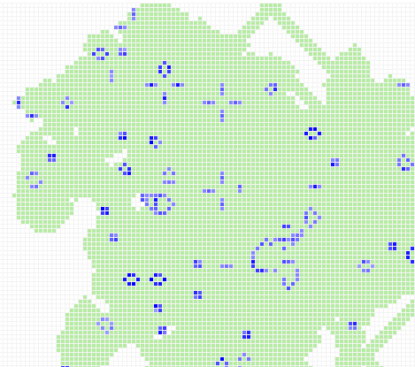
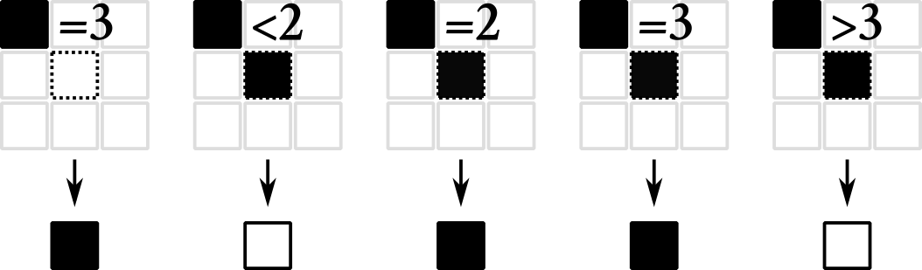
Simulations
The Game of Life (John Conway)
http://pmav.eu/stuff/javascript-game-of-life-v3.1.1/

Slide 61
Simulations
Cellular autometa can be used to make 2D and 3D maps

Slide 62


Slide 63


Slide 64


Slide 65


Slide 66


Slide 67


Slide 68


Slide 69


Slide 70


Slide 71



Simulations
Hexagonal grids
More types of tile

Slide 72

Simulations
  3D?
  http://www.cubes.io/

Slide 73
Simulations
Basic implementation:
  Randomly initialise map
  Write a simulation step function
    Count alive neighbours
    Apply rules simultaneously to all tiles
float chanceToStartAlive = 0.45f;
public boolean[][] initialiseMap(boolean[][] map){
for(int x=0; x<width; x++)
for(int y=0; y<height; y++){
if(random() < chanceToStartAlive)
map[x][y] = true;
}
return map;
}
https://gamedevelopment.tutsplus.com/tutorials/generate-random-cave-levels-using-cellular-automata--gamedev-9664

Slide 74
Simulations
Basic implementation:
  Randomly initialise map
  Write a simulation step function
    Count alive neighbours
    Apply rules simultaneously to all tiles
public doSimulationStep(boolean[][] oldMap){
boolean[][] newMap = new boolean[width][height];
//...

Slide 75
Simulations
public countAliveNeighbours(boolean[][] map, int x, int y){
int count = 0;
for(int i=-1; i<2; i++)
for(int j=-1; j<2; j++){
int neighbour_x = x+i;
int neighbour_y = y+j;
if(i == 0 && j == 0) {}
else if(neighbour_x < 0 || neighbour_y < 0 || neighbour_x >= map.length || neighbour_y >= map[0].length)
count = count + 1;
else if(map[neighour_x][neighbour_y])
count = count + 1;
}
}
Basic implementation:
  Randomly initialise map
  Write a simulation step function
    Count alive neighbours
    Apply rules simultaneously to all tiles

Slide 76
Simulations
public boolean[][] doSimulationStep(boolean[][] oldMap){
boolean[][] newMap = new boolean[width][height];
for(int x=0; x<oldMap.length; x++)
for(int y=0; y<oldMap[0].length; y++){
int nbs = countAliveNeighbours(oldMap, x, y);
if(oldMap[x][y]){
if(nbs < deathLimit) newMap[x][y] = false;
else newMap[x][y] = true;
}
else{
if(nbs > birthLimit) newMap[x][y] = true;
else n ewMap[x][y] = false;
}
}
return newMap;
}
Basic implementation:
  Randomly initialise map
  Write a simulation step function
    Count alive neighbours
    Apply rules simultaneously to all tiles

Slide 77






Simulations
Challenges
  Neighbourhood type
  Initialising map (what % of each tile?)
  What rules to use?
  How many iterations?
  Hard to control

Slide 78


Simulations
Games
  Tombs of Temeria
  Luminous Corridor 0

Slide 79

Using PCG

Slide 80

Using PCG
  What is PCG?
    Content representation defines possibility space
      i.e. the total set of things that can be defined
    Algorithm defines generative space
      i.e. the total set of things that can be generated by that algorithm

Slide 81


Slide 82

  The generative space

Slide 83


Slide 84
Using PCG
We don’t necessarily want a large generative space!
  We want to be able to generate good content
  We might want to be able to guarantee certain properties
How is our generator being used?
  Within our game? (Online)
  As a tool to support development? (Offline)

Slide 85
Using PCG
Generator requirements
  Functional
    e.g. Playable
    Traversable
  Aesthetics
    Looks good
    Gives the desired player experience

Slide 86
Using PCG
Constructive
  Bake in requirements to algorithm
  e.g. constraint satisfaction (e.g. ASP)
Generate and test
  Visualisation
  AI (e.g. neural network)
  Human Players

Slide 87


Using PCG
Answer Set Programming (ASP)
  Declarative programming language
  Models the problem domain and expected result
Evgenia Antonova 2015. Applying Answer Set Programming in Game Level Design. Masters Thesis. Aalto University

Slide 88

Using PCG

Slide 89
Using PCG
PCG as search
  Content encoding defines space
  Content function renders the content encoding
  Content requirements defines constraints to be satisifed/optimised
  Search algorithm explores this space

Slide 90

Using PCG
Final Thoughts

Slide 91
Using PCG
Whitelisting good generated content by seed might be cheaper than making a robust generator
Save seeds, make seed-based random generators
Iterating is important
Unexpected stuff happens, sometimes following what your generator is good at gives cool unexpected results

Slide 92
Using PCG
What do we want from a PCG system?
  Speed
  Reliability
  Controllability
  Diversity
  Creativity

Slide 93

Using PCG
Diversity
  How unique is your content?
    Background
    Perceptual differentiation
    Perceptual uniqueness
    Characterful

Slide 94


Slide 95


Slide 96


Slide 97

Further Reading
Practical Procedural Generation for Everyone, Kate Compton at GDC 2017 https://youtu.be/WumyfLEa6bU
ProcJam http://www.procjam.com/
Procedural Content Generation in Games
http://pcgbook.com/

