Slide 1
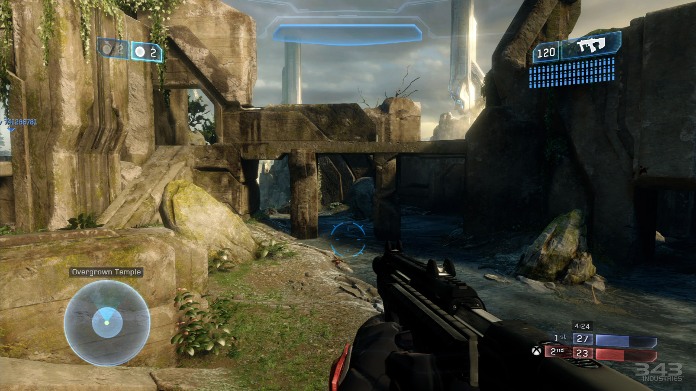
Games AI
Lecture 4.1
Behaviour Trees

Slide 2
Overview
Behaviour Trees
  Programming idiom for game AI
  Task oriented, not state oriented
  Modular, reusable behaviours
  Build hierarchy of increasingly complex behaviours

Slide 3
Overview
Behaviour Trees
  Hierarchical tree of nodes
  Controls flow of behaviour
    Intermediate nodes control flow of execution
    Leaf nodes run code/perform actions

Slide 4
Overview
Basic Behaviour Tree Flow
  BT is traversed from the root node every frame*
  Run each node as we encounter it
    If node returns running, we don’t go any further
  Unless we hit a behaviour of higher priority to run (i.e. higher up the tree), we will find “active” node (where we were last frame), then continue normal execution
*not the only/best way to design a BT

Slide 5
Overview
BT Flow
  Any node will return one of three statuses:
    success, failure, running
  The running status permits actions that take multiple frames to complete, e.g. walk to door
  Gives contract for what will be the case when node returns success
    eg. walk to door – we will be at door

Slide 6
Overview
Node types
  Action nodes control the things an agent does
    e.g. play animation, set variable, check variable
  Composite nodes process children in some order, and at some point determine success or failure
  Decorator nodes affect the processing or result of a single child node

Slide 7
Composite Nodes

Slide 8
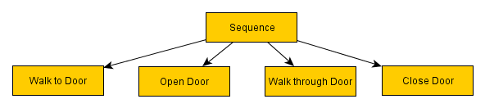
Composite nodes
Sequence Nodes
  Tries each child in turn
  Stops and returns failure when a child fails
  Returns success if none fail
  Used where you want to try and complete a whole sequence and only consider it a success if you get to the end without failure
    e.g. open door. You can move to it pick the lock, but if it’s wedged shut, you still return failure.
      If you fail to move to the door, there is no point trying to pick the lock

Slide 9
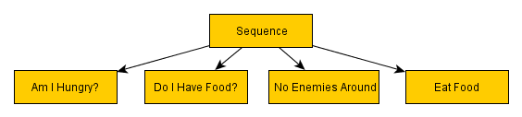
Composite nodes
  Other uses of sequences
    Check variables
    Behaves like &&, with short-circuiting

Slide 10
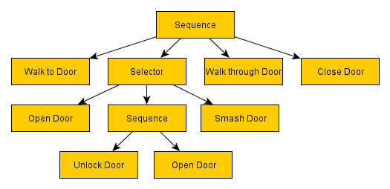
Composite nodes
Selector Nodes
  Tries each child in turn
  Stops and returns success when a child succeeds
  Returns failure otherwise
  Behaves like || with short-circuiting
  eg. try to open door, try to unlock door and open it, then try to smash door.
    If one fails, we keep trying the others
    So long as one succeeds, the door is open

Slide 11
Composite nodes
Parallel
Random Sequence
And many more...

Slide 12
Decorator Nodes

Slide 13
Decorator nodes
Inverter
  Flips result of child node
success
failure
failure
success

Slide 14
Decorator nodes
Suceeder
  Always return success
  Use where failure is expected but you don’t want that failure to have its usual affect on the flow of execution
success
success
failure
success

Slide 15
Decorator nodes
Repeater
  Reprocess child node when it returns a result
  Creates an infinite loop
  Can set a maximum number of repeats
repeat x5

Slide 16
Decorator nodes
Repeat until fail
  Reprocess child node whenever it returns a success, but if it returns a failure, then stop
And many more...
repeat
until fail

Slide 17
Action Nodes

Slide 18
Action nodes
Actions nodes
  Change state of game world
    Perform animation, play audio
    Update character state
    Set variable in context
      eg. set WalkTarget to ClosestEnemy.Position
    Run a pre-defined piece of code
      e.g. pathfind to WalkTarget
  Read/test variable e.g. Me.Health < Me.MaxHealth
  Return success or failure (or running)

Slide 19
Action nodes
Storing context
  Nodes have shared context (i.e. database or blackboard) where they can update and access varibles
  e.g. when a BT is called on an AI agent, a context is created which stores arbitrary variables in a dictionary
  Action nodes can read/write to this dictionary, e.g.
    set SpellAttackCooldown = 10 seconds
    Calculate closest enemy and store as ClosestEnemy
    Check if EnemyInSight is true

Slide 20
Action nodes
Reference Node
  Call another behaviour tree, passing context
  Useful for splitting up different behaviour trees into separate files/resources for managing workflow

Slide 21
Action nodes
Dynamic Node
  Behaviour specified at runtime by attaching a behaviour tree in code
  Useful for e.g. smart objects

Slide 22
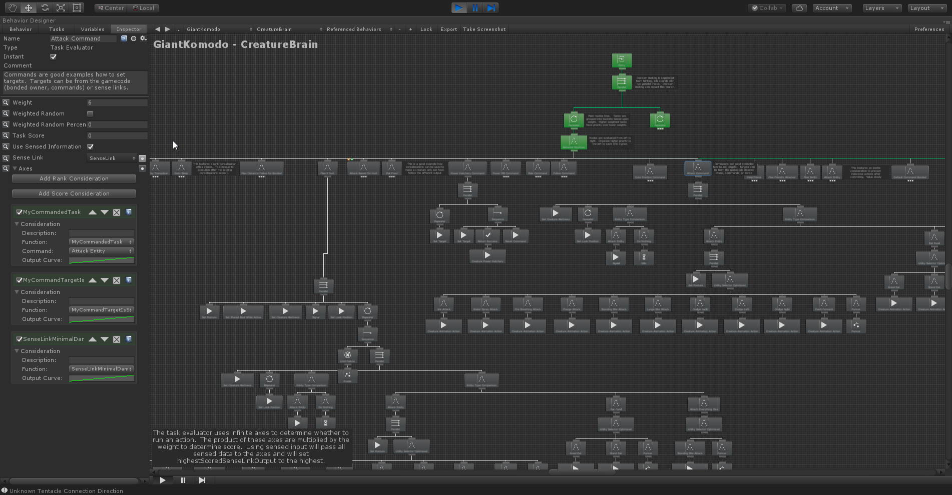
Best Practices

Slide 23
Best practices
Behaviour Trees
  Good at describing individual behaviours
  Definite execution of decisions
  Bad at interruptions/transitions
  Bad at representing cyclic behaviour
  Get messy and hard to manage if allowed to grow too big

Slide 24
Best practices
Ideally decisions made should be local to “how to enact this behaviour”, not high level “what should I be doing”
There are better ways for describing high-level decision logic, such as state machines
  Combining approaches can keep your AI more manageable

Slide 25
Best practices
Drawing a Behaviour tree
  Usually top-down
  Node priority top-down,
  Execution order top-down
1
2
4
7
3
5
6

Slide 26
Best practices
Drawing a Behaviour tree
  Can be nicer to draw in reading order
  Node priority top-down,
  Execution order left-right
1
2
3
4
5
6
7

Slide 27
Best practices
Sequence
Node Decorators
  Alternate way to structure BTs
  Decorators as part of nodes
  Compact representation
  Easy to read and understand
Abort Condition
PrimaryTarget.Visible is true
Condition
PrimaryTarget to Self > 15 m
Task
Task
Always Succeed
OnTerminateSetProperty
If failed Self.Cooldown = 10s

Slide 28
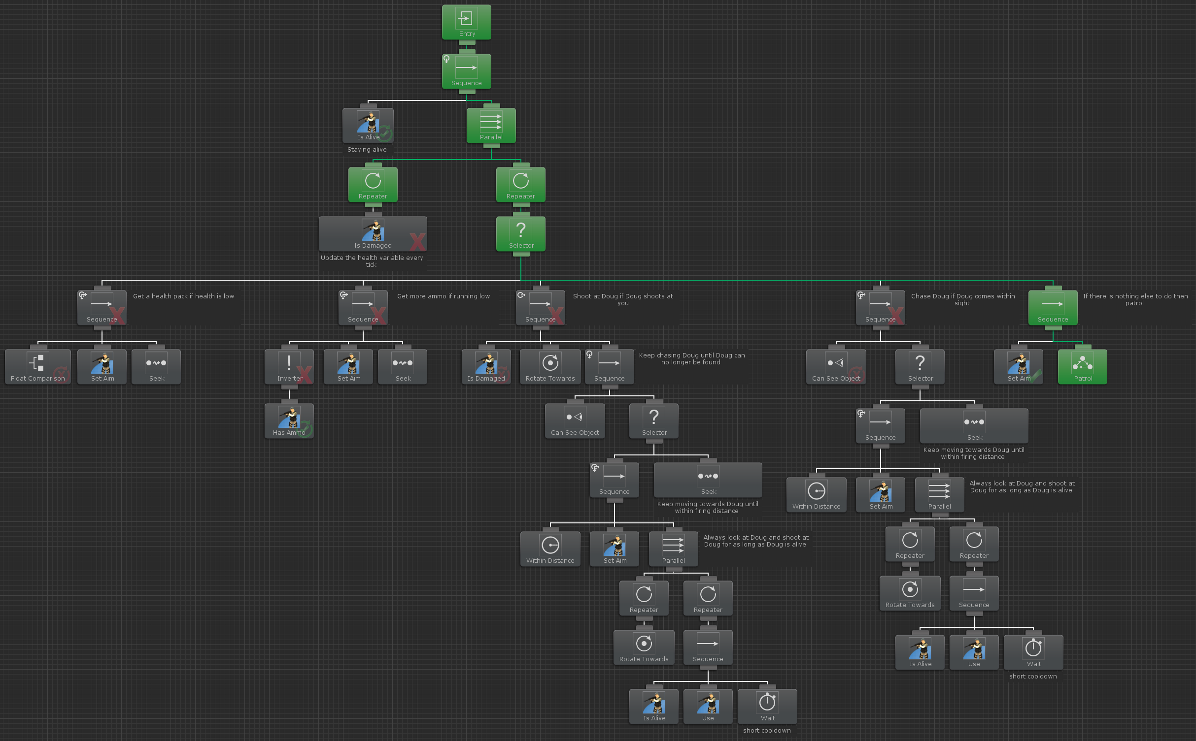
Modular AI

Slide 29
Modular AI
We’ve seen three ways of controlling behaviour:
  State machines
  Behaviour Trees
  Utility-based AI
These have their pros and cons, and can be used together
How do we combine them?

Slide 30
Modular AI
“Modular AI” is a fancy term for the application of basic software engineering principles to AI development.
Each AI module is
  Small
  Does one clearly defined task
eg. “target selection” module decides on our primary target, for melee attack module, ranged attack module, flee module, …

Slide 31
Modular AI
Modular encapsulation, as in OOP
Have clearly defined interface for each module
Some AI, e.g. behaviour trees, is primarily data driven
  Define standard variables you use in your blackboard
Have predictable behaviour (e.g. events in hierarchical state machines)

Slide 32
Modular AI
Essential problem:
  Connect output of one module to input of another
  Ideally avoid any accidental complexity
Loosely coupled modules
  If remove module, then only impairs that behaviour
Tightly coupled modules
  Missing module causes compilation failures/runtime errors
Special Cases
  Special case code often breaks on re-use

Slide 33
Modular AI
Work at right level of granularity
  Small, but abstracting away from fine-grained implementation details
Represent a single human concept
  How far away is he?
  How long have I been doing this?
  I want to move over there

Slide 34
Modular AI
Conceptual abstractions
  Considerations
  Actions
Modular Components
  Distance Consideration
  Move Action

Slide 35
Modular AI
Common Abstractions
  Reasoners
    Make decision
  Considerations
    e.g. Distance, Execution History, Picker
  Actions
    e.g. Moving, fire weapon, Subreasoner
  Targets
    e.g. Fixed position, named entity, controlled entity
  Weight functions
    Convert an input to weight values
  Region
    Repesents space with inside and outside

Slide 36
Modular AI
Separation of Responsibility
  Sensing
  Deciding
  Acting

Slide 37
Modular AI
A lot of the challenge of implementing game AI is the architecture, rather than the algorithms
  Games are big, complex projects
In your assessment you are encouraged to combine multiple AI approaches
You need to decide how best to do this
How you architect your AI code is important. You will need to discuss this in your report.

Slide 38


Recommended “reading”
Behavior trees for AI: How they work Chris Simpson. 2014 Gamasutra https://www.gamasutra.com/blogs/ChrisSimpson/20140717/221339/Behavior_trees_for_AI_How_they_work.php
AI Arborist: Proper Cultivation and Care for Your Behavior Trees Panel at GDC 2017 https://youtu.be/Qq_xX1JCreI
Nuts and Bolts: Modular AI From the Ground Up Panel at GDC 2016 https://youtu.be/IvK0ZlNoxjw
The Behavior Tree Starter Kit, Alex Champandard, Philip Dunstan in Game AI Pro Ch. 6 http://www.gameaipro.com/

Slide 39
Implementing BTs

Slide 40
Implementing BTs
We’ll need a class to represent our BT nodes
  Subclasses for Composite nodes, Decorator nodes, Action nodes, ...
  Keeps track of a list of child nodes
  Has a run() method or similar that takes a context object and returns a status
Use an enum to encode status (Success, Failure, Running)

Slide 41
Implementing BTs
Action nodes
  call init() method called first time it is run to do any setup
  call process() method called every time it is run
Overload these methods in subclass to define specific behaviour

Slide 42
Implementing BTs
BTs are supposed to be data-driven - we don’t want to manually specify them in code – so we’ll need a way to create them easily from data
  Specify tree structure in data object (e.g. JSON) and create tree using a Factory
  Specify node type with an enum
  Specify any arguments for the constructor
{
  type: BTNode.Sequence,
children: [
{
  type: BTNode.Inverter,
  args: [5],
  children: [
        { type:BTNodeType.Void }
      ]
}
  ]
}

Slide 43
Implementing BTs
Create a BehaviourTree class to manage the BT
  Runs BT by calling run() on top level node and passing in context object
  May want to keep track of currently running node to avoid having to traverse the tree each frame
    ( But need to re-check periodically in case a higher-priority action can run )
Each agent may want their own BT

Slide 44
Implementing BTs
Create a context or blackboard to share data within your BT (and with other parts of your AI)
  Store data about the state of the world
  e.g. sensors can process world data and provide agent-specific information tailored for easy decision making in your BT
    Can I see enemy?
      true/false
    How injured am I?
      not at all, a bit, lots, near death

