Slide 1
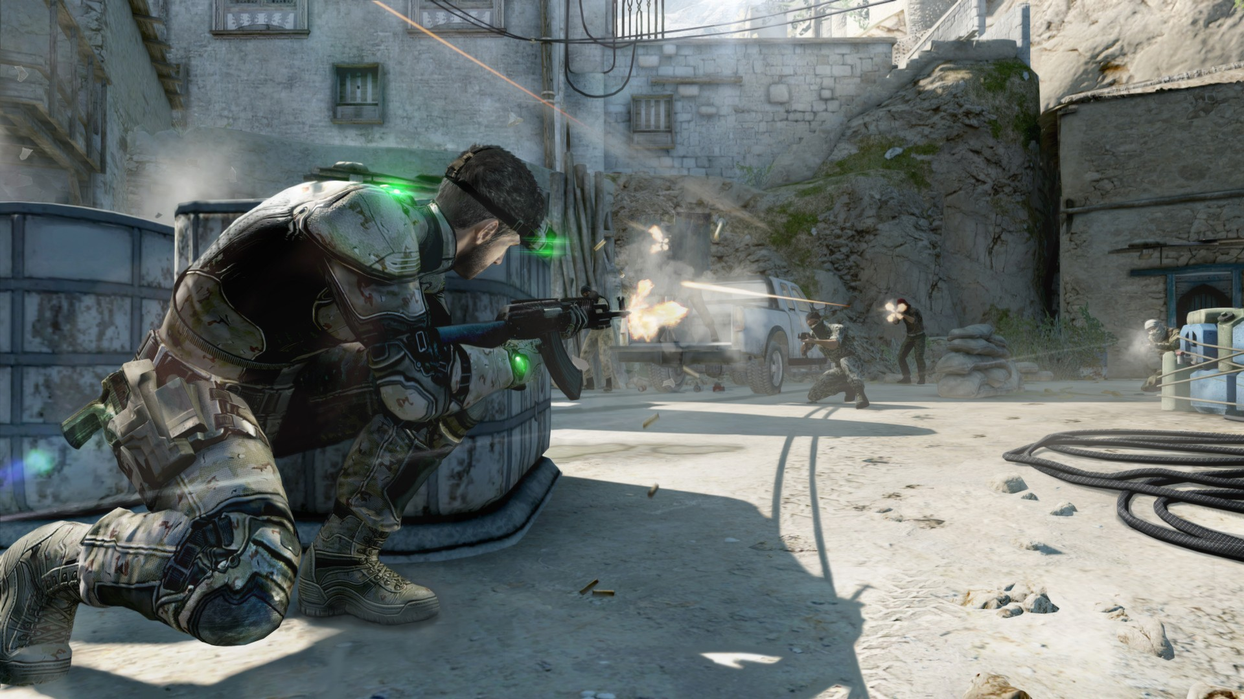
Games AI
Lecture 1.0
Course introduction

Slide 2
Overview
Course introduction
  Content
  Assessment

Slide 3
Content
Content
  First 1/3: 80% of Games AI
  Second 1/3: 20% of Games AI
  Third 1/3: More techniques

Slide 4
Content
First 1/3: 80% of Games AI:
  Finite State Machines
  Utility-based AI
  A* for Navigation
  Behaviour Trees

Slide 5
Content
Second 1/3: 20% of Games AI:
  PCG
  Automatic Game Testing
  Whole-game search
  Planning

Slide 6
Content
Third 1/3: More techniques
  Machine Learning
  More A*?
  More planning?
  More PCG?

Slide 7
Assessment
Assessment
  You develop a game with interesting AI
  You each submit:
    Written report
    Source code
    Playable version

Slide 8
Assessment
Your AI System:
  Support the game experience (not e.g. monetsation optimisation!)
  You decide:
    Agent AI?
    Procedural Content Generation?

Slide 9
Assessment
Evaluation
  Written report:
    Describe
    Justify
    Evaluate
  Demonstrates clear evidence of significant and complex artificial intelligence coding and development work
  Shows that you understand of the techniques you used and the ones you didn’t use (and why!)

Slide 10
Assessment
Save your code!
  Use the lecture practicals to test out new techniques
  Combine and reuse the code (appropriately!) for your assessment
Don’t write the whole thing after one lecture!
  You’ll need to combine multiple techniques
  (or do something clever from the later parts of the course)
Keep your game simple!
  You get marks for your AI
  Don’t worry about graphics, story, etc.

Slide 11
Assessment
Keep a design diary
  You’ll need to talk about the decisions you made during the development of your AI system

Slide 12
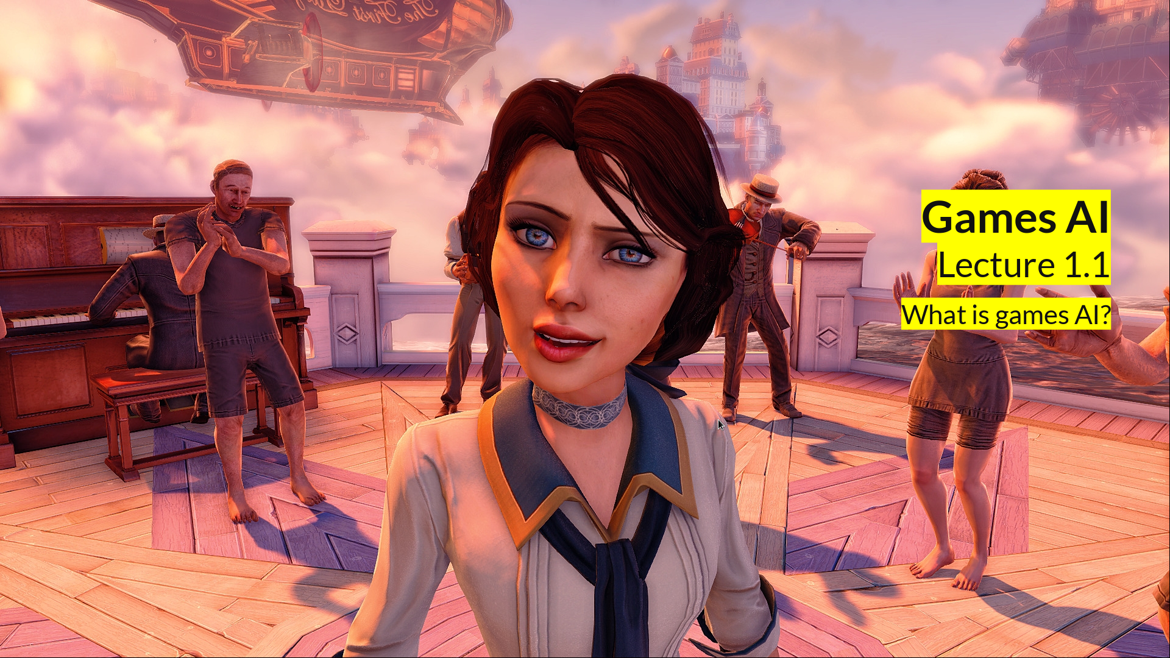
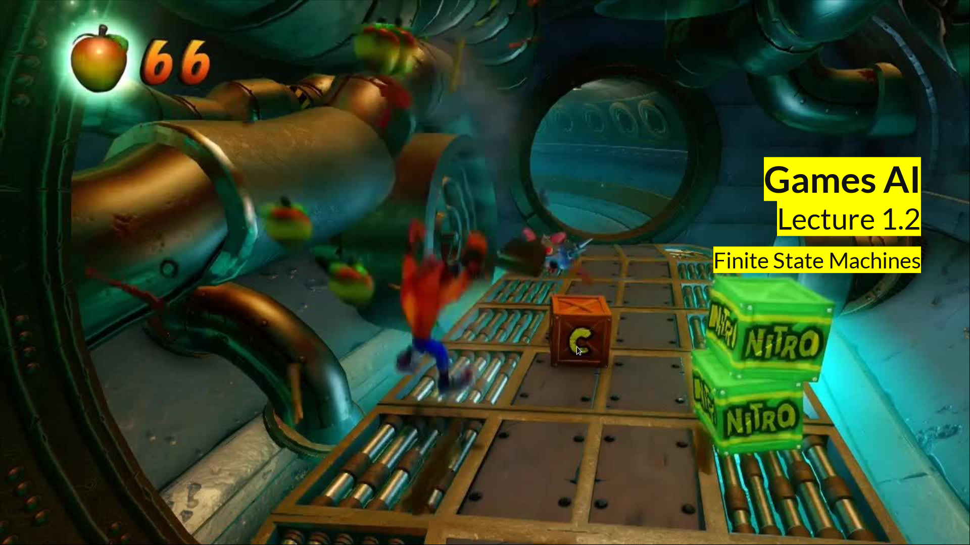
Coming up
Coming up:
  What is Games AI?
  Finite State Machines
  What kind of game do you want to make?

