Slide 1
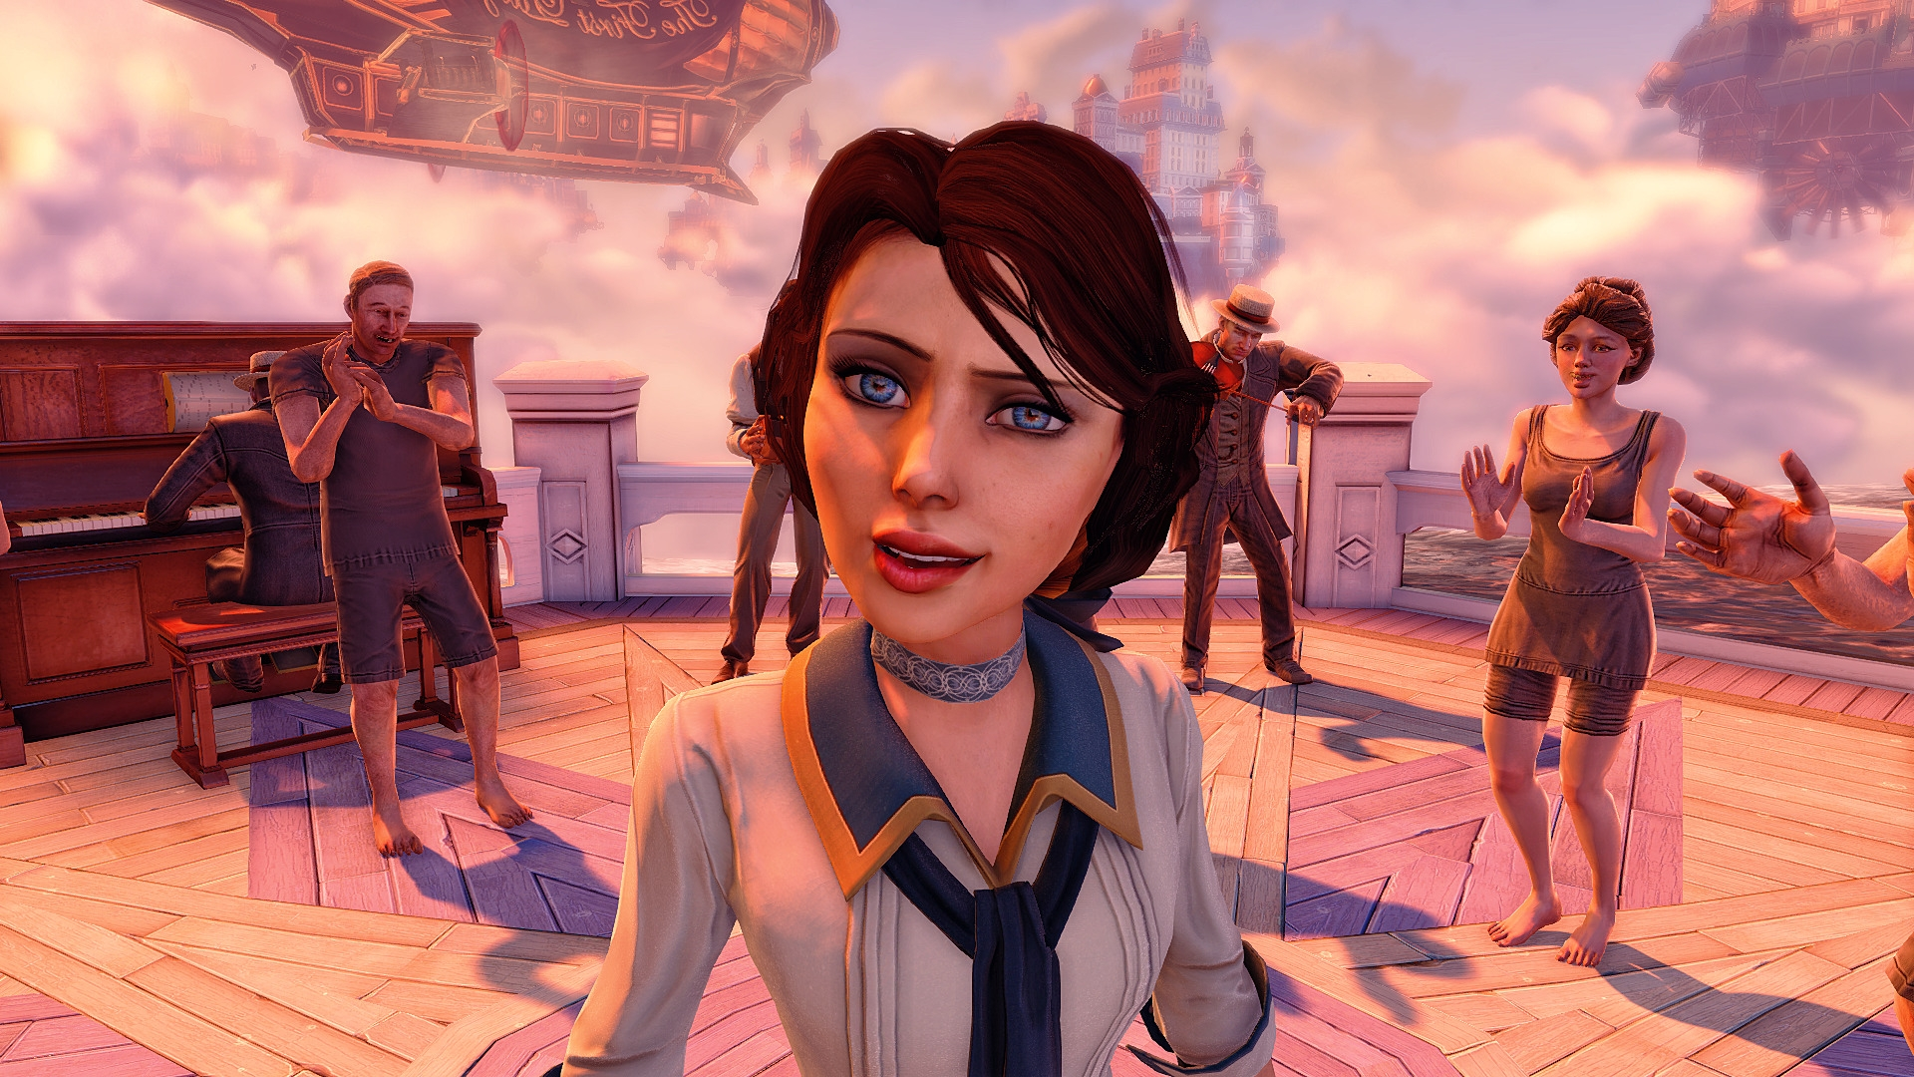
Games AI
Lecture 1.1
What is games AI?

Slide 2
Introduction
We want to make good games AI
  What is games AI?
  What makes it “good”?

Slide 3
Introduction
What is good game AI?
  go to YouTube
  show us an example of good game AI
  what makes it good?
  what makes it AI?

Slide 4
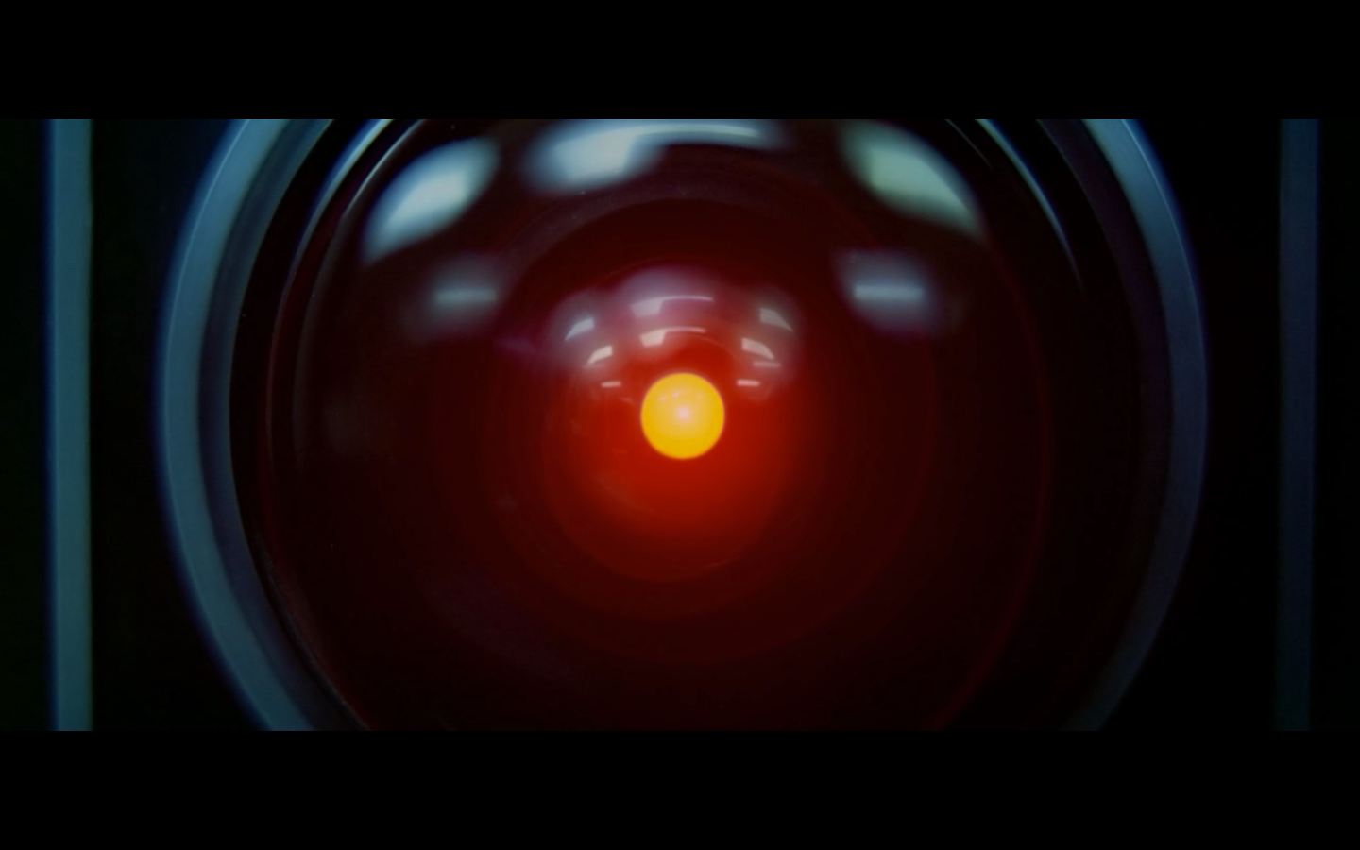
Artificial Intelligence:
  Making computers able to do things which currently only humans can do

Slide 5
Games AI:
  Making computers able to do things which currently only humans can do
in games

Slide 6
Introduction
Games AI:
  Content Creation
  Player Modeling
  Game Playing

Slide 7
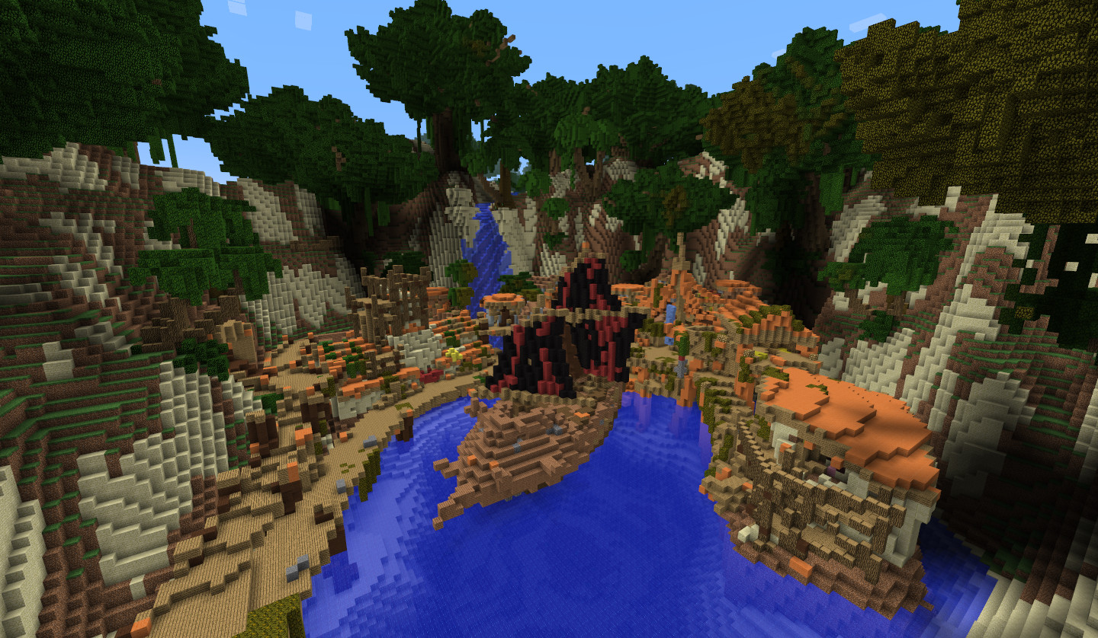
Content Creation

Slide 8
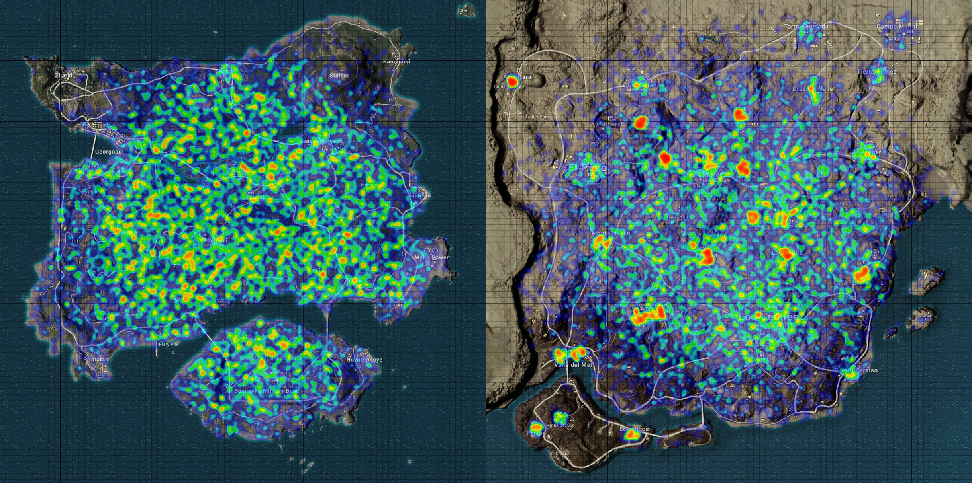
Player Modeling

Slide 9
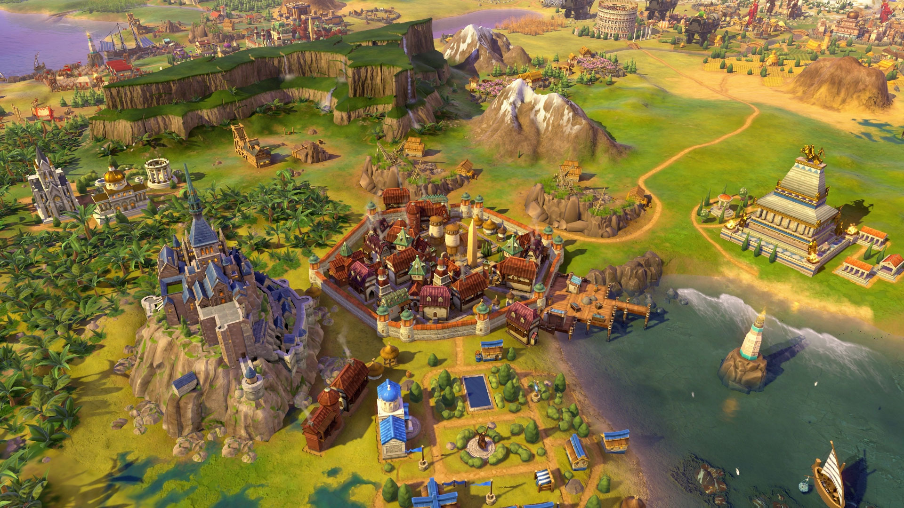
Game Playing

Slide 10
Game playing
AI for games
AI in games

Slide 11
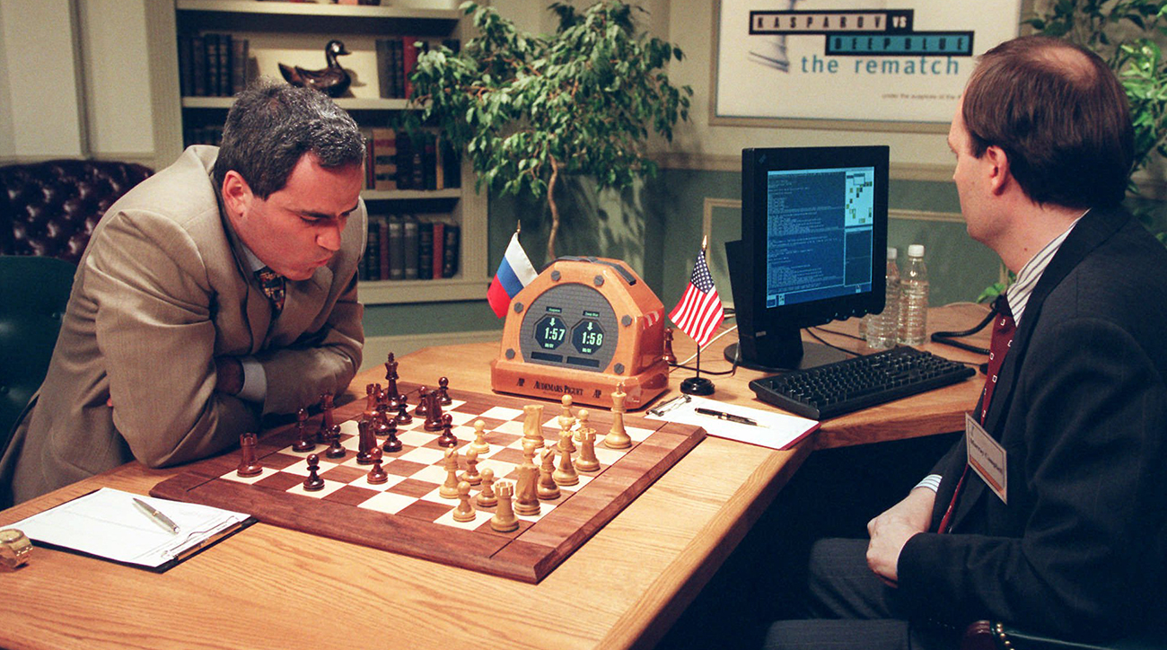
AI for Games

Slide 12
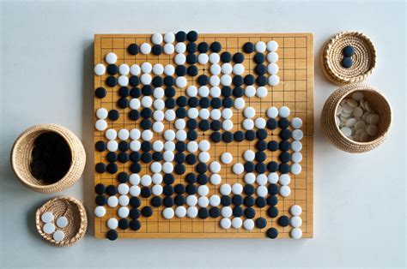
Game playing
Deep Blue beats Garry Kasperov 1997
  Minimax algorithm with modifications
  Highly tuned evaluation function
  Custom supercomputer
AlphaGo beats Lee Sedol 2016
  Deep convolutional neural networks and MCTS
OpenAI playing Dota2 at a professional level
  Deep reinforcement learning

Slide 13
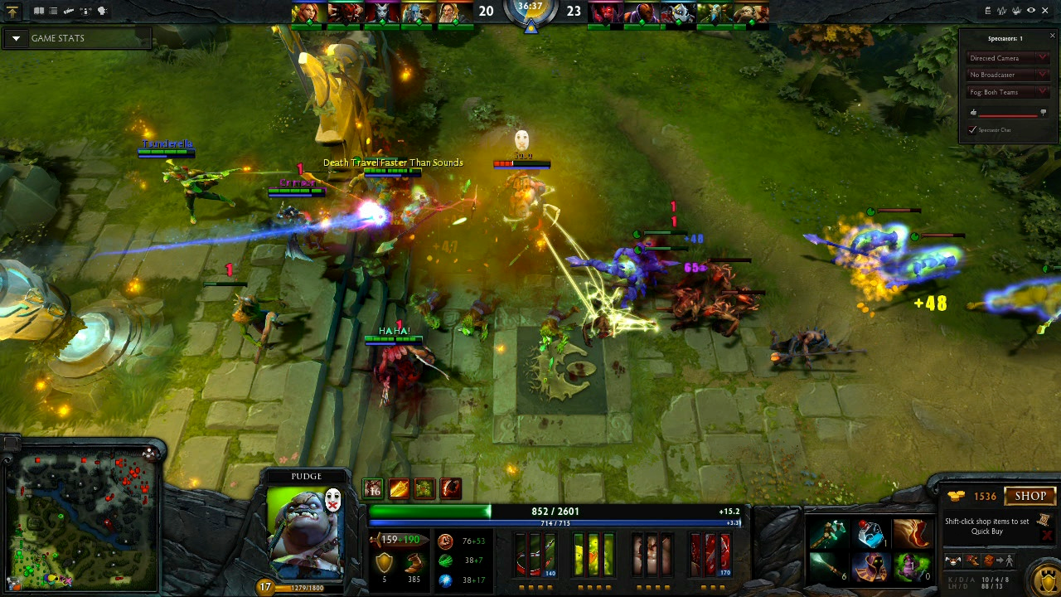

Slide 14
AI for games
Why do AIs play games?
  To provide opponents
  Because they are challenging tests
  Prestige
  Automatic testing and game balancing
    e.g. for QA and content creation

Slide 15
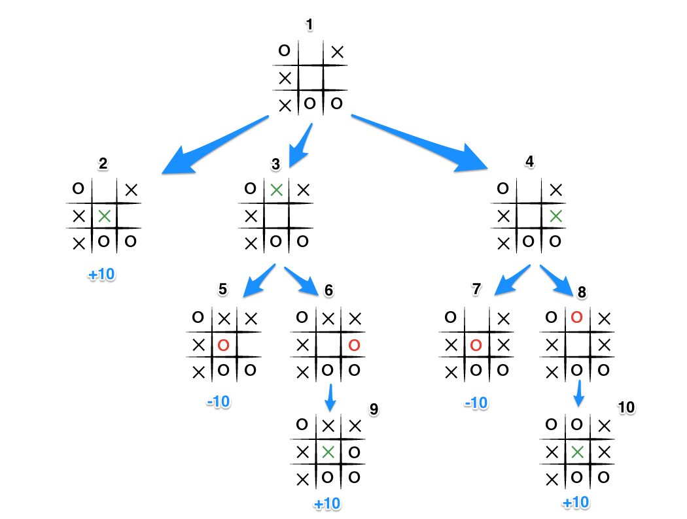
AI for games
How do AIs play games?
  Planning
  Reinforcement Learning
  Supervised Learning
  ...cheating!

Slide 16
AI for games
So what is AI?

Slide 17
AI for games
Representing knowledge
Assigning utility
  Good actions
  Good states

Slide 18
AI for games
Representing knowledge
  Variables
  Data
  NPC “state”
  Game “state”
  Symbolic representation of the world

Slide 19
AI for games
Assigning Utility
  What is a good action?
  What is a good state?
    Optimal chance of winning
    Most informative

Slide 20
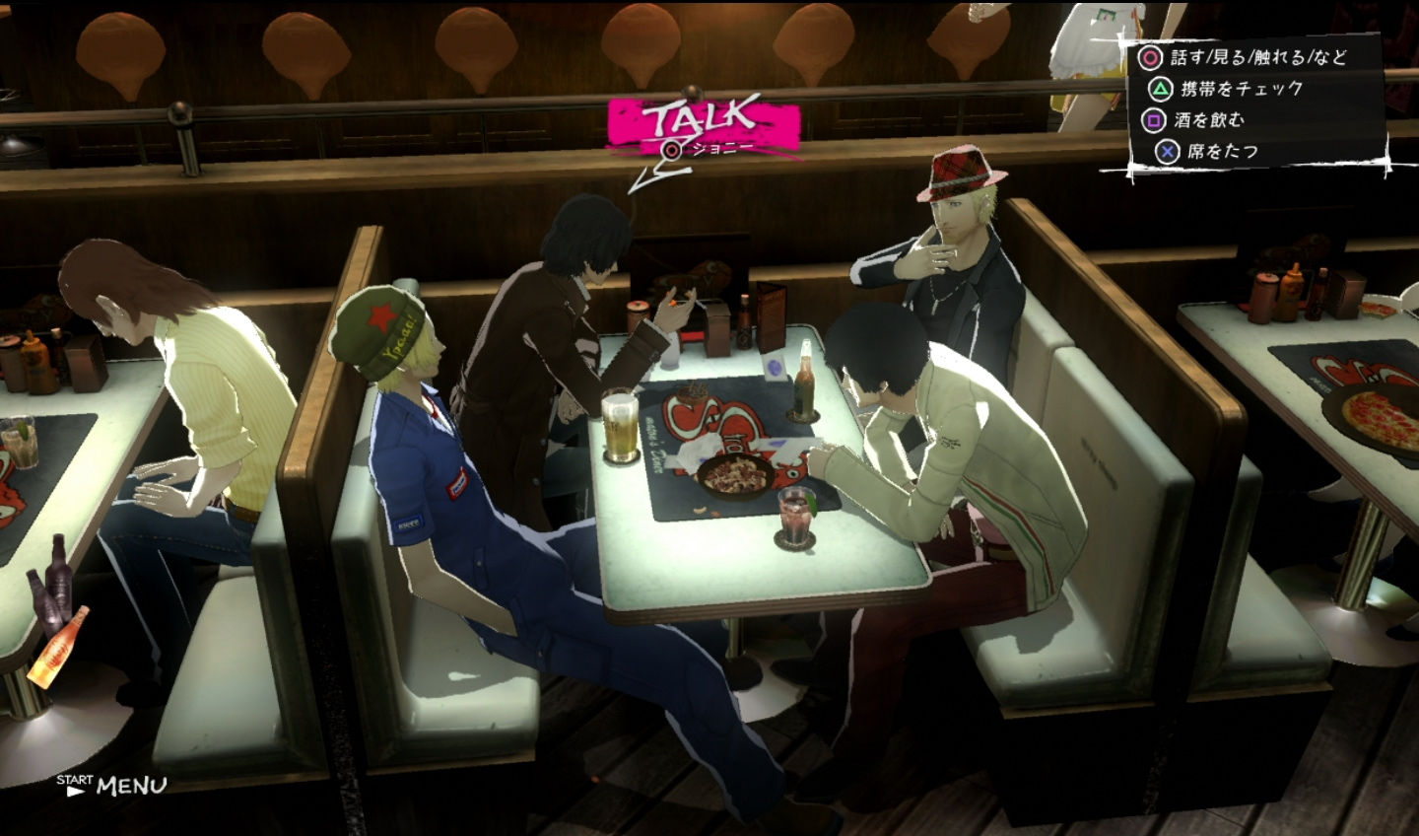
AI in Games

Slide 21
AI in games
Brainstorm:
  What sorts of AI are there in games?
  What roles does it take?
  What makes it good/bad?
  Get examples on the web/YouTube

Slide 22
AI in games
“Game AI should be about one thing and one thing only: enabling the developers to create a compelling experience for the player” (Kevin Dill 2014).

Slide 23
AI in games
Roles of AI in games
  Opponent: providing challenge
  Character: part of atmosphere or story
  Advisor: assisting the player
  Trainee: being taught by the player
  Director: controlling the action
  Analyst: interpreting the gameplay
  Designer: creating the game
  Cameraman: controlling what is on screen

Slide 24
AI in games
How do AIs work in games?
  Rule-based approaches
    Finite State Machines
    Behaviour Trees
    Utility-based AI
  Planning
    Tree search, e.g. A*
    Symbolic planners, e.g. GOAP
  Machine learning
    Evolutionary algorithms
    Supervised learning

Slide 25
AI in games
How do AIs work in games?
  Showmanship

Slide 26
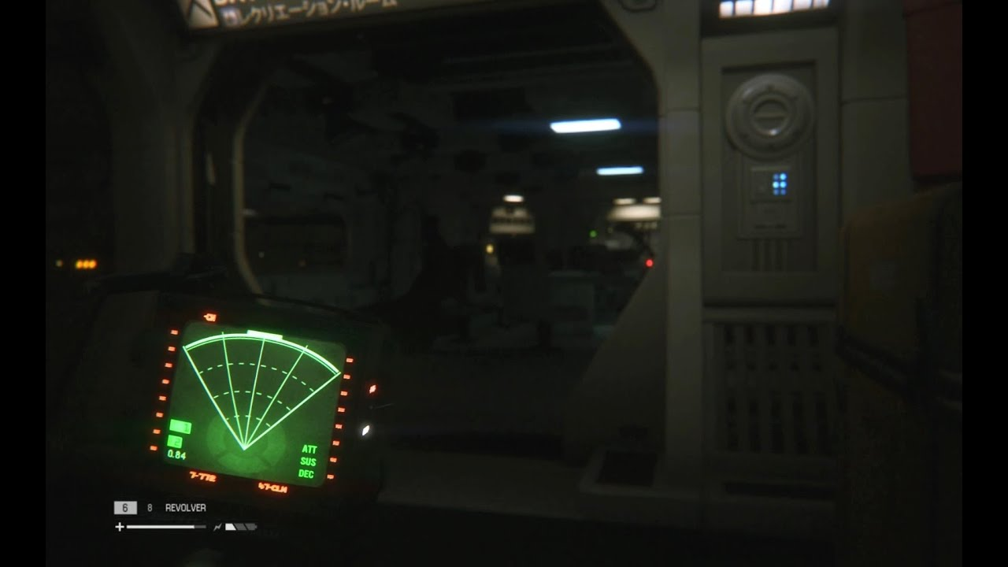

Slide 27
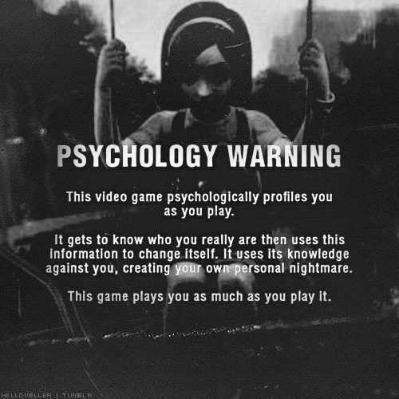

Slide 28
AI in games
Challenges
  Authorial control
  Performance overhead
  Development time
  Required architecture
  Game design constraints/opportunities

Slide 29
Summary
Summary
  AI can do a bunch of things

Slide 30
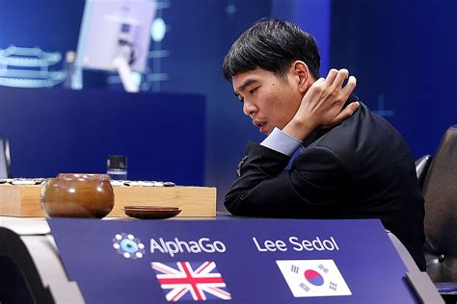
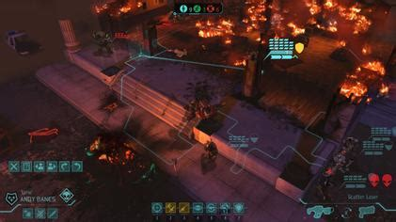
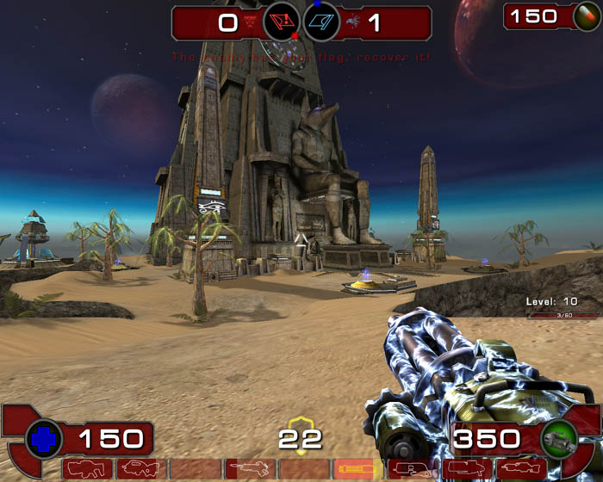
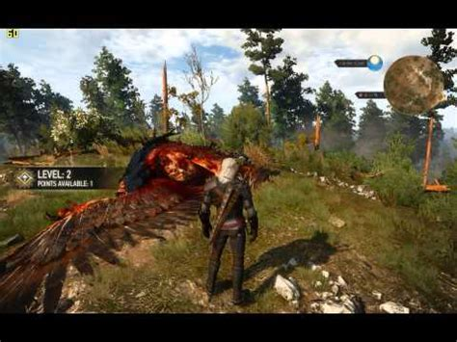
Summary
AI Player
AI NPC
Play to win
Create an experience

Slide 31
Summary
We’re going to be focusing on NPC AI to support the player experience
  i.e. how most games AI is used in industry
  “Cheating” is encouraged
  We’ll discuss whole-game playing AI later in the course, mostly in the context of its uses for testing and content creation

Slide 32
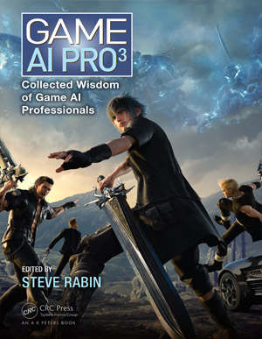

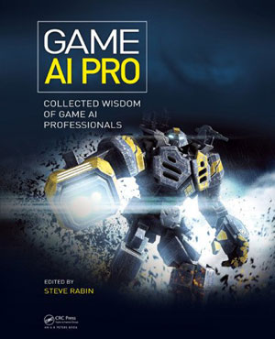
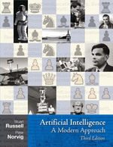
Recommended texts
Recommended Texts
  Steve Rabin (ed), Game AI Pro series
  (free!) www.gameaipro.com
  Steve Rabin (ed), AI Game Programming
  Wisdom series.
  Russell & Norvig, Artificial Intelligence:
  A Modern Approach, 3rd ed., 2010.

Slide 33
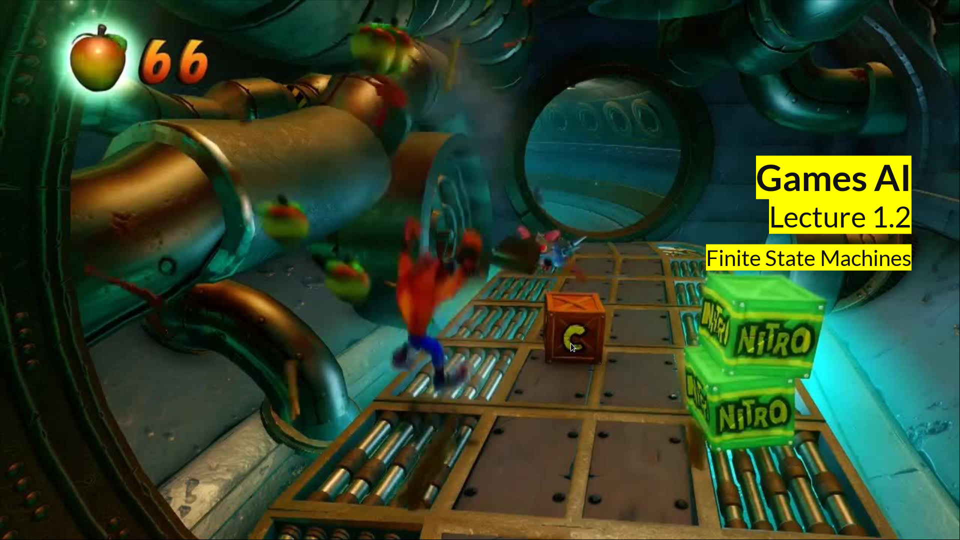
Coming up
Coming up:
  Finite State Machines
  What kind of game do you want to make?

