Slide 1
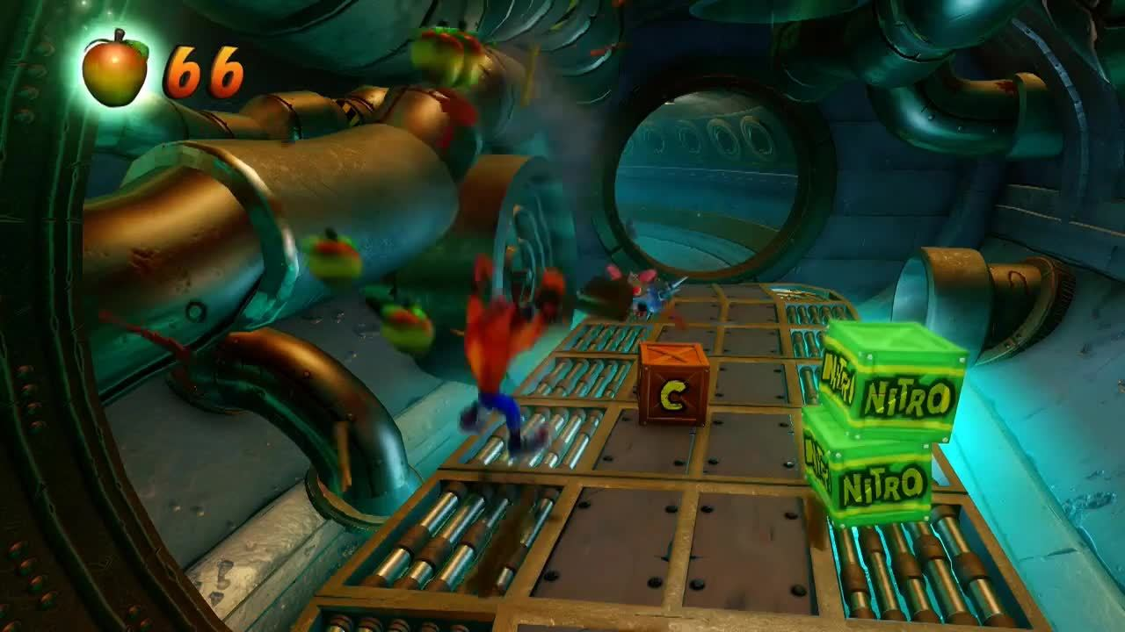
Games AI
Lecture 1.2
Finite State Machines

Slide 2
Introduction
Finite State Machines
  Simple idea
  Widely used
  Several variations

Slide 3
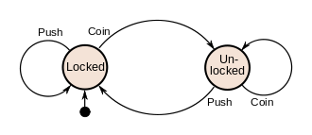
Finite state machines
Agent can be in one of a finite set of states
States can be connected by transitions
Transitions are triggered by events

Slide 4
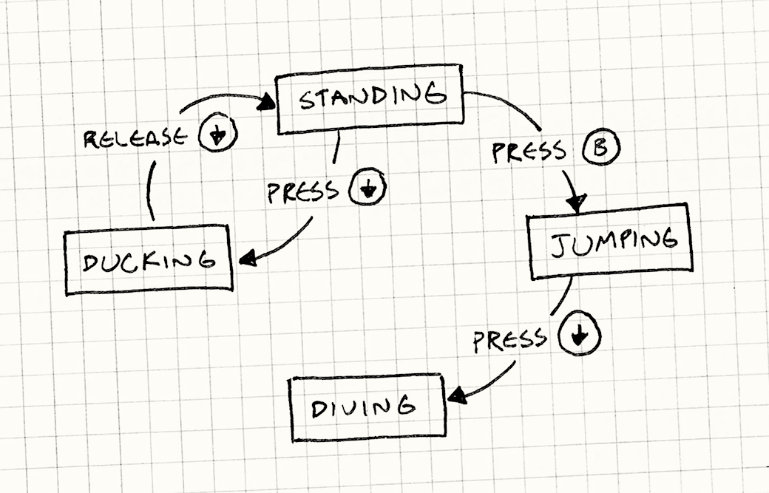
Finite state machines
Break down complex systems into a discrete set of states
Each state performs a narrowly defined task

Slide 5
Finite state machines
Benefits
  Easily understood
  Small and easy to code
  Negligible overhead
  Various extensions to the idea
Limitations
  Simple formalism means can’t handle complexity

Slide 6
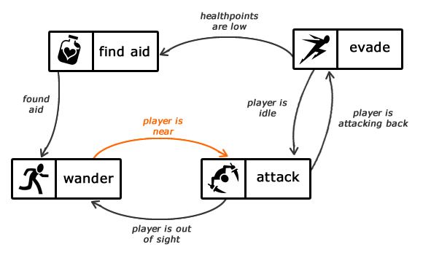
Finite state machines

Slide 7
Finite state machines
Where can you see FSMs in use in games?
  Opponent AI
  Animation
  UI
  Game design and mechanics
  and more...

Slide 8
Finite state machines
Lets design some FSMs together for agents that you might want to implement
  Turret?
  Mob?
  Bullet hell?

Slide 9
Basic finite state machines
Implementing an FSM (1)
  Switch statement
let currentState: State
switch (currentState)
{
case State.Idle:
//do something
break;
case State.Attack:
// attack the player
break;
case State.Flee:
// run away
break;
}

Slide 10
Basic finite state machines
Pros
  Simple
Cons
  State update code all in one place

Slide 11
Basic finite state machines
Implementing an FSM (2)
  Encapsulate in a class
  Implement each state as a function or method
  Use a property to determine active state
  Call active state function per game update
export class FSM
{
private activeState: () => void;
public setState(state: () => void) :void
{
this.activeState = state;
}
public update(): void
{
if (this.activeState != null)
this.activeState();
}
}

Slide 12
Basic finite state machines
Problem
  Potential for invalid state transitions

Slide 13
Basic finite state machines
A rethink:
  Store current state
  Accept events (e.g. function calls to public interface)
  Lookup next state
  Change state
  Run update for current state

Slide 14
Basic finite state machines
Go and implement an FSM AI
  Start with a simple implementation
  Get it doing something cool
  Improve your implementation to make it more reliable
Then think about how your code can scale and fit into a larger AI system
  What limitations do you find with FSMs?

Slide 15
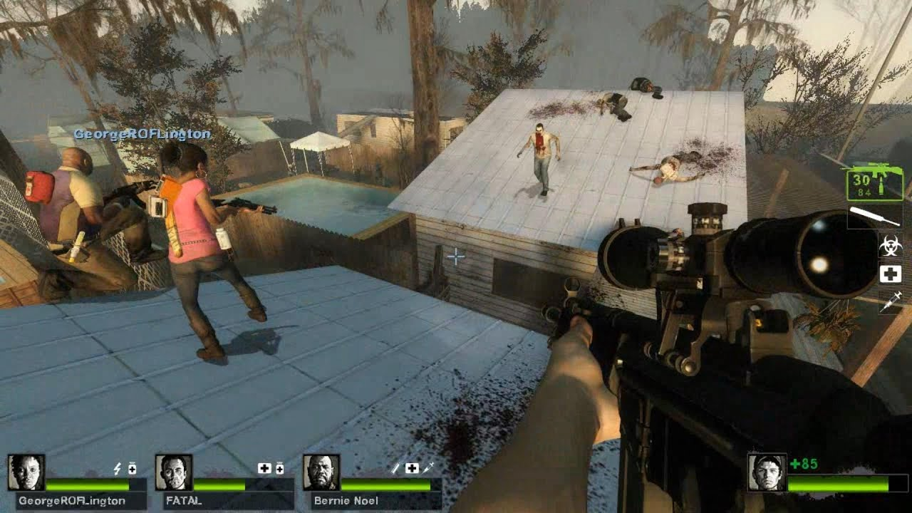
More State Machines

Slide 16
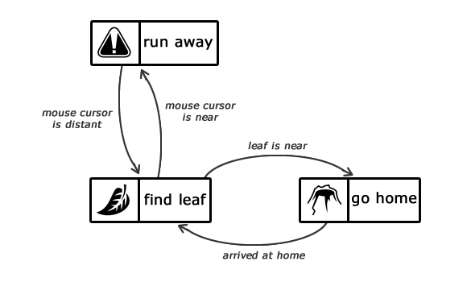
More state machines
Problem: FSMs don’t store history
  Need to use duplicate states
  Can quickly get unmanageable

Slide 17
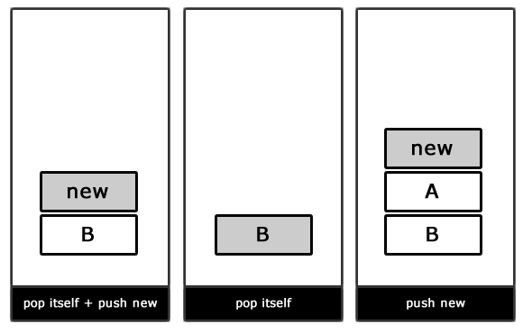
More state machines
Solution 1
  Stack-based FSM
  Top of stack points to current state
  State transitions: push, pop, pop and push
  How would we implement our “run away” state?

Slide 18
More state machines
Solution 2:
  Hierarchical State Machines
  States can contain sub-FSMs
  Each state stores the current state for its internal FSM
  How would we update our ant state machine?

Slide 19
More state machines
State machines are a widely used tool, but best when combined with other techniques
State/event oriented, hard to design goal-oriented behaviour
Adding concurrency and non-determinism can increase sophistication/realism

Slide 20
More state machines
Implement a hierarchical FSM
  How does it compare to a standard FSM for creating more complex behaviours?
  Make your code robust and reusable
    You might want to use these techniques in your assessment

