Slide 1
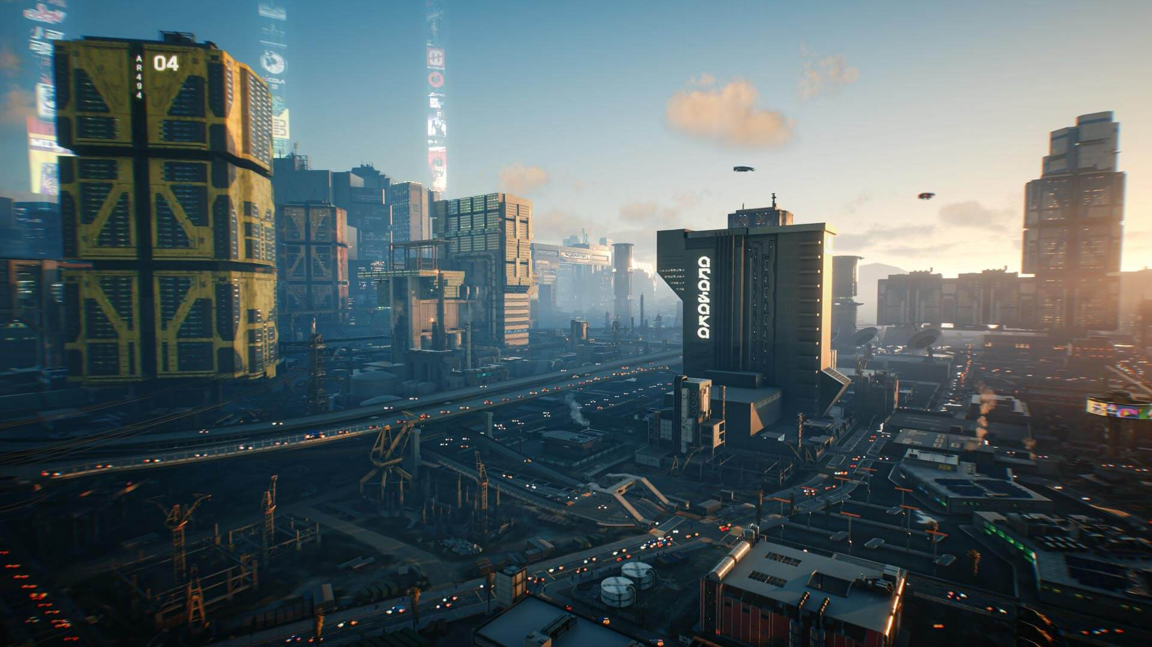
Games AI
Lecture 10.1
Discussion and Performance

Slide 2
Overview
Writing and presenting the report
Performance

Slide 3
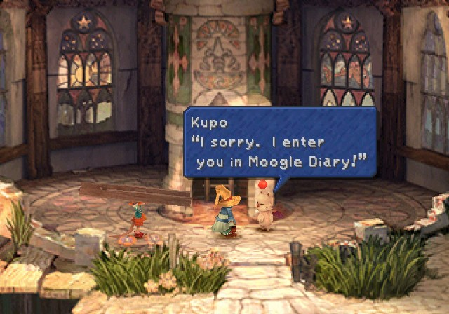
Writing the Report

Slide 4
Writing the report
15 Pages A4 maximum
  Do not write 15 pages of text
  That’s to give space for illustrations / screenshots / graphs / diagrams
  Screenshots to illustrate, for example:
    The game
    The AI in the game
    Specific behaviours (series of screenshots/overlaid diagram)
    Specific contexts/levels/scenerios (e.g. “it glitches on certain kinds of level geometry”)
    Test scenarios
    Examples of content generated
    Editing/content creation tools (if any). How it looks in the Unity inspector.

Slide 5
Writing the report
Part 1.1 Introduction (20%)
  Clear explanation of the game that was selected (25%)
  Clear description of the intended behaviour of the AI system (25%)
  Clear explanation of the techniques selected for use in developing the AI system for this game (25%)
  Justifiable description of why these techniques were selected (25%)

Slide 6
Writing the report
Clear explanation of the game that was selected
  You’re designing an AI system for a game
    What is the game (intended to be) like?
    It’s fine if you haven’t implemented everything!
  This will let you talk about your AI in context
    Lets you justify your decisions for your game
    What AI is appropriate depends on the game

Slide 7
Writing the report
Clear description of the intended behaviour of the AI system
  The goals you have for your AI System
    These should relate to the game
    It’s fine not to achieve them all!
  Think about
    What would the e.g. agents do? (Anything it should avoid doing?)
    How would this impact the game and the player?
    Does your game put any special requirements on the AI?
      performs well (mobile?)
      is customisable/reusable (lots of content creation?)
      is controllable (authorial intent?)
      is unpredictable (replay value?)

Slide 8
Writing the report
Clear explanation of the techniques selected for use in developing the AI system for this game
  What techniques did you use?
    Introduce them in general terms (save implementation details for later)
    Show that you understand the principles/theory involved
  Think of this a bit like a Literature Review - introduce us to the concepts we will need to understand what you have done or the decisions you’ve made
    Refer back to this when talking about implementation and design decisions

Slide 9
Writing the report
Justifiable description of why these techniques were selected
  Why did you use these techniques?
    Why were these suitable for achiving your goals?
    Make sure to contextualise it in your (intended) game
  Were there any other factors influencing their selection?
    Implementation time/effort? (What is it about these techniques that makes them easier to implement?)
    Technical/library/game engine limitations?
    Build requirements? (available compute to train)
    Runtime requirements? (memory/CPU footprint)

Slide 10
Writing the report
Part 1.2 Implementation Report (40%)
  Clear description of the AI system architecture using the terminology taught during the course (30%)
  Clear justification of major design decisions taken during the development of the AI system with reference to the desired behaviour, game experience feasability of implemetation, and runtime requirements of the system (30%)
  Clear evidence of significant and complex artificial intelligence coding and development work (40%)

Slide 11
Writing the report
Clear description of the AI system architecture using the terminology taught during the course
  Imagine you’ve hired a programmer. Explain everything they need to know to keep developing your AI
    Describe the implementation of techniques introduced earlier
    This will be technical
    Use technical terminology (states, response curves, fitness landscapes, classes, interfaces, delegates, …)
    Use diagrams/flowcharts/tables - a picture is worth 1000 words
  Show you understand any third-party AI (e.g. Unity NavMeshAgent), but don’t claim credit
  Describe the game code to the extent that it’s relevant to the AI
    How does the AI get it’s data?
    What behaviours are there? How do they work?

Slide 12
Writing the report
Clear justification of major design decisions taken during the development of the AI system with reference to the desired behaviour, game experience feasability of implemetation, and runtime requirements of the system
  This implementation was the result of your decisions - what were they and why did you make them?
    Was technique X not working? (Why?)
    Did changing to Y improve something (What?)
    Did your timeline change? (How? How did your implementation plan change?)
    Did you compare A and B in some metric? (What? Why? Which was better?)
  Here you can technically justify your implementation
    Was X the most performant implementation?
    Did Y minimise garbage collection / draw calls / cache misses?
    Was Z done to follow best coding practices / achieve modular AI?

Slide 13
Writing the report
Clear evidence of significant and complex artificial intelligence coding and development work
  Do something technically sophisticated
  Describe it in a way that shows off its technical sophistication
    I’m going to assume you’ve told me everything worth marks in the report
      Make sure I don’t overlook something
      I won’t go digging through your code to find it - it must be evidenced!
  Use UML diagrams/code snippets/psuedocode to describe your code

Slide 14
Writing the report
Part 1.3 Discussion (40%)
  Clear understanding how the selected techniques and the implemetation effected the behaviour of the system and a judgment of how successful this is at achieving the desired behaviour and/or desired game experience (50%)
  Clear understanding of how the approach taken influenced the feasibility of implementation and the runtime requirements of the system (25%)
  Clear understanding of alternative approaches that could be taken to solving the same problem and discussion of the pros and cons of these techniques (25%)

Slide 15
Writing the report
Clear understanding how the selected techniques and the implemetation effected the behaviour of the system and a judgment of how successful this is at achieving the desired behaviour and/or desired game experience
  Describe how what you’ve implemented actually works
    Clearly and objectively describe behaviour
    Consider different contexts (e.g many/few opponents; levels size; level geometry) particularly those relevant to your game (intention)
    Give examples/screenshots/diagrams
  Evaluate it
    Call back to your goals
    Be honest - your might have tried something that failed, that’s okay.
  Quantify, if possible, in ways meaningful to your goals
    Win rate? FPS? Average play time? Performance on mobile? User feedback?

Slide 16
Writing the report
Clear understanding of how the approach taken influenced the feasibility of implementation and the runtime requirements of the system
  A chance to talk about practicalities
    Did it take longer to develop than you expected? Why?
    Was the goal too big/small? Was the approach taken suited to implementing this within the time constraints?
    Was it more resource-intensive than hoped? Why?
    Did it take too long to train?
    Did the game engine/programming language make your approach/technique more difficult? (e.g. was Unity suited to the style of game/AI?)

Slide 17
Writing the report
Clear understanding of alternative approaches that could be taken to solving the same problem and discussion of the pros and cons of these techniques
  You should have already discusssed specific technical decisions (e.g. why A* instead of BFS). The section should have a broader perspective.
  Look further afield, show you understand the wider AI landscape
    Could Machine Learning (e.g. neural networks) have been used?
    What about whole-game search?
    Could heriarchical state machines / utility AI / behaviour trees have been used instead?
    Could content have been hand authored instead of generated or vice versa?
    Could automated game testing have been used?
    Could evolutionary algorithms have been used?
  Give me an idea of how these could potentially be used. Give pros and cons.

Slide 18
Writing the report
Playable Build (Potential Mark Adjustment)
  Your submission should include a playable game with your AI system included.
    If the game is not submitted – or cannot be run with reasonable effort – then your mark will be adjusted.
    Remember the CD/102 computers are not very powerful, and they run Linux
    I run Linux too, build for Linux
  Instructions to run and play in README.md

Slide 19
The Git Repository

Slide 20
Git Repository
Git is a form of source control

Slide 21
Git Repository
Git repository
  Root of repository will usually be root directory of Unity/Unreal project
  You can use graphical or command line tools with git
    The instructions here are command line

Slide 22
Git Repository
Basic setup: In root directory of project, run:
  git init (create a new repository)
  git branch -m main (rename branch from master to main)
  git add . (stage all files for commit)
  git status (show what files are staged for commit)
  commit -m “Initial commit” (commit staged files)

Slide 23
Git Repository
Create new remote repository on e.g. Git Lab
Get local repository to track remote repository
  git remote add origin <project url> (give a url for a remote called ‘origin’)
Push your commits
  git push --set-upstream origin main (push your commits to origin on branch main)

Slide 24
Git Repository
Alternatively, create a repository on e.g. GitLab
  git clone <project url>
Copy your files into the newly created folder
  git add .
  git status
  git push
Check on e.g. GitLab that the files are there

Slide 25
Git Repository
In your git repository you need three things
  Source code (repository will be root of project)
  README.md
  LICENSE.md
  Your report document (PDF preferred)

Slide 26
Git Repository
Source Code
  All the source and assets I need to build the playable build you submitted
  Exclude unnecessary files (e.g. cached files) with a .gitignore

Slide 27
Git Repository
README.md
  Often the first file someone encounters
  Gives a detailed description of your project
  Documentation how to use it
    How to get it
    How to run it
    How to develop it

Slide 28
Git Repository
Project Title
  A descriptive name, or the name of the game
Description
  What it does
  What core technologies it uses
  What key challenges does it solve
  Important areas where it is incomplete

Slide 29
Git Repository
How to install and run the project
  Software and hardware dependances
  Steps required to build / install / run the project
  Assume a technically competent reader
    Standard tools don’t need to be described
      “Navigate to the root of the repository and run `npm install`”
    Console commands are fine
    Anything that can be easily found by a web search

Slide 30
Git Repository
How to use the project
  Brief introductory information to how to use the project, e.g.
    Necessary initial configuration required
    Game controls
    Description of game goal, rules, if not obvious
  Assume a technically competent user
    This is not the place for detailed instructions about specific tasks – use a tutorial or in-depth documentation for that

Slide 31
Git Repository
How to develop the project
  Information about how to continue development
    Any development dependencies
      Software I need to compile from source
      e.g. Unity
    How to compile
    How to contribute (if open source)
    How to run tests

Slide 32
Git Repository
Credits
  If you’ve included third-party code or tools under license
  Assets with a creative commons attribution license
  If you’ve adapted an existing project

Slide 33
Git Repository
After reading your README.md I should be able to build and run your game and be able to understand how to play
Keep it brief and to the point
  It’s not your job to teach anything
  You’re making the steps unambiguous for a technically competent user
Use Markdown (https://www.markdownguide.org/basic-syntax/)
  A standard way of formatting plain text files

Slide 34
Git Repository
LICENSE.md
  What are people allowed to do with your code?
  Use a standard software license or copyright statement
e.g. “Copyright (c) 2022 Joe Blogs”
  https://github.com/licenses/license-templates/tree/master/templates
Copyright (c) {{ year }} {{ organization }}
Permission is hereby granted, free of charge, to any person obtaining a copy
of this software and associated documentation files (the "Software"), to deal
in the Software without restriction, including without limitation the rights
to use, copy, modify, merge, publish, distribute, sublicense, and/or sell
copies of the Software, and to permit persons to whom the Software is
furnished to do so, subject to the following conditions:
The above copyright notice and this permission notice shall be included in all
copies or substantial portions of the Software.
THE SOFTWARE IS PROVIDED "AS IS", WITHOUT WARRANTY OF ANY KIND,
EXPRESS OR IMPLIED, INCLUDING BUT NOT LIMITED TO THE WARRANTIES OF
MERCHANTABILITY, FITNESS FOR A PARTICULAR PURPOSE AND NONINFRINGEMENT.
IN NO EVENT SHALL THE AUTHORS OR COPYRIGHT HOLDERS BE LIABLE FOR ANY CLAIM,
DAMAGES OR OTHER LIABILITY, WHETHER IN AN ACTION OF CONTRACT, TORT OR
OTHERWISE, ARISING FROM, OUT OF OR IN CONNECTION WITH THE SOFTWARE OR THE USE
OR OTHER DEALINGS IN THE SOFTWARE.

Slide 35
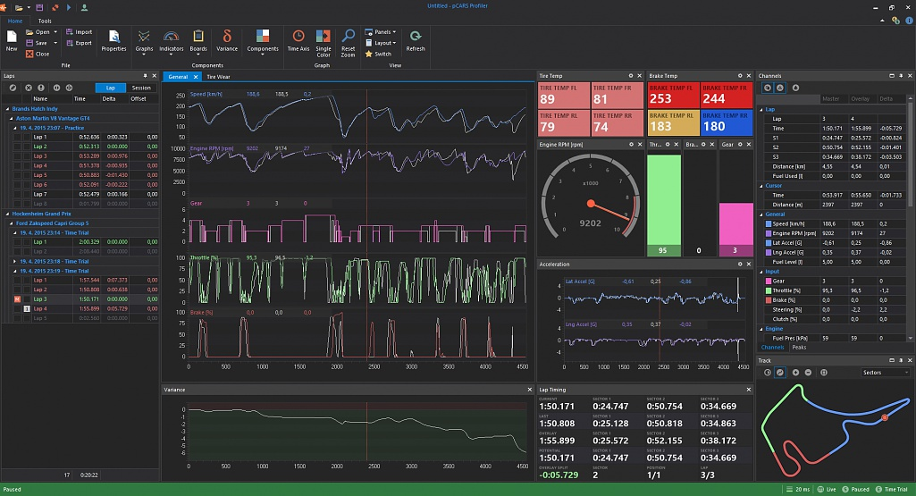
Performance and Measurement

Slide 36
Performance and Measurement
Measurement
  Time.realtimeSinceStartup()
  FPS Counter

Slide 37
Performance and Measurement
Profiling Performance
  Unity Profiler

