Slide 1
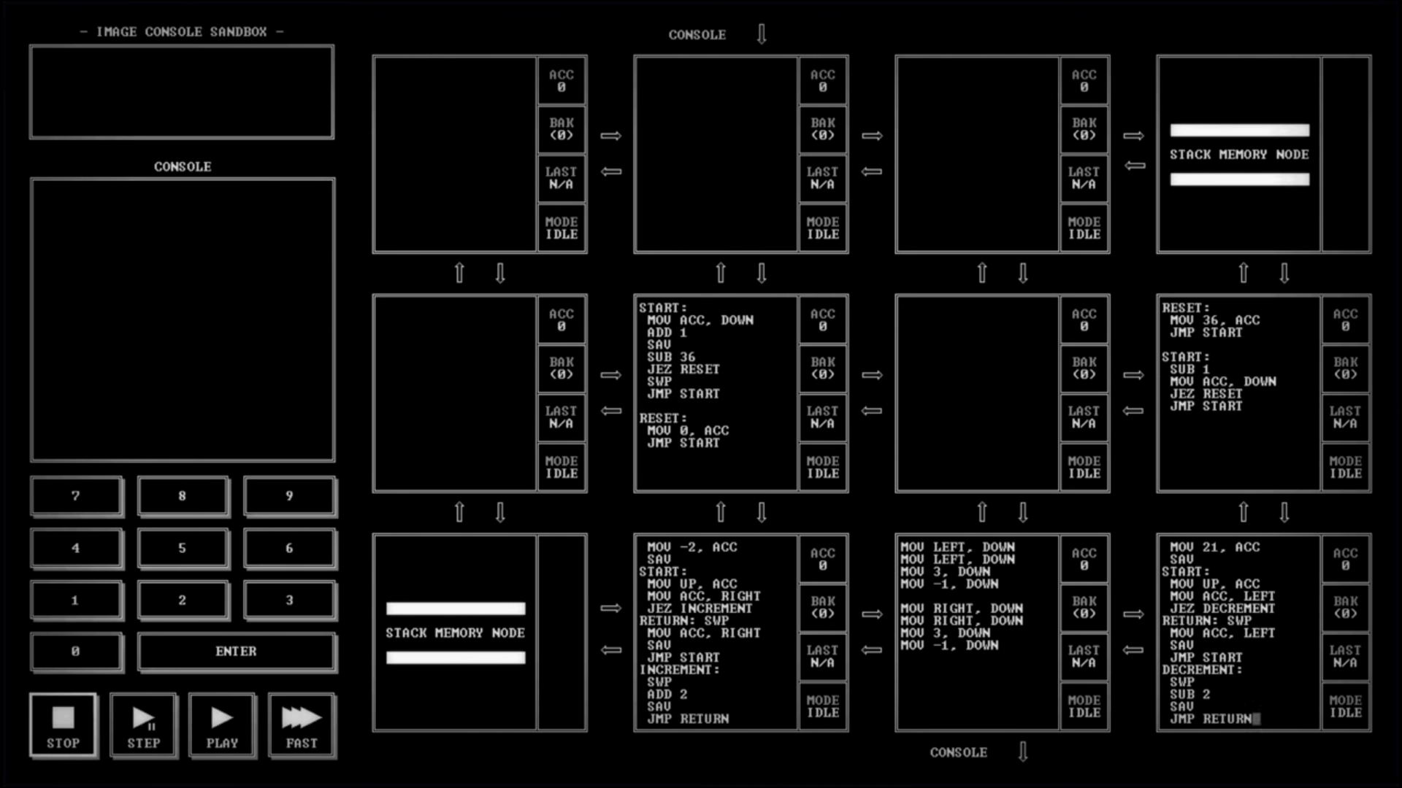
Games AI
Lecture 10.2
Git

Slide 2
Overview
Overview
  Why Git
  Git Concepts
    Commits and Branches
    Working with remotes
  Basic tasks in git

Slide 3

Why Git

Slide 4

Git Repository
You have a project folder on your computer

Slide 5
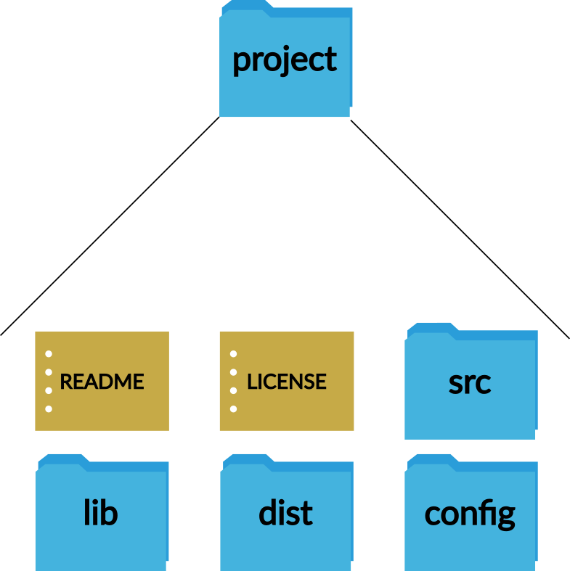
Git Repository
Inside are the files for your project
  Source code
  Libraries
  Built code
  Configuration files
  Assets

Slide 6
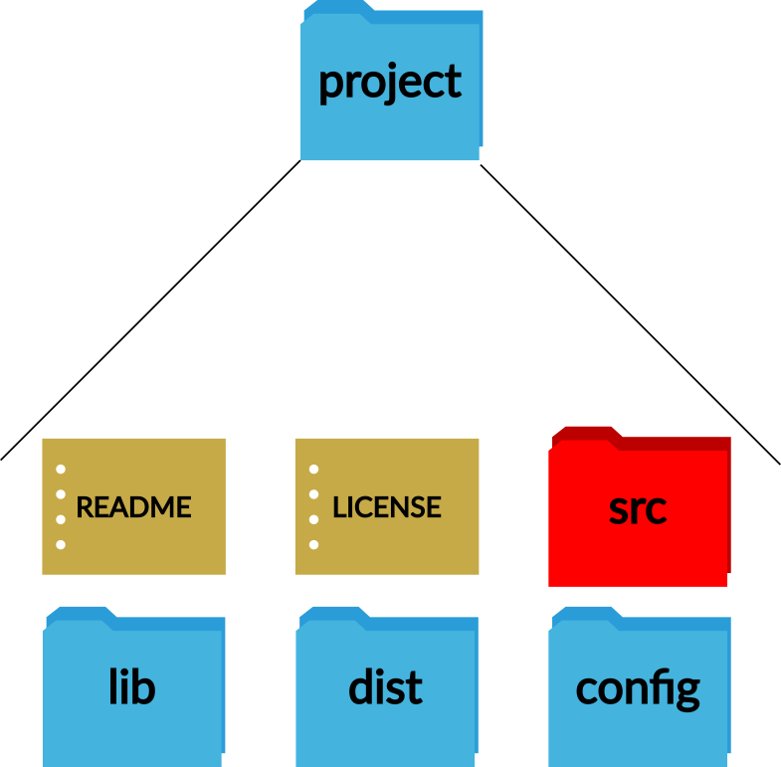
Git Repository
What happens if
  You delete a file?

Slide 7
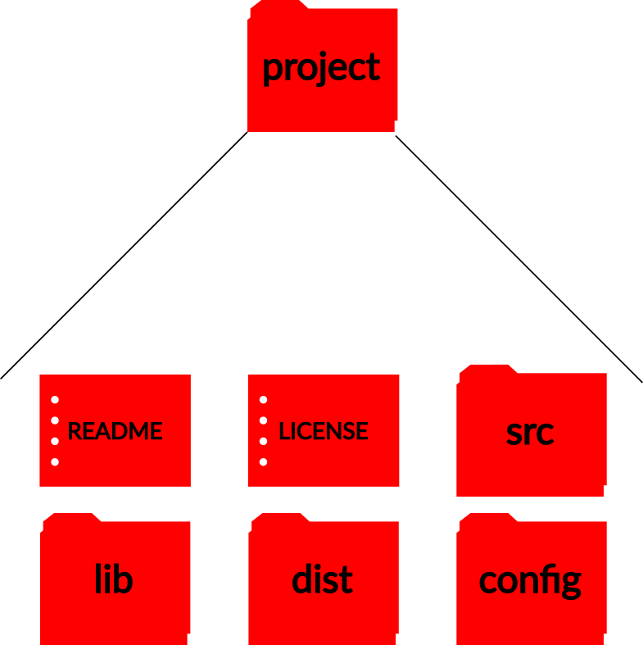
Git Repository
What happens if
  You delete a file?
  You delete the whole folder?

Slide 8
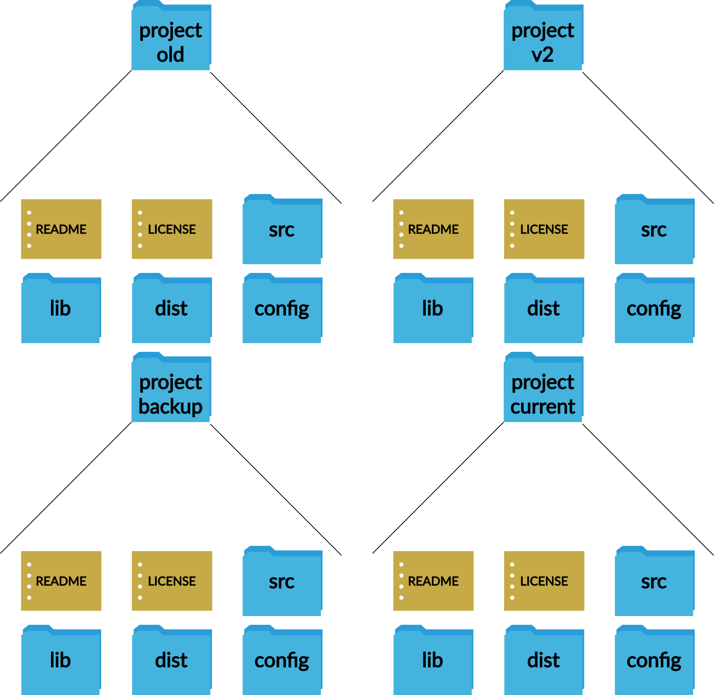
Git Repository
What happens if
  You delete a file?
  You delete the whole folder?
  You backup the folder?

Slide 9
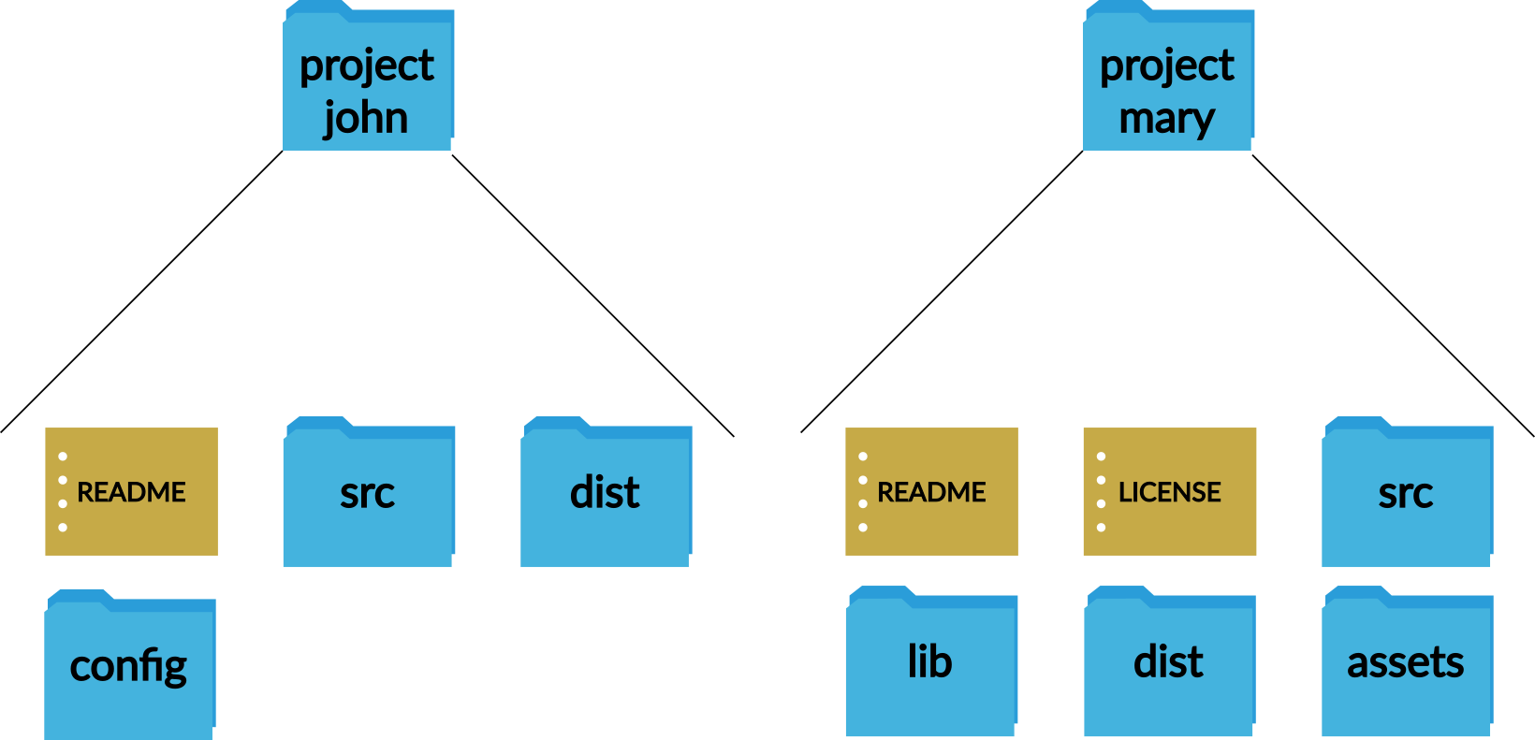
Git Repository
What happens if
  You delete a file?
  You delete the whole folder?
  You backup the folder?
  A team works on the same project?

Slide 10
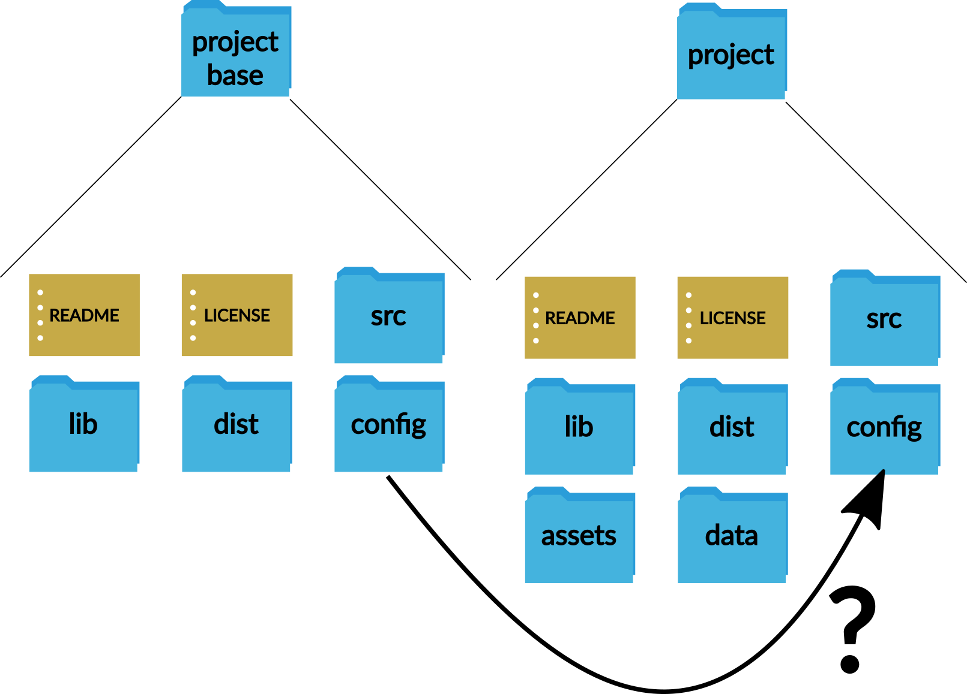
Git Repository
What happens if
  You delete a file?
  You delete the whole folder?
  You backup the folder?
  A team works on the same project?
  You adapt a template project but want to apply updates?

Slide 11

Git Repository
What happens if
  You want to backup a team project that adapts an existing project, and then incorporate updates to the base project while simultaneously developing new features

Slide 12
Git Repository
What happens if
  You want to backup a team project that adapts an existing project, and then incorporate updates to the base project while simultaneously developing new features
  AND have a central server that regularly runs tests on everyone’s contributions

Slide 13
Git Repository
What happens if
  You want to backup a team project that adapts an existing project, and then incorporate updates to the base project while simultaneously developing new features
  AND have a central server that regularly runs tests on everyone’s contributions
  AND automatically build and deploy a new version of your product every time the main version is updated

Slide 14
Git Repository
What happens if
  You want to backup a team project that adapts an existing project, and then incorporate updates to the base project while simultaneously developing new features
  AND have a central server that regularly runs tests on everyone’s contributions
  AND automatically build and deploy a new version of your product every time the main version is updated
  AND then split your project into multiple libraries that can be reused across multiple projects while keeping them updated and automatically running tests and automatically publishing them

Slide 15
Git Repository
What happens if
  You want to backup a team project that adapts an existing project, and then incorporate updates to the base project while simultaneously developing new features
  AND have a central server that regularly runs tests on everyone’s contributions
  AND automatically build and deploy a new version of your product every time the main version is updated
  AND then split your project into multiple libraries that can be reused across multiple projects while keeping them updated and automatically running tests and automatically publishing them
And do all this with freely available tools and services

Slide 16
Git Repository
What happens if
  You want to backup a team project that adapts an existing project, and then incorporate updates to the base project while simultaneously developing new features
  AND have a central server that regularly runs tests on everyone’s contributions
  AND automatically build and deploy a new version of your product every time the main version is updated
  AND then split your project into multiple libraries that can be reused across multiple projects while keeping them updated and automatically running tests and automatically publishing them
You use git to
  create a remote repository which each team member clones

Slide 17
Git Repository
What happens if
  You want to backup a team project that adapts an existing project, and then incorporate updates to the base project while simultaneously developing new features
  AND have a central server that regularly runs tests on everyone’s contributions
  AND automatically build and deploy a new version of your product every time the main version is updated
  AND then split your project into multiple libraries that can be reused across multiple projects while keeping them updated and automatically running tests and automatically publishing them
You use git to
  create a remote repository which each team member clones
  which forks another repository

Slide 18
Git Repository
What happens if
  You want to backup a team project that adapts an existing project, and then incorporate updates to the base project while simultaneously developing new features
  AND have a central server that regularly runs tests on everyone’s contributions
  AND automatically build and deploy a new version of your product every time the main version is updated
  AND then split your project into multiple libraries that can be reused across multiple projects while keeping them updated and automatically running tests and automatically publishing them
You use git to
  create a remote repository which each team member clones
  which forks another repository
  that you keep as a remote and merge changes from

Slide 19
Git Repository
What happens if
  You want to backup a team project that adapts an existing project, and then incorporate updates to the base project while simultaneously developing new features
  AND have a central server that regularly runs tests on everyone’s contributions
  AND automatically build and deploy a new version of your product every time the main version is updated
  AND then split your project into multiple libraries that can be reused across multiple projects while keeping them updated and automatically running tests and automatically publishing them
You use git to
  create a remote repository which each team member clones
  which forks another repository
  that you keep as a remote and merge changes from
  Your repository has multiple branches

Slide 20
Git Repository
What happens if
  You want to backup a team project that adapts an existing project, and then incorporate updates to the base project while simultaneously developing new features
  AND have a central server that regularly runs tests on everyone’s contributions
  AND automatically build and deploy a new version of your product every time the main version is updated
  AND then split your project into multiple libraries that can be reused across multiple projects while keeping them updated and automatically running tests and automatically publishing them
You use git to
  create a remote repository which each team member clones
  which forks another repository
  that you keep as a remote and merge changes from
  Your repository has multiple branches
  You add a Continuous Integration tool to your git server that automatically builds and tests the code on push

Slide 21
Git Repository
What happens if
  You want to backup a team project that adapts an existing project, and then incorporate updates to the base project while simultaneously developing new features
  AND have a central server that regularly runs tests on everyone’s contributions
  AND automatically build and deploy a new version of your product every time the main version is updated
  AND then split your project into multiple libraries that can be reused across multiple projects while keeping them updated and automatically running tests and automatically publishing them
You use git to
  create a remote repository which each team member clones
  which forks another repository
  that you keep as a remote and merge changes from
  Your repository has multiple branches
  You add a Continuous Integration tool to your git server that automatically builds and tests the code on push
  You get your CI tool fire a webhook to a service that builds and deploys your code

Slide 22
Git Repository
What happens if
  You want to backup a team project that adapts an existing project, and then incorporate updates to the base project while simultaneously developing new features
  AND have a central server that regularly runs tests on everyone’s contributions
  AND automatically build and deploy a new version of your product every time the main version is updated
  AND then split your project into multiple libraries that can be reused across multiple projects while keeping them updated and automatically running tests and automatically publishing them
You use git to
  create a remote repository which each team member clones
  which forks another repository
  that you keep as a remote and merge changes from
  Your repository has multiple branches
  You add a Continuous Integration tool to your git server that automatically builds and tests the code on push
  You get your CI tool fire a webhook to a service that builds and deploys your code
  You turn your libraries into submodules

Slide 23
Git Repository
What happens if
  You want to backup a team project that adapts an existing project, and then incorporate updates to the base project while simultaneously developing new features
  AND have a central server that regularly runs tests on everyone’s contributions
  AND automatically build and deploy a new version of your product every time the main version is updated
  AND then split your project into multiple libraries that can be reused across multiple projects while keeping them updated and automatically running tests and automatically publishing them
You use git to
  create a remote repository which each team member clones
  which forks another repository
  that you keep as a remote and merge changes from
  Your repository has multiple branches
  You add a Continuous Integration tool to your git server that automatically builds and tests the code on push
  You get your CI tool fire a webhook to a service that builds and deploys your code
  You turn your libraries into submodules
  That integrate with CI tools and automated publishing workflows

Slide 24
Workflow

Slide 25
Tasks in Git
Workflow is important
  Your time is important
  Your enthusiasm is important
Bad workflow leads to bad projects
  Poor code quality
  Cutting corners
  Slow updates
  Integration hell

Slide 26

Tasks in Git
Good workflows make development easier

Slide 27

Tasks in Git
Continuous Delivery

Slide 28

Git Concepts
  Commits and Branches

Slide 29
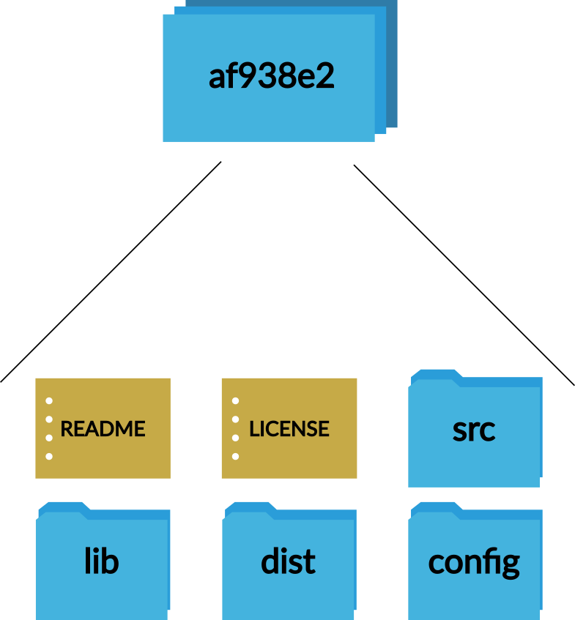
Git Concepts
Commit (noun)
  A snapshot of your project

Slide 30
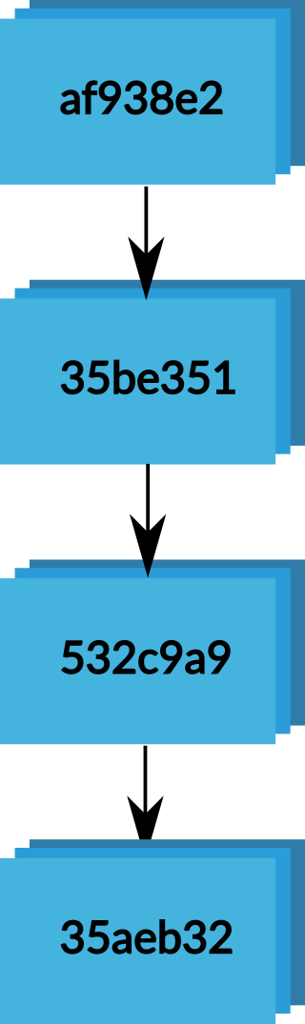
Git Concepts
Branch (noun)
  A sequence of commits
  Shows how your project has changed over time

Slide 31
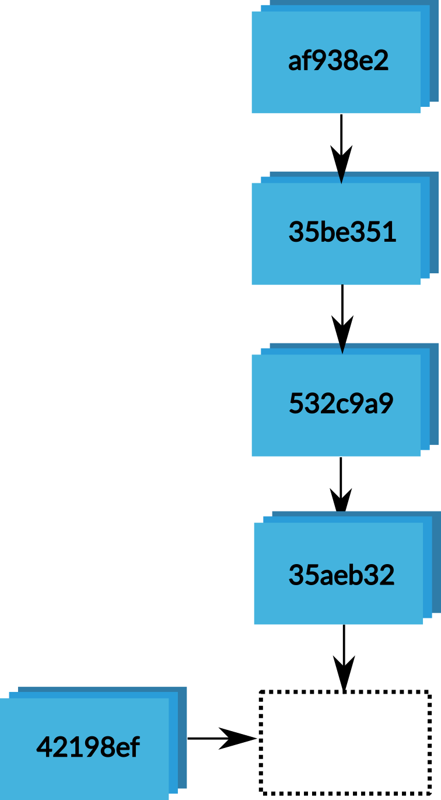
Git Concepts
Commit (verb)
  Take a snapshot of your project and add it onto the end of the current branch

Slide 32
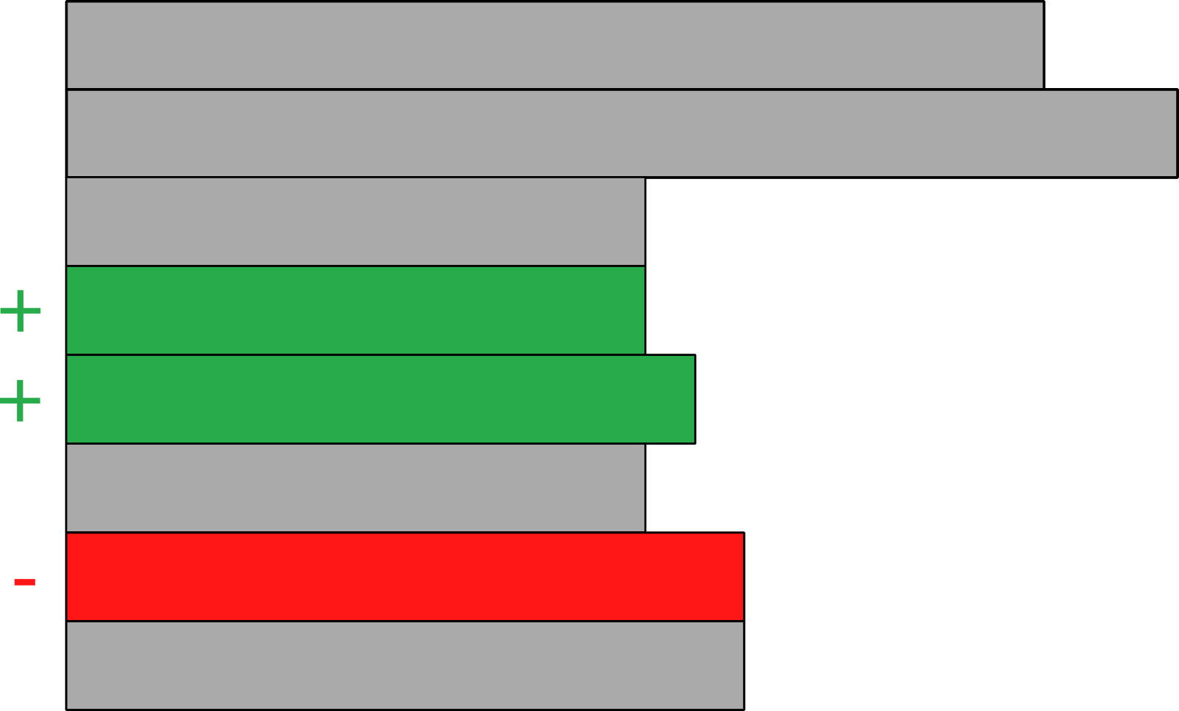
Git Concepts
Commits
  Commits are calculated line-by-line
  A commit stores just the changes that have been made since the last commit

Slide 33

Git Concepts
Simple workflow example
  Create a new repository and make an initial commit

Slide 34
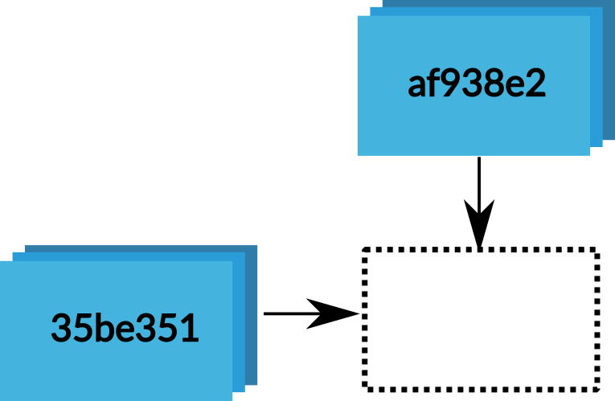
Git Concepts
Simple workflow example
  Create a new repository and make an initial commit
  Do some work, then commit it

Slide 35
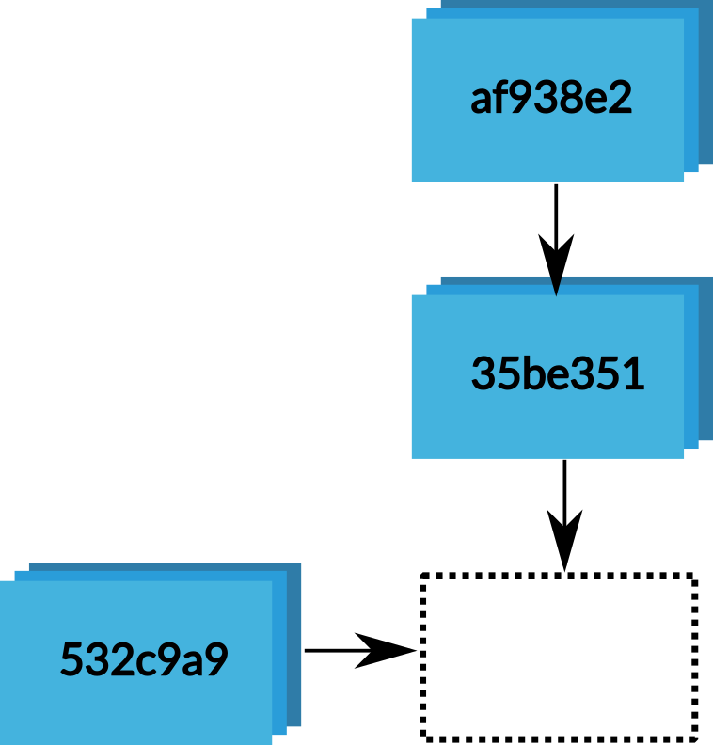
Git Concepts
Simple workflow example
  Create a new repository and make an initial commit
  Do some work, then commit it
  Do some more work, then commit it

Slide 36
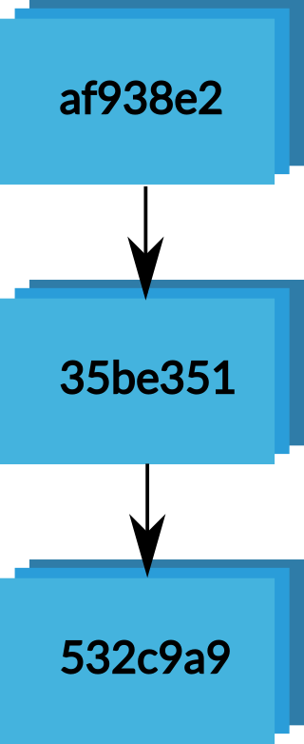
Git Concepts
Simple workflow example
  Now you’ve got a branch with
    The current state of your project
    All changes made to your project

Slide 37
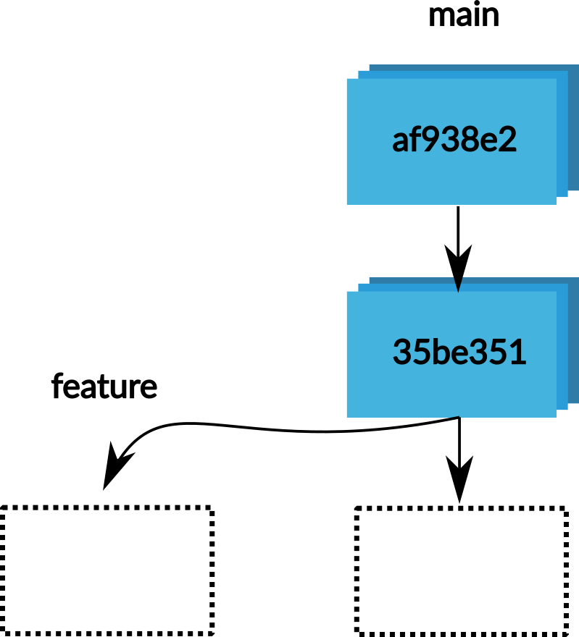
Git Concepts
Branch (verb)
  Take a branch and split a new one off it
  Now you’ve got two branches

Slide 38
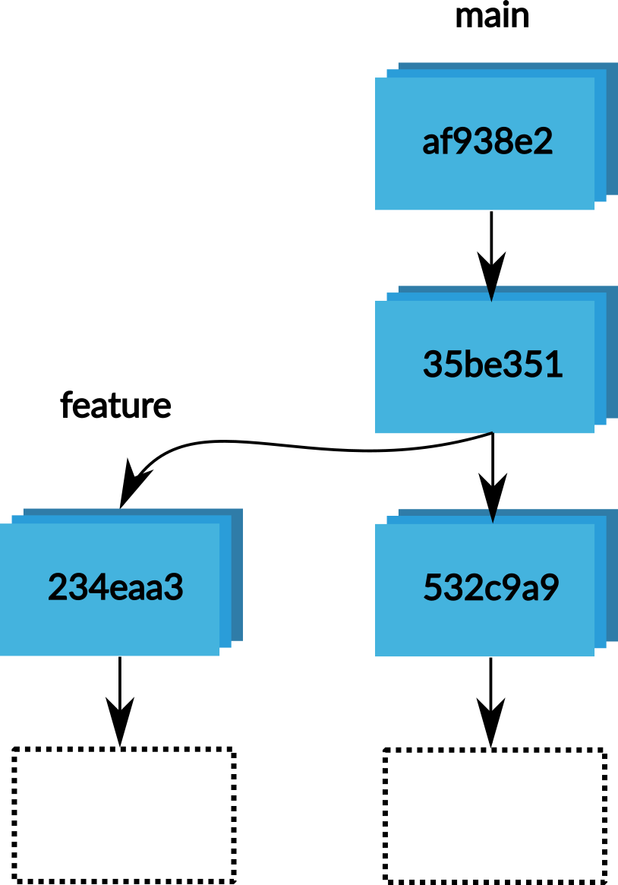
Git Concepts
Multiple branches
  You can add commits to each branch
  This gives you two different versions of your project

Slide 39
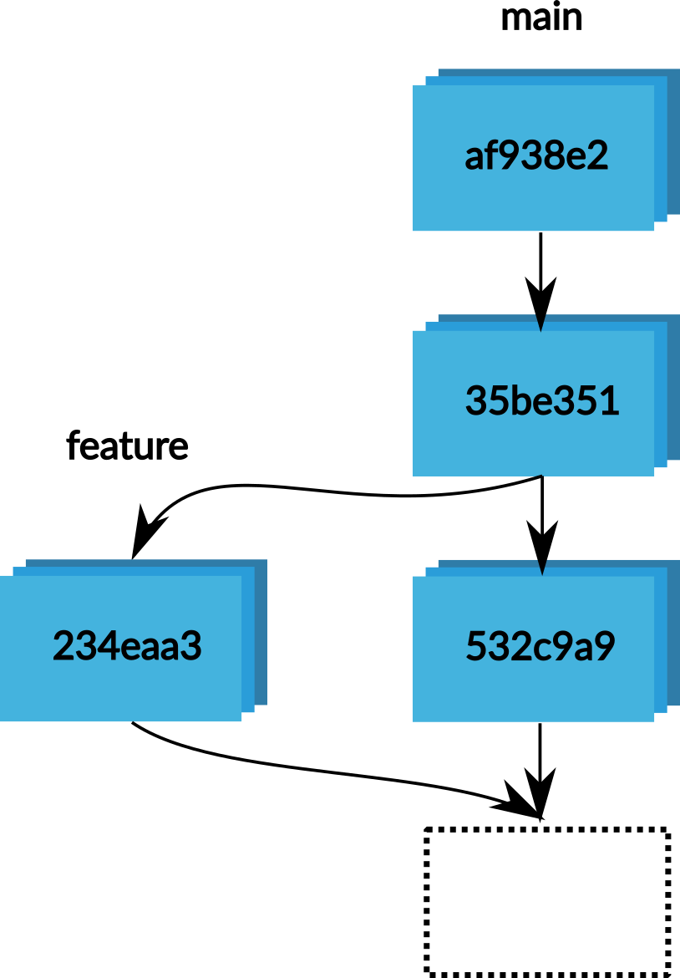
Git Concepts
Merge
  Combine the changes made in two branches

Slide 40
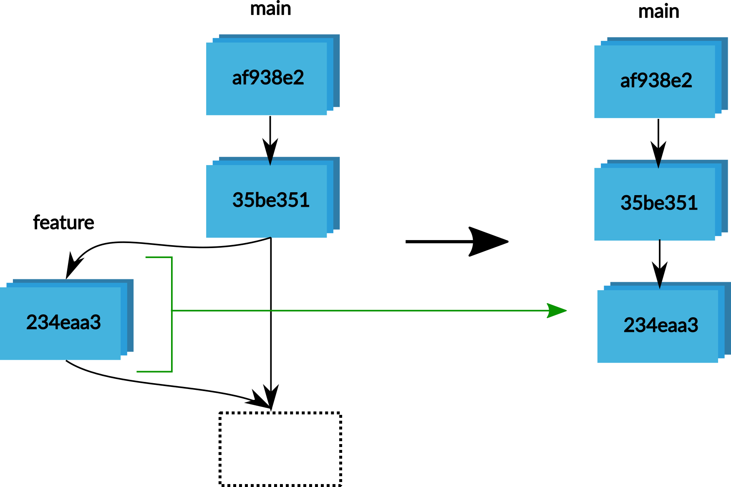
Git Concepts
Merge (Fast Forward)
  There are only commits on the branch to merge in
  These commits can be added on to the end of the main branch

Slide 41
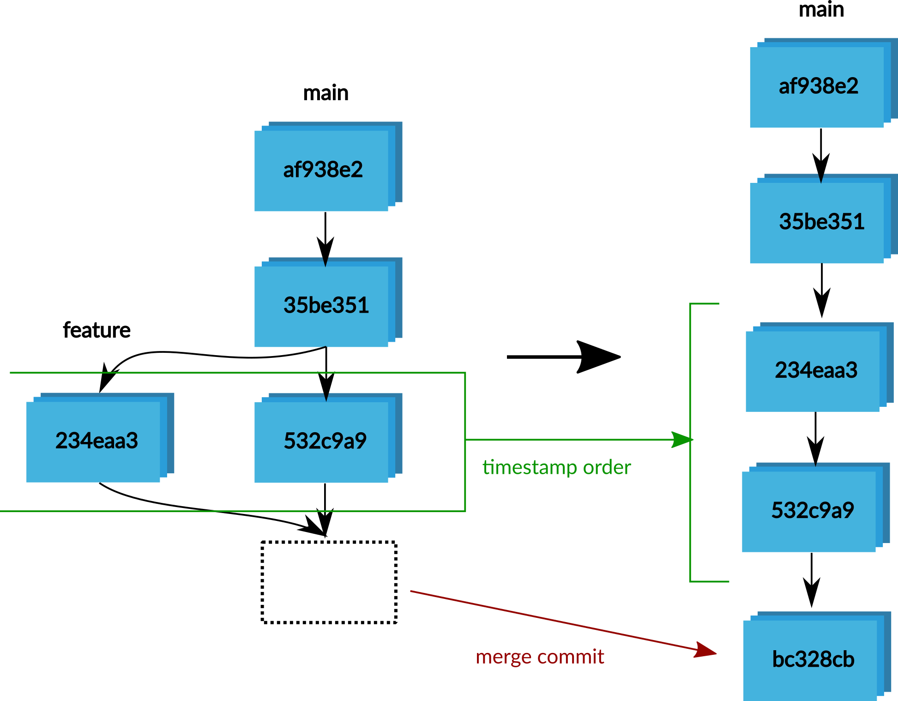
Git Concepts
Merge (Standard Merge)
  Adds commits in timestamp order
  Create a new commit for the merge

Slide 42
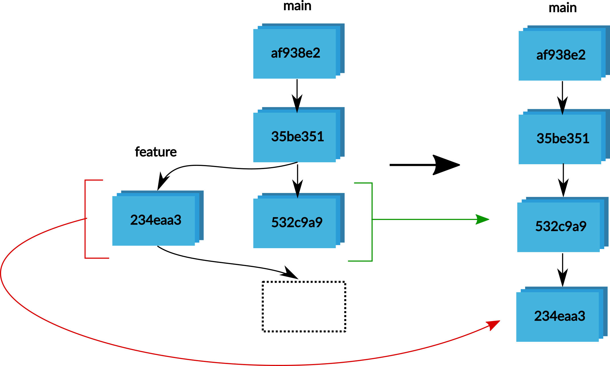
Git Concepts
Merge (Rebase)
  Replay the feature branch on top of the new commits on the main branch

Slide 43
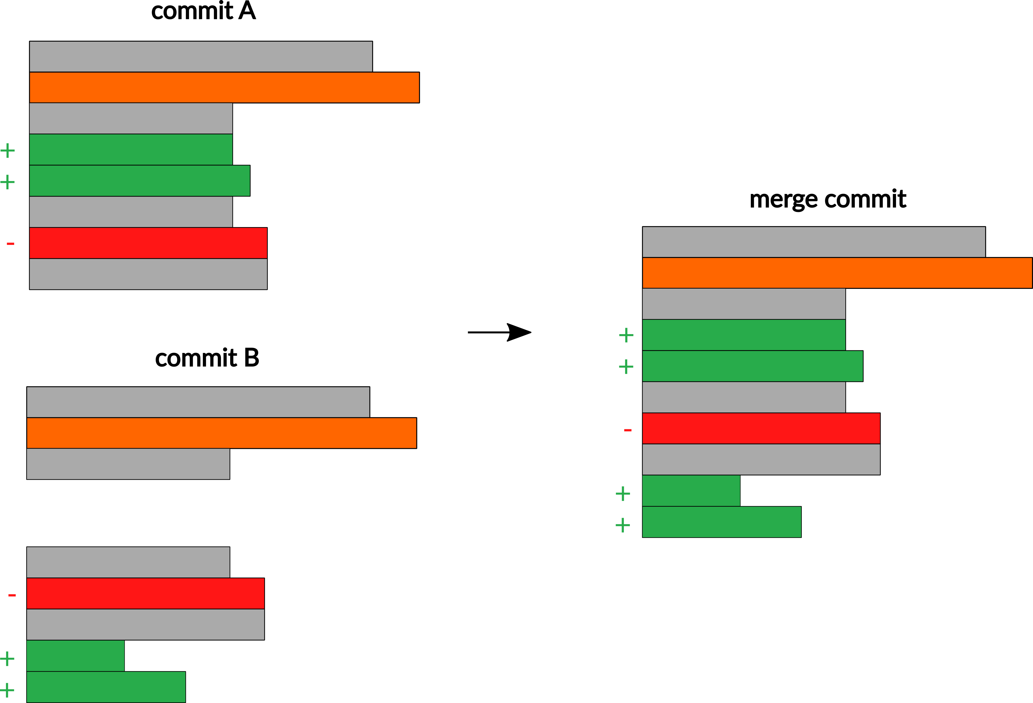
Git Concepts
Resolving a merge
  Git merges line-by-line
  If the branches change different lines everything resolves automatically

Slide 44
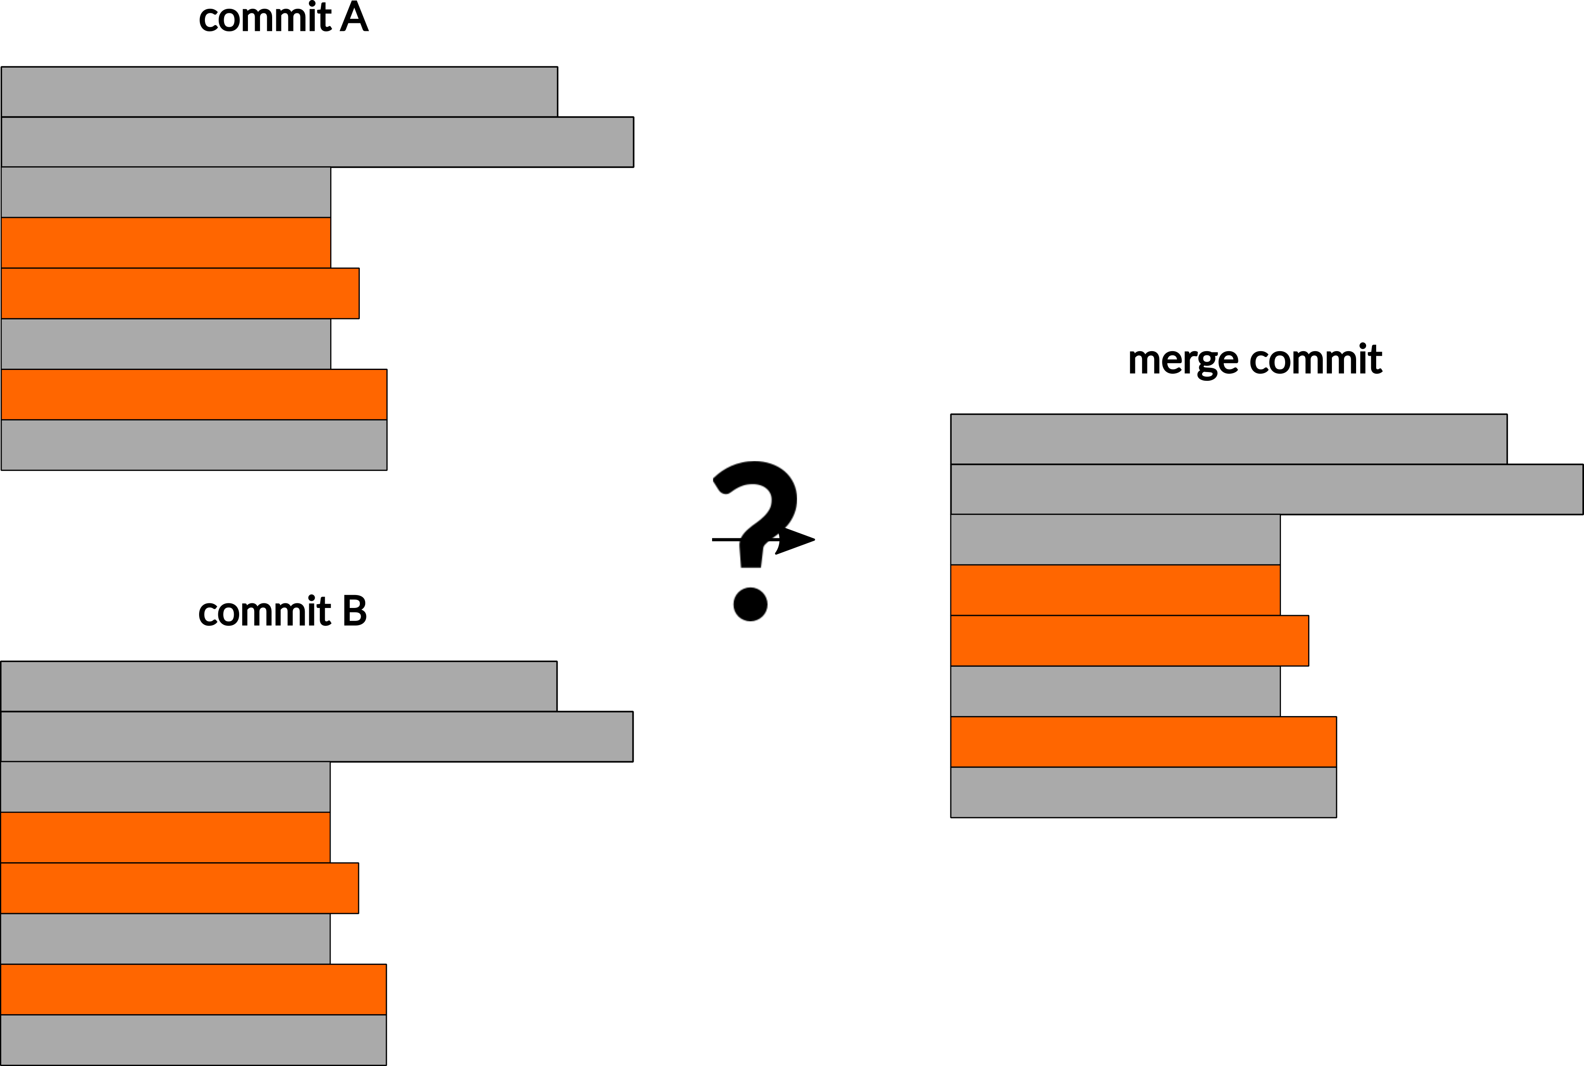
Git Concepts
Resolving a merge
  If both branches change the same line, you need to resolve the merge manually
  Git will edit the files with the options. You delete the appropriate section and commit the merge

Slide 45
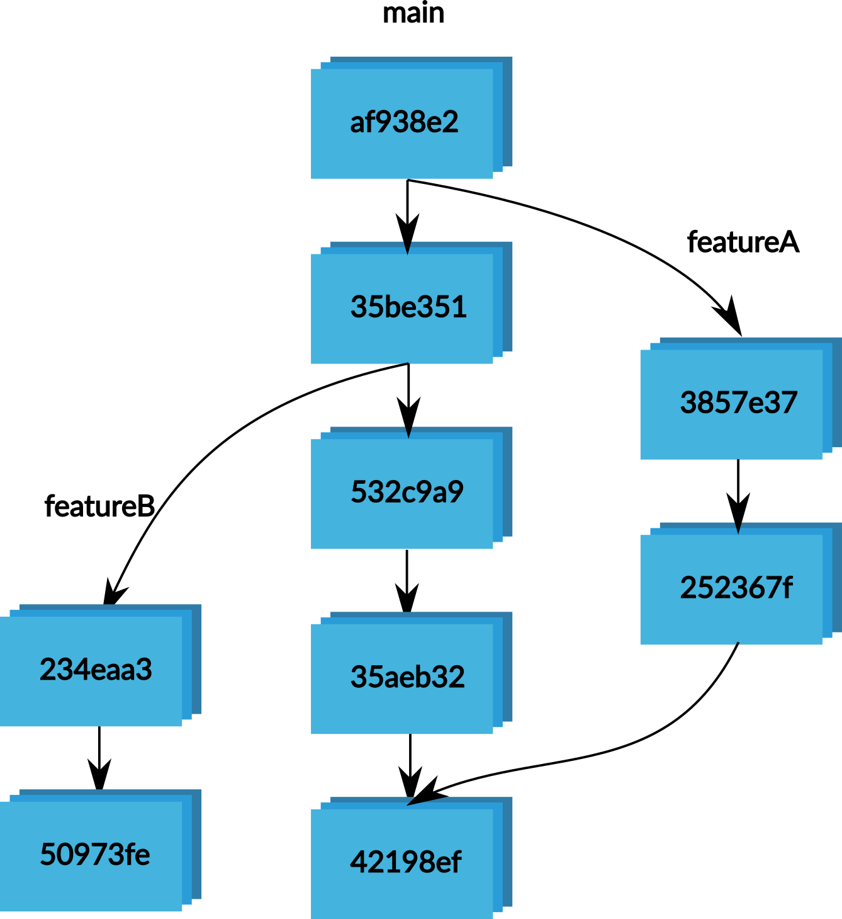
Git Concepts
Repository (noun)
  Everything git keeps track of for your project
  A collection of branches

Slide 46
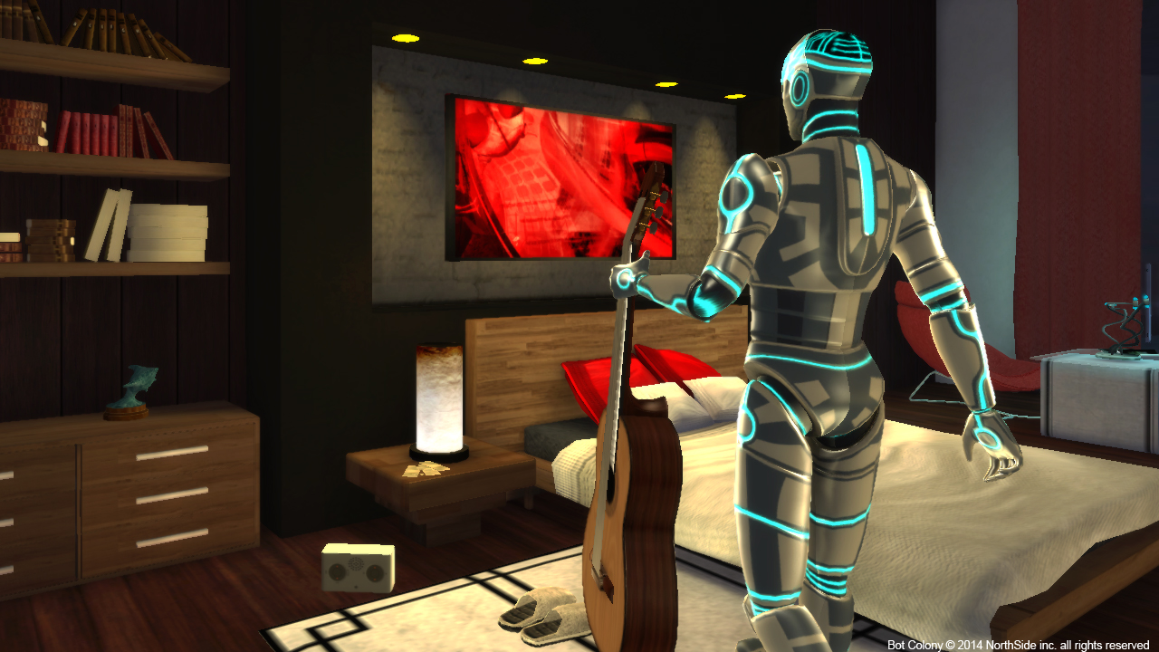
Git Concepts
  Working with remotes

Slide 47
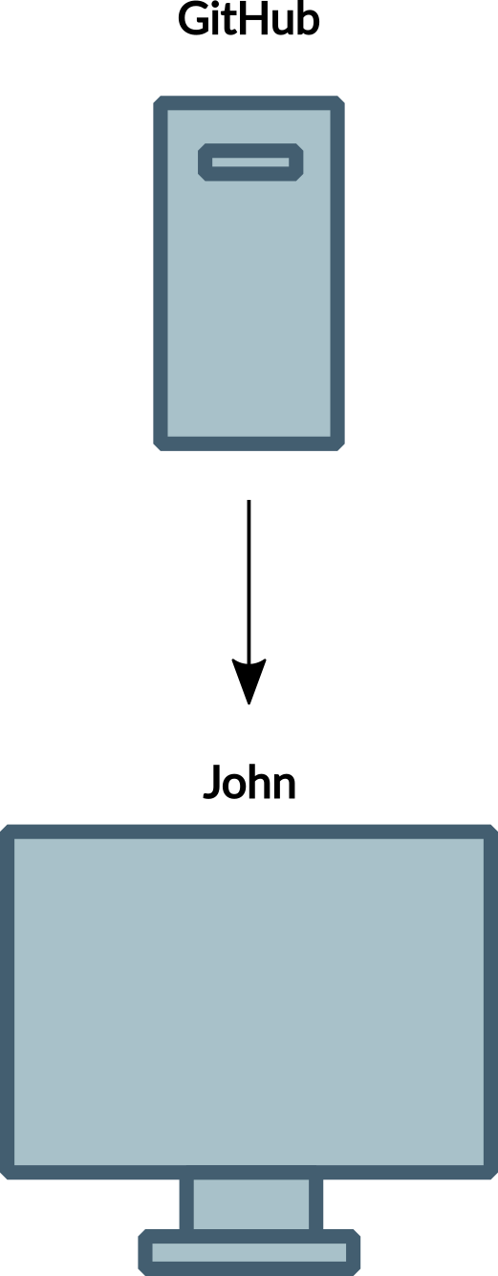
Git Concepts
Clone (verb)
  Make a copy of a repository held on a git server

Slide 48
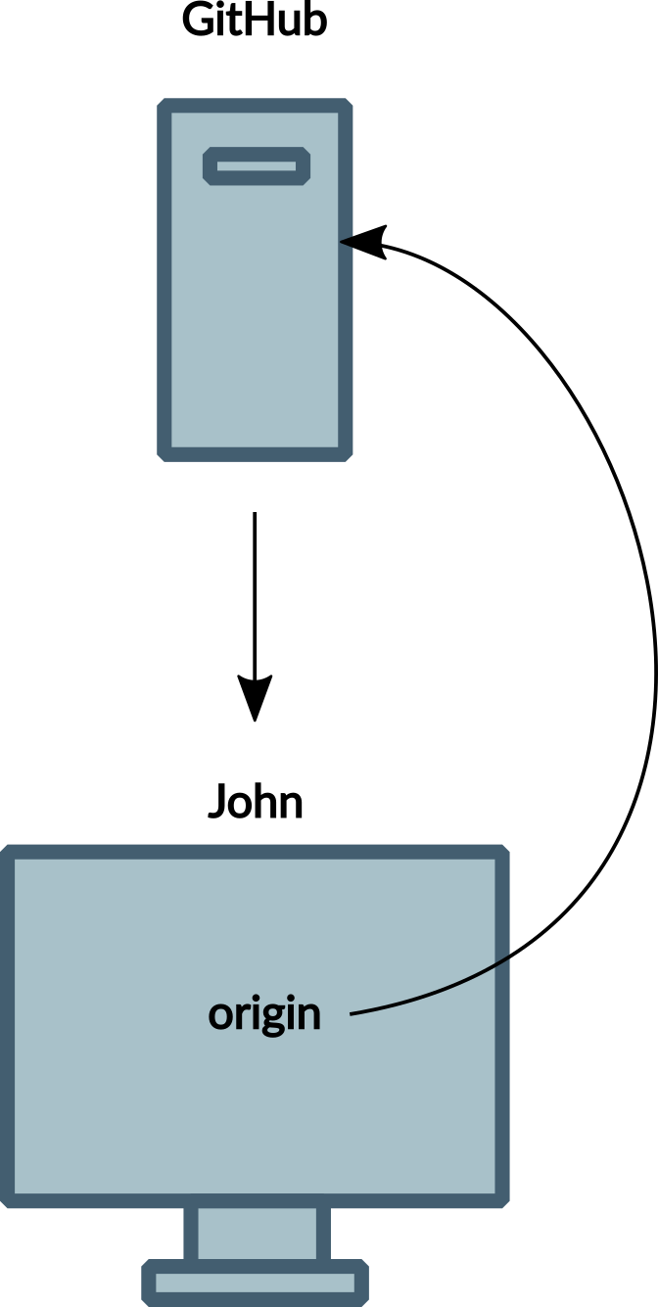
Git Concepts
Remote (noun)
  A reference in your git repo to a repository elsewhere
  When you clone a repo, it creates a remote called origin

Slide 49
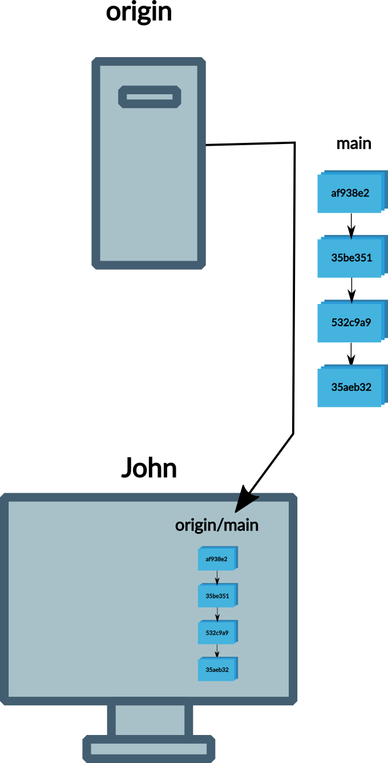
Git Concepts
Fetch (verb)
  Download commits made on a remote branch
  Fetching branch main from origin would put result in branch origin/main

Slide 50
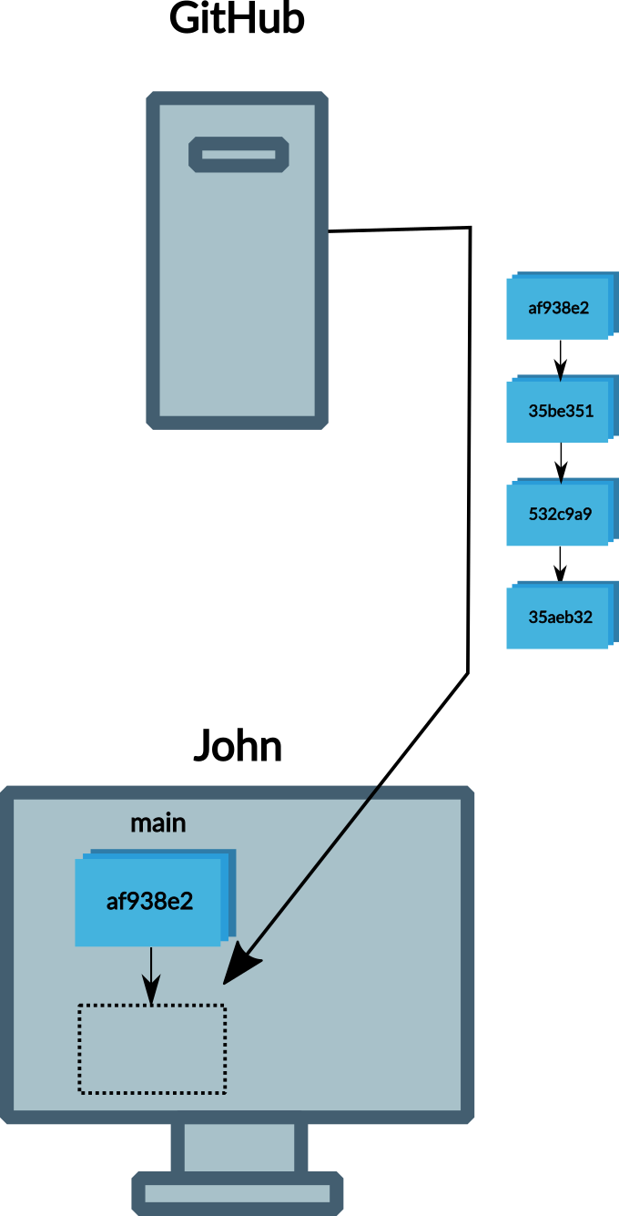
Git Concepts
Pull (verb)
  Fetch and merge commits made on a remote branch

Slide 51
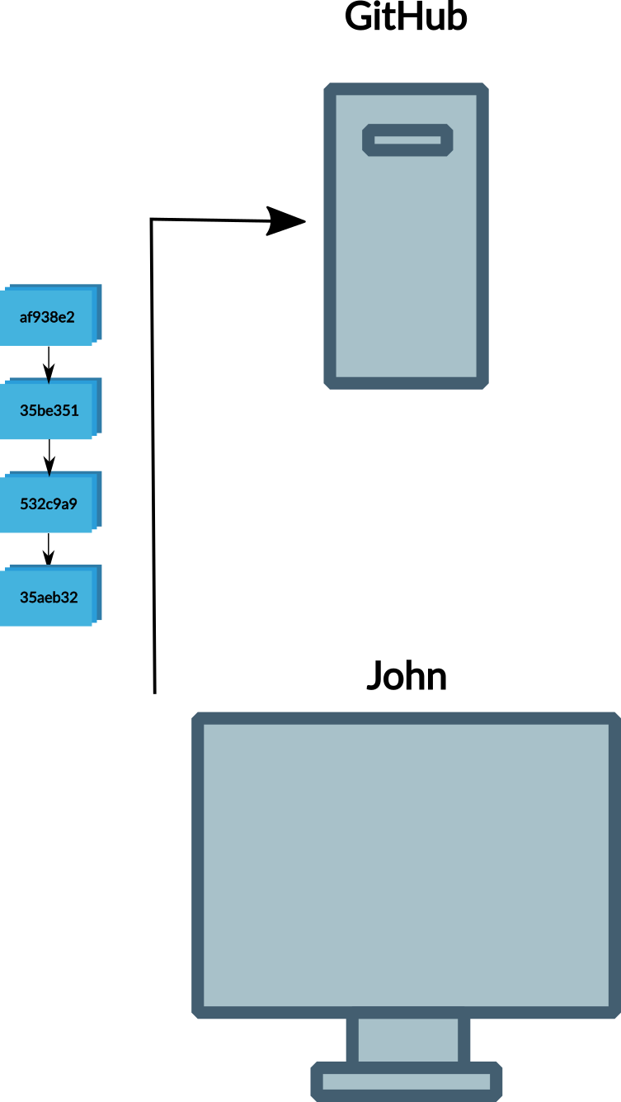
Git Concepts
Push (verb)
  Upload new commits in the local repository to a remote branch

Slide 52
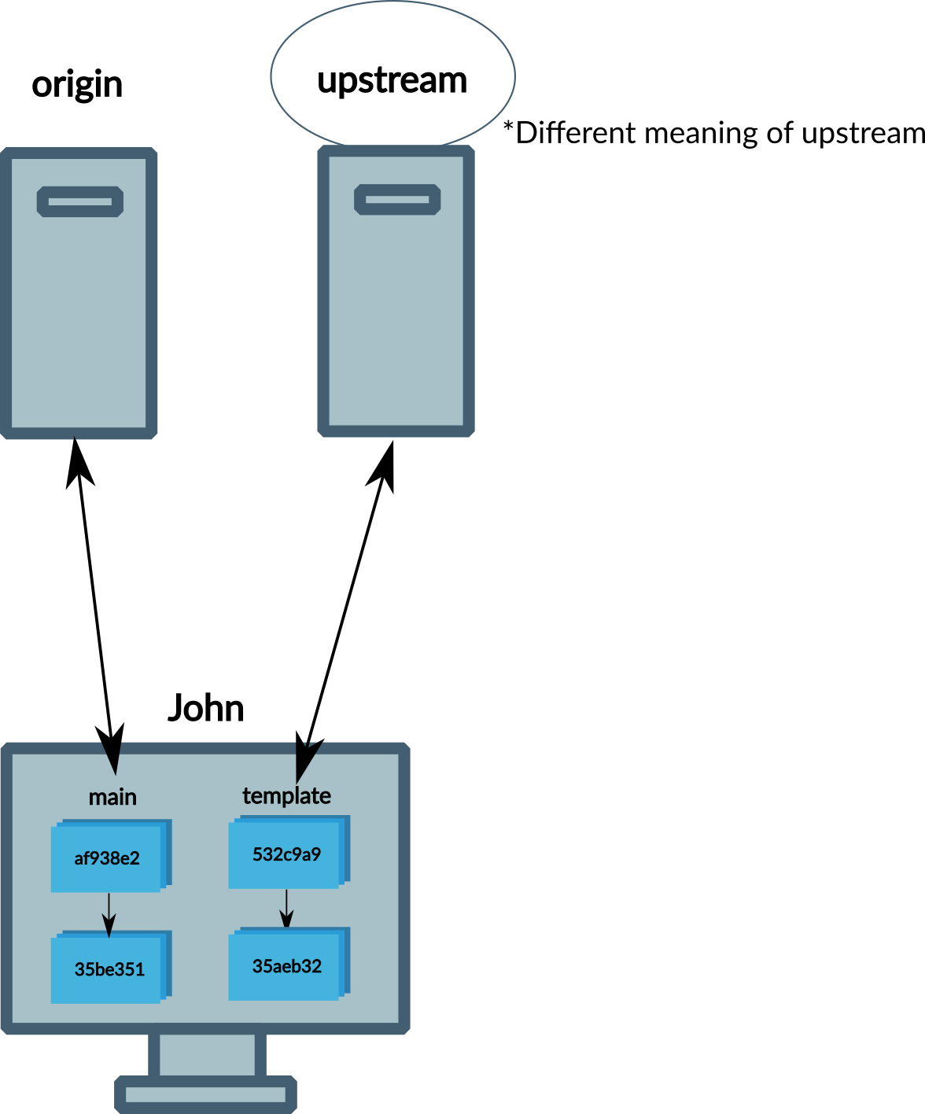
Git Concepts
Upstream (noun)
  Which remote branch our branch should fetch/pull from and push to
  Different branches may have upstreams on different remotes

Slide 53

Git Concepts
Example workflow
  Clone a repository

Slide 54

Git Concepts
Example workflow
  Clone a repository
    Remote origin is set automatically

Slide 55
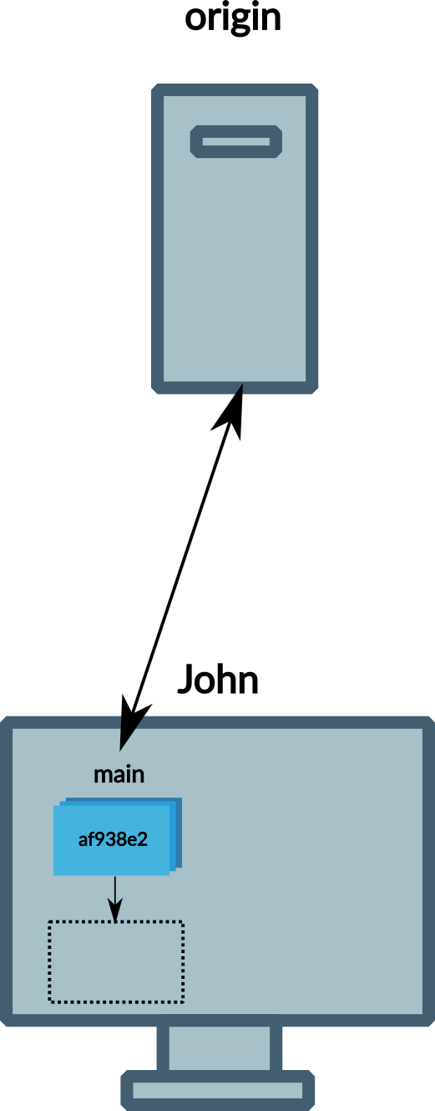
Git Concepts
Example workflow
  Clone a repository
    Remote origin is set automatically
  Set upstream for branch main

Slide 56
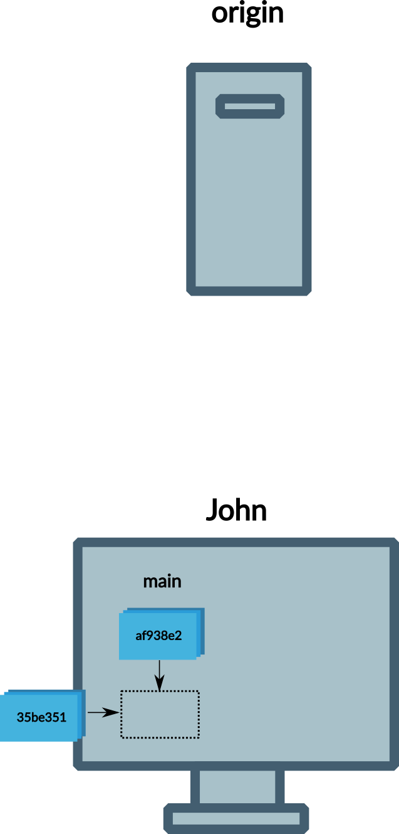
Git Concepts
Example workflow
  Clone a repository
    Remote origin is set automatically
  Set upstream for branch main
  Commit changes on branch main

Slide 57
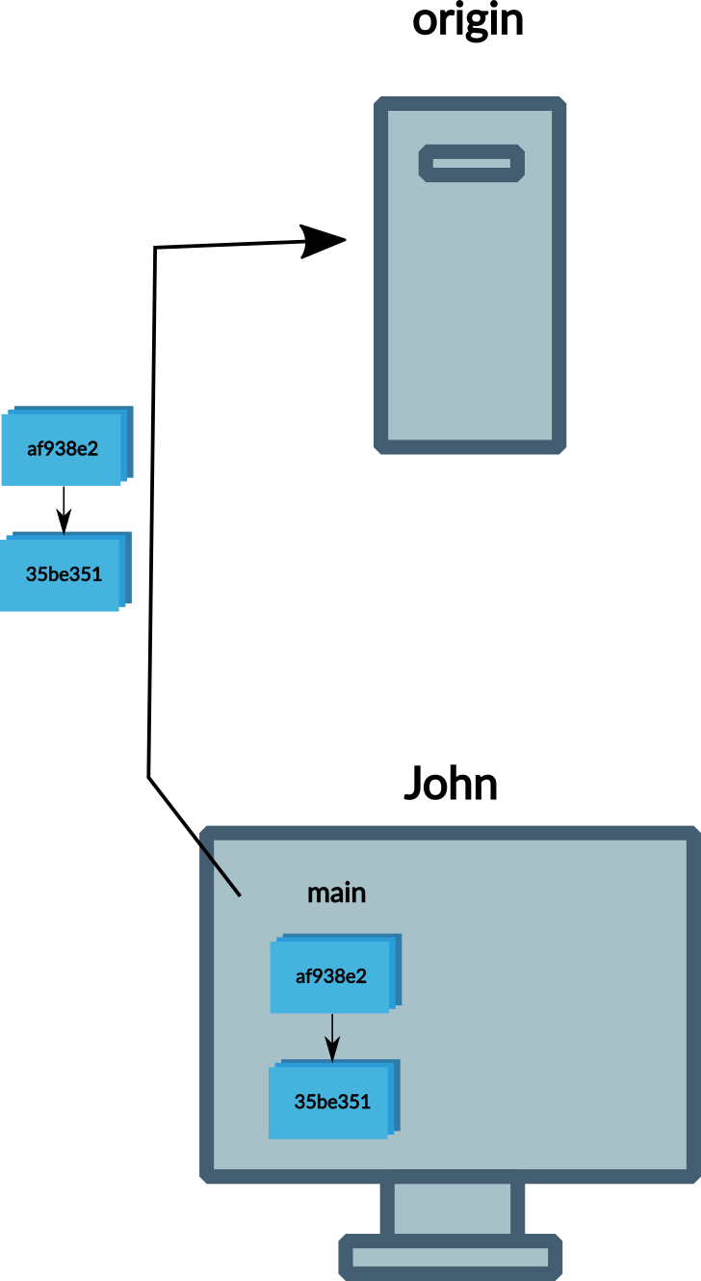
Git Concepts
Example workflow
  Clone a repository
    Remote origin is set automatically
  Set upstream for branch main
  Commit changes on branch main
  Push commits to remote branch

Slide 58
Git Concepts
Question: What would be the steps involved in the following:
  Create a repository locally
  Add content to it
  Create an empty repository on GitHub
  Push your content to the empty repository

Slide 59
Git Concepts
Answer: What would be the steps involved in the following:
  Create a repository locally
    git init
  Add content to it
    git commit
  Create an empty repository on GitHub
    git remote add
    git push --set-upstream
  Push your content to the empty repository
    git push

Slide 60
Git Concepts
Question: What would be the steps involved in the following:
  Copy an existing repo (upstream)
  Make a new GitHub repo for it
  Work on a new feature
  Update with changes to upstream
  Incorporate new feature into main branch
  Push to GitHub repo

Slide 61
Git Concepts
Answer: What would be the steps involved in the following:
  Copy an existing repo (upstream)
    git clone
  Make a new GitHub repo for it
    git remote add
  Work on a new feature
    git branch
    git commit
  Update with changes to upstream
    git pull
  Incorporate new feature into main branch
    git merge
  Push to GitHub repo
    git push --set-upstream

Slide 62

Basic tasks in Git

Slide 63
Tasks in Git
Git tools
  You can use graphical tools with git
  The instructions here are command line
    Clear what’s happening
    Learn once – use anywhere
    You need to resort to command line to do anything complicated anyway

Slide 64
Tasks in Git
We will see
  HTTPS authentication with a Personal Access Token
  SSH authentication with an SSH Key
  Create a repository
  Set a remote and push commits
  Clone a repository

Slide 65

Clone a repository

Slide 66
Clone a repository
Here we’re going to see
  How to clone an existing repository

Slide 67
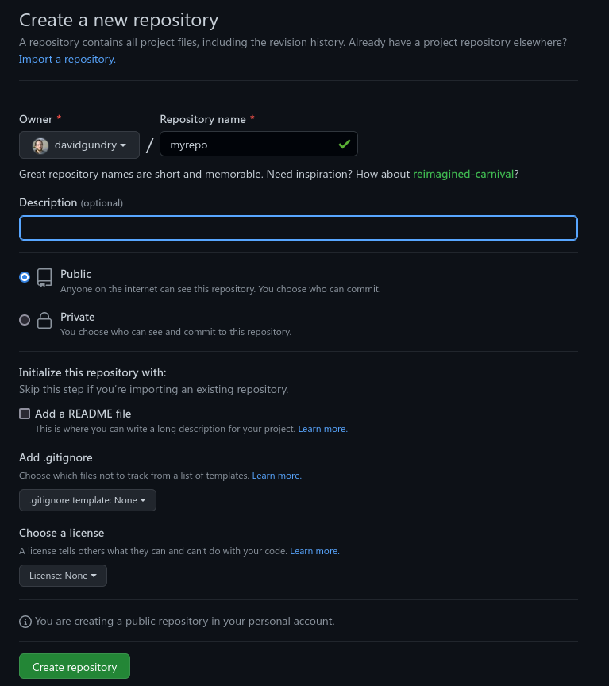
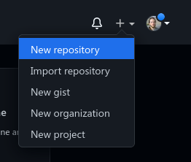
Clone a repository
Find or create a repository on e.g. GitHub
  Here I’m assuming there is content in the repository, so feel free to add Readme, .gitignore, and license

Slide 68
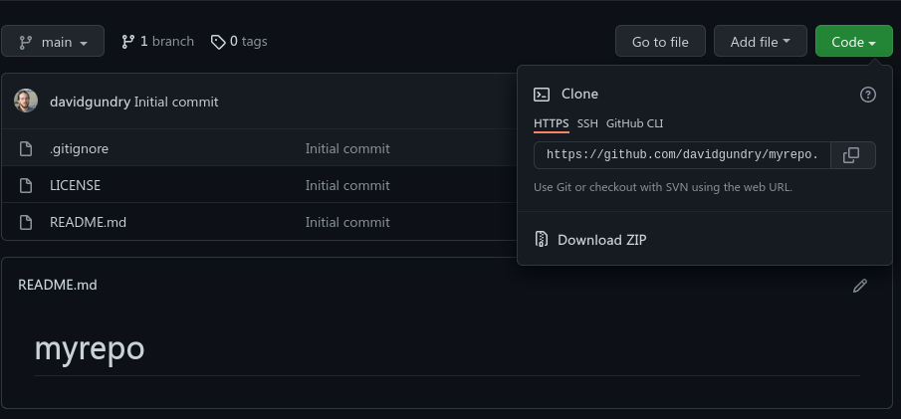
Clone a repository
Find the URL of the repository

Slide 69
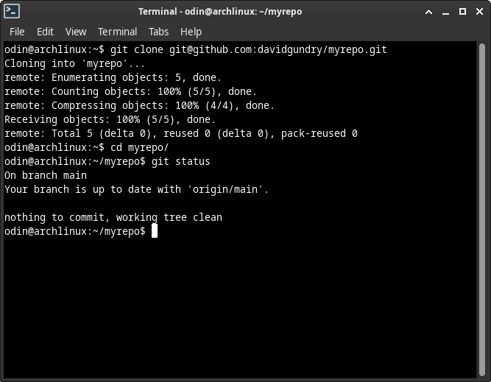
Clone a repository
Clone the repository
  git clone <repository-url>
Enter the directory
  cd
Check the status of the repository
  git status

Slide 70
Clone a repository
Try it now:
  Create a public repository on GitHub
  Clone the repository

Slide 71
HTTPS authentication with Personal Access Token

Slide 72
Tasks in Git
GitHub doesn’t allow authentication with username and password
One method is to create a Personal Access Token
  This is basically your password, so keep it safe

Slide 73
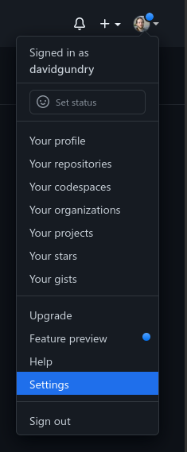
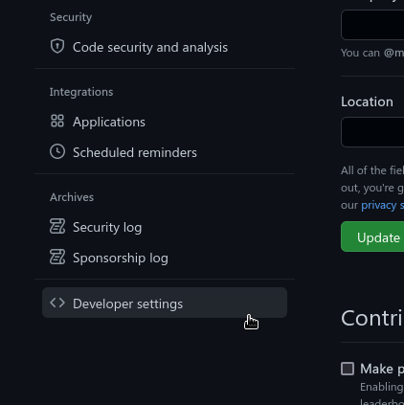
Tasks in Git
Go to GitHub Settings > Developer Settings

Slide 74
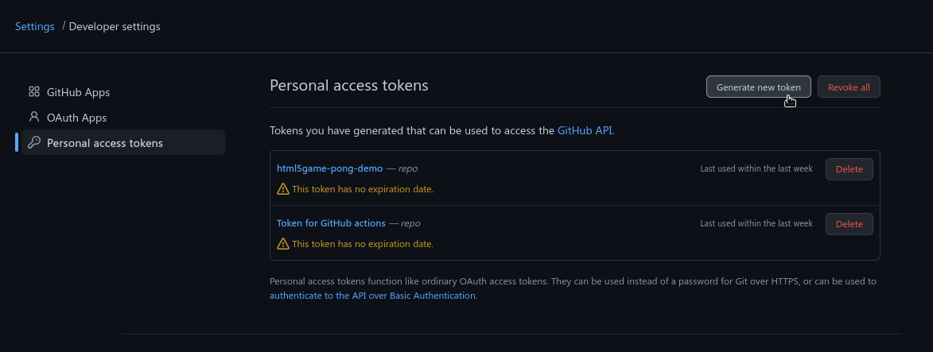
Tasks in Git
Click generate new token

Slide 75
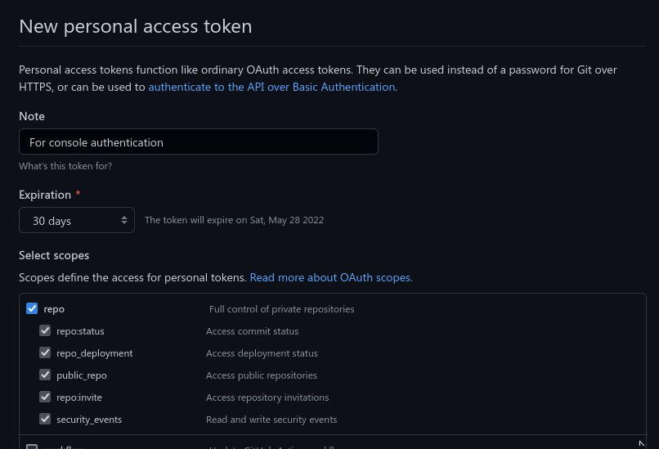
Tasks in Git
Give the token control over repositories

Slide 76
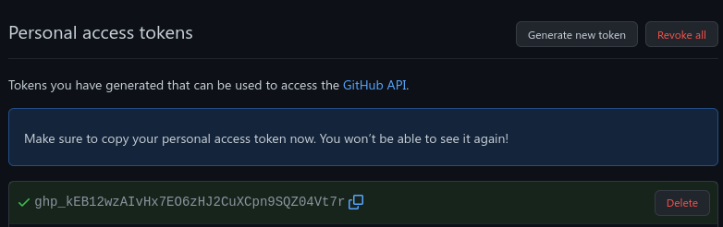
Tasks in Git
Copy the code it gives you
This is what to use instead of your password in the console

Slide 77
Tasks in Git
If you connect to a remote with an HTTPS url you will need to type in your username and enter this token as your password
Test it now:
  Create a private repository on GitHub
  Set up a Personal Access Token
  Clone the repository using the HTTPS url

Slide 78
SSH authentication with SSH key

Slide 79
Tasks in Git
Another method is to create an ssh key

Slide 80
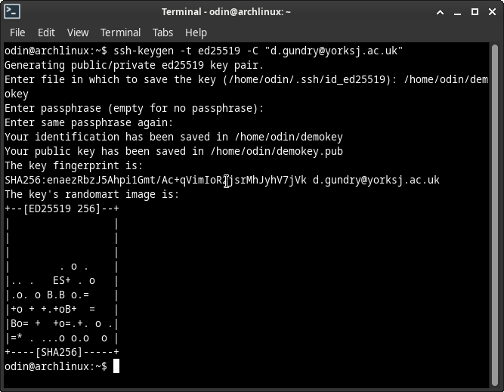
Tasks in Git
Generate your ssh key
  ssh-keygen -t ed25519 -C “<your email>”

Slide 81
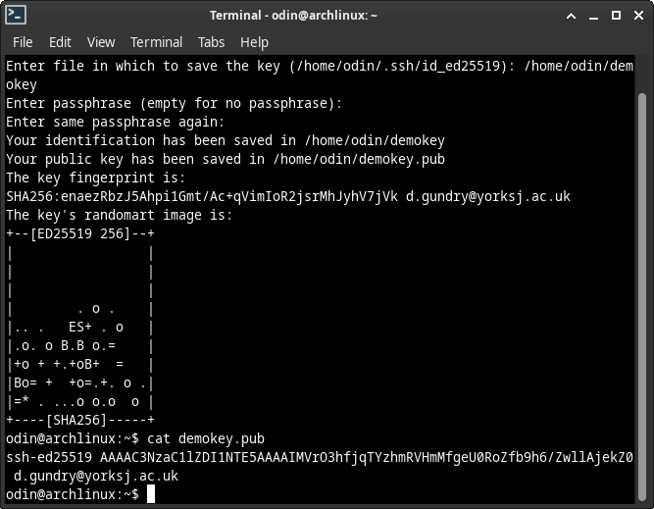
Tasks in Git
Copy the content of the .pub file created
  This is your public key
  The other file is the private key

Slide 82
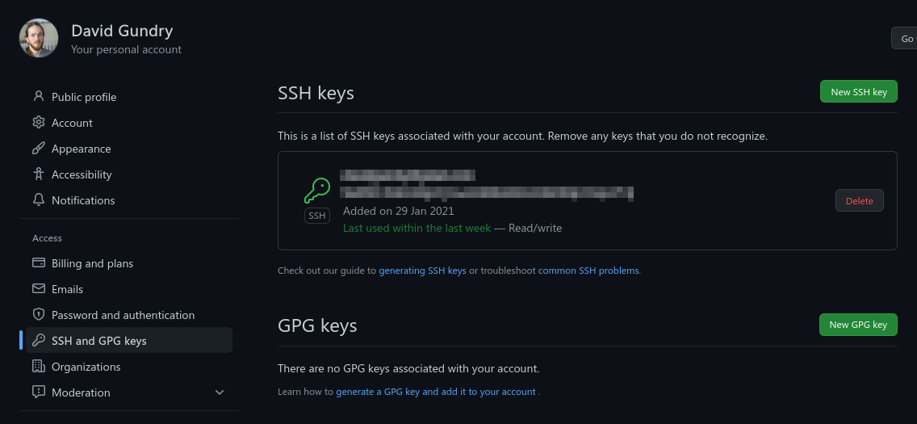
Tasks in Git
Go to GitHub Settings > SSH and GPG keys > New SSH Key

Slide 83
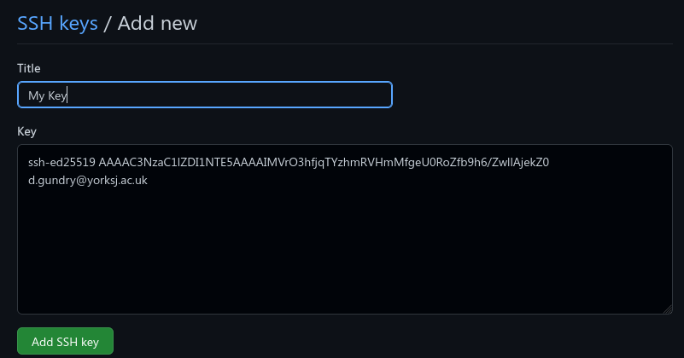
Tasks in Git
Paste the .pub file content into the Key field and click Add SSH key

Slide 84
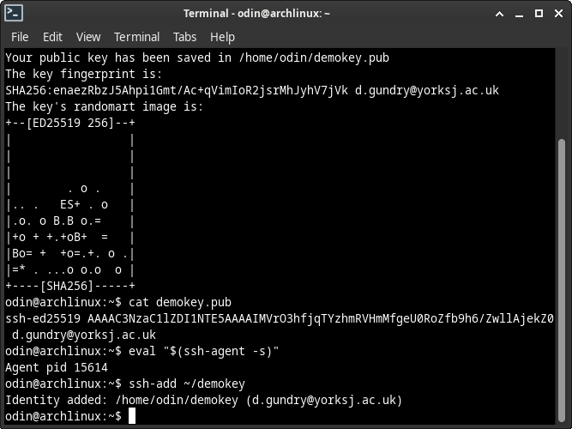
Tasks in Git
Before you can authenticate with your key, it needs to be added to ssh-agent
  Start ssh-agent
  add your private key
ssh-add /path/to/key/file
It will remember your key but only for the session

Slide 85
Tasks in Git
If you connect to a remote with an SSH url you will automatically be authenticated
Test it now:
  Create a private repository on GitHub
  Set up an SSH key
  Clone the repository using the SSH url

Slide 86
Create a local repository

Slide 87
Create a repository
Here we’re going to see
  How to create a new repository from scratch
  How to make our first commit

Slide 88
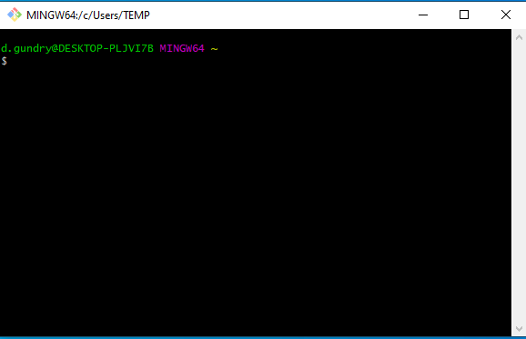
Create a repository
Open your terminal emulator of choice
  On Windows you can use Git Bash
Navigate to wherever you want to store your project
  Hint: use ls and cd commands to orient yourself and change directory

Slide 89
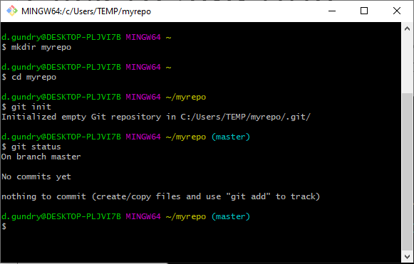
Create a repository
Make a directory to store your repository
  mkdir
Enter that directory
  cd
Initialise a git repository
  git init
Check the status of the repository
  git status

Slide 90
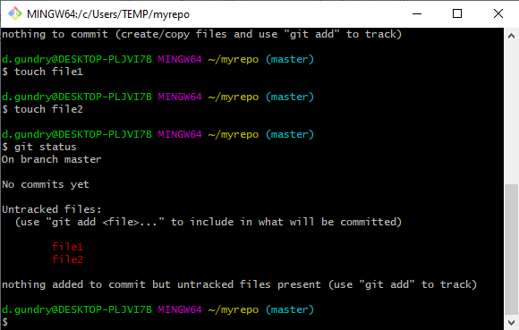
Create a repository
Add some files. You can copy in your project files.
  (I’ve used touch to create empty files for the demo)
Check the status of the repository
  git status
  There are unstaged changes (shown in red)

Slide 91

Create a repository
Stage all changes
  git add .
Check the status of the repository
  git status
  There are staged changes (shown in green)

Slide 92

Create a repository
Commit the staged changes with a message
  git commit -m “<message>”
  It’s common to use “Initial commit” for the first commit message.

Slide 93

Create a repository
Check the status of the repository
  git status
  There are no changes
  All our changes have been committed

Slide 94
Create a repository
Task:
  Create a new repository and commit a file called README.md
  Add another file called LICENSE.md and then make a second commit
git init
  turn directory into a new repository
git add .
  stage all files for commit
git status
  show what files are staged for commit
commit -m “Initial commit”
  commit staged files

Slide 95
Set a remote and push commits

Slide 96
Set remote and push commits
Here we’re going to see
  How to associate our local repository with an empty remote repository
  How to push our commits to the remote

Slide 97
Set remote and push commits
Go to GitHub and create an empty repository
  Do not add readme, .gitignore or license as these will mean the repository is not empty

Slide 98

Set remote and push commits
Note the URL of your repository
  ends in .git
There are two options:
  HTTPS (connect via HTTPS)
  SSH (connect via SSH)
The main difference is how your authenticate
  HTTPS: personal access token
  SSH: ssh key

Slide 99
Set remote and push commits
Open your terminal emulator of choice
Navigate into your repository
  Hint: use ls and cd commands to orient yourself and change directory

Slide 100

Set remote and push commits
Add the GitHub repository as a remote called ‘origin’.
  git remote add
GitHub calls its main branch ‘main’ instead of ‘master’ Rename our current branch (master) to follow this standard
  git branch -M main

Slide 101

Set remote and push commits
Push our commits
  git push
The first time we do this, we need to tell our main branch where it needs to push to
  git push -u origin main
  Our ‘upstream’ is set to the main branch on our origin remote

Slide 102
Set remote and push commits
Summary
  In repository, run:
  git remote add origin <repository-url> (add a remote)
  git branch -M main (name branch to GitHub’s default)
  git push -u origin main (push, setting upstream for branch)

Slide 103
Other useful commands

Slide 104
Set remote and push commits
git branch <name>
  Create a new branch called <name>
git checkout <branch>
  Switch to the branch called <branch>
git merge <branch>
  Merge the named branch into the current branch
git reset
  By itself unstages all staged files
git log
  Show a history of commits
git commit –amend
  Add currently staged changes to the previous commit

