Slide 1
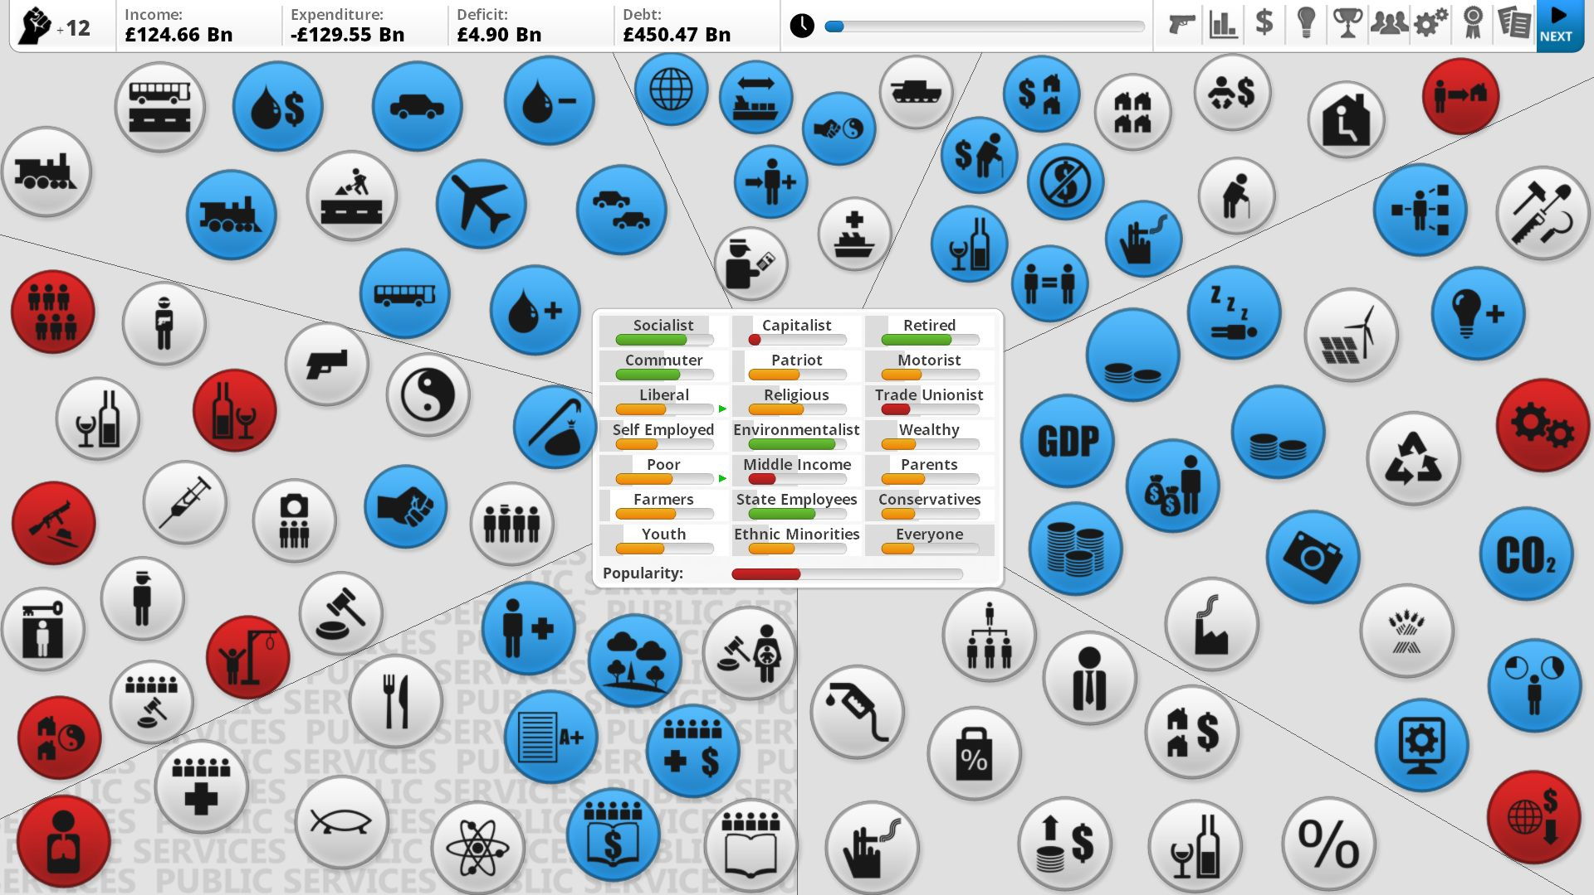
Games AI
Lecture 3.1
Utility-based AI

Slide 2
Overview
Utility-based AI
  Utility theory
  Decision factors
  Designing response curves
  Implementing utility-based AI

Slide 3
Overview
Utility theory
  General model of decision making
  Every possible action can be scored on a single scale of “goodness” (utility, weight, score, priority, ...)
  Agents act rationally to maximise utility
    “Irrationality” / cognitive biases / personality traits can be added into the model as factors

Slide 4
Overview
Utility != value
  Value is a measurable quantity, eg. price
  Utility is how much you desire something
  Money has fixed value but variable utility depending on context
    eg. £20 on a desert island is worthles
  Utility is abstract, but it can be based on values

Slide 5

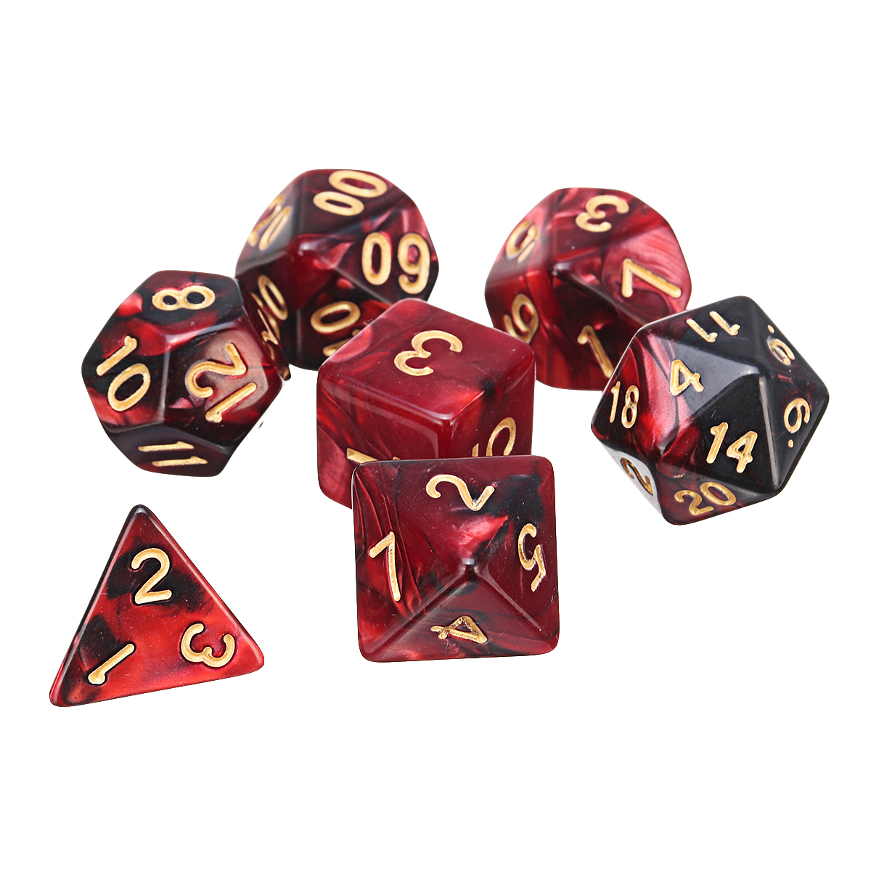
Overview
Principle of Maximum Expected Utility
  Multiply utility of each outcome (D) by probability of it occouring (P)
  e.g. attack in D&D
    Critical hit: 5%, utility: 0.9
      = 0.045
    Regular hit: 90%, utility: 0.6
      = 0.56
    Fumble: 5%, utility:-1
      = -0.05
  .: expected utility of attack = 0.555

Slide 6
Overview
Utility-based AI basics
  Every action is scored at once using a mathematical model of the value (utility) of each action
  Top scoring actions change as scores fluctuate dynamically
  One of top scoring actions is chosen

Slide 7
Overview
Pros
  More nuanced behaviours than using booleans
  Hand authored → Tight authorial control
  Simple to implement
  Considerations are reusable between agents
  Considerations reflect decision making process - can be exposed to the player
Cons
  Designing behaviours can be a “dark art”
  No planning or look-ahead

Slide 8
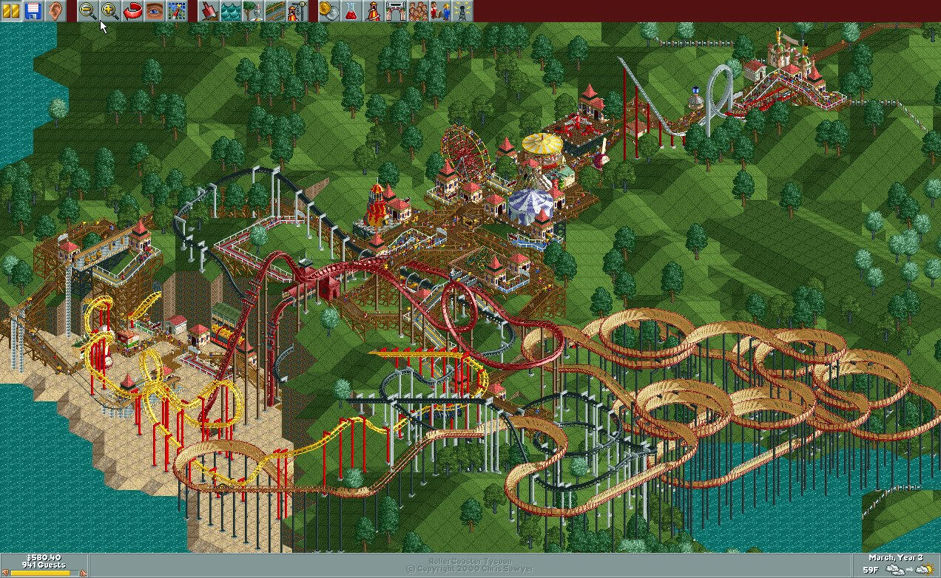
Making Decisions

Slide 9
Making decisions
Decision factors
  Multiple pieces of data weigh into any given decision
    Health, Ammo, Distance to enemy
    Wealth, hunger, enjoyment of rollercoasters
    Conversation choices, loyalty, distance to allies
  Almost anything can be a decision factor
    Cooldown, repeat penalty, aggressiveness, conscientiousness, ...

Slide 10
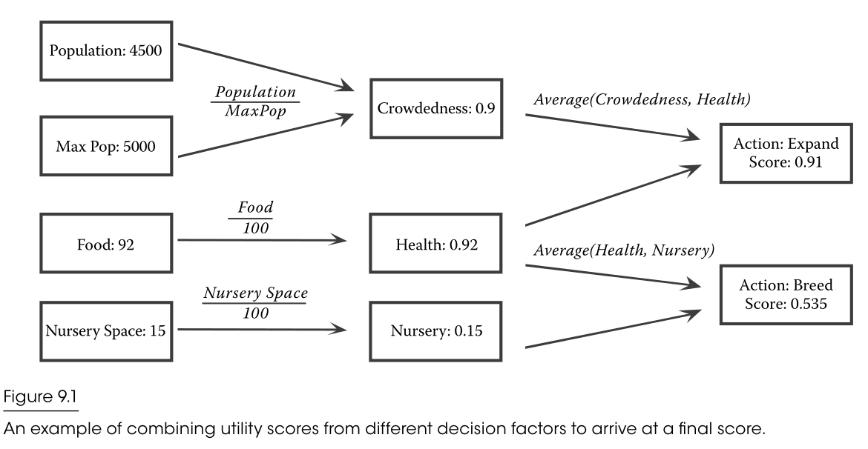
Making decisions
David Graham. An Introduction to Utility Theory

Slide 11
Making decisions
Take with highest score (absolute utility)
  Take “best” decision
  Rigid, predictable
Select an option at random, but weight probabilities (relative utility)
  Variation, interesting
  Periodically will do something that makes your AI look stupid
Combine the two for the best results

Slide 12
Making decisions
Decision factors
  Art of design is mostly selecting considerations to weight actions and pairing with appropriate response curves
  By averaging normalised scores can build endless chain of combinarions

Slide 13
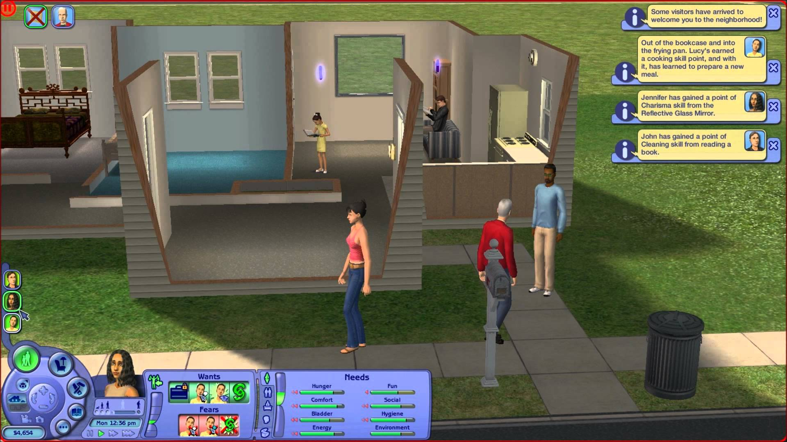
Designing Response Curves

Slide 14
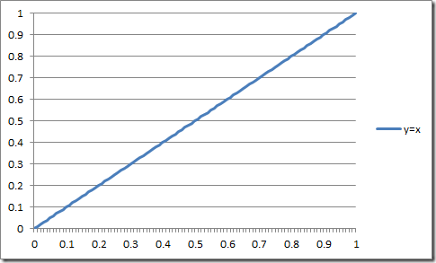
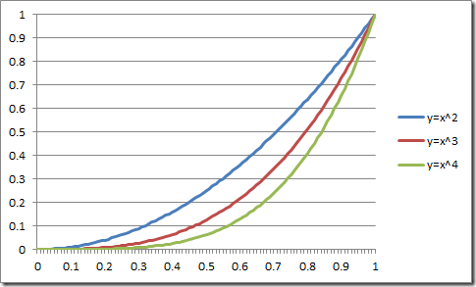
Designing response curves
What is a response curve?
  A mathematical representation of a relationship modelling how a change in the input affects the output

Slide 15
Designing response curves
A response curve is a function with domain and range in [0-1]*
  It maps some normalised input value (eg. health %) to a consideration for our AI
    eg. health% → desireToHeal
    eg. ammo% → desireToReload
  Useful properties:
    Multiplying curves always gives result in [0-1]
    Multiplying by 0 always gives 0
    Can combine any number of curves
    Outputs of one curve can be inputs to another
*or another consistent range, but mathematical properties may change

Slide 16
Designing response curves
Four types of curve
  Linear/Quadratic
  Exponential
  Logistic
  Logit

Slide 17
Designing response curves
Linear
  y=mx + c
  Change in x always causes the same change in y

Slide 18
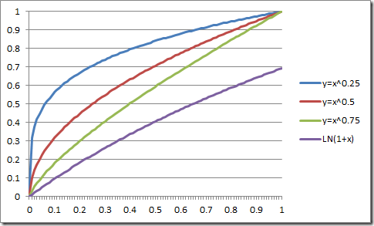
Designing response curves
Quadratic
  y=xª
  a > 1 increasing gradient
  0 < a < 1 decreasing gradient
  Changes in x lead to bigger/smaller changes in y

Slide 19
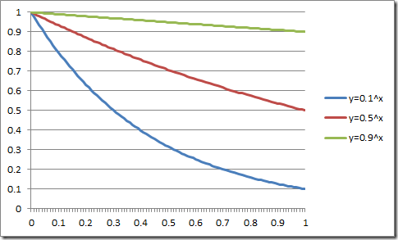
Designing response curves
Exponential
  y=a^{x} -1: exponential growth
  y=a^{x}, where 0 < a < 1: exponential decay

Slide 20
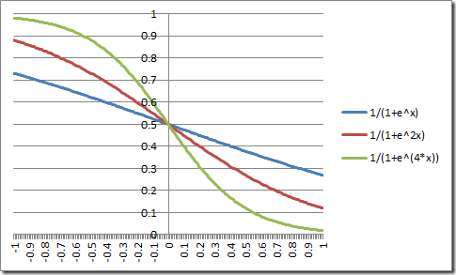
Designing response curves
Logistic
  y = 1/(1+e^{x})
  y = 1/(1+e^{-x}) for reverse
  “Soft threshold” giving a more or less sudden change between low and high
https://www.desmos.com/calculator/j7ucn0rkfc

Slide 21
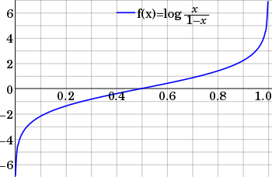
Designing response curves
Logit curve
  y = log (x / 1-x)
  Differences at the extremes are more significant than those in the middle
https://www.desmos.com/calculator/q9hkfpqc2s

Slide 22
Designing response curves
Can customise your own functions using these mathematical components
  Need to adjust to fit within your scale (e.g. 0-1)
  Clamp if necessary
Much easier:
  Paramatise these four basic function types

Slide 23

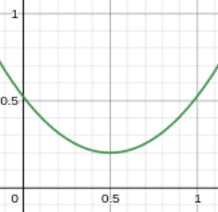

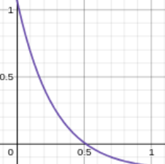

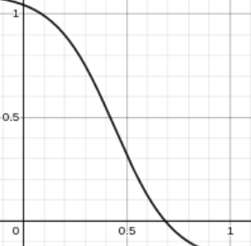

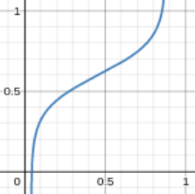
Designing response curves
These four curve type can all be paramatised: b,c,k,m
  Linear/Quadratic
  Exponential
  Sigmoid/Logistic
  Logit
https://www.desmos.com/calculator/gzq7hnz8az

Slide 24
Designing response curves
Linear/Quadratic
  m = slope
  k = how much bend
  b = vertical shift
  c = horizontal shift

Slide 25
Designing response curves
Exponential
  m = horizontal stretch
  k = how much bend
  b = vertical shift
  c = horizontal shift

Slide 26
Designing response curves
Sigmoid/Logistic
  m = slope at inflection point
  k = vertical size of curve
  b = vertical shift
  c = horizontal shift

Slide 27
Designing response curves
Logit
  m = horizontal size of curve
  k = slope at inflection point
  b = vertical shift
  c = horizontal shift

Slide 28

Implementing Utility-based AI (1)
  Infinite Axis Utility System Architecture

Slide 29
Implementing Utility-based AI
Each response curve can be defined by an enum and four floats:
  [{Quadratic, Exponential, Logistic, Logit}, m, k ,b ,c]
Curve type | m | k | b | c
Quadriatic | 0.5 | 0.1 | 0.25 | 0.0
Logistic | 50, | -0.95 | 1.0 | 0.6

Slide 30
Implementing Utility-based AI
Processing a response curve
  Function takes paramatised curve and in input x
    (type, m, k ,b ,c, x)
  Clamp input to [0-1]
  Apply function determined by curve type
  Clamp output to [0-1]
  Return y

Slide 31
Implementing Utility-based AI
Processing a consideration (decision factor)
  Each consideration has an array of inputs
    Inputs can come from other considerations or from a “Clearing House” function that returns normalised input values (eg. health, ammo)
  Each input is assigned a paramatised utility function
  The outputs of these functions are multiplied together
  The result is the utility of the consideration

Slide 32
Implementing Utility-based AI
Processing an action
  Each action has an array of considerations
  The utility of each consideration is calculated and multiplied together
  The result is then multiplied by a weight, e.g.
    Idle actions: x1
    Attack actions: x3
    Scripted actions: x5
    Combat responses: x10

Slide 33
Implementing Utility-based AI
Calculate the score of each action
  Score actions with targets on a per-target basis
Push scored actions onto a list of possible actions
Pick (one of the) top scoring actions from the list

Slide 34

Implementing Utility-based AI (2)
  Dual-utility Reasoning

Slide 35
Implementing Utility-based AI
Each consideration has
  A utility
  A rank
Rank of action is maximum rank of any consideration
  i.e. considerations can force overall action to be of high rank
Weight of action determined by the product of utility of considerations

Slide 36
Implementing Utility-based AI
Dual-utility reasoning
  1. Eliminate the options with a weight of zero.
  2. Find the highest rank category, and eliminate options that don’t belong to it.
  3. Find the best remaining option (i.e. the one with the highest weight), and eliminate options that are much worse (i.e. much lower weight) than it.
  4. Use weight-based random to select from the options that remain
Kevin Dill. Dual-Utility Reasoning in Game AI Pro 2, ch 3

Slide 37

Implementing Utility-based AI
Dual-utility reasoning eg.
  Normal needs rank 0
    Hunger, entertainment, bathroom
  Context-specific behaviours higher ranks
    e.g. only tree climbing behaviours when climbing trees
  Death rank of 1,000,000

Slide 38
Further “reading”
David “Rez” Graham. An Introduction to Utility Theory in Game AI Pro. Ch.9
  http://www.gameaipro.com/
  Also several other chapters in the Game AI Pro books about utility systems
Dave Mark’s Infinite Axis Utility System Architecture at GDC
  http://www.gdcvault.com/play/1018040/Architecture-Tricks-Managing-Behaviors-in (third speaker)
...and more of his GDC talks about Utility Systems:
  http://intrinsicalgorithm.com/IAonAI/2013/02/both-my-gdc-lectures-on-utility-theory-free-on-gdc-vault/
Kevin Dill Dual-Utility Reasoning in Game AI Pro 2. Ch.3
www.desmos.com Free online graphing tool

