Slide 1
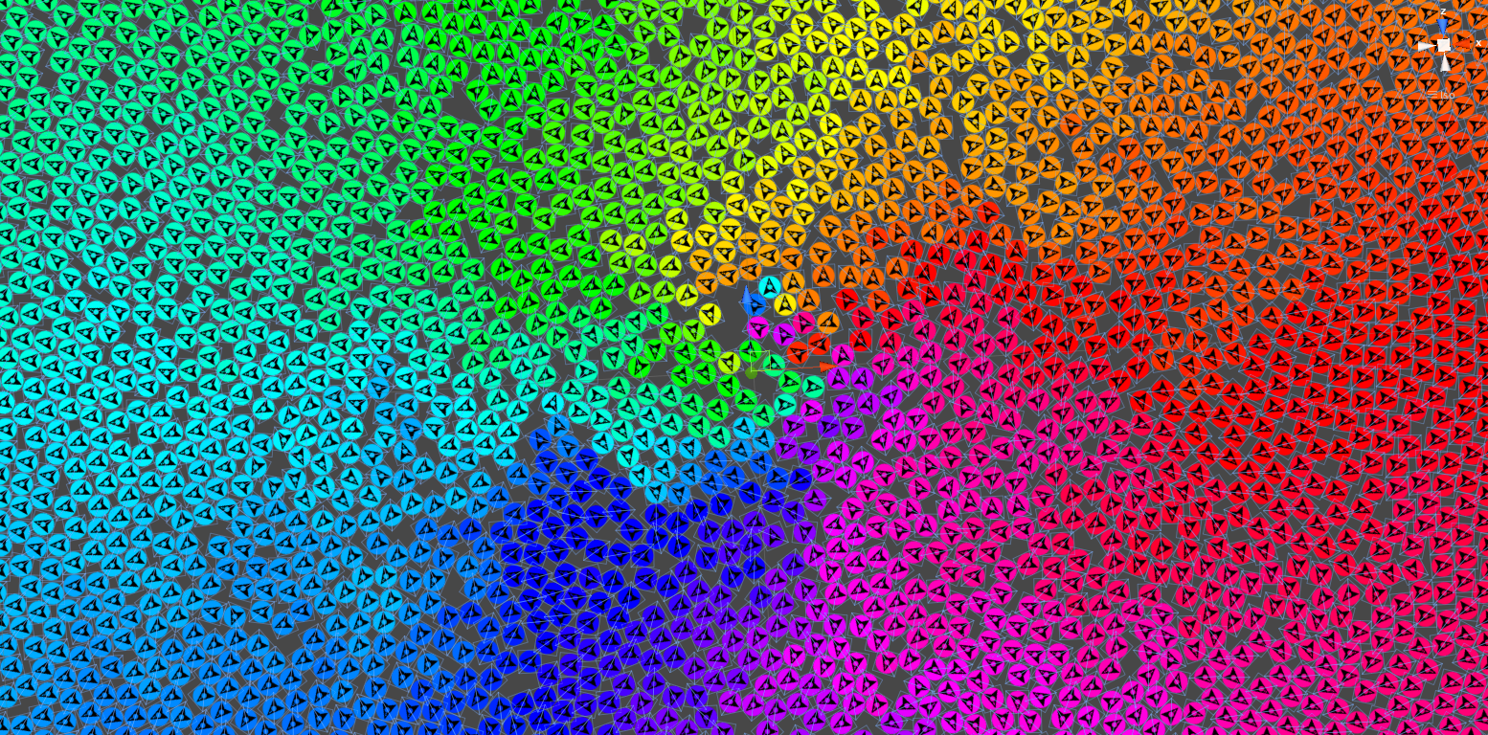
Games AI
Lecture 2.1
Pathfinding

Slide 2
Overview
Pathfinding
  Breadth-first search
  A* search
  Heuristics
  Navigation graphs
  A* variants

Slide 3
Tree search
Graph Search
  What is a graph?

Slide 4
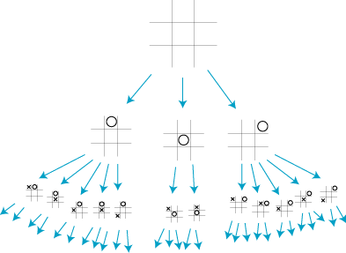
Tree search
Graph Search
  What is a graph?

Slide 5
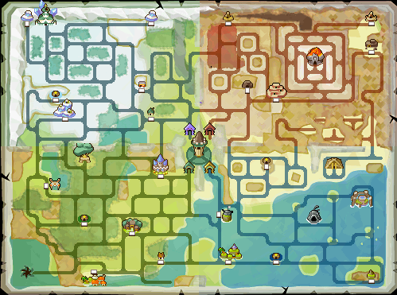
Tree search
Graph Search
  What is a graph?

Slide 6
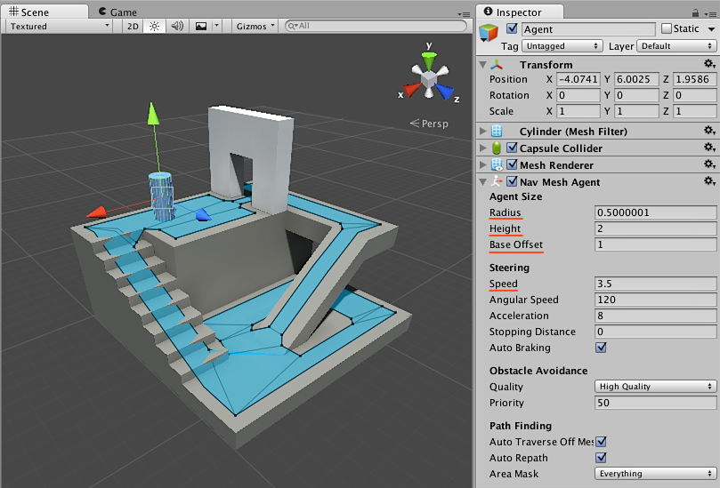
Tree search
Graph Search
  What is a graph?

Slide 7
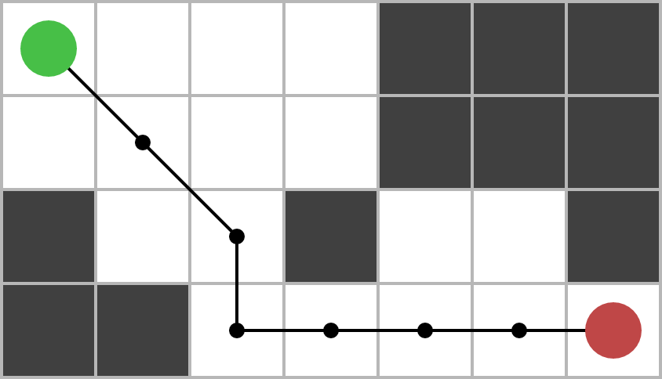
Tree search
Graph Search
  What is a graph?

Slide 8
BFS
0
Queue
0
Breadth-first search
Set up:
  Create queue
  Add start to queue
  Mark as discovered

Slide 9
BFS
0
Queue
While queue is not empty
  Select top of queue
  Check if goal

Slide 10
BFS
0
Queue
1
2
3
While queue is not empty
  Select top of queue
  Check if goal
  Add all undiscovered children to queue
  Mark each child as discovered
1
2
3

Slide 11
BFS
0
Queue
2
3
4
5
6
While queue is not empty
  Select top of queue
  Check if goal
  Add all undiscovered children to queue
  Mark each child as discovered
1
2
3
4
5
6

Slide 12
BFS
0
Queue
3
4
5
6
7
8
9
While queue is not empty
  Select top of queue
  Check if goal
  Add all undiscovered children to queue
  Mark each child as discovered
1
2
3
4
5
6
7
8
9

Slide 13
BFS
2
1
2
1
4
4
7
7
2
1
4
7
2
1
4
7
0
0
2
2
5
5
0
2
5
0
2
5
3
3
6
6
8
8
3
6
8
3
6
8
Queue:
Queue: 1,2,3
Queue: 2,3,4

Slide 14
BFS
2
1
4
7
2
1
4
7
2
1
2
1
4
4
7
0
2
5
0
2
5
0
0
2
2
5
5
3
6
8
3
6
8
3
3
6
6
8
8
Queue: 3,4,5,6
Queue: 4,5,6
Queue: 5,6,7

Slide 15
BFS
procedure BFS(G: Graph, v: Vertex of G) is
create a queue Q
enqueue v onto Q
mark v
while Q is not empty do
w ← Q.dequeue()
if w is what we are looking for then
return w
for all edges e in G.adjacentEdges(w) do
x ← G.adjacentVertex(w, e)
if x is not marked then
mark x
enqueue x onto Q
return nulls.

Slide 16
breadthFirstSearch(initialState: T): A[]
{
this.openList.push(new TreeNode<T, A>(initialState, null, null));
while (this.openList.length > 0)
{
let current = this.openList.shift();
if (this.goalTest(current.state))
return this.getActions(current);
let edges = this.stateActionMapping(current.state)
for (let i=0;i<edges.length;i++)
{
let newState = this.transitionModel(current.state, edges[i]);
let duplicate = false;
for (let i=0,len=this.closedList.length;i<len;i++)
if (this.stateEquals(this.closedList[i], newState))
{
duplicate = true;
break;
}
if (!duplicate)
{
let newNode = new TreeNode<T, A>(newState, edges[i], current);
this.openList.push(newNode);
this.closedList.push(newNode.state);
}
}
}
return null;
}

Slide 17
BFS
Pros:
  Finds shortest path (by number of nodes)
Cons
  Unguided

Slide 18
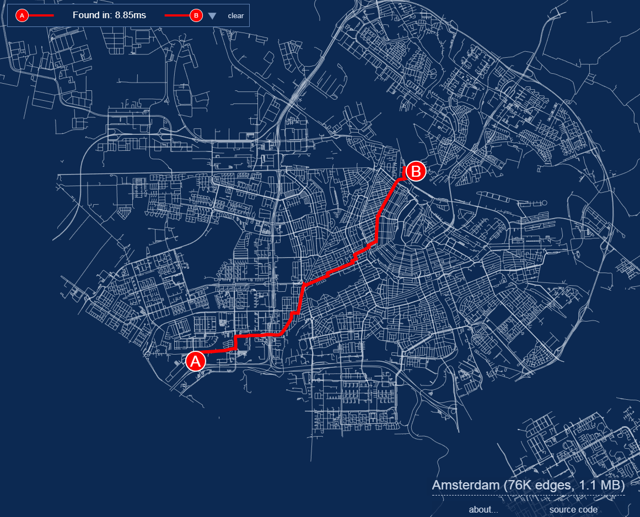
A* Search

Slide 19
A*
A* Search
  Guided / Best-first search
  Prioritise nodes to explore based on cost + heuristic
    g(n): cost to reach node
    h(n): heuristic for node
    f(n) = g(n) + h(n): priority of node

Slide 20
A*
2
1
2
1
4
4
7
Set up:
  Create empty list (Open set)
  Create maps from node → cameFrom, gScore, and fScore (or store f(n), g(n), and parent for each node)
  Add start node to Open Set
7
0
0
f=14
g=0
2
2
5
5
3
3
6
6
8
8

Slide 21
A*
2
1
2
1
f=20
g=10
4
4
7
While open set is not empty:
  Remove node in Open Set with lowest f(n)
  Check if goal
  For each neighbour n:
    If new g(n) smaller:
      Update g(n), f(n)
      Set parent to current node
7
U
R
0
0
f=14
g=0
2
2
f=20
g=10
5
5
D
3
3
f=34
g=10
6
6
8
8

Slide 22
A*
2
1
2
1
f=20
g=10
4
4
f=20
g=20
7
While open set is not empty:
  Remove node in Open Set with lowest f(n)
  Check if goal
  For each neighbour n:
    If new g(n) smaller:
      Update g(n), f(n)
      Set parent to current node
7
U
R
U
0
0
f=14
g=0
2
2
f=20
g=10
5
5
f=34
g=20
R
D
D
3
3
f=34
g=10
6
6
f=40
g=20
8
8

Slide 23
A*
2
1
2
1
f=20
g=10
4
4
f=20
g=20
7
While open set is not empty:
  Remove node in Open Set with lowest f(n)
  Check if goal
  For each neighbour n:
    If new g(n) smaller:
      Update g(n), f(n)
      Set parent to current node
7
U
R
U
0
0
f=14
g=0
2
2
f=20
g=10
5
5
f=34
g=20
R
D
D
3
3
f=34
g=10
6
6
f=40
g=20
8
8

Slide 24
A*
2
1
2
1
4
4
f=20
g=20
7
Reconstruct path
  Create empty list
  Current node = goal node
  Add action to reach current node to list
  While current node has parent
    Set current node = parent
    Prepend action to react current node to list
7
R
U
0
0
f=14
g=0
2
2
f=20
g=10
5
5
3
3
6
6
8
8

Slide 25
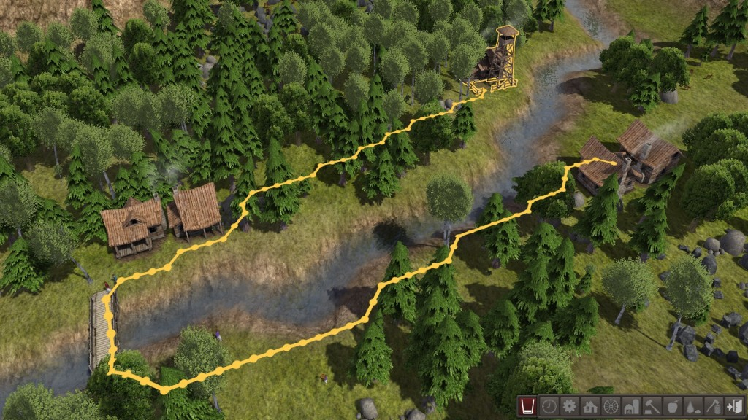
Heuristics

Slide 26
Heuristics
Heuristics
  Quick to compute approximation of value/distance to goal of a given node
  For A* must be equal to or an under-estimate of true cost
  Weighted heuristics: f(n) = w * h(n) + (w-1) * g(n)
    If w = 0, A* is equivalent to Dijkstra’s algorithm
    If w = 1, A* is equivalent to greedy best-first search

Slide 27
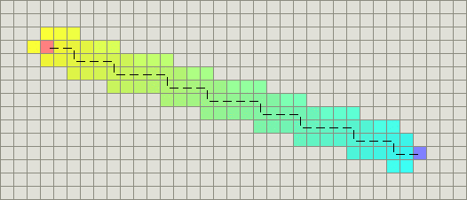
Heuristics
Manhattan distance
  function heuristic(node)
  dx = abs(node.x - goal.x)
  dy = abs(node.y - goal.y)
  return D * (dx + dy)
  Best for 4-connected grids

Slide 28
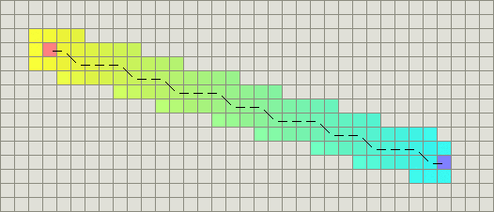
Heuristics
Diagonal distance
  function heuristic(node)
  dx = abs(node.x - goal.x)
  dy = abs(node.y - goal.y)
  return D * (dx + dy) + (D2 - 2 * D) * min(dx, dy)
  Best for 8-connected grids

Slide 29
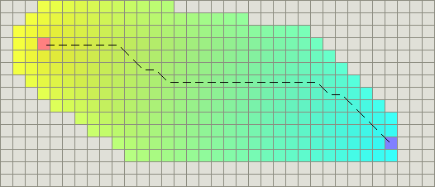
Heuristics
Straight line distance
  function heuristic(node)
  dx = abs(node.x - goal.x)
  dy = abs(node.y - goal.y)
  return D * sqrt(dx * dx + dy * dy)
  If you can move at any angle, but leads to more exploration as cost function g and heuristic h will not match

Slide 30
Heuristics
If you have multiple goals
  function heuristic(node)
  h1 = heuristicToA(node)
  h2 = heuristicToB(node)
  ...
  return min(h1, h2, …)

Slide 31
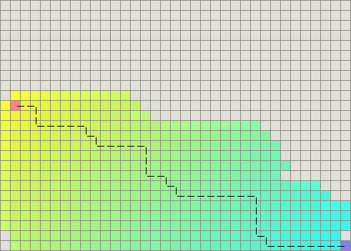
Heuristics
Breaking ties
  Often many paths with same length, leading to lots of unnecessary exploration
  Tweaking A* heuristics can improve performance, but impacts on behaviour

Slide 32
Implementing A*
Implement an agent that uses A* to plan a path to a goal (e.g. the player)
  First localise the start and goal positions in terms of grid coordinates
  Then search to determine a path (sequence of grid cells/directions)
  Then position the grid cells back in world space and move between them.
Explore different options for tie-breaking and see how they affect behaviour and performance:
  https://theory.stanford.edu/~amitp/GameProgramming/Heuristics.html

Slide 33
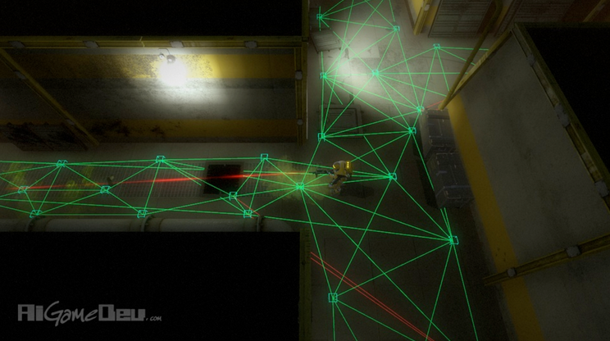
Map Abstractions

Slide 34
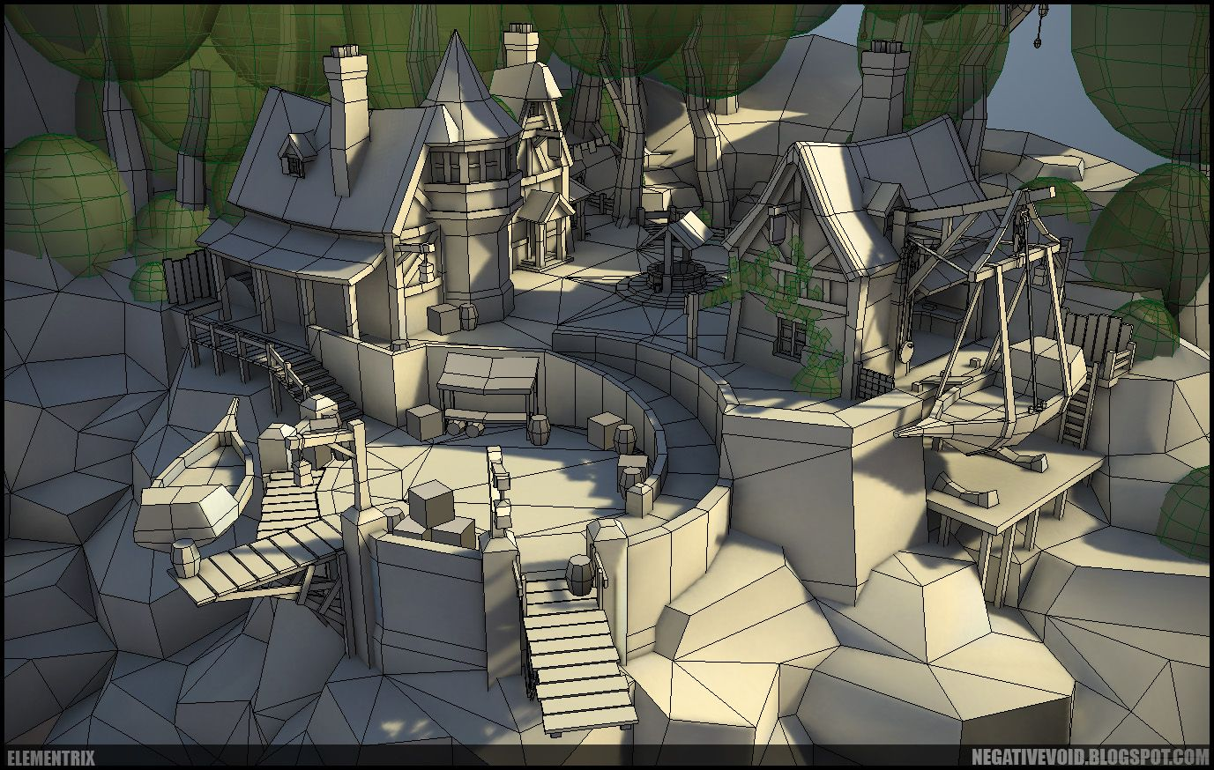
Abstractions
Game worlds are usually unsuitable for navigation
  “Polygon soup”
  Doesn’t encode navigable areas
  Irrelevant detail

Slide 35
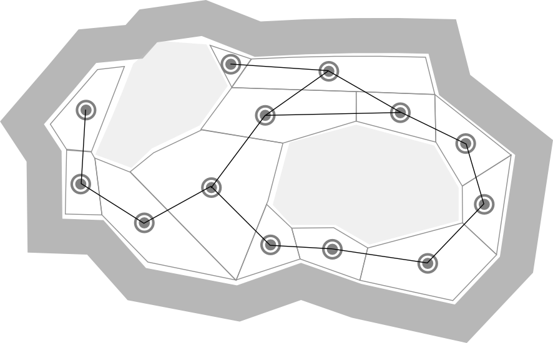
Abstractions
Navigation graph
  Graph size affects
    Search performance
    Path quality
  Content creation problem

Slide 36
Abstractions
Pathfinding tasks
  Localisation: convert position to node
  Search: find node path in nav graph
  Positioning: convert node(s) to position(s)
  Smoothing: improve quality of path

Slide 37
Abstractions
Requirements
  Validity: If two nodes are linked they are navigable in the world (the graph doesn’t mislead)
    Invalid structures result in paths that agent’s can’t follow
  Completeness: All navigable spaces in the world are represented in the graph (the graph doesn’t omit)
    Incomplete structures prevent agents taking valid paths

Slide 38
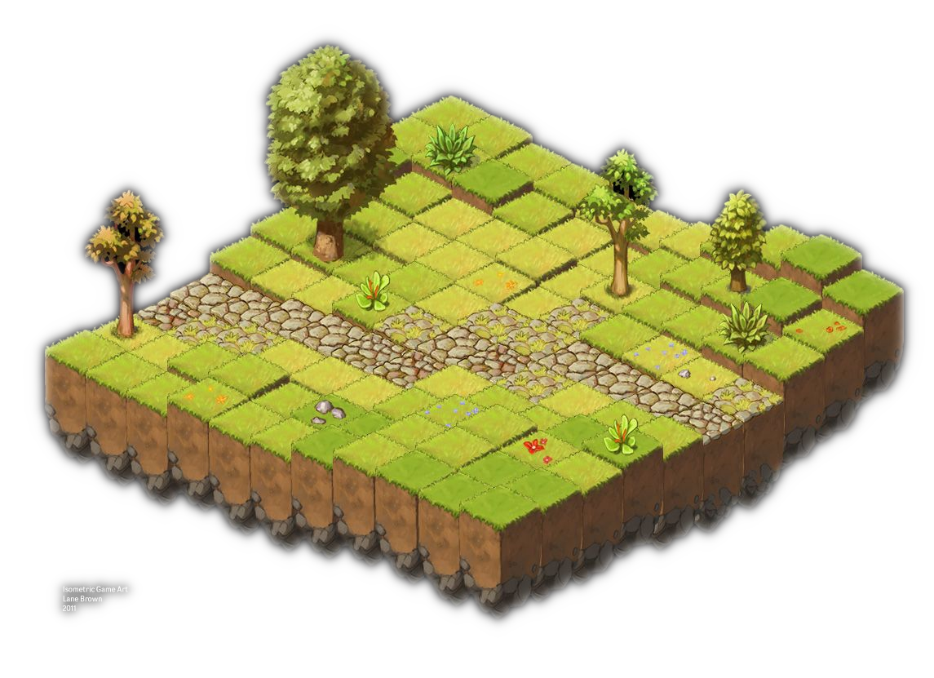
Abstractions
Grid Navigation
  Divide world into regular regions
  Easy to generate
  Large numbers of (unnecessary?) nodes

Slide 39
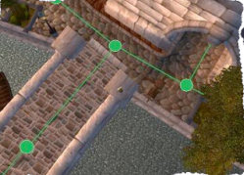
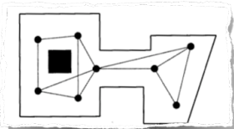
Abstractions
Waypoint Navigation
  Place waypoints and connections in the world
  Difficult to generate
  Localisation searches for nearest waypoint, but we need to validate movement to the waypoint (raycast)

Slide 40
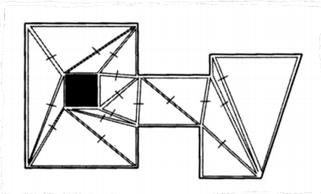
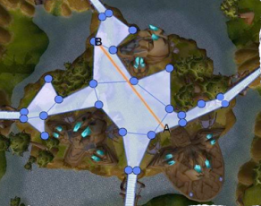
Abstractions
Navigation Meshes
  Set of polygons (often triangles) that describe navigable surface
  Better paths from smaller graphs
  Can generate from level geometry

Slide 41
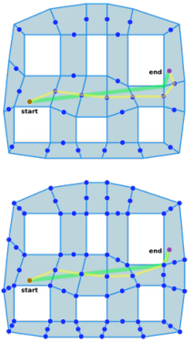
Abstractions
Navigation Meshes: Pathfinding
  Pathfinding returns a series of polygons
  Polygons can be crossed using edge midpoints.
    Adding vertex points improves cornering
  The path remains valid as long as the same polygons are used

Slide 42
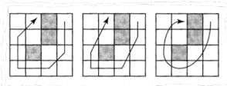
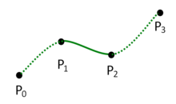
Abstractions
Path smoothing
  String pulling checks three consecutive points at a time: if the line from the first to the third is navigable, then the second is removed
  A smooth path that pass through the remaining points can be computed, e.g. using Catmull-Rom splines

Slide 43
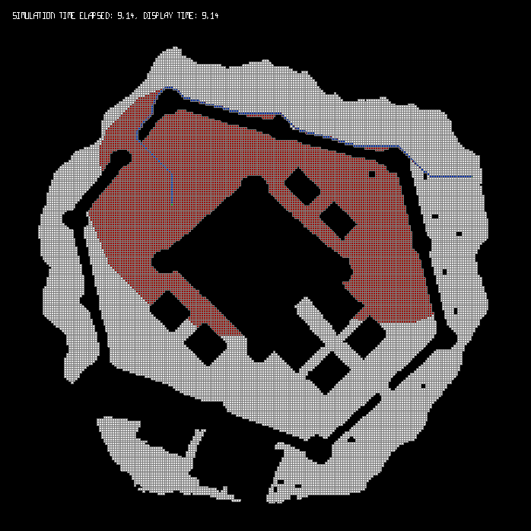
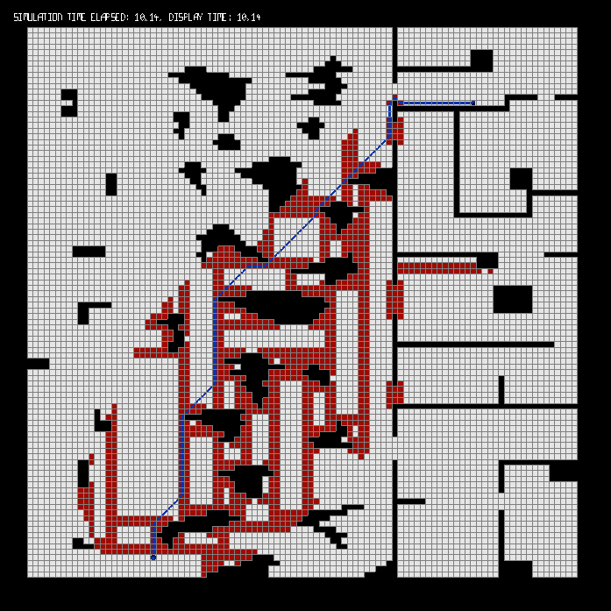
Improving A*

Slide 44
Improving A*
Memory Heuristics: Store precomputed distances between key locations
  Fast
  Optimal
  High memory
Abstraction: reduces size of search space
  Fast
  Low-memory
  Suboptimal paths
Search-space pruning: Identify nodes that don’t need to be explored
  Slow
    Low memory

Slide 45
Improving A*
Goal node
Precomputing paths
  “Next node” lookup table
    For given current, goal, return next node/edge in path
    Time: O(n)
    Space: O(n^2)
  Alteratively store as edge number as there are usually fewer edges per node than nodes
 | 1 | 2 | 3 | 4 | 5
1 | - | 2 | 3 | 3 | 2
2 | 1 | - | 3 | 3 | 5
3 | 1 | 2 | - | 4 | 2
4 | 3 | 3 | 3 | - | 5
5 | 2 | 2 | 2 | 4 | -
Current node
1
2
5
3
4

Slide 46
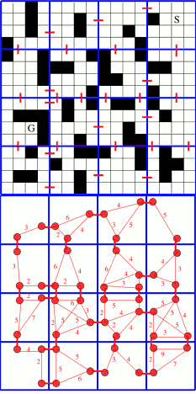
Improving A*
HPA*: Heirarchical variant of A*
  Pre-computed abstract graph
  Group low-level nodes into clusters
  Each cluster is represented by a subset that borders other clusters
  A* from start and goal to members of this cluster
  A* over abstract graph
  Refine into a path on original graph using A* or cached paths

Slide 47
Improving A*
Symmetry breaking
  In grids, you often get paths that only differ in the order of moves
  Performance gain from avoiding unnecessary work

Slide 48
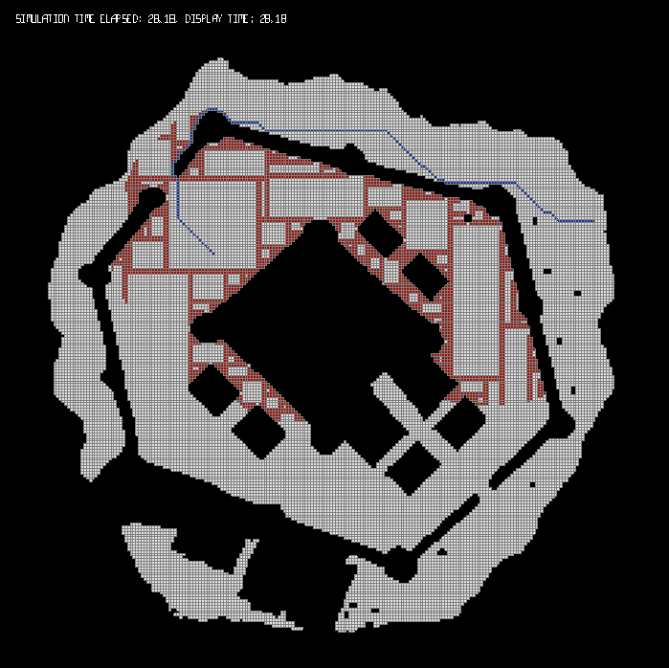
Improving A*
Rectangular Symmetry Reduction (RSR)
  Decompose map into empty rectangles
  Only expand nodes on perimeter of rectangle
Baulder’s Gate A* + RSR

Slide 49
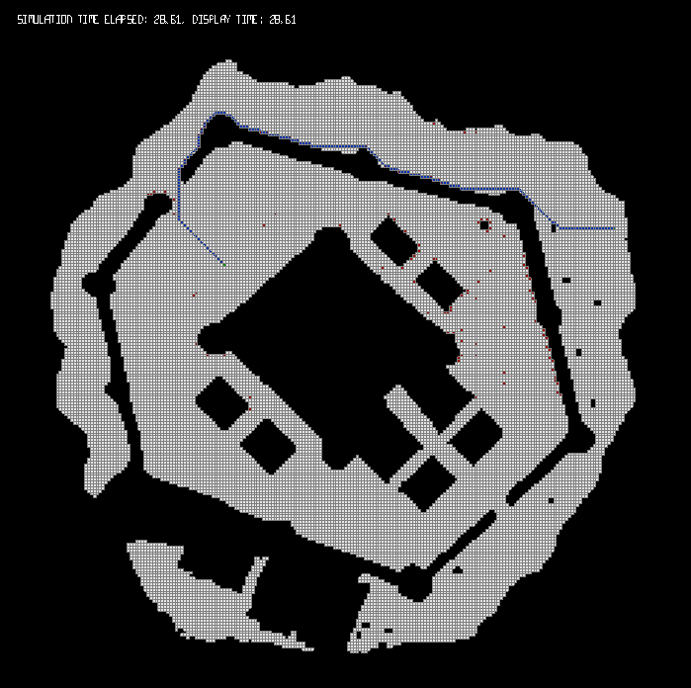
Improving A*
Jump Point Search (JPS)
  Avoid expanding neighbours that could be reached more optimally by parent
  Make jumps across open spaces
  More expensive per node, but fewer nodes
Baulder’s Gate A* + JPS

Slide 50
Improving A*
Dynamic pathfinding, e.g. D* Lite
  Plan in unexplored space or where path costs are changing
Angle-angle pathfinding, e.g. BlockA*
  Genertes shortest straight-line paths using line-of-sight checks
  Path smoothing as part of the algorithm
Incremental pathfinding, e.g. LPA*
  Re-uses information generated for previous (similar) searches
Low memory use, e.g. IDA*

Slide 51
Improving A*
Experiment with improvements to A* in your pathfinding agent
    Breaking ties
      https://theory.stanford.edu/~amitp/GameProgramming/Heuristics.html
    Path smoothing
    Precomputing paths
    Symmetry Reduction
      https://harablog.wordpress.com/2011/08/26/fast-pathfinding-via-symmetry-breaking/
    Implement an A* variant algorithm

Slide 52
Resources
More resources
  Amit’s A* Pages
    http://theory.stanford.edu/~amitp/GameProgramming/
  The Moving AI Lab @ U. Denver movingai.com

