Slide 1
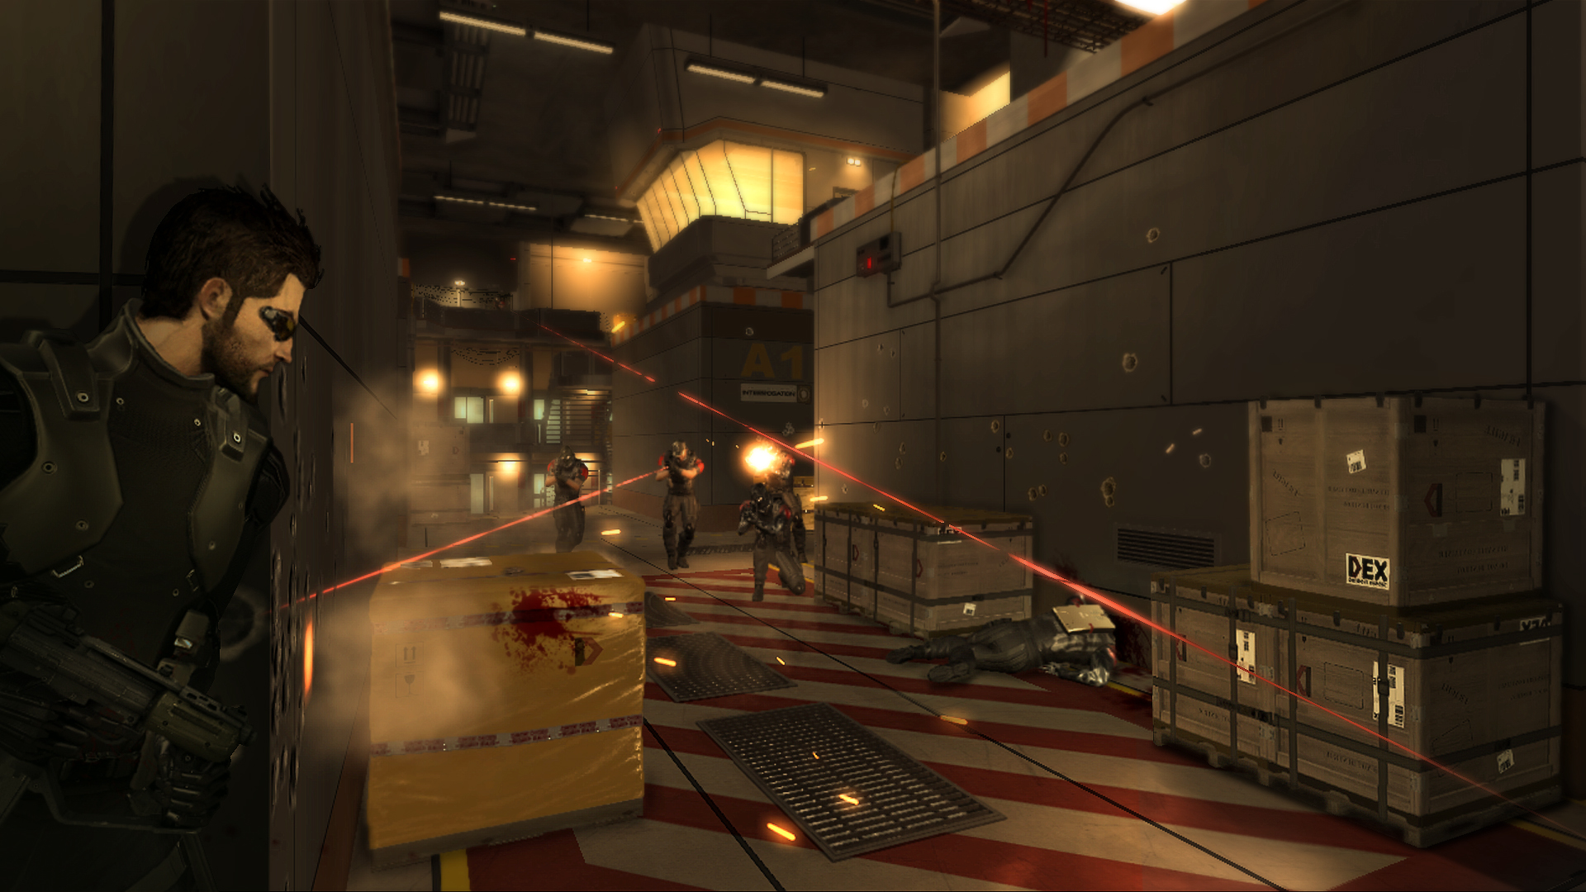
Games AI
Lecture 12.1
GOAP

Slide 2

Introduction
Most agent AI can be boiled down to the following tasks:

Slide 3
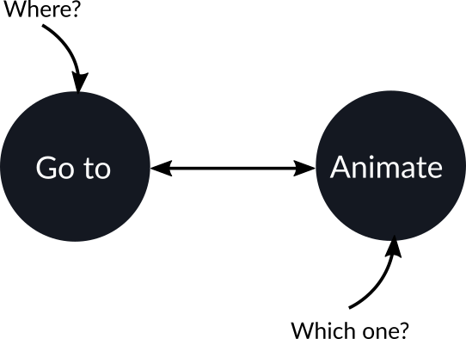
Introduction
This needs to be specified with parameters

Slide 4
Introduction
Managing increasing complexity is the challenge
  Bigger FSMs
  Larger FSM states
All to tell the agent where to go and what animation to play

Slide 5
Introduction
This is supposed to be AI
  Surely it should be deciding for itself!

Slide 6

Introduction
F.E.A.R:
  Rather than hard-code this in the FSM
  Decide using a planner
    Goal
    Oriented
    Action
    Planning

Slide 7
Introduction
Smarter, easier-to-build AI
  Actions are decoupled from one another
  Selected when appropriate to satisfy a goal

Slide 8
Introduction
Games using GOAP
F.E.A.R., Monolith Productions, 2005
  Jeff Orkin

Slide 9
















Slide 10
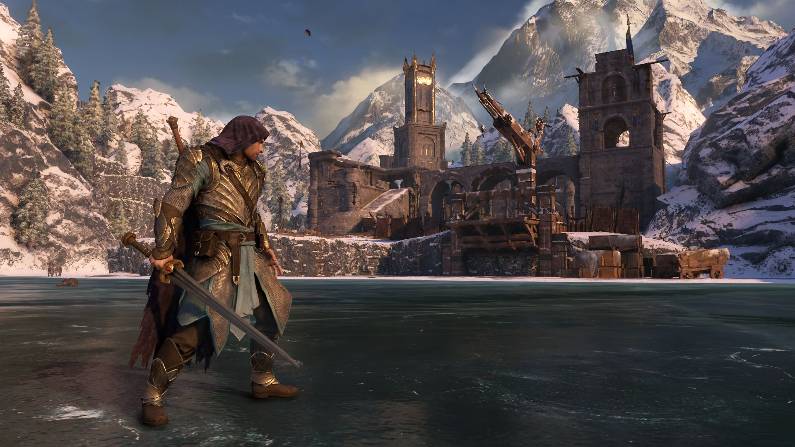
Planning

Slide 11
Planning
Planning
  Use a model to decide a sequence of actions to achieve a goal

Slide 12
Planning
FSM
  Procedural
Planning
  Declarative

Slide 13
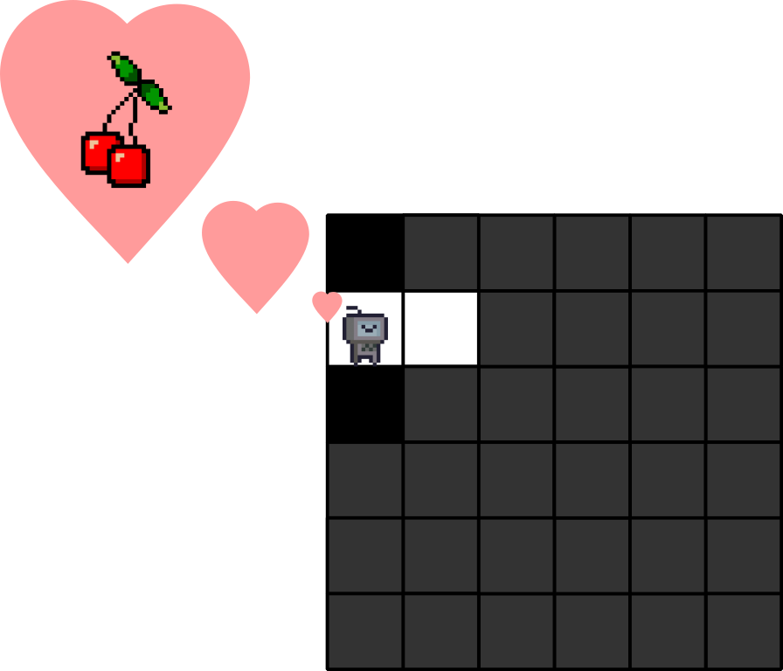
Planning
Problem:
  Find the cherries in the maze

Slide 14
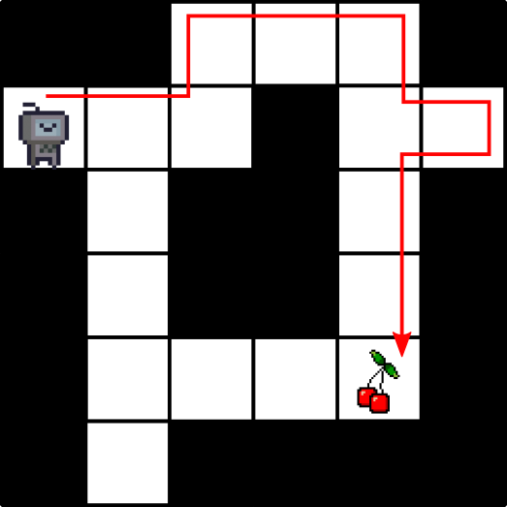
Planning
Procedural
  Always follow left wall

Slide 15
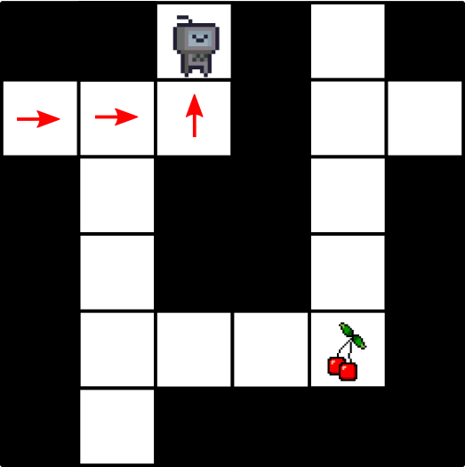
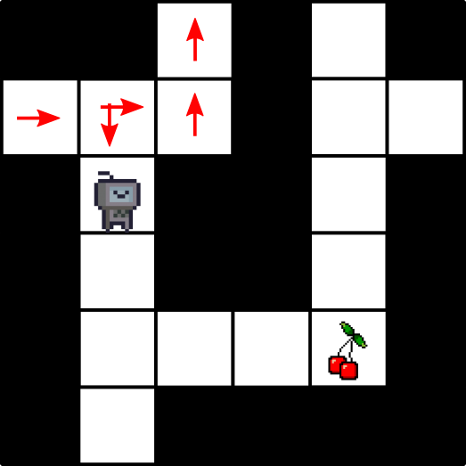
Planning
Procedural
  Always follow left wall
  Leave chalk arrows and backtrack when reach a dead-end

Slide 16
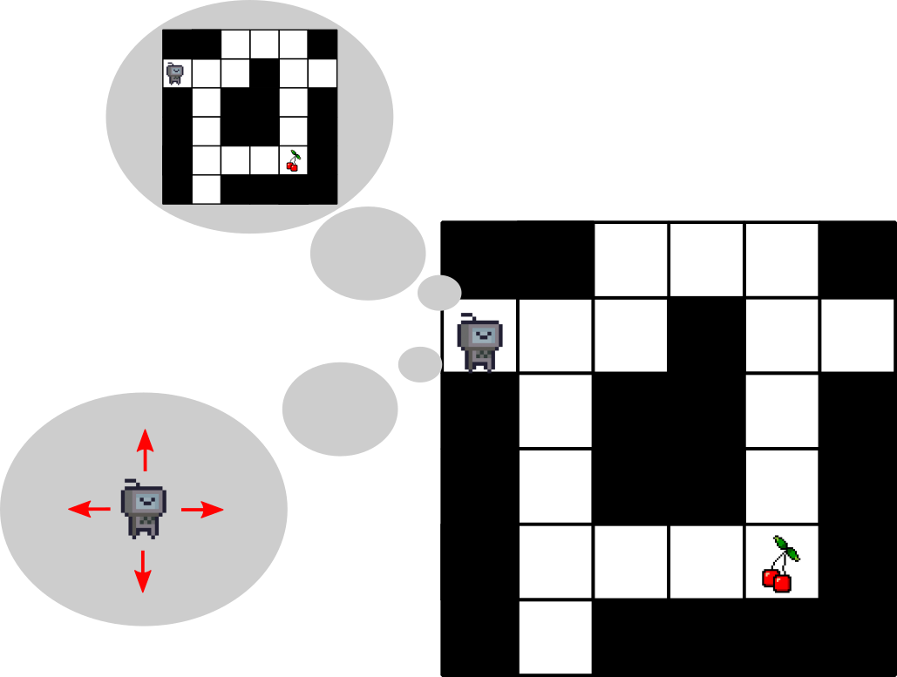
Planning
Declarative
  Give a problem definition:
    What is the map?
    What are the ways you can move?
  Plan a path before moving

Slide 17
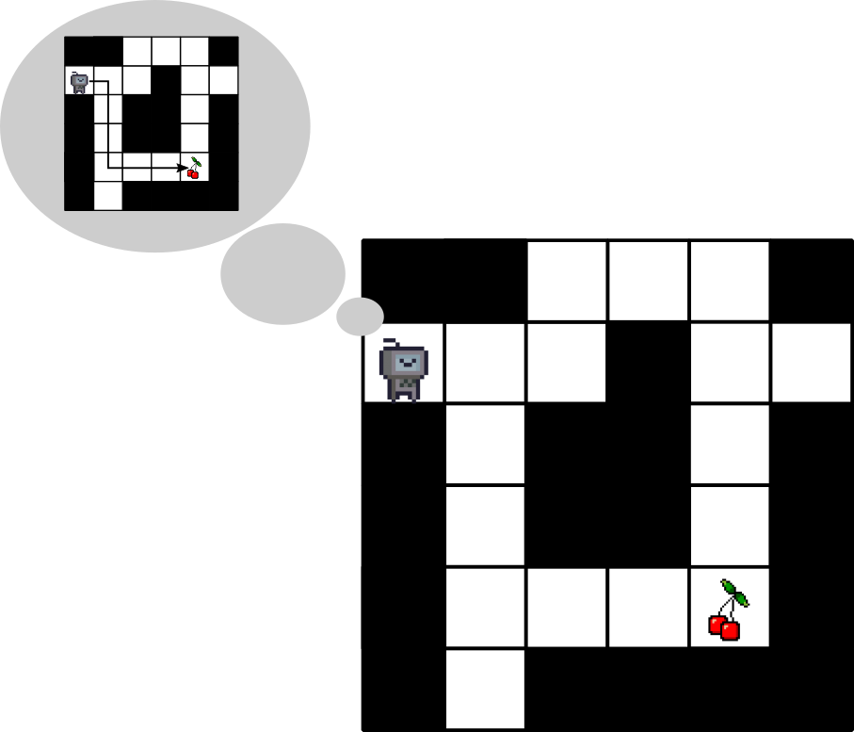
Planning
A*
  Uses a map to plan a sequence of moves to get to a target

Slide 18
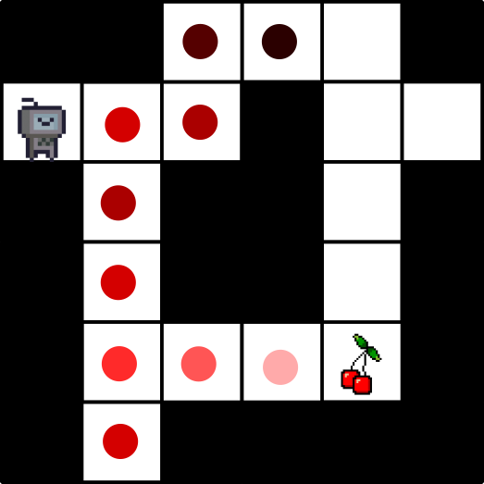
Planning
A*
  Explores neighboring states/positions
  Priorities which to explore by
    Cost to reach
    Heuristic

Slide 19
Planning
Declarative approach:
  You can solve any problem you can define in the declarative language
  e.g. any map you can give to A* it can find the shortest path (if it exists)

Slide 20
Planning
Requirements for planning
  Goal
  Model
    States
    Actions

Slide 21

Planning
State
  How do we represent an agent’s knowledge about the world?
  Goal: What does the agent want to be true of the state?

Slide 22

Planning
Actions:
  What actions can an agent perform?

Slide 23

Planning
Actions:
  Preconditions: What needs to be true of the state to perform an action?

Slide 24
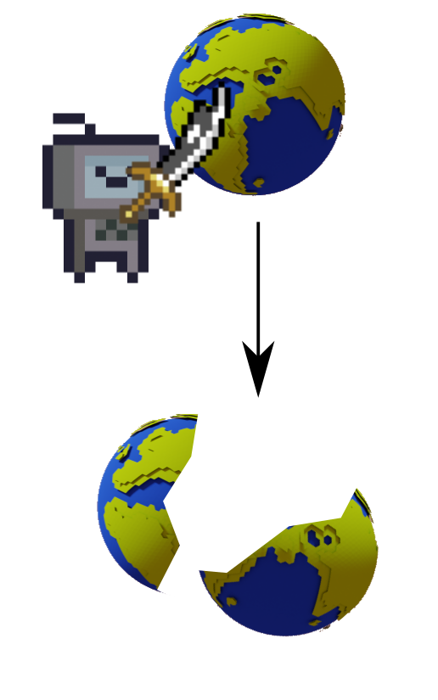
Planning
Actions:
  Preconditions: What needs to be true of the state to perform an action?
  Effects: How does an action change the state?

Slide 25
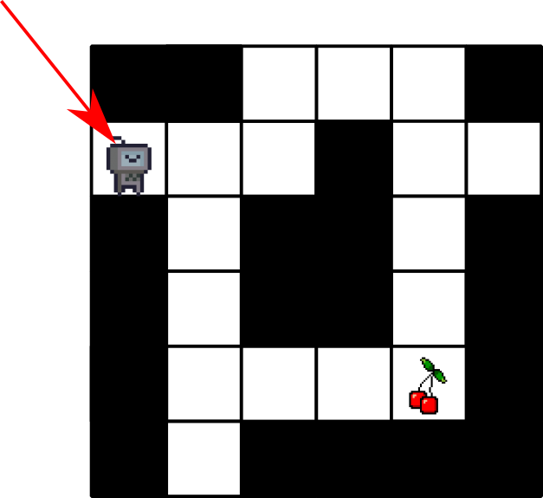
Planning
A* State
  Position of agent

Slide 26
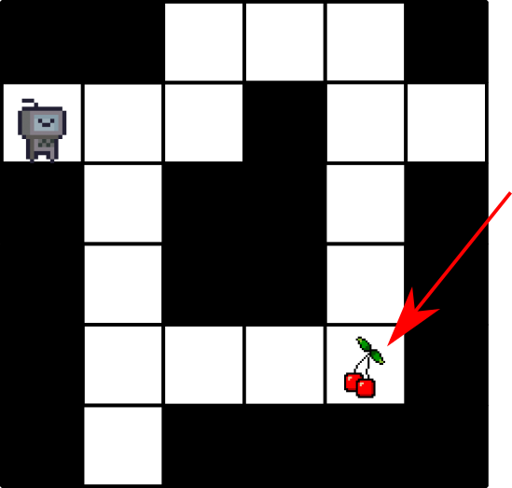
Planning
A* Goal
  Agent at target

Slide 27
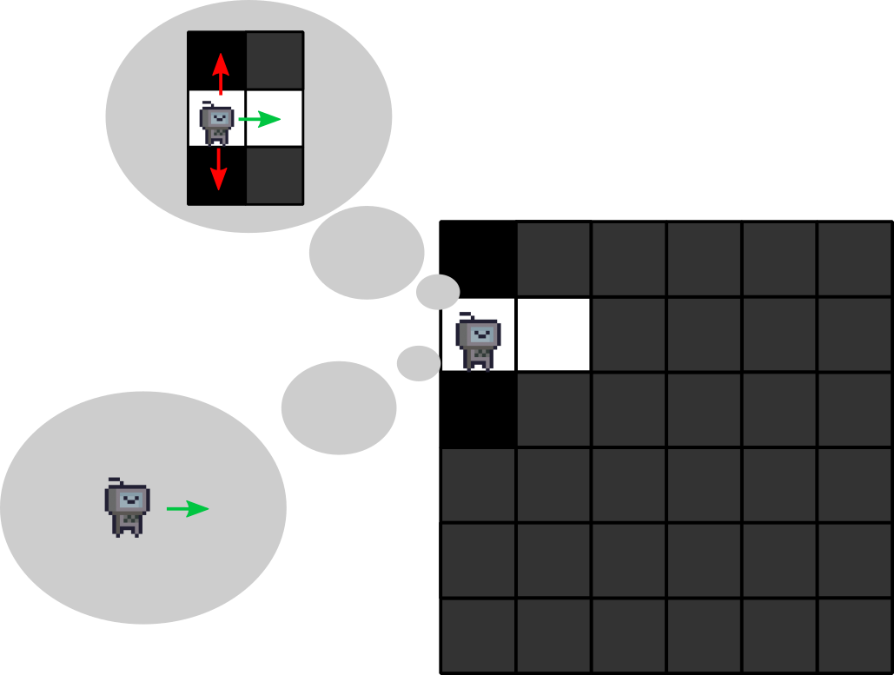
Planning
A* Actions
  Precondition: The tile is walkable
  Effect: The agent moves to the tile

Slide 28
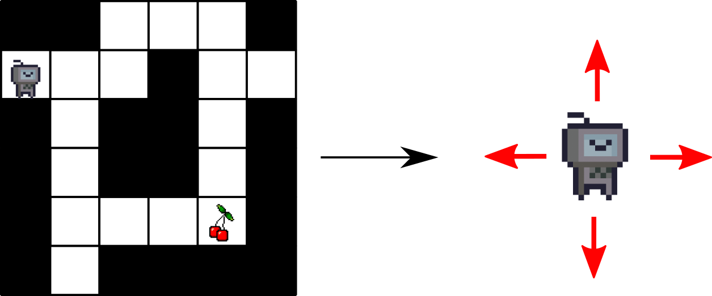
Planning
Planning as Search
  What actions can we perform?

Slide 29
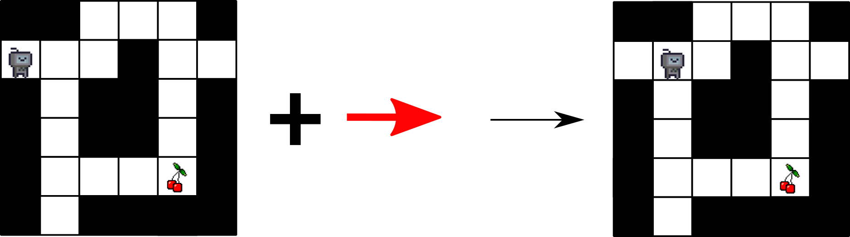
Planning
Planning as Search
  What actions can we perform?
  What state do they take us to?

Slide 30
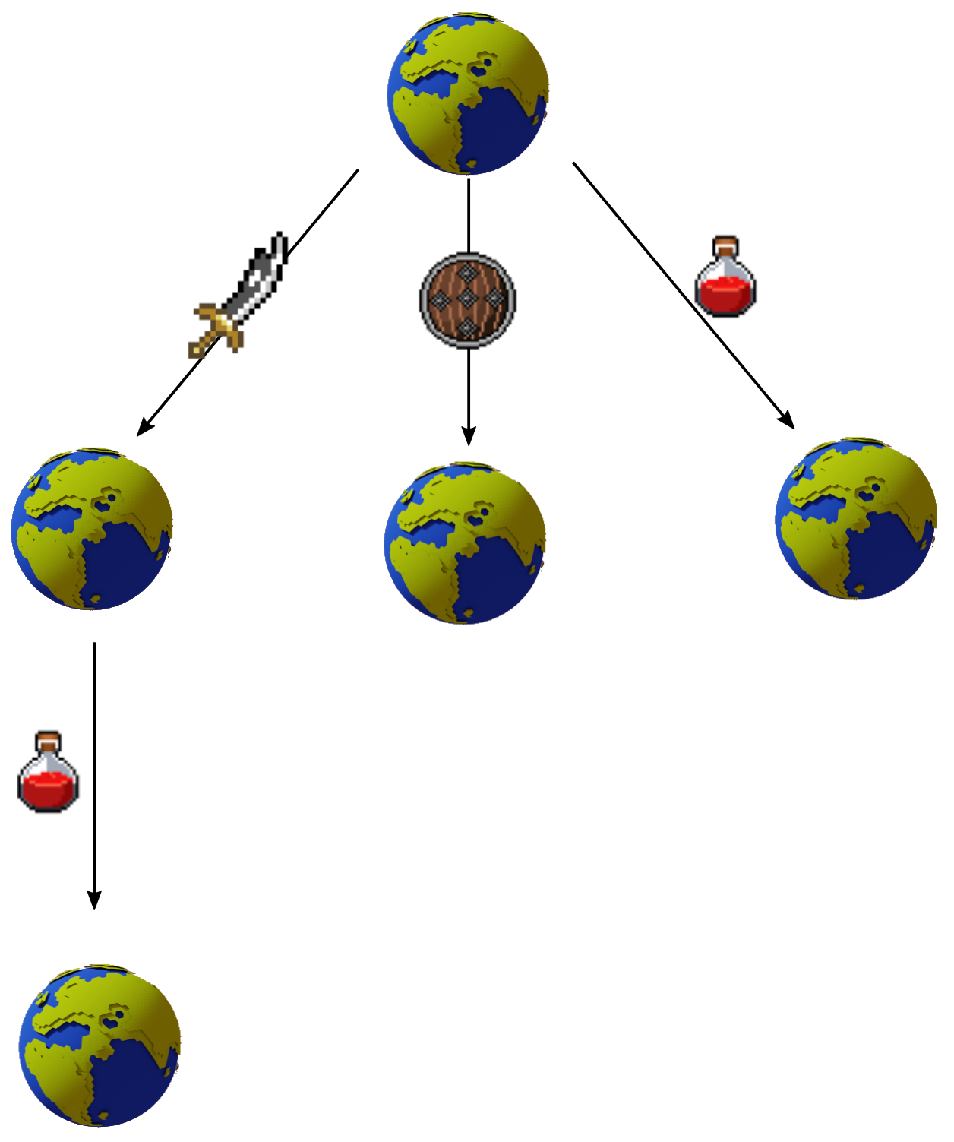
Planning
Planning as Search
  What actions can we perform?
  What state do they take us to?
  Construct a tree of action sequences

Slide 31
Planning
Summary
  Represent agents knowledge as state
  Define (declarative)
    Goal
    Actions
      Preconditions
      Effects

Slide 32
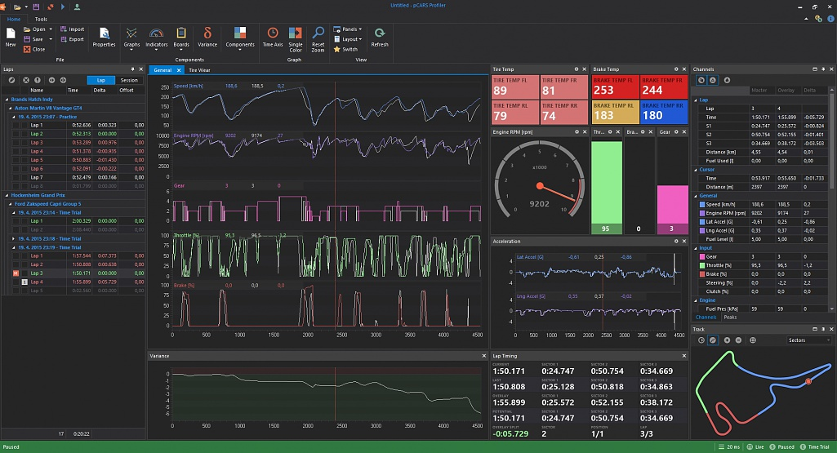
GOAP planner

Slide 33
GOAP Planner
GOAP is based on STRIPS
  STanford Research Institute Problem Solver
  Goals
    Desired state of world
  Actions
    Preconditions
    Effects

Slide 34
GOAP Planner
State is a set of variables that define the world (model)

Slide 35

GOAP Planner
State:
  Have sword?
  Have shield?
  Have potion?
  Healthy?
  Enemy alive?

Slide 36

GOAP Planner
State tracks knowledge about the world
  Starting state
    What facts do we know?
Start:
  true
  false
  true
  true
  true

Slide 37
GOAP Planner
State tracks knowledge about the world
  Starting state
    What facts do we know?
  Action effects
    What changes?
Reckless attack:
–––
–––
–––
false
false

Slide 38
GOAP Planner
State tracks knowledge about the world
  Starting state
    What facts do we know?
  Action effects
    What changes?
  Goals
    What do we want to be true?
Goal:
  –––
  –––
  –––
  true
  false

Slide 39
GOAP Planner
Action prerequisites and effects are described in terms of the variables in the state
Prerequisites
Effects
Attack:
true
–––
–––
true
true
Defend:
–––
true
–––
true
–––
Potion:
–––
–––
true
–––
false
Attack:
–––
–––
–––
false
false
Defend:
–––
–––
–––
–––
–––
Potion:
–––
–––
false
true
–––

Slide 40
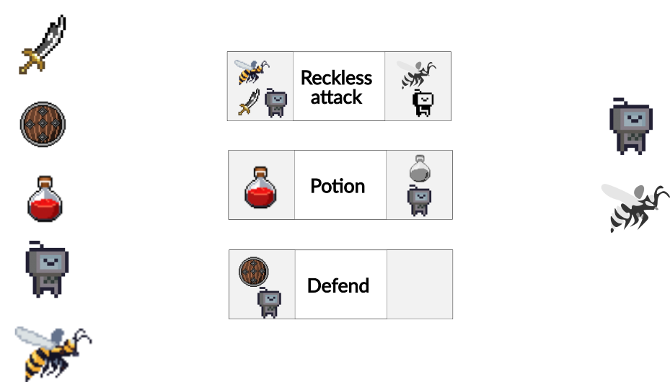
GOAP Planner

Slide 41
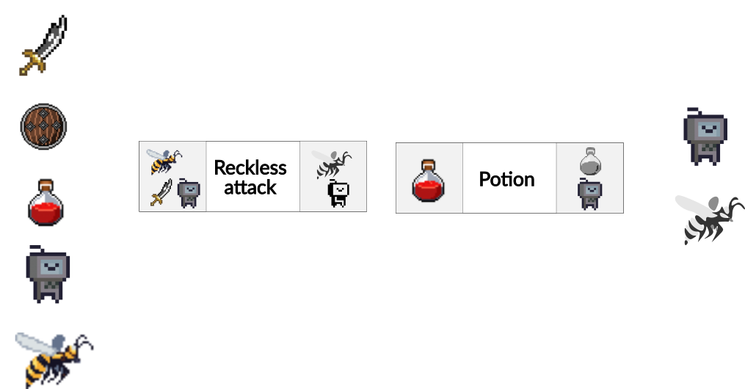
GOAP Planner

Slide 42
GOAP Planner
How do we plan? Tree search
  Initial State: Starting state
  State-Action mapping: from action preconditions
  Transition Model: from action effects
  Goal Test: Goal satisfied?
  Cost function: each action can be assigned a cost

Slide 43
GOAP Planner
How do we plan? A*
  Cost function: action cost
  Heuristic: distance from goal in # different variables

Slide 44
GOAP in F.E.A.R

Slide 45
GOAP in F.E.A.R
Each agent has a GoalSet, e.g.
  Patrol
  Kill Enemy
New goals can easily be added to this set

Slide 46
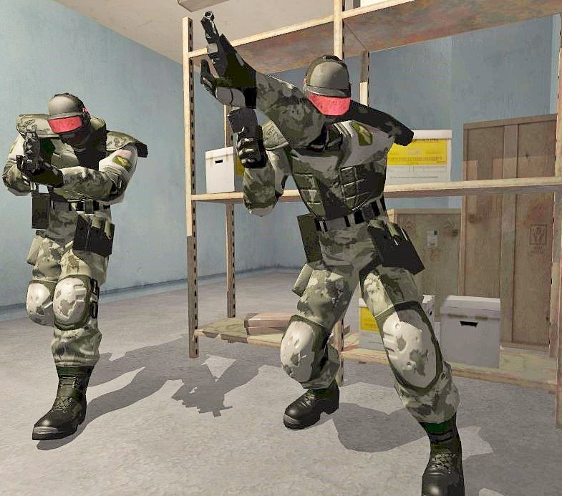
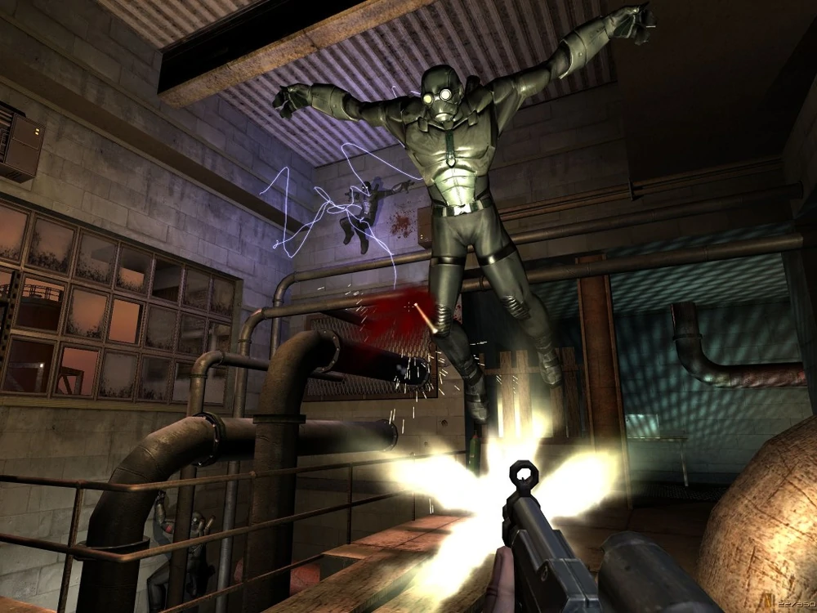

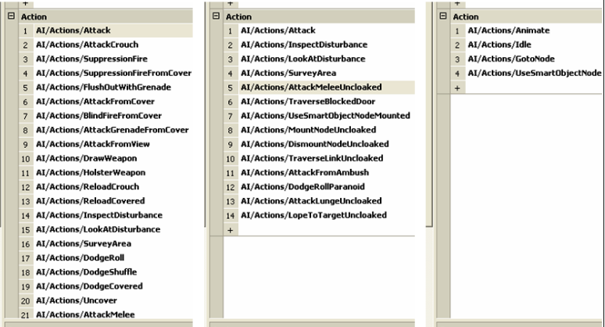
GOAP in F.E.A.R
Agents have different actions available
  Attempt to accomplish goals in very different ways

Slide 47
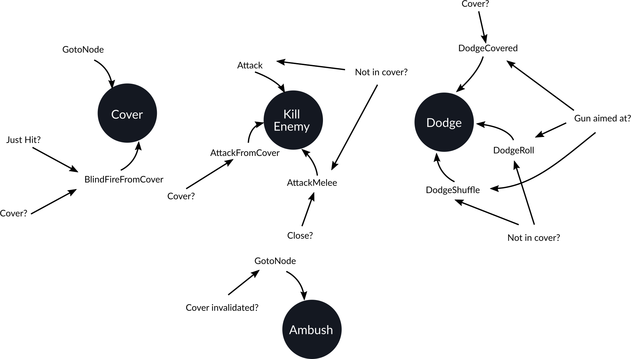
GOAP in F.E.A.R

Slide 48
GOAP in F.E.A.R
Procedural Preconditions
  Preconditions that you evaluate when you need them, rather than always keeping up to date
Procedural Effects
  Let acting system apply changes to world state model

Slide 49
GOAP in F.E.A.R
The world changes around the agents
  Player actions
  Other agents
Plans must be validated / replanned
  Plans are validated when created
  Actions are validated before being performed
    If an action is no longer possible, the agent replans

Slide 50
GOAP in F.E.A.R
Cooperation
  Enemies in F.E.A.R. have no knowledge of each others’ existence
  Cooperative behavior comes from agents being assigned goals that line up nicely

Slide 51
GOAP in F.E.A.R
Squads
  Squad manager periodically assigns units to squads based on proximity
  Squad manager assigns squad behaviors
  Units have goal to follow squad behavior
    But their own goals, e.g. Dodge might sometimes take priority

Slide 52
GOAP in F.E.A.R
Simple Squad Behaviors
  Get-to-Cover
    All squad members get to cover
  Advance-cover
    One squad member provides covering fire while others advance to closer cover
  Orderly-Advance
    Advance in a line
  Search
    Split into pairs who cover each other and search rooms

Slide 53
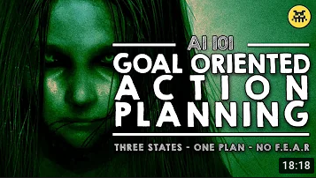
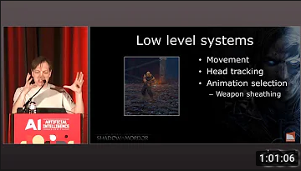
Recommended Reading
Jeff Orkin’s Goal-Oriented Action Planning (GOAP) page http://alumni.media.mit.edu/~jorkin/goap.html
Jeff Orkin. 2006. 3 States and a Plan. GDC http://alumni.media.mit.edu/~jorkin/gdc2006_orkin_jeff_fear.pdf
Building the AI of F.E.A.R. with Goal Oriented Action Planning | AI 101 https://youtu.be/PaOLBOuyswI
Goal-Oriented Action Planning: Ten Years of AI Programming https://youtu.be/gm7K68663rA

