Slide 1
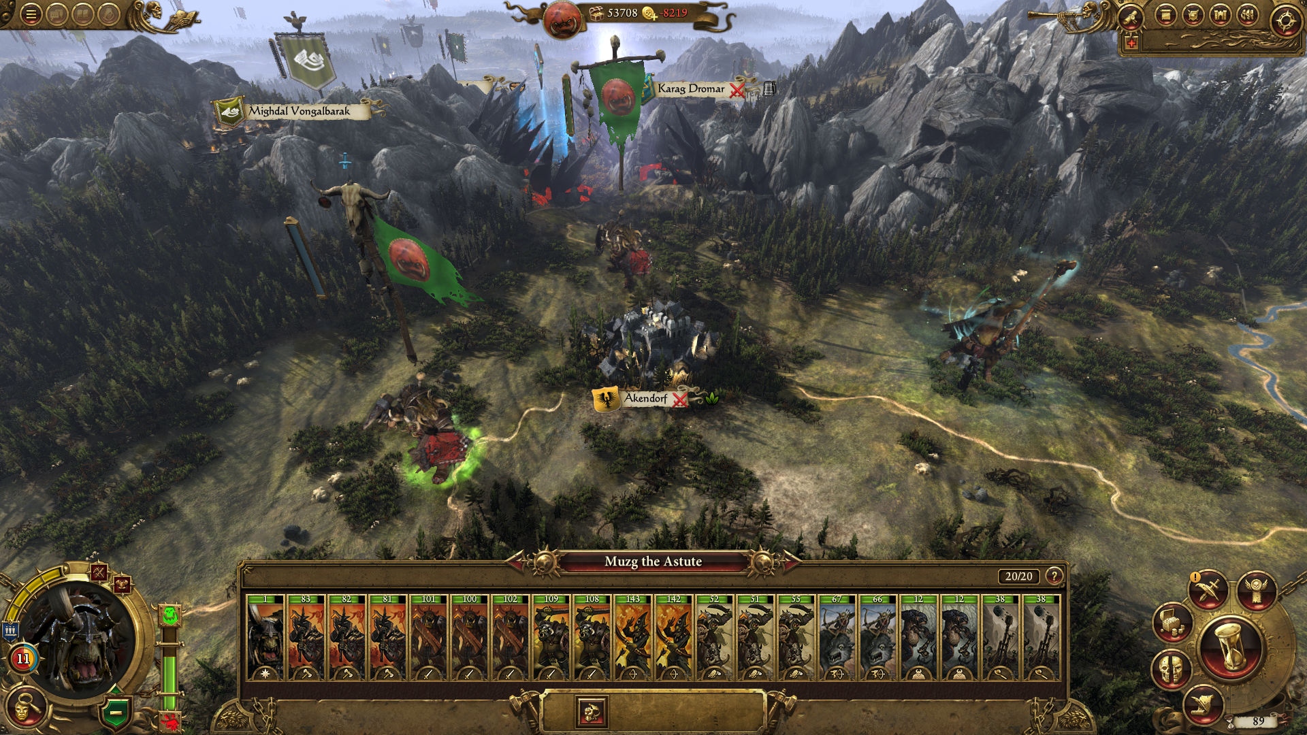
Games AI
Lecture 7.1
Whole Game Search

Slide 2
Overview
Whole-Game Search
  Solving Problems with Serach
  Tree Search
  Adversarial Search

Slide 3
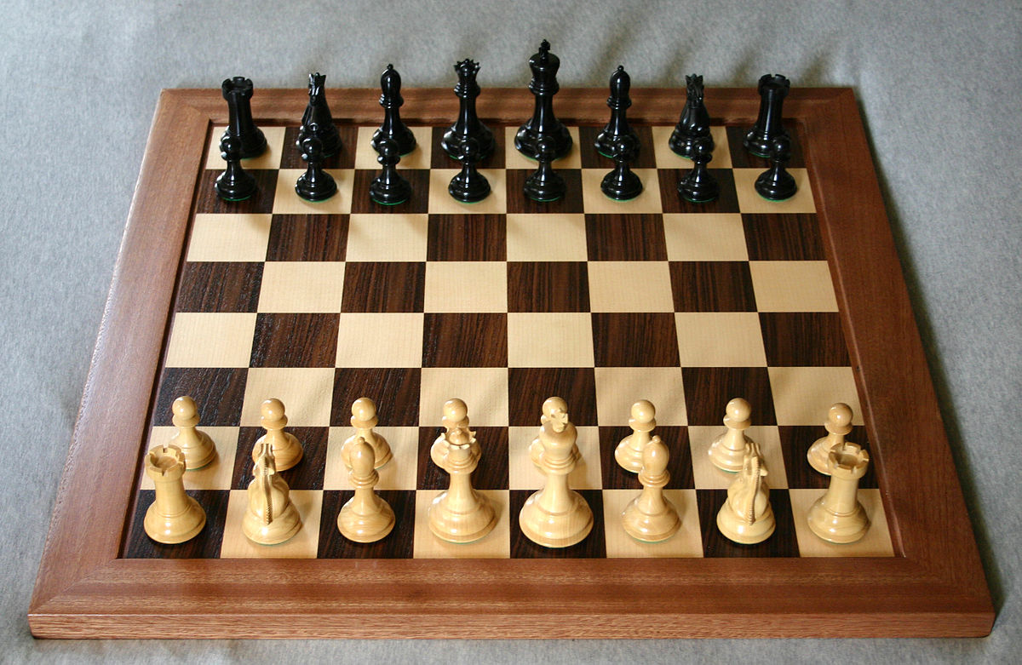
Introduction
AI Player
  Turn based games
  Playing to win

Slide 4
Introduction
State 1
Turn-based Games
  Game states
  Actions
State 2

Slide 5
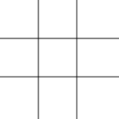
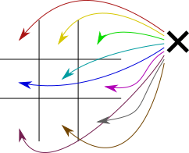
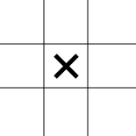
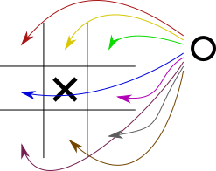
Introduction

Slide 6
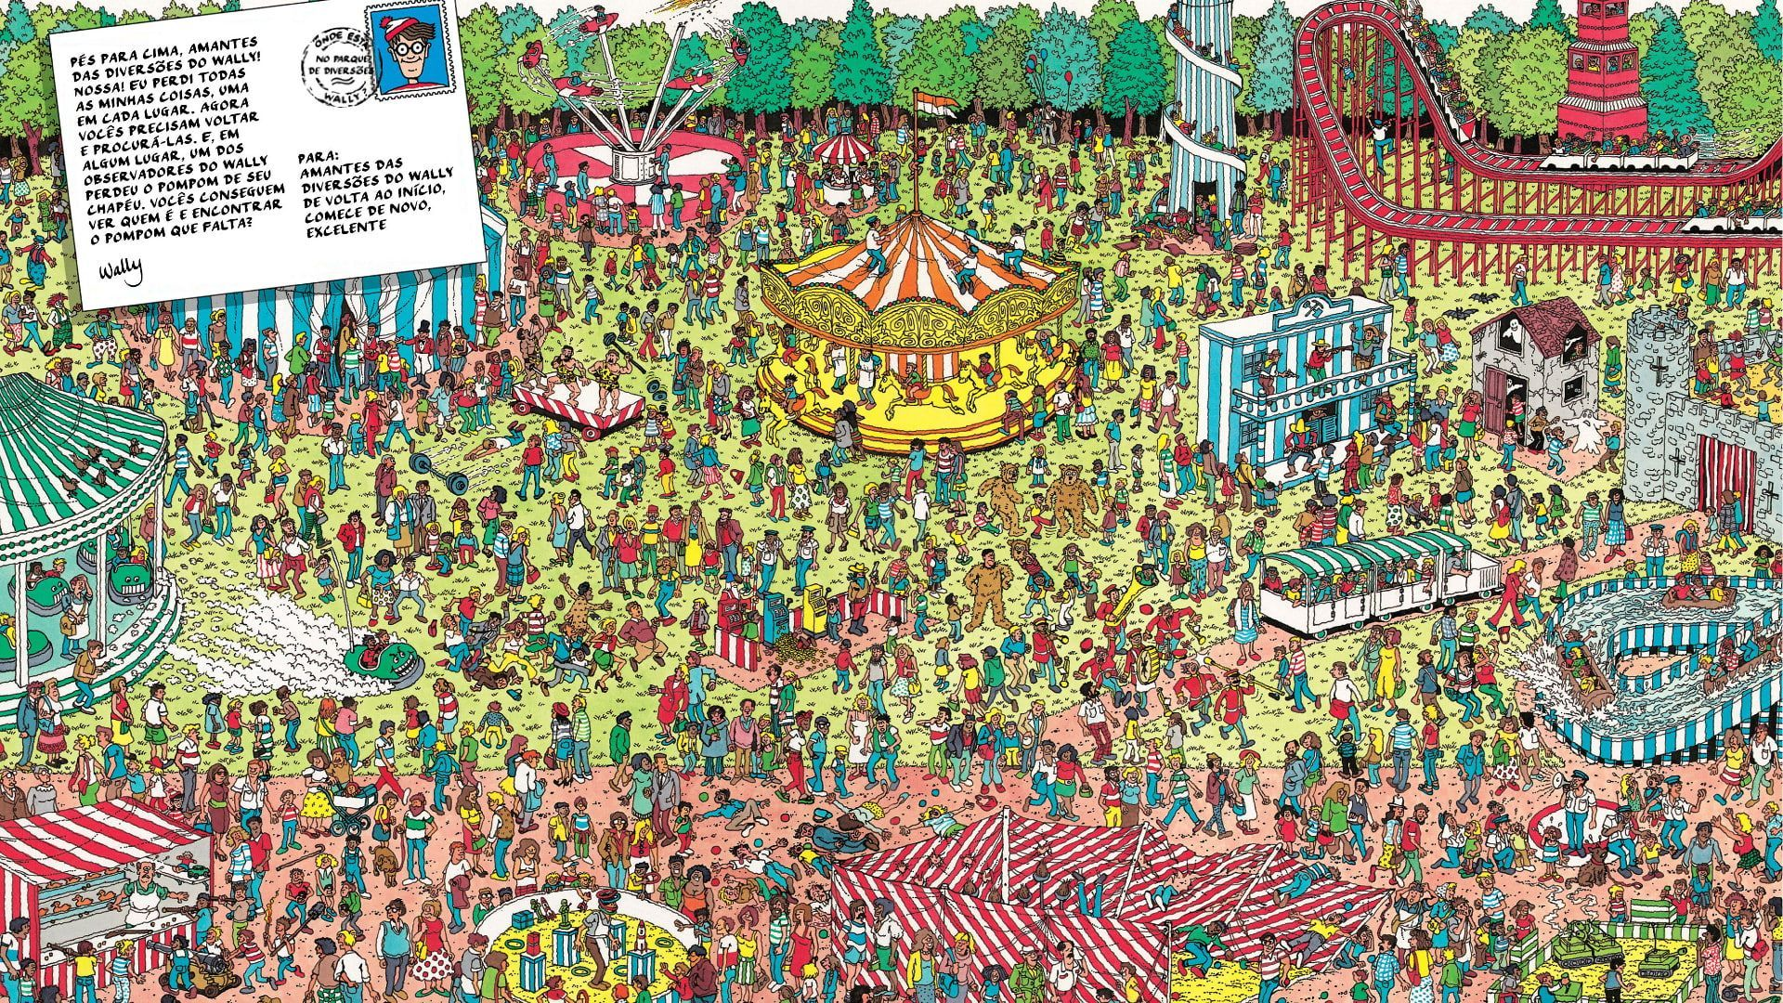
Solving Problems With Search

Slide 7
Solving Problems with Search
Well-defined problems have five components
  Initial state
  State-action mapping
  Transition model
  Goal test
  Path cost function

Slide 8

Solving Problems with Search
1 player game
  A farmer has a fox, a chicken, and a sack of corn
  He needs to get them all across a river
  If he leaves the sack of corn with the chicken, it eats it
  If he leaves the fox with the chicken, it eats it
  Only one thing can fit in his boat

Slide 9

Solving Problems with Search
Initial State
  LeftBank: { Farmer, Chicken, Corn, Fox }
  RightBank: { }

Slide 10
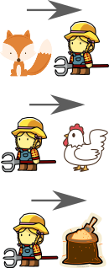
Solving Problems with Search
State-Action Mapping
  What actions can we do from this state?

Slide 11

Solving Problems with Search
Transition Model
  What state do we get if we apply action X in state Y?
?
+

Slide 12

Solving Problems with Search
Goal Test
  Have we won?
✓

Slide 13
Solving Problems with Search
Step Cost Function
  How expensive is a particular move?
1
1
1

Slide 14
Solving Problems with Search
For many games, we can define these five components
  Initial state
  State-action mapping
  Transition model
  Goal test
  Path cost function
Combined, these let us build a tree of game states
  Then we search this tree

Slide 15
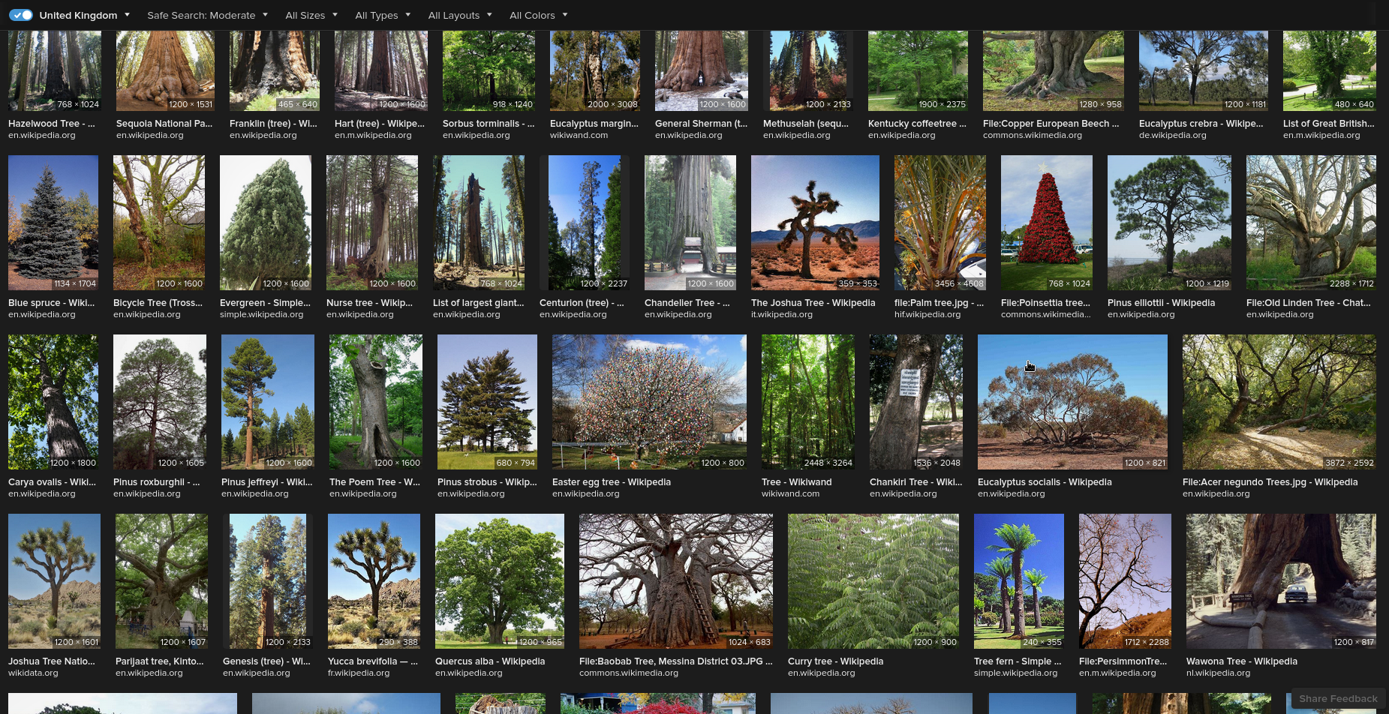
Tree Search

Slide 16
Tree Search
We can construct a tree of Game States
  Root of tree is Initial State
  Each child is the result of applying one action (transition model)
  Goal states are leaf nodes
Let’s remind ourselves of a basic tree search algorithm

Slide 17
Tree Search
0
Queue
0
Breadth-first search
Set up:
  Create queue
  Add start to queue
  Mark as discovered

Slide 18
BFS
0
Queue
While queue is not empty
  Select top of queue
  Check if goal

Slide 19
BFS
0
Queue
1
2
3
While queue is not empty
  Select top of queue
  Check if goal
  Add all undiscovered children to queue
  Mark each child as discovered
1
2
3

Slide 20
BFS
0
Queue
2
3
4
5
6
While queue is not empty
  Select top of queue
  Check if goal
  Add all undiscovered children to queue
  Mark each child as discovered
1
2
3
4
5
6

Slide 21
BFS
0
Queue
3
4
5
6
7
8
9
While queue is not empty
  Select top of queue
  Check if goal
  Add all undiscovered children to queue
  Mark each child as discovered
1
2
3
4
5
6
7
8
9

Slide 22
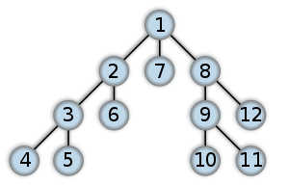
Tree Search
Depth-first Search
  Start at the root node
  Pick the first child
  Keep exploring down the tree until terminal node is reached.
  Then backtrack a step and take next branch...

Slide 23
Tree Search
Depth-first Search Pseudocode
procedure DFS_iterative(G, v) is
let S be a stack
S.push(v)
while S is not empty do
v = S.pop()
if v is not labeled as discovered then
label v as discovered
for all edges from v to w in G.adjacentEdges(v) do
S.push(w)

Slide 24
Tree Search
Depth-first Search
  Path found may not be shortest
  Might find a path quickly (depending on tree)
  Might not terminate (if infinite tree)

Slide 25
Tree Search
Find a path to goal state
  Path is a sequence of actions = a plan
Deterministic?
  Execute plan step by step
Stochastic/Multiplayer?
  Execute 1st action in plan
  Replan

Slide 26
Tree Search
Guided Search
  We can use heuristics to guide our search (remember A*)
  Heuristics often involve domain-specific knowledge
    e.g. count value of peices in chess
    What would be a good heuristic for the farmer puzzle?
  MCTS uses rollouts (playing the game randomly until win/lose) to decide how interesting a state is
    It’s an example of a general game-playing algorithm

Slide 27
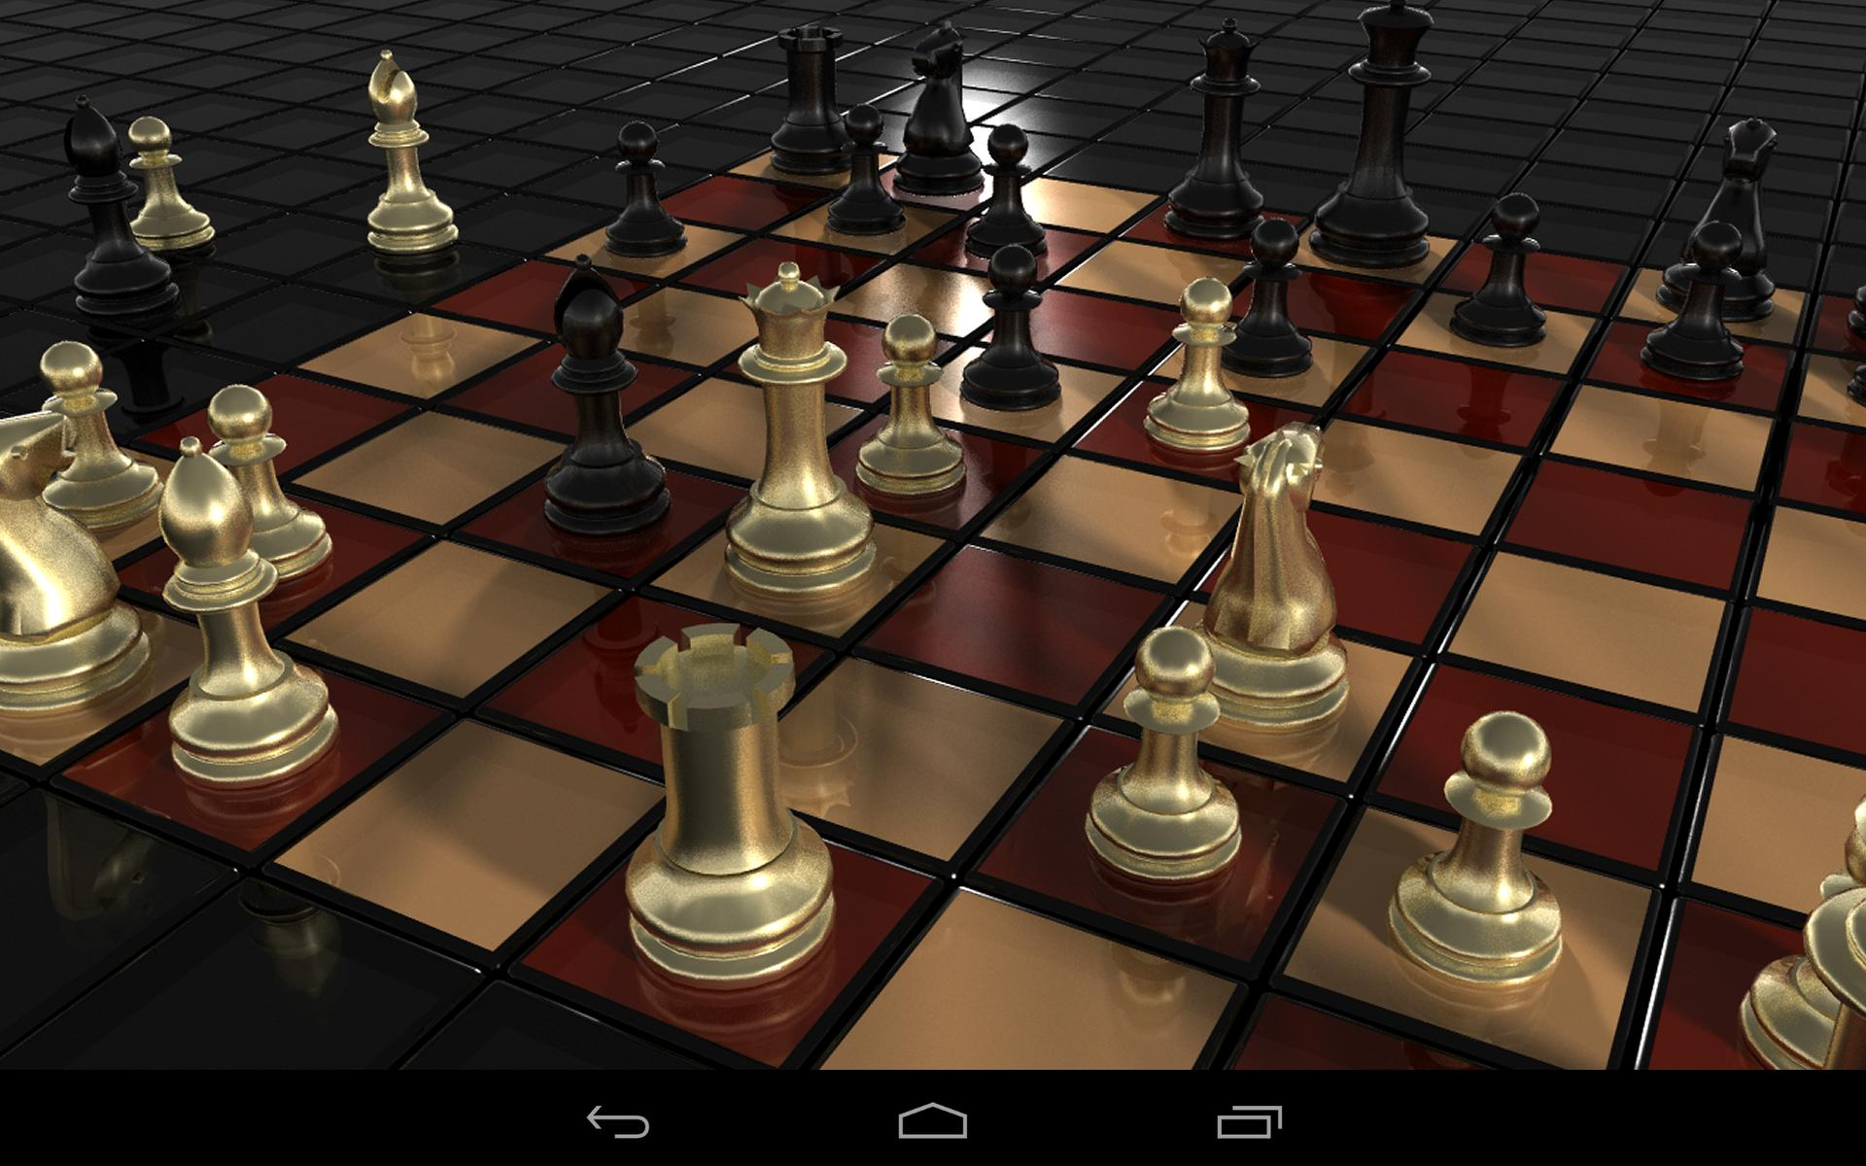
Adversarial Search

Slide 28
Adversarial Search
Two-player zero-sum games (e.g. chess/tic-tac-toe)
  Two players called MIN and MAX
Imagine we’re playing MAX
  On our turn we (MAX) want to pick a good move
  On their turn, MIN wants to pick a bad move (for us)
    Assume MIN is playing optimally

Slide 29
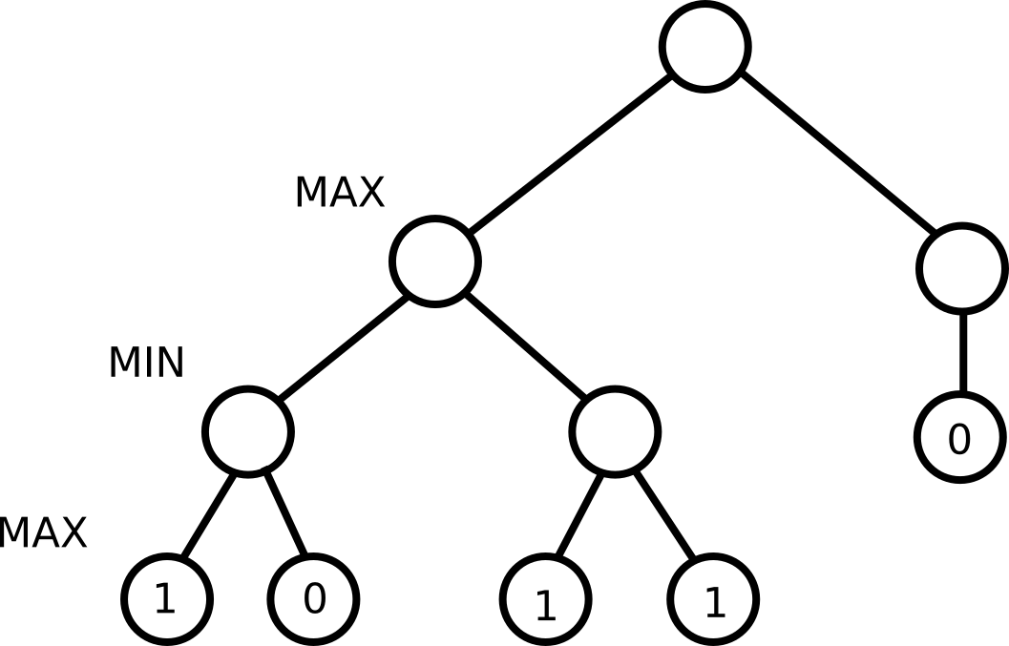
Adversarial Search
Terminal States
  If MAX wins, utility = 1
  If MIN wins, utility = 0

Slide 30
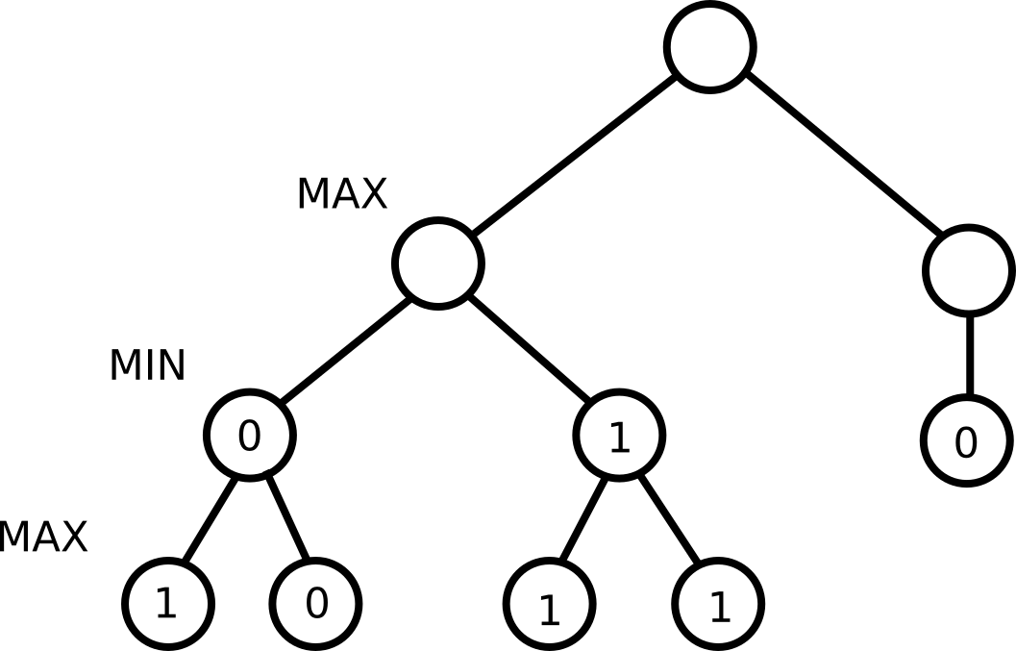
Adversarial Search
MINIMAX value of a state s
  MAX’s turn: max utility of all children
  MIN’s turn: min utility of all children

Slide 31
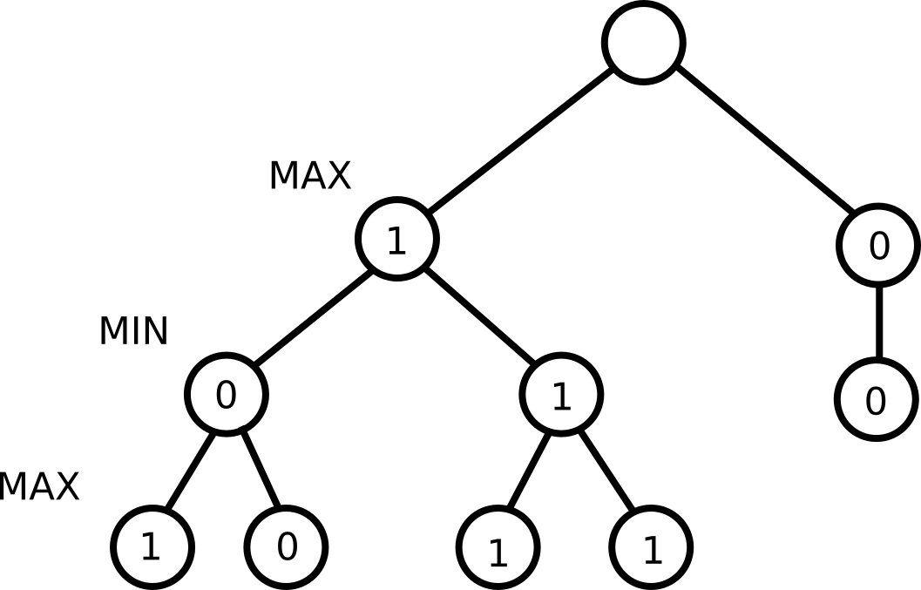
Adversarial Search
MINIMAX value of a state s
  MAX’s turn: max utility of all children
  MIN’s turn: min utility of all children

Slide 32
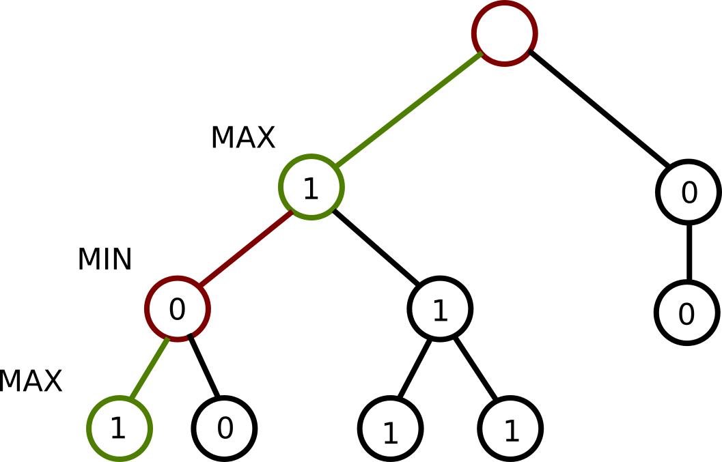
Adversarial Search
Which move should we pick?

Slide 33
Adversarial Search
The Minimax Algorithm
function minimax(node, maximizingPlayer)
if node is a terminal node then
return the heuristic value of node
if maximizingPlayer then
value := −∞
for each child of node do
value := max(value, minimax(child, FALSE))
return value
else /* minimizing player */
value := +∞
for each child of node do
value := min(value, minimax(child, TRUE))
return value

Slide 34
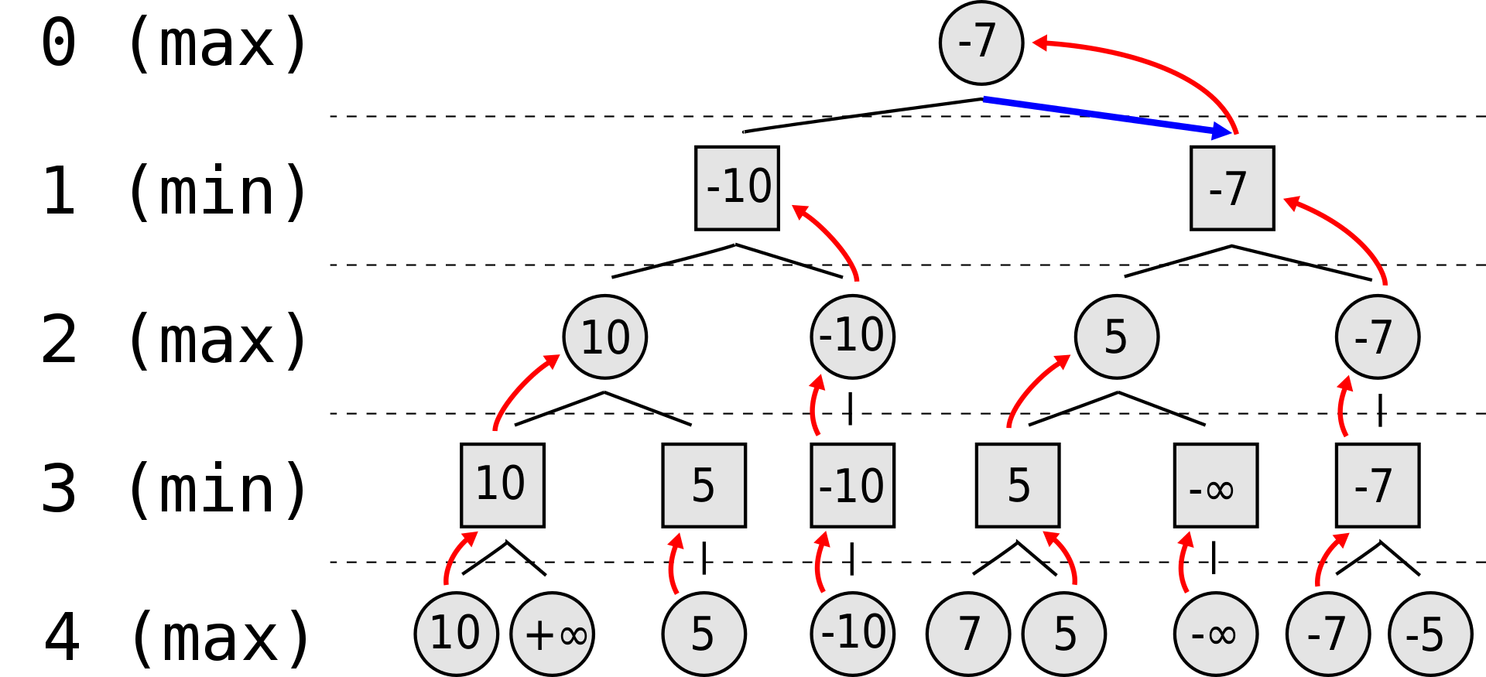
Adversarial Search
Image CC BY-SA 2.5 Nuno Nogueira on Wikipedia

Slide 35
Adversarial Search
Alpha-beta Pruning
  Sometimes parts of a minimax tree will have no effect on the final outcome
    We can “prune” those branches (not explore them)

Slide 36
Adversarial Search
Say you’ve got a good move, Move A
  You check other moves just in case one is better
  Move B looks pretty good at first, but then you find your opponent can force a win
  Even if every other outcome of Move B is amazing, you’ll never want to take Move B.

Slide 37
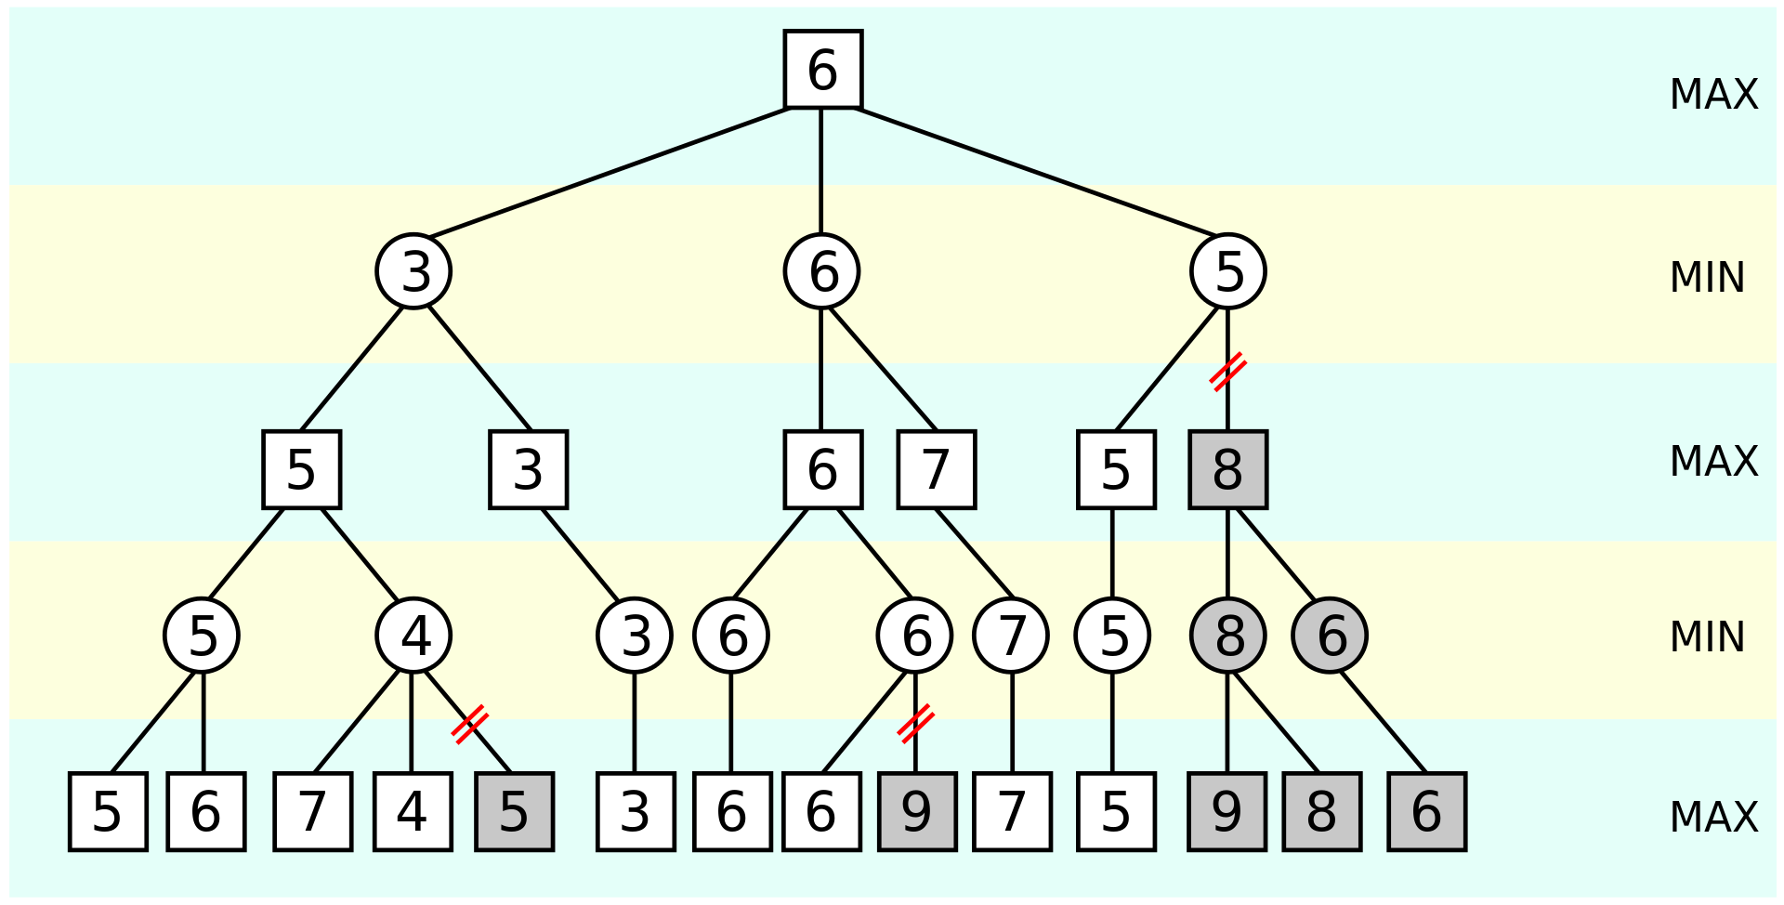
Adversarial Search
Image CC BY-SA 3.0 Jez9999 on Wikipedia

Slide 38
Abstracting for Search

Slide 39
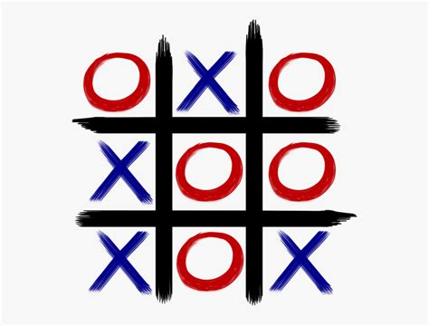
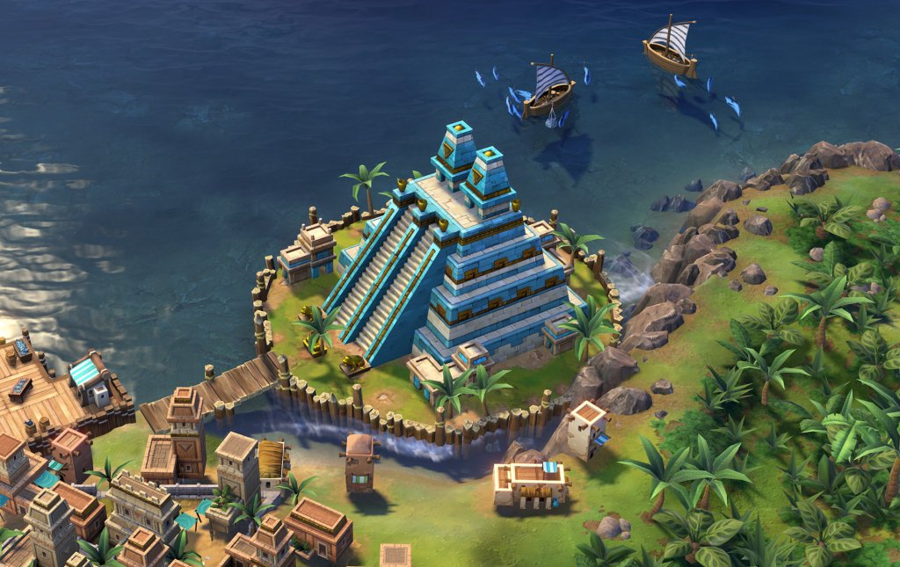
Abstracting for Search
Branching Factor
  The more moves available, the more search required

Slide 40
Abstracting for Search
Depth
  The move move it takes to a goal state, the more search required
    Use depth-limited search, and value non-terminal states using a heuristic

Slide 41
Abstracting for Search
Continuous games still have states - they’re just very quick (leading to very deep trees)
  MCTS can play simple continuous games
  Macro actions = e.g. “Move Left for 10 turns”

Slide 42
Abstracting for Search
Too complex?
  Devise strong heuristics
  Search a simplified version of the game
    Just like we can simplify our pathfinding graph
      Non-optimal, but faster
  Cheat

Slide 43
Abstracting for Search
Summary
  Construct tree of game states
  Search tree for path to goal
  Can do adversarial search
  Games are often too complex for simple search algorithms
    Use heuritics
    Alpha-beta pruning
    MCTS

Slide 44
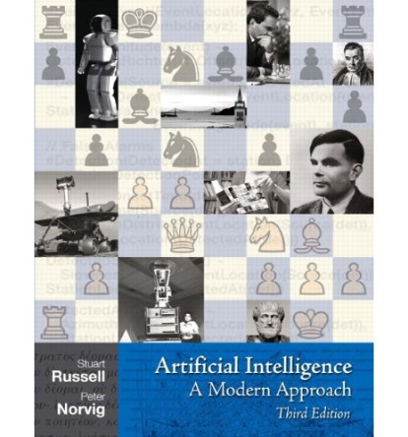
Recommended Reading
Recommended Reading
  Russel & Norvig, Ch. 5

