Slide 1
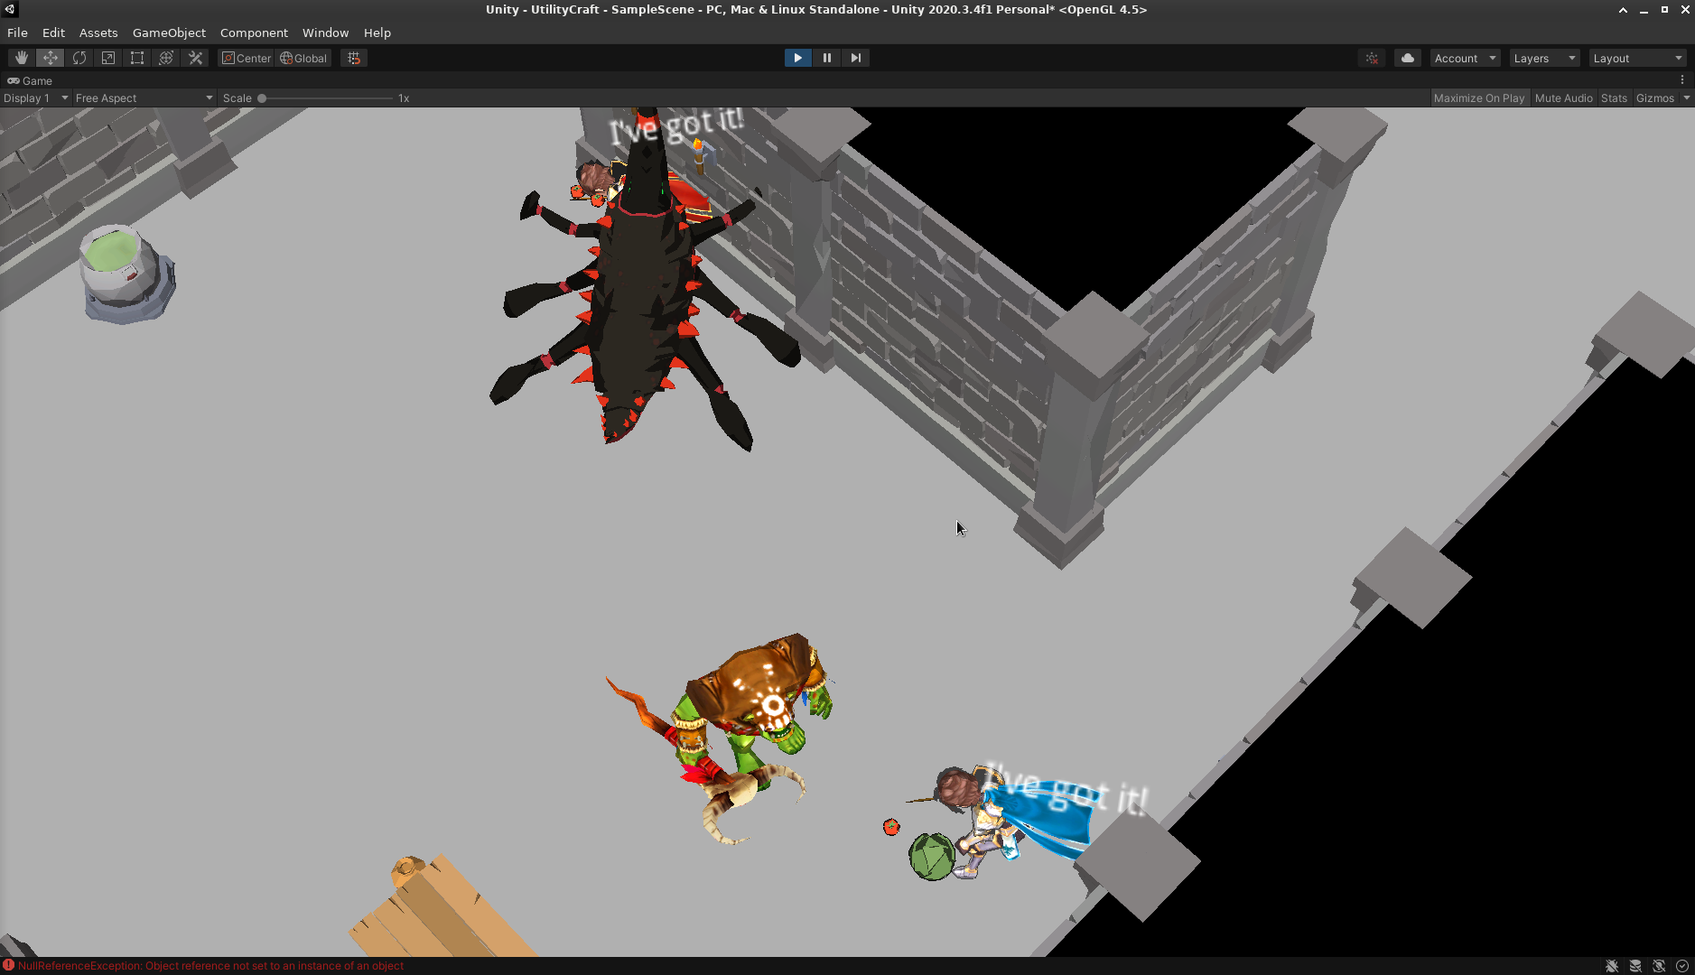
Games AI
Lecture 9.1
Implementing AI in Unity: An Example

Slide 2
Overview
Intro to Unity Components
Representing objects/data
Representing agents
Representing actions
Implementing Utility AI
Implementing Heirarchical State Machine
Modular AI

Slide 3
Overview
Implementation is Hard,
  not talked about much
  game dependant
Disclaimers
  This is not the only way/best way
  But it’s useful to see something fleshed out

Slide 4

General Architecture

Slide 5
General Architecture
Agent
AgentCommand
Behaviours
ObjectData
Database

Slide 6
General Architecture
Agent
  On a GameObject
    (Which may also have NavMeshAgent, etc.)
  SetAction
    Takes ActionCommand
    Adds a behaviour (component) to the GameObject
    Removes previous behaviour

Slide 7
General Architecture
AgentCommand
  What behaviour to run
  What targets it should have
  Any custom properties to set

Slide 8
General Architecture
Behaviours
    e.g. AttackBehaviour
    MoveBehaviour
    PickupBehaviour
  Just a Unity Component
    Start()
    Update()
    OnDestroy()

Slide 9
General Architecture
ObjectData
  Dictionary(s) of arbitrary data about an object
  Events currently on DataObject (Unity Component wrapper)

Slide 10
General Architecture
Database
  Keeps track of every ObjectData in the game
  Use a Query to get all matching criteria

Slide 11

Utility AI

Slide 12
Utiltiy AI
UtilityAgent: Agent
UtilityAI
Data classes
  UtilityInput
  Consideration
  UtilityOption

Slide 13
Utiltiy AI
UtilityInput
  Where our input comes from
  In what range to clamp it

Slide 14
Utiltiy AI
Consideration
  What input to use
  What response curve to apply

Slide 15
Utiltiy AI
UtilityOption
  What behaviour to run
  What considerations to combine
  What targets we need to evaluate for
  Custom properties for the behaviour

Slide 16
Utiltiy AI
UtilityAgent: Agent
  Loads possible actions from JSON
    Dictionary<string, UtilityOption>
  On Update:
    Ask UtilityAI to evaluate UtilityOption
    Ask UtiltiyAI to pick best
    Uses the Agent code to instantiate that new behaviour

Slide 17
Utiltiy AI
UtiltyAI
  Loads utility info from JSON
    Dictionary<string, UtilityInput>
    Dictionary<string, Consideration>
  EvaluateAction
    Scores UtilityOption for all possible target objects
    Populates dictionary with AgentCommands
  PickBest
    Picks command with highest score

Slide 18
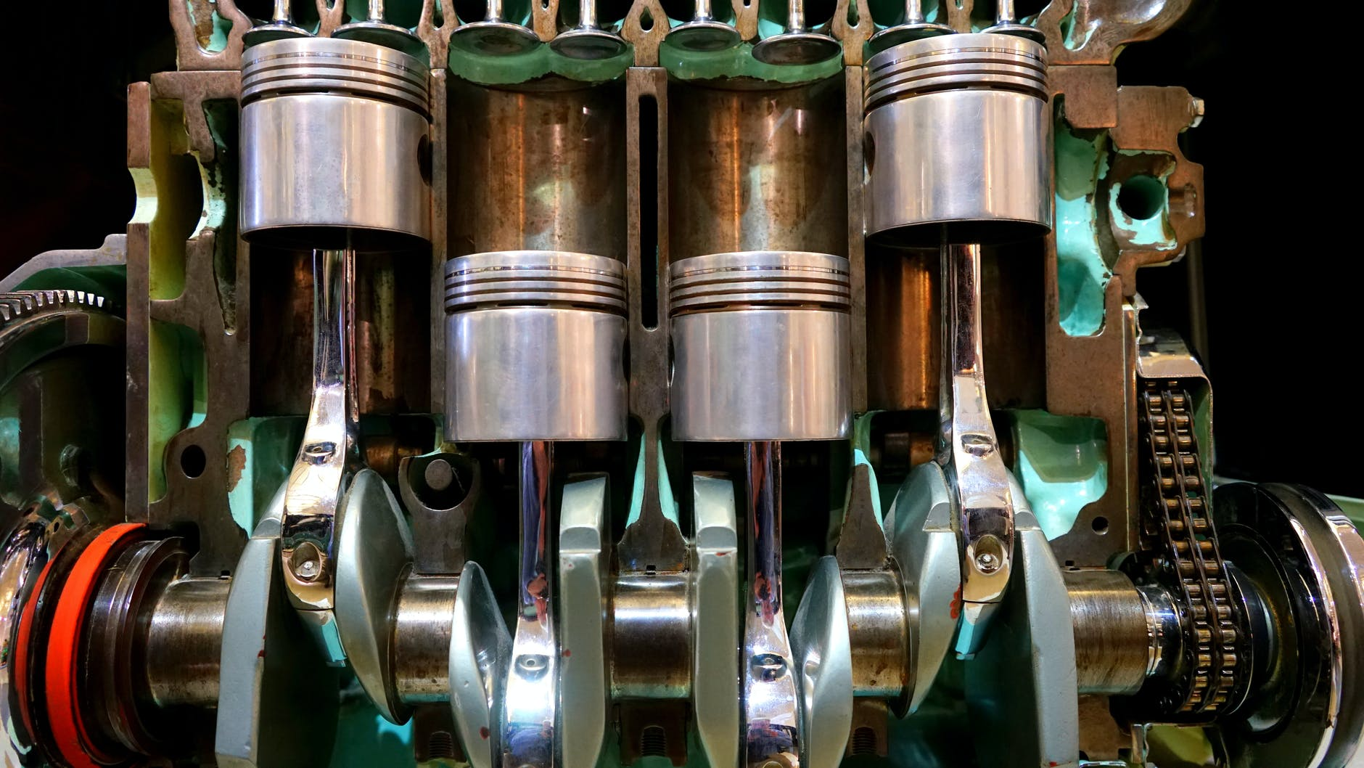
Heirarchical Finite State Machine

Slide 19
HFSM
StateAgent: Agent
StateMachine

Slide 20
HFSM
StateAgent: Agent
  Holds StateMachine
  Get events from DataObject
  Send them to StateMachine
  Listen to updates from StateMachine
  Converts them to AgentCommands for SetAction on Agent

Slide 21
HFSM
StateMachine
  Implements Heirarchical Finite State Machine
  Recursive
  Recieves events from StateAgent
    Can transition? Do so
    Can’t? Pass down to child StateMachine
    If changed state, get innermost state for StateAgent

Slide 22
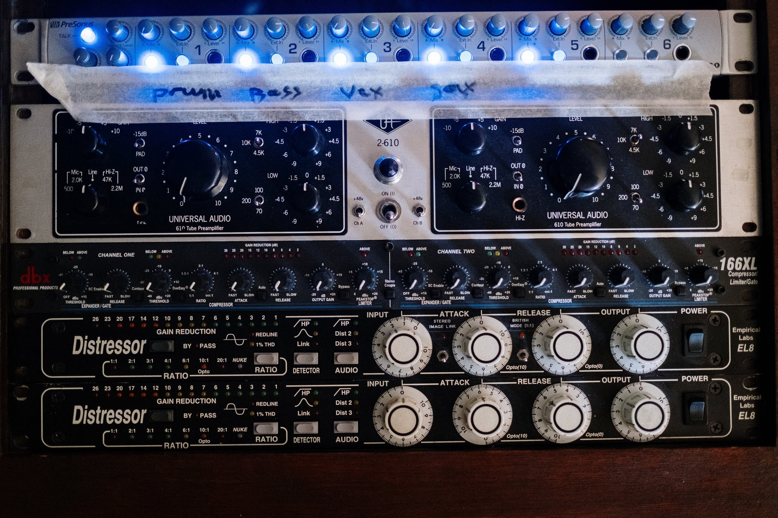
Modular AI

Slide 23
Modular AI
Sensing
  Sensor Components
Deciding
  Agent
Acting
  Behaviours

