Slide 1
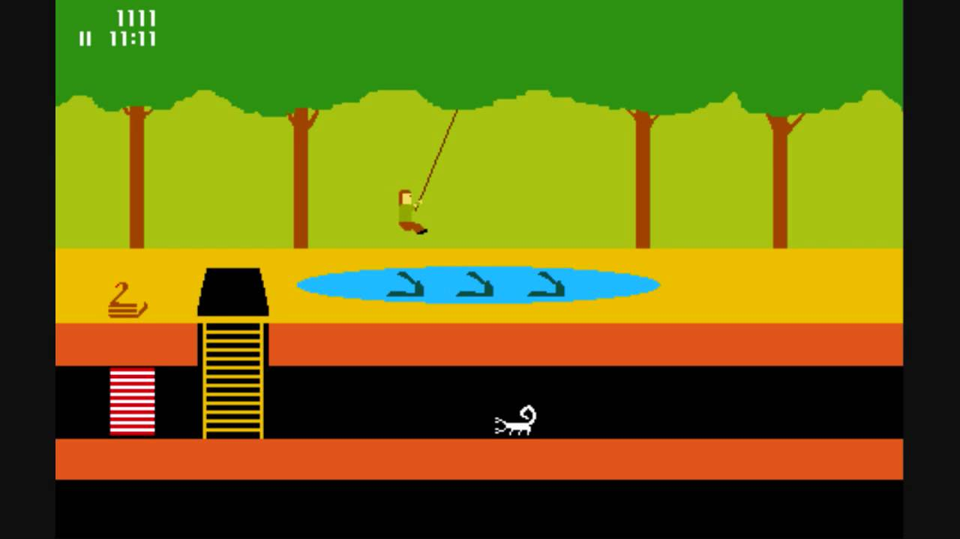
Games AI
Lecture 9.1
Reinforcement Learning

Slide 2
Overview
Machine Learning (ML)
  ML approaches progressively improve the performance of a specific task with data
  For example, neural networks learn a function from labeled data in a training data set

Slide 3
Overview
ML comes in two kinds
  Supervised Learning
    When training, each decision can be compared to a known correct value
    Neural networks (except autoencoders)
  Unsupervised Learning
    Correct value not known
    Agent figures out the best thing to do by itself

Slide 4


Overview
Reinforcement Learning (RL)
  RL agents learn how to act in an environment in order to maximise their cumulative reward

Slide 5
Overview
RL agents observe their environment and receive rewards. This is the data that helps them to improve at their task.
  This is why they are learning agents
We do not know what actions an agent should perform to maximise their reward so RL is unsupervised learning
  We only know when to give them rewards

Slide 6
Overview
When to use RL
  Learning to make a sequence of decisions under uncertainty,
  No or little pre-existing knowledge of environment
  Limited knowledge, limited feedback
  You cannot tell how good an action is immediately, but you can give a (possibly delayed) reward, e.g.
    completing a maze
    return on financial investments

Slide 7
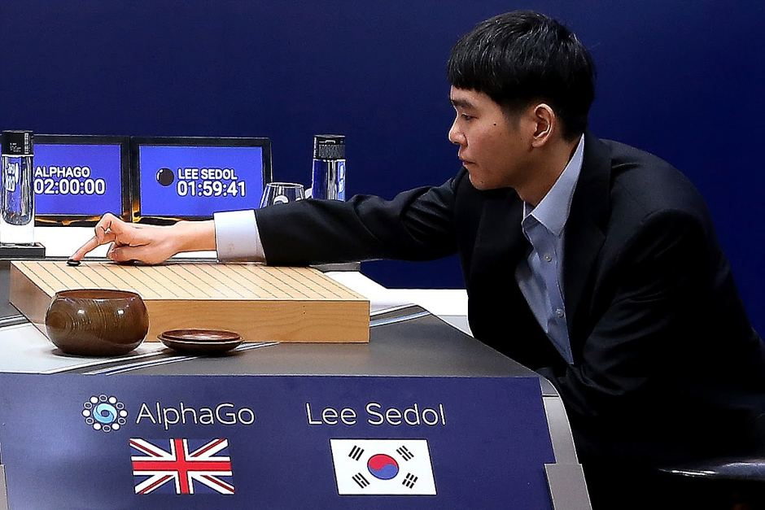
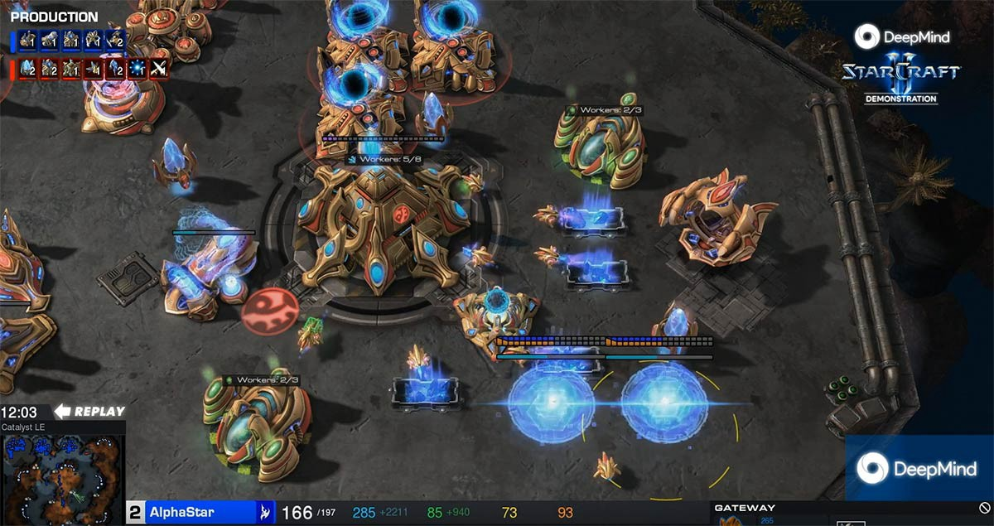
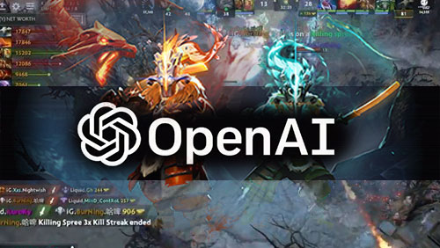
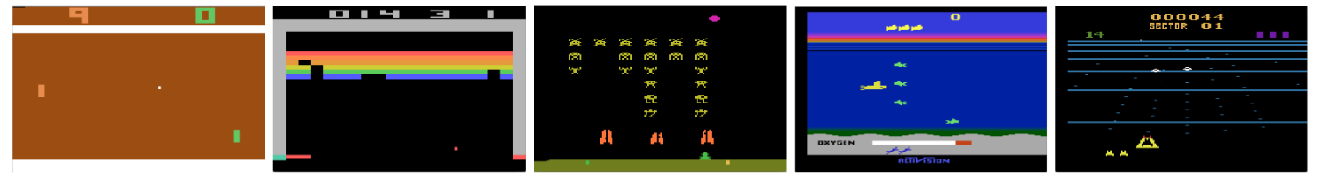
Overview

Slide 8
Overview
Examples
  Learn to fly a helicopter (https://youtu.be/VCdxqn0fcnE)
  Play Atari 2600 games (https://youtu.be/Q70ulPJW3Gk)
  Trade shares
  Control a power station

Slide 9
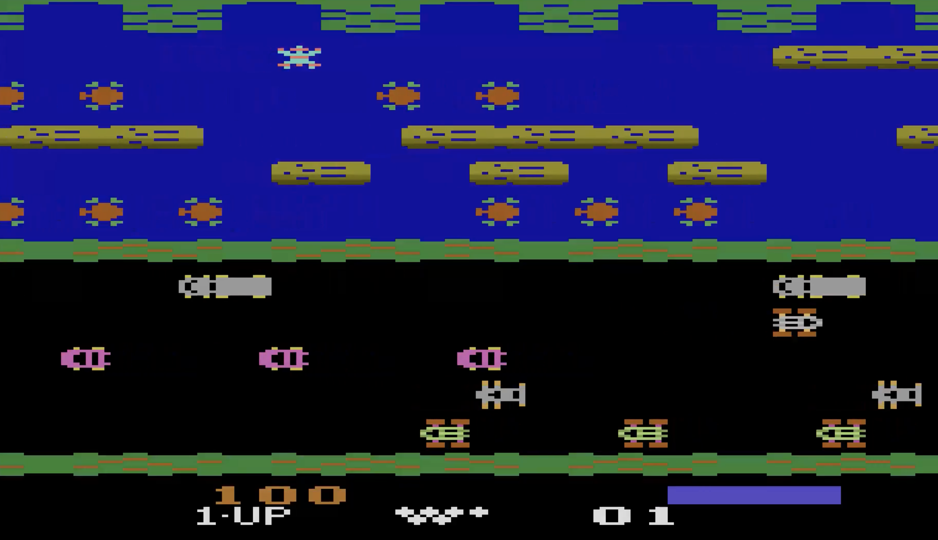
Structure of a Reinforcement Learning problem

Slide 10
Structure of an RL problem
Agent
Observations
Environment
Actions
Rewards

Slide 11
Structure of an RL problem
Time
  Agents interact with environment over a sequence of time steps
    t1, t2, t3, t4, …
  For example,
    A game of chess takes multiple turns
    An autonomous vehicle driving to a destination takes time
    An algorithm trades stocks every millisecond

Slide 12
Structure of an RL problem
Observations
  At each time step, the agent can observe the environment, usually in a limited way, e.g.
    Autonomous vehicle sensors
    X, Y position in a maze
    Pixels on the screen
  In combination with rewards, this is the experience that an agent learns from

Slide 13
Structure of an RL problem
Actions
  (Usually) discrete set of actions to perform, e.g.
    Move king’s bishop to H3
    Turn left 10 degrees
  Actions affect the environment

Slide 14
Structure of an RL problem
Reward
  Reward signal at each time step
  Quantitative, e.g.
    Change in score in a game
    Distance robot has walked
    End game reward 1 = win, -1 = loss

Slide 15
Structure of an RL problem
From these
  Observations
  Actions
  Reward
An agent learns how to act in a way to maximise their cumulative reward
  (A way of acting is called a policy)

Slide 16
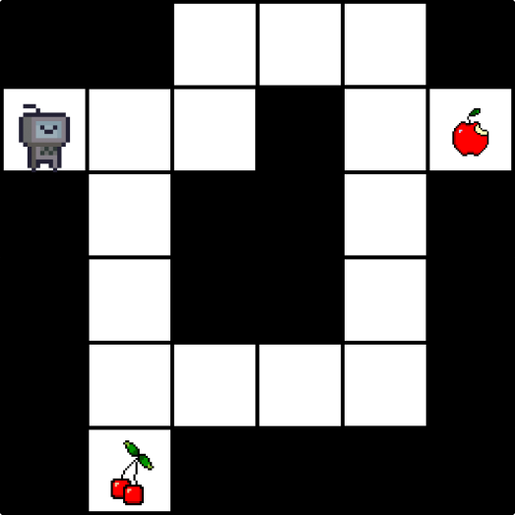
Structure of an RL problem
Imagine we have a maze and our goal is to collect fruit
  What are the:
    Observations
    Actions
    Rewards

Slide 17
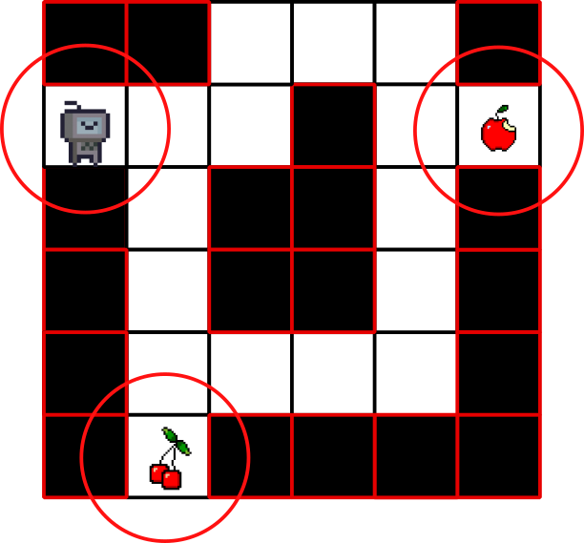
Structure of an RL problem
Observations
  The information about the environment we choose to give to the agent,
  What the agent can “sense”, e.g.
    Position of agent
    Positions of walls
    Positions of fruit

Slide 18
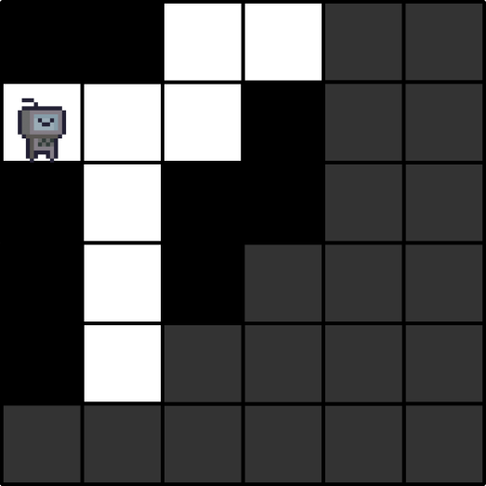
Structure of an RL problem
The agent doesn’t always get all the information about the environment
  Fully observable
    Agent sees everything
  Partially observable
    Agent sees only part

Slide 19
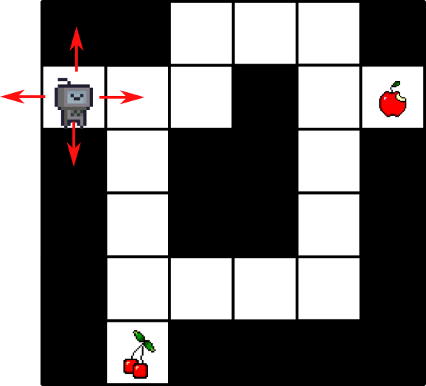
Structure of an RL problem
Actions
  The set of actions our agent can perform, e.g.
    Move up
    Move down
    ...

Slide 20
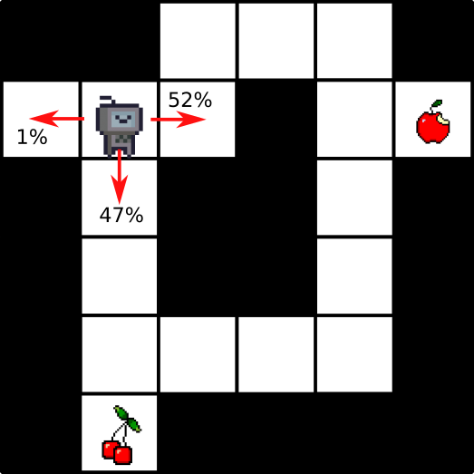
Structure of an RL problem
A plan of action is called a policy, e.g.
  Act randomly
  Always turn left
  Move to state with highest utility
We want the agent to learn the optimal policy
  There is always at least one optimal policy

Slide 21
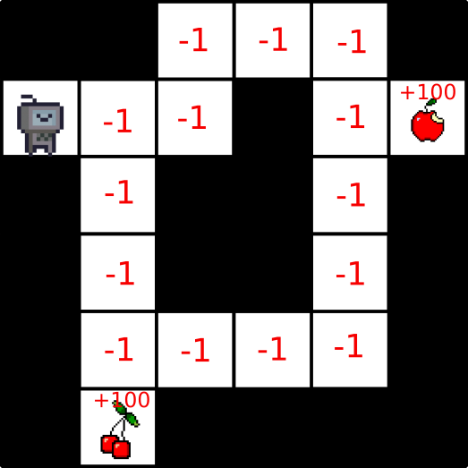
Structure of an RL problem
Rewards
  A score we give the agent when it does something we want
  Agents often need to take several actions before they get a reward

Slide 22
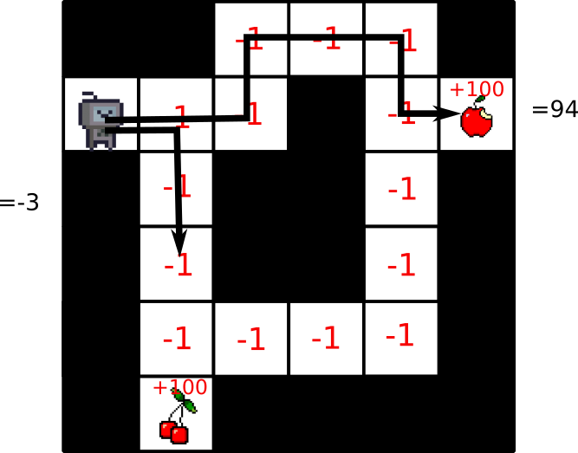
Structure of an RL problem
The agent learns by taking actions and getting rewards
  It tries to maximise its cumulative reward
In this example, it would (hopefully) learn to collect all the fruit with as few steps as possible

Slide 23
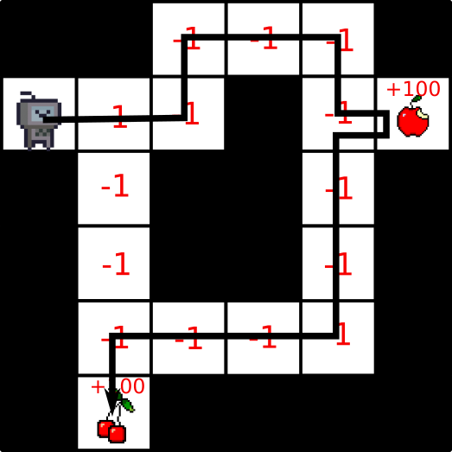
Structure of an RL problem
Return
  The cumulative reward over an episode (a sequence of states and actions)
We want to learn the policy with the highest return

Slide 24
Structure of an RL problem
Assumption:
  Every goal can be expressed as the maximisation of some reward value, e.g.
    Maximise game score
    Maximise financial return
    Optimise power output while following safety regulations
      Here we might decide on the ‘exchange rate’ for efficiency vs. regulations

Slide 25
Structure of an RL problem
RL algorithms use observations and rewards to decide on a policy for selecting actions in order to maximise their return
Agent
Observations
Environment
Actions
Rewards

Slide 26
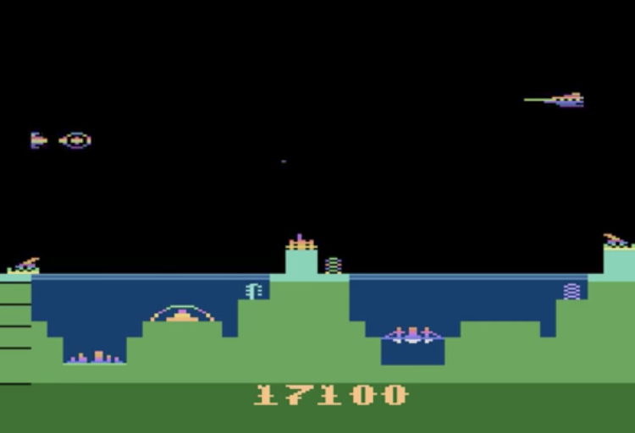
State

Slide 27
State
Agents learn from their observations
When deciding what to do, it is inefficient to recall past observations in full
  Instead the agent abstracts a history of observations into a state

Slide 28
State
State
  A function of a history of observations
  i.e. Abstract all the information seen so far into a useful summary that tells you ‘where you are’

Slide 29

State
A state might include just the present observations
  In a racing game we observe our position and velocity at each time step
  Our state might contain our position and velocity
    (So we can slow down at the corners)

Slide 30
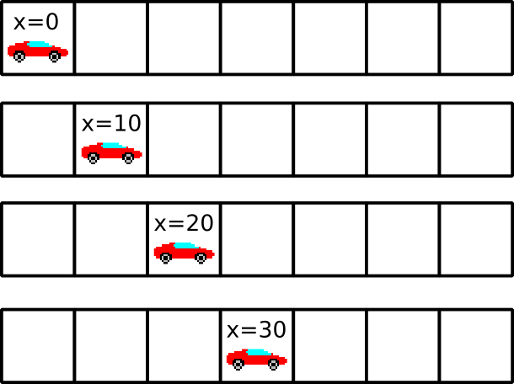
State
The state might incorporate past observations
  In this game we now only observe position
  To calculate velocity, we need information from past observations

Slide 31
State
Environment State
  The state of the environment
    Game state in chess
  Often not accessible
    e.g. autonomous vehicle

Slide 32
State
Agent State
  What state does the agent think they are in?
  This represents (some of) the environment state
As environment state is usually inaccessible, most of the time when we talk about state we mean agent state

Slide 33
State
What is the environment state in the maze game?
What information might we include in the agent state?

Slide 34
Structure of an RL problem
RL algorithms abstract observations of the environment into a state, which tells them where they are and helps them to select actions to maximise their return
Agent
Observations
Environment
Actions
Rewards

Slide 35
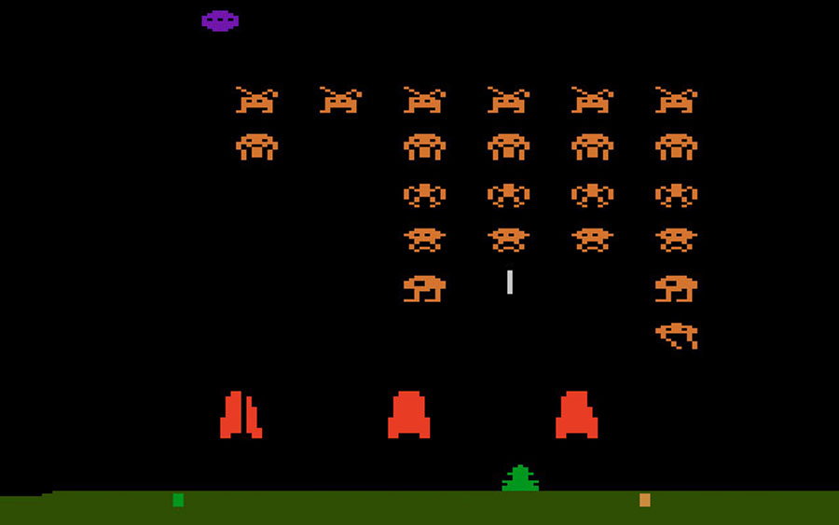
Parts of a Reinforcement Learning Agent

Slide 36
Parts of an RL agent
There are three components that RL agents often have
  Value Function
  Model
  Policy
RL algorithms can be described by which of these it uses

Slide 37
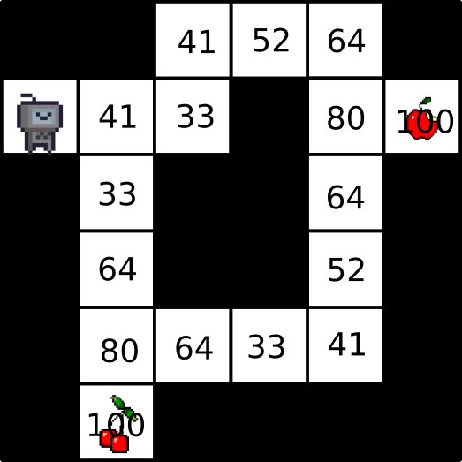
Parts of an RL agent
Value Function
  A value function assigns each state a score
  It’s helpful to know how good any given state is
  Value comes from our total expected future reward from that state

Slide 38
Parts of an RL agent
Value combines current and expected future rewards
value of state = reward + value of next state
This is a Bellman Equation
For example
  I’ll get 100 points now, and I expect that – if I act optimally – I’ll get 95 points in the future
  So the value of the state is 195

Slide 39
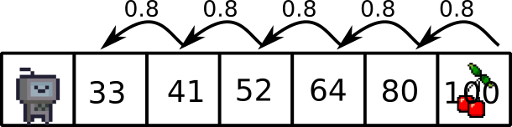
Parts of an RL agent
Discount factor
  In practice, we multiply our expected future reward by a discount factor, e.g. 0.8
  This decreases the importance of future rewards
Why?
  Future rewards are uncertain because our model is imperfect
  Prevents infinite cumulative rewards which makes the maths harder

Slide 40
Parts of an RL agent
The value of a state is thus:
reward + discount factor * value of next state
I’ll get 100 points now, and I expect that – if I act optimally – I’ll get to a state with a value of 95 in 1 time step, which is 0.8*95 = 76
  So the value of the state is 176

Slide 41
Parts of an RL agent
Policy
  For a given state, with what probability should we select the actions available to us?
  If we have a value function, that give an implicit policy – always take the highest valued action

Slide 42
Parts of an RL agent
Model
  Does the agent try to build a model of the environment?
    i.e. try and work out the dynamics of the environment
  E.g. the maze agent might walk around finding all the walls to build a map of the environment

Slide 43
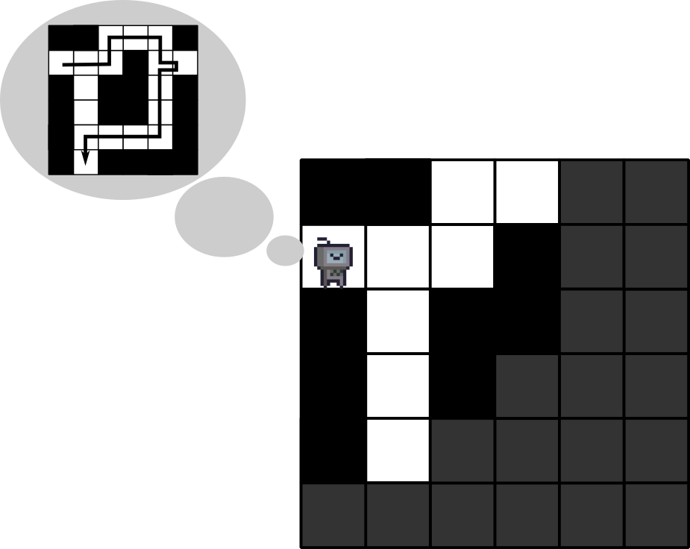
Parts of an RL agent
Models allow planning
  The maze agent could build a model and then use it to plan a route

Slide 44
Markov Processes

Slide 45
Markov Processes
A Markov Process is a way of mathematically modeling stochastic sequences of events
  It is a formal tool to help understand and build RL algorithms
    (It’s widely used outside RL as well)
  Basically a finite state machine where the transitions are uncertain

Slide 46
Markov Processes
Markov Process are sequences of states where the probability of each state is dependent only on the last state
  (Here we have a third meaning of “state”: information state)
A state contains all information about past states
  i.e. knowing the history gives you no more information about what’s happening next
P(St | St-1) = P(St | S1, S2, ... St-1)

Slide 47
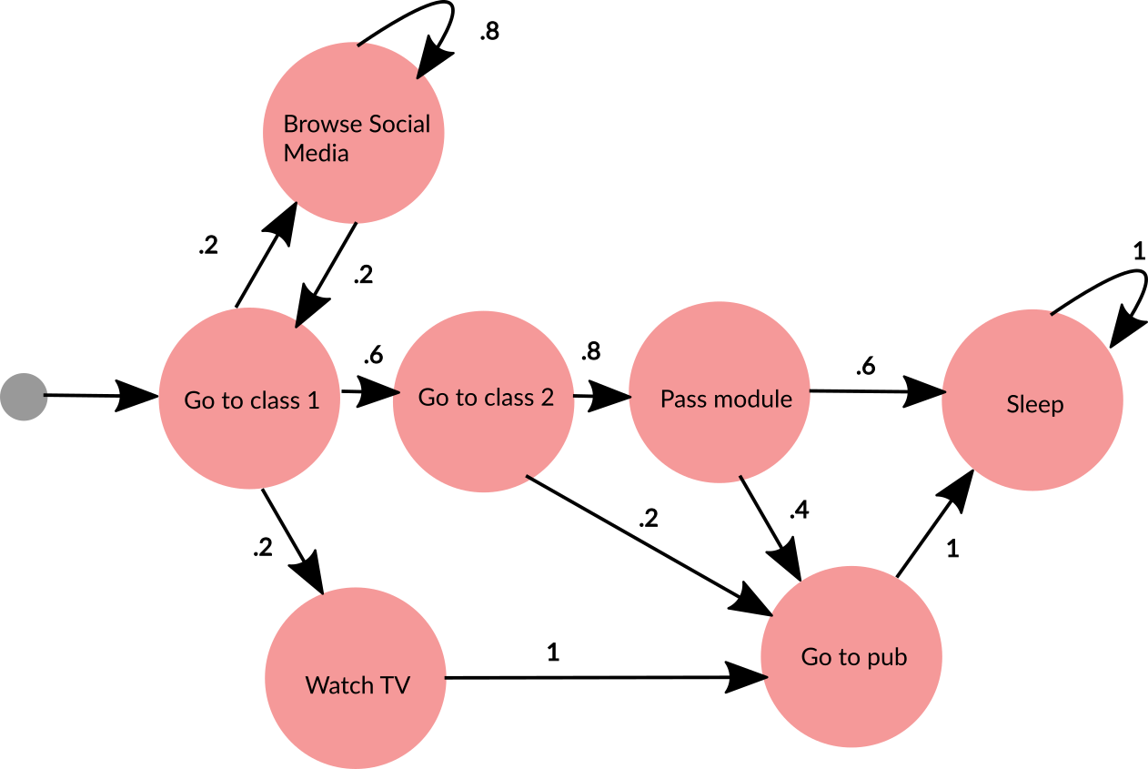
Markov Processes

Slide 48
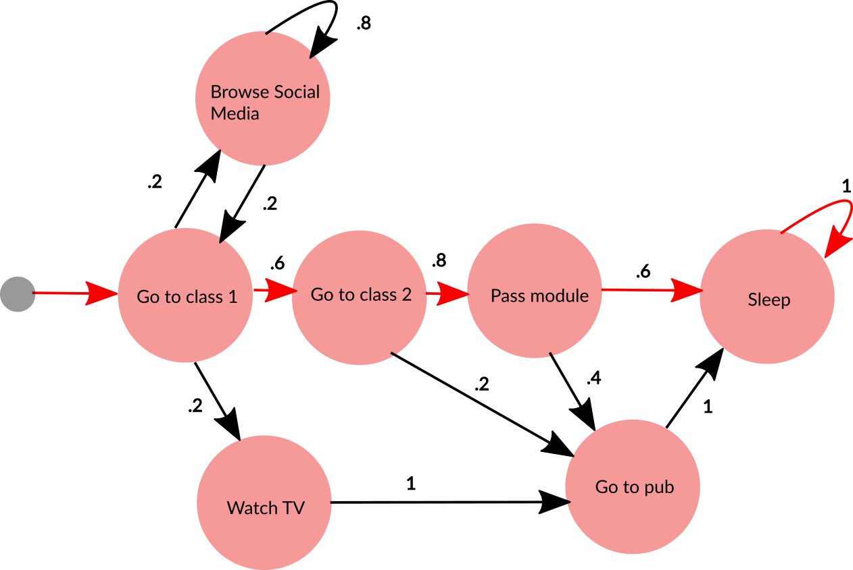
Markov Processes
We can work out the probabilities of taking different paths through a Markov Process
  This path has probability
  .6 x .8 x . 6 = 0.288

Slide 49

Markov Processes
Lets add rewards to make this a Markov Reward Process
  Now we can work out the return of this path by adding the rewards
  -2 + 10 = 8

Slide 50
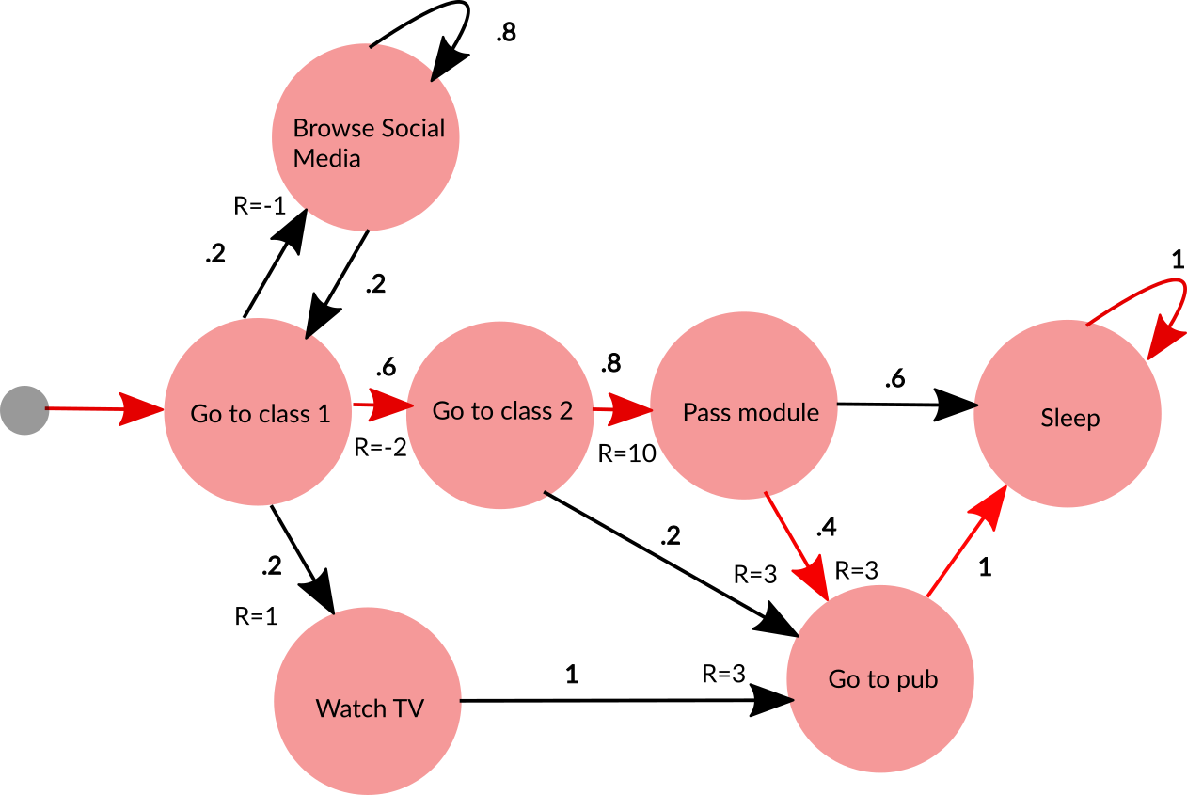
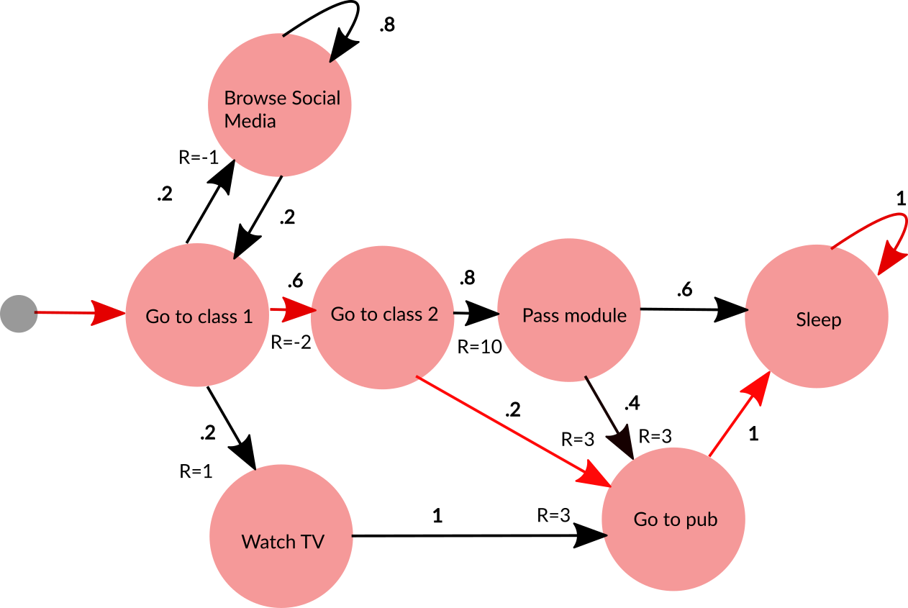
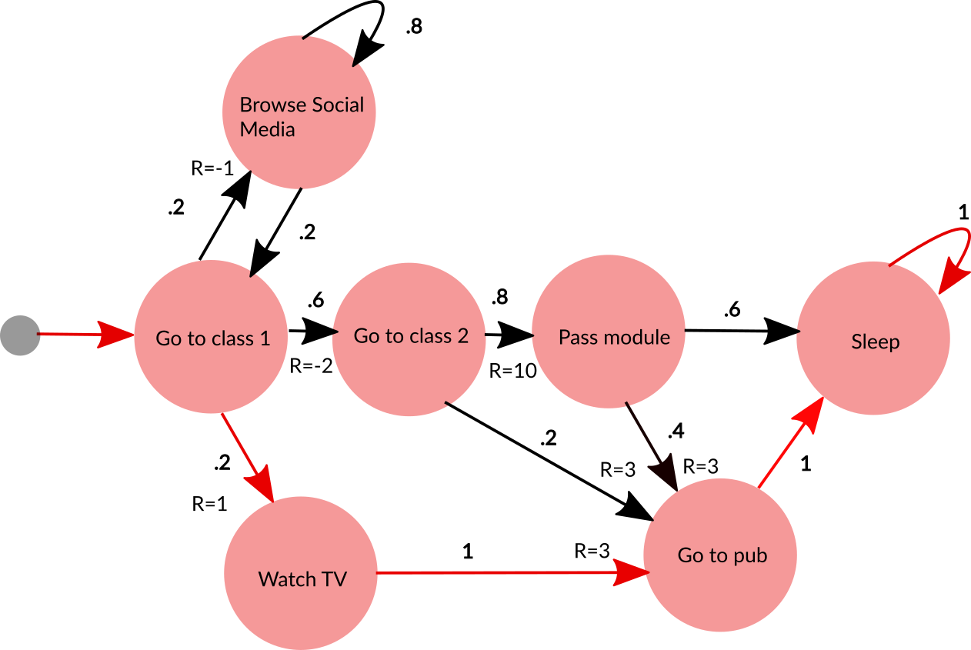
Markov Processes
We can also work out the expected cumulative future reward from a state
  Considering probability and return of each path

Slide 51

Markov Processes
Question: If we could change these probabilities, could we improve our expected return?

Slide 52
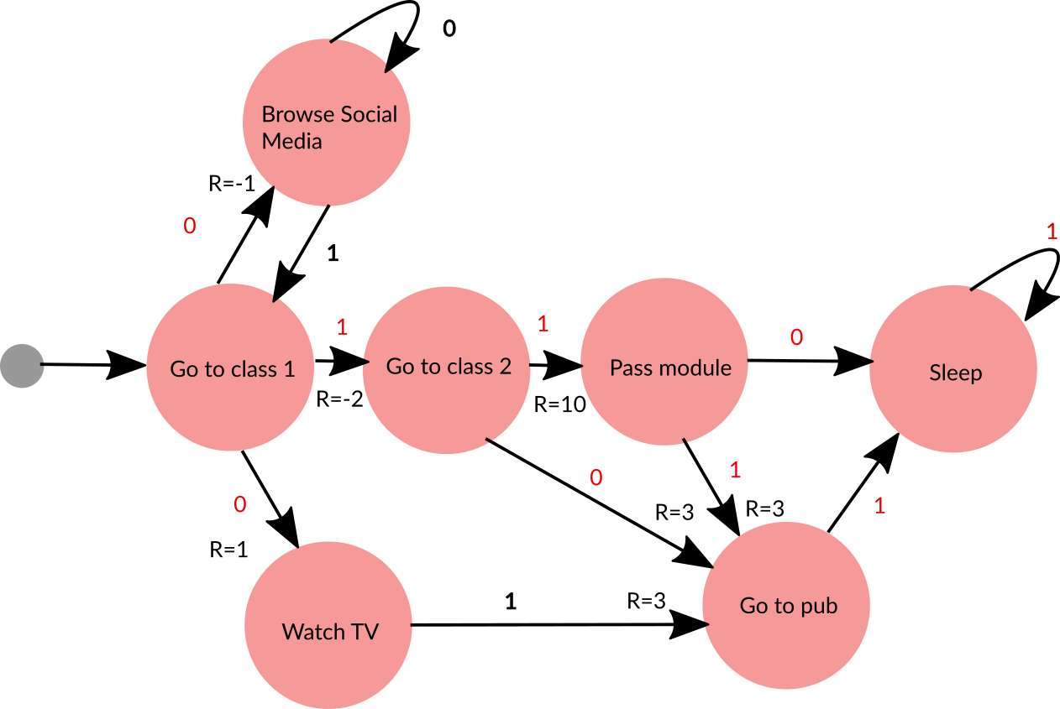
Markov Processes
The probabilities of taking each action are our agent’s policy
Our RL agent wants to learn the best probabilities to use
  (Because we’re making decisions, it’s now called a Markov Decision Process)

Slide 53

Markov Processes
So, an RL algorithm, faces a Markov Decision Process and needs to work out the action probabilities to maximise their expected return
  (The example here was fully observable)
Agent
Observations
Environment
Actions
Rewards

Slide 54
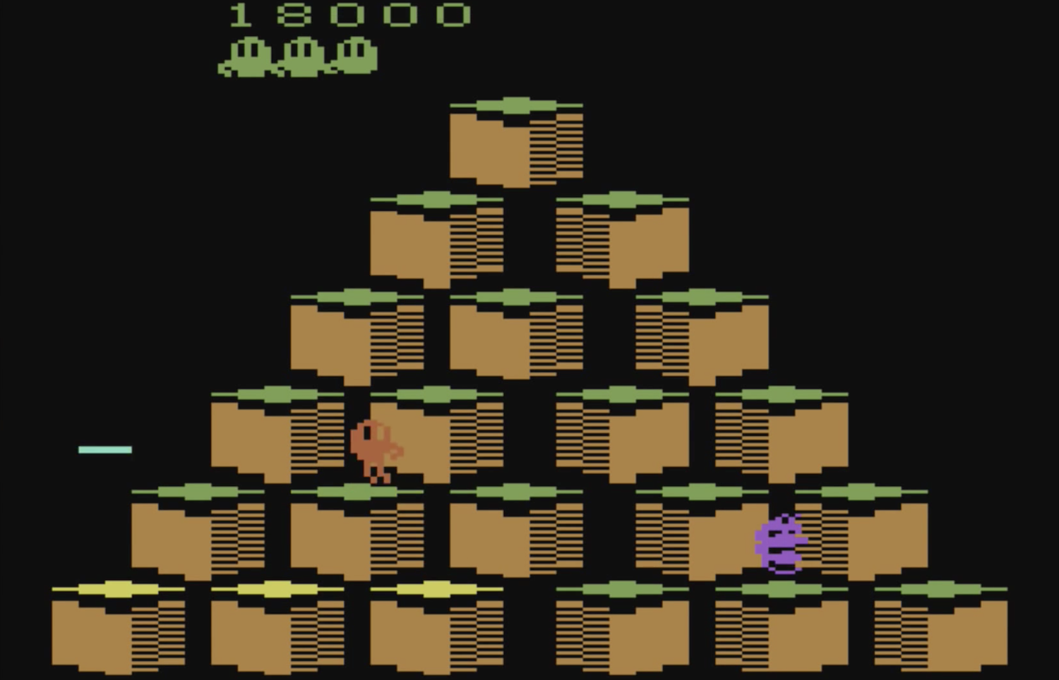
Q Learning

Slide 55
Q Learning
Necessary functions in an RL algorithm
  Reward Prediction: Predicting expected reward in given state
  Choice: Optimal action selection
Q learning is one approach to solving this

Slide 56
Q Learning
Approach: Learn a value function (Q function) for each state-action pair
  i.e. what’s the value of doing action A in state S?
Take actions with highest value
  An implicit policy
Challenge: representing and fitting the Q function

Slide 57
Q Learning
Q learning uses Temporal Difference (TD) Learning
  Derive reward predictions from delayed rewards
    Learn by bootstrapping from estimates of value function
    Sample the environment
    Update based on current estimates
  Model free

Slide 58

Q Learning
Q Learning
  Learn a function Q that take an action a ∈ A in a given state s ∈ S and returns the expected future reward
    Q: S x A → R

Slide 59
Q Learning
Simplest approach is to use a Q table
  Represent every combination of inputs (state-action pairs) with their output
  i.e. for each state and action, what is the expected future reward?
 | a1 | a2 | a3 | a4
s1 | 24 | 57 | 7 | 98
s2 | 42 | 0 |  | 56
s3 | 1 |  | 76 | 0
s4 | 24 | 34 | 55
s5 | 5 | 3 | 62 | 3

Slide 60
Q Learning
Start with arbitrary values (e.g. 0)
Bootstap the correct values by a series of increasingly accurate approximations
  Start using arbitrary values and improve them when we can
 | a1 | a2 | a3 | a4
s1 | 0 | 0 | 0 | 0
s2 | 0 | 0 | 0 | 0
s3 | 0 | 0 | 0 | 0
s4 | 0 | 0 | 0 | 0
s5 | 0 | 0 | 0 | 0

Slide 61

Q Learning
Imagine we have a simple maze game
  The agent starts somewhere on the grid shown (S)
  They can move up, down, left, or right
If they move to a goal (G) they get a reward of 100 points

Slide 62
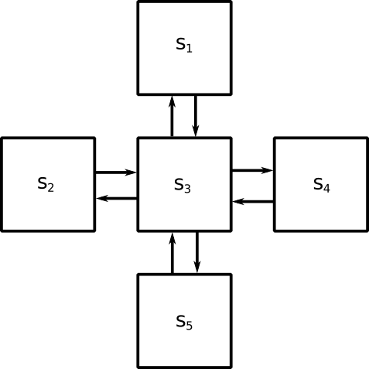
Q Learning
Let’s represent this as 5 states and 4 actions
  States s1, s2… ∈ S
  Actions aup, adown… ∈ A

Slide 63
Q Learning
Create a table of states/action pairs (Q table)
  Stores the utility of each action from each state
  Initialise with arbitrary values
 | aup | adown | aleft | aright
s1 | 0 | 0 | 0 | 0
s2 | 0 | 0 | 0 | 0
s3 | 0 | 0 | 0 | 0
s4 | 0 | 0 | 0 | 0
s5 | 0 | 0 | 0 | 0

Slide 64
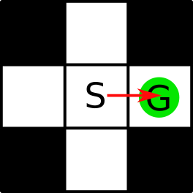
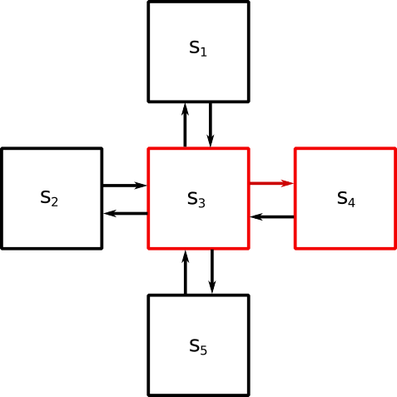
Q Learning
 | aup | adown | aleft | aright
s1 |  | 0
s2 |  |  |  | 0
s3 | 0 | 0 | 0 | 0
s4 |  |  | 0
s5 | 0
Imagine we start in state s3
  We pick an action to perform at random
    For demonstration purposes, let’s choose aright (highlighted)
  Taking this action takes us to the goal, so we give a reward of 100
We’ve learned something about the value of that action in that state
  It’s pretty good!
  We need to update Q(s3, aright)

Slide 65
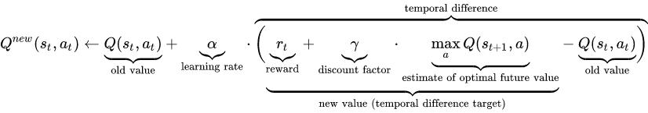
Q Learning
We need to update Q(s3, aright)
  We had an expectation of its value
  We now have better estimate
    We have now visited it and know what reward we got
    We can look up the expected future reward (from the best-scoring action from the new state)
  We multiply the difference by a learning rate (e.g. 0.8)
We use a Bellman Equation:

Slide 66
Q Learning
So, to update Q(s3, aright)
  Q^{old}(s3, aright) = 0
  Learning rate = 0.8
  Reward = 100
  Discount factor = 0.8
  Max(0) = 0
  Q^{new}(s3, aright) = 0 + 0.8 * (100 + 0.8 * 0 – 0) = 80
 | aup | adown | aleft | aright
s1 |  | 0
s2 |  |  |  | 0
s3 | 0 | 0 | 0 | 0
s4 |  |  | 0
s5 | 0

Slide 67
Q Learning
We have updated the Q table
 | aup | adown | aleft | aright
s1 |  | 0
s2 |  |  |  | 0
s3 | 0 | 0 | 0 | 80
s4 |  |  | 0
s5 | 0

Slide 68
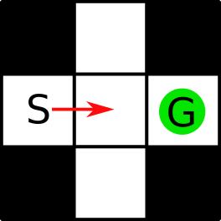
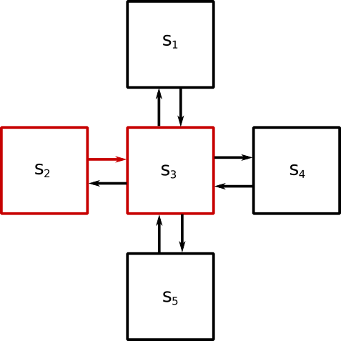
Q Learning
 | aup | adown | aleft | aright
s1 |  | 0
s2 |  |  |  | 0
s3 | 0 | 0 | 0 | 80
s4 |  |  | 0
s5 | 0
Imagine we start again from state s2
  We pick an action to perform at random
    Let’s choose aright (highlighted)
  We don’t get a reward
We’ve learned something about the value of that action
  There was no reward, but it gets us to a state from which there is a good action
  We need to update Q(s2, aright)

Slide 69
Q Learning
We need to update Q(s2, aright)
  Q^{old}(s2, aright) = 0
  Learning rate = 0.8
  Reward = 0
  Discount factor = 0.8
  Max(0, 0, 0, 80) = 80
  Q^{new}(s2, aright) = 0 + 0.8 * (0 + 0.8 * 80 – 0) = 64
 | aup | adown | aleft | aright
s1 |  | 0
s2 |  |  |  | 0
s3 | 0 | 0 | 0 | 80
s4 |  |  | 0
s5 | 0

Slide 70
Q Learning
We have updated the Q table
 | aup | adown | aleft | aright
s1 |  | 0
s2 |  |  |  | 64
s3 | 0 | 0 | 0 | 80
s4 |  |  | 0
s5 | 0

Slide 71
Q Learning
 | aup | adown | aleft | aright
s1 |  | 400
s2 |  |  |  | 400
s3 | 320 | 320 | 320 | 500
s4 |  |  | 400
s5 | 400
If we keep randomly restarting and updating the table, eventually we’ll converge on a table of values like those shown
We can normalise these values by dividing by the highest (500)
  (and multiplying by 100 to avoid decimals)
 | aup | adown | aleft | aright
s1 |  | 80
s2 |  |  |  | 80
s3 | 64 | 64 | 64 | 100
s4 |  |  | 80
s5 | 80

Slide 72
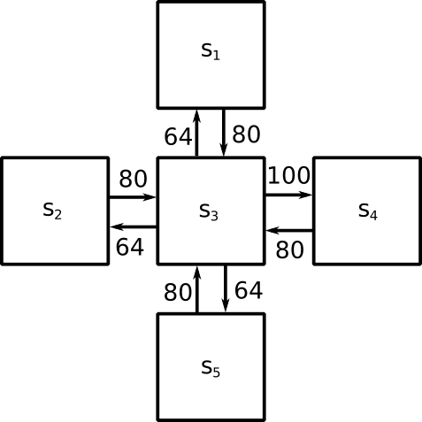
Q Learning
This table gives defines the Q function that we have learned
  Gives utility of state/action pairs
We can use this to take the optimal move from each state by always taking the action with the highest value

Slide 73
Q Learning
It doesn’t always make sense to explore the whole state space first
We could choose to always start from the same state
  Then we would explore different paths to the goal
  Then we balance
    Exploration – trying new/untried actions
    Exploitation – picking high-value actions to focus effort on promising directions

Slide 74
Q Learning
Often the state space is too big to use a table
Instead of learning a function Q expressed as a table (exhaustively calculating and storing every value), Q can be a function approximation
  Neural networks learn to approximate functions
  Deep reinforcement learning uses a deep neural network as a function approximator
    Deep Q-Learning is used in AlphaGo

Slide 75
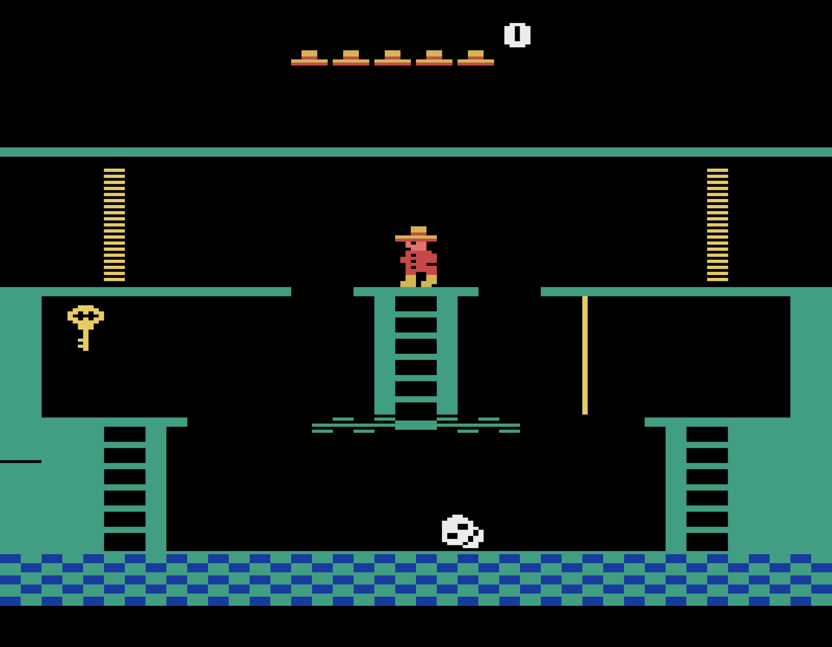
Summary

Slide 76
Summary
RL agents learn from interacting with an environment and getting rewards
They represent their history of observations in a state
  Value functions assign a value to a state
  They decide how to act using a policy
  They might learn a model of the environment and do planning
Agent
Observations
Environment
Actions
Rewards

Slide 77
Summary
One approach is to learn a Q function that gives the expected future reward from each state-action pair
  Store a value for each pair in a table
  Update these as you explore and discover which actions are rewarded
A neural network could be used to approximate the Q function

Slide 78
Recommended Reading
Recommended Reading
  AlphaGo Documentary
    https://youtu.be/WXuK6gekU1Y
  Lecture series taught by David Silver of DeepMind
    https://youtu.be/2pWv7GOvuf0
  RL in Unity using ML Agents
    https://medium.com/nerd-for-tech/an-introduction-to-machine-learning-with-unity-ml-agents-af71938ca958
    https://github.com/Unity-Technologies/ml-agents/blob/release_18_docs/docs/Installation.md#clone-the-ml-agents-toolkit-repository-optional
  Q Learning worked example:
    https://people.revoledu.com/kardi/tutorial/ReinforcementLearning/Q-Learning-Example.htm

