Slide 1

Mathematics and Problem Solving
  Lecture 1.0
    Course Introduction

Slide 2
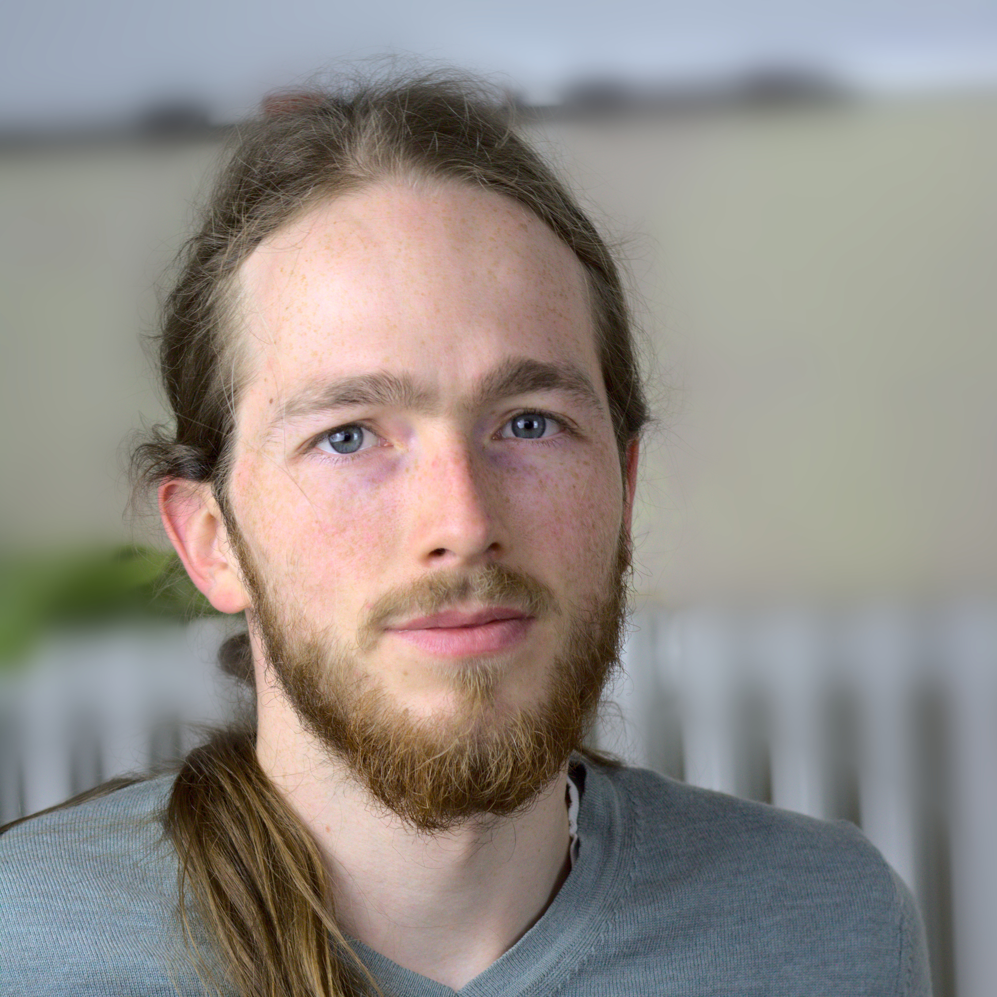
Hello!
David Gundry
  Visiting lecturer at YSJ
  Games Design / Research
  d.gundry@yorksj.ac.uk

Slide 3
Overview
The Course
  Materials
  Assessment
  Content
What is Mathematics? (Parts I, II, and III)

Slide 4

The Course

Slide 5
Course Materials
Lectures
  Online at https://mathsforcs.netlify.app
  Videos, questions, exercises
  Complete in your own time
Attend practicals on Fridays

Slide 6
Practicals
Software
  Microsoft Teams
  Replit https://repl.it
Problem-based
  Materials online in advance if you want them

Slide 7
Assessment
Coursework assignment
  Multiple parts
  Demonstrating knowledge and skills taught in the course
  Apply knowledge to solve problems
Prepare by completing questions from lectures and practicals

Slide 8
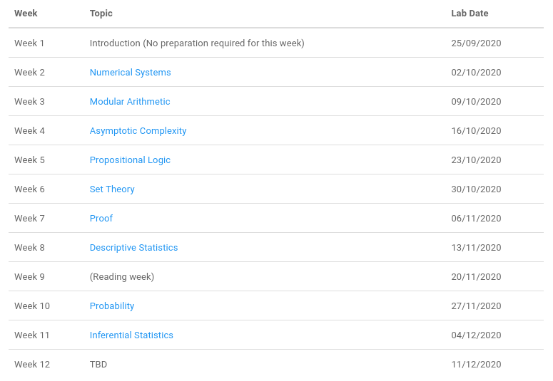
Content

Slide 9
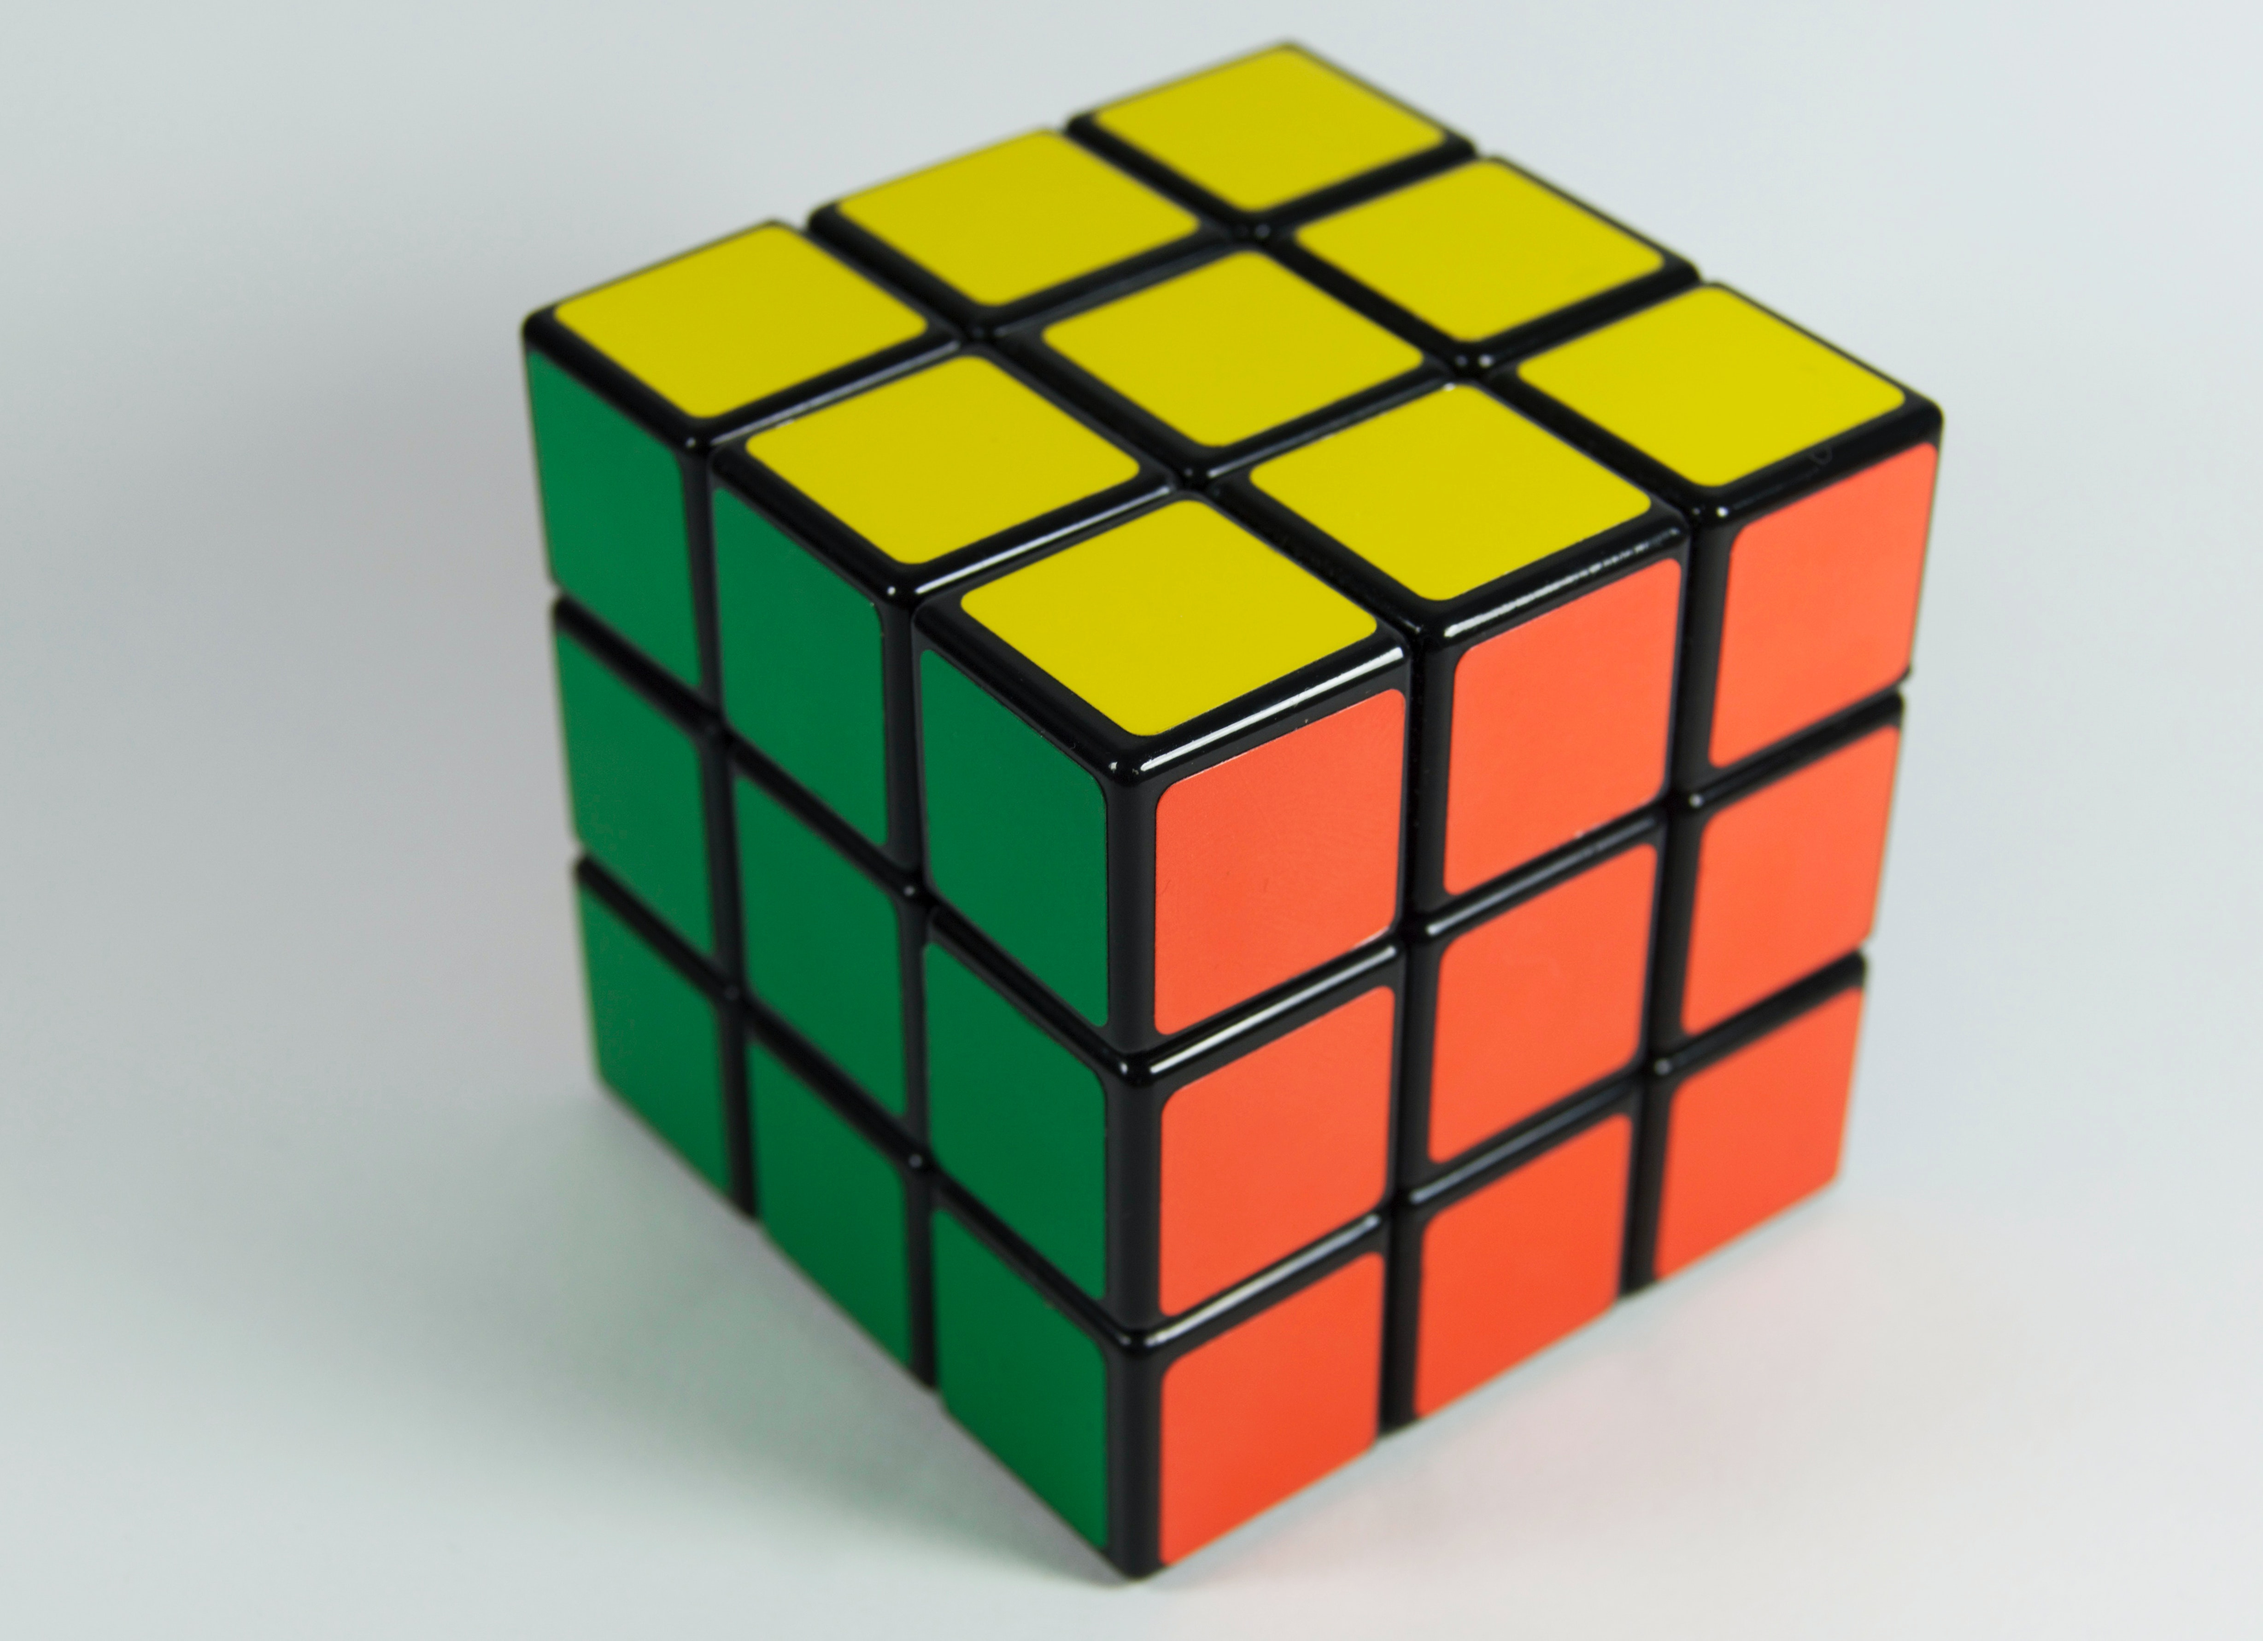
What is Mathematics?

Slide 10
Why was it invented?
Problem solving
  Area of fields
  Inheritance
  Taxes
  Distribution of grain

Slide 11
Babylonians
Algorithmic
Base 60 number system (many different units)
Zero as a placeholder

Slide 12
Indians
Astronomy
Calculating very big numbers
Positional notation
Oral transmission in verse
Decimal number system

Slide 13
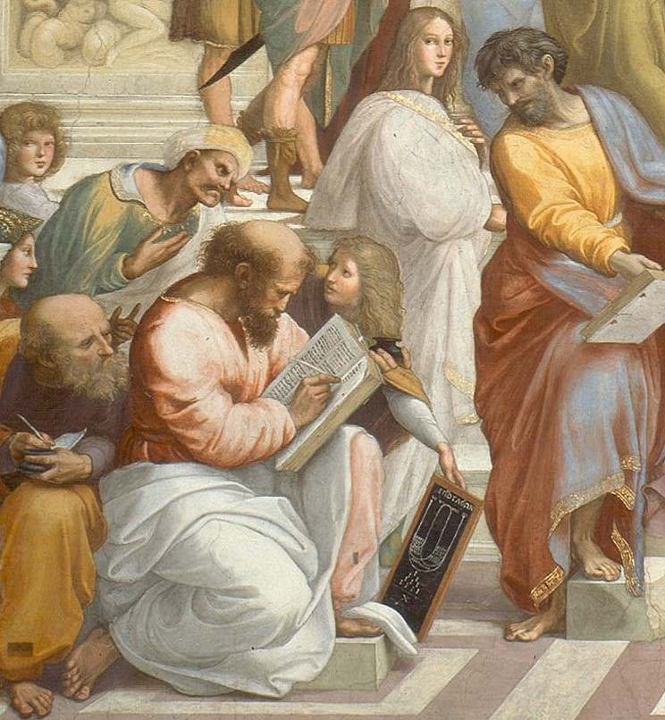
Greeks
Aristocratic
Geometry
Proof from Axoims
Euclid
Pythagoras

Slide 14
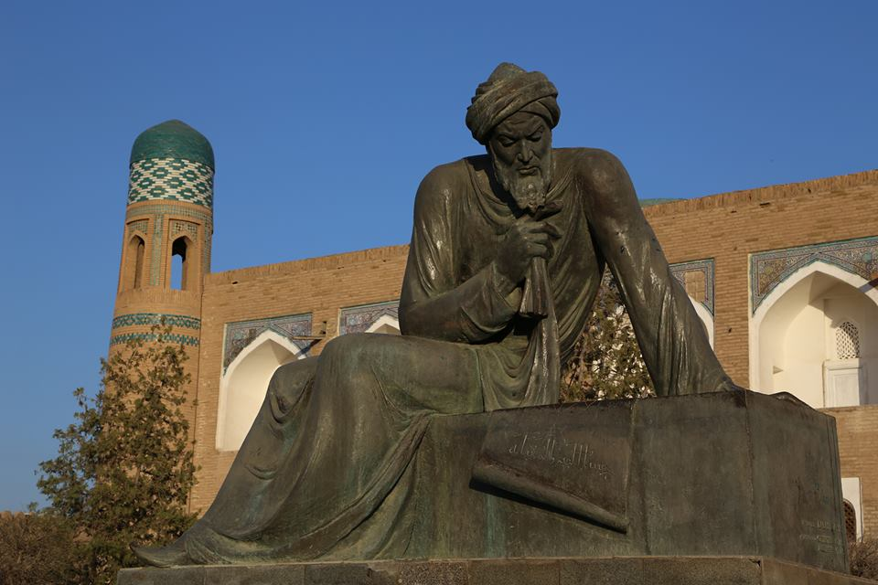
Islamic Empire
Algebra
Algorithms
Still written in prose
Muhammad ibn Musa al-Khwarizmi

Slide 15
What is it?
Solving problems
Patterns
Language to abstract these things

Slide 16
Mathematical Language
Way of expressing problems and their solutions
  Verse
  Prose
  Symbols
To communicate knowledge

Slide 17
What sort of knowledge?
Games
  Drawing curves
  Graphics/shaders
  Path-finding
  Physics engines
  Simulations
Software Engineering
  Complexity
  Networks
  AI
  Big data

Slide 18
Why Maths?
Benefits of using maths for this
  Precise
  Unambiguous
  Easy to interpret (once you know how)
  Concise
Perfect if you want to implement an algorithm

Slide 19

But what is Mathematics?

Slide 20
Maths as a Formal Language
Formal Language
  A
  A→B
  ∴ B
Truth

Slide 21
Maths as Symbol Manipulation
Maths
Problem
Derivation
Solution

Slide 22
Translation
“My field should be 100m², but the markers have been washed away. I know it’s 10m long. How wide should it be?”
100 = 10w

Slide 23
Derivation
100 = 10w
10 = w
w = 10

Slide 24
Translation
w = 10
Means that the width of my field should be 10m

Slide 25


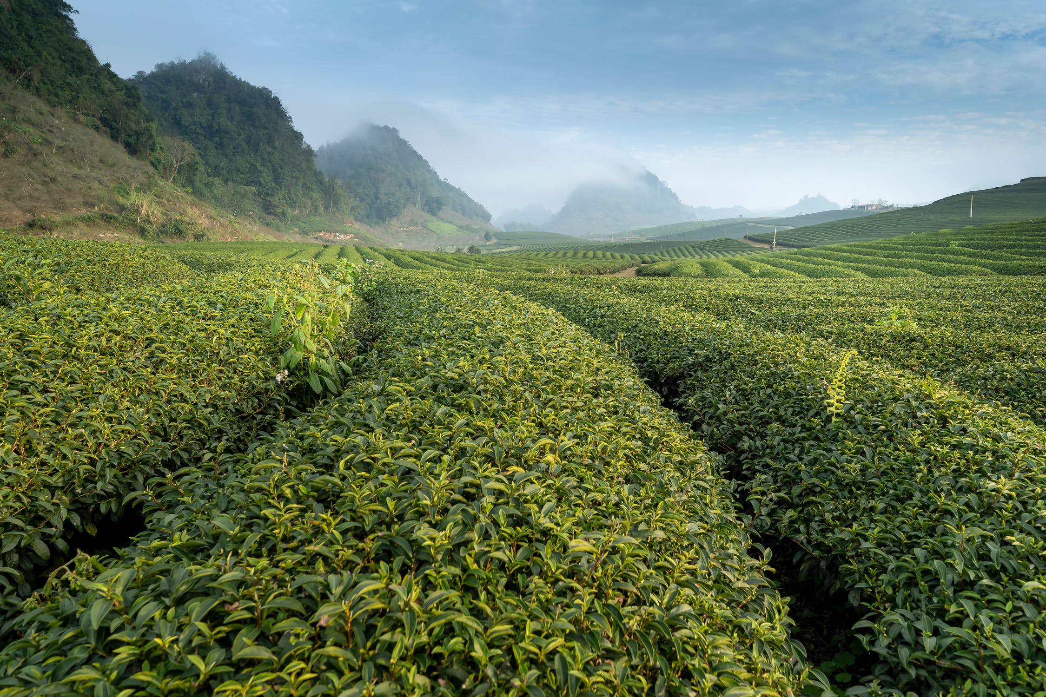
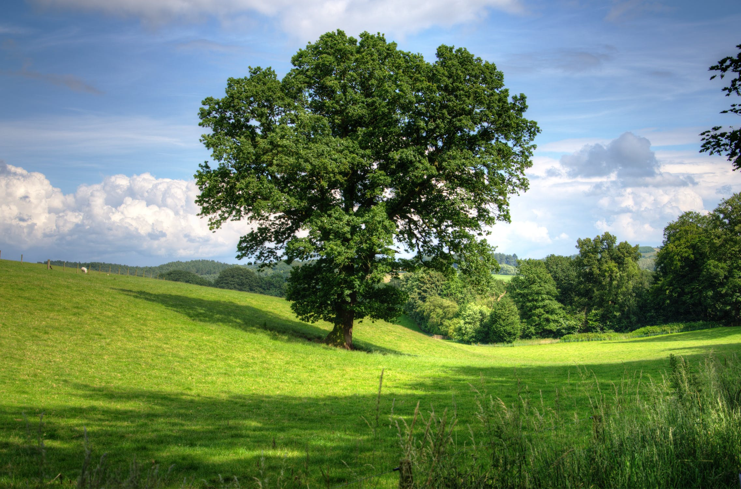

Slide 26
Abstraction
Take only the things we think are essential
Represent a complex system in terms of simple concepts
Separate ideas from physical objects

Slide 27
Truth
If our axioms are true, our conclusions are true
All mathematical truth is relative to the truth of its axioms
How we get to those axioms, however...

Slide 28
Meaning
Our symbols are meaningful if there is some kind of isomorphism between our formal system and the real world
Why does it need to be meaningful?
  Formal systems are games
  Some are useful, some not, some unexpectedly so
  Usefulness, like a game, is not the point

Slide 29
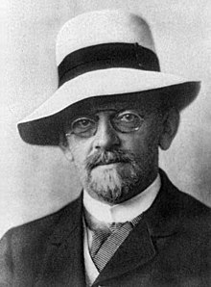
Hilbert’s Program
Idealy we want out maths to be
  Consistent
  Complete

Slide 30
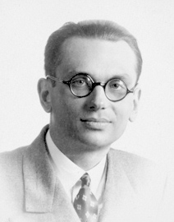
Gödel
But any system complex enough to encode algebra is provably not complete
There will always be things that are true that we can’t prove
  We can’t know everything

Slide 31
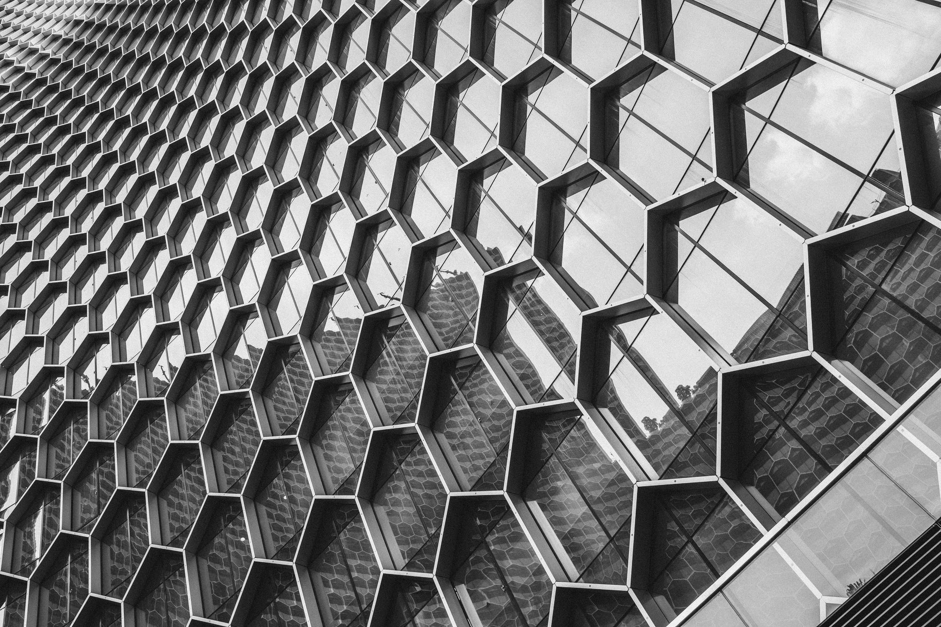
But, really, what is Mathematics?

Slide 32
Numbers
Like 4
How do we write them down?
  Numerical Systems
How do we add them up?
  Algebra
What if we change the rules?
  Modular Arithmetic

Slide 33
Algebra (“reunion of broken parts”)
Equations
  [some stuff] = [some other stuff]
  y = ax² + bx + c
Do stuff to both sides
  i.e. derive new equations that must also be true

Slide 34
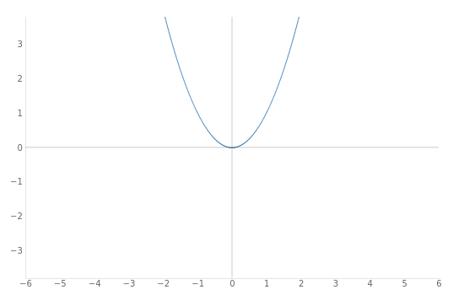
Functions
f(x) = ax² + bx + c
  f(1) = a + b + c
  f(2) = 4a + 2b + c
  f(3) ….

Slide 35
Important for algorithms
How fast does a function grow?
  Asymptotic Complexity

Slide 36
Logic
Reasoning
  If I am wearing socks I am not cold
  I am wearing socks
  I am not cold
Propositional Logic
  If A implies B, and A, then B
Predicate Logic
Second-order logic

Slide 37
Sets
Like the set of natural numbers < 4
  { 0, 1, 2, 3}
Foundational in Mathematics
  We may not be able to know everything, but we can know most stuff because of Set Theory

Slide 38
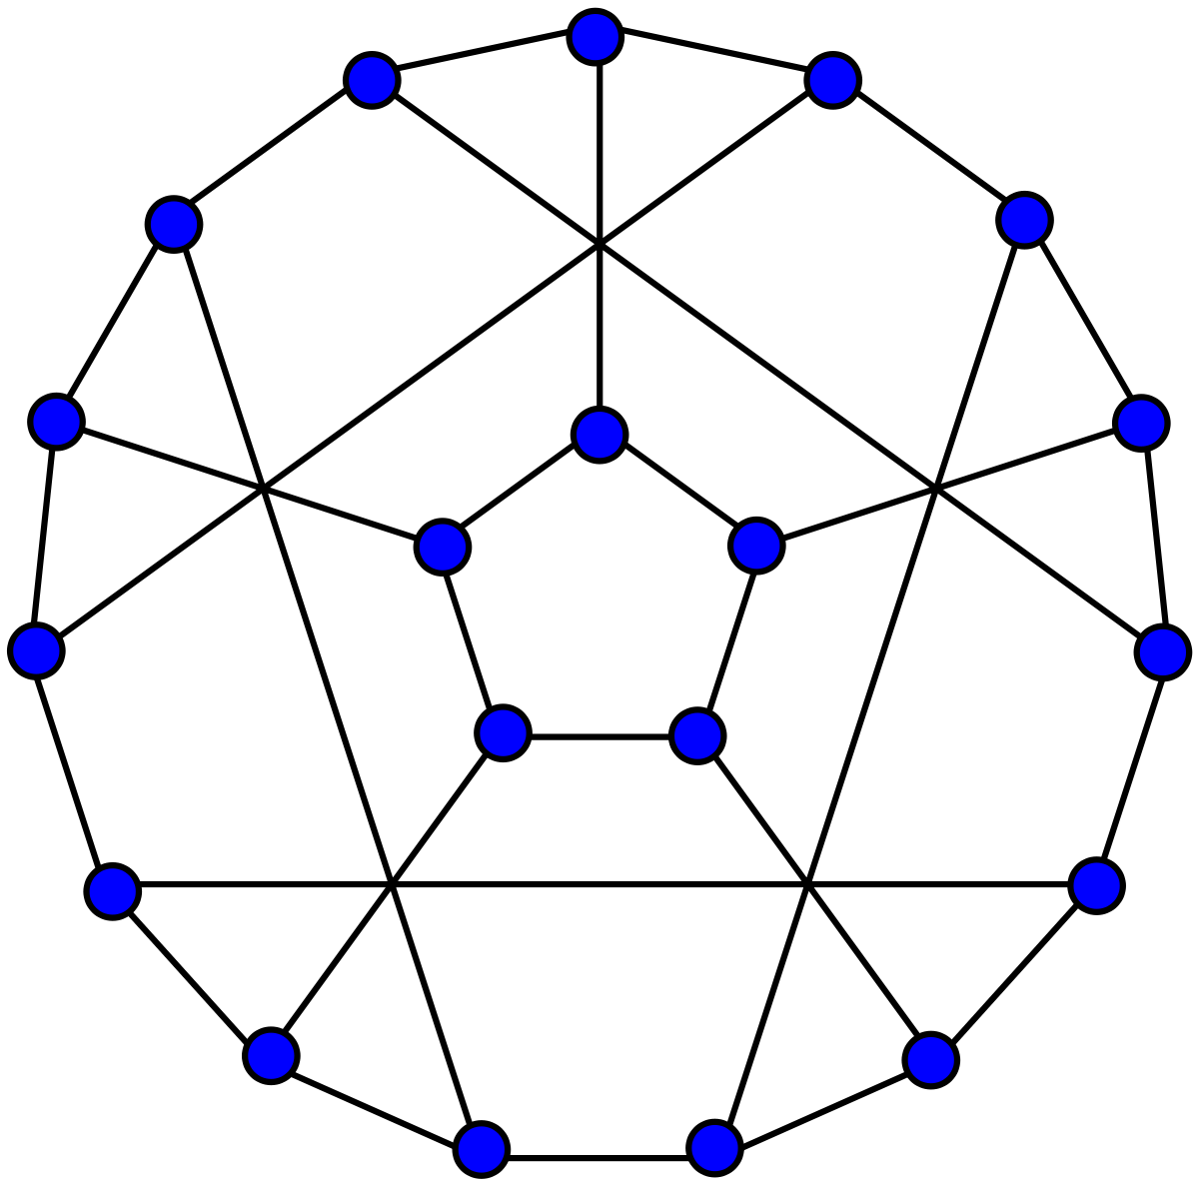
Graphs
And extending the idea of a set, we could have a graph:
  A set of nodes
  A set of edges

Slide 39
Probability
Using numbers to say how likely things are.
The real world is messy
  We never know things for sure
  Things are just more or less likely
We can model uncertainty using Probability

Slide 40
Statistics
How do we make compelling arguments about this messy world?
  Giving science a reliable foundation
  By applying probability theory to our observations of the world using Statistics

Slide 41

Okay, that’s enough of that

Slide 42
The End
See you on Friday
No preparation required this week

