Slide 1

Mathematics and Problem Solving
  Lecture 9
    Maths to Code

Slide 2
Overview
Two Paradgims
Bridging the Gap
Functions
Nuts and Bolts

Slide 3
This might hurt a little
  There are no easy answers
  It’s about thinking in different ways

Slide 4

Two Paradigms

Slide 5
Programming
What is programming?

Slide 6
Programming
What is programming?
  Writing a sequence of instructions
  Designing an algorithm
  Controlling the flow of execution

Slide 7
Programming
What is imperative programming?
  Writing a sequence of instructions
  Designing an algorithm
  Controlling the flow of execution

Slide 8
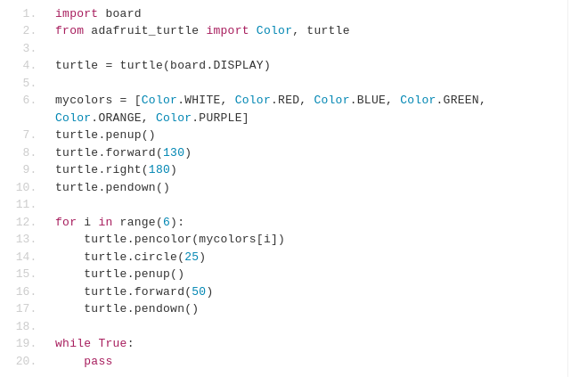
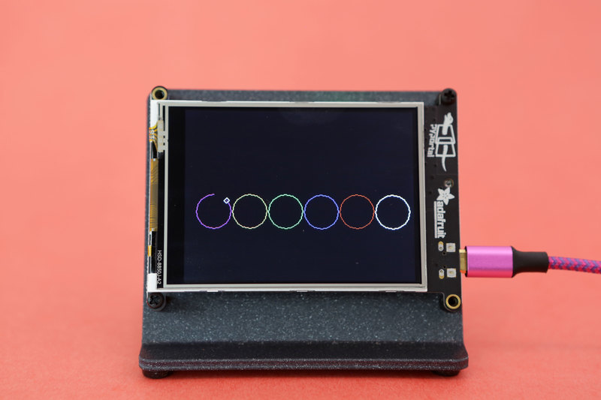

Slide 9
Maths
What is maths?
  Declaring what is the case
  Defining relations between ideas
  Solving within constraints

Slide 10
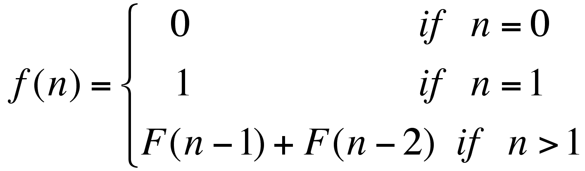

Slide 11
The Conceptual Divide
Programming is imperative*
Maths is declarative

Slide 12
Imagine trying to write a program to perfrom the process of mathematics
  Detect when it can apply transformation rules
  Transform strings
  Infer patterns
  Find solutions within constraints
  Reason over this process to prove that some solutions don’t exist

Slide 13
Imagine writing maths to describe a program
  Function: input → output
    Whole code
    Each method
  Sequnce of all variables
    [(a1,b1,c1), (a2,b2,c2), ... (an,bn,cn)]
    Function relating them
  Recursion

Slide 14
Maths
Generalities
Solving
Proving
Holistic
Intuitive
Programming
Instances
Evaluating
Testing
Local
Formal

Slide 15

Bridging the gap

Slide 16

Think like a school child
We reason holistically and intuitively
  But only once we are familiar with patterns
We are taught step-by-step instructions
+
=

Slide 17
Work through the maths yourself with example values
What steps do you take?
  Each step is a line of code
  Create interim variables for clarity
  Add brackets for clarity

Slide 18
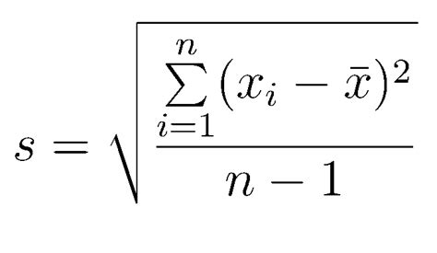

Slide 19
Mean
  double meanOfX = mean(x)
In the sum
  Difference
    double diff = x[i] – meanOfX
  Square
    double diff2 = diff * diff
Sum
  for (int i=0;i<n;i++) { }
Division
  double sSquared = Sum / n-1
Square root
  double s = Math.sqrt(sSquared)

Slide 20
Make code more declarative
We define things in code all the time
  double pi = 3.14;
  int add(int a, int b) { return a + b; }
  class Set
Look for declarative ways to write your code

Slide 21
What does it mean to define?
  X is something (is a)
    Or has a particular type
  X has something (has a)
    Or stores particular types of variables

Slide 22
Has a
In OOP, we design classes
Classes have certain properties
  Variables
  Methods
All of this type information is declarative

Slide 23
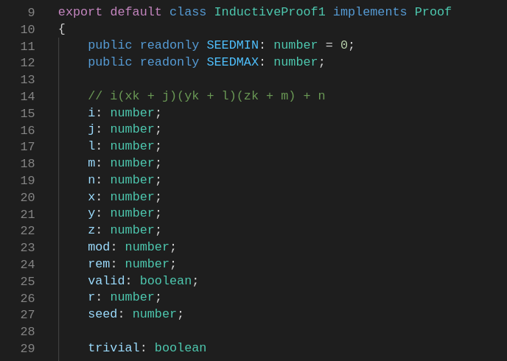

Slide 24
Variables, objects and functions have a name
  No operational effect
  Really important for understanding your code!
  Choose good descriptive names!

Slide 25
Is a
When we ask what a thing is we’re asking about it’s type
  numerical?
  boolean?
  Array?
  Object? (ClassA, ClassB, ClassC, …)
    What does the class have?
  Function
    What are it’s arguments?
    What is it’s return type?

Slide 26
OOP gives us powerful inheritence tools
  A class can extend another class
  A class can implement an interface
Each class in a heirarchy defines some properties
  When a class Cat extends another class Animal, the Cat is a Animal
  Cat has the properties of an Animal
  ArrayList is a AbstractList is a AbstractCollection is an Object; and ArrayList is a Serializable, Clonable, Iterable, Collection, List, RandomAccess

Slide 27
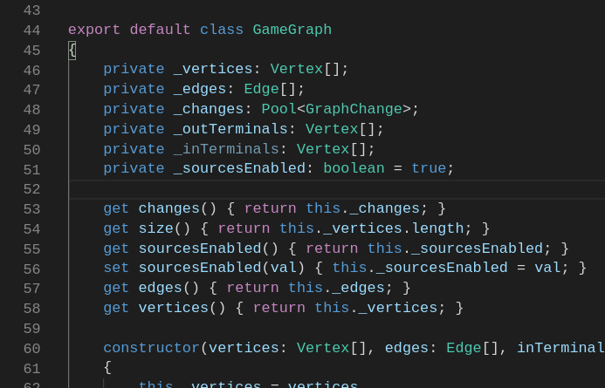
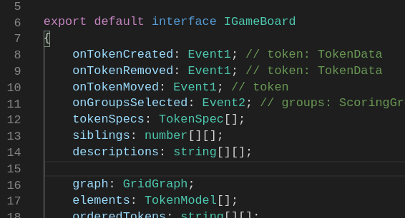
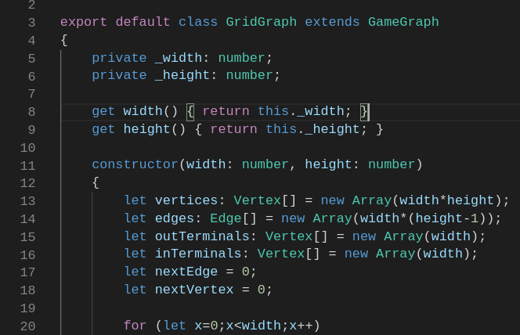
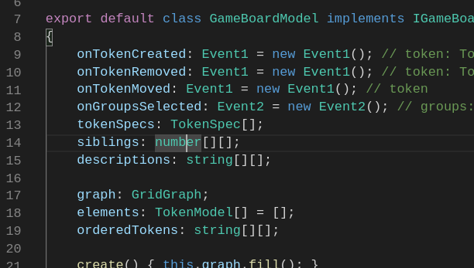

Slide 28
Structure your code so that it’s
  Easy to do things that work
  Hard to do things that don’t work
Explicit typing is your friend

Slide 29
Bridging the Gap
Make your maths more imperative
  Think like a school child
Make your code more declarative
  What is x? What does x have?
  Of functions: What arguments does x take? What sort of thing does it return?
  What shall I call it?

Slide 30
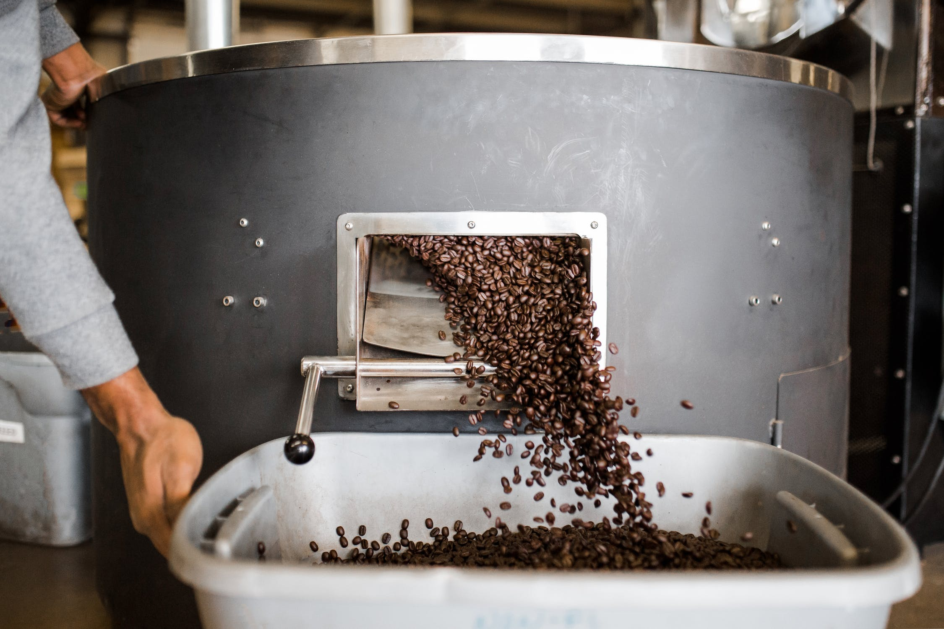
Functions

Slide 31
Not all programming langages are imperative
  Declarative Programming
Program defines a problem domain
  Defines what the program should achieve
  Not how it achieves it

Slide 32
Functional Programming
  Programs are constructed of functions, combining other functions...
  Functions are first-class citizens
    You can pass them as arguments and return them from other functions
  You don’t have a state
    No variables to store and manipulate
    Lazy evaluation means that functions are evaluted when needed

Slide 33
Make good use of functions
  They can be small
  Do a single well defined task
  Call other functions
  Be recursive
  You don’t need to store the value if you have a function to calculate it
See if your programming langauge supports
  Delegates (e.g. C#)
  Callbacks (e.g. JS)
  (Not really supported in Java :( )

Slide 34
A function might be defined imperatively, but once it’s written, it’s a magic box
  If it does a clearly defined job, you can treat it like a mathematical function
Ensure side-effects are always expected (and as expected)
  Maths doesn’t have side-effects!

Slide 35
Good use of functions is the most important step to making maths code more managable

Slide 36

Nuts and Bolts

Slide 37
Types
Integers → Integer Primatives
  byte 8 bits -128 to +127
  short 16 bits -32,768 to +32,767
  int 32 bits -2 billion to +2 billion (approximately)
  long 64 bits -9x10¹⁸ to +9x10¹⁸ (approximately)

Slide 38
Reals → Floating Point Primatives
  float 32 bits -3.4x10³⁸ to +3.4x10³⁸
  double 64 bits -1.7x10³⁰⁸ to 1.7x10³⁰⁸
Beware: precision
  Treat floating point values as non-deterministic

Slide 39
Arrays → Arrays
  X = [X1, …, Xn] → int[]
Watch out for indexes
  Maths usually indexes from 1 → n
  Code usually indexes from 0 → n-1

Slide 40
Mathematical objects such as
  Sets
  Tuples
  Graphs
you’ll probably need to create your own class

Slide 41
Operators
a + b → a + b
a - b → a - b
a x b, ab, a.b → a*b
a÷b, → a/b
a mod b → a % b
a^{b} → Math.pow(a,b)
log2 a→ Math.log(a)
a
b

Slide 42
Log to any base
  int log(int a, int base)
  {
  return log(a) / log(base);
  }

Slide 43
a ∧ b → a && b
a∨b → a || b
¬a → !a

Slide 44
And when this doesn’t work
Ask: what is this formula achieving?
  Isolate the formula you can’t translate
  Think of the formula like a function f(x) → ?
    What does it depend on? (i.e. the inputs)
    What is it’s output?
  How can you write the same function a different way?
    Perhaps even as a function!
  eg. Summation → for loop

Slide 45
Elegance and Clarity
Brackets
  There’s no harm doing ((a) + (b))
Simplify
  Do only as many operations in one line that are easy to understand
  Interim variables
Descriptive names
  Reading the name of a function in context should make it clear exactly what it does

Slide 46
Takeaways
Make maths more imperative
Make code more declarative
Make good use of functions
Make sure you know what your types are
Descriptively named, interim variables
Translate each operator. When in doubt, add brackets

