Slide 1

Mathematics and Problem Solving
  Lecture 10.4
    Data Visualisation

Slide 2
Visualising Data
Why?
  Look at your data
  Understand your data
  Communicate your findings

Slide 3
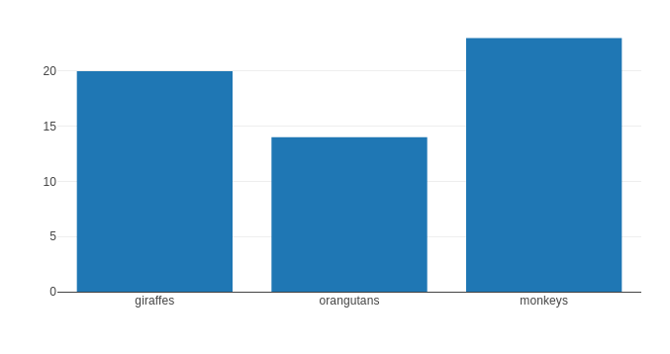
Nominal
Distribution
  Counts
Bar Chart

Slide 4
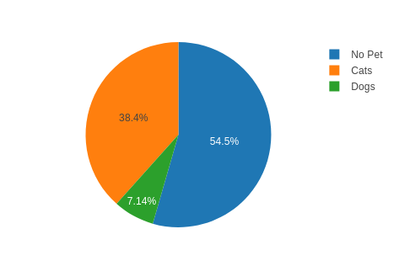
Proportion
  Pie charts?
    Harder to read
    Avoided in research literature
  Stick with a bar chart

Slide 5
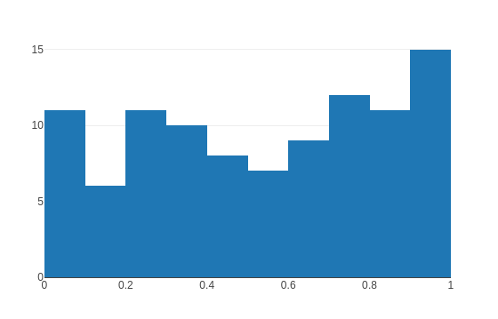
Numeric
Group into bins
  Can vary in size
Histogram

Slide 6
Ordinal
Few values → bar chart
Many values → histogram

Slide 7
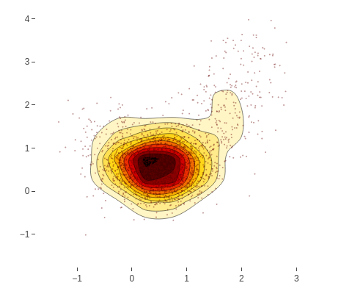
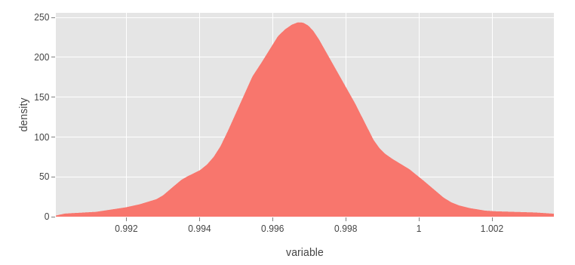
Density Plot
Show distribution of data

Slide 8
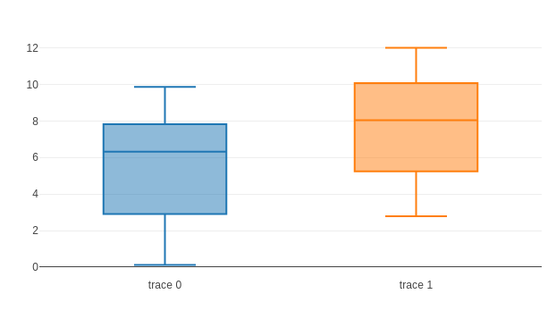
Boxplot
Line = mean
Box = IQR
Whiskers = range (minus outliers)
Outliers as dots

Slide 9
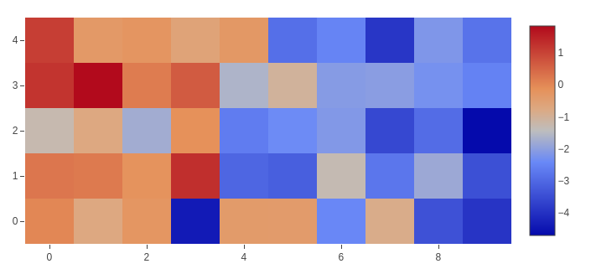

Heatmap
Shows magnitude in 2D data
  Clusters
  Over space

Slide 10
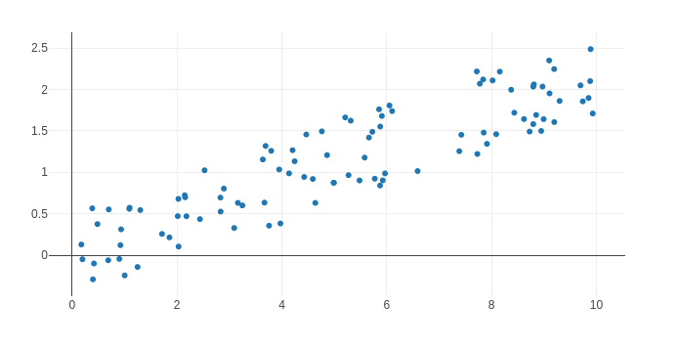
Correlations
Correlation?
  Linear relationship between variables
  Correlations between -1 → 1
Scatterplot

Slide 11
Summary
Nominal
  Bar Chart
Numeric
  Histogram
Hypothesis test
  Box plot

