Slide 1

Mathematics and Problem Solving
  Lecture 11.2
    Hypothesis Testing

Slide 2
Starting with a question
Often you’ll come to data with a question:
  “Do players prefer character A or character B?”

Slide 3
Hypotheses
To answer this with statistics, you need to turn it into two hypotheses:
  Null Hypothesis
  Alternate Hypothesis

Slide 4
Null Hypothesis
The null hypothesis says that
  whatever results you got were the result of chance
  i.e. nothing interesting is happening
e.g. “Players like both characters more or less the same”

Slide 5
Alternate Hypothesis
Your alternate hypothesis is what you’re trying to prove
  e.g. “Players either prefer Character A or they prefer character B”
  This is the hypothesis that we’re going to test

Slide 6
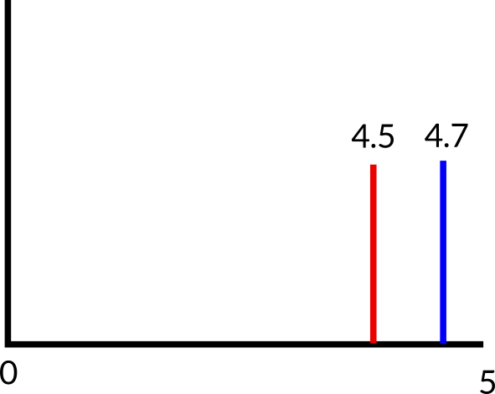
Now, imagine we find the mean score for characters A and B to be 4.5 and 4.7
Can we confirm our hypothesis?
  No, because we only sampled our population, the difference might be chance
Inferential statistics tell you how likely it is that the effect you observe is the result of chance.

Slide 7
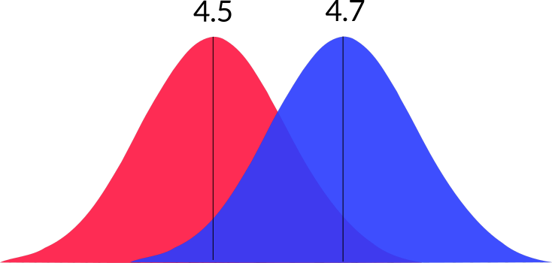
Instead, imagine we have the distributions of the results.
  Now can we confirm our hypothesis?

Slide 8
Statistics
Key values
  Test statistic (varies)
  p
  α
  Effect size (if possible)

Slide 9
Statistical Significance
p = probability the effect observed was chance
  p < α
    statistically significant
  p > α
    not statistically significant

Slide 10
Alpha
Alpha (α) is usually set at 0.05
Reduced for multiple testing

Slide 11
Effect Size
How big an effect is
  e.g. Cohen’s d
    d = 0.2 is small
    d = 0.5 is medium
    d = 0.8 is large
Important for interpreting results

Slide 12
Type I error
Falsely rejecting the null hypothesis
  we claim an effect when there is no effect
If α = 0.05, we have a 5% chance of making a Type I error.

Slide 13
Type II error
Falsely accepting the null hypothesis
  there is an effect, but you don’t detect it
The probability of making a type II error is called beta (β)
  This is related to your statistical power. (= 1-β)
  A good power is 0.8 (β = 0.2)

Slide 14
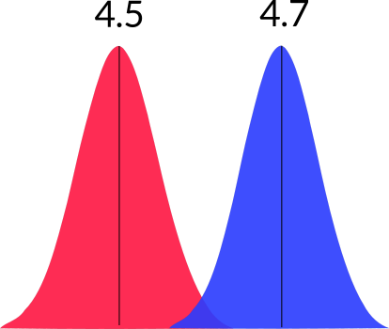
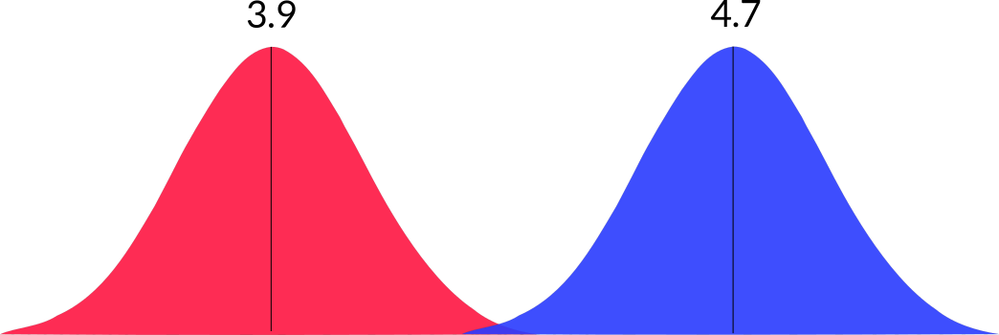
Power
Related to
  sample size
  effect size
  spread of data

Slide 15
In closing
Inferential statistics = lots of numbers about your data
It’s frighteningly easy to make mistakes
  If that is in science that people rely on, that’s a big problem

