Slide 1

Mathematics and Problem Solving
  Lecture 11.3
    Probability Distributions

Slide 2
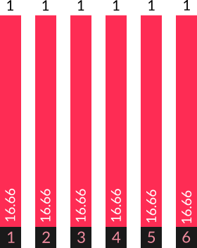
Roll one dice
  The probability of getting each number is the same

Slide 3
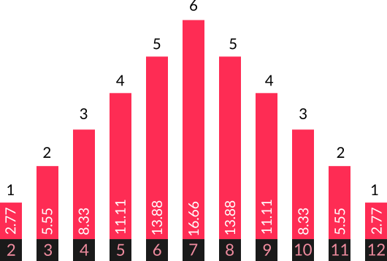
Roll two dice and add them together
  The probability differs for each number

Slide 4
What’s the probability of rolling 7?
  6/36 = 1/6 = 16.66
  P(1) * P(6)
  + P(2) * P(5)
  + P(3) * P(4)
  + P(4) * P(3)
  + P(5) * P(2)
  + P(6) * P(1)

Slide 5
These are two different probability distributions

Slide 6
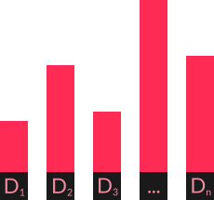
Discrete Distribution
Discrete
  Countable D1 … Dn
Probability mass function = list of values and their probabilities
  Sum to 1

Slide 7
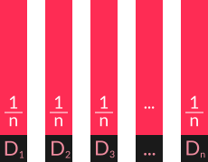
Discrete Uniform Distribution
Discrete
  Countable D1 … Dn
Uniform
  All same probability

Slide 8
Binomial Distribution
Flip a coin, twice
  Probability of success constant = 0.5
  Independant trials
  Variable = number of heads
Number of Heads | Probability
0 | 0.25
1 | 0.5
2 | 0.25

Slide 9
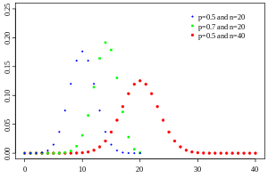
Binomial Distribution
Number of successes in a sequence of yes/no questions
  e.g. flip a coin 10 times, count the number of heads
Defined by
  n (number of questions) and
  p (probability of a “yes”)

Slide 10
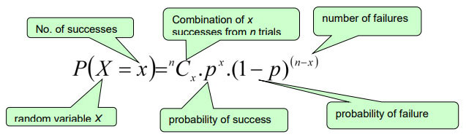
Binomial Distribution
Binomial formula
  Probability of x successes

Slide 11

Continuous Distribution
Probability density function represents a curve
  Area under curve adds up to 1

Slide 12

Continuous Distribution
Probability density function represents a curve
  Probability of single value = 0

Slide 13
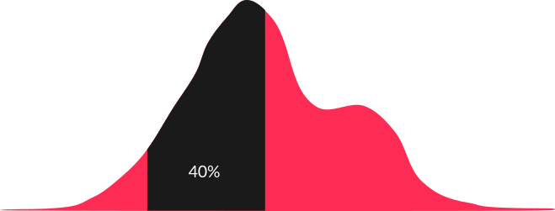
Continuous Distribution
Probability density function represents a curve
  Area under the curve is probability of range of values

Slide 14
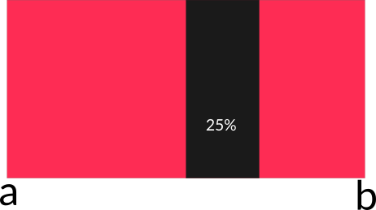
Continuous Uniform Distribution
Continuous
  Range a → b
Uniform
  All same probability

Slide 15

Normal Distribution
Measure height of everyone in a class
  1.56 1.37 1.14 1.38
  1.09 1.18 1.68 1.22
  1.15 1.43 1.58 1.59
  1.02 ….

Slide 16
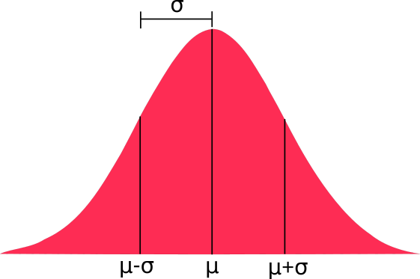
Normal Distribution
Defined by:
  mean (μ)
  standard deviation (σ)
Used a lot in inferential statistics

Slide 17
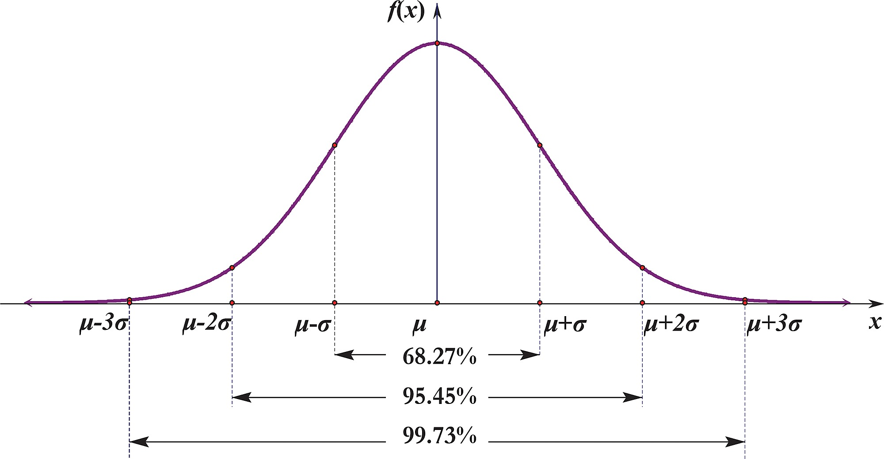
Normal Distribution

Slide 18
Summary
Discrete vs. Continuous
Uniform
Binomial
Normal

