Slide 1

Mathematics and Problem Solving
  Lecture 12.1
    Samples and Populations

Slide 2


Notes:
Inferential statistics let us use a sample to infer something about a population

Slide 3
Inference
A claim that the evidence supports a particular conclusion
Inferential statistics help justify this claim
  Not because numbers are impressive
  They show how likely the conclusions are (given certain assumptions)

Slide 4
Population
The group of people (or things) we are interested in
Notes:
For example, “humans” is a pretty common population to be interested in.
But we might only be interested in humans of a particular age, or gender, or…
Or we might be interested in the classifications generated by an algorithm

Slide 5
Sample
The subset we collect data from is called our sample.
Notes:
When we want to study a population, usually we can’t gather data for every member of it
It’s usually impossible
If you’re studing humans, what about those humans not born yet?
So we sample the population, collecting data from only some of its members.

Slide 6
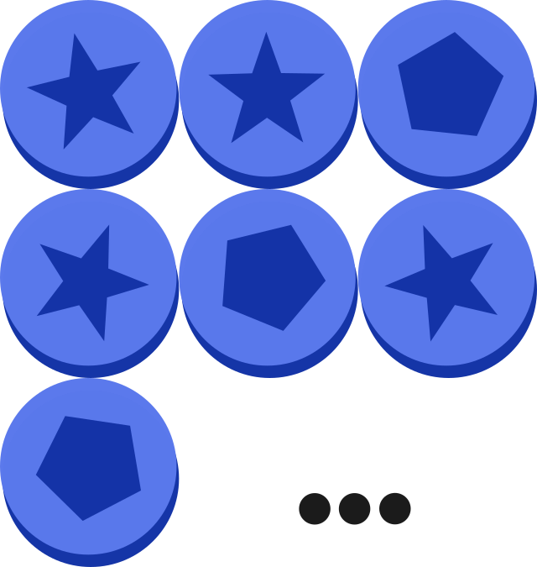
Coin flips
Is a coin biased?
  Population: All coin flips with that coin (past, present, future)
  Sample: We flip the coin lots of times and record the results

Slide 7


Sampling Problems
We can easily collect a biased sample
  We usually don’t sample our population randomly
  There might be things our sample has in common just due to the way we collected it
This is a threat to validity – something that means our inferences might not be correct

Slide 8
Construct Validity
Validity is an argument that you make in support of your conclusions
  Has your experiment actually measured what you think it has?
Biased sample → less convincing

Slide 9
External Validity
Can we generalise our findings beyond our sample?

Slide 10
Coin Flips
Does the fairness of the coin change over time?
  We don’t expect that to be the case
  Unlikely to make someone reject our argument

Slide 11
A common criticism...
Social science studies
  Population: all humans
  Sample: undergraduates
A big problem?
  Are undergraduates a biased sample for this variable?

Slide 12
Drug studies
We run a study to check a drug is safe
  We recruit 1000 healthy people to our study
  Our results show the drug is safe
Is the drug safe?

Slide 13
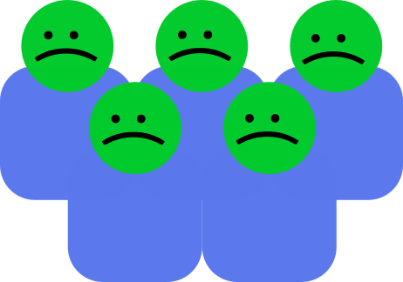

Slide 14
Summary
Population
  Set we want to say something about
Sample
  Subset we collect data from
Inference
  Claim data supports a conclusion
External Validity
  Do our findings generalise from sample to population?

