Slide 1

Mathematics and Problem Solving
  Lecture 12
    Inferrential Statistics
“An approximate answer to the right problem is worth a good deal more than an exact answer to an approximate problem.”
John Tukey

Slide 2
Probability Distributions

Slide 3
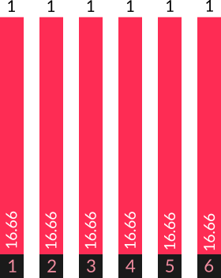
Probability Distributions
Roll one dice
  The probability of getting each number is the same

Slide 4
Probability again
Exercise 1:
Imagine you roll two 6-sided dice. What’s the probability of getting:
  7
  12

Slide 5
  P(1) * P(6)
  + P(2) * P(5)
  + P(3) * P(4)
  + P(4) * P(3)
  + P(5) * P(2)
  + P(6) * P(1)
What’s the probability of rolling 7?
  6/36 = 1/6 = 16.66

Slide 6
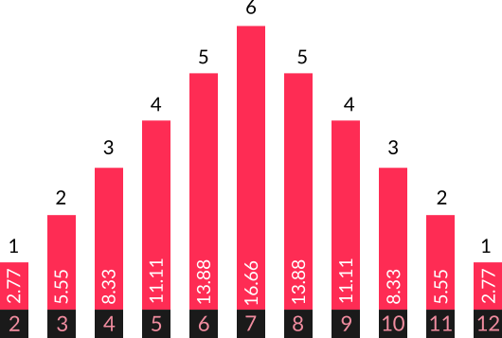
Roll two dice and add them together
  The probability differs for each number

Slide 7
These are two different probability distributions

Slide 8
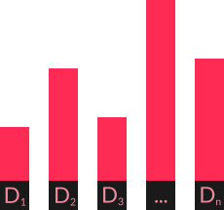
Discrete Distribution
Discrete
  Countable D1 … Dn
Probability mass function = list of values and their probabilities
  Sum to 1

Slide 9
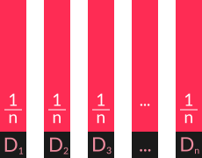
Discrete Uniform Distribution
Discrete
  Countable D1 … Dn
Uniform
  All same probability

Slide 10
Binomial Distribution
Flip a coin, twice
  Probability of success constant = 0.5
  Independant trials
  Variable = number of heads
Number of Heads | Probability
0 | 0.25
1 | 0.5
2 | 0.25

Slide 11
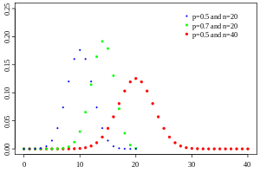
Binomial Distribution
Number of successes in a sequence of yes/no questions
  e.g. flip a coin 10 times, count the number of heads
Defined by
  n (number of questions) and
  p (probability of a “yes”)

Slide 12
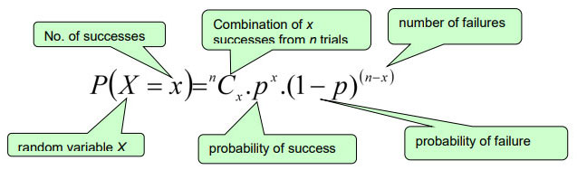
Binomial Distribution
Binomial formula
  Probability of x successes

Slide 13

Continuous Distribution
Probability density function represents a curve
  Area under curve adds up to 1

Slide 14

Continuous Distribution
Probability density function represents a curve
  Probability of single value = 0

Slide 15
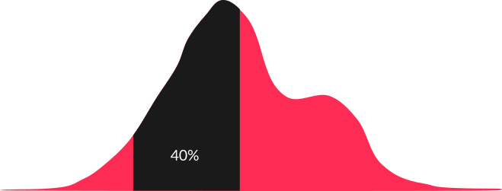
Continuous Distribution
Probability density function represents a curve
  Area under the curve is probability of range of values

Slide 16
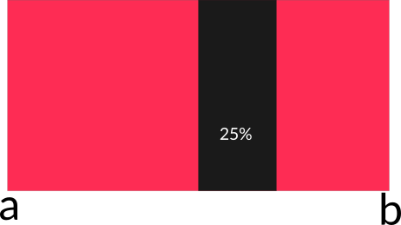
Continuous Uniform Distribution
Continuous
  Range a → b
Uniform
  All same probability

Slide 17
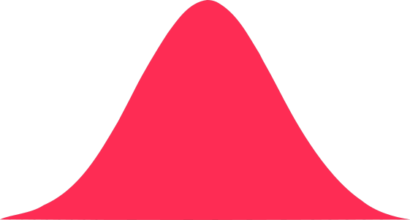
Normal Distribution
Measure height of everyone in a class
  1.56 1.37 1.14 1.38
  1.09 1.18 1.68 1.22
  1.15 1.43 1.58 1.59
  1.02 ….

Slide 18
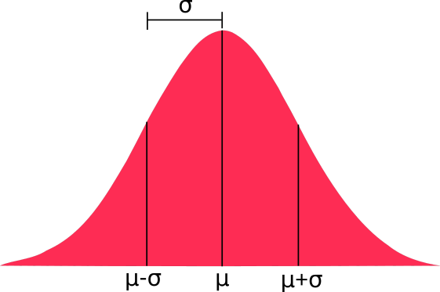
Normal Distribution
Defined by:
  mean (μ)
  standard deviation (σ)
Used a lot in inferential statistics
Also called a Gaussian Distribution

Slide 19
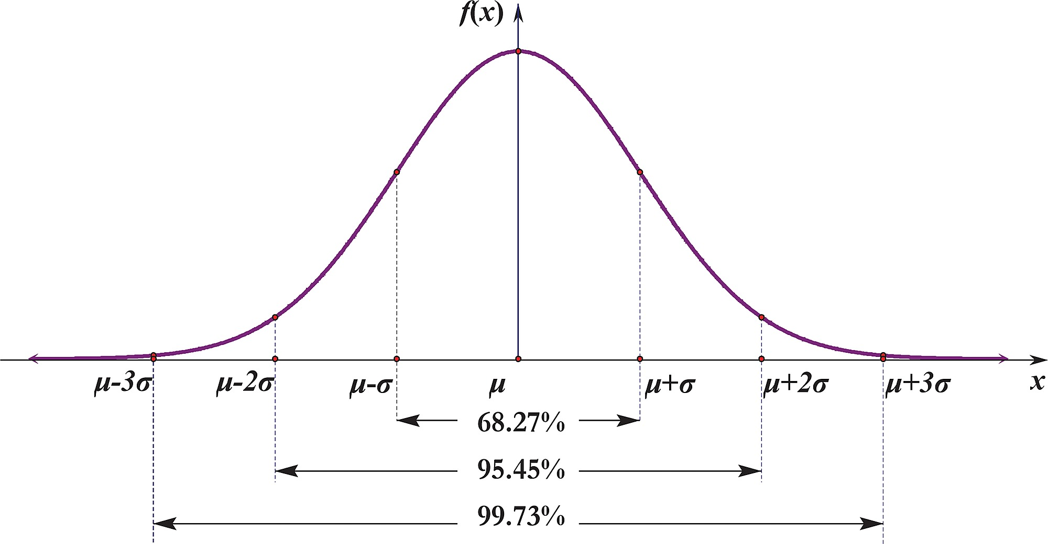
Normal Distribution

Slide 20
Question
Exercise 2:
Which of the following are discrete, which are continuous?
  Rolling a biased dice
  Java’s Math.random()
  A random integer 0-100
  A binomial distribution
  A gausian distribution

Slide 21
Summary
Discrete vs. Continuous
Uniform
Binomial
Normal

Slide 22
Question
Exercise 3:
  What is the liklihood of getting 0.5 on a continuous uniform distribution of numbers from 0-1?
  What do the probabilities in a probability mass function sum to?
  What do you get if you integrate a probability density function?

Slide 23
Samples and Populations

Slide 24


Notes:
Inferential statistics let us use a sample to infer something about a population

Slide 25
Inference
A claim that the evidence supports a particular conclusion
Inferential statistics help justify this claim
  Not because numbers are impressive
  They show how likely the conclusions are (given certain assumptions)

Slide 26
Population
The group of people (or things) we are interested in
Notes:
For example, “humans” is a pretty common population to be interested in.
But we might only be interested in humans of a particular age, or gender, or…
Or we might be interested in the classifications generated by an algorithm

Slide 27
Sample
The subset we collect data from is called our sample.
Notes:
When we want to study a population, usually we can’t gather data for every member of it
It’s usually impossible
If you’re studing humans, what about those humans not born yet?
So we sample the population, collecting data from only some of its members.

Slide 28

Coin flips
Is a coin biased?
  Population: All coin flips with that coin (past, present, future)
  Sample: We flip the coin lots of times and record the results

Slide 29
Exercise 3:
Suggest samples and populations for the following studies:
  Trial of a new drug
  Testing purity at a water processing plant
Hint:
  Population: population we are interested in
  Sample: subset we collect data from

Slide 30


Sampling Problems
We can easily collect a biased sample
  We usually don’t sample our population randomly
  There might be things our sample has in common just due to the way we collected it
This is a threat to validity – something that means our inferences might not be correct

Slide 31
Construct Validity
Validity is an argument that you make in support of your conclusions
  Has your experiment actually measured what you think it has?
Biased sample → less convincing

Slide 32
External Validity
Can we generalise our findings beyond our sample?

Slide 33
Coin Flips
Does the fairness of the coin change over time?
  We don’t expect that to be the case
  Unlikely to make someone reject our argument

Slide 34
A common criticism...
Social science studies
  Population: all humans
  Sample: undergraduates
A big problem?
  Are undergraduates a biased sample for this variable?

Slide 35
Drug studies
We run a study to check a drug is safe
  We recruit 1000 healthy people to our study
  Our results show the drug is safe
Is the drug safe?

Slide 36


Slide 37
Summary
Population
  Set we want to say something about
Sample
  Subset we collect data from
Inference
  Claim data supports a conclusion
External Validity
  Do our findings generalise from sample to population?

Slide 38
Question
Exercise 4:
Roulette is a casino game where a numbered wheel is spun by a croupier. A ball is spun in the opposite direction and eventually lands in one of the 37 (or 38) numbers.
You suspect a roulette wheel is biased and ran a study to prove it:
  What would your population be?
  What would your sample be?

Slide 39
Hypothesis Testing

Slide 40
Variables
Independant Variable (IV)
  The thing you control
Dependant Variable (DV)
  The thing that you observe

Slide 41
Starting with a question
Often you’ll come to data with a question:
  “Do players prefer character A or character B?”

Slide 42
Hypotheses
To answer this with statistics, you need to turn it into two hypotheses:
  Null Hypothesis
  Alternate Hypothesis

Slide 43
Null Hypothesis
The null hypothesis says that
  whatever results you got were the result of chance
  i.e. nothing interesting is happening
e.g. “Players like both characters more or less the same”

Slide 44
Alternate Hypothesis
Your alternate hypothesis is what you’re trying to prove
  e.g. “Players either prefer Character A or they prefer character B”
  This is the hypothesis that we’re going to test

Slide 45
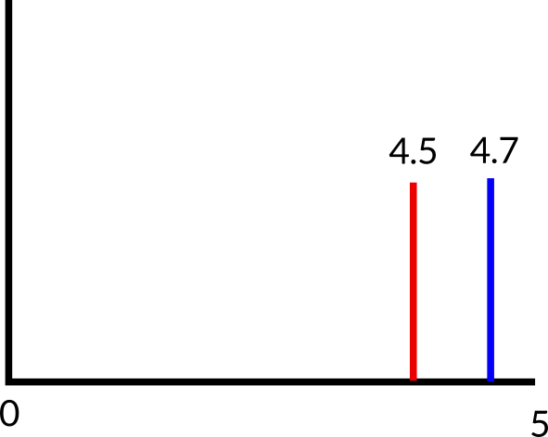
Now, imagine we find the mean score for characters A and B to be 4.5 and 4.7
Can we confirm our hypothesis?
  No, because we only sampled our population, the difference might be chance
Inferential statistics tell you how likely it is that the effect you observe is the result of chance.

Slide 46
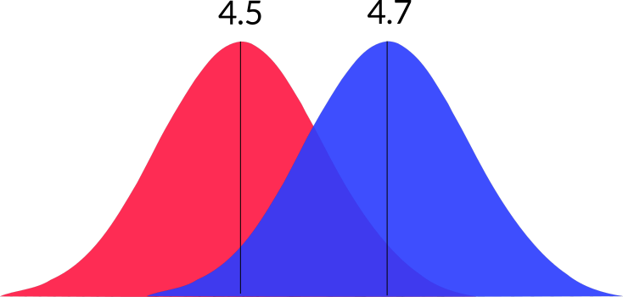
Instead, imagine we have the distributions of the results.
  Now can we confirm our hypothesis?

Slide 47
Statistics
Key values
  Test statistic (varies)
  p
  α
  Effect size (if possible)

Slide 48
Statistical Significance
p = probability the effect observed was chance
  p < α
    statistically significant
  p > α
    not statistically significant

Slide 49
Alpha
Alpha (α) is usually set at 0.05
Reduced for multiple testing
  Simplest method is the Bonferoni Correction. For m hypothesis tests, alpha is set at
  αadjusted = αoverall / m

Slide 50
Effect Size
How big an effect is
  e.g. Cohen’s d
    d = 0.2 is small
    d = 0.5 is medium
    d = 0.8 is large
Important for interpreting results

Slide 51
Type I error
Falsely rejecting the null hypothesis
  we claim an effect when there is no effect
If α = 0.05, we have a 5% chance of making a Type I error.

Slide 52
Type II error
Falsely accepting the null hypothesis
  there is an effect, but you don’t detect it
The probability of making a type II error is called beta (β)
  This is related to your statistical power. (= 1-β)
  A good power is 0.8 (β = 0.2)

Slide 53
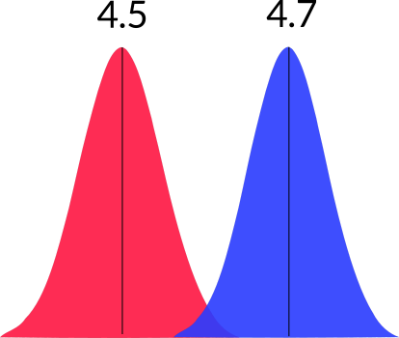
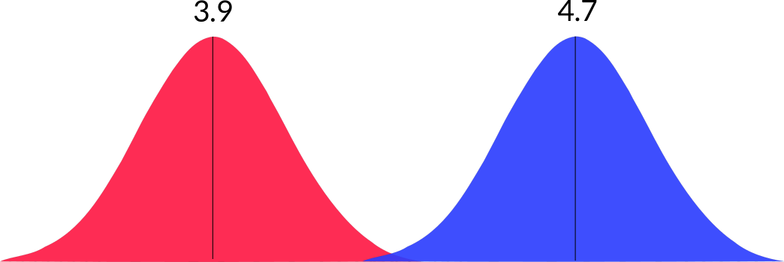
Power
Related to
  sample size
  effect size
  spread of data

Slide 54
Mistakes
Inferential statistics = lots of numbers about your data
It’s frighteningly easy to make mistakes
  If that is in science that people rely on, that’s a big problem

Slide 55
Exercise 5:
Assuming a conventional value for α = 0.05, say which of the following p-values are statistically significant:
  0.12
  0.04
  0.96
  0.012

Slide 56
Exercise 6:
Imagine you ran 4 experiments using an overall α = 0.05. The p value of each experiment is given below. Which of the results is significant?
  0.04
  0.011
  0.028
  0.001

Slide 57
Z Statistic

Slide 58
Doing Inferrential Statistics
Lots of formulas
Lots of different versions/cases

Slide 59
Inferential Statistics Basics
Compare 2 numbers
  Observed (O)
    Measurement
    Mean
    Difference between groups
  Expected (E)
    No difference (0)
    Population mean (100 IQ)
Is difference (O-E) small or big?

Slide 60
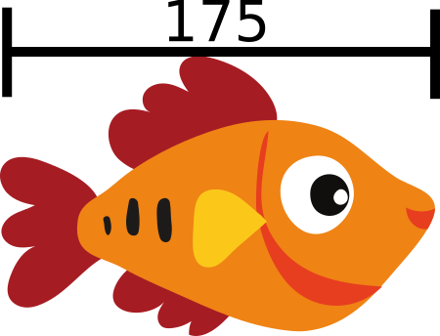
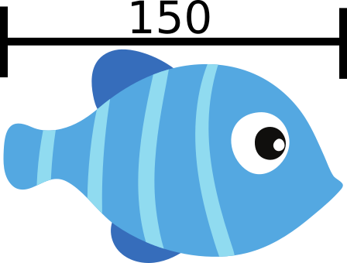
Measure a fish
  What is the size = 175
What is the expected value?
  Average size of a fish = 150
Fish by Vecteezy.com

Slide 61





Difference = 175 – 150 = 25
Is this interesting?
  What is the variance in fish size?

Slide 62
Assuming a normal distribution!
Parametric, defined by:
  mean, μ
  Standard deviation, σ
Assuming we know population standard deviation

Slide 63
If our values are
  μ = 150
  σ = 10
175 is over 2 standard deviations away from mean
  95% of data is within 2 standard deviations of mean
  Interesting fish!
σ
σ
σ
μ

Slide 64
Basic formula for an inferential statistic
Can express as ratio:
  observed – expected
  typical variation
The bigger observed difference is compared to typical variation, the bigger the (absolute) number

Slide 65
Z Statistic
The formula for the z-statistic is as follows:
  x - μ
  σ
Replace
  Observed with a single value, x
  Expected with a mean, μ
  Typical variation with standard deviation, σ
z =

Slide 66
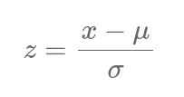
Z Statistic
Exercise 7:
For the following values, calculate the z statistic:
  x = 175; μ = 150; σ = 10
  x = 80; μ = 100; σ = 20
  x = 5; μ = 5; σ = 3

Slide 67
Z Distribution
The unit of z is standard deviations
Interpret on z distribution
Z distribution is a normal distribution
  Mean at 0
  Scale such that 1 standard deviation of distribution corresponds to 1
Describes probability of getting a particular z value
  Z close to 0 → likely
  95% of z scores within approx 2 standard deviations (-2 < z < 2)

Slide 68
Critical Thresholds

Slide 69
Critical Thresholds
When you have a inferrential statistic (e.g. z, t) you can compare it against a critical threshold to test for statistical significance
Depends on whether test is one tailed or two tailed
  Critical value for 1 tailed test is 1.645
  Critical value for 2 tailed 1.96

Slide 70


One and Two-Tailed Tests
Two tailed
  Are observed and expected values different?
One tailed
  Is observed value larger than expected value?
  Is observed value smaller than expected value?
2.5%
2.5%
5%

Slide 71
Critical Thresholds
Exercise 8:
The critical threshold for a one-tailed t test is 1.645 . For a two-tailed z test it is 1.96 Which of the following results are significant?
  z = 2
  z = 0.96 (one tailed)
  z = -1.85
  z = -0.5
  z = 1.5 (one tailed)

Slide 72
Sampling Distributions and Standard Error

Slide 73
Sampling Distribution
The sampling distribution is where your observed value comes from
  If we sample individuals, our sampling distribution is the same as our population distribution
  If we sample group means of size n, our sampling distribution is a distribution of means of groups of size n
So far we’ve sampled individual fish, so our sampling distribution was the same as our population distribution, which was a normal distribution

Slide 74
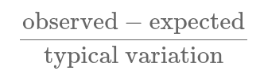
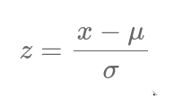
Standard Error for Individuals
Also called Standard Error
When comparing individuals, our standard error is the standard deviation

Slide 75
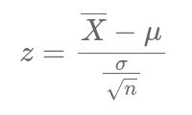
Standard Error for Group Means
When comparing group means, we need to adjust our standard error
  Divide σ by the square root of the group size
We can still calculate a z statistic (as it’s still in standard deviations)

Slide 76
Sampling Distributions
Exercise 8:
What is the sampling distribution for the following?
  (e.g. population distirbution, group means, differences in group means)
  You compare your IQ to the population
  You compare the average height of children in a class against an estimate for the population
  You catch a big fish and compare it against a population mean
  A factory produces pipes. You select one pipe from that day’s production and compare its thickness against a benchmark value
  You measure the average number of frogs per square meter in two different wetland habitats and compare the results

Slide 77

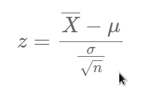
Sampling Distributions
Exercise 9:
For each of the following, pick the correct formula
  Is my score on a standardised test higher than average?
  Are the scores of a class on the same test higher than average?
  I generate numbers from a normal distribution. I get 100 surprisingly low values and think there is a bug in my code
  I think a particular person has an unusually high IQ

Slide 78
Summary
We can calculate z statistics
  Need to know population standard deviation
  Need to know sampling distribution to use correct Standard Error
We can compare a z statistic against a critical threshold to determine statistical significance
  We need to decide if we’re doing a one-tailed or two-tailed test

Slide 79
Student’s T Test

Slide 80
Remember this formula?
General formula for an inferrential statistic:
  observed – expected
  typical variation
Working out exact form of formula is difficut
Interpreting is difficult

Slide 81
T-Test
Hypothesis testing
Compares means
Two groups

Slide 82
Assumptions
The data follows a normal distribution
  This makes it a parametric test
  There are also non-parametric tests
Representative, randomly selected samples
Similar variance

Slide 83




What you need
Difference in means
Standard Deviation of each group
Count of each group

Slide 84
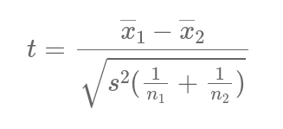

Slide 85
Options
One-sample
  Compare one group against standard value
Two-sample
  Two different groups
Paired
  Before/after data

Slide 86
Alternatives
More than two groups?
  ANOVA
Non-parametric?
  Mann-Whitney U
  Wilcoxon Signed-Rank

Slide 87
Summary
Hypothesis Test
Compares two groups
Normal distribution

