Slide 1

Mathematics and Problem Solving
  Lecture 1
    Introduction and Formal Systems
“Mathematics is a game played according to certain simple rules with meaningless marks on paper”
David Hilbert

Slide 2
Overview
The Course
Computation
A bit of history
Formal Systems
Revising the Basics

Slide 3
The Course

Slide 4
Structure
Each week we have a 4 hour lecture/practical
  I introduce some mathematical concepts
  Slides are broken up by exercises
  You’ll see similar exercises in the assessment
Problem questions each week
  Practice the content
  Submit them as your assessment

Slide 5
Assessment
Each week there will be a sheet of problem questions
You will submit all of these together at the end of the course
  There will be submission instructions on Moodle closer to the deadline
  Some variation on “staple them all together”
Do them each week
  It’s a lot of work to leave to the end
  Get help on what you‘re not confident on
It must be all your work

Slide 6
Content
1. Formal Systems
2. Modular Arithmetic
3. Numerical Systems
4. Sequences and Summation
5. Propositional Logic
6. Set Theory
7. (reading week)
8. Set Theory 2
9. Graph Theory
10. Descriptive Statistics
11. Probability
12. Inferrential Statistics

Slide 7
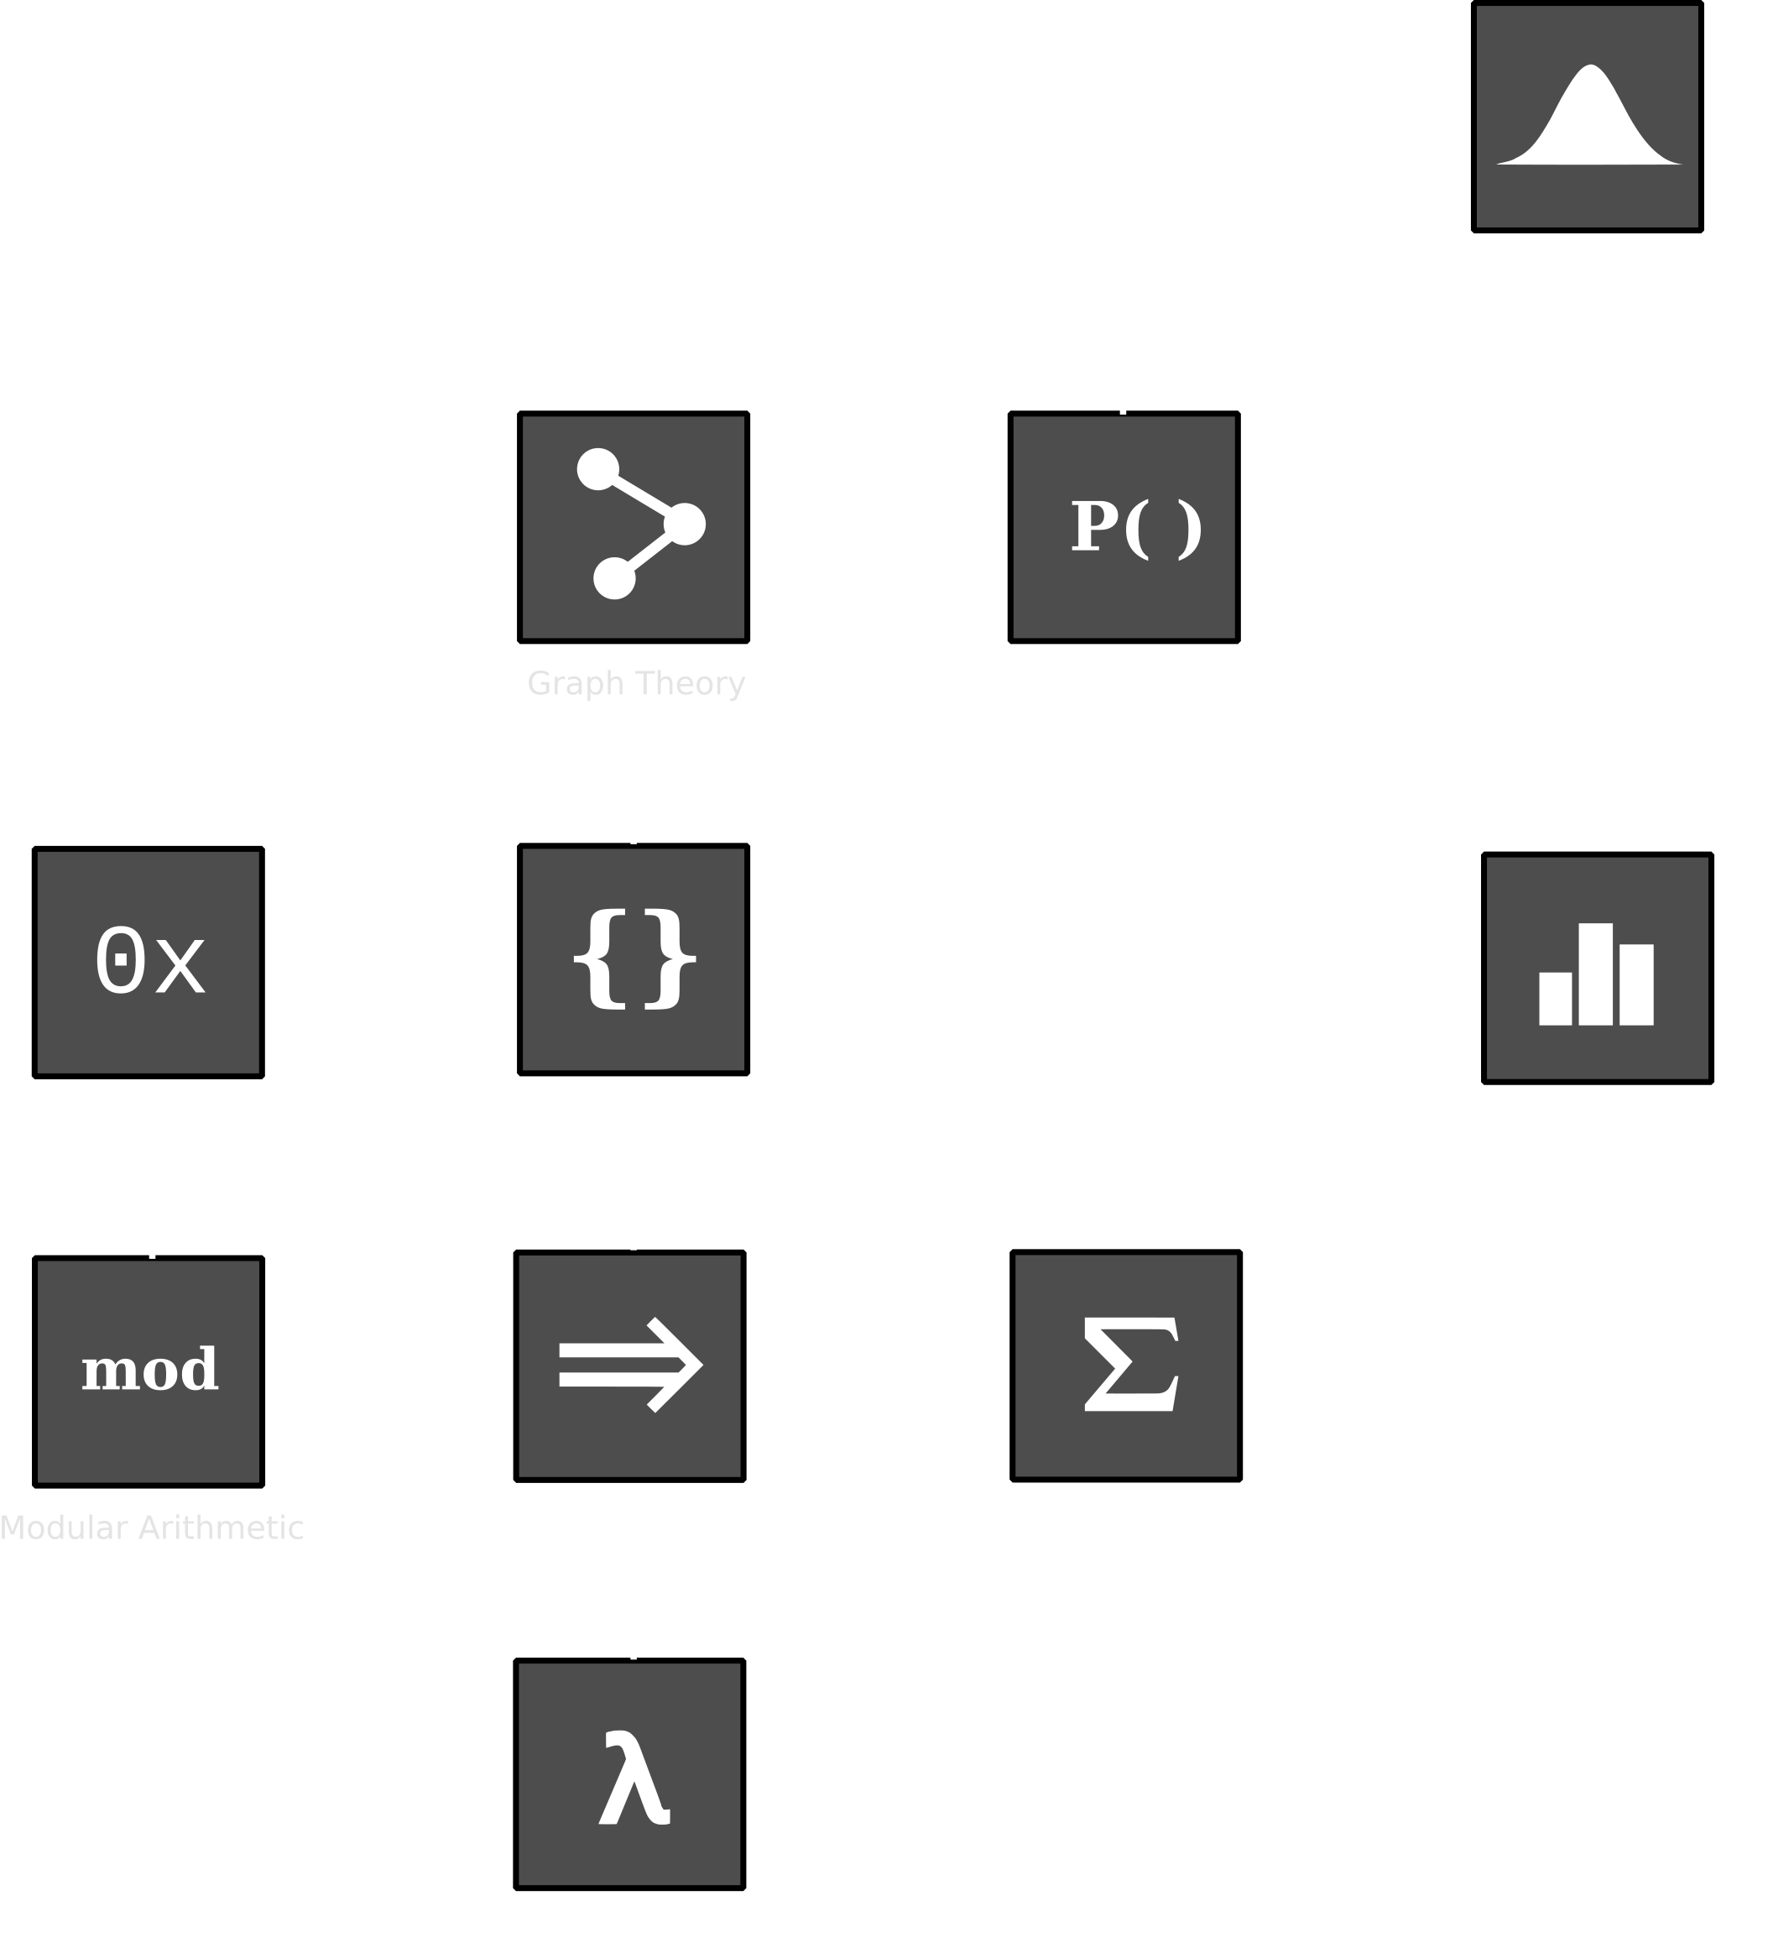

Slide 8
Why is Maths important for Computer Science?

Slide 9
Computers
Exercise 1:
What is a computer?

Slide 10
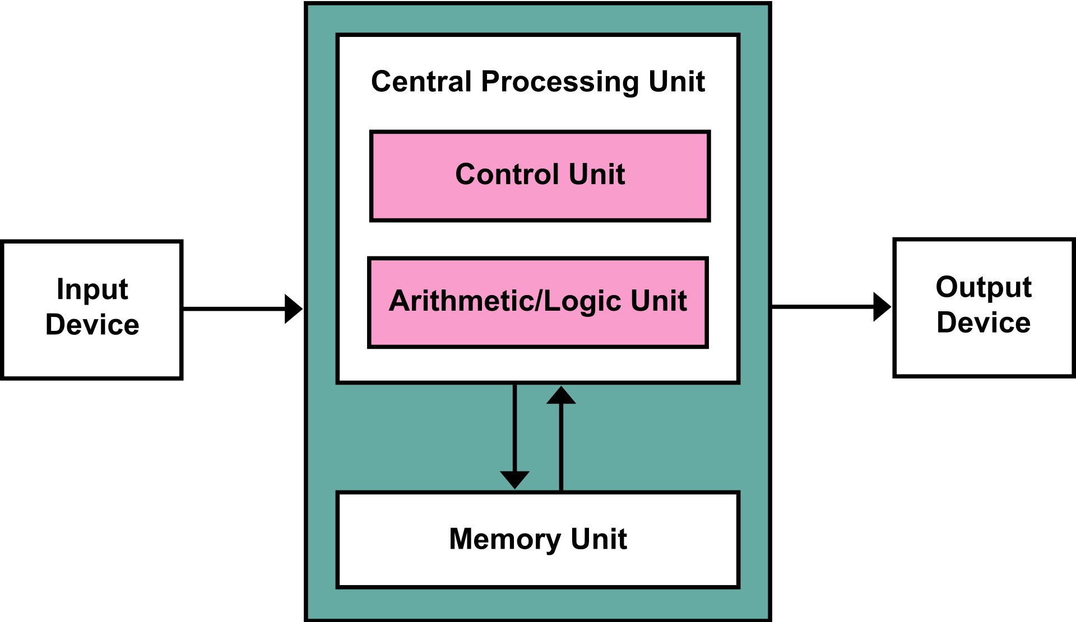
Computers
We usually think of computers as
  Magical boxes with user-friendly interfaces
  von Neumann architecture
But that’s just what we’re used to
CC BY-SA 3.0 Kapooht

Slide 11
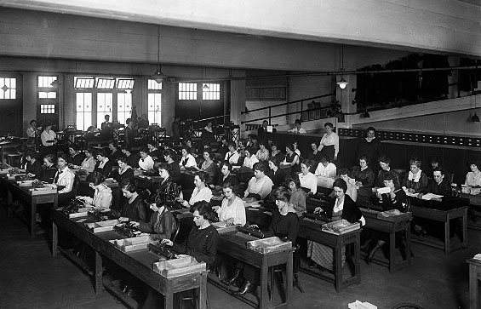
Human Computers
For most of history, “computers” were human
Calculations were broken down into steps and then performed by teams of people
Image: Computer History Museum

Slide 12
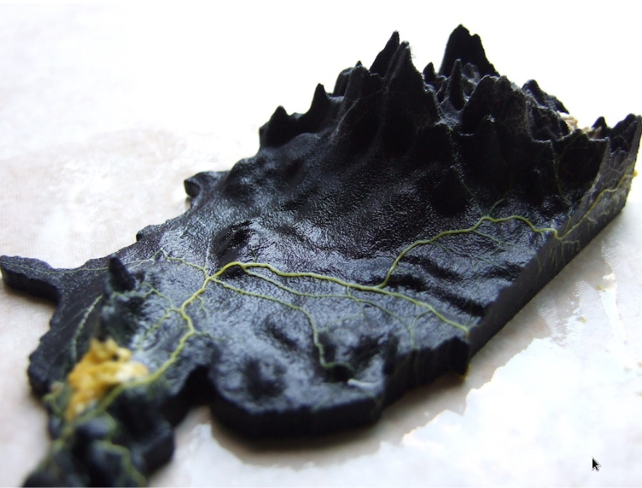
Slime mould
Slime mould computes the shortest path, e.g.
  Through a maze
  A topographical map of the US
Adamatzky, Andrew I. "Route 20, autobahn 7, and slime mold: approximating the longest roads in USA
and Germany with slime mold on 3-D terrains." IEEE transactions on cybernetics 44.1 (2013): 126-136.

Slide 13
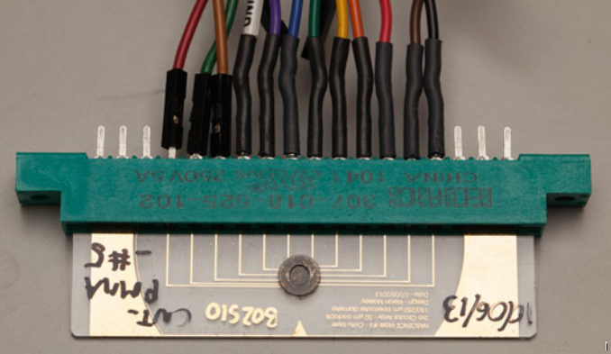
Computation In-Materio
The conductive properties of a lump of carbon nanotubes when peturbed by small currants
  Some input (encoded into voltages)
  Physical properties of the material is the computation
  Some output (read off voltages)
Dale, Matthew, Julian F. Miller, and Susan Stepney. "Reservoir computing as a model for in-materio
computing."Advances in Unconventional Computing. Springer, Cham, 2017. 533-571.

Slide 14
Computation
The physical instantiation of the computation can vary
  Transistors
  Humans
  Mould
  Carbon Nanotubes
  Buckets of water
  The universe?
If so, how do we understand computation?
Exercise 3:
What is computation?

Slide 15
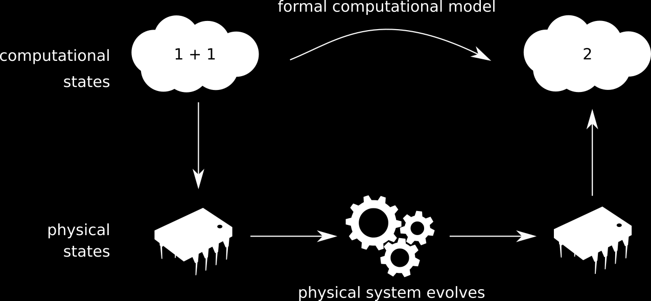
The Mapping account of computation
A physical system performs computation when there is a mapping between states of the system and computational states

Slide 16
Lambda Calculus
Formal model of computation
  Turing Complete
  Can express any computation possible with a computer
“Smallest universal programming language”
Uses just strings of symbols and rules to rewrite them
  All you need is a pencil and paper!
You do not need to learn Lambda Calculus for this course!
  We’re seeing this an example of a formal model of computation

Slide 17
Lambda Calculus
In lambda calculus, everything is a function
  Functions look like this
λ sz . s(z)
When we want to compute something we
  Translate it into a lambda calculus function
  Apply the rules of lambda calculus
  Translate back to see our answer

Slide 18
Lambda Calculus
Define functions
  λ <variable > . <expression>
Function application
  (λ <variable > . <expression>) <expression>
  (λx . x) y
  Rewrite occourances of x with y in λx . x
  (λx . x) y = [y / x] x = y

Slide 19
Representation in Lambda Calculus
Everything is represented by a function
Zero
  λ s z . z
Numbers 1-3:
  λ sz . s(z)
  λ sz . s(s(z))
  λ sz . s(s(s(z))
True and False
  λxy.x
  λxy.y
Identity function
  λ z . z
Successor function
  λwyx . y (wyx)
Multiplication
  λxyz . x (yz)
And
  λxy.xy(λuv.v)
Lots more can be defined...

Slide 20
Working with Lambda Calculus
Let’s say we want to calculate the sucessor of 1 (=2)
We translate that into lambda calculus as
  S ≡ λwyx . y (wyx)
  1 ≡ λ sz . s(z)
  S1 ≡ (λwyx . y (wyx)) λ sz . s(z)
Now we derive an answer
  (λwyx . y (wyx)) λ sz . s(z)
  λyx . y (λ sz . s(z) yx)
  λyx . y (λ z . y(z) x)
  λyx . y ( y (x) )
Which we can see has the form
  λ sz . s( s ( z ) )
  Which is 2!

Slide 21
Summary
Computers perform computation by physically instantiating problems
  We can also understand computation mathematically
Lambda calculus represents and performs computation in a very different way to a microprocessor
  It shows the underlying mathematical nature of computation
  It was invented to study mathematical properties of computable functions
  It has informed the development of functional programming languages like Haskel

Slide 22
The SPAMputer

Slide 23
The SPAMputer
I have designed a computer. It’s a mechanical device that works with cards with holes punched in them. The holes look like
  ·
There are also some special shaped holes that I’ve represented with the letters
  s, p, a, m
Today you’ll have to work through the steps manually
  As I’ve had difficulties getting a grant to build it
You can do this with a hole punch and cards. But it’ll probably be easier if you just write it out on paper.

Slide 24
SPAMputer Transformations
The computer takes in a card with holes punched in it (a piece of paper with writing on it)
  The “input string”
It outputs another card with holes punched in it.
  The “output string”
The output string is the same as the input string, with a single change, determined by a rule, such as:
s· ⤳ ··
“If there is an instance of the substring ‘s·’ in the input string you can replace it with ‘··’”

Slide 25
SPAMputer Rules
Each of the rules opposite identify and replace a substring
  Read ⤳ as “is replaced with”
Only one rule applies at a time
The top two rules are special. “__” stands in for everything else in the string
  Basically, you need to swap (a/m) each time you do
s · · · · · · · · · · · · ⤳ s·
  These rules also have the highest priority
s · · · · · · · · · · · · __ a ⤳ s · __ m
s · · · · · · · · · · · · __ m ⤳ s · __ a
If neither of the above apply, then perform one of the following
s · ⤳ · ·
· · ⤳ · p ·
· · p ⤳ · p s
· p ⤳ s

Slide 26
Example
Example
The following is a valid computation:
· · p s · a
· · p · · a
· p s · · a
s s · · a
s · · · a
· · · · a
s · · · · · · · · · · · · __ a ⤳ s · __ m
s · · · · · · · · · · · · __ m ⤳ s · __ a
If neither of the above apply, then perform one of the following
s · ⤳ · ·
· · ⤳ · p ·
· · p ⤳ · p s
· p ⤳ s

Slide 27
Discovering the SPAMputer
Exercise 2:
You start with the card:
· · · · · · · · p · · · · · · a
Run the SPAMputer until no more rules can be applied.
What is the result?
s············__a ⤳ s·__m
s············__m ⤳ s·__a
If neither of the above apply, then perform one of the following
s· ⤳ ··
·· ⤳ ·p·
··p ⤳ ·ps
·p ⤳ s

Slide 28
Using the SPAMputer
Exercise 3:
Compute the results for the following inputs
  s · p s s · a
  · · · · p · · p · m
  · · p · · · · · · · · · · · · a
s············__a ⤳ s·__m
s············__m ⤳ s·__a
If neither of the above apply, then perform one of the following
s· ⤳ ··
·· ⤳ ·p·
··p ⤳ ·ps
·p ⤳ s

Slide 29
Explaining the SPAMputer
Exercise 4:
What does the SPAMputer do?
s············__a ⤳ s·__m
s············__m ⤳ s·__a
If neither of the above apply, then perform one of the following
s· ⤳ ··
·· ⤳ ·p·
··p ⤳ ·ps
·p ⤳ s

Slide 30
Explaining the SPAMputer
Let me explain how to translate questions for the SPAMputer. Take a question like
“What is two hours after four pm”
Follow the rules opposite to get
· · p · · · · a
Run the SPAMputer for an answer
· · · · · · a
Which we translate as “six pm”
one ⤳ ·
two ⤳ · ·
three ⤳ · · ·
… etc.
what is ⤳
hours after ⤳ p
am ⤳ m
pm ⤳ a

Slide 31
Explaining the SPAMputer
Exercise 5:
Use the SPAMputer to answer the following questions
  What is ten hours after three am?
  What is one hours after two hours after three hours after four pm?
one ⤳ ·
two ⤳ · ·
three ⤳ · · ·
… etc.
what is ⤳
hours after ⤳ p
am ⤳ m
pm ⤳ a

Slide 32
Explaining the SPAMputer
Exercise 6:
Answer the following:
  What computation is the SPAMputer doing?
  What numbers can’t we represent in the SPAMputer?
  Is there a more familiar way of representing the same computation?
  Can we ask other questions like “what is x hours before y?”
  or “what is x lots of y hours?”
  Can the SPAMputer be extended to make these work?

Slide 33
Understanding Computation
You don’t need mathematics to use computers
  But to understand computation, you need mathematics

Slide 34
Computation is maths
Maths isn’t just numbers
  I gave a formal definiton of the SPAMputer without using any numbers
Maths isn’t just a set of “platonic forms”
  I constructed a set of rules that constructed the strings we get in the SPAMputer
  Does the set of all possible SPAMputer strings exist?
Maths is computation – a very “formal” kind
  It’s a process by which we do stuff
  Makes it really good for abstracting and reasoning about physical computation
To convince you, let’s take a quick tour of the history of mathematics

Slide 35
What is Mathematics?
  Why do people do this weird thing with numbers and stuff?

Slide 36
Why was it invented?
Problem solving
  Area of fields
  Inheritance
  Taxes
  Distribution of grain

Slide 37
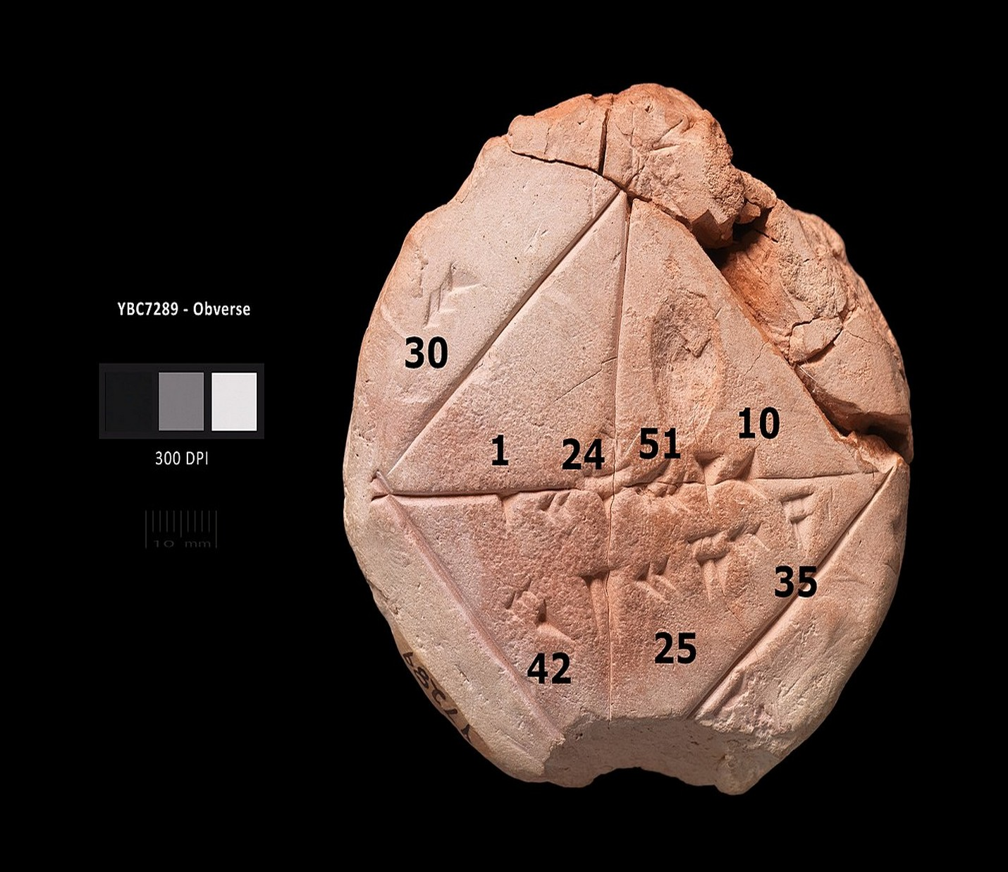
Babylonians
Algorithmic
  i.e. they came up with “programs” to solve common problems
Base 60 number system
  Zero as a placeholder
Calendars
► Approximation of the square root of 2 in four sexagesimal figures, 1 24 51 10, The tablet also gives an example where one side of the square is 30, and the resulting diagonal is 42 25 35 (Wikipedia)

Slide 38
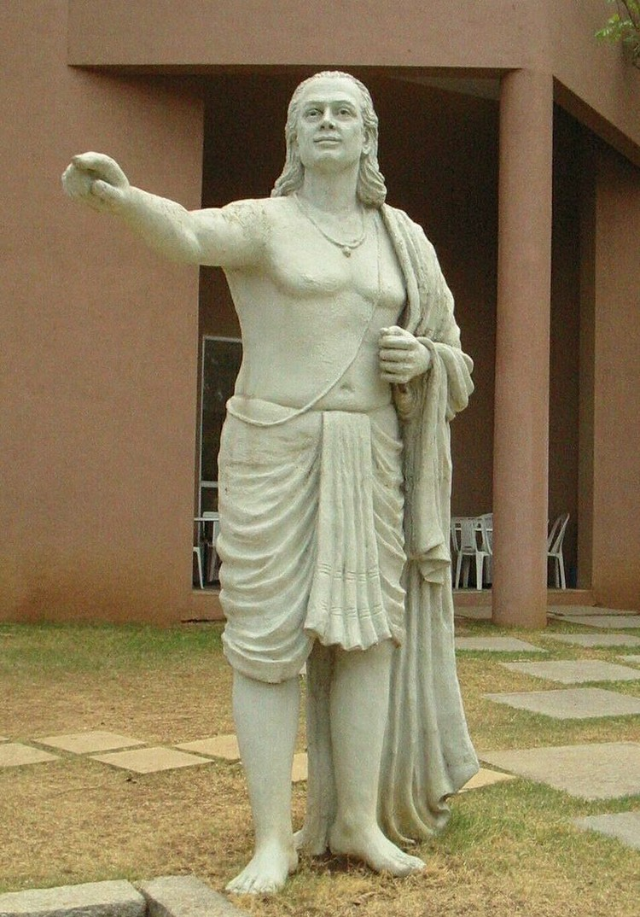
Indians
Calculating very big numbers
  Astronomy
  Religious reasons
Positional notation
  Efficient at writing big numbers
  Decimal number system
Oral transmission in verse
  Not like the way we write maths today!
Aryabhata

Slide 39
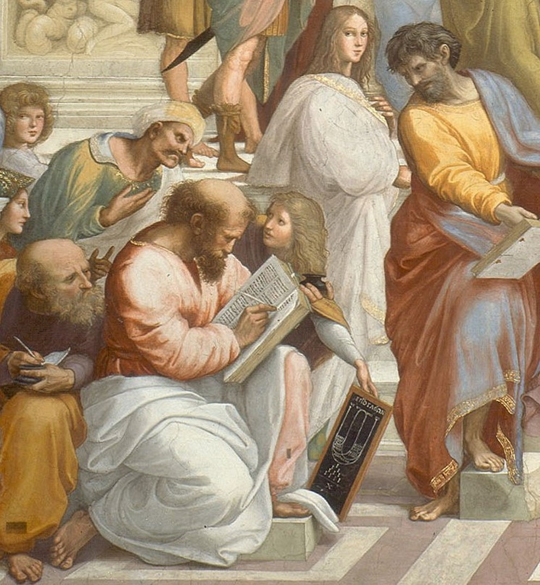
Greeks
Lots of fledgling approaches to understanding the world competing
Thought it was important to prove things
  Mathematical proof from axioms
  Legal evidence and proof
Mathematicians needed to convince people that maths was a good idea
Pythagoras

Slide 40
Problems with proofs
Say you’re a mathematician in ancient Greece, trying to justify why maths is a good way to understand the world
Problem is, it’s easy to make embarassing mistakes, like arguing:
  A super-right triangle is a triangle formed of 3 right angles.
  The angles of a super right triangle add up to more than 180 degrees
  The angles of some triangles add up to more than 180 degrees
What’s wrong with this?
How can you ensure that you won’t make this sort of mistake?

Slide 41
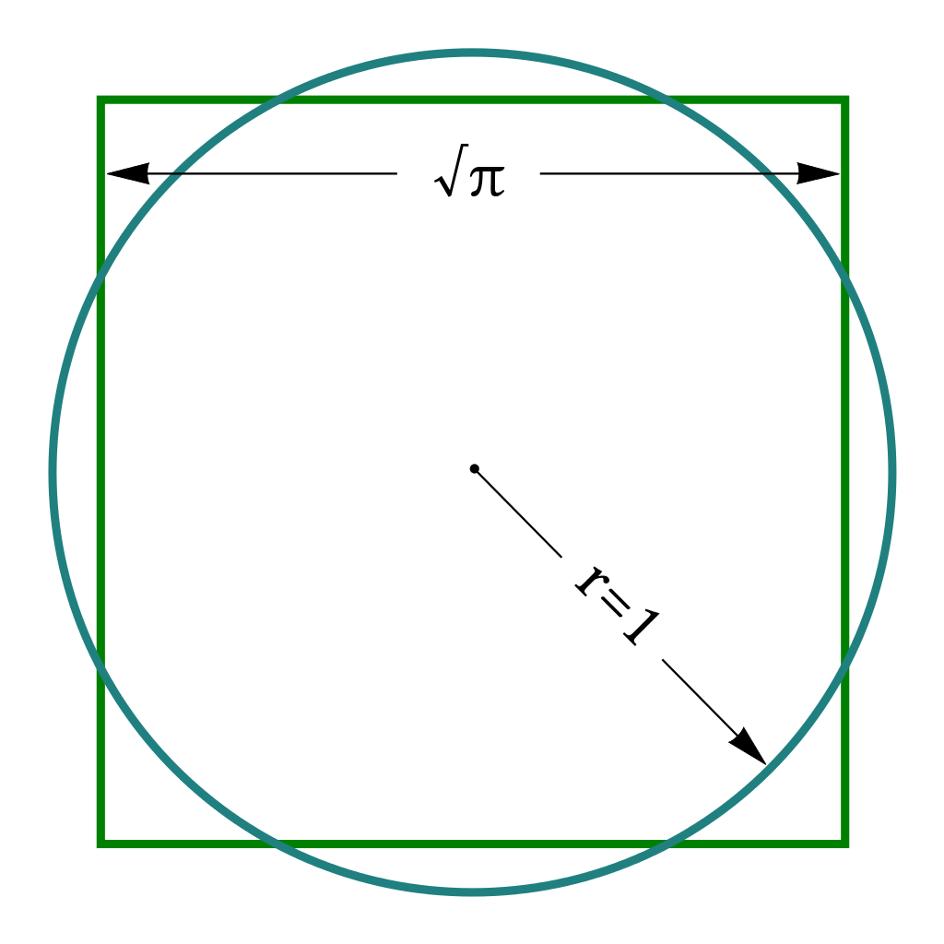
Constructions
Provide a way of practically testing claims through constructions
Constructivism is a philosophy of mathematics that says
  to prove a mathematical object exists you must first give a way to make one
For the Greeks, this meant constructing geometric shapes from a straight edge and a pair of compasses
  e.g. How to “Square the Circle”
    Constructing a square with the same areas as a circle
Their maths wasn’t formulas, but diagrams!

Slide 42
Mathematics as Empirical
Euclid expressed the axioms of his geometry as something you can test
  “Given two points, we can always draw a (unique) straight line segment connecting these points.”
  “Given a straight line segment, we can (uniquely) extend the line segment indefinitely.”
  “We can draw a (unique) circle with any desired center and radius.”
  “All right angles are equal to one another.”
  “If a straight line falling on two straight lines makes the interior angles on the same side less than two right angles, the two straight lines, if produced indefinitely, meet on that side on which are the angles less than the two right angles.”

Slide 43
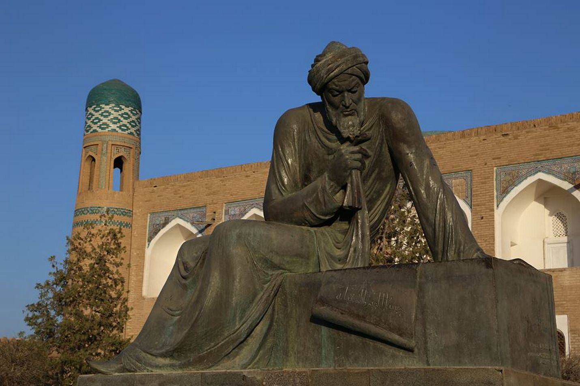
Islamic Empire
Algorithms
Algebra
  “Reunion of broken parts”
Still written in prose
  Very few symbols before the 17th century!
Muhammad ibn Musa al-Khwarizmi

Slide 44
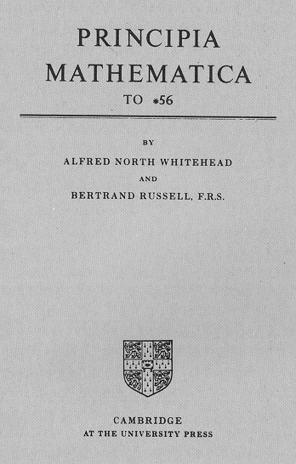
20th Century
Generalisation, abstraction and formalisation
  Constructions out of fashion
Rise of mathematical logic
Rather than proving as “self evident truth”, the goal became systems that are
  Consistent
  Complete (until Gödel’s Incompleteness Theorem!)
Including attempting to build complete systems of all of mathematics
  Founded upon Set Theory

Slide 45
So what is Mathematics?
Maths is a tool to do things
  Measuring a field, tracking the seasons
  Algorithms?
Maths is about constructing things
  shapes, numbers, proofs
  Formal Systems?
Maths is a language to abstract ideas about
  logic, shape, quantity, arrangement
  Computation?

Slide 46
Mathematical Language
Way of expressing problems and their solutions
  Verse, Prose, Diagrams, Symbols
Nowadays we benefit from symbolic systems that have been invented
  But just like the SPAMputer’s representations, they’re more or less arbitrary
  Not “better” than using diagrams / prose
  Maths is not just equations!
Formal mathematics helps us communicate knowledge

Slide 47
What sort of knowledge?
Games
  Graphics/shaders
  Path-finding
  Physics engines
  Simulations
  Probability
  Game Theory
  ...
Software Engineering
  Networks
  Machine Learning
  Algorithms
  Data analysis
  Type systems in programming languages
  ...
Computer Science
  Complexity
  Models of computation
  Computability Theory
  Data structures
  Cryptography
  Type Theory
  ...

Slide 48
Why Maths?
Why not just program the...
  Shader, ML algorithm, cryptographic blockchain
using your own intutition, or code from StackOverflow?
  You are doing maths, whether you realise it or not
  Mathematical language is
    Precise
    Unambiguous
    Concise
  Perfect if you want to implement an algorithm and avoid mistakes in interpretation

Slide 49
Mathematics a Formal Language

Slide 50
Maths as Abstraction
Maths
Problem
Derivation
Solution

Slide 51
Translation into Maths
“My field should be 100m², but the markers have been washed away. I know it’s 10m long. How wide should it be?”
Maths:
100 = 10w
Solve for w

Slide 52
Derivation
Problem
  100 = 10w, solve for w.
Derivation
  100 = 10w
  10 = w [Divide both sides by 10]
  w = 10 [Equality is symmetric]

Slide 53
Translation out of Maths
“My field should be 100m², but the markers have been washed away. I know it’s 10m long. How wide should it be?”
100 = 10w
w = 10
The width of my field should be 10m
Question:
Is this correct?

Slide 54


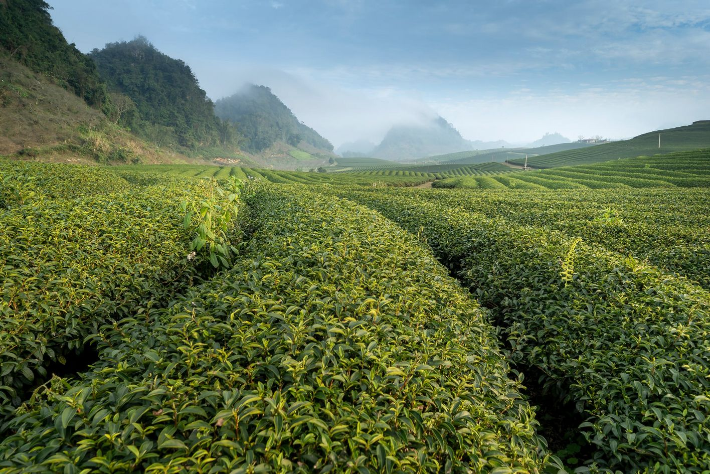
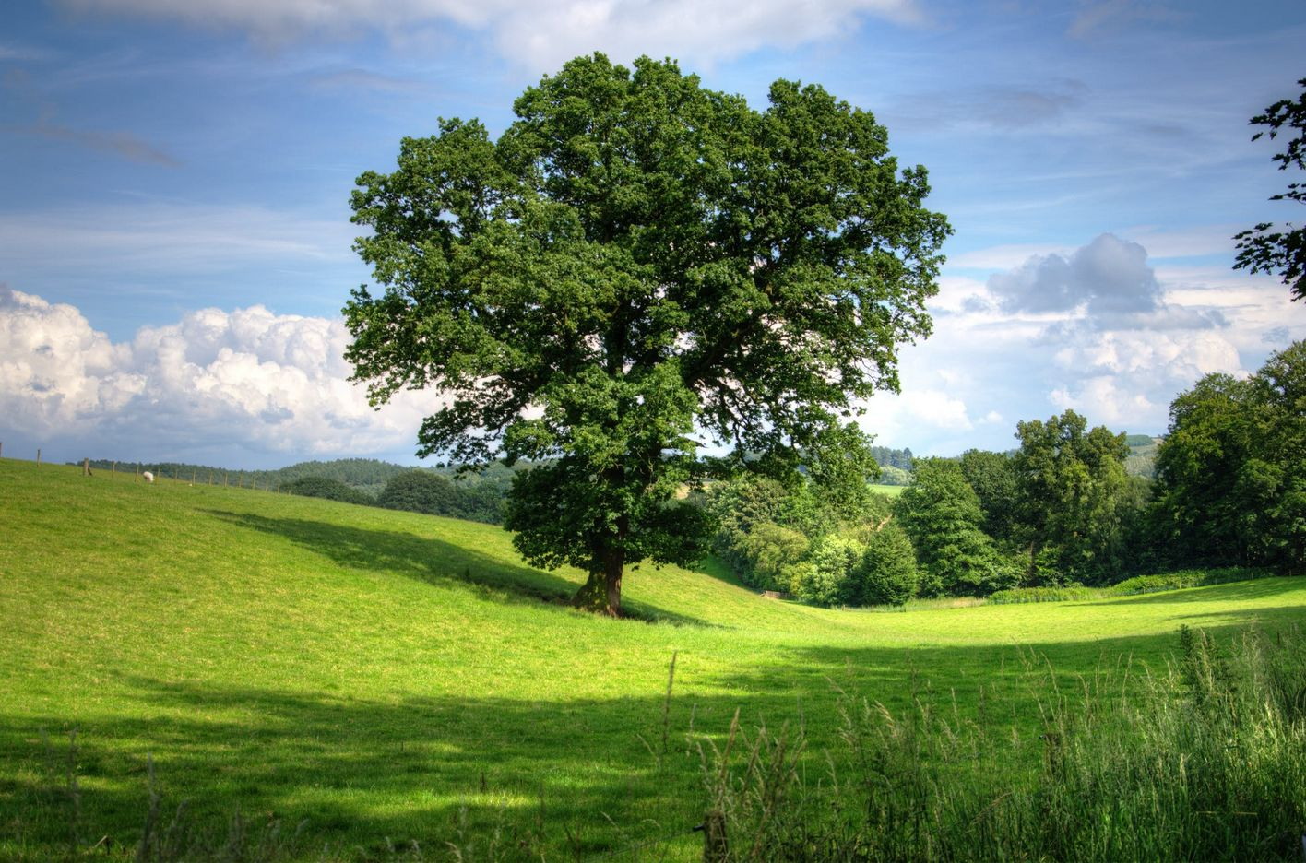

Slide 55
Abstraction
Take only the things we think are essential
Represent a complex system in terms of simple concepts
Separate ideas from physical objects

Slide 56
Maths as a Formal System
Maths is a Formal System (like our SPAMputer)
  Abstracts the real world to a set of axioms (strings)
  Uses laws to derive theorems (string rewriting rules)
  Translates back into the real world
All mathematical truth is relative to the truth of its axioms
  Our solution of w =10 was true (given arithmetic laws)

Slide 57
String Rewriting Systems

Slide 58
Formal Systems
Formal systems represent
  States (=Data Structures)
  Rules that govern what transitions are allowed between states
Imagine a game of chess
  A data structure represents all the information about the board – the game state
  We have rules that say what moves are allowed – what transitions are allowed between states

Slide 59
Transitions
Imagine we had a state that we call X
  X represents one configuration of a chess board
  Or one state of a computer
We have some rules R
  The rules of chess
  The rules of computation
If a transition from X to another state Y is allowed under R, we can write
X ⇒R Y

Slide 60
Derivation
A finite sequence of steps is called a derivation
X1 ⇒R X2 ⇒R … ⇒R Xn
We can write this
X1 ⇒*R Xn
(it is possible to go from X1 to Xn following rules R in a finite sequence of steps)
The length of a derivation is the number of steps it requires. Here it is n-1

Slide 61
Exercise 7:
In a formal system with rules R, and states A, B, C, D, E the following transitions are allowed
  A ⇒R B
  A ⇒R C
  C ⇒R D
  D ⇒R E
Is there a derivation A ⇒*R E in this system?

Slide 62
String Rewriting Systems
A string rewriting system is a type of formal system
Each state is represented by a string
  Just like in our SPAMputer
    · · p s · a
  Or in lambda calculus
    λ sz . s(z)

Slide 63
Rules to transition between states (strings) are given by a grammar
For example,
  Say you are allowed to replace any single occourance of a given string with another string, e.g.
a ⤳ ab
  Then
a ⇒ ab ⇒ abb ⇒ abbb ⇒ abbbb ⇒ ... etc.

Slide 64
Exercise 8:
You have the string rewriting rules
X ⤳ ab
X ⤳ aXb
  Starting with the string X, derive 5 strings in this system
  Is it possible to derive the string bXa?

Slide 65
The MU Puzzle
Exercise 9:
You have a collection of strings. At first you only have the string MI
These are the derivational rules:
  If a string ends in I, you can add U on the end, e.g. MI → MIU
  If you have a string of form Mx, you can have the new string Mxx
  If the substring III appears anywhere you can replace it for U
  If the string UU, you can replace it with an empty string
Is it possible to add the string MU?
From the book Godel, Escher, Bach: An Eternal Golden Braid by Douglas Hofstadter.

Slide 66
Things we will cover in this course

Slide 67
Beyond Arithmetic
We’re used to maths being about numbers
1 + 1 = 2
That’s arithmetic. It’s a formal language.
  There are all sorts of rules by which we can derive new statements in arithmetic
We’ll see new formal languages (a notation and system of rules) to describe
  Logic
  Sets (i.e. collections of things)
  Networks (graphs)

Slide 68
New Concepts
We want to be able to work with concepts such as
  Binary numbers and operations
  Algorithms
  Networks
  Logic
  Databases
We’re going to need to go beyond just representing numbers
  (But we’ll need them, too)

Slide 69
Numbers, like 4
What numbers exist?
  Classes of Numbers
How do we write them down?
  Numerical Systems
How do we add them up?
  Algebra
  Binary Arithmetic
  Modular Arithmetic

Slide 70
Sequences
What do we get if we put numbers in an order?
  Sequences
How do we add a series of numbers?
  Summation

Slide 71
Logic
What are statements of fact in mathematics?
  Propositions
How do you formalise an argument?
  Propositional Logic
How do you prove a conclusion follows from premises?
  Equational Reasoning

Slide 72
Groups of things
How do you represent a collection of things?
  Sets
How do collections relate to each other?
  Set Theory
How do you work out all possible orders or arrangements of things
  Combinatorics

Slide 73
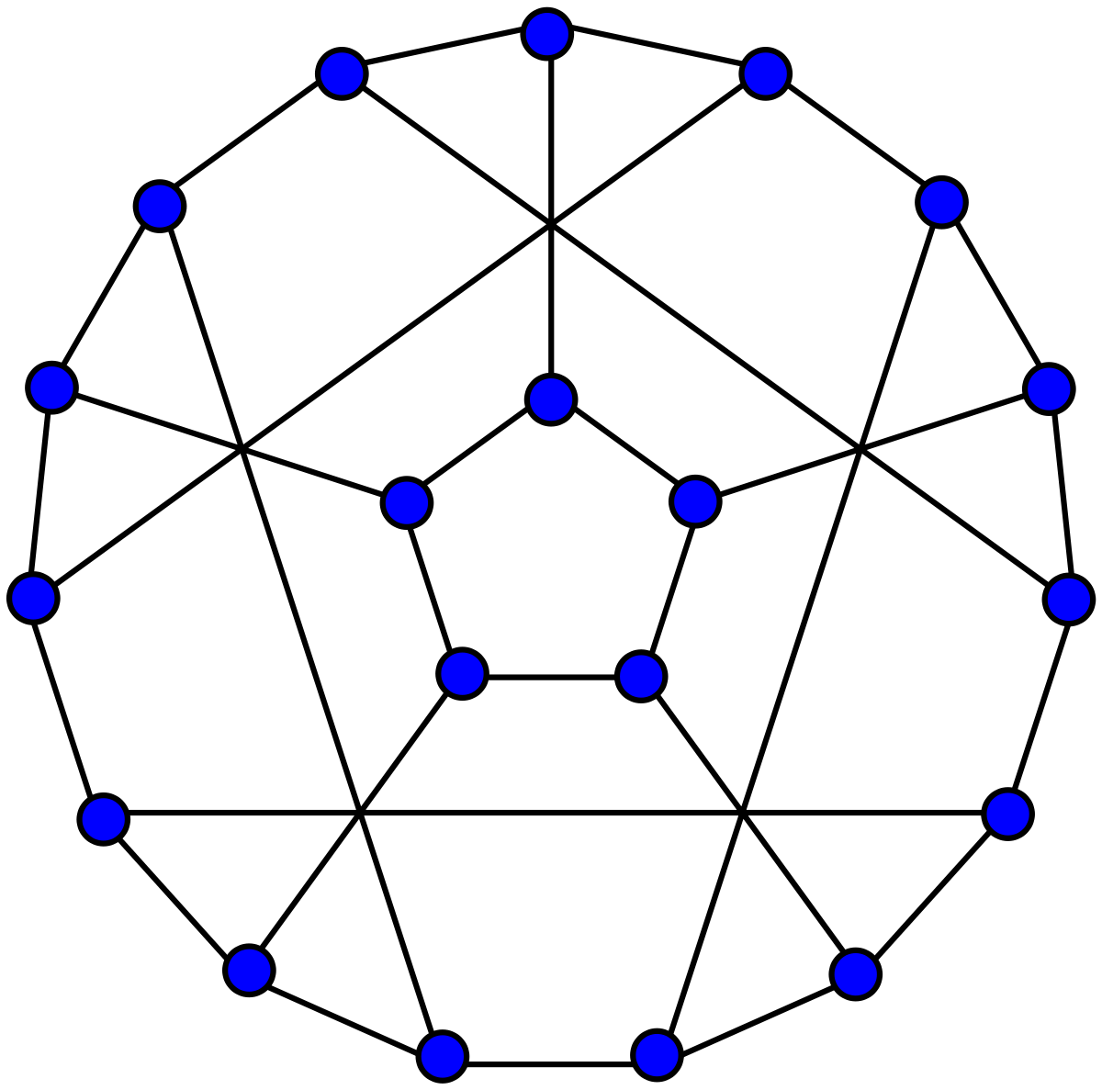
Graphs
How do you represent relationships between things?
  Graph Theory

Slide 74
Probability
How do you compare the liklihood of events?
  Probability
How do you represent sequences of decisions/events?
  Decision Trees
How do you model the range of values a variable can take?
  Probability Distributions

Slide 75
Statistics
How do we summarise data and make it understandable?
  Descriptive Statistics
  Data Visualisation
How do we make compelling arguments from data?
  Inferential Statistics

Slide 76
Back to basics

Slide 77
Basics
The following is foundational knowledge you’ll need to do this course
  You don’t necessarily need to know all of this stuff in detail
  But you need to be familiar with it
Now is a good chance to make sure you understand it

Slide 78
Equations
Algebra translates to “the reunion of broken parts”
We set some stuff equal to some other stuff, e.g.
  1 + 2 = 4 – 1
  Both sides must remain equal
Equality is unlike the = button on a calculator which means “calculate”
  1 + 2 = 3 + 1 = 4 is incorrect
  Be careful laying out equations!
    1 + 2 = 3
    3 + 1 = 4

Slide 79
Equations
Exercise 10:
Which of the following are correct?
  100 x 2 = 200 = 10 x 20
  55 – 5 = 50 / 2 + 30 = 55
  a/b = b/a = 1
  1 + 2 + 3 + 4 … = 100

Slide 80
Inequalities
Like equality, inequalities express a relationship between the thing on the left and the thing on the right, e.g.
  a < b, a > b
  Be careful when laying out multiple inequalities
    5 < 10 > 15 is incorrect

Slide 81
Inequalities
Exercise 12:
Let a = 3, b = 5, c = 8.
Which of the following are true?
  a < b > c
  a < b < c
  a > b < c
  a < b < c

Slide 82
Variables
A placeholder for a value that may vary or change, e.g. x in
  4 = x + 2
  f(x) = 2x
Used to represent, e.g.
  Numbers
  Vectors
  Matrices
  Functions

Slide 83
Indexes (an)
Indexes are written with subscripts
  Identify an element of a collection such as a list of numbers
    A0 means the 0th element, or element 0,
    A1 means the 1st element, or element 1, which is
    An means the n^{th} element, or element n
Not to be confused with indices (also pluralised indexes) that are written in superscript, and show a number has been multiplied by itself

Slide 84
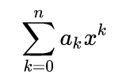
Polynomials
A polynomial is an expression constants and variables, e.g.
  x² + 4
  x3 + x² - 2
It can be expressed as follows: (an is a constant, x is a variable)
anx^{n} + an-1x^{n-1} + … + a1x¹ + a0
Or as a summation:

Slide 85
Function
A function is a mapping that associates inputs and outputs, e.g.
  f(x) = 2x, f(2) = 4
Like a function machine. It takes an input and does something to it
The type of a function depends on its inputs (domain) and its outputs (range), e.g.
  ℕ → ℕ

Slide 86
Kinds of Function (in ℝ → ℝ)
Polynomial function
  Has the form of a polynomial, e.g.
  f(x) = 2x² + 3x + 6
Exponential function
  f(x) = 2^{x}
Log functions (inverse exponential)
  f(x) = x log 3x + 2

Slide 87
Operators
Operators are functions, e.g.
  a + b = add(a,b)
  a x b = multiply(a,b)
Exercise 13:
  Give operators that are not:
    Commutative
    Associative
    Distributive over addition
Addition and multiplication are commutative
  a + b = b + a
  a x b = b x a
Addition and multiplication are associative
  a + ( b + c) = (a + b) + c
  a x (b x c) = (a x b) x c
Multiplication distributes over addition
  a(b + c) = ab + ac

Slide 88
Order of Operations
Arithmetic operations have precidence
  Different orders may give incorrect results
Order of Operations (BIDMAS)
  Brackets
  Indices
  Division (note fraction notation)
  Multiplication
  Addition
  Subtraction

Slide 89
Binary Relations
To foreshadow some stuff in the course...
Equality and inequalities are binary relations
  They relate two things, a and b
Assert a truth claim: aRb is true

Slide 90
Properties of Binary Relations
Equality is reflexive
  a = a
Equlity is symmetric
  If a = b, then b = a
Equality is transitive
  If a = b, and b = c, then a = c
Greater than is not reflexive
  a > a is incorrect
Greater than is not symmetric
  If a > b, then b > a is incorrect
Greater than is transitive
  If a > b, and b > c, then a > c
We’ll see these again later in the course

Slide 91
Properties of Binary Relations
Exercise 14:
Another binary relation is | “divides”
  2 | 10 (i.e. 2 divides 10, because 10/2 = 5, a whole number)
  3 | 9
  8 | 24
Which of the following are true of the relation | “divides”?
  Reflexive
  Symmetric
  Transitive

Slide 92
Sets
A set is an unordered collection of elements, e.g.
  The set of all pandas
  The set of all numbers 3 < x < 5
Written between curly braces, e.g.
  A = { a, b, c }
  B = { 1, 2, 3, 4 }
  C = { x | x is a animal }
See lecture on Set Theory

Slide 93
Summation
Summation is adding together lots of things
Often uses Sigma Notation
  Condense
See lecture on Sequences and Summation

Slide 94
Summary

Slide 95
Summary
Why do we need maths in computer science?
  Computation can be understood mathematically
  Science is empirical and requires working with data
  Maths gives us a precice language to communicate knowledge
  Maths gives us the tools to formally model problems

