Slide 1

Mathematics and Problem Solving
  Lecture 4
    Sequences and Series
“Mathematics is the language of nature.”
Fibonacci

Slide 2
Overview
Sigma Notation
Summation
Product Notation

Slide 3
Sigma Notation

Slide 4
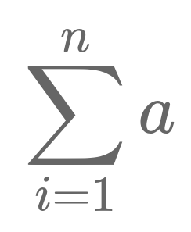
Summation
Summation is adding up lots of things
It has a special notation written with the Greek capital letter sigma
  Sigma Notation
This allows us to express summations compactly

Slide 5
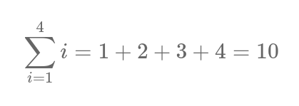
Sigma and Polynomial form
We are familiar with seeing addition written in a polynomial

Slide 6
Parts of a Summation
a
  formula to sum
i
  variable
=1
  Lower limit
  starting point (inclusive)
n
  Upper Limit
  ending point (inclusive)

Slide 7
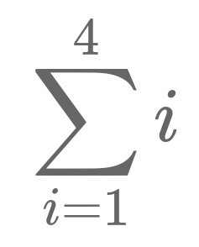
Determine the Sum - Example
Start at i =1
For each value of i
  Substitue every occourance of i for 1 in the formula
  Formula becomes
    1
  Is i less than 4?
  Increment 1

Slide 8
Determine the Sum - Example

Slide 9
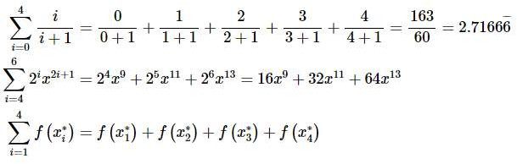
Determine the Sum – More Examples

Slide 10
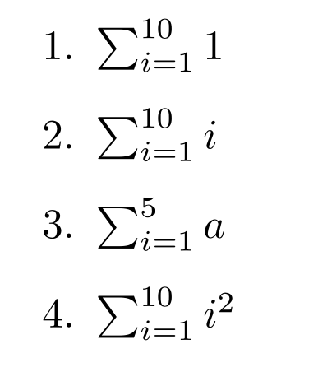
Exercise
Exercise 1:
Solve the following summations

Slide 11
Summing a Constant Sequence
Lets say we have a constant sequence of numbers, such as:
  2, 2, 2, 2, 2, …
What is the sum of the first n values of this sequence
  If we have n values, then n x 2 = 2n
We can express this as a summation
  We cannot solve this to get a number, but we can simplify it to a polynomial form that is easier to work with

Slide 12
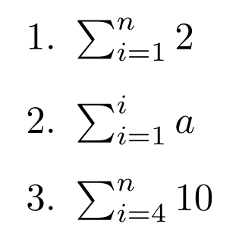
Exercise 2:
Solve the following summations
Hint:
  Summations are inclusive of both start and end values
  Adding up n copies of a number k is nk

Slide 13
Sequences

Slide 14
Sequences and Series
A sequence is a progression of numbers, e.g.
  { 1, 10, 4, 2, 4, 77, 6, 4, … }
If we add them all together, we get a series
  { 1 + 10 + 4 + 2 + 4 + 77 + 6 + 4 + … }
Because a series can be arbitrarily long or infinite, we often use sigma notation to express it
There are special types of sequences that we are going to look at
  Arithmetic Sequences
  Geometric Sequences

Slide 15



Notating Sequences
A sequence can be notated in a number of ways
Pay attention to subscripts!
  an+1 ≠ an + 1

Slide 16
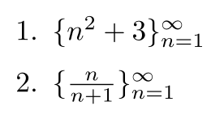
Exercise 3:
Give the first 4 values of the following sequences

Slide 17
Terminology about Sequences
A sequence {an} is increasing if, for every n
  an < an+1
  { 1, 23, 112, 158 } is an increasing sequence
A sequence {an} is decreasing if, for every n
  an > an+1
  { 202, 150, 3, 0.1} is a decreasing sequence
Both increasing and decreasing sequences are monotonic

Slide 18
Bounded Sequences
If there is a number m ≤ an for every n (less or equal to any number in the sequence)
  m is a lower bound of the sequence
  The sequence is bounded below
If there is a number m ≥ an for every n
  m is an upper bound of the sequence
  The sequence is bounded above
A sequence bounded both below and above is called bounded

Slide 19
Exercise 4:
For the finite sequence { 4, 2, 3, 2 }
  Is 2 a lower bound?
  Is 1 a lower bound?
  Is 3 an upper bound?
  Is the sequence bounded?
  Is the sequence monotonic?
Hint:
  m is a lower bound if m ≤ an for every n
  m is a upper bound if m ≥ an for every n

Slide 20

Exercise 5:
Consider the sequence
  Give an upper / lower bound if such exist
  Is it increasing/decreasing?

Slide 21
Arithmetic and Geometric Sequences

Slide 22
Arithmetic Sequences
An Arithmetic Sequence is a list of numbers with an:
  Initial Term
  Common Difference
For example (initial term in red)
  { 1, 2, 3, 4, 5, 6, … } (common difference 1)
  { 5, 10, 15, 20, 25, … } (common difference 5)
  { 3, 6, 9, 12, 15, … } (common difference 3)

Slide 23
Exercise 6:
What is the initial term and common difference for these sequences?
  { 1, 2, 3, 4, 5, … }
  { 99, 104, 109, 114, … }

Slide 24
Arithmetic Sequences
We can define an arithmetic sequence recursively
an = an-1 + d
Or give an explicit formula
an = a1 + d(n-1)

Slide 25
Arithmetic Sequences
Exercise 7:
Find the last term of the sequence that starts with 5, has a common difference of 0.25 and has 10 terms.
Hint:
  We can define an arithmetic sequence recursively
    an = an-1 + d
  Or give an explicit formula
    an = a1 + d(n-1)

Slide 26
Arithmetic Sequences
Exercise 8:
  What is the implicit formula for the sequences
    { 2, 3, 4, 5, … }
    { -1, -3, -5, -7, … }
  What is the explicit formula for the sequences
    { 4, 5, 6, 7, … }
    { 10, 20, 30, 40, … }
Hint:
  an = an-1 + d
  an = a1 + d(n-1)

Slide 27
Geometric Sequence
An Arithmetic Sequence is a list of numbers with an:
  Initial Term
  Common Ratio
For example
  { 10, 40, 160, 640, … } (common ratio 4)

Slide 28
Exercse 9:
What is the initial term and common ratio for these sequences?
  { 1,3,9,18, … }
  { 1, 0.5, 0.25, 0.125, … }

Slide 29
Geometric Sequence
We can define a geometric sequence recursively
gn = gn-1 × r
Or explicitly
gn = g1 × r^{n-1}

Slide 30
Geometric Sequence
Exercise 10:
  What is the implicit formula for the sequences
    { 2, 3, 4, 5, … }
    { -1, -3, -5, -7, … }
  What is the explicit formula for the sequences
    { 4, 5, 6, 7, … }
    { 10, 20, 30, 40, … }
Hint:
  gn = gn-1 × r
  gn = g1 × r^{n-1}

Slide 31
Fibonacci Sequence
One well known sequence is the Fibonacci sequence, defined as follows:
Fn = Fn-1 + Fn-2
Where F0 = 0 and F1 = 1

Slide 32

Fibonacci Sequence
The Fibonacci Sequence can be expressed as an explicit formula
Where φ is the golden ratio
  1.6180339887…
And ψ is -φ⁻¹, the negative multiplicative inverse of the golden ratio
  -0.6180339887...

Slide 33

Exercise 11:
I define a sequence using the following explicit definition
sn = (0.5 x 10^{x-1}) + 2(x-1)
  Write out the first 5 elements
  Decompose this into two sequences
  How could you write a recursive definition for this sequence?
Hint:
  The number of digits in a base 10 number is given by
    log10 n
  Remember mod
  To round down (floor) we can write

Slide 34
Summation of Series

Slide 35
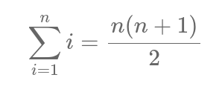
Sum of first n numbers
We often need to sum the first n natural numbers: 1, 2, 3, 4, …, n
  1 + 2 + 3 + 4 + … + n
Problem: arbitrarily long
  Easy to write with sigma notation!
But how do we calculate the sum for a given n?

Slide 36
Sum of first n numbers
We can write this in a more familiar form
Where does this come from
  Find the average of first value 1 and n, the last value, which is (n+1)/2
  Multiply this by the length of the series

Slide 37
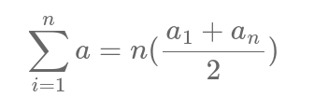
Sum of an Arithmetic Series
We can generalise this for a formula for the sum of the first n values of a sequence a
  Find average value:
    (a1 + an)/2
  Multiply by length of sequence n
We can always use substitute the formula for the nth term of the sequence in place of an

Slide 38
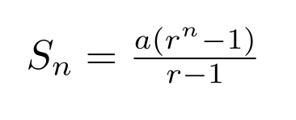
Sum of a Geometric Series
We can also define the sum of the first n values of a Geometric Series
  a is the initial value
  r is the common ratio

Slide 39
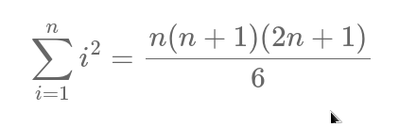
Sum of first n squares
It is also common to want to sum the first n square numbers
  You can derive this using simultaneous equations
  Or just look up the formula

Slide 40
Arithmetic Properties of Summation

Slide 41
Arithmetic Properties of Summation
When you cannot resolve a summation to a number, we often need to transform it
  Factor constants out of a summation
  Break up summation across a sum or difference
By transforming it, we can often get it to a state where it is easier to work with
  e.g. so we can substitute one of the formulas we’ve seen

Slide 42
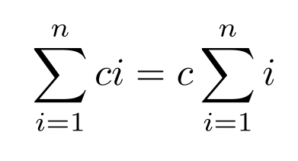
Factor Constants out of Summation
Due to the distributivity of multiplication over addition
  n(a+b) = na + nb
We can factor constants out of a series
  1c + 2c + 3c = c ( 1 + 2 + 3)
This lets us transform summations into more manageable forms

Slide 43
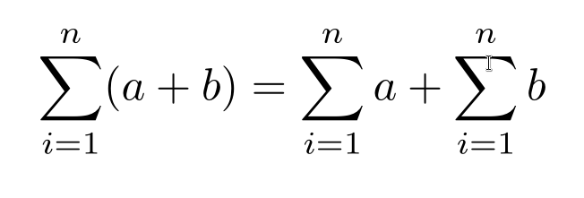
Break up Summation across a Sum
Due to the associativity of addition
  (a + b) + c = a + (b + c)
We can split summations across sums
  (1 + a) + (2 + b) + (3 + c)
  = (1 + 2 + 3) + (a + b + c)
This lets us transform summations into more manageable forms

Slide 44
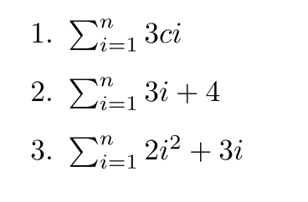
Exercise 12:
Simplify the following summations
Hint:

Slide 45
Product Notation

Slide 46
Product Notation
To add a sequence we can use sigma notation and use summation
What if we want to multiply a sequence? e.g.
  1 x 2 x 3 x … x n-1 x n
Product Notation
  Uses the Greek capital letter pi, Π

Slide 47
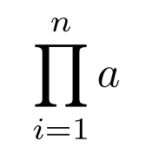
Parts of a Product
a
  formula to multiply
i
  variable
=1
  Lower limit
  starting point (inclusive)
n
  Upper Limit
  ending point (inclusive)

Slide 48
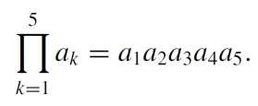
Example Product
Multiply the first 5 elements of the sequence a:
  a1 x … x a5
Lower limit = 1
Upper Limit = 5
Variable = k
Formula to multiply = ak

Slide 49
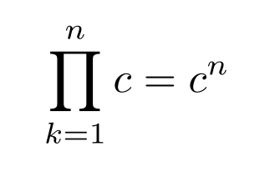
Product of a constant
The product of n values of a constant c is given by the n^{th} power of c
The product of, e.g.
  10 x 10 x 10 x 10 = 10⁴ = 10000
  c x c x c = c³

Slide 50
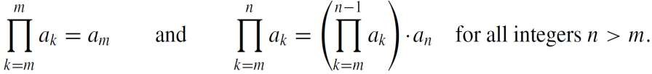
Product Notation
We can also define a product recursively
  The left part gives a base case - the product of one element is that element
  The product of multiple elements (m → n) is the product of the first (m → n-1) elements multiplied by the n^{th} element

Slide 51
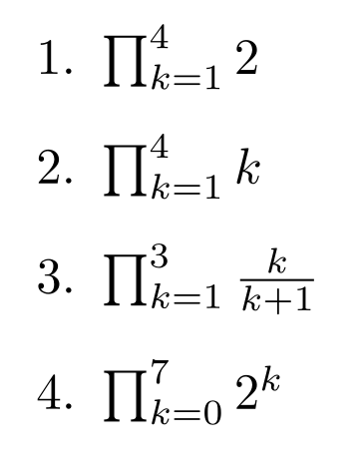
Exercise 13:
Compute the following products:

Slide 52
Summary

Slide 53
Summary
Sigma Notation – Summation
Product Notation
Sequences
Summation of a Series

