Slide 1

Mathematics and Problem Solving
  Lecture 9
    Graph Theory

Slide 2
Overview
What is a Graph
Terminology
Representing Graphs

Slide 3
Why do we study graph theory ?
Graph gives us the tool to formally study structures in graphical representations
  Databases
  Task planning
  Pattern recognition
  Tasks optimization
  Scheduling
  Data mining – Clustering
  Solve shortest path problems

Slide 4
What is a Graph?

Slide 5
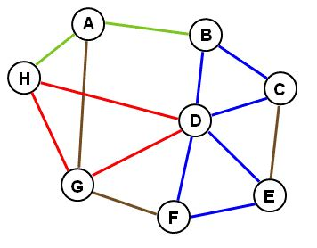
What is a graph?
A graph is a set of vertices connected by edges
In other words, it’s
  Circles and lines
  Dots and arcs
  Boxes and arrows
  Junctions and pipes
  Cities and roads
  Rooms and doors
  ...etc.

Slide 6
Exercise 1:
How might you use a graph to solve the following problems? What are the nodes? What are the edges?
  Planning a delivery route
  Playing Tic-Tac-Toe
  Creating levels for a video game
  Machine translation

Slide 7
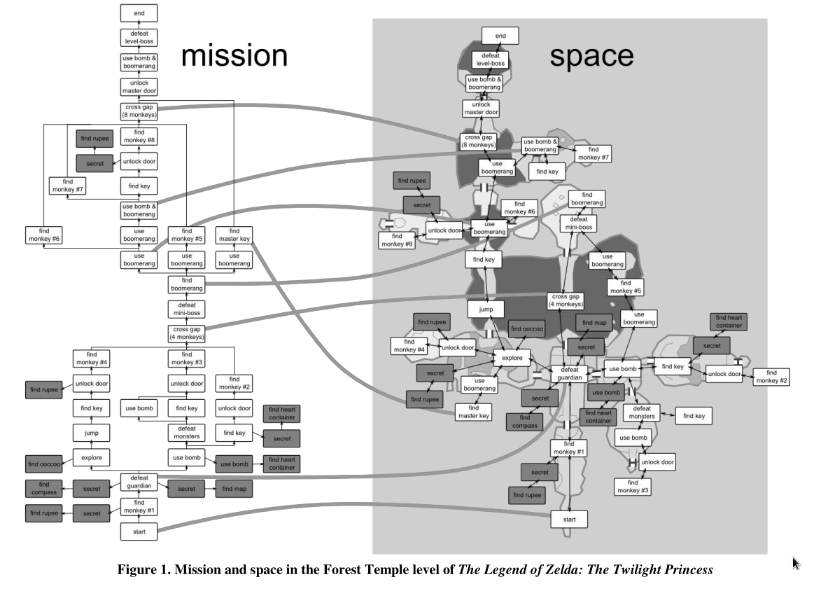
Dormans, Joris. "Adventures in level design: generating missions and spaces for action adventure
Games." Proceedings of the 2010 workshop on procedural content generation in games. 2010.

Slide 8
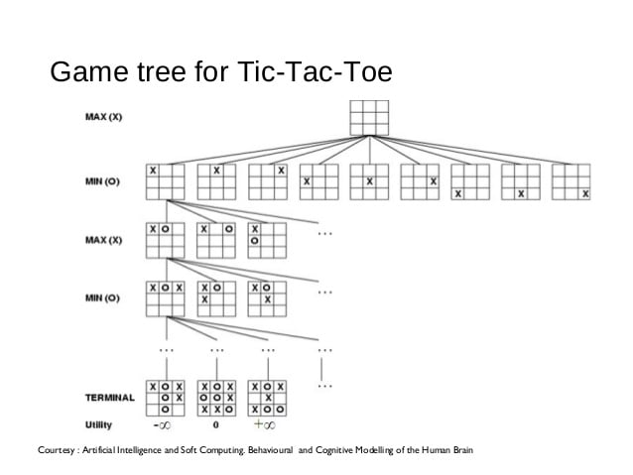
Game AI with MINIMAX search
Construct a game state tree
  Terminal states have +/- utility
  You take moves to maximise utility
  Assume oponent takes moves to minimise utility

Slide 9
Terminology

Slide 10
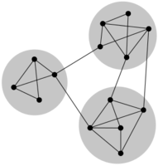
Connected
If a graph is connected there is a path from every point to every other point
Nodes are immediately connected if they share an edge

Slide 11
Connected
Exercise 2:
Which of the following are connected graphs?
  A graph of possible derivations in a formal system
  The road network in the UK
  A social network
  The Internet

Slide 12
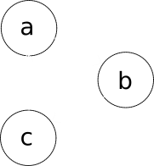
Directed Graph (Digraph)
A graph is directed if the edges have a direction
  Represented with arrow heads
Otherwise it is undirected
Directed graphs might represent
  The flow of water through pipes
  A one-way relationship such as derivation: A ⇒R B

Slide 13
Exercise 3:
Which of the following are digraphs?
  Sat-Nav directions
  A graph of game states in a game of chess
  A computer network
  A snakes and ladders game board

Slide 14
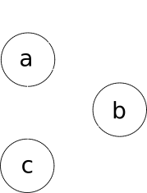
Degree of a Node
The degree of a node is the number of edge connections it has
  The numbers of edges incident to it
  Loops count for 2
For example
  deg(a) = 4
  deg(b) = 2
  deg(c) = 2

Slide 15
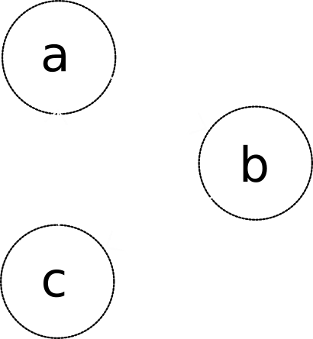
Indegree and Outdegree
For a node in a directed graph
  indegree is the number of edges pointing to a node
  outdegree is the number of edges pointing away from it
degree = indegree + outdegree

Slide 16
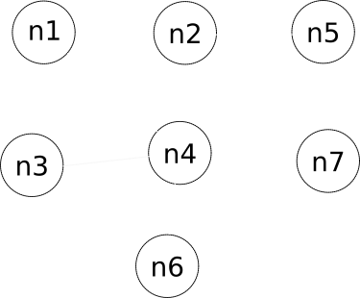
Exercise 4:
What is the degree of the following nodes:
  n1
  n3
  n4
  n7

Slide 17
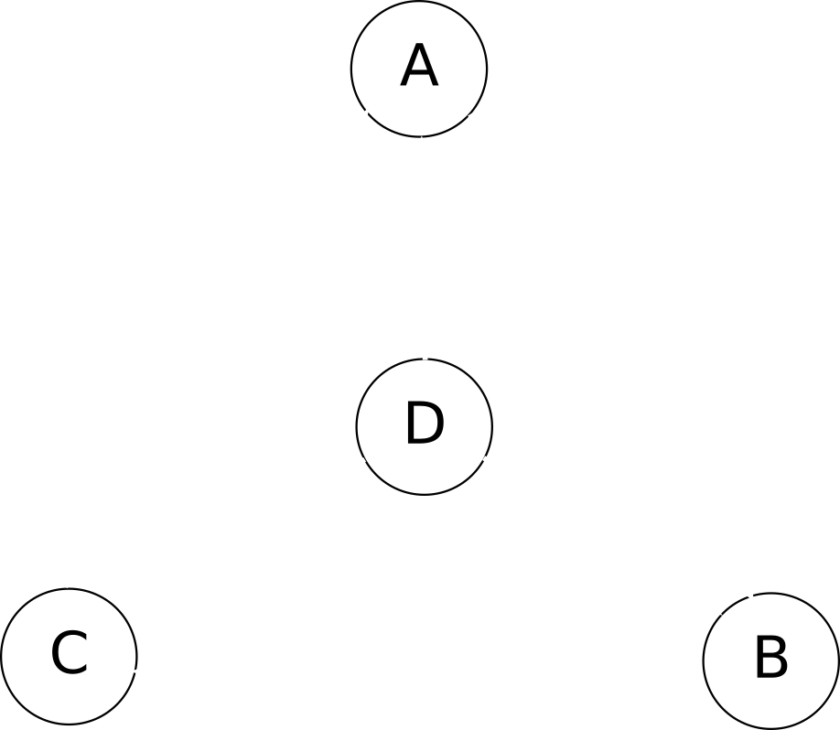
Exercise 5:
What is the in- and out-degree of the following nodes?
  A
  B
  C
  D

Slide 18
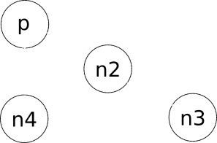
Some “types” of node for directed graph
Source node is a node with
  indegree = 0.
Sink node is a node with
  outdegree = 0.
Transfer node is node with
  indegree ≠ 0 and outdegree ≠ 0.

Slide 19
Exercise 6:
Which of the nodes for the graph below are sources, sinks, and transfer nodes?
Hint:
  Source node is a node with indegree = 0.
  Sink node is a node with outdegree = 0.
  Transfer node is node with indegree ≠ 0 and outdegree ≠ 0.

Slide 20
Terminology
  Paths

Slide 21
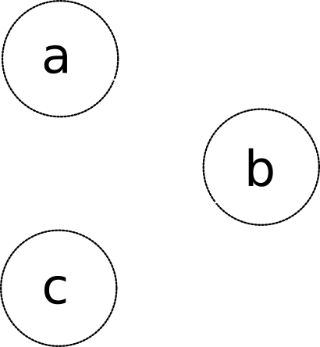
Immediately Connected
Two nodes are immediately connected if there is an edge between the two nodes.
In the example:
  a and b
  b and c

Slide 22
Path
A path is a sequence of immediately connected vertices:
  Ni, … Nj
  Ni is immediately connected to Ni+1
  Ni+1 is immediately connected to Ni+2
  ...
  Nj-1 is immediately connected to Nj
In the example there is a path
a, b, c

Slide 23
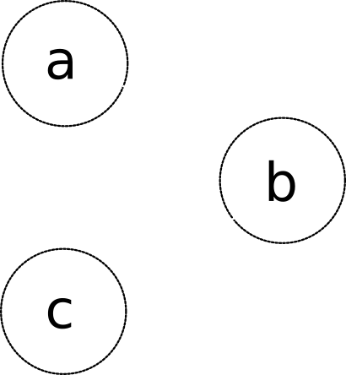
Representing Paths with Edges
A path may also be defined as a sequence of edges, such that
  for any pair of edges, ei and ei+1
  ei and ei+1 share a common node.
In the example, there is a path (represented by edges):
e1, e2

Slide 24
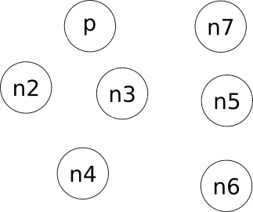
Exercise 6:
Identify a path in the graph shown. Express it as both a
  sequence of vertices
  sequence of edges

Slide 25
Example Paths
There are several paths in the example graph.
  Path 1: n2, p, n3, n5
  Path 2: p, n3, n4
Or represented with edges:
  Path 1: e1, e2, e3
  Path 2: e2, e3

Slide 26

Cycle
A cycle is a path whose first and last vertices are the same
The path
a, b, c, a
is a cycle
A graph that contains one or more cycles is called cyclic
  Otherwise it’s called acyclic

Slide 27
Simple Paths and Cycles
A path (or cycle) is simple if it has no repeated vertices
  Except for first and last in the case of a cycle
A simple cycle:
  a, b, c, a
A cycle that is not simple:
  a, b, c, a, b, c, a

Slide 28
Path Length
The length of a path (or cycle) is the number of edges

Slide 29
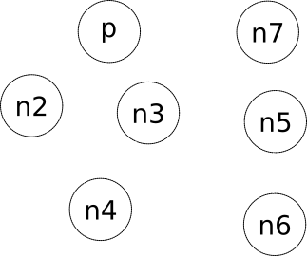
Path Length
Exercise 7:
  Identify a simple path of length 6
  Identify a simple cycle
  Is it possible to connect every node with one path?

Slide 30
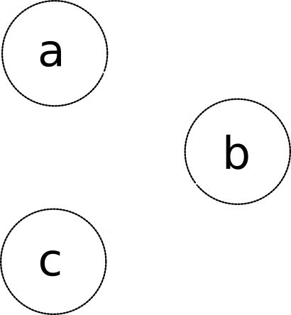
Directed Paths
A sequence of vertices connected by directed edges is a directed path
  A directed path:
a b c
  A path that is not directed
c b a

Slide 31
Exercise 8:
List all the directed simple paths in this graph
Identify which ones are cycles.

Slide 32
Connectedness
Node ni is connected to node nj if there is a path from ni to nj
  An undirected graph is connected if there is a path from every node to every other node
Node ni is strongly connected to node nj if there is a directed path from ni to nj
  A digraph is strongly connected if there is a directed path from every node to every other node

Slide 33
Component
A component of a graph is defined as the maximal set of connected nodes.
  In the example graph:
    {p, n2, n3, n4, n5, n6} form a component
    {n7} also forms a component

Slide 34
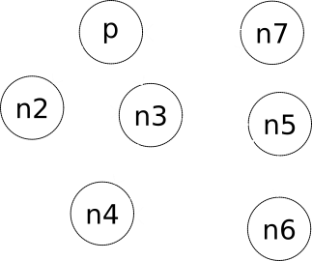
Strongly Connected Component
In a digraph, a strongly connected component is maximal set of strongly connected nodes.
  In the example graph:
    {p, n2, n3, n7} form a strongly connected component
    {n4, n5, n6} forms a strongly connectedcomponent

Slide 35

Condensation graph
A condensation graph is formed by replacing each component in the original graph by a “condensed” single node. There are no edges.
  Condensation graph of a graph gives us a view of the “complexity” through the number of components.
We can consense a digraph as well, to see the relationships between its strongly connected components

Slide 36
Exercise 9:
Look at the graph shown
  Identify the strongly connected components
  Draw its condensation graph

Slide 37
Terminology
There is a lots more terminology about graphs
  And some different ways these terms can be defined
For this course, use the terminology and definitions given
For example
  Walks
  Trails
  Paths
  Circuits
  Multigraph
  Pseudograph
  Bouquet
  ...

Slide 38
Definitions – Graph Type
Type | Edges | Multiple Edges Allowed ? | Loops Allowed ?
Simple Graph | undirected | No | No
Multigraph | undirected | Yes | No
Pseudograph | undirected | Yes | Yes
Directed Graph | directed | No | Yes
Directed Multigraph | directed | Yes | Yes

Slide 39
Graph Grammar

Slide 40
Graph Grammar
We’ve seen formal string rewriting systems
  The rules that defined a system were a grammar
  These worked on strings
We can also define grammars for graphs

Slide 41
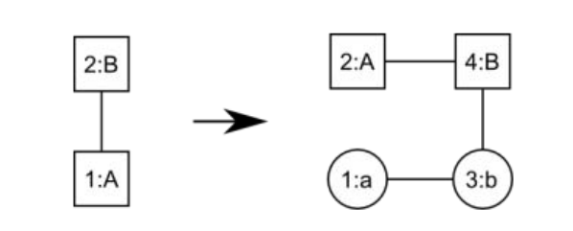
Graph Grammar Rules
A rule in a graph grammar transforms one graph fragment into another
  Just like a string rewriting system transforms a symbol into another
Here numbers identify nodes, letters are labels of node contents
Dormans, Joris. "Adventures in level design: generating missions and spaces for action adventure
Games." Proceedings of the 2010 workshop on procedural content generation in games. 2010.

Slide 42
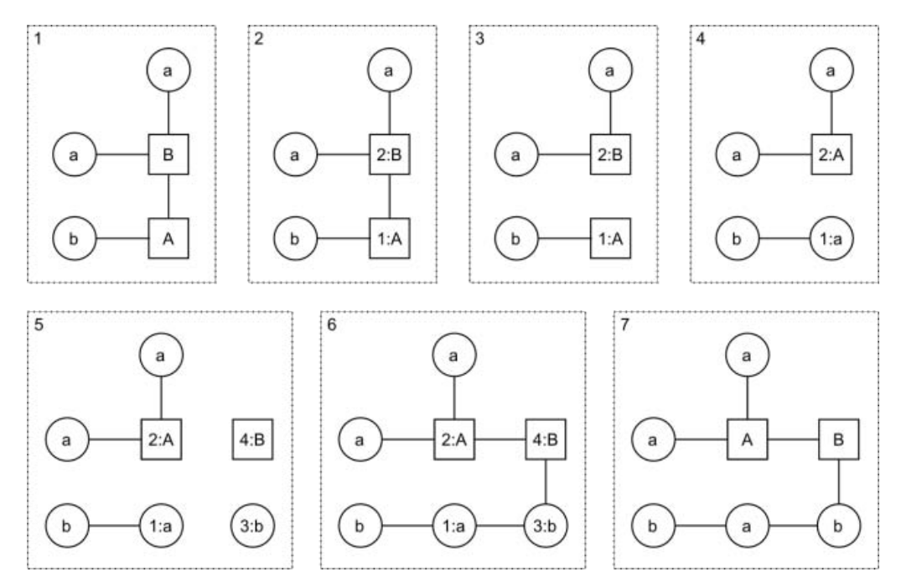
Applying the rule
Dormans, Joris. "Adventures in level design: generating missions and spaces for action adventure
Games." Proceedings of the 2010 workshop on procedural content generation in games. 2010.

Slide 43
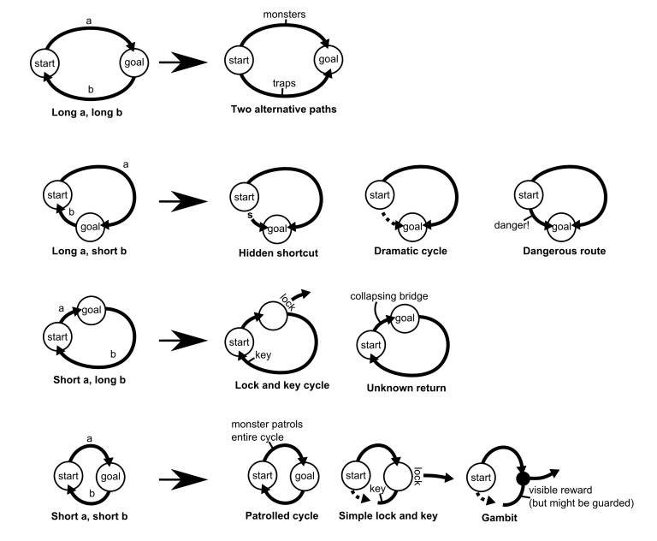
Design Patterns in Unexplored 2
Game level design patterns using cyclic graphs
  Here each edge is marked either “short” or “long”
Used in Unexplored 2 by Ludomotion
https://ctrl500.com/tech/handcrafted-feel-dungeon-generation-unexplored-explores-cyclic-dungeon-generation/

Slide 44
Exercise 10:
Devise a graph grammar to construct simple levels for a game like the Legend of Zelda
Start by including some of the design patterns shown opposite
Try out your rules as you go to see what they make
Hint:
  Search for the title of the paper below on Google Scholar
    Look at section 4 in detail
Dormans, Joris. "Adventures in level design:
Generating missions and spaces for action
Adventure Games." Proceedings of the 2010
workshop on procedural content generation in
games. 2010.

Slide 45
Exercise 10:
Read Section 4 of Dormans (2010)
What are levels generated by this system like?
  What do they always have?
What can’t this system generate?
  How could it be adapted to generate this?
Can you describe a simple level generation system using a similar grammar?
  Try it out and see what it generates
Dormans, Joris. "Adventures in level design: Generating missions and spaces for action
Adventure Games." Proceedings of the 2010 workshop on procedural content generation in
games. 2010.

Slide 46
Representation

Slide 47
Representing a Graph
When working with a graph mathematically, we want a formal representation
  Allows us to express properties about our graph using the tools of Set Theory, Logic, etc.
  Allows generalisation over possible graphs
  Allows us to describe algorithms on graphs
Different representations can express different sorts of graph

Slide 48
Set-theoretic representation
A simple graph can be represented as an ordered pair G = ( V, E ) composed of :
  a set of vertices, V, and
  a set of edges, E, which connects the nodes.
For the example
  V = { p, n2, n3, n4, n5, n6, n7 }
  E = {e1, e2, e3, e4, e5 }

Slide 49
Representing Vertices
Vertices are usually represented as labels if their content doesn’t matter
  V = { a, b, c }
We could also represent the data of each node, for example with numbers:
  V = {2, 54, 25}
  Or define the labels above, e.g. a = 2
Question:
The following set of vertices is not allowed, why? How could we fix it?
  V = { 12, 42, 42 }

Slide 50
Representing Edges
There are different ways of representing edges
Edges are commonly represented as sets or tuples
  E1 = {n2, p}
  E1 = (n2, p)
Question:
What difference does this make?

Slide 51
Exercise 11:
Draw the undirected graph G1 = ( V1, E1 ) where
  V1 = { a, b, c, d }
  E1 = {{a, b}, {a, c}, {a, d} }
Draw the directed graph G2 = ( V2, E2 ) where
  V2 = { a, b, c, d }
  E2= {(a, b), (a, c), (a, d) }

Slide 52
Defining Edges
So far we’ve seen an extensional definition of the set of edges
  We can also describe it as follows
E ⊆ { {x, y} | x, y ∈ V ∧ x ≠ y }
Or if you prefer, we could express the set comprehension with a term
E ⊆ { x: V; y: V | x ≠ y ⦁ {x, y} }
And if we want directed edges, we just change the term to a tuple
E ⊆ { x: V; y: V | x ≠ y ⦁ (x, y) }

Slide 53
Representation
  Multigraphs

Slide 54
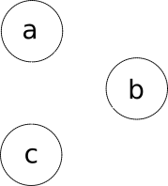
Exercise 12:
Try to give an extensional definition for the graph shown. What problem do you encounter?
Hint:
  An extensional definition is listing all the elements of a set
G = (V, E)
V = { … }
E = { … }

Slide 55
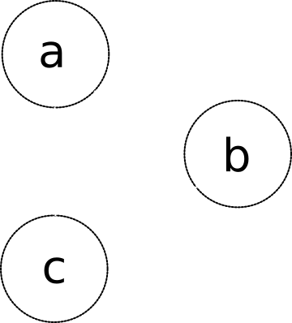
Multiple Edges (Multigraph)
With a graph (V, E) there is no way to represent multiple edges
  We need to change our representation
Let’s invent a function, ϕ, that tells us, for each edge, what vertices it joins
  G = (V, E, ϕ)
For example,
  ϕ(e1) = {a, b}
  ϕ(e2) = {a, b}

Slide 56
Multigraphs
We can define the type of the function ϕ.
  Functions map inputs in a domain (edges) to a range (2-sets of vertices)
ϕ : E → P
where P = { { x, y } | x, y ∈ V ∧ x ≠ y }
Here P is the set of sets {x, y}, where x and y are
  vertices in our graph (∈ V)
  not equal to one another

Slide 57
Functions in Set Theory
Function, like everything else in Set Theory, are sets
A function is a set of pairs (A, B), such that
  A is an element of the domain
  B is an element of the range
For example the successor function, S : ℕ → ℕ, is the set of pairs
  S = {(1, 2), (2, 3), (3, 4), …, (n, n+1), ... }

Slide 58
Functions in Set Theory
Exercise 13:
Let f be a function of type ℕ4 → ℕ4
f(x) = x² mod 4
  Give an extensional definition of f
Hint:
  ℕ4 = {0, 1, 2, 3}
  Functions in set theory are sets of pairs
    { ( input1, output1 ), ( input2, output2 ) … }
  An extensional definition lists all the elements

Slide 59
Multigraph
We now have the tools to give an extensional definition of our multigraph
G = (V, E, ϕ )
V = {a, b, c}
E = {e1, e2, e3, e4}
ϕ = {(e1, {a, b}), (e2, {a, b}), (e3, {a, c}), (e4, {b, c})

Slide 60

Exercise 14:
Try to give a formal representation for the graph shown. What problem do you encounter?
Hint:
It’s a simple graph (not a multigraph) so we don’t need ϕ here
G = (V, E)
V = { … }
E = { … }
E ⊆ { x: V; y: V | x ≠ y ⦁ {x, y} }

Slide 61
Loops
Representing looping edges
  Can’t use a 2-set, as all elements in a set are unique
    { a, a }
  Don’t want to use a tuple, as it’s unordered
    (a, a)
We have to change our representations to allow edges to be singletons { a } representing a loop

Slide 62
Edges that Permit Loops
To permit loops we need to drop the requirement that x ≠ y
E ⊆ { {x, y} | x, y ∈ V }
Or using a term...
E ⊆ { x: V; y: V ⦁ {x, y} }

Slide 63
Exercise 15:
Allowing loops in a multigraph means we need to change our definition of ϕ. What does it need to become?
Hint:
  An undirected multigraph has a function ϕ of type
ϕ : E → { { x, y } | x, y ∈ V ∧ x ≠ y }

Slide 64
Directed Multigraph Permitting Loops
If we want a directed graph that
  allow loops
  allows multiple edges between nodes
We can adapt our previous definition to that shown on the right
G = (V, E, ϕ )
V = { … }
E = { … }
ϕ : E → { ( x, y ) | x, y ∈ V }

Slide 65
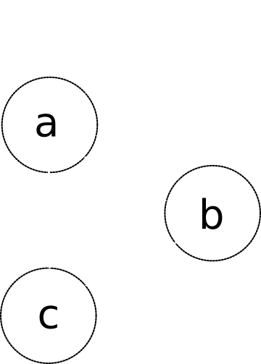
Exercise 16:
Give an extensional definition of the graph opposite
Hint:
G = (V, E, ϕ )
V = { a, ... }
E = { e1, ... }
ϕ = { (e1, (a, b)), … }

Slide 66
Graphs and Set Comprehensions
User ID | Name | Address | Orders
5 | John | 1 A St | {13}
6 | Mary | 2 B St | {14,15}
Exercise 17:
  Draw a graph of the relationships between users, orders, and items
  Intensionally define the set of edges connecting Items to Items (which have a offer price associated with them)
  Intensionally define the set of edges connecting Users to Orders
Order ID | User | Shipping Cost | Items Cost | Items
13 | 5 | 4.00 | 22.50 | {3, 4}
14 | 6 | 4.00 | 22.50 | {3, 4}
15 | 6 | 2.55 | 4.50 | {4}
Item ID | Name | Price | Offer Items
3 | Shoe | 20.00 | { 4 }
4 | Laces | 4.50 | { }

Slide 67
Summary

Slide 68
Summary
What is a Graph
Terminology
  Node/vertex, edge
  (Strongly) Connected, Directed (digraph), (In/Out)degree,
  (Simple) Path, Cycle,
  Multigraph, Loops
Representing Graphs
  Set theoretic definitions

