Slide 1

Mathematics and Problem Solving
  Lecture 10
    Probability

Slide 2
Overview
Probability Basics
  Events
  Addition Rule
  Multiplication Rule for Independent Events
  General Multiplication Rule
Combinatorics
Probability Trees
Law of Total Probability
Bayes Rule

Slide 3
Disease Screening
There is a national screening programme for a particular disease
  1 in 10,000 people have this disease
  The test is 99% sensitive (true positive rate)
  If it is caught early, treatment is effective, however the treatment is invasive and you will need to take a year out of your degree
  You get a positive test result.
Question:
Your doctor asks whether you want to begin treatment. What do you say?

Slide 4
Disease Screening
Asking for more information, you are given a leaflet that says:
  The test correctly diagnoses 99 out of 100 people who have the disease
  If you don’t have the disease there is a 1 in 100 chance of a positive result
  1 in 10,000 people have this disease
Question:
Do you begin treatment?

Slide 5
Disease Screening
We want to know:
  What is the liklihood that I have the disease?
By the end of this lecture, you will be able to make an informed answer to the sort of question presented here, and many others

Slide 6
Applied Probability
Probability is often counter-intuitive
  This can lead to problems in how people understand
    Medicine (e.g. screening programes, vaccines)
    Criminal evidence (e.g. DNA evidence)
  Often games (e.g. Civilisation) lie about probailities to better fit player’s expectations
  How numbers are presented affects perception e.g. “1 in 200” > 0.5%
Because of this, it’s also very easy to make mistakes

Slide 7
Events

Slide 8
Experiment
An experiment is a procedure for discovering something unknown
  pulling a ball out of a bag
  rolling a dice
  flipping a coin
  measuring a piece of string
Experiments have one or more outcomes
  Drawing a particular ball (b1, b2, ....)
  Rolling a particular number (1, 2, … )
  Getting a particular measurement (l = 12cm)

Slide 9
Sample Space
All the possible outcomes are called the sample space
  The sample space is a set
E.g. for rolling a 6-sided dice
  S = {1, 2, 3, 4, 5, 6}
The probability that we will get an outcome from the sample space is 1 (certain)
  P(S) = 1

Slide 10
Events
An event E is a non-empty subset of the sample space
  It is a set of outcomes
  0 < P(E) < 1
For example
  Draw a Red ball ( R = { b1, b3, b5 } )
  Draw a Black ball (B = {b2, b4 } )
  Roll an even number (E = {2, 4, 6 } )
  Roll a 4 (F = { 4 } )

Slide 11
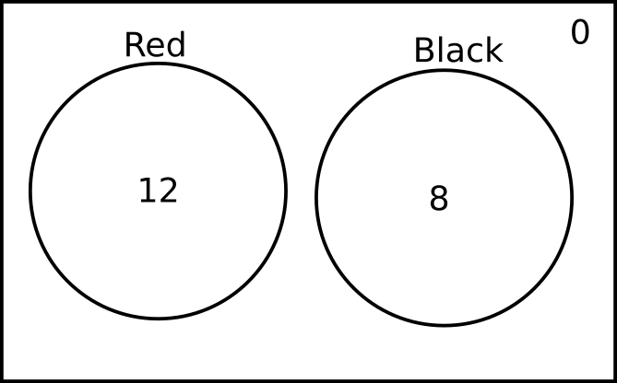
Venn Diagram
We can represent an experiment with a Venn Diagram
  Each circle represents an event (set)
  We give the number of outcomes in each event

Slide 12
Classical Probability
Assuming each outcome is equally likely:
P(event) = favourable outcomes / total possible outcomes
Assume a bag of balls
  12 Red balls (12 outcomes)
  8 Black balls (8 outcomes)
P(red) = 12 / 20
P(black) = 8/20

Slide 13
Exercise 1:
Represent the information opposite as a Venn diagram.
What is the probability of:
  A randomly selected employee works remotely
  A randomly selected company laptop being used by someone on-site
A company has 100 employees
  60 employees work on site
    50 of whom use company-provided laptops
  40 employees work remotely
    20 of whom use company-provided laptops
Hint:
P(event) = favourable outcomes / total possible outcomes

Slide 14
Complement
Complement of a probability P(A) is
P(A’) = 1 - P(A)
Chance I don’t draw a red ball
P(red’) = 1 – (12/20) = 8/20

Slide 15
Exercise 2:
Using the information opposite.
What is the probability of:
  A randomly selected on-site employee not using a company-provided laptop
A company has 100 employees
  60 employees work on site
    50 of whom use company-provided laptops
  40 employees work remotely
    20 of whom use company-provided laptops
Hint:
P(event) = favourable outcomes / total possible outcomes
P(A’) = 1 - P(A)

Slide 16
Mutually Exclusive Events
Mutually exclusive events cannot both occour at once
  On a Venn diagram, they do not overlap
  Their intersection is the empty set
In the example, Red and Black are mutually exclusive events

Slide 17
Independent Events
Two events are independent if their probabilities do not change depending on the outcome of the other
For example
  Rolling two dice
  Flipping a coin 10 times
Events that are not independent are called dependant events

Slide 18
Exercise 3:
Which of the following involve dependant or independent events?
  Generating two random numbers in Python
  Drawing two cards from a deck and looking at their suit
  Two people each choosing a random chair in this room
  The probability of two successive requests to a webserver failing

Slide 19
Summary
Experiment
  Outcomes
  Events
Venn Diagrams
Probabilities of Events
  Favourable outcomes / Total possible outcomes
Complement
  P(A’) = 1 - P(A)

Slide 20
Exercise 4:
You have a deck of 52 cards (4 suits, no jokers). What is the probability of drawing the following.
  The ace of hearts (🂱)
  A heart (🂱 🂲 🂳 🂴 🂵 🂶 🂷 🂸 🂹 🂺 🂻 🂽 🂾)
  A face card (🂻 🂽 🂾 🂫 🂭 🂮 🃋 🃍 🃎 🃛 🃝 🃞)
  A joker (🃏)

Slide 21
Probability of Union

Slide 22
Adding Probabilities
Exercise 5:
For the deck of cards described opposite, what is the:
  Probability of drawing a spade?
  Probability of drawing a face card?
I have a deck of cards and I’m making a game
  4 suits
  13 cards in each suit
  3 face cards in each suit
  52 cards overall

Slide 23

Adding Probabilities
What is the probability of drawing either a spade or a face card?
Assuming
  P(♠) = 1/4
  P(face) = 3/13
The probability of A or B is the probability of the union of A and B
P( A ∪ B )

Slide 24
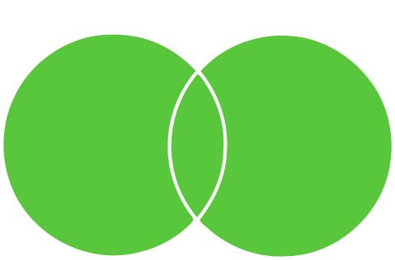
Union (∪)
If events are sets of outcomes, the set-theoretic union of two events is the event that either event occurs
To find this, we
  Add up the probabilities of each event
  Take away the probability that the events co-occur

Slide 25
Addition Rule
Addition Rule:
The combined probability of two events A and B is the sum of the probabilities of those events, less the probability that those events co-occur:
P(A ∪ B) = P(A) + P(B) - P(A ∩ B)

Slide 26
Addition Rule (Example)
We know
  P(♠) = 1/4 = 13/52
  P(face) = 3/13 = 12/52
  P(♠∩ face) = 3/52 (because there are 3 spade face cards in the deck)
P(♠∪ face) = P(♠) + P(face) - P(♠∩ face)
P(♠∪ face) = 13/52 + 12/52 – 3/52
P(♠∪ face) = 22/52

Slide 27
Exercise 6:
Two mutually exclusive events have probabilities P(A) = ½ and P(B) = ¼
What is the probability that A or B occurs?
Hint:
P(A ∪ B) = P(A) + P(B) - P(A ∩ B)

Slide 28
Probability of Intersection

Slide 29
Intersection
What is the liklihood that A and B occur?
  The probability of the intersection of the events A and B
P(A ∩ B)

Slide 30
Multiplication Rule for Independent Events
Multiplication Rule for Independent Events:
To find the probability of two independent events co-occuring (their intersection) we multiply their probabilities together
P(A ∩ B) = P(A) x P(B)

Slide 31

Intersection
What is the probability of rolling ⚅ and ⚅ on two dice?
  P(⚅∩⚅) = P(⚅) x P(⚅)
  = 1/6 x 1/6
  = 1/36
  (Note these are independent events)

Slide 32
Exercise 7:
Work out the probabilities for the following independent events:
  Flip a coin twice and get two heads
  P(A) = 0.2; P(B) = 0.5; P(A∩B) = ?
  Draw a red card that is an even number from a 52 card deck

Slide 33
General Multiplication Rule

Slide 34
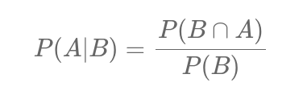
Conditional Probability
The chance of event A assuming, or conditional, on event B also happening
  Written P( A | B )
To find P( A | B ) you:
  find the chance that A and B co-occur
  divide by the probability of B.

Slide 35
General Multiplication Rule
General Multiplication Rule:
To find the chance that two events co-occur you multiply their the probability of event A occurring given B by the probability of B.
P(A∩B) = P(A|B) x P(B)

Slide 36
Combinatorics

Slide 37
Combinatorics
A fancy name for three things
  Enumeration
  Combination
  Permutation

Slide 38
Factorial
Formulas for combinatorics make use of factorial
  Written n!
  n! is n multiplied by every natural number <n
1! = 1
2! = 2 x 1
3! = 3 x 2 x 1
4! = 4 x 3 x 2 x 1
Note that
  0! = 1

Slide 39
Enumeration
An enumeration is just a listing of a set
If I have a set A = {a, b, c, d}
Its enumeration is
  {a, b, c, d}

Slide 40
Combination
Say we have a set A = {a, b, c, d} and we want combinations of 3 elements
Every subset of A with 3 elements is a combination
  {a, b, c}
  {b, c d}
  {a, c, d}
  {a, b, d}
Combinations don’t have order

Slide 41
Permutation
Permutations have order
Permutations of 3 elements of the set A = {a, b, c, d}
  (a, b, c)
  (a, c, b)
  (b, a, c)
  (b, c, a)
  (c, a, b)
  (c, b, a)
  (a, b, d)
  (a, d, b)
  ...

Slide 42
Exercise 8:
Which of the following are enumerations, combinations, and permutations?
  I pick some books to take on holiday
  I select three films to watch
  I compile a playlist of my favourite music
  I list all the numbers from 1-100

Slide 43
Calculating Number of Permutations
Exercise 9:
How can we write a formula for permutations?
Hint:
  Permutations of 1 out of 4
    4
  Permutations of 2 out of 7
    7 x 6
  Permutations of 3 out of 5
    5 x 4 x 3
  Permutations of 5 out of 20
    20 x 19 x 18 x 17 x 16

Slide 44
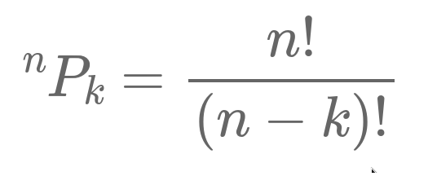
Calculating Number of Permutations
Where n is the size of the set and k is the size of the subset we are ordering

Slide 45
Exercise 10:
Work out the answers to the following permutations
  ¹P1
  ²P1
  ⁴P2
  ⁵P3

Slide 46
Calculating Number of Combinations
Start by treating it as a permutation
  Gives us (number of combinations) x (number of possible orders)
Then divide by number of possible orders there could be
How many orders of k things?
  ^{k}pk = k!

Slide 47
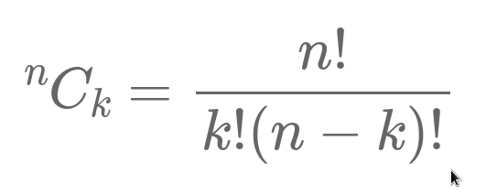
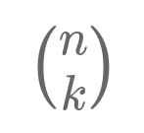
Calculating Number of Combinations
Where n is the size of the set and k is the size of the subset we are picking
This is also called the Binomial Coefficient and can be written:

Slide 48
Comparing Permutations and Combinations
Where n is the size of the set and k is the size of the subset we are picking/ordering

Slide 49
Exercise 11:
Work out the answers to the following combinations
  ¹C1
  ²C1
  ⁴C2
  ⁵C3

Slide 50
Summary
Factorial
Permutations and Combinations
  Two formulas to remember (or look up)

Slide 51
Probability Trees

Slide 52

Decision Trees
A way of representing a sequence of Decisions
For example, in a MOBA
  Choose to play Ranked/Unranked
  Choose character

Slide 53

Probability Trees
Lets say we assign probabilities to each decision
  Each probability is conditional upon its position in the tree
  Then we have a probability tree
We can also write conditional probabilities like this
  P( C1 | R ) = 2/10
  P( C1 | U ) = 3/10

Slide 54

Multiplying Down Branches
To work out the absolute probability of a set of decisions, we can multiply down the tree
Rememeber the Multiplication Rule
  P(A∩B) = P(A|B) x P(B)

Slide 55

Adding Across Branches
Branches are mutually exclusive, so we can add them together to get their combined probability
Remember the Addition Rule
  P(A ∪ B) = P(A) + P(B) - P(A ∩ B)

Slide 56
Exercise 12:
What are the following probabilities:
  P (C1 | U)
  P (U ∩ C3 )
  P (R ∩ U )
  P (U ∩ ( C1 ∪ C2) )

Slide 57

Disease Screening
We can use Probaility trees to visualise testing for disease, for e.g. screening programmes.
  Prevalence
P(+D)
  Sensitivity
P(+T | +D)
  Specificity
P(-T | -D)

Slide 58
Exercise 13:
Assume a random individual is tested. What is the liklihood of a:
  True positive
  False positive
  True negative
  False negative

Slide 59
Law of Total Probability

Slide 60
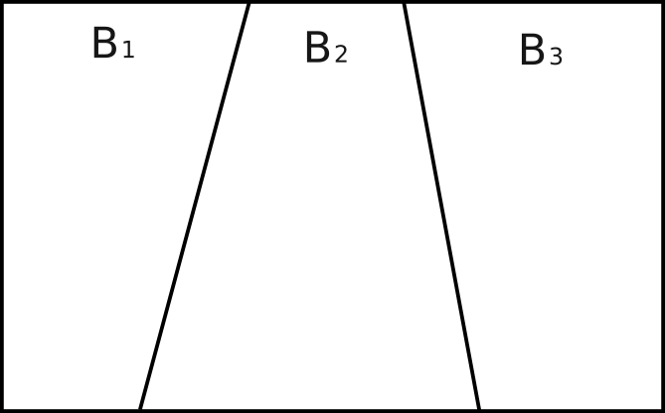
Partition
A partition is a way of subdividing a set into partitions B1, B2, …, Bn that are:
  disjoint (i.e. there is no overal between Bi and Bj, or in other words Bi ∩ Bj = ∅)
  collectively exhaustive (i.e. together they contain everything in the set)

Slide 61
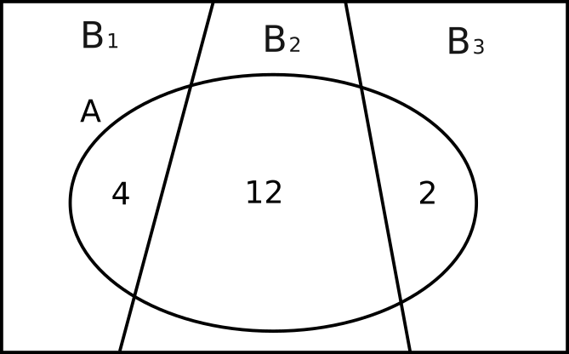
Summing Conditional Probabilities
Events may be divided across these partitions
We can reason about the event A as the sum of conditional probabilities
  P(A | B1) +
  P(A | B2) +
  P(A | B3)

Slide 62
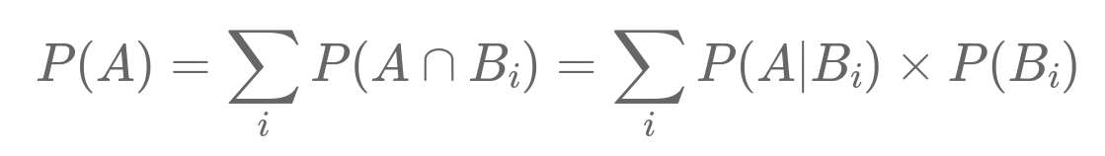
Law of Total Probability
Law of Total Probability:
If B1, B2, B3, … is a partition of the sample space S, then for any event A:

Slide 63
Exercise 14:
You have 2 bags of balls that each contain 70 balls.
  Bag 1 has 50 red balls and 20 black balls
  Bag 2 has 30 red balls and 40 black balls
You pick a bag at random and pick a random ball from that bag. What is the probability that you pick a red ball?
Hint:
P(A∩B) = P(A|B) x P(B)

Slide 64
Bayes Rule

Slide 65
Bayesian Reasoning
Say we had a scientific hypothesis
  We gather evidence
  We want to know how certain we should be of the hypothesis
We want to give a value to the formula:
P (H | E)
  Probability of hypothesis H given evidence E
What do we need to know to calculate this?

Slide 66
What we (might) know
Lets say we know
  P(H), the prior probability of hypothesis H
  P(E), the liklihood that the evidence is true
  P(E | H), the liklihood of the evidence given the hypothesis
This is enough to work out P(H | E)
  Called the posterior probability of hypothesis H

Slide 67
Revision Example
For example, assuming:
  Half of students revise
  Half of students pass their exam
  Of those who revise, 80% passed their exam
What is the liklihood that a student who passed their exam had revised?

Slide 68
Revision Example
What is the liklihood that a student who passed their exam had revised?
  Prior probability of hypothesis
    P(H) = 50% (Half of students revise)
  Probability of evidence
    P(E) = 50% (Half of students pass their exam)
  Probability of evidence given hypothesis
    P(E | H) = 80% (Of those who revise, 80% passed their exam)
We need to rearrange this for P(H | E)

Slide 69
Exercise 15:
Using the formulas opposite, rewrite:
P (H | E)
in terms of
  P(H)
  P(E)
  P(E | H)
Hint:
P(A∩B) = P(A|B) x P(B)
P(A ∪ B) = P(A) + P(B) - P(A ∩ B)

Slide 70
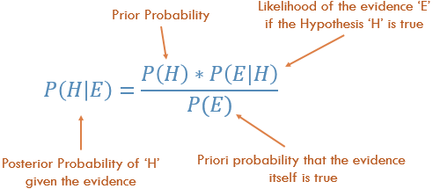
Bayes Rule

Slide 71
Disease Screening
Probability is often counter intuitive.
Imagine you have been screened for a disease (e.g. cancer)
  You get a positive result
  What is the probability that you have the disease?
Question:
Given the statistics opposite, would you be willing to undergo potentially harmful treatment after a positive test?

Slide 72
Disease Screening
We want to work out P(H | E), we know:
  P(H) = 1/10000 (prior probability = prevalence)
  P(E | H) = 0.99 (sensitivity)
  P(E) = ?

Slide 73
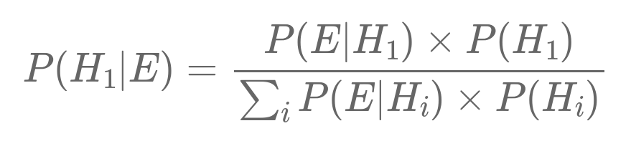
Our hypotheses (Has disease, doesnt have disease) is a partition
  Disjoint
  Collectively exhaustive
We can rewrite P(E) using the Law of Total Probability

Slide 74
Disease Screening
We want to work out P(H1 | E), we know:
  P(H1) = 1/10000
  P(H2) = 9999/10000
  P(E | H1) = 0.99
  P(E | H2 ) = 0.01

Slide 75
Exercise 16:
Work out P(H1 | E),:
  P(H1) = 1/10000
  P(H2) = 9999/10000
  P(E | H1) = 0.99
  P(E | H2 ) = 0.01
Would you undergo potentially harmful treatment?
Hint

Slide 76

Exercise 17:
A player of a MOBA chooses to play Ranked/Unranked and then picks one of three characters to play. The probabilities are shown in the probability tree opposite
You see someone playing character C3. What is the liklihood they are playing ranked?

Slide 77
Summary

Slide 78
Summary
Probability Basics
  Events
  Addition Rule
  Multiplication Rule for Independant Events
  General Multiplication Rule
Combinatorics
Probability Trees
Law of Total Probability
Bayes Rule

