Slide 1

Identifying Bugs Before Runtime With Jedi
Or
The future of static analysis in Python
By Dave Halter

Slide 2
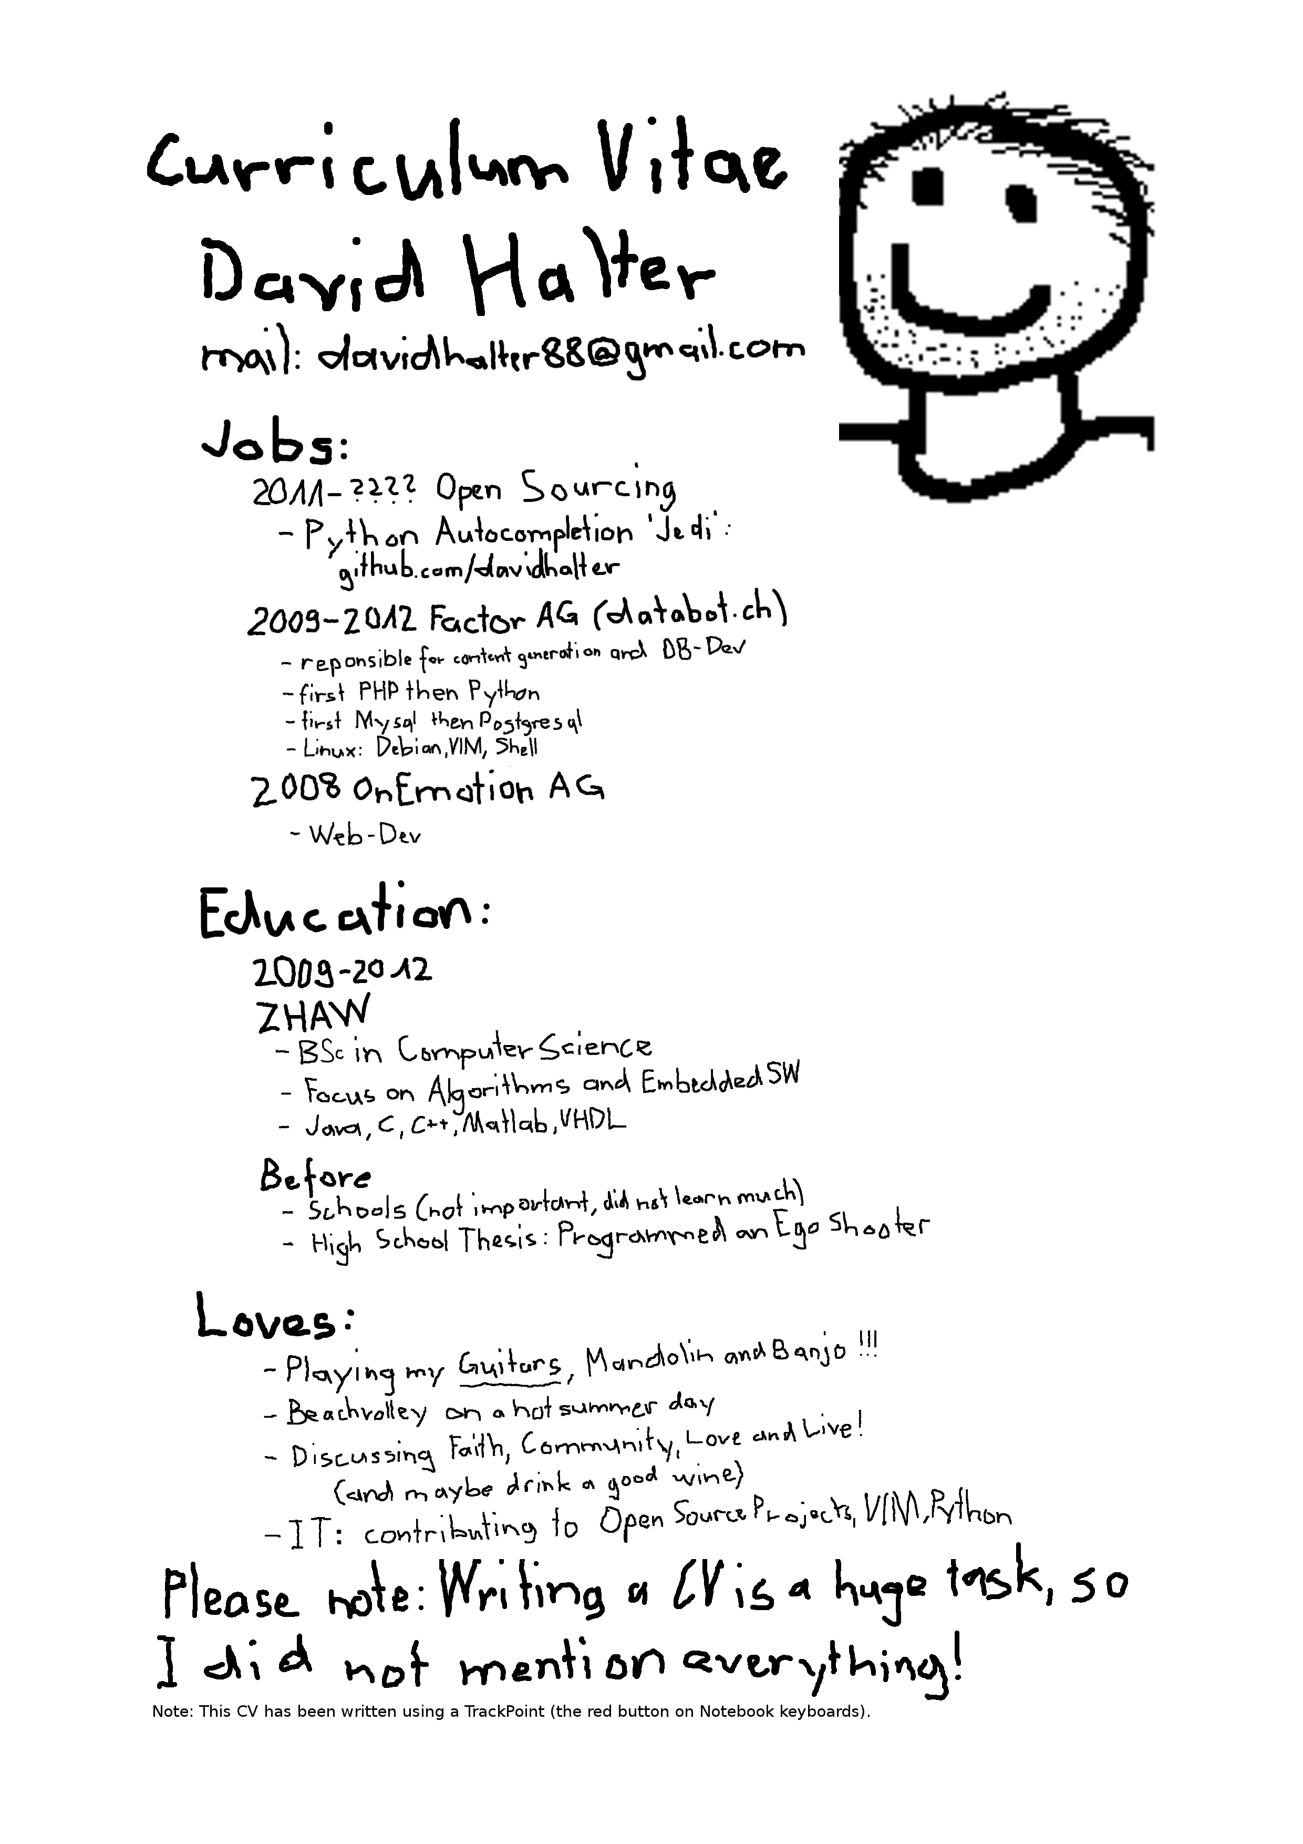

Slide 3


Slide 4
Jedi – Awesome Autocompletion – Facts
Jedi is “only” a library, you need an editor or an IDE to use it. I'm using my own “jedi-vim”.
About 12 different plugins for about 8 editors/IDEs
~ 1200 stars on github
3000+ commits
Well tested → ~ 1100 tests
Around since 2012
Python 2/3 compatible, Python 3 preferred.

Slide 5
Why this talk?
Jedi is quite sophisticated and interesting
We want more contributors
The new static analysis capabilities would be really interesting for the Python ecosystem.

Slide 6
Jedi's autocompletion engine
Works different than e.g. PyCharm
Autocompletion boils down to good type deduction
Based on Lazy Evaluation
But: Jedi is Value, not type based.

Slide 7
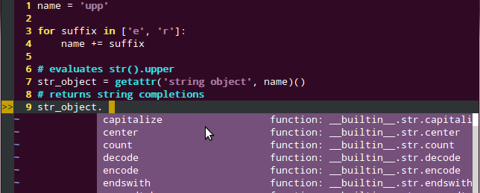
Jedi uses values to deduct types

Slide 8
Jedi's Parser
Is fault-tolerant, important for autocompletion.
A “fast parser” exists to only reparse parts of the source code that has changed.
The fast parser improves performance to about 10x.
Notes:
japanese

Slide 9
The dynamic nature of Python
Jedi supports getattr/__getattr__/__getattribute__/__getitem__
Handles array manipulations (as of now list/set, not yet dict).
Not handled by PyCharm, PyDev, Rope...

Slide 10
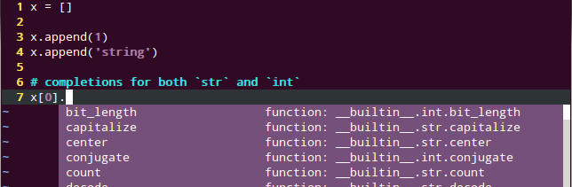
List manipulation

Slide 11
Conclusion:
Jedi understands almost everything.
Decorators
Generators
List comprehensions
Simple sys.path modifications
Descriptors (Who understands that?)
[..]
But unfortunately not metaclasses/setattr

Slide 12
Birth of a new linter
Static analysis should be really easy with Jedi. Just evaluate everything. Slow, but should work.
Turns out, it's not that slow.
Yields good results after only one month of work.

Slide 13
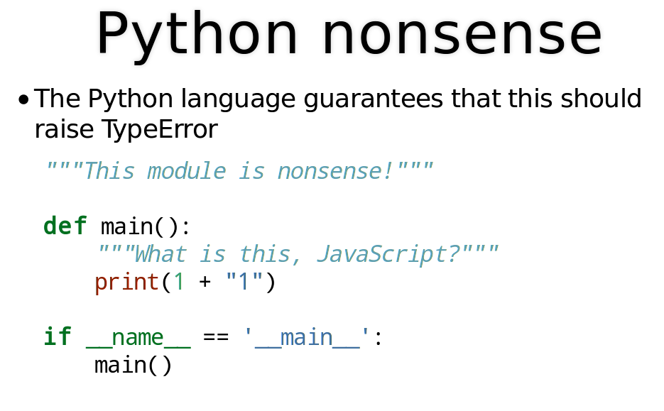
Haskell FTW Keynote
“Static analysis tools for Python are primitive”, Keynote of Bob Ippolito

Slide 14
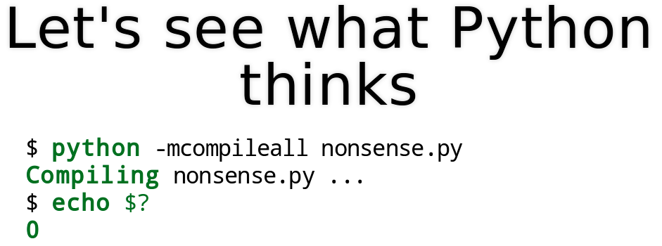
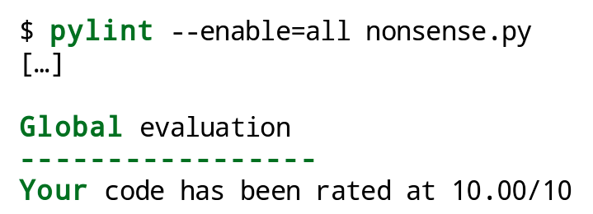
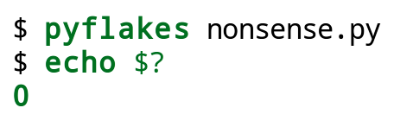
Python ecosystem doesn't help
(Bob Ippolito Keynote slides)

Slide 15
Dynamically typed sucks, because:
(according to stackoverflow)
Earlier detection of programming mistakes (e.g. preventing adding an integer to a boolean)
Better documentation in the form of type signatures (e.g. incorporating number and types of arguments when resolving names)
Performance (Solutions include PyPy, Cython, …)

Slide 16
Jedi???!!!11!1!

Slide 17

Jedi???!!!11!1!
Notes:
To be fair... Beer

Slide 18
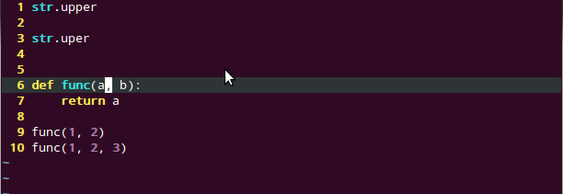
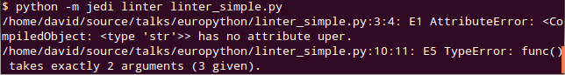
The linter
Finds AttributeError and TypeError with ease!

Slide 19
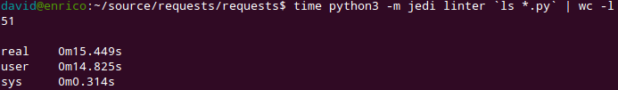
Example: requests
Scanning ~4000 lines of code takes 15s
51 errors reported (no actual errors)
~22 errors are errors that you want to show up (compatibility)
About 6 errors are Jedi bugs, all others are related to mixin classes.
Pretty Awesome.

Slide 20
Requests: Demo

Slide 21
You can try it:
python -m jedi linter <file>
This is an alpha version API. It is likely to change. If you want to stay up to date, use Jedi's dev branch from github.
Get Jedi: pip install jedi

Slide 22
Jedi's future
Static analysis with very few false positives.
Adoption in mainstream IDE's (Spyder & PyDev)
If we have enough manpower: Refactoring
Integration of Sebastian Kreft's “Python Type Annotator” will improve support for builtin Python types and numpy. @Europython Sprints

Slide 23
My “Jedi future”
Working on Jedi fulltime for about 14 months. Financially unsustainable.
Hire me! Your big company really needs a good linter for Python! I'm available :-)
Alternative: More Japanese Contributors! Cause they're awesome.
Or Kickstarter...

Slide 24
The end.
If you want to help, please contact me!
→ davidhalter88@gmail.com
twitter: @jedidjah_ch
github: @davidhalter
https://www.gittip.com/davidhalter/
Test well and often (travis-ci, coverage.py, tox, py.test)
Create libraries if they don't exist. That's the strength of the Python ecosystem.

Slide 25

Questions?
No seriously. I'm a pacifist :-)

Slide 26

Pictures by balzkubli.com

