Slide 1
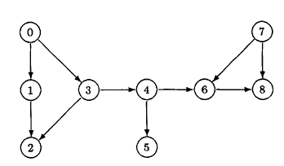
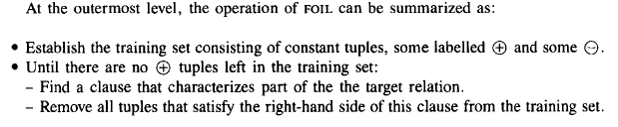
"two nodes are linked to each other."

Slide 2
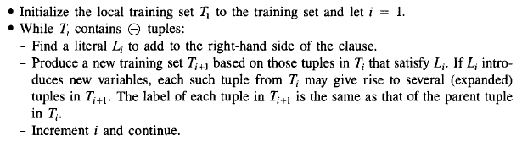

Slide 3
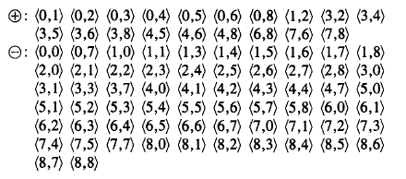

T1:
T1:

Slide 4
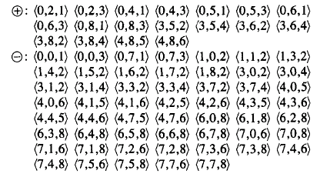

T2:
can-reach(X₃,X₂)
T3:
P0=18,n0=54; p1=10,n1=0; t=10 gain=10*(-log₂18/(18+54))=20

Slide 5
linked-to(X3, X2)
T3: +: (0,2,1) (0,2,3) (0,4,3) (3,5,4) (3,6,4) (4,8,6)
P0=18,n0=54;p1=6,n1=0;t=6 gain=6*(-log₂18/(18+54))=12
can-reach(X1 ,X2) <- linked-to(X1, X3), can-reach(X3, X2).

