Slide 1
Course outline
Introduction of pattern recognition system
Bayesian Decision Theory
Parameter Estimation
Nonparametric Techniques
Linear Discriminant Functions
Multilayer Neural Networks
Nonmetric Methods
Unsupervised Learning and Clustering
Algorithm Independent Techniques

Slide 2
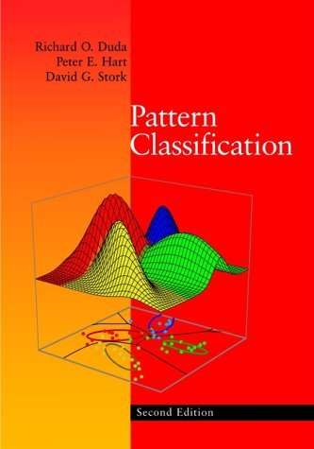
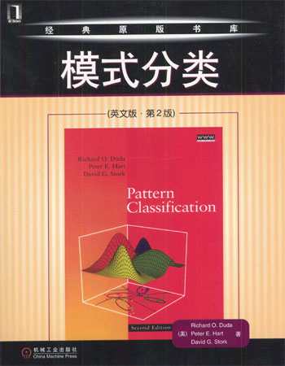
Text book
Richard Duda, Peter Hart, David Stork, Pattern Classification, 2nd edition, John Wiley,2001
李宏东，姚天明等译，模式分类，机械工业出版社，2003

Slide 3
Pattern Classification: An Introduction
Recognizing patterns
Designing pattern recognition systems
Applying pattern recognition systems
The connection to learning and adaptation
Summary

Slide 4
Recognizing Patterns
Definition 1.
Pattern recognition is the “act of taking in raw
data and taking an action or category of the pattern”
(Pattern Classification, Duda, Hart, and Stork).
Input Signal
Computer
Pattern Recognition
Action

Slide 5
Examples of Pattern Recognition
Automated speech recognition
Fingerprint identification
Face identification
Medical diagnosis
Finding targets
Fraud detection
……

Slide 6
A Particular Example
Fish packing plant
Sort incoming fish on a belt according to two classes:
  Salmon or
  Sea Bass
Steps:
  Preprocessing (segmentation)
  Feature extraction (measure features or properties)
  Classification (make final decision)

Slide 7
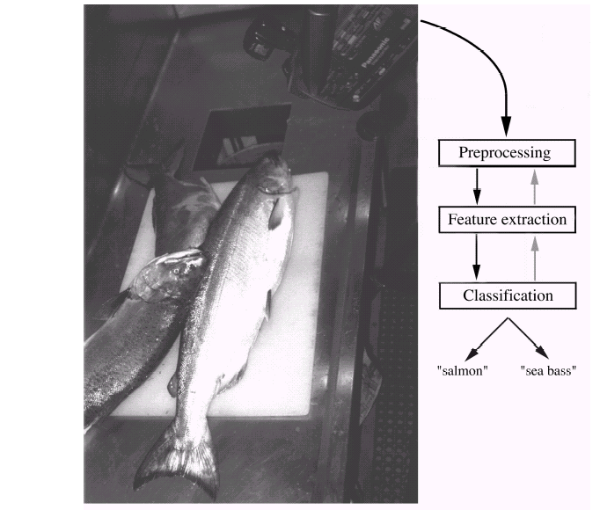
Figure 1.1

Slide 8
Histograms
We decide to use “length” as the first feature.
Classification is then easy:
Decide Salmon if length l < l*
Decide Sea Bass if length l > l*
(l* : critical threshold)
Some features may give poor results.
Part of the design of pattern recognition systems
is to find the right features to discriminate between classes.
What if we try lightness of fish scales?

Slide 9
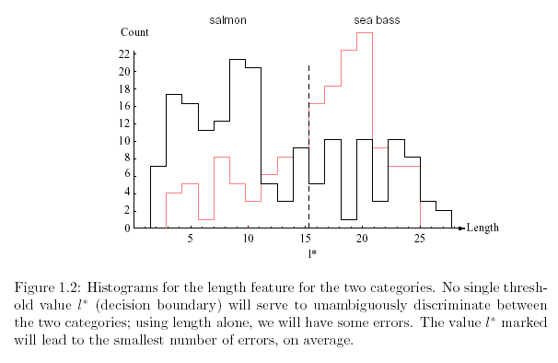
Figure 1.2

Slide 10
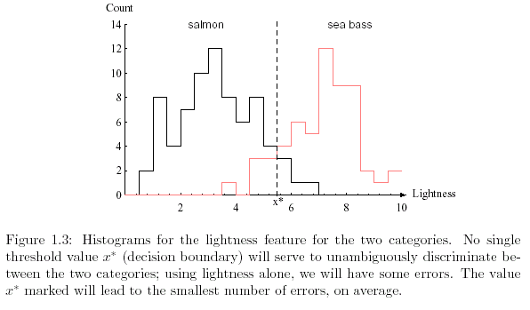
Figure 1.3

Slide 11
Decision Theory
Most times we assume “symmetry” in the cost.
(e.g., it is as bad to misclassify salmon as sea bass).
That is not always the case:
Case 1.
Case 2.
Sea bass can with pieces
of salmon
X Salmon can with pieces of
sea bass

Slide 12
Decision Boundary
We will normally deal with several features at a time.
An object will be represented as a feature vector
X =
x1
x2
Our problem then is to separate the space of feature values
into a set of regions corresponding to the number of classes
.
The separating boundary is called the decision boundary.

Slide 13
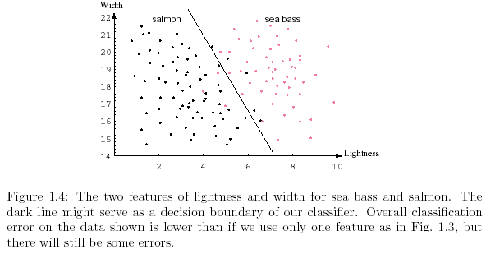
Figure 1.4

Slide 14
Generalization
The main goal of pattern classification is as follows:
To generalize or suggest the class or action of objects
as yet unseen.
Some complex decision boundaries are not good at generalization.
Some simple boundaries are not good either.
One must look for a tradeoff between performance and simplicity
This is at the core of statistical pattern recognition

Slide 15
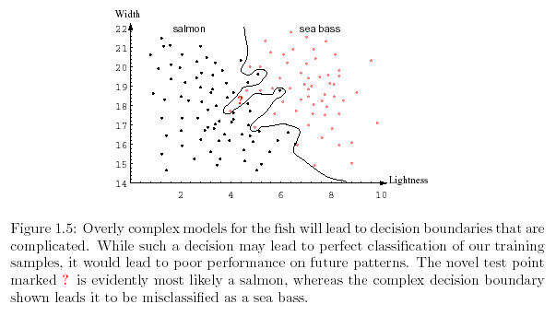
Figure 1.5

Slide 16
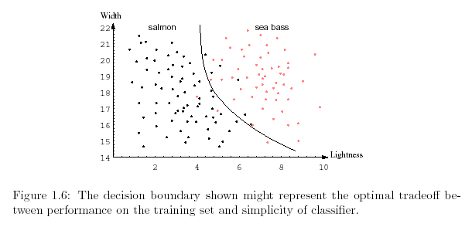
Figure 1.6

Slide 17
Some terminology
Neural pattern recognition:
Here we are concerned about statistical properties of patterns
(expressed in probability densities).
Syntactic pattern recognition:
Our decision is made of logical rules or rules of grammar.

Slide 18
Related Fields
Image processing
  Input: image; output: image.
Associative memory
  Input: pattern; output: pattern representative of groups of patterns
Regression
  Predict values for new input (e.g., linear regression)
Interpolation
  Predict the function for ranges of input
Density estimation
  Estimate the probability density of input members

Slide 19
Pattern Classification: An Introduction
Recognizing patterns
Designing pattern recognition systems
Applying pattern recognition systems
The connection to learning and adaptation
Summary

Slide 20
Designing Pattern Recognition Systems
Components in a system:
Sensing devices
  Often a transducer such as a camera or microphone (features: bandwidth,
  resolution, sensitivity, distortion, latency, etc.)
Segmentation and grouping
  Patterns must be segmented (there may be overlapping).
Feature extraction
  Extract features that simplify classification.
  Ideally: values similar in same category and different among categories.
  That is we need distinguishing features (invariant to transformations).

Slide 21
Designing Pattern Recognition Systems
Components in a system:
d) Classification
  Use feature vectors to assign an object to the right category.
  Ideally: determine probability of category membership for an object.
  Learn to handle noise.
e) Post processing
  Use output of classifier to suggest an action.
  Classifier performance? Error rate?Context?
  Minimize expected cost or “risk”.

Slide 22
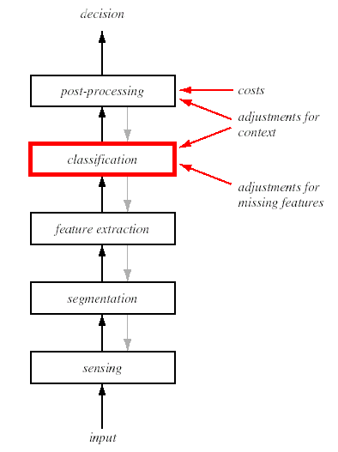
Figure 1.7

Slide 23
Pattern Classification: An Introduction
Recognizing patterns
Designing pattern recognition systems
Applying pattern recognition systems
The connection to learning and adaptation
Summary

Slide 24
Applying Pattern Recognition Systems
Steps:
Data Collection
  Usually very time consuming
Feature Choice
  Prior knowledge is crucial
Model Choice
  Switch to new features, new classifier.
Training
  Learn from example patterns.
Evaluation
  Avoid overfitting.

Slide 25
Pattern Classification: An Introduction
Recognizing patterns
Designing pattern recognition systems
Applying pattern recognition systems
The connection to learning and adaptation
Summary

Slide 26
The Connection to Learning and Adaptation
Computer
Learning
Algorithm
Class of Tasks T
Performance P
Experience E
Supervised learning
Unsupervised learning
Reinforcement learning

Slide 27
Pattern Classification: An Introduction
Recognizing patterns
Designing pattern recognition systems
Applying pattern recognition systems
The connection to learning and adaptation
Summary

Slide 28
Summary
Pattern recognition: taking in raw data → taking an action or
category of the pattern
The main goal of pattern classification is to generalize or suggest
the class or action of objects as yet unseen.
One must look for a tradeoff between performance and simplicity
Components in a system: sensing devices, segmentation and grouping,
feature extraction, classification, post processing.
Applying pattern recognition systems has the following steps:
Data Collection, Feature Choice, Model Choice, Training, and Evaluation.

