Slide 1
Bayesian Decision Theory
Basic Concepts
Discriminant Functions
The Normal Density
Decision Theory for Discrete Features

Slide 2
Basic Concepts
Definitions.
State of nature.
Let ω denote the state of nature. ω is a random variable.
(e.g., ω = ω₁ for sea bass or ω = ω₂ for salmon )
A priori probabilities.
Let P(ω ₁) and P(ω ₂) denote the a priori probability of ω₁ and ω₂ respectively.
We know P(ω₁) + P(ω₂) = 1.
Decision rule.
Decide ω₁ if P(ω₁) > P(ω₂); otherwise choose ω₂.
But we know there will be many mistakes ….

Slide 3
Basic Concepts
Class-conditional probability density function.
Let x be a continuous random variable.
p(x| ω) is the probability density for x given the state of nature ω.
For example, what is the probability of lightness given that the
class is salmon?
P(lightness | salmon) ?
Or what is the probability of lightness given that the class is sea bass?
P(lightness | sea bass) ? P(x |ω)?

Slide 4
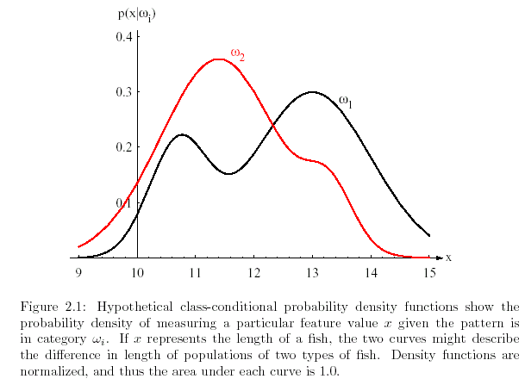
Figure 2.1

Slide 5
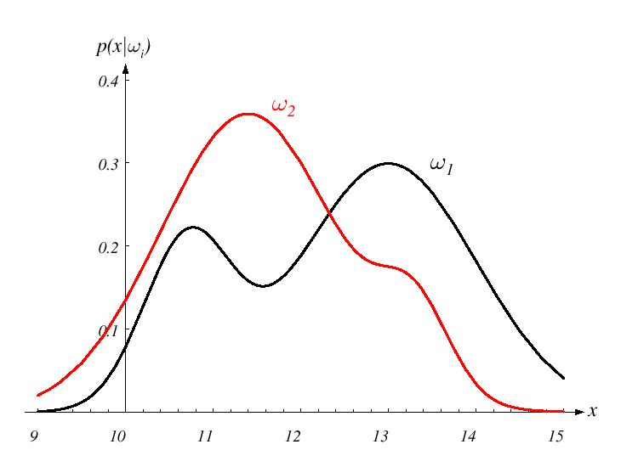
Class Conditional Probabilities
ω1: Sea bass
ω2: Salmon
p(x | ω2): Class conditional probability for salmon
Likelihood: Given that salmon has been observed, what is the
probability of this salmon’s lightness is between 11 and 12?
lightness

Slide 6
Bayes Formula
How do we combine a priori and class-conditional probabilities
to know the probability of a state of nature?
Bayes Formula.
P(ω_{j} | x) = p(x|ω_{j}) P(ω_{j}) / p(x)
prior probability
evidence
posterior
probability
likelihood
Bayes Decision:
Choose ω₁ if P(ω₁|x) > P(ω₂|x); otherwise choose ω₂.

Slide 7
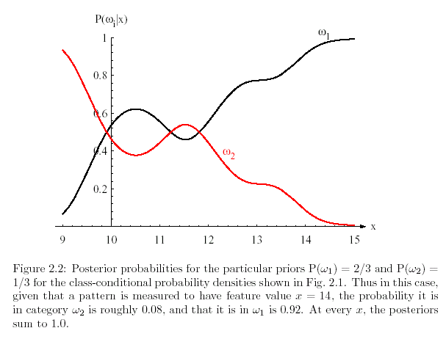
Figure 2.2

Slide 8

Minimizing Error
What is the probability of error?
P(error | x) = P(ω₁|x) if we decide ω₂
P(ω₂|x) if we decide ω₁
Does Bayes rule minimize the probability of error?
and if for every x we minimize the error then P(error|x)
is as small as it can be.
Answer is “yes”.

Slide 9
Simplifying Bayes Rule
Bayes rule allows us to compute the posterior probability (difficult to determine) from prior probabilities, likelihood and the evidence (easier to determine).
Bayes Formula.
P(ω_{j} | x) = p(x|ω_{j}) P(ω_{j}) / p(x)
The evidence p(x) is the same for all states or classes so
We can dispense with it to make a decision.
Rule:
Choose ω₁ if p(x| ω₁)P(ω₁) > p(x| ω₂)P(ω₂); otherwise decide ω₂
Observations:
  If p(x| ω₁) = p(x| ω₂) then the decision depends on the prior probabilities only.
  If P(ω₁) = p(ω₂) then the decision depends on the likelihoods only.

Slide 10
Loss Function
Let {ω₁, ω₂, …, ω_{c}} be the possible states of nature.
Let {α₁, α₂, …, α_{k}} be the possible actions.
Loss function
λ_{ij} = λ(α_{i} | ω_{j}) is the loss incurred for taking action α_{i} when
the state of nature is ω_{j}.
Suppose we observe a particular x and think about taking action α_{i}.
If the true state is ω_{j}, the loss will be λ(α_{i} | ω_{j}) .
Expected loss
R(α_{i}|x) = Σ_{j} λ(α_{i} | ω_{j}) P(ω_{j}|x) (this is also called the conditional risk.)
Decision: Select the action that minimizes the conditional risk
( ** best possible performance ** )

Slide 11
Two Categories
How does this apply when we only have two categories?
Assume λ_{ij} = λ(α_{i} | ω_{j}) .
R(α₁|x) = λ₁₁ P(ω₁|x) + λ₁₂ P(ω₂|x)
R(α₂|x) = λ₂₁ P(ω₁|x) + λ₂₂ P(ω₂|x)
Decide ω₁ if
(λ₂₁ - λ₁₁₎ P(ω₁|x) > (λ₁₂ - λ₂₂ )P(ω₂|x)

Slide 12
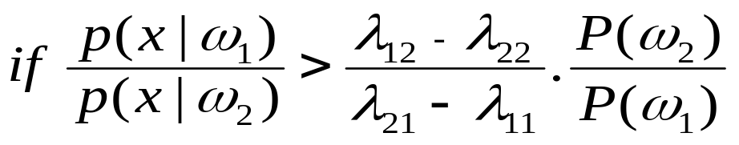
Two Categories
Another way of stating this is as follows.
Decide ω₁ if
Stated as:
Choose ω₁ if the likelihood ration exceeds a threshold value
independent of the observation x.
likelihood ratio
constant

Slide 13
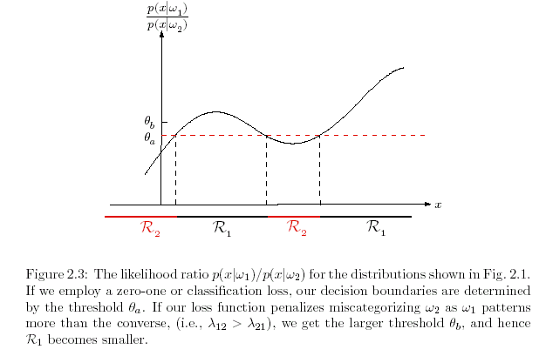
Figure 2.3

Slide 14
Zero-One Loss
We will normally be concerned with the
symmetrical or zero-one loss function:
λ_{ij} = λ(α_{i} | ω_{j}) = 0 if i = j
1 if i ≠ j
In this case the conditional risk is:
R(α_{i}|x) = Σ_{j} λ(α_{i} | ω_{j}) P(ω_{j}|x)
= 1 – P(ω_{i}|x)

Slide 15
Discriminant Functions
How do we represent pattern classifiers?
The most common way is through discriminant functions.
Remember we use {ω₁, ω₂, …, ω_{c}} to be the possible states of nature.
For each class we create a discriminant function g_{i}(x).
The classifier assigns class ω_{i} if
g_{i}(x) > g_{j}(x) for all j ≠ i
Our classifier is a network or machine that computes c discriminant functions.

Slide 16
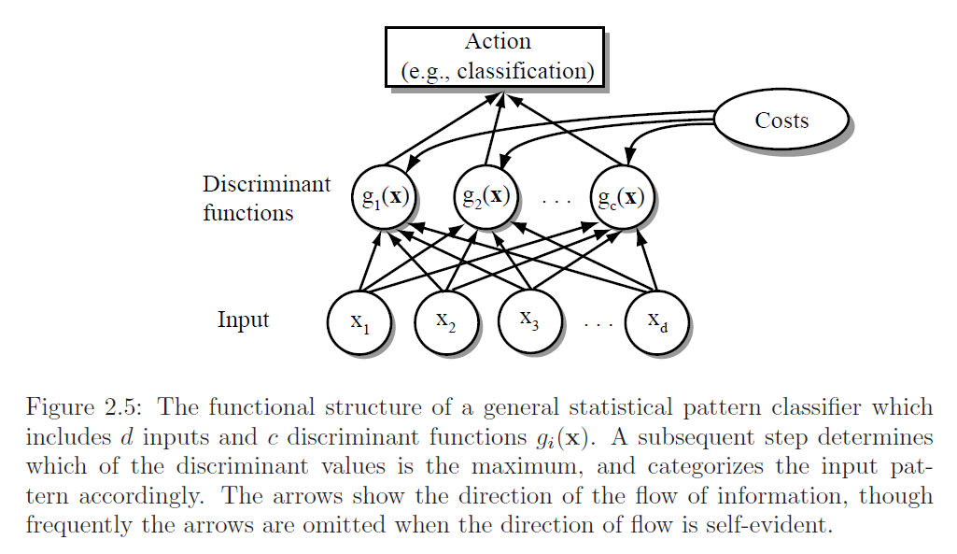
Figure 2.5

Slide 17
Simplifying the Discriminant Functions
Notice the decision is the same if we change every g_{i}(x) for f(g_{i}(x))
Assuming f(.) is a monotonically increasing function.
Alternatives:
  g_{i}(x) = P(ω_{i}|x)
  g_{i}(x) = p(x|ω_{i}) P(ω_{i})
  g_{i}(x) = ln p(x|ω_{i}) + ln P(ω_{i}) ( where ln is the natural logarithm)
The net effect is to divide the feature space into c regions (one for each class).
We then have c decision regions separated by decision boundaries.

Slide 18
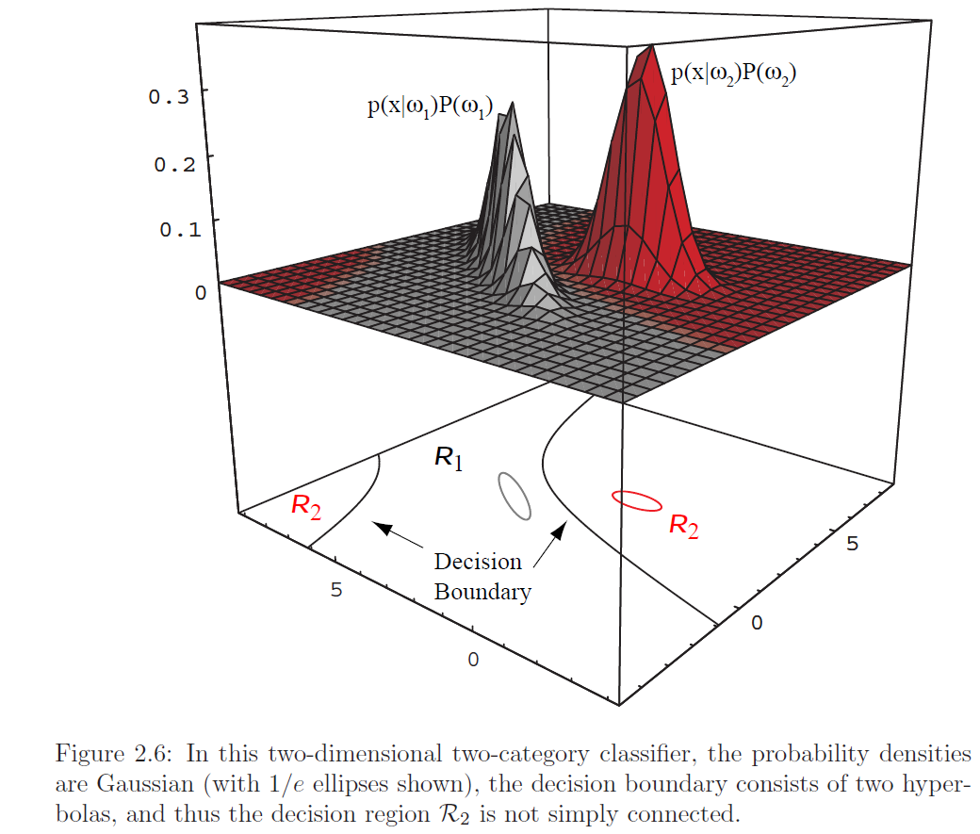
Figure 2.6

Slide 19



Normal Density
Recall that using Bayes rule a discriminant function needs two probabilities:
  g_{i}(x) = p(x|ω_{i}) P(ω_{i})
How do we model the likelihood or class-conditional probability?
The most common approach is to assume a Multivariate normal density.

Slide 20
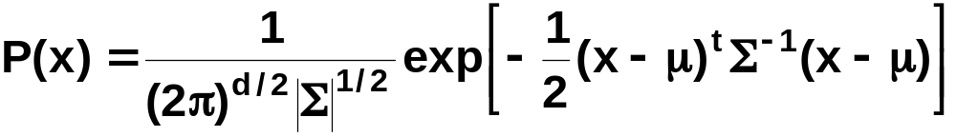
Multivariate normal density
Multivariate density
  Multivariate normal density in d dimensions is:
where:
x = (x₁, x₂, …, x_{d})^{t} (t stands for the transpose vector form)
μ = (μ₁, μ₂, …, μ_{d})^{t} mean vector
Σ = d*d covariance matrix
|Σ| and Σ⁻¹ are determinant and inverse respectively

Slide 21
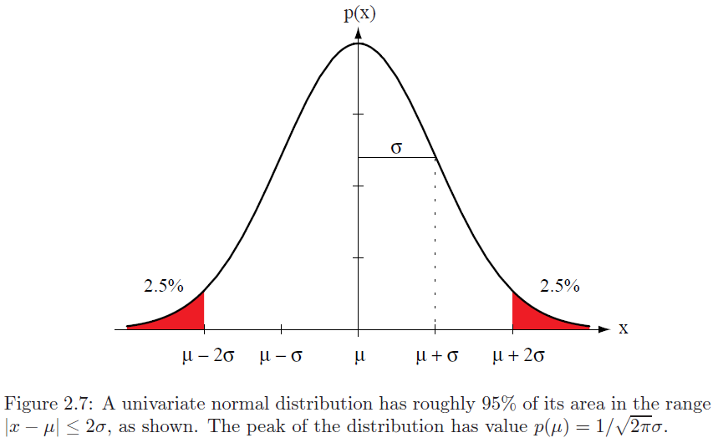
Figure 2.7

Slide 22
Normal Density
If features are statistically independent and the variance is the same
For all features, the discriminant function is simple and is linear in nature.
A classifier that uses linear discriminant functions is called
a linear machine.
The decision surface are pieces of hyperplanes defined
by linear equations.

Slide 23
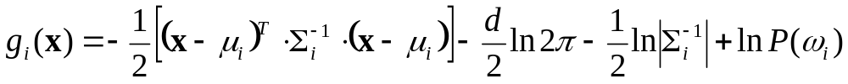
Normal Density
If likelihood probabilities are normally distributed, then a number of simplifications can be made. In particular, the discriminant function can be written as in this greatly simplified form (!)
There are three distinct cases that can occur

Slide 24
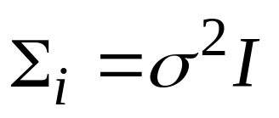
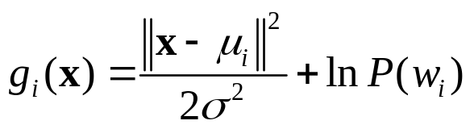
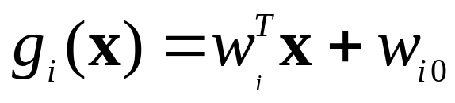
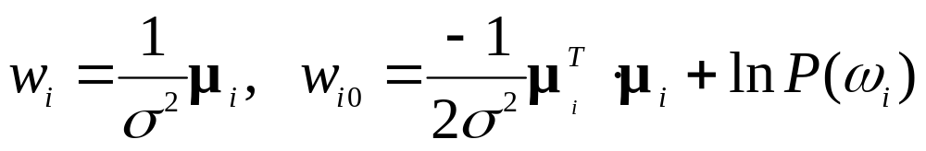
Case 1:
Features are statistically independent, and all features have the same variance: Dist. are spherical in d dimensions, and the boundary is a generalized hyperplane of d-1 dimensions, and featured create equal sized hyperspherical clusters.
This case results in linear discriminants of the form:

Slide 25
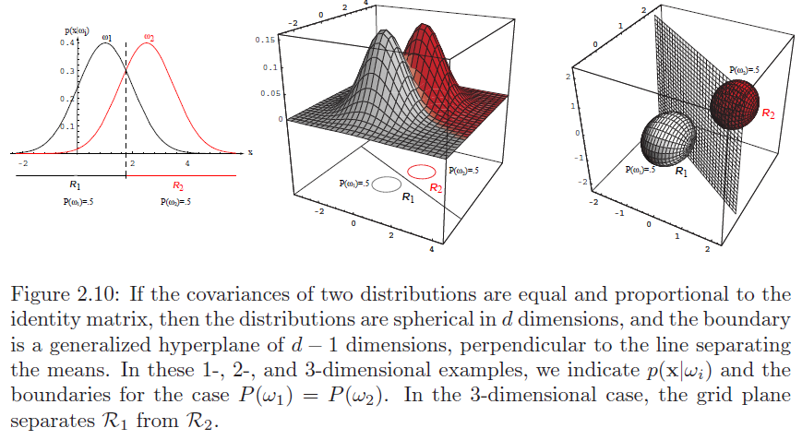


Slide 26
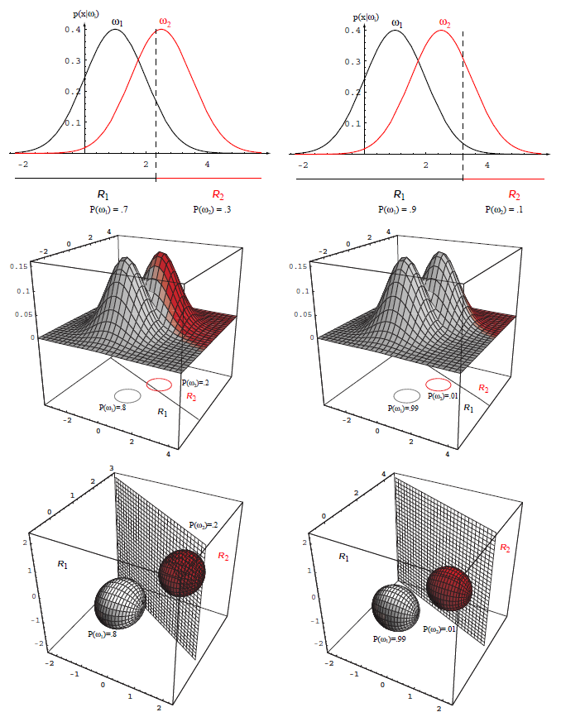

Slide 27
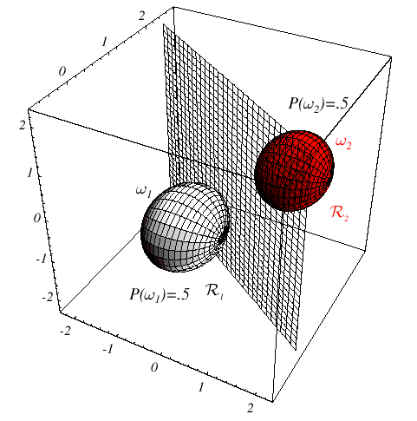
Case 1 (cont.)

Slide 28
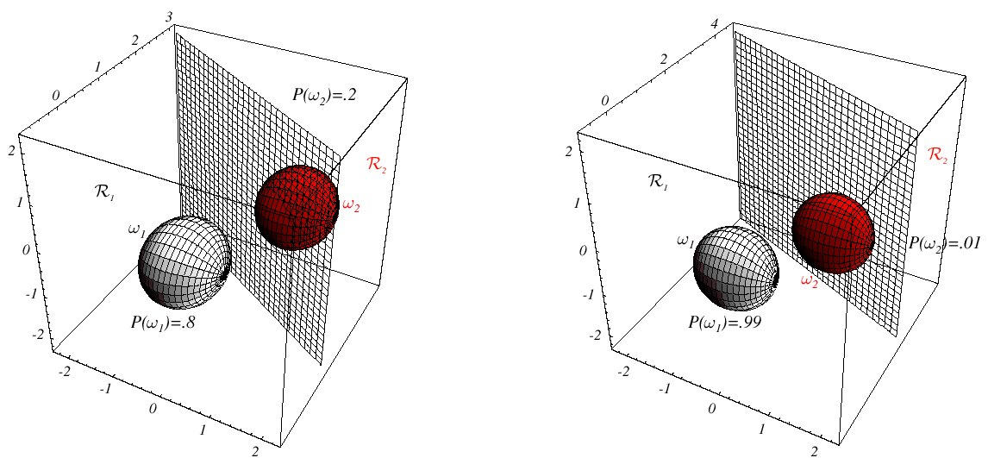
Case 1 (cont.)
3-D case
Note how priors shift the discriminant function away from the more likely mean !!!

Slide 29
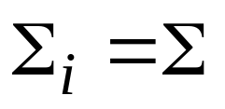
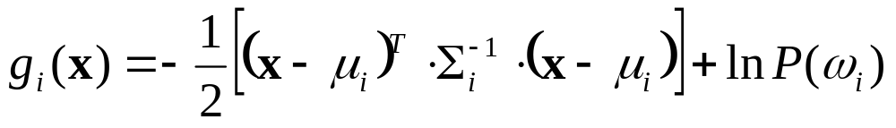
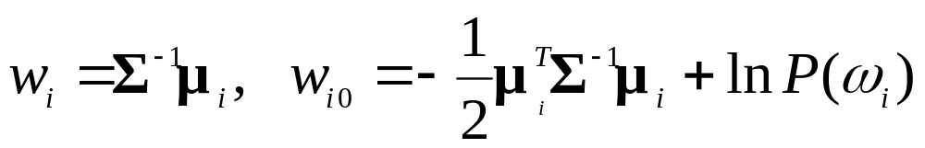
Case 2:

Slide 30
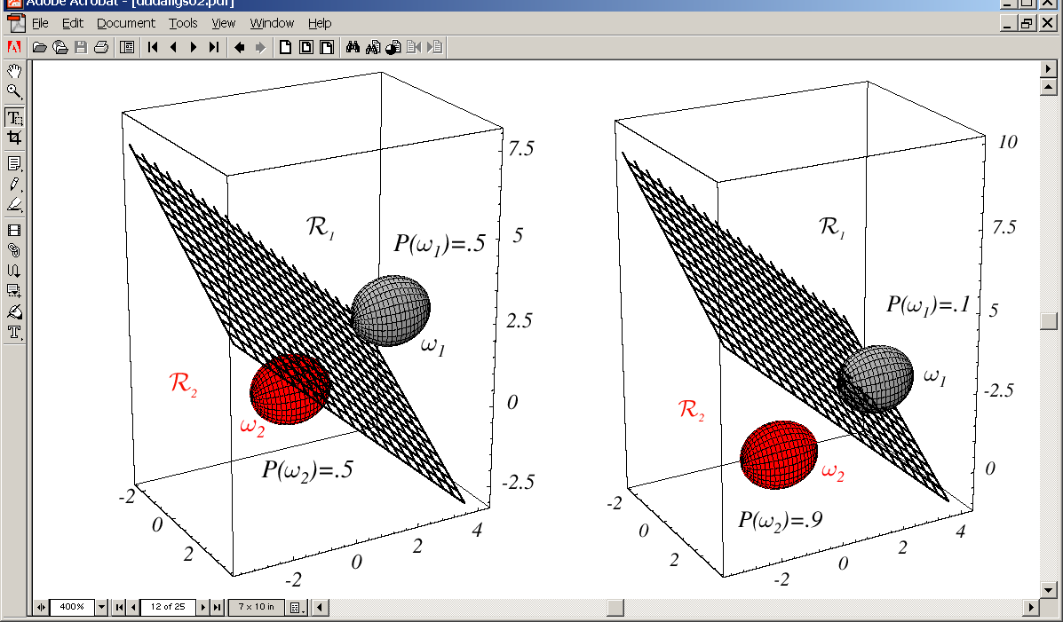
Case 2:

Slide 31
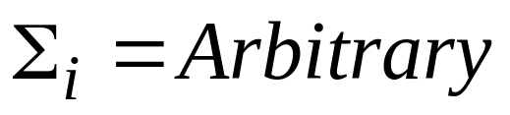
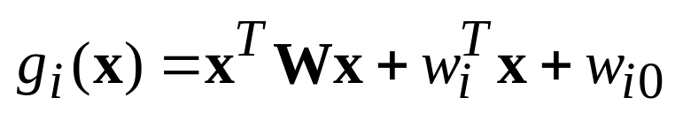
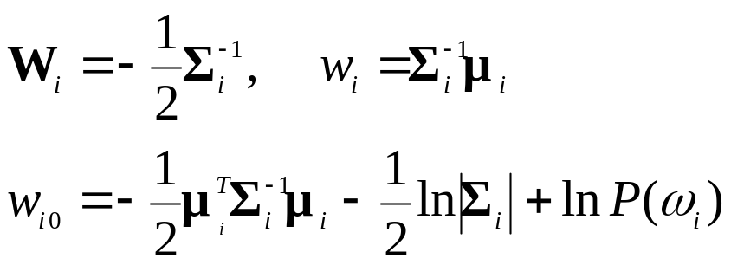
Case 3:
In two class case, the decision boundaries form hyperquadratics.
The discriminant functions are now, in general, quadratic (nor linear)

Slide 32
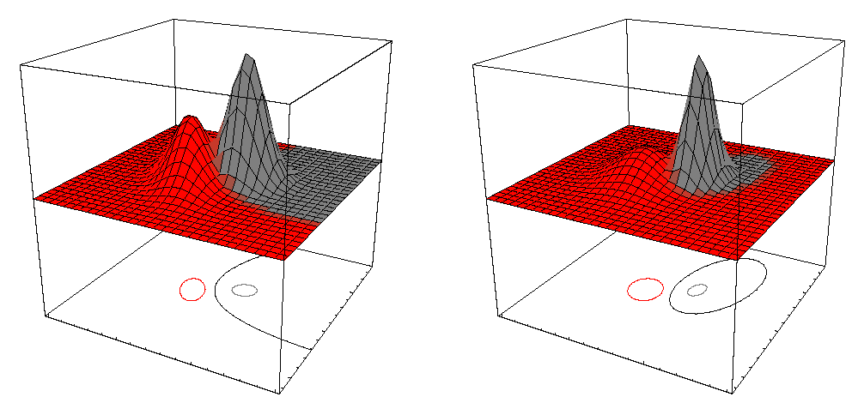
Case 3 (cont.)

Slide 33
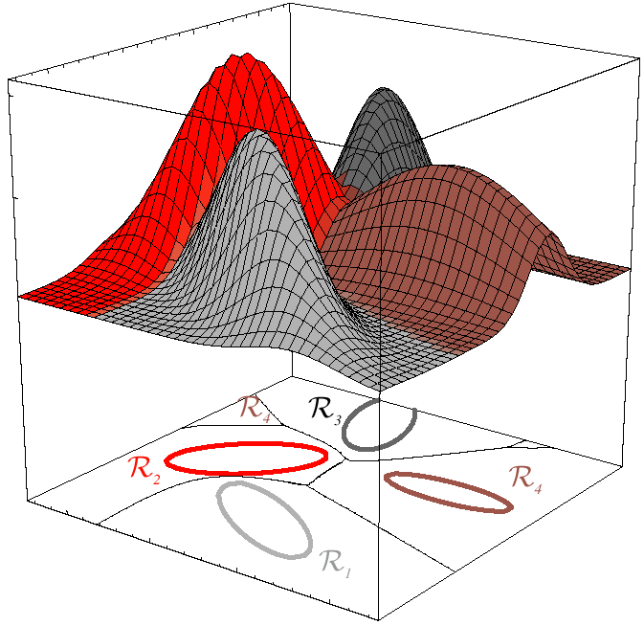
Case 3 (cont.)

Slide 34
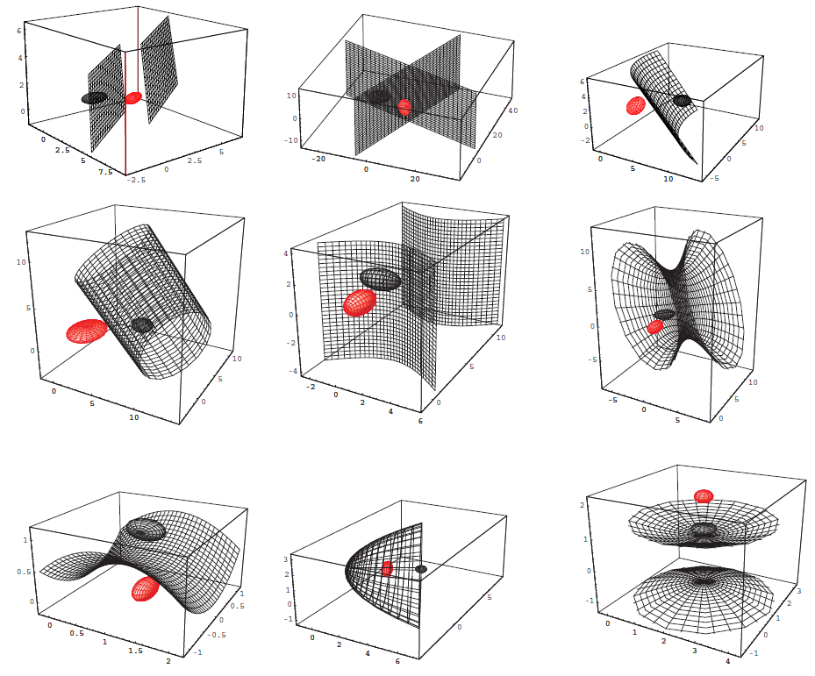
Case 3 (cont.)

Slide 35
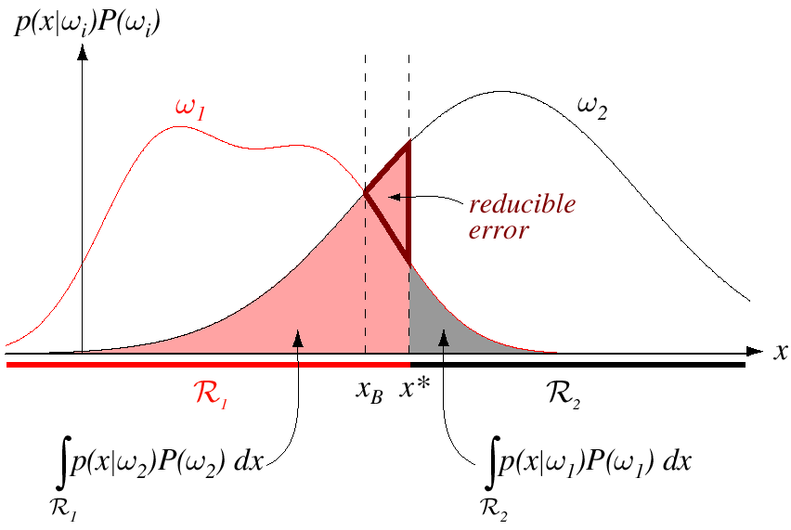
Error Probabilities
x_{B}:Optimal Bayes solution
x*:Non-optimal solution

Slide 36
Error Bounds
It is difficult, at best if possible, to analytically compute the error probabilities, Particularly when the decision regions are not contiguous. However, upper bounds for this error can be obtained:
The Chernoff bound and its approximation Bhattacharya bound are two such bounds that are often used. If the distributions are Gaussian, these expressions are relatively easier to compute➔ Often times even non-Gaussian cases are considered as Gaussian.
Notes:
Contiguous 接触的，邻近的，共同的

Slide 37
Signal Detection Theory
Suppose we want to detect a single pulse from a signal.
We assume the signal has some random noise.
When the signal is present we observe a normal distribution with mean u2.
When the signal is not present we observe a normal distribution with mean u1
We assume same standard deviation.
Can we measure the discriminability of the problem?
Can we do this independent of the threshold x*?
Discriminability:
d′ = | u2 – u1 | / σ

Slide 38
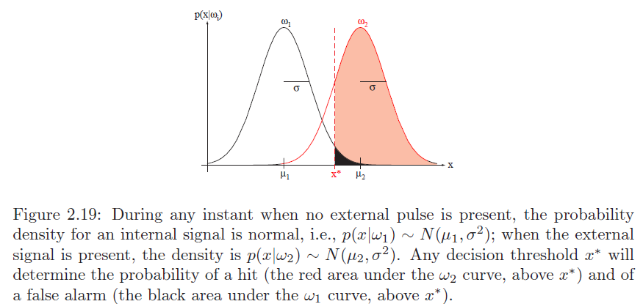
Figure 2.19

Slide 39
Signal Detection Theory
How do we find d’ if we do not know u1, u2, or x*?
From data we can compute:
P( x > x* | ω₂) a hit.
P( x > x* | ω₁) a false alarm.
P( x < x* | ω₂) a miss.
P( x < x* | ω₁) a correct rejection.
If we plot a point in a space representing hit and false alarm rates,
Then we have a ROC (receiver operating characteristic) curve.
With it we can distinguish between discriminability and bias.

Slide 40
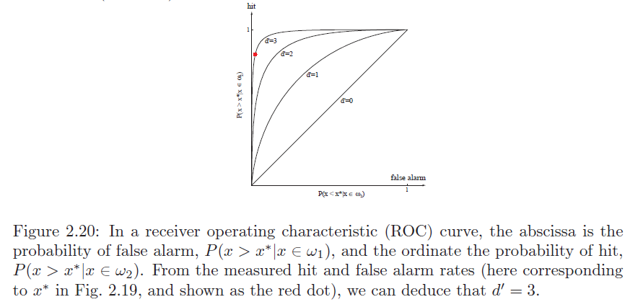
Figure 2.20

Slide 41
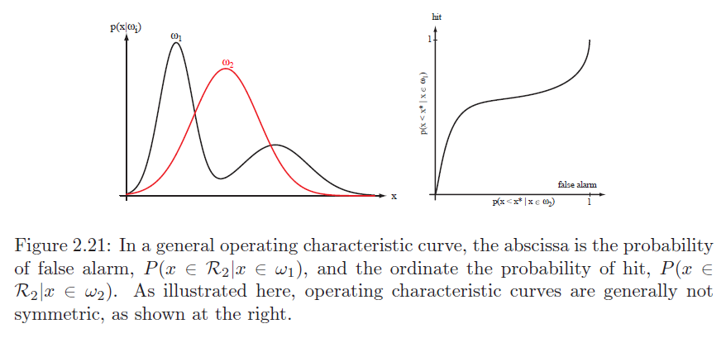
ROC

Slide 42
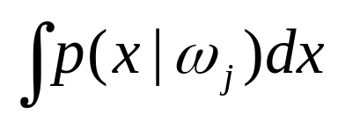
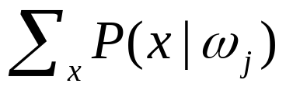
Discrete Features
Now we consider the case when the feature vector x is such
that each component takes on discrete values.
Examples:
Color, Texture, Type, etc.
We no longer have probability densities, but probability masses:
becomes
But all we have said about Bayes rule and conditional risks remains the same.

Slide 43
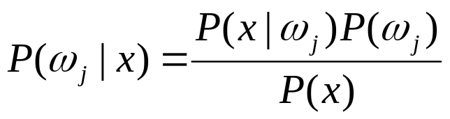
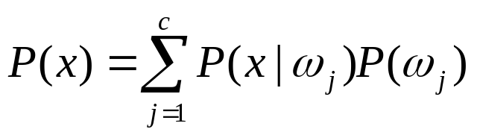
Bayes formula
Bayes formula becomes
where

Slide 44
Independent Binary Features
Consider two classes only: ω₁ and ω₂ .
Consider also that features are binary-valued:
X = ( x₁, x₂, …, x_{d} )^{t} each x_{i} can be either 1 or 0.
Now, for each feature component define two probabilities:
p_{i} = P[ x_{i} = 1 | ω₁ ]
q_{i} = P[ x_{i} = 1 | ω₂ ]
Remember it is usually very complicated to compute the
following probability in Bayes formula:
P(ω_{j} | x) = P(x|ω_{j}) P(ω_{j}) / P(x)

Slide 45
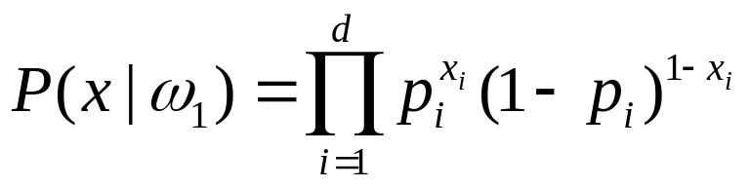
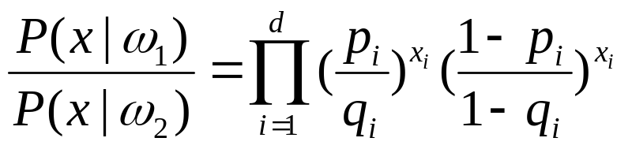
Independent Binary Features
Things, however, are much easier if we assume attributes to
be independent. In that case we can define the following
likelihoods based simply on products of conditional probabilities:
The likelihood ratio is then

Slide 46
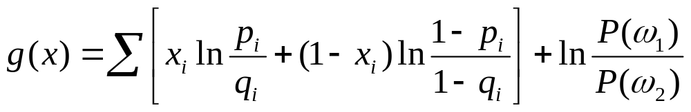
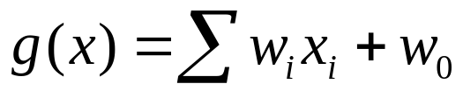
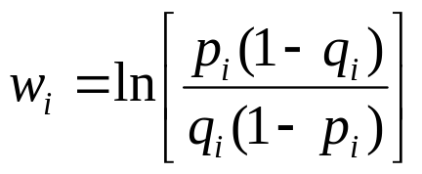
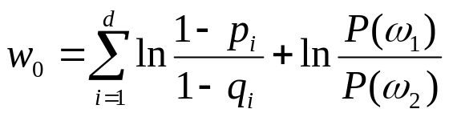
Independent Binary Features
Now remember that using Bayes rule, we select ω₁ if
P(x| ω₁ ) / P(x| ω₂ ) > P(ω₂ ) / P(ω₁ )
or [P(x| ω₁ ) / P(x| ω₂ )] - [P(ω₂ ) / P(ω₁ )] > 0
Then our discriminant function is:
This can be expressed as
(linear combination of features)
and

Slide 47
Points to Remember
Bayes formula and Bayes decision theory
Loss functions (e.g., zero-one loss)
Discriminant functions
ROC curves
Discriminant functions for independent binary-valued features
Notes:
What is machine learning?

