Slide 1
Maximum Likelihood and
Bayesian Parameter Estimation
Maximum-Likelihood Estimation
Bayesian Estimation
Problems of Dimensionality
Principal Component Analysis
Fisher Linear Discriminant
Expectation Maximization
Hidden Markov Models

Slide 2
Maximum Likelihood and
Bayesian Parameter Estimation
Recall that we can obtain an optimal classifier if we know two probabilities:
The a priori probability of each class P(ω_{j})
The likelihood p(x| ω_{j})
The first is easy to obtain, the second is not.
Assume p(x| ω_{j}) is normal with mean μ_{i} and covariance Σ_{i}.
Then all we need to do is to estimate those parameters.
Two methods:
  Maximum-Likelihood estimation
  Bayesian Methods

Slide 3
Maximum Likelihood and
Bayesian Parameter Estimation
    Parameters in ML estimation are fixed but unknown!
    Best parameters are obtained by maximizing the probability of obtaining the samples observed
    Bayesian methods view the parameters as random variables having some known distribution
    In either approach, we use P(ω_{i} | x)
    for our classification rule!

Slide 4
Maximum Likelihood
General principle:
Suppose we have a dataset D with several classes ω₁, ω₂, …, ω_{c}.
We could separate D into mutually exclusive sets where each set has
examples of the same class:
D₁, D₂, …, D_{c}.
For each dataset D_{i} we estimate p(x| ω_{j}).
We do this by estimating parameters θ_{i} = {μ_{i}, Σ_{i} }.
How do we do this?

Slide 5
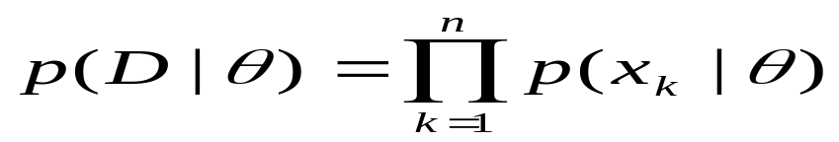

Maximum Likelihood
Let D_{i} = D (just remember D has example of same class)
Then D = { x₁, x₂, …, x_{n} }
Because the examples are drawn independently:
This is called the likelihood of θ with respect to the dataset D.
For different possible parameter values θ, we want to find the
Vector that maximizes p(D | θ).

Slide 6
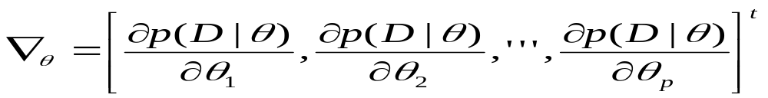
Maximum Likelihood
Let θ = (θ₁, θ₂, …, θ_{p})^{t} and let ∇_{θ} be the gradient operator
If p(D | θ ) is well behaved and differentiable, then we can
compute the gradient of θ :
Our goal is to find a maximum in this function and output that .

Slide 7
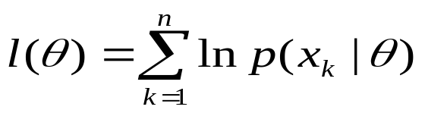
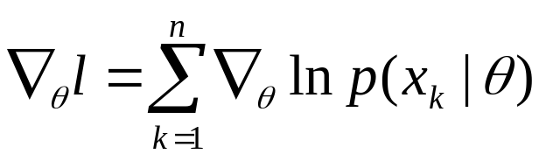
Log-Likelihood
In practice it is easier to deal with logarithms:
The definition of the log-likelihood function is
l(θ ) = ln p(D | θ)
And so
The derivative is defined as:
And we try to find a maximum in this function.

Slide 8
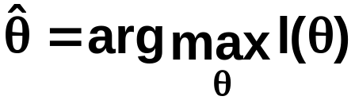
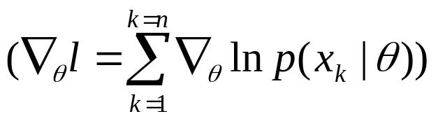
Log-Likelihood
determine θ that maximizes the log-likelihood
Set of necessary conditions for an optimum is:
∇_{θ}l = 0

Slide 9
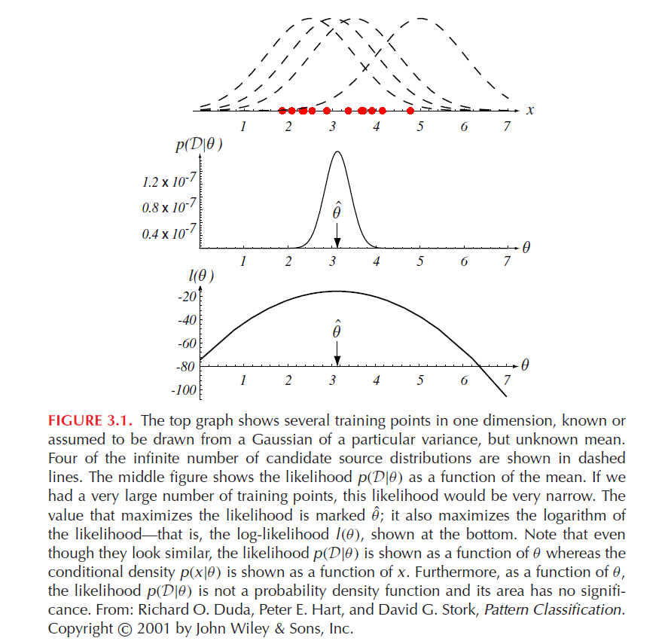
Figure 3.1

Slide 10
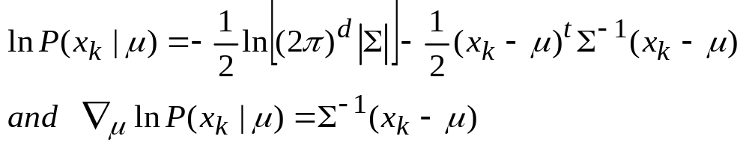
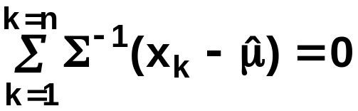
Example of a specific case: unknown μ
Example of a specific case: unknown μ
  p(x_{i} | μ) ~ N(μ, Σ)
  (Samples are drawn from a multivariate normal population)
  θ = μ therefore:
    The ML estimate for μ must satisfy:

Slide 11
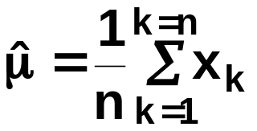
Example of a specific case: unknown μ
    Multiplying by Σ and rearranging, we obtain:
    (Just the arithmetic average of the samples of the training samples!)
    Conclusion:
    “If p(x_{k} | ω_{j}) (j = 1, 2, …, c) is supposed to be Gaussian in a d
    dimensional feature space; then we can estimate the vector
    θ = (θ₁, θ₂, …, θ_{c})^{t} and perform an optimal classification !”

Slide 12
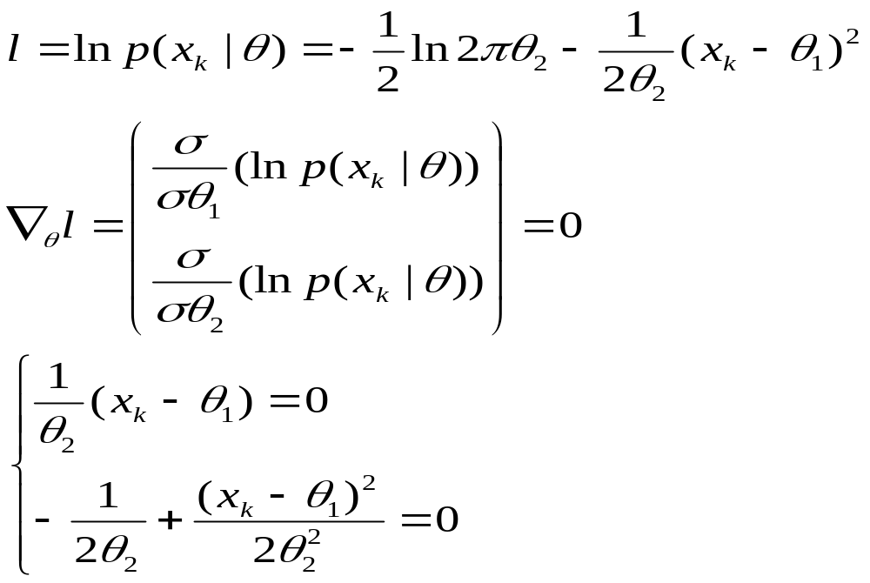
Gaussian Case: unknown μ and σ
θ = (θ₁, θ₂)^{t} = (μ, σ²)^{t}

Slide 13
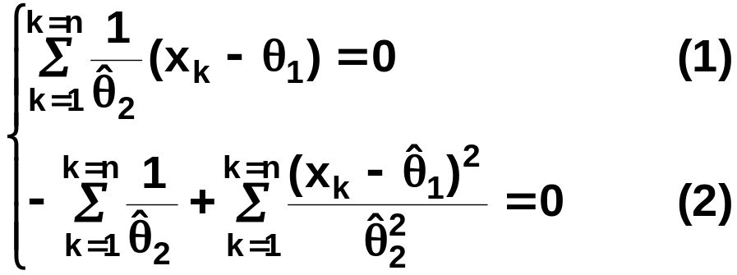
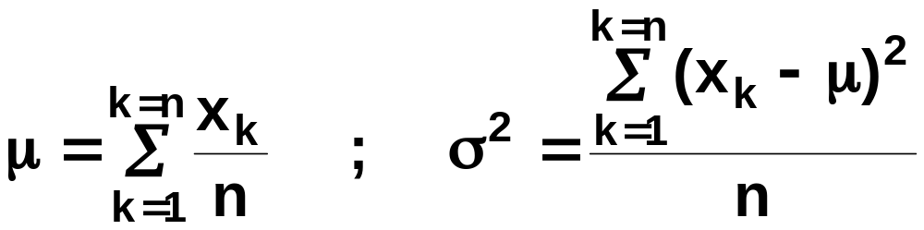
Gaussian Case: unknown μ and σ
Summation:
Combining (1) and (2), one obtains:

Slide 14
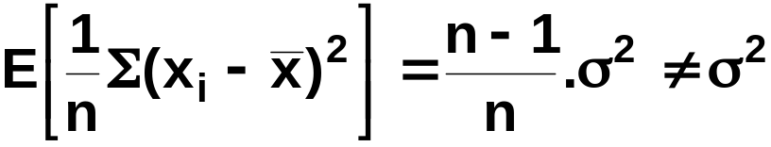
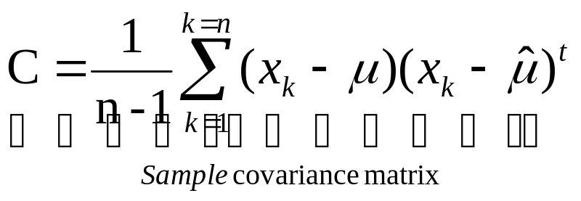
Bias
  ML estimate for σ² is biased
  An elementary unbiased estimator for Σ is:

Slide 15
Bayesian Estimation
In Bayesian estimation we don’t assume the parameter vector θ to
be fixed but unknown, as we did with maximum-likelihood estimators.
Here we assume θ to be a random variable and the data will convert it
into a posterior probability density p(θ | D).
Maximum Likelihood Bayesian Estimation
Max p(D | θ )
p(X|D) where p(θ | D) peaks.
Computationally simpler Computationally expensive
Easier to interpret Harder to interpret
Assumption of distribution Assumption of distribution
must be right may be erroneous

Slide 16
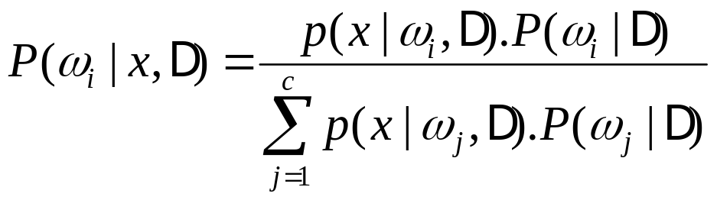
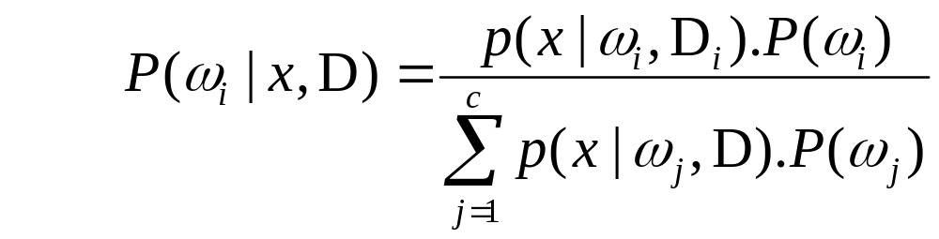
Bayesian Estimation: Class-Conditional Densities
Given the sample D, Bayes formula can be written:
Since the supervised case

Slide 17
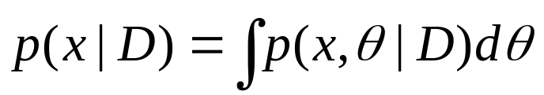
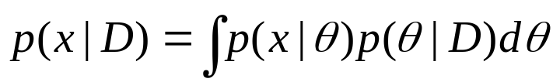
Bayesian Estimation
Since we depend on the data to obtain our estimates , we
are concerned to estimate:
p(x | ω_{i}, D_{i} )
Assuming the class fixed we need to compute:
or equivalently:
This key equation links p(x|D) to the posterior density p(θ|D)

Slide 18
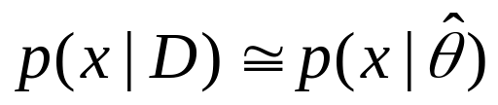
Bayesian Estimation
If p(θ|D) peaks very sharply about some value
We obtain:
i.e. the result we would obtain by substituting the estimate for the true parameter vector
In general, if we are less certain about the exact value of θ, this equation directs us to average p(x| θ ) over the possible values of θ.

Slide 19
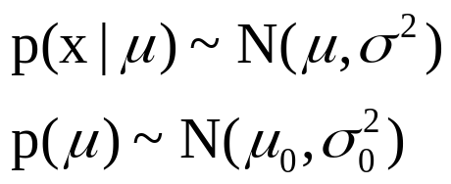
Bayesian Parameter Estimation:
Gaussian Case
  The univariate case: p(μ | D)
  μ is the only unknown parameter
  (μ₀ and σ₀ are known!)
  Given the sample D, Bayes formula can be written:

Slide 20
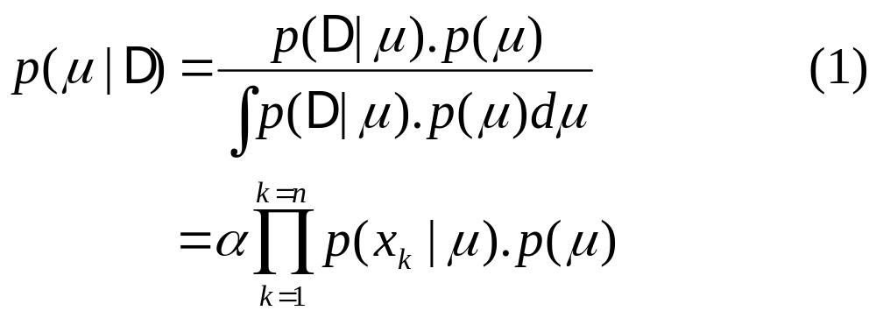
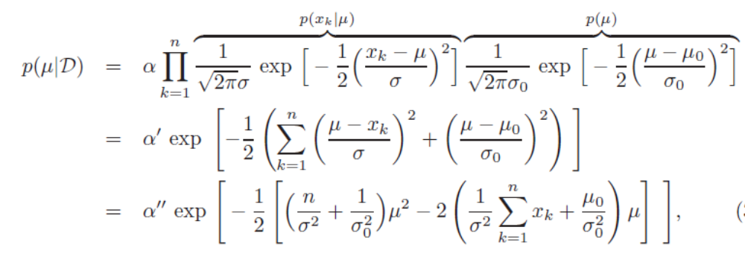
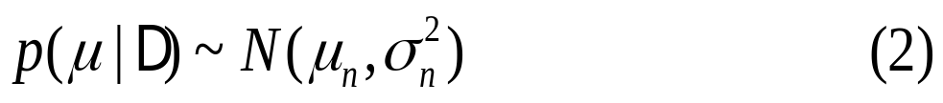
  Reproducing density (conjugate prior p(u))

Slide 21
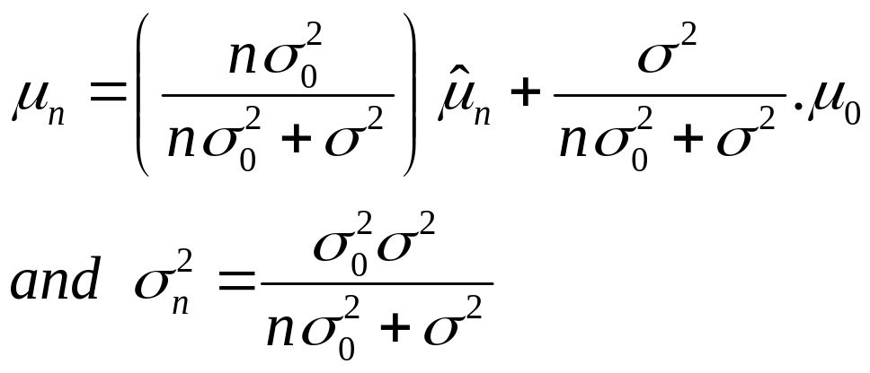
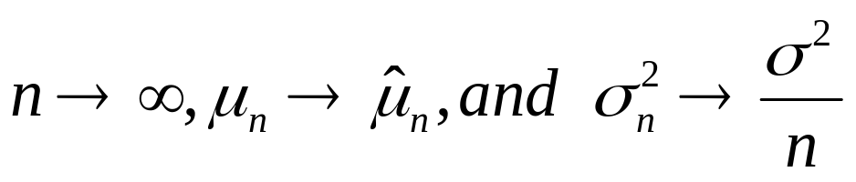
  Identifying (1) and (2) yields:

Slide 22
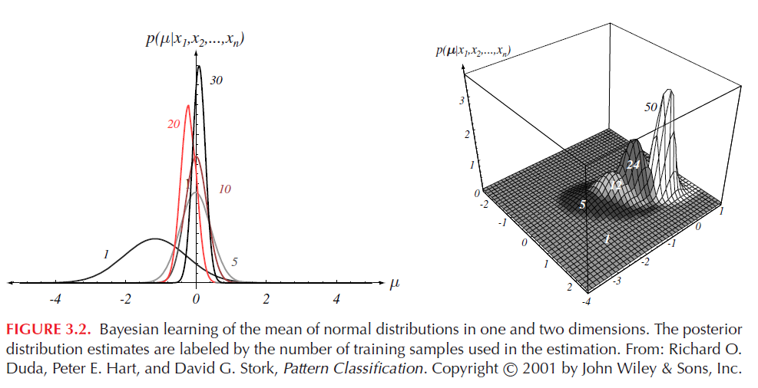

Slide 23
Bayesian Parameter Estimation: General Theory
  The Bayesian approach has been applied to compute p(x | D). It can be applied to any situation in which the unknown density can be parameterized:
  The basic assumptions are:
    The form of p(x | θ) is assumed known, but the value of θ is not known exactly
    Our knowledge about θ is assumed to be contained in a known prior density p(θ)
    The rest of our knowledge about θ is contained in a set D of n random variables x₁, x₂, …, x_{n} that follows p(x)

Slide 24
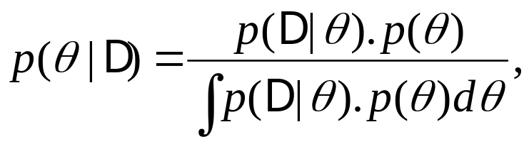
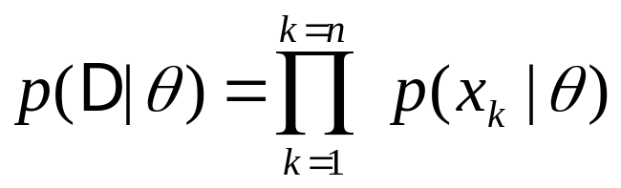
Bayesian Parameter Estimation: General Theory
The basic problem is:
“Compute the posterior density p(θ | D)”
then “Derive p(x | D)”
Using Bayes formula, we have:
And by independence assumption:

Slide 25
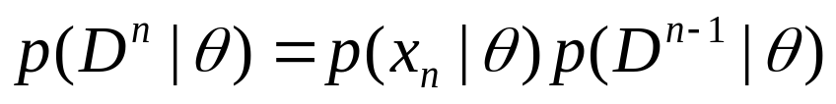
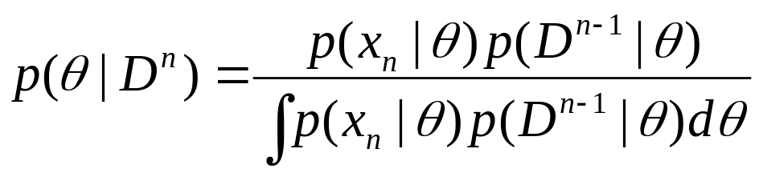

Recursive Bayes approach
Writing D^{n}={x₁,…,x_{n}}, we obtain:
The posterior density satisfies the recursion relation:
Incremental learning or online learning

Slide 26
Problems of Dimensionality
Accuracy, Dimension, and Training Sample Size
If the features are independent, then each of them contributes
to separating the classes away.
It makes sense to add features to increase the ability to separate
examples of different class, although that increases the computationally
complexity of the problem.
At some point it is of no use to add features, because they
do not contribute to the separation of classes.

Slide 27
Generalization and Overtraining
Generalization refers to how well a classifier performs on unseen data (i.e. data not in the training set)
Overtraining or overfitting occurs when a classifier has been fit too closely to the training set, leading to poor generalization.

Slide 28
Problems of Dimensionality
Overfitting.
if sample is too small with respect to feature dimension ,overfitting happens
to avoid data overfitting.
  we might need to do feature selection.
  We need to reduce the dimensionality of the space

Slide 29
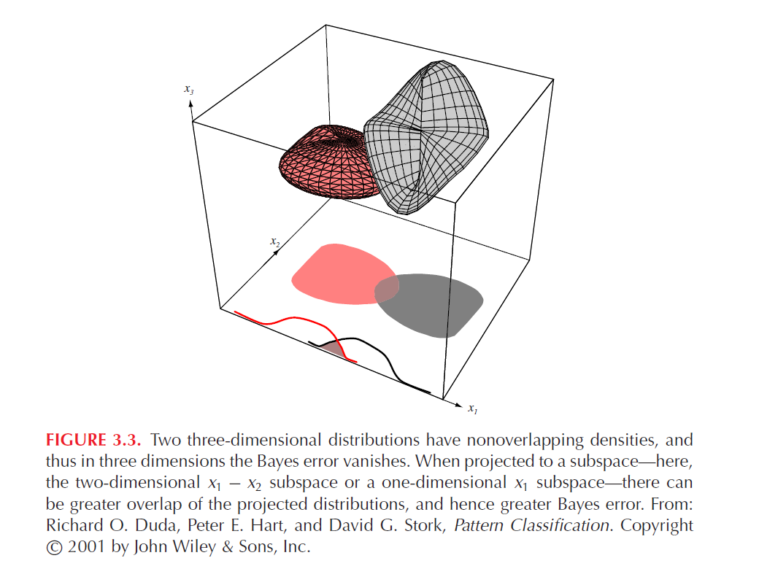
Figure 3.3

Slide 30
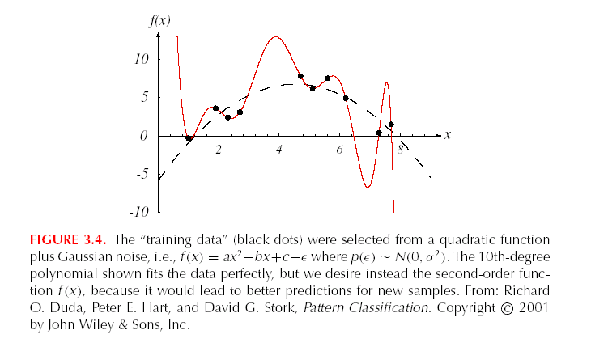
Sample set is small and classiﬂer is too complex

Slide 31
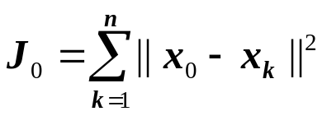
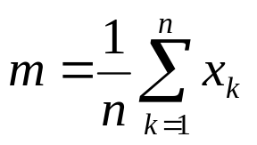
Principal Component Analysis
We wish to reduce the dimensionality of the feature space
through linear combinations of features.
Assume we have a dataset with n examples or vectors:
{ x₁, x₂, …, x_{n} }
We want to represent them all with single vector x₀. x₀ should be selected so that the distance between the vectors and x₀ is as small as possible.
Minimize:
Solution:
mean x₀=m

Slide 32
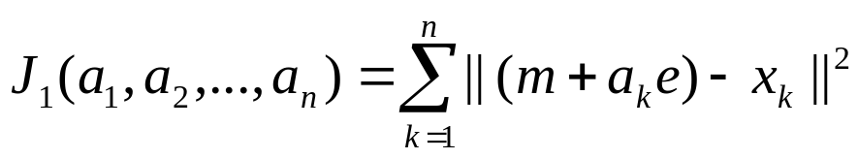
Principal Component Analysis
This is a zero-dimensional representation of the data.
It is simple but not very interesting.
How about a linear representation of the data?
We can obtain a 1-d representation by projecting data onto a line.
x = m + ae
where e is a unit vector in the direction of the line
And a is a scalar corresponding to the distance from m to point x.
Now we want to minimize:

Slide 33
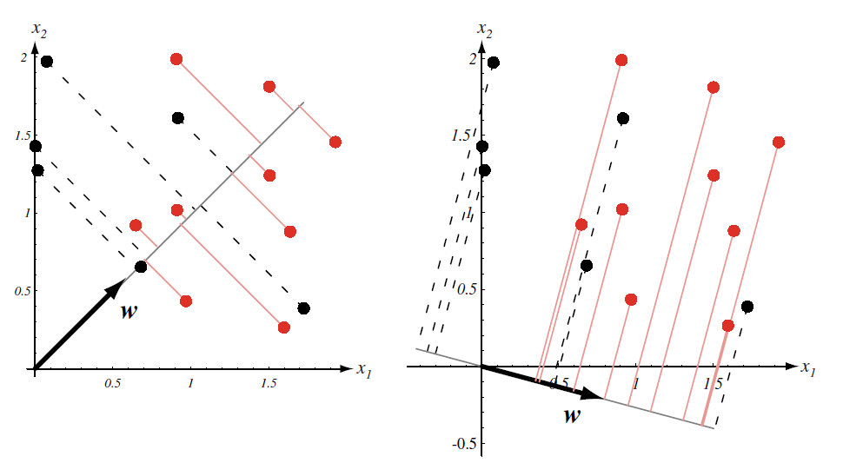

Slide 34
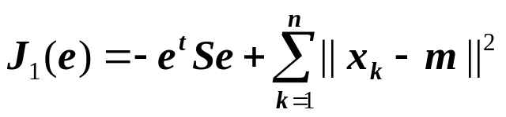
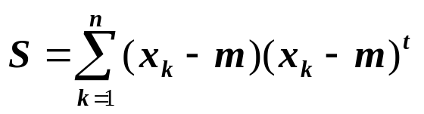
Principal Component Analysis
Partially differentiating for a_{k} we get the following:
a_{k} = e^{t} ( x_{k} – m)
If we move that back to our formula for J₁(a₁,a₂,…,a_{n},e)
We get:
Where S is called the scatter matrix:
The solution for the best e is to maximize e^{t}Se.

Slide 35

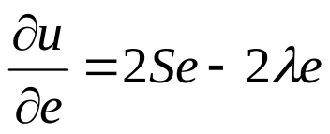
Principal Component Analysis
Use the method of Lagrange multipliers
Letting λ be the undetermined multiplier, we differentiate
with respect to e to obtain
Set it to 0, we obtain Se= λe ( e must be an eigenvector of the scatter matrix)

Slide 36
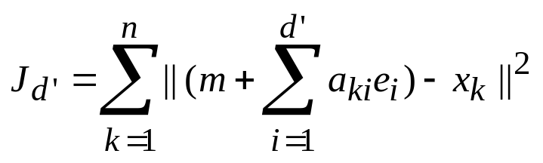
Principal Component Analysis
The best projection is to project data on to a line through the sample mean in the direction of the eigenvector of the scatter matrix having the largest eigenvalue.
This result can be extented from 1-dimensional projection to d’-dimensional projection, d’<=d

Slide 37
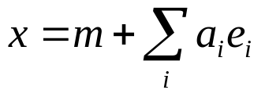
Principal Component Analysis
Obtained by doing a higher dimensional projection
Notes:
e1 e2

