Slide 1
Maximum Likelihood and
Bayesian Parameter Estimation
Maximum-Likelihood Estimation
Bayesian Estimation
Problems of Dimensionality
Principal Component Analysis
Fisher Linear Discriminant
Expectation Maximization
Hidden Markov Models

Slide 2
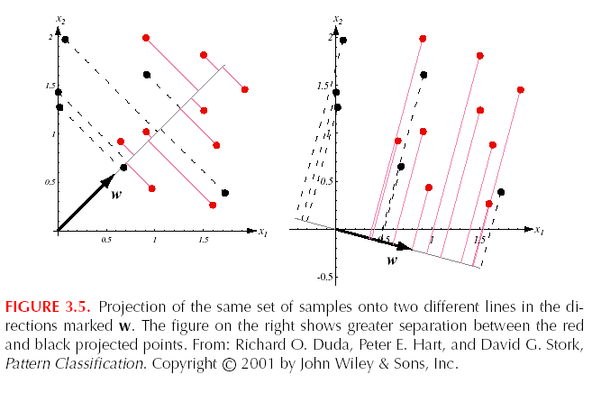
Fisher Linear Discriminant
PCA is best in the least-sum-of-squared-error sense, not in discrimination

Slide 3
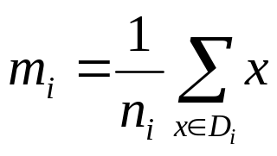
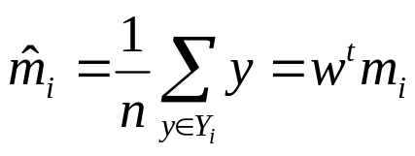
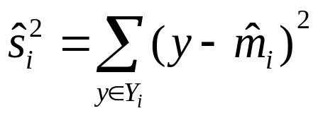
Fisher Linear Discriminant
How to find best w for discrimination?
n samples x_{i},n₁ in the D₁ and n₂ in the D₂
y=w^{t}x is the projection of x onto w ,n samples in Y₁ and Y₂
scatter

Slide 4
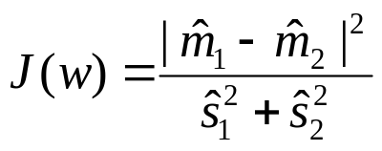
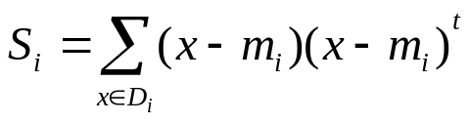
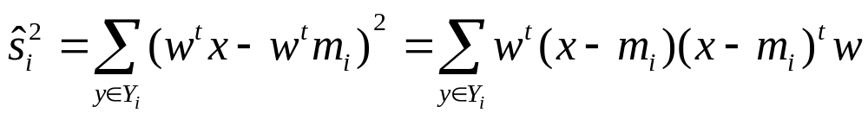
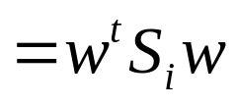
Fisher Linear Discriminant
Fisher Linear Discriminant employs linear function w^{t}x for which the criterion function
is maximum
Define scatter matrices S_{i} and S_{w}
S_{w}= S₁ + S₂
then

Slide 5
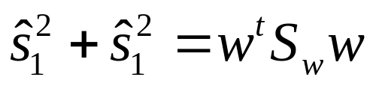
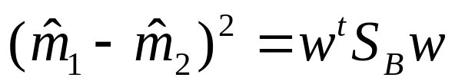

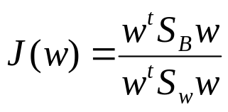

Fisher Linear Discriminant
Where
so
Raileigh quotient
A vector w that maximizes J(.) must satisfy
S_{B}w=λS_{w}w

Slide 6
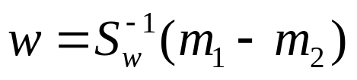
Fisher Linear Discriminant
S_{B}w and m₁-m₂ have same direction
so
Fisher Linear Discriminant =Linear Discriminant Analysis, LDA

Slide 7
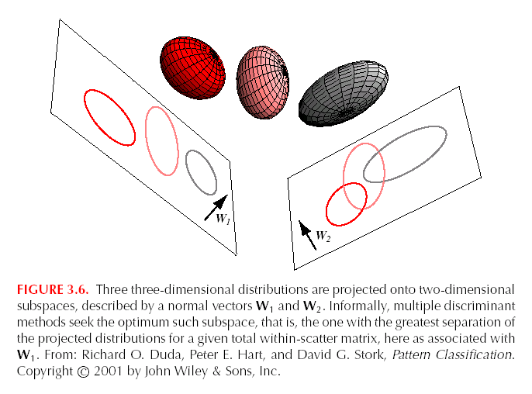
Fisher Linear Discriminant

Slide 8
Expectation Maximization
Recall that the maximum-likelihood principle helps us estimate
the parameters of an underlying distribution.
Question:
What are we to do if some of the examples have missing features?
Expectation maximization can help us estimate the likelihood
given only the data available.
Example: medical database with symptoms from patients missing
(e.g., temperature, blood pressure, etc.).

Slide 9
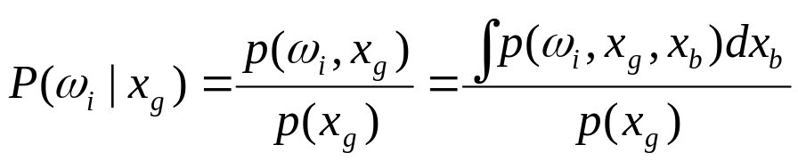
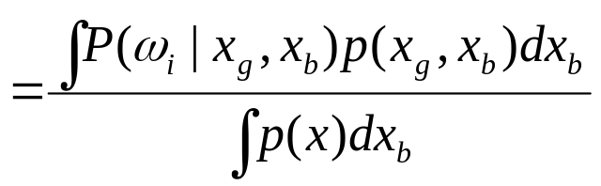
Good and Bad Features
Suppose we have a dataset D = {x₁, x₂, …, x_{n}} of examples.
Now, each example may have some features missing.
A point or example x can be written as
x = {x_{g}, x_{b} } meaning it has good features x_{g} and missing or bad features x_{b}.
In terms of good features the posteriors are:

Slide 10
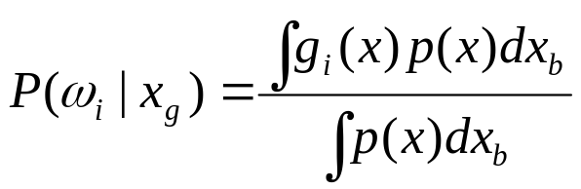
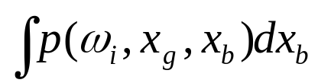
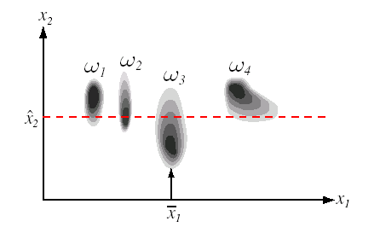
Good and Bad Features
Where g_{i}(x)=g_{i}(x_{g},x_{b})=P(ω_{i}|x_{g},x_{b}) is one form of our discriminant function
a marginal distribution
We must integrate the posterior probabilities over the bad features.
x₁ missing

Slide 11

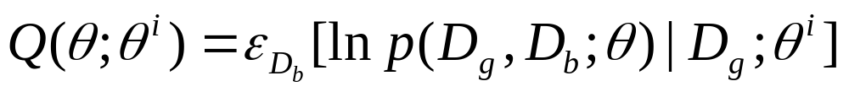
Good and Bad Features
For a fixed example x let D_{g} be the good features set and D_{b} be the bad features set with
We form the following function:
This is a function of parameter vector θ assuming vector θ^{i} to be fixed.
The formula means the following:
We assume certain parameter vector θ^{i} fixed.
We have a candidate parameter vector θ.

Slide 12
Interpreting the Formula
We calculate the likelihood of the data (including the bad features)
with respect to θ. The bad features are estimated using θ^{i} .
Select the candidate θ the maximizes that likelihood.
Call that best candidate θ^{i+1}.
We continue iterating using θ^{i+1} as the fixed parameter vector until
we reach a convergence criterion.

Slide 13
Algorithm
begin
Initialize θ^{i} , i = 1;
  Do
  E step: compute Q(θ ; θ^{i} )
  M step: θ^{i+1} = arg max Q(θ ; θ^{i} )
  i = i + 1;
  Until Q(θ^{i+1} ; θ^{i} ) - Q(θ^{i} ; θ^{i-1} ) <= T
Return θ^{i+1}
End
The algorithm is guaranteed that the log-likelihood of the data will
increase monotonically.

Slide 14
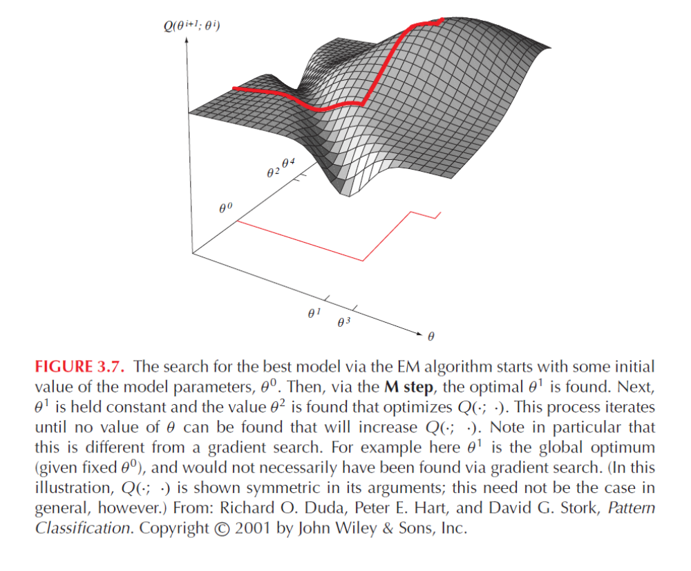
Figure 3.7

Slide 15
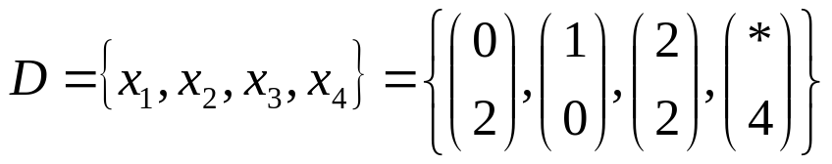
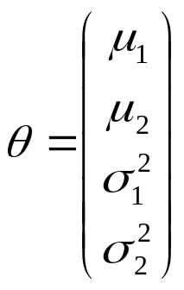
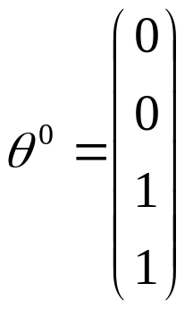

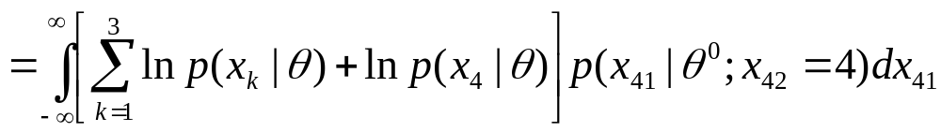
EM example
D_{b} contains of the single feature x₄₁
Assume model is Gaussian with diagonal covariance and arbitrary mean

Slide 16
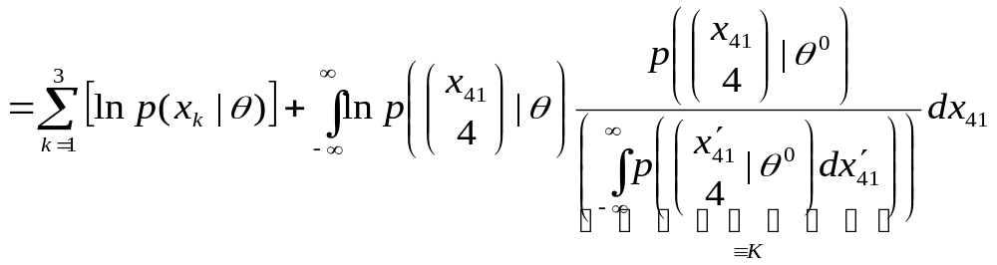
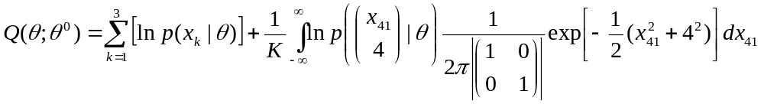
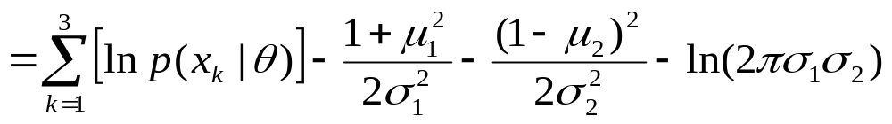
EM example
For a Gaussian distribution

Slide 17
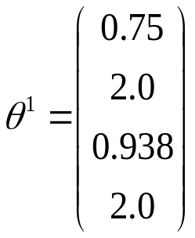
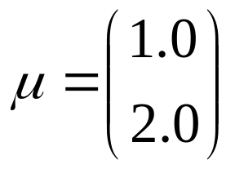
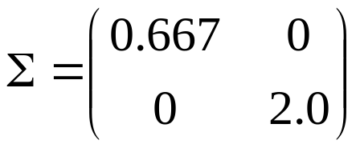
EM example
This completes the expectation or E step.
Maximize Q(), get the next estimate
After three iterations the algorithm converges at the solution

Slide 18
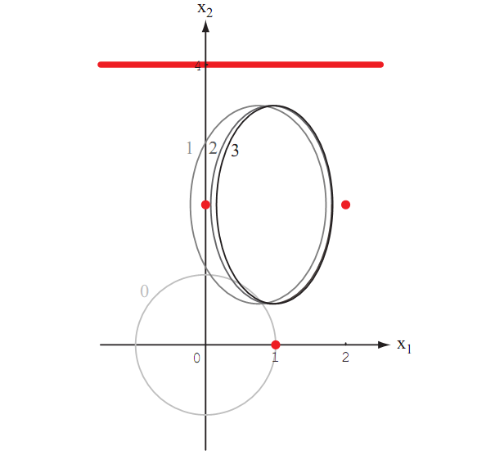

Slide 19
Generalized Expectation Maximization GEM
An improved θ^{i+1} be set in E step of the algorithm
—not necessarily optimal

Slide 20
Hidden Markov Models
We now contemplate the problem of making a series of decisions
on data that has a temporal component.
First-Order Markov Models.
We have a sequence of states; the state at time t is denoted as ω(t).
A sequence of length T is denoted as S = {ω(1), ω(2), …, ω(T) }
In first order models we assume that the state at time t+1 is only influenced by
the state at time t.
Examples:
A robot moving in a certain environment (e.g., playing soccer)
Production of spoken words (e.g., word cat has the sequence of
phonemes /k/ /a/ /t/

Slide 21
Transition Probability
For example, assume a robot has four different states:
ω₁: walking, ω₂: standing still, ω₃: running, ω₄: hitting the ball.
We capture a sequence of states using fixed intervals of time:
S = {ω₁, ω₄, ω₂, ω₂, ω₁, ω₂ }
Notice some states can be revisited and some states need not be visited.
We model the behavior of the system through transition probabilities:
P(ω_{j}(t+1)| ω_{i}(t) ) = a_{ij}
This is the probability of moving to state ω_{j} at time t+1 given that
the state at time t is ω_{i}.

Slide 22
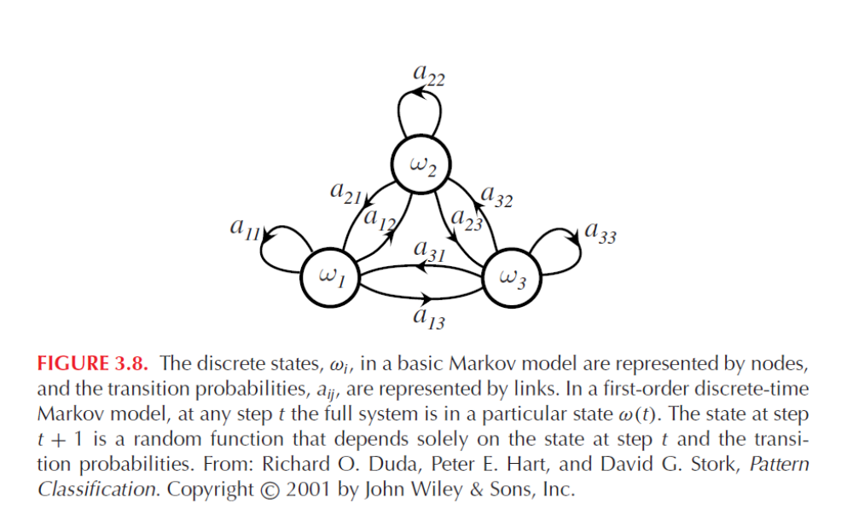
Figure 3.8

Slide 23
Probability of a sequence
Suppose we know the nodes, links, and transitional probabilities.
We encode that as model θ.
How do we know the probability of a sequence S?
We simply use the model and compute the product of the
successive probabilities:
P(S | θ ) = a₁₄ a₄₂ a₂₂ a₂₁ a₁₄
Where S = (ω₁, ω₄, ω₂, ω₂, ω₁, ω₄ )

Slide 24
First Order Hidden Markov Models
In some problems we do not know what the state is at time t.
The state at time t is ω(t), but all we know is a visible symbol v(t).
For example, in speech recognition we do not know what state
we are in. All we have is some sound (a visible state).
visible states are measurements of the true states.
Now we have a sequence,
V^{T}= { v(1), v(2), …, v(T) }
We have probabilities of seeing a visible state given a state:
P( v_{k}(t) | ω_{j}(t) ) = b_{jk}

Slide 25
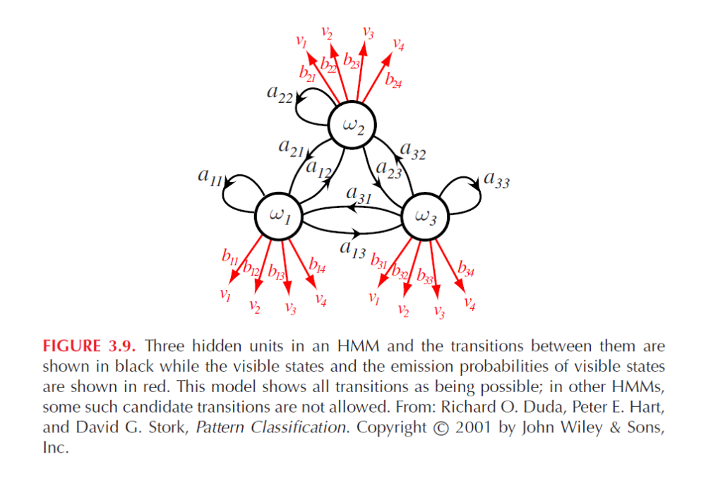
Figure 3.9

Slide 26
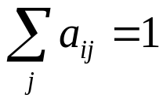
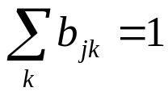
Definitions
Hidden markov models are also called Markov Networks.
They are called:
Casual: probabilities depend on previous states.
Ergodic: if every state has a nonzero probability of occurring.
In summary:
P(ω_{j}(t+1)| ω_{i}(t) ) = a_{ij} (state transition probability)
P( v_{k}(t) | ω_{j}(t) ) = b_{jk} (visible state probability)
Where and

Slide 27
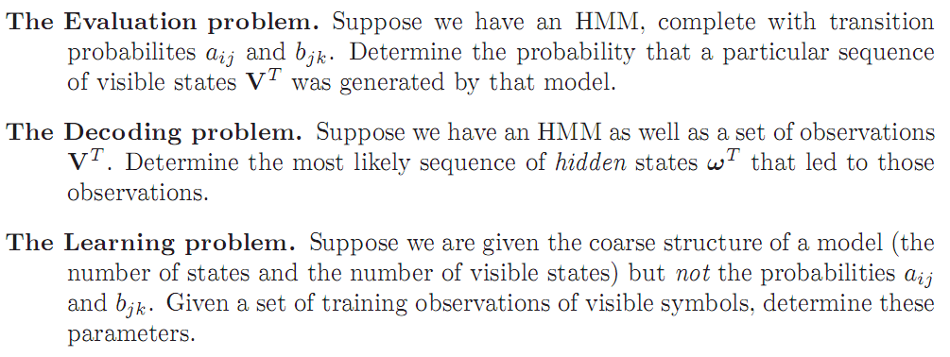
Three central issues

Slide 28
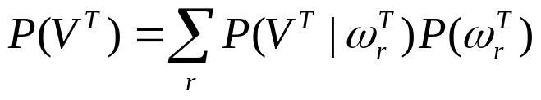

The Evaluation Problem
Suppose you have a HMM with all probabilities.
What is the probability of seeing a sequence of visible states?
Given a sequence of visible states V^{T} = { v₁, v₂, .., v_{T} } of length T,
such probability is
Where the sum is over all sequences of hidden states of size T.
If there are c hidden states, then the sum is done over c^{T} sequences.
r_{max}=c^{T}

Slide 29
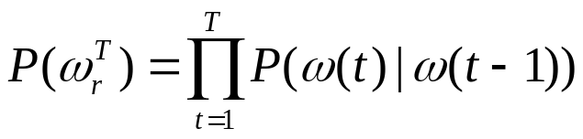
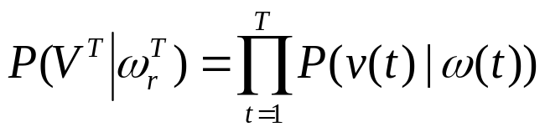
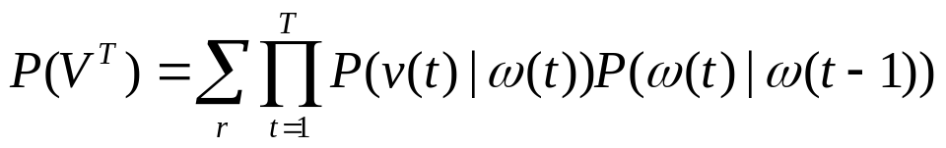
The Evaluation Problem
We can also write the probability as

Slide 30
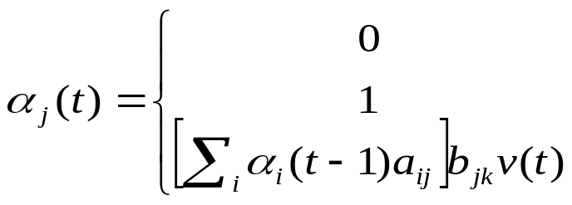
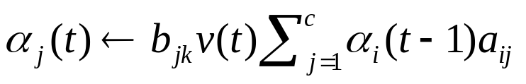
The Evaluation Problem
Solutions exist that apply the formula recursively.
We define
t=0 and j≠initial state
t=0 and j=initial state
otherwise
Algorithm (HMM Forword)
1 initialize t←0, a_{ij},b_{ij},V^{T},α_{j}(0)
for t ←t+1
3
until t=T
return P(V^{T}) ← α₀(T) for the final state
6 end
α_{j}(t) represents the probabilities that our HMM is in hidden state ω_{j} at step t having generated the first t elements

Slide 31
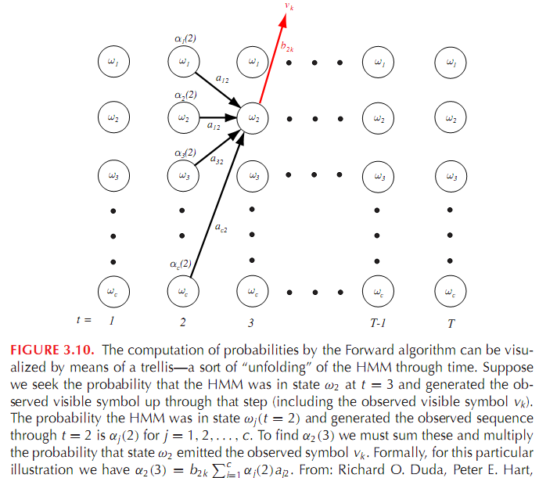

Slide 32
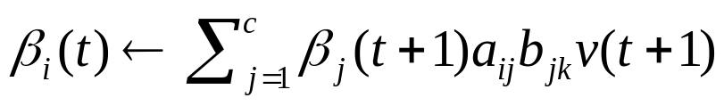
The Evaluation Problem
Backward algorithm is the time-reversed version of Forword algorithm
Algorithm (HMM Backword)
1 initialize t←T, a_{ij},b_{ij},V^{T},α_{j}(0)
for t ←t-1
3
until t=1
return P(V^{T}) ← β_{i}(0) for the final state
6 end
β_{j}(t) represents the probabilities that our HMM is in hidden state ω_{j} at step t and will generate the remainder of given target sequence

Slide 33
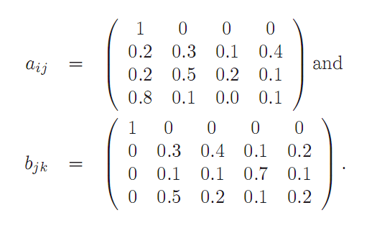
The Evaluation Example

Slide 34
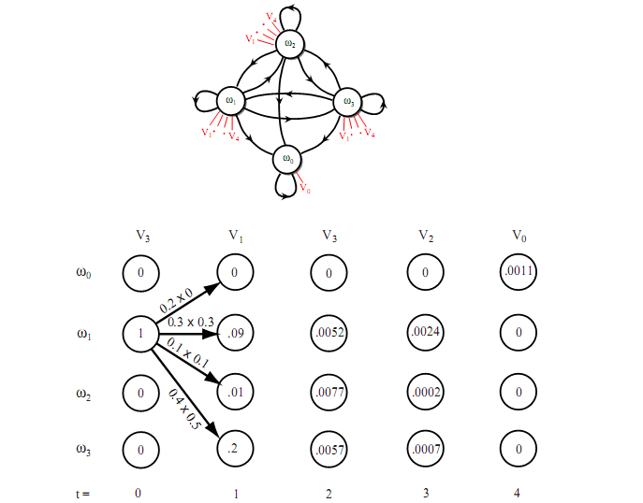

Slide 35
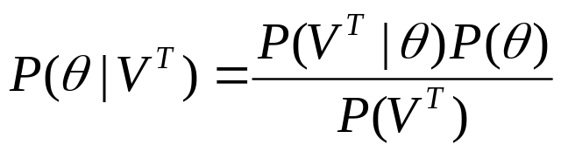
HMM pattern recognition
If we denote our model –the a’ and b’ – by θ, we have by the Bayes formula that the probability of model given the observed sequence is
We would have a number of HMMs, one for each category and classify a test sequence to the model with the highest probability.

Slide 36
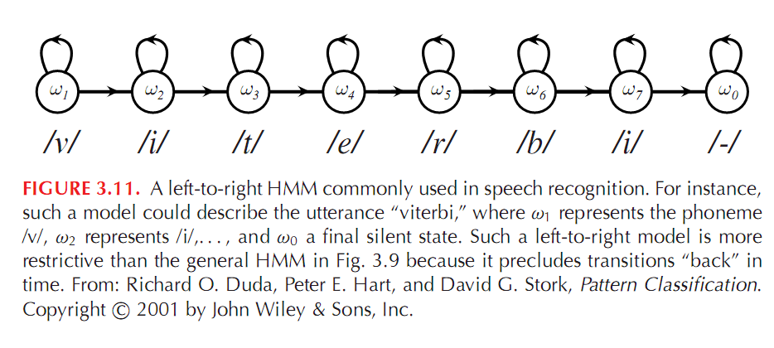

Slide 37
Other Problems
Decoding Problem.
Given a sequence of visible states find the most probable sequence
of hidden states
Learning Problem.
Determine the parameters of the model from training examples.
That is determine the transition probabilities a_{ij} and b_{jk} from an
ensemble of training examples.

Slide 38
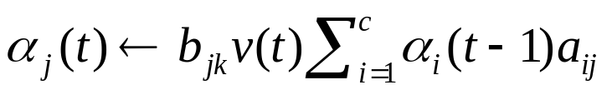
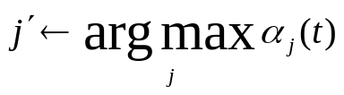

The Decoding Problem: Simple Algorithm
Algorithm (HMM Decoding)
1 begin initialize Path←{}, t ←0
for t ←t+1
j ←0
for j ←j+1
5
6 until j=c
7
8 Append to Path
until t=T
return Path
11 end

Slide 39


Slide 40






The Decoding Problem: Viterbi Algorithm
Algorithm (HMM Decoding)
1 begin initialize t ←0, Path[n]←{}, n=1,2, … , c
for t ←t+1
j ←0
for j ←j+1
5
6 Append to Path[j], here is used to calculate the
7 until j=c
8 until t=T
Append to Path[j], where j with max
return Path
11 end

Slide 41


Slide 42

The Learning Problem
The Forward-Backward Algorithm
is a instance of GEM algorithm.The general approach will be iteratively update the wrights in order to better explain the observed training sequences
t=0 and j≠initial state
t=0 and j=initial state
Otherwise
ω_{i}(t) ≠ ω₀ and t=T
ω_{i}(t) = ω₀ and t=T
Otherwise
Notes:
Baum-Welch

Slide 43



The Learning Problem
But we don’t know a_{ij} and b_{jk} in above Eq.
We define γ_{ij}—the probability of transition between ω_{i}(t-1) and ω_{j}(t),given the model generated the entire training sequence by any path.
The expectation of transition between ω_{i}(t-1) and ω_{j}(t) is
The expectation of any transition from ω_{i} is

Slide 44


The Learning Problem
Now we can estimate a_{ij,} b_{jk}.

Slide 45
Summary
If we know the distribution for the class-conditional probabilities we
can learn the parameters using methods like maximum-likelihood estimation.
Bayesian estimation is even better than maximum-likelihood but it is harder
to compute; in the limit both give almost the same accuracy.
Expectation maximization is a method to to maximize model parameters
when data is missing. At each iteration we do two steps:
  Expectation step. Estimates the missing values
  Maximization step. Optimum parameters of the new model are selected.
Hidden Markov Models are made of hidden states joined by links describing
the conditional probabilities of transitions between states.
HHM are useful to model sequences, specially those where there is context
dependencies (e.g., phonemes in speech).

