Slide 1
Nonparametric Techniques
Density Estimation
Parzen Windows
Nearest-Neighbor
Metrics and Nearest-Neighbor Classification

Slide 2
Density Estimation
We now make NO assumptions about the form of the probability density function of the likelihood p(ω_{j} | x).
There are two types of nonparametric methods:
  Estimating p(x | ω_{j} )
  Bypass probability and go directly to a-posteriori probability estimation

Slide 3
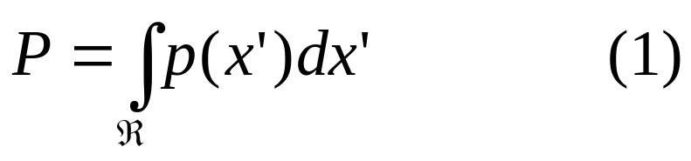
Density Estimation
To begin consider a point x in the feature space. Assume x belongs
to a region R. The probability P of that region is as follows:
for all x’ in region R

Slide 4
Prob. Of Region R
Feature Space
R
x
P = Prob( R )
Question: how can we estimate p(x) given that we know P?
Example R : { x | 20 cm < length(x) < 30 cm }
What is the density function p(x) of x = 25cm ?

Slide 5
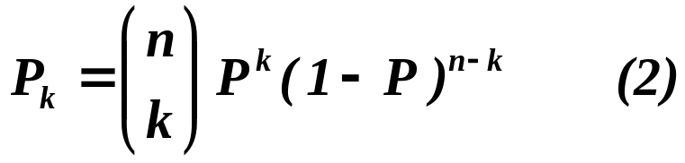
Estimation of p(x)
P is a smoothed (or averaged) version of the density function p(x).
If we have a sample of size n, therefore, the probability that k points fall in R is then:
and the expected value for k is:
  E(k) = nP (3)

Slide 6
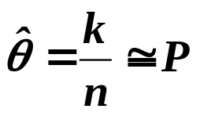
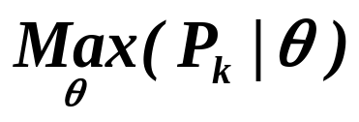
Estimation of p(x)
  ML estimation of P = θ
  is reached for
  Therefore, the ratio k/n is a good estimate for the probability P and hence for the density function p.

Slide 7
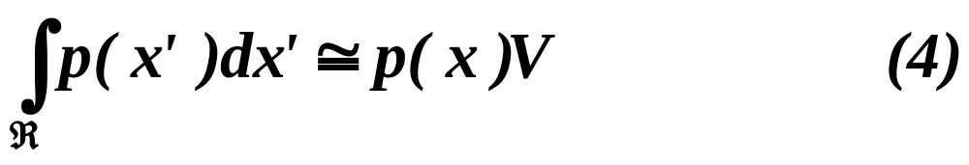
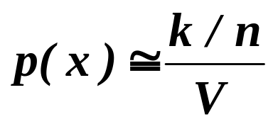
Estimation of p(x)
  p(x) is continuous and that the region R is so small that p does not vary significantly within it, we can write:
  where x is a point within R and V the volume enclosed by R.
  Combining equation (1) , (3) and (4) yields:

Slide 8
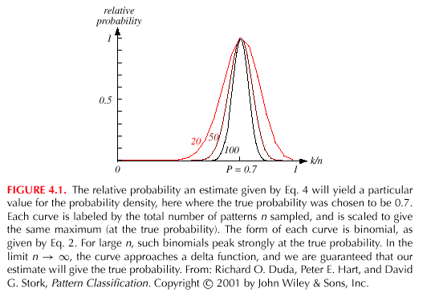
Estimation of p(x)

Slide 9
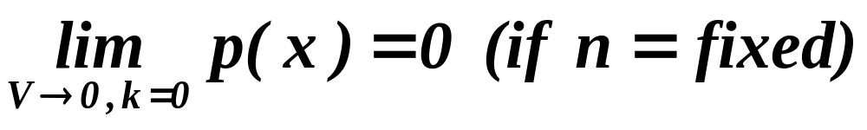
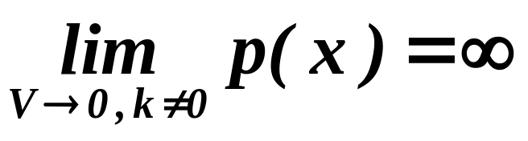
Conditions for Convergence
To find the real p(x) and not a smooth version of it, we need to
reduce the size of the volume V as the number of examples
grows large. However
This is the case where no samples are included in R: it is an uninteresting case!
In this case, the estimate diverges: it is an uninteresting case!

Slide 10
Conditions for Convergence
The volume V needs to approach 0 anyway if we want to use this estimation
    Practically, V cannot be allowed to become small since the number of samples is always limited
    One will have to accept a certain amount of variance in the ratio k/n

Slide 11
Conditions for Convergence
    Theoretically, if an unlimited number of samples is available, we can circumvent this difficulty.
    To estimate the density of x, we form a sequence of regionsR₁, R₂,…containing x:
    the first region to be used with one sample, the second two samples and so on.
    Let V_{n} be the volume of R_{n}, k_{n} the number of samples falling in R_{n} and p_{n}(x) be the n^{th} estimate for p(x):
    p_{n}(x) = (k_{n}/n)/V_{n} (7)

Slide 12
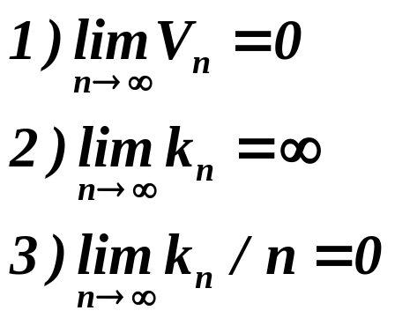
Conditions for Convergence
    Three necessary conditions should apply if we want p_{n}(x) to converge to p(x):

Slide 13
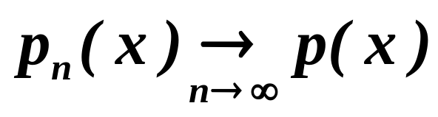
Conditions for Convergence
    There are two different ways of obtaining sequences of regions that satisfy these conditions:
    (a) Shrink an initial region where V_{n} = 1/√n and show that
    This is called “the Parzen-window estimation method”
    (b) Specify k_{n} as some function of n, such as k_{n} = √n ; the volume V_{n} is grown until it encloses k_{n} neighbors of x. This is called “the k_{n}-nearest neighbor estimation method”

Slide 14
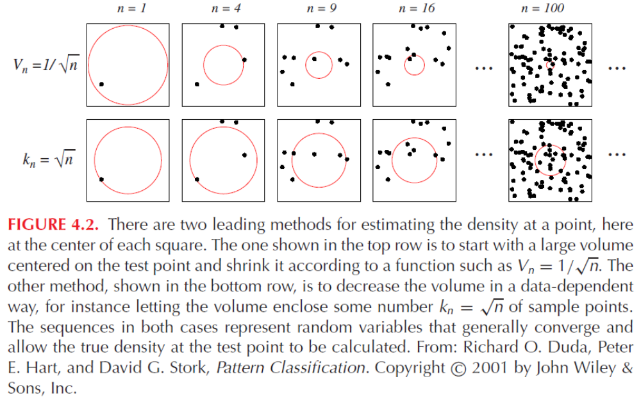
Figure 4.2

Slide 15
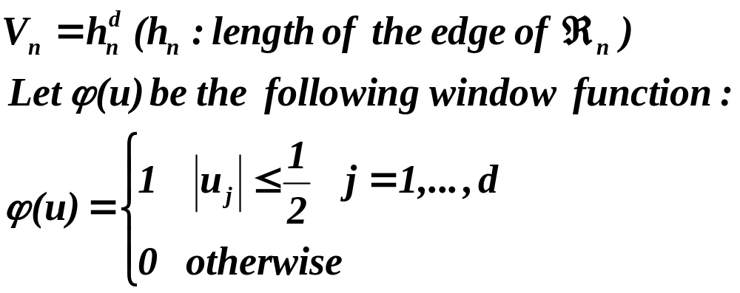
Parzen Windows
  Parzen-window approach to estimate densities assume that the region R_{n} is a d-dimensional hypercube
  ϕ((x-x_{i})/h_{n}) is equal to unity if x_{i} falls within the hypercube of volume V_{n} centered at x and equal to zero otherwise.

Slide 16
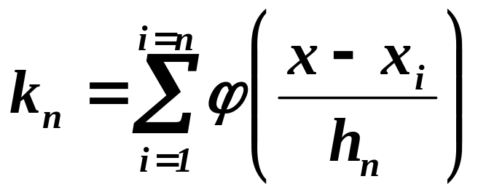
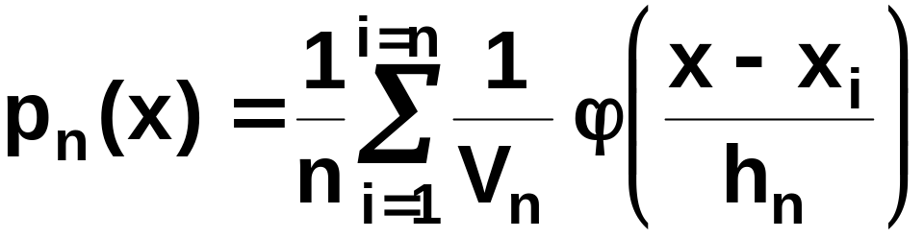
Parzen Windows
  The number of samples in this hypercube is:
  By substituting k_{n} in equation (7), we obtain the following estimate:

Slide 17
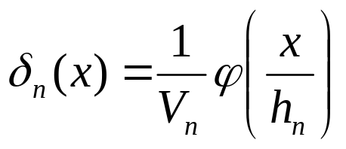
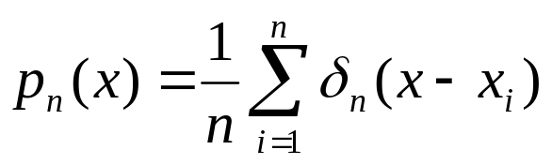
The Effect of the Window Width h
What is the effect of the window width h on our estimate of p(x) ?
Let us first define a function δ(x):
Then we can write p(x) as :
Now it must be clear that h affects the amplitude and
width of δ(x).

Slide 18
The Effect of the Window Width h
If h is large the amplitude is small and x needs to be far from xi
to see any change on δ(x – x_{i}) .
In that case p(x) is a very “smooth” estimate (it is “out-of-focus”).
But if h is very small, then δ (x – x_{i}) will have a large value close
to x = x_{i}.
In this case p(x) has “sharp pulses” centered at the samples (the
estimate is noisy).

Slide 19
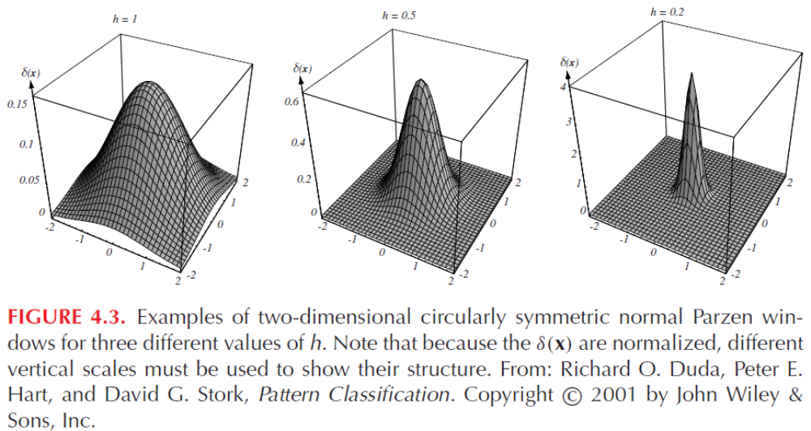
Figure 4.3

Slide 20
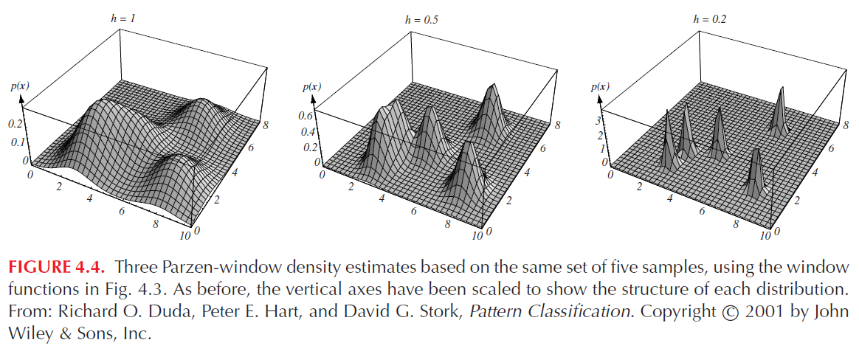
Figure 4.4

Slide 21
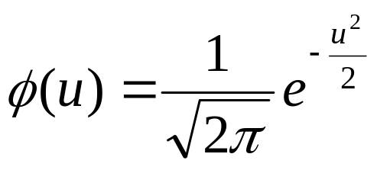
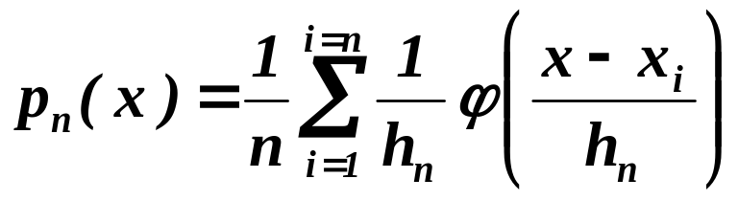
More Examples
Let’s look at another example. Consider the case where p(x) is
a zero-mean unit-variance univariate normal density. Let the
window function have the following form:
Let h = h1 / √n where h1 is a known parameter.
Our estimate is then an average of normal densities centered
at the samples:

Slide 22
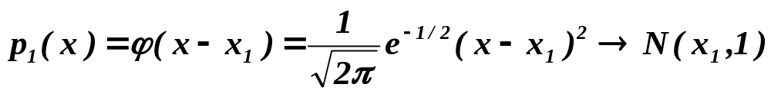
More Examples
      Numerical results:
      For n = 1 and h₁=1
      For n = 10 and h = 0.1, the contributions of the individual samples are clearly observable !

Slide 23
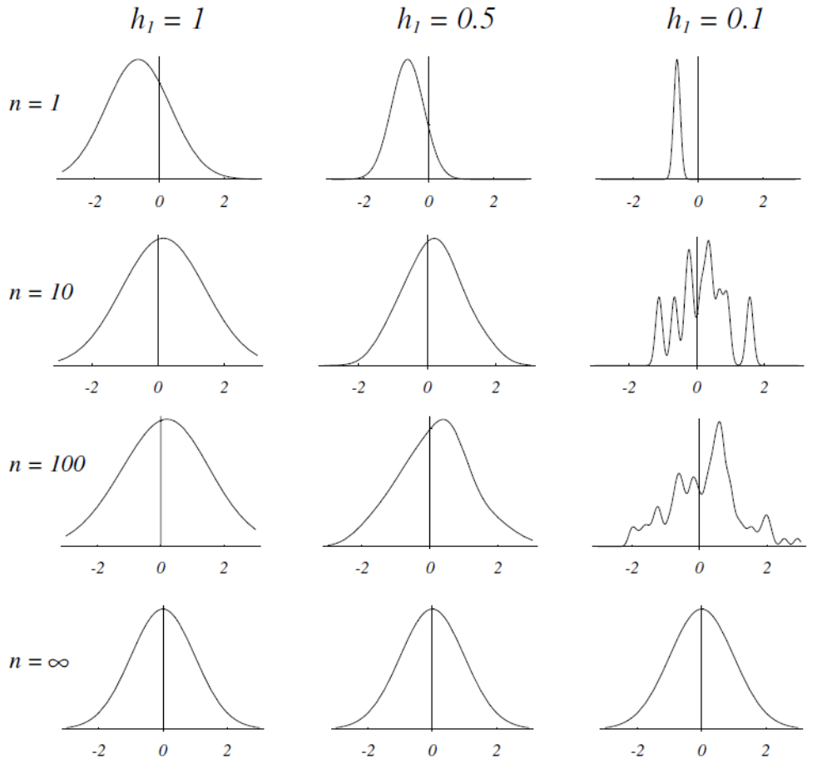
Figure 4.5

Slide 24
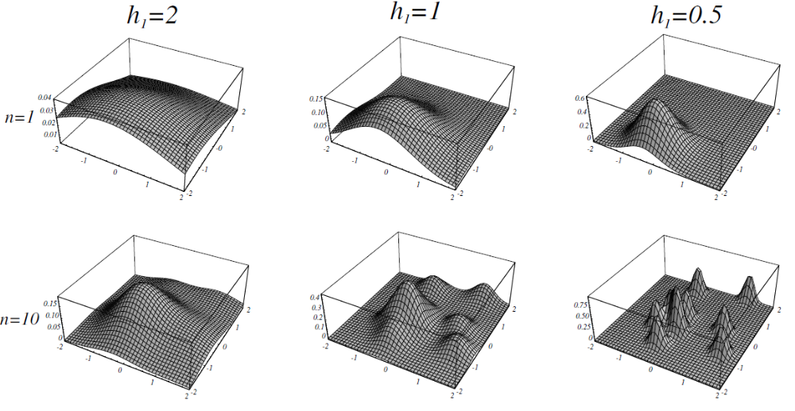
Figure 4.6(a)

Slide 25
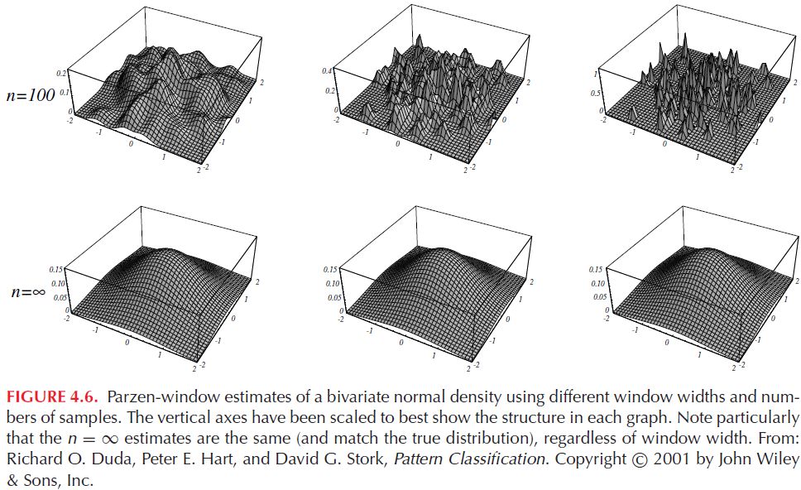
Figure 4.6(b)

Slide 26
Another Example
Another example is shown where the unknown density is a mixture of a uniform and a triangle density.

Slide 27
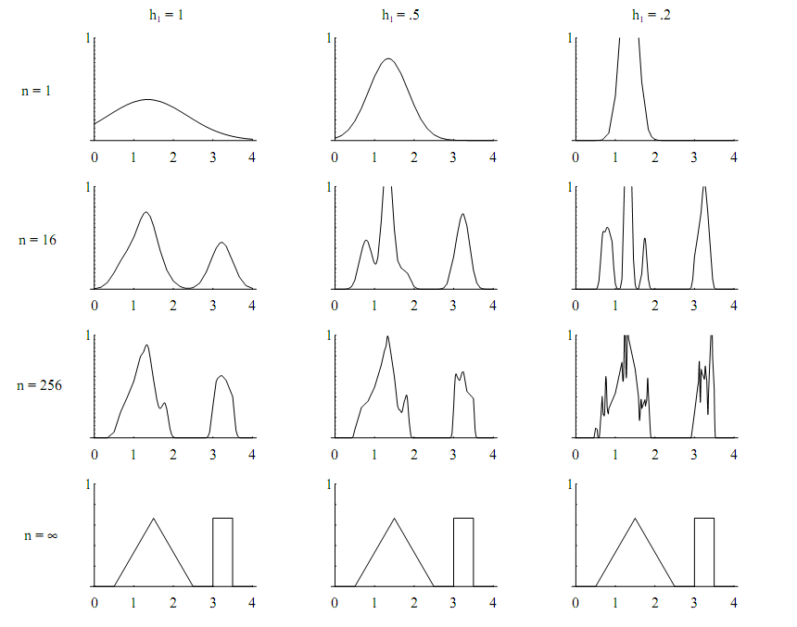
Figure 4.7

Slide 28
Classification
How do we apply Parzen Windows to classification?
We simply estimate the densities for each class p(x| ω_{j}) and
assign a class corresponding to the maximum posterior.
The decision boundaries depend on the choice of the
window function.

Slide 29
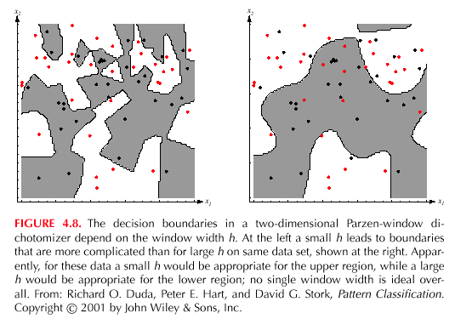
Figure 4.8

Slide 30
Nonparametric Methods
Advantages:
They are very general. We do not have to make assumptions
about the distribution of the data.
Convergence is guaranteed with enough examples.
Disadvantages:
Number of examples required is very large.
The demand for more examples grows exponentially
with the dimensionality of the data. This is called the
“curse of dimensionality”.

