Slide 1
Non-Parametric Techniques
Density Estimation
Parzen Windows
PNN
Nearest-Neighbor
Metrics and Nearest-Neighbor Classification

Slide 2
Probabilistic Neural Networks
Implementation of Parzen windows approach is based on n patterns
Patterns with d features sampled from c classes
    The input unit is connected to n patterns
.
.
.
.
.
W₁₁
x₁
p₁
x₂
p₂
.
.
.
.
.
.
Input unit
Input
patterns
.
.
W_{d2}
x_{d}
W_{dn}
p_{n}
Modifiable weights (trained)

Slide 3
Probabilistic Neural Networks
.
p_{n}
p₁
.
p₂
.
Input
patterns
.
.
.
ω₁
.
.
ω₂
.
.
.
.
Category
units
p_{k}
.
.
.
.
ω_{c}
p_{n}
Activations
(Emission of nonlinear functions)

Slide 4
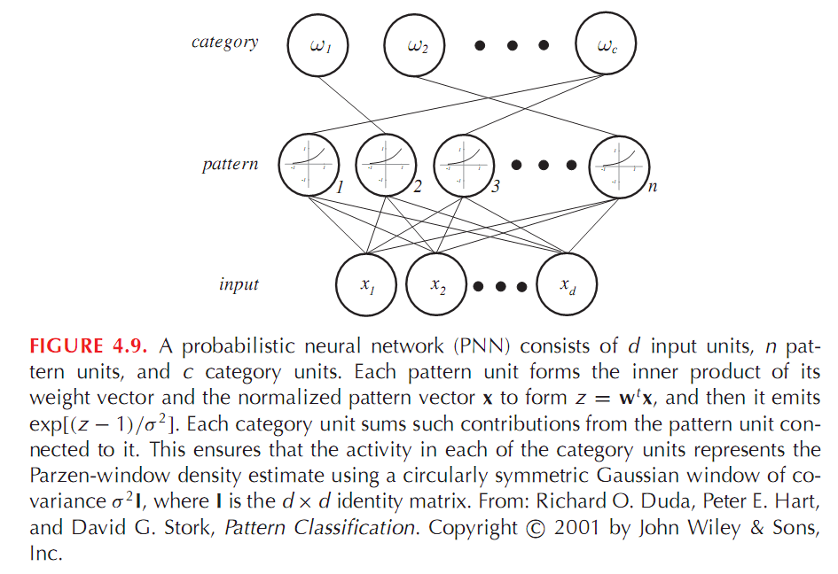

Slide 5
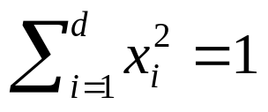
Training the network: Algorithm
      Normalize each pattern x of the training set to 1
        Place the first training pattern on the input units
        Set the weights linking the input units and the first pattern units such that: w₁ = x₁
        Make a single connection from the first pattern unit to the category unit corresponding to the known class of that pattern
        Repeat the process for all remaining training patterns by setting the weights such that w_{k} = x_{k} (k = 1, 2, …, n)
        We finally obtain the following network

Slide 6
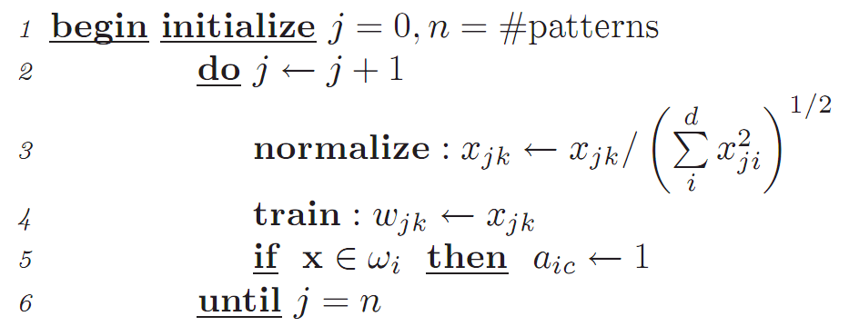
Algorithem1 (PNN training)
7 end

Slide 7
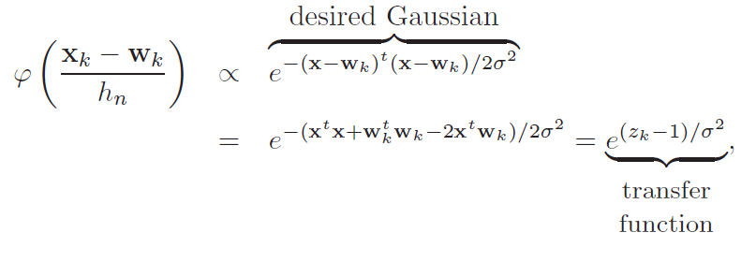
Testing the network: Algorithm
Consider an Gaussian window centered on the position of one of the training patterns w_{k} , if we let our effective width h_{n} be a constant, the window function is

Slide 8
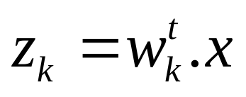
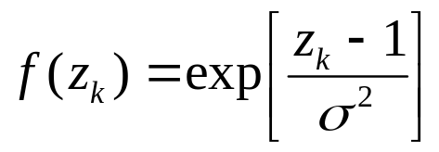
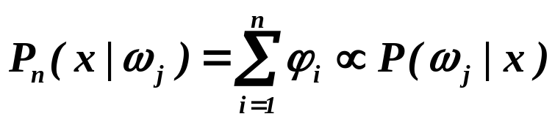
Testing the network: Algorithm
        Normalize the test pattern x and place it at the input units
        Each pattern unit computes the inner product in order to yield the net activation
        and emit a nonlinear function
        Each output unit sums the contributions from all pattern units connected to it
        Classify by selecting the maximum value of P_{n}(x | ω_{j})
        (j = 1, …, c)

Slide 9
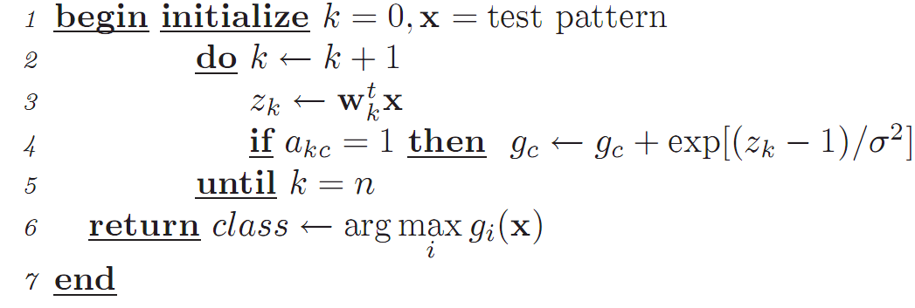
Algorithem1 (PNN classification)

Slide 10
K-Nearest-Neighbor Density Estimation
Goal: a solution for the problem of the unknown “best” window function
    Let the cell volume be a function of the training data
    Center a cell about x and let it grows until it captures k_{n} samples (k_{n} = f(n))
    k_{n} are called the k_{n} nearest-neighbors of x
  2 possibilities can occur:
    Density is high near x; therefore the cell will be small which provides a good resolution
    Density is low; therefore the cell will grow large and stop until higher density regions are reached
  We can obtain a family of estimates by setting k_{n}=k₁/√n and choosing different values for k₁

Slide 11
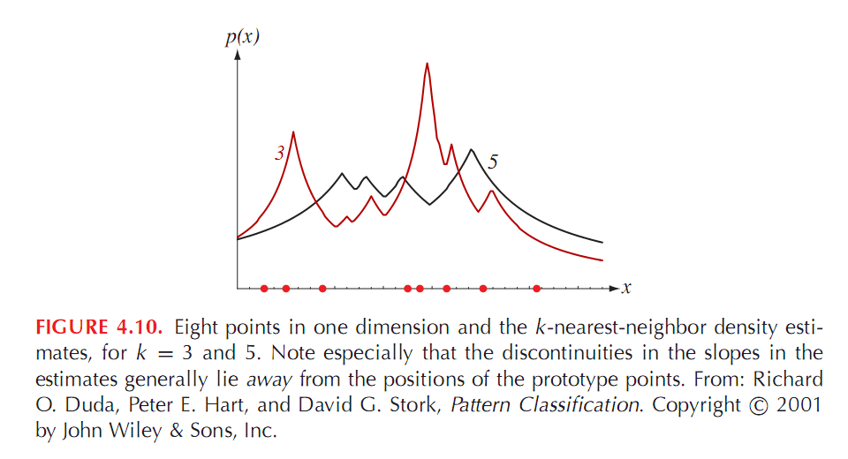
Figure 4.10

Slide 12
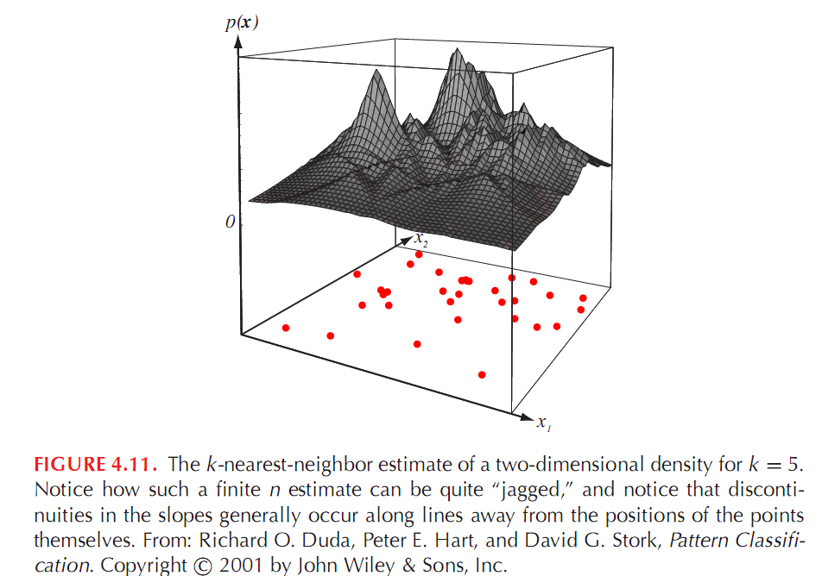
Figure 4.11

Slide 13
K-Nearest-Neighbor Density Estimation
Illustration
  For k_{n} = √n = 1 ; the estimate becomes:
    P_{n}(x) = k_{n} / n.V_{n} = 1 / V₁ =1 / 2|x-x₁|
    This is clearly a poor estimate of p(x),with its integral diverging to infinity. The estimate becomes considerably better as n gets large.

Slide 14
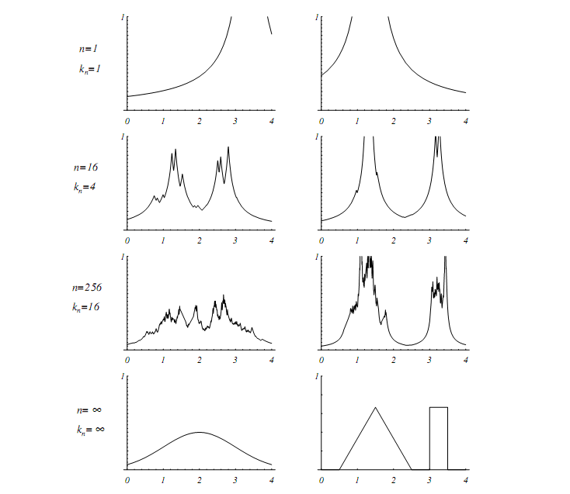
Figure 4.12

Slide 15
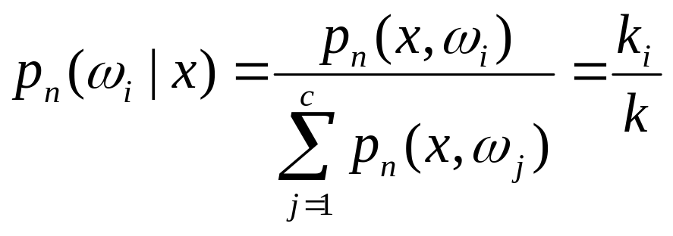
Estimating A-Posteriori Probabilities
Instead of predicting p(x) we can directly estimate p(ω_{j}|x) as follows.We place a cell around x and capture k examples:
x
      k_{i} samples amongst k turned out to be labeled ω_{i} then:
      p_{n}(x, ω_{i}) = k_{i} /n.V
      An estimate for p_{n}(ω_{i}| x) is:

Slide 16
Estimating A-Posteriori Probabilities
      k_{i} /k is the fraction of the samples within the cell that are labeled ω_{i}
      For minimum error rate, the most frequently represented category within the cell is selected
      If k is large and the cell sufficiently small, the performance will approach the best possible

Slide 17
The Nearest Neighbor Rule
Let D_{n} = {x₁, x₂, …, x_{n}} be a set of n labeled prototypes
Let x’ ∈ D_{n} be the closest prototype to a test point x then the nearest-neighbor rule for classifying x is to assign it the label associated with x’
The nearest-neighbor rule leads to an error rate greater than the minimum possible: the Bayes rate
If the number of prototype is large (unlimited), the error rate of the nearest-neighbor classifier is never worse than twice the Bayes rate (it can be demonstrated!)
If n → ∞, it is always possible to find x’ sufficiently close so that:
  P(ω_{i} | x’) ≅ P(ω_{i} | x)

Slide 18
Voronoi-Tessellations
The nearest-neighbor rule partitions the feature space into cells.
All points in such a cell are labeled by the category of the training point;
That is called a Voronoi tessellation.

Slide 19
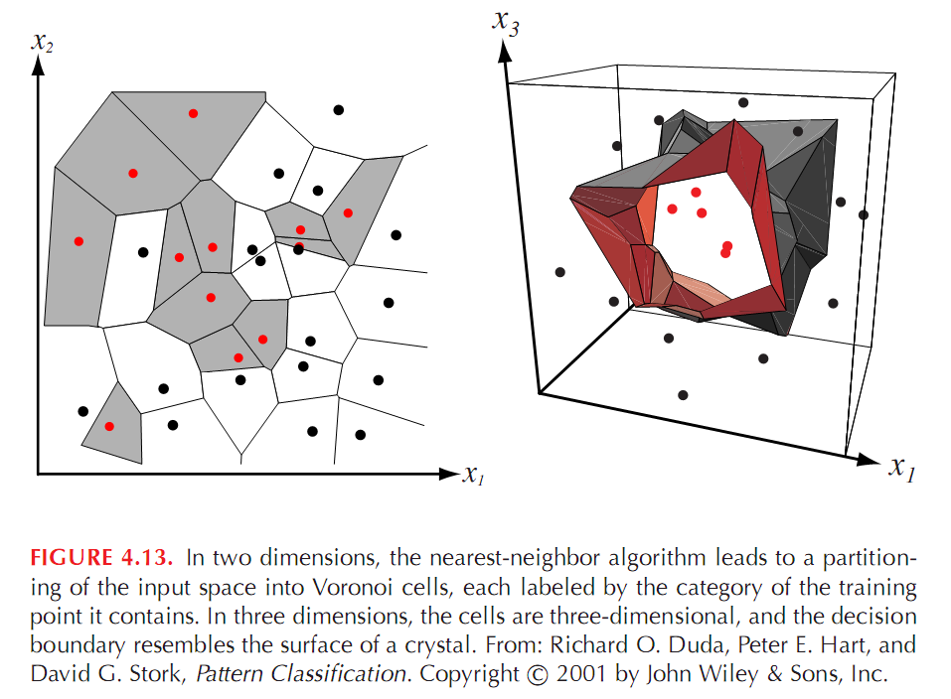
Figure 4.13

Slide 20
The k-Nearest-Neighbor Rule
An extension of the nearest-neighbor rule is to use k neighbors instead of one single neighbor.
The idea is to make a decision by examining the labels of the k nearest neighbors and taking a vote.

Slide 21
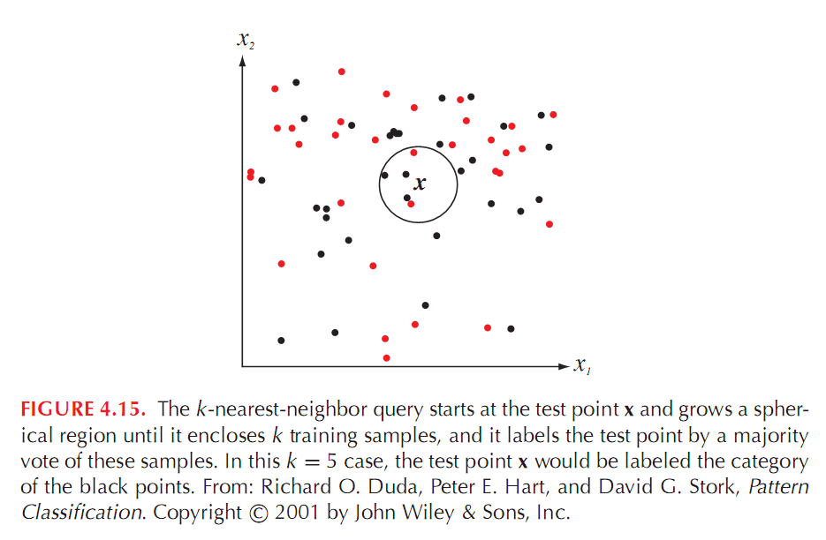
Figure 4.15

Slide 22
Metrics
The nearest-neighbor method assumes a distance metric.
Properties of distance metrics:
nonnegativity: D(a,b) >= 0
Reflexivity: D(a,b) = 0 if and only if a = b
Symmetry: D(a,b) = D(b,a)
Triangle inequality: D(a,b) + D(b,c) >= D(a,c)
The Euclidean distance has these properties although the
results may not always be meaningful.

Slide 23
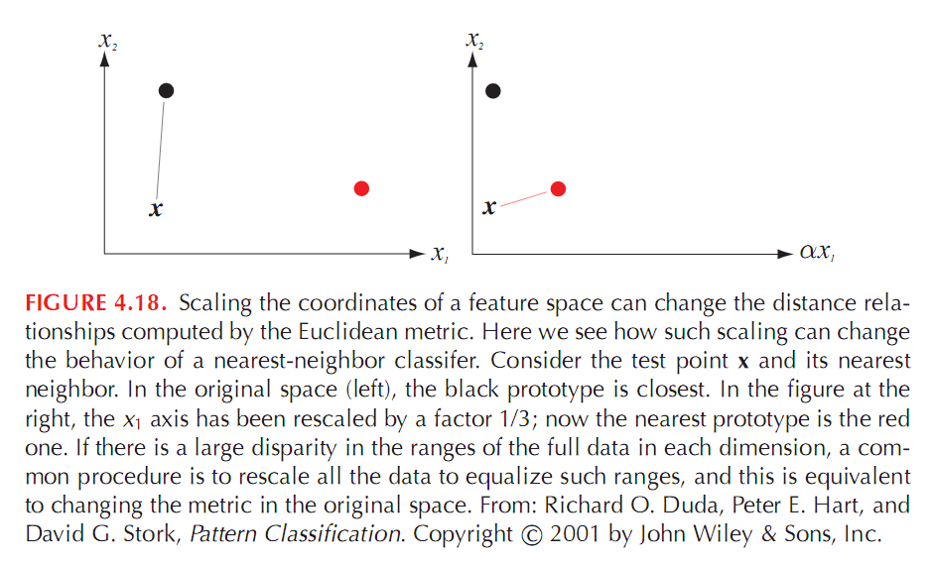
Figure 4.18

Slide 24
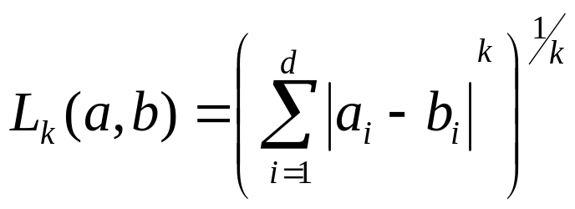
Other Metrics
Other metrics are listed as follows:
Minkowski Metric:
b. Manhattan (or city block) Distance
It is the L₁ norm (Minkowski distance with k = 1).
c. L∞ Distance (k→∞)
It is the maximum of its projection onto each of d coordinate axes

Slide 25
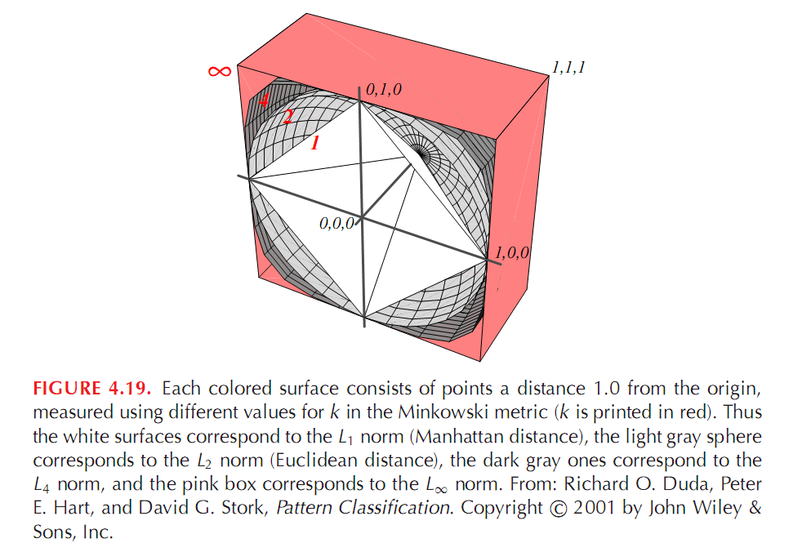

Slide 26
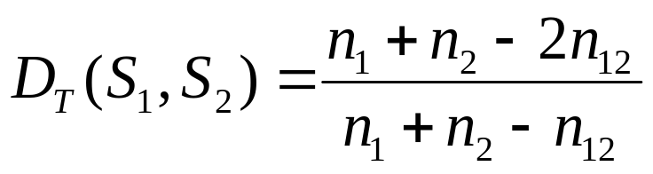
Other Metrics
Tanimoto Distance
between two set S₁ and S₂ is:
Where n₁ and n₂ are the number of element in sets S₁ and S₂ ,respectively,and n₁₂ is the number that is in both sets.

