Slide 1
Linear Discriminant Functions
Overview
The Perceptron Algorithm
Relaxation Procedures
Support Vector Machines

Slide 2
Introduction
In chapter 3, the underlying probability densities were known (or given).
The training sample was used to estimate the parameters of these probability densities.
In this chapter, we only know the proper forms for the discriminant functions: similar to non-parametric techniques
They may not be optimal, but they are very simple to use
They provide us with linear classifiers

Slide 3
Linear Discriminant Functions
A discriminant function is a linear combination of the components of x:
g(x) = w^{t} x + w₀
where
w^{t} is the weight vector
w_{o} is the bias or threshold weight
For the two-class problem we can use the following decision rule:
Decide ω ₁ if g(x) > 0 and ω ₂ if g(x) < 0.
For the general case we will have one discriminant function for each class

Slide 4
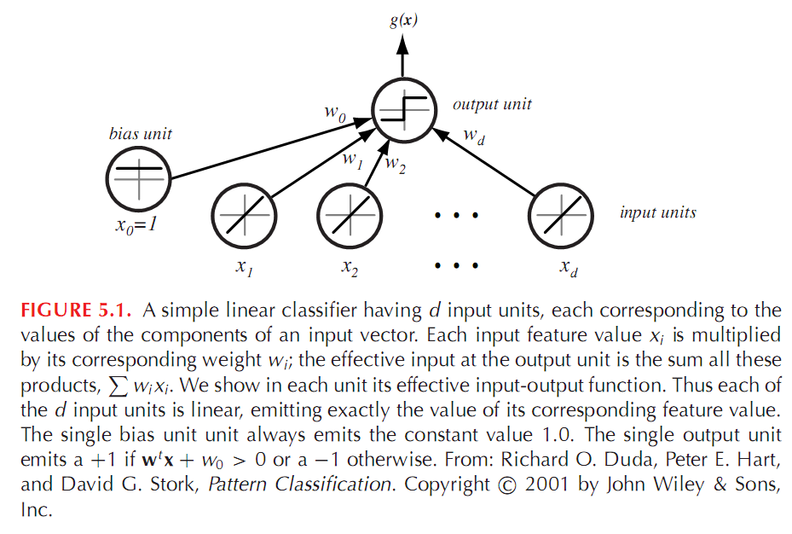
Figure 5.1

Slide 5
Decision surface
  The equation g(x) = 0 defines the decision surface that separates points assigned to the category ω₁ from points assigned to the category ω₂
  When g(x) is linear, the decision surface is a hyperplane
  Algebraic measure of the distance from x to the hyperplane (interesting result!)

Slide 6
The Normal Vector w
The hyperplane H divides the feature space into two regions:
Region R₁ for class ω₁ and
Region R₂ for class ω₂.
For two points x₁ and x₂ on the decision boundary:
w^{t} x₁ + w₀ = w^{t} x₂ + w₀
which means
w^{t} (x₁ – x₂) = 0
Thus w is normal to any vector in the hyperplane.
Because g(x)>0 if x in R₁, it follows that the normal vector w point into R₁.
It is sometimes said that any x in R₁ is on the positive side of H, and x in R₂ is on the negative side.

Slide 7
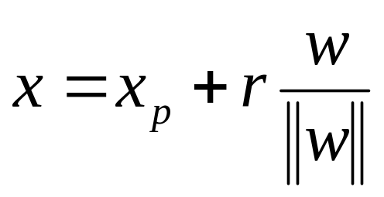
Algebraic Measure of Distance
The function g(x) tells us in a sense how far is x from the decision boundary:
A point x can be represented as
where x_{p} is the projection of x into the decision boundary and
r is the algebraic distance.
Thus the higher g(x) the farther away the point from the decision boundary.

Slide 8
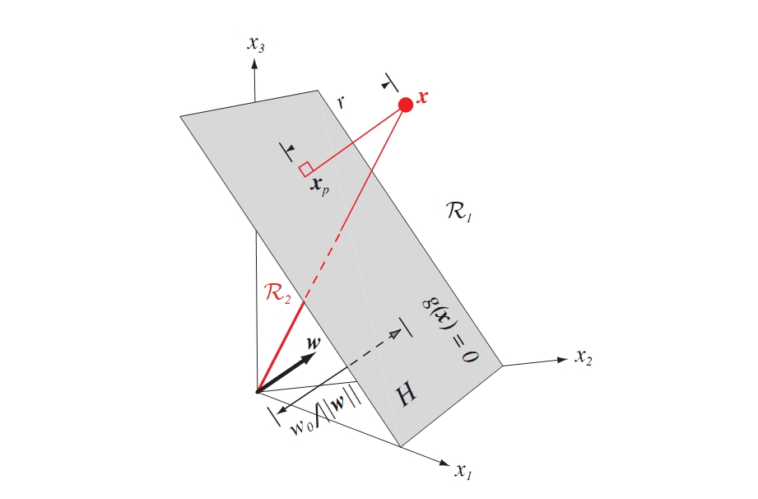
Figure 5.2

Slide 9
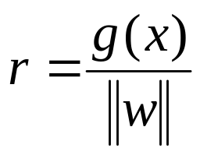
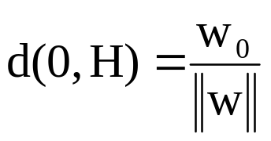
Algebraic Measure of Distance
Because g(x_{p})=0,
g(x)= w^{t} x + w₀=r||w||
Or
In particular
  The orientation of the surface is determined by the normal vector w and the location of the surface is determined by the bias

Slide 10
Multiple Classes
How do we use a linear discriminant when we have more
than two classes?
There are two approaches:
One discriminant function for each class (ω_{i}/not ω_{i})
A discriminant function for all pairs of classes(ω_{i}/ω_{j})
If c is the number of classes, in the first case we have c functions and in the second c(c-1) / 2 functions.
In both cases we are left with ambiguous regions.

Slide 11
Ambiguous regions
Case1 classification rule:
  if g_{i}(x)>0 and all j≠i g_{j}(x)<0, choose ω₁
  ambiguous regions:
  1)all g_{j}(x)<0 2)more then one g_{j}(x)>0
Case2 classification rule:
  for all j≠i g_{ij}(x)>0 , choose ω₁
  ambiguous regions:
  all g_{ij}(x) < 0

Slide 12
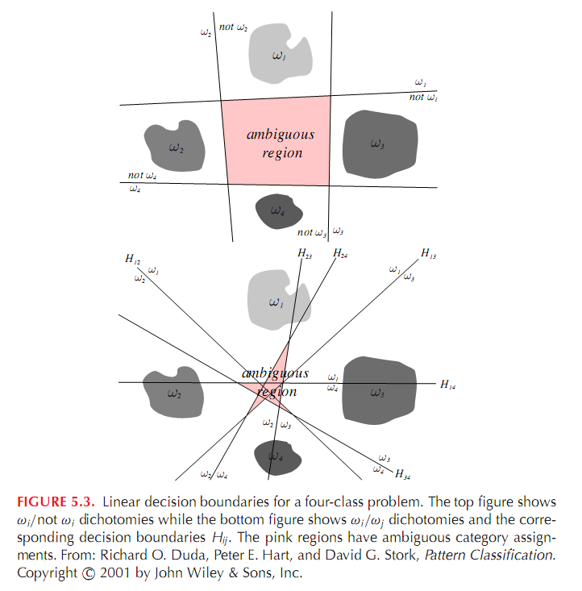
Figure 5.3

Slide 13
Linear Machines
To avoid the problem of ambiguous regions we can use linear machines:
We define c linear discriminant functions and choose the one
with highest value for a given x.
g_{i}(x) = w_{i}^{t} x + w_{i0} k = 1, …, c
i.e. assign x to ω_{i} if g_{i}(x) > g_{j}(x) ∀ j ≠ i

Slide 14
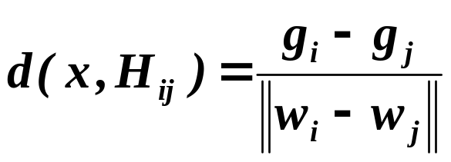
Linear Machines
For a two contiguous regions R_{i} and R_{j}; The boundary that separates them is a portion of hyperplane H_{ij} defined by:
g_{i}(x) = g_{j}(x)
(w_{i} – w_{j})^{t}x + (w_{i0} – w_{j0}) = 0
w_{i} – w_{j} is normal to H_{ij} and

Slide 15
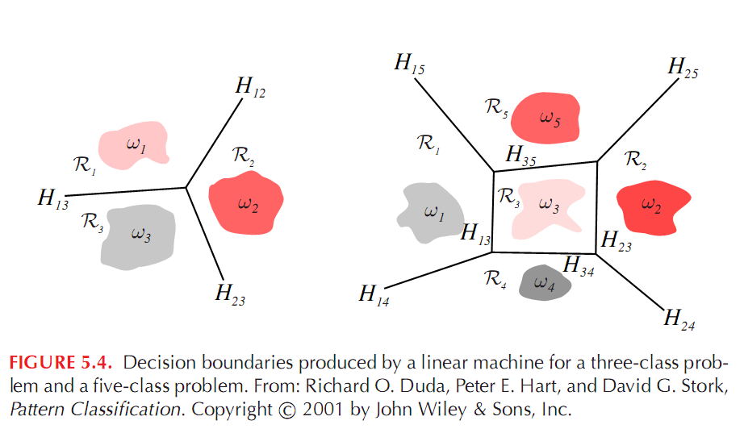
Figure 5.4

Slide 16
Generalized Linear Discriminant Functions
Decision boundaries which separate between classes may not always be linear
The complexity of the boundaries may sometimes request the use of highly non-linear surfaces
A popular approach to generalize the concept of linear decision functions is to consider a generalized decision function as:
g(x) = w₁y₁(x) + w₂y₂(x) + … + w_{N}y_{N}(x) + w_{N+1} (1)
where y_{i}(x), 1 ≤ i ≤ N, are scalar functions of the pattern x,
    x ∈ R^{n} (Euclidean Space)

Slide 17
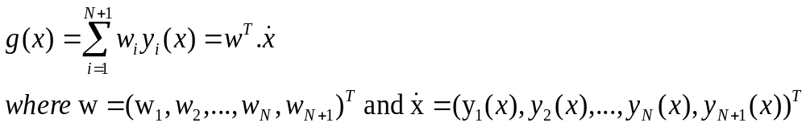
Generalized Linear Discriminant Functions
Introducing y_{n+1}(x) = 1 we get:
This latter representation of g(x) implies that any decision function defined by equation (1) can be treated as linear in the (N + 1) dimensional space (N + 1 > n)
g(x) maintains its non-linearity characteristics in R^{n}

Slide 18
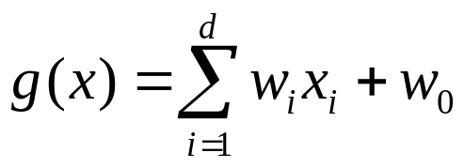
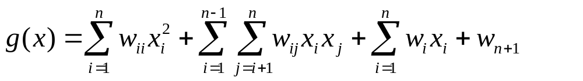
Quadratic discriminant function
A linear discriminant function g(x) can be written as:
We could add additional terms to obtain a quadratic discriminant function:
The quadratic discriminant function introduces d(d-1)/2 coefficients corresponding to the products of attributes. The surfaces are thus more complicated (hyperquadric surfaces).

Slide 19
Generalized Linear Discriminant Functions
We could even add more terms w_{ijk} x_{i} x_{j} x_{k} and obtain the class
of polynomial discriminant functions. The generalized form is
g(x) = Σ_{i} a_{i} y_{i}(x)
or g(x) = a^{t} y
Where the summation goes over all functions y_{i}(x).
The y_{i}(x) functions are called the phi or φ functions.
The function is now linear on the y_{i}(x).
The functions map a d-dimensional x-space into a d’ dimensional y-space.
Example: g(x) = a₁ + a₂x + a₃x² y = (1 x x² ) ^{t}

Slide 20
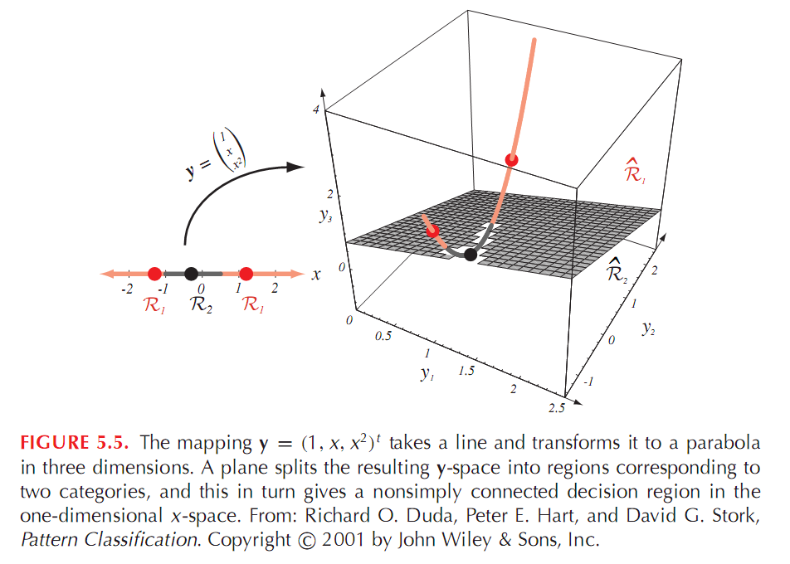
Figure 5.5

Slide 21
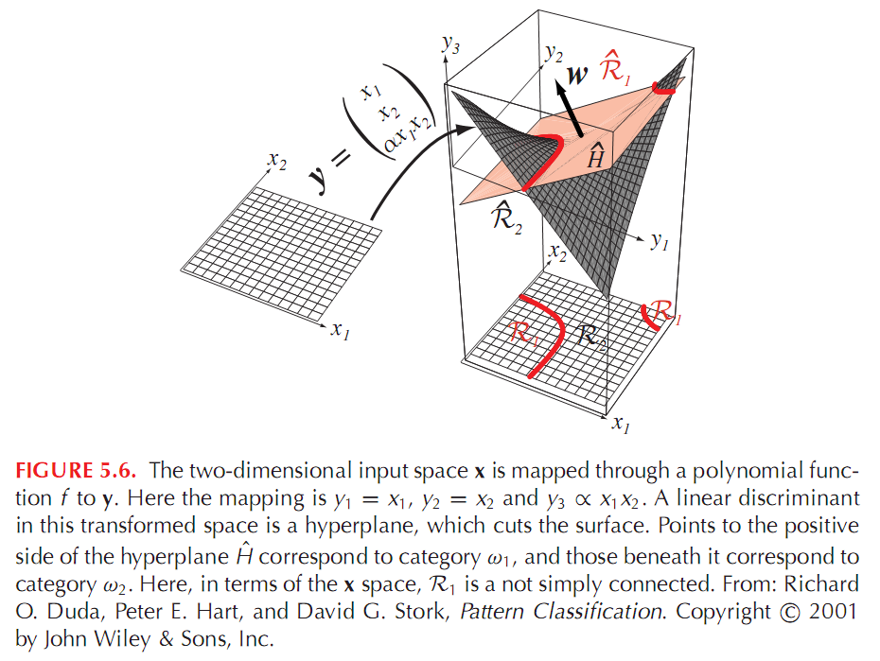
Figure 5.6

Slide 22
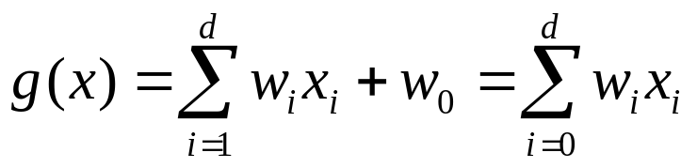
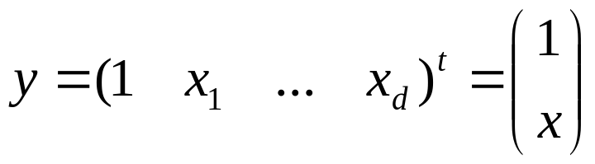
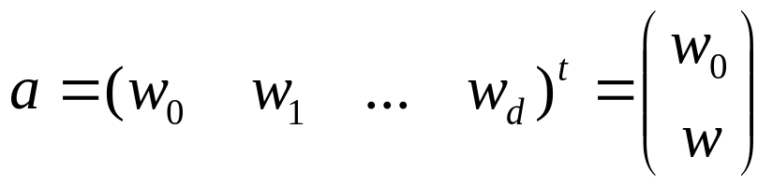
Augmented vector
In the case of linear discriminat function we have
Where we set x₀=1. Thus we can write
and y is called an augmented feature vector.
An augmented weight vector can be write as

Slide 23
Two-Category Linearly Separable Case
Now assume we have n samples y₁, y₂, …, y_{n}. And two classes ω₁ and ω₂. We want to find the values of a weight vector a in the following linear discriminat function:
g(x) = a^{t} y
If there is a vector a^{t} that when plugged into g(x) separates away examples of different class away, we say the problem is linearly separable.

Slide 24
Two-Category Linearly Separable Case
An example y_{i} is classified correctly if a^{t} y_{i} > 0 and y_{i} belongs to class ω₁,or a^{t} y_{i} < 0 and y_{i} belongs to class ω₂.
If we replace all the y_{i} in ω₂ with their negatives, then what we need is a vector a such that a^{t} y_{i} > 0 for all samples.
Such a weight vector is called a solution vector
It is clear that the solution vector is not unique. There are several way to impose additional requirements to constrain the solution vector.
One possibility is to seek the minimum-length weight vector satisfying a^{t} y_{i} ≥ b, where b is a positive constant called the margin

Slide 25
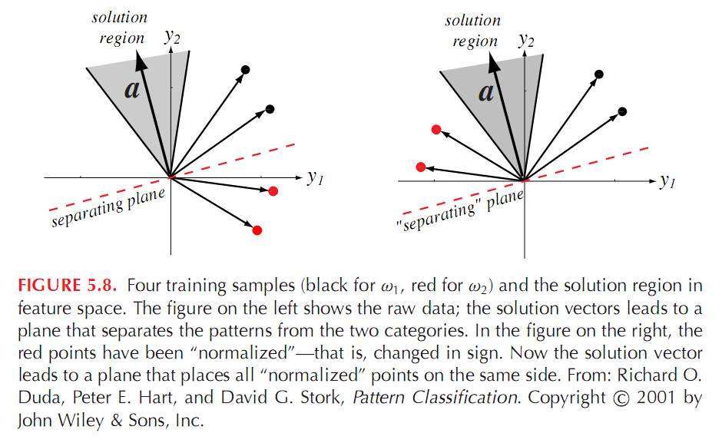
Figure 5.8

Slide 26
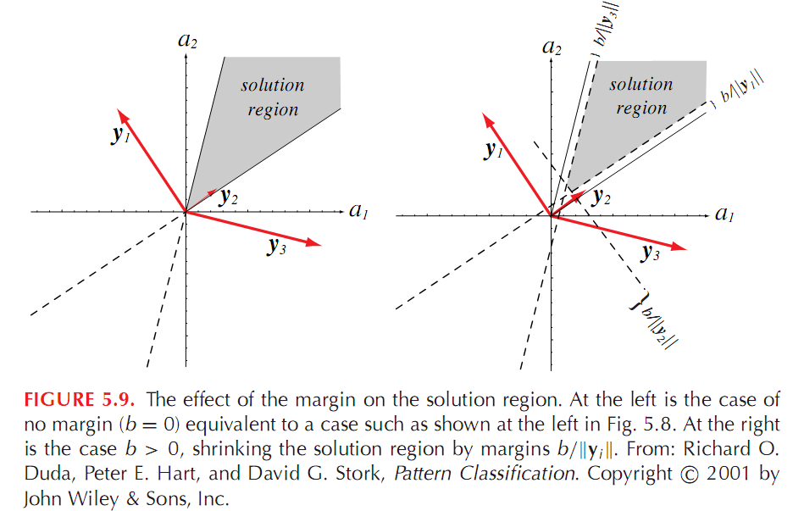

Slide 27
Criterion Function
So how do we find the appropriate solution region / vector that satisfies a^{T}y_{i}>0?
We define a criterion function , J(a), and minimize it such that a is the solution vector.
This reduces the problem of a massive search into a problem of minimizing a scalar function

Slide 28
Gradient Descent
We can us “Gradient Descent”. The idea is as follows:
Start with an arbitrary value for a, call it a(1).
Compute the gradient ∇J(a(1))
Now compute a(2) by moving along the negative of the gradient (the direction of steepest descent).
In general:
a(k+1) = a(k) - η(k) ∇J(a(k))
where η is the learning rate.

Slide 29

Gradient Descent
J(a)
J(a₁)
*
  -∇ J(a₁)
J(a₂)
*
Initialize a, θ, η(k), k=0;
do k←k+1
a ← a- η(k) .∇J(a)
until |η(k) .∇J(a)|< θ
return a end
  -∇ J(a₂)
*
J(a₃)
a₁
a₂
a₃
a
η₁
η₂

Slide 30
The Learning Rate
The learning rate η is critical to gradient descent.
If it is too small the method takes many computation steps to converge to a solution.
b. If it is too large, we run the risk of “overshooting” and miss the optimal solution.

Slide 31
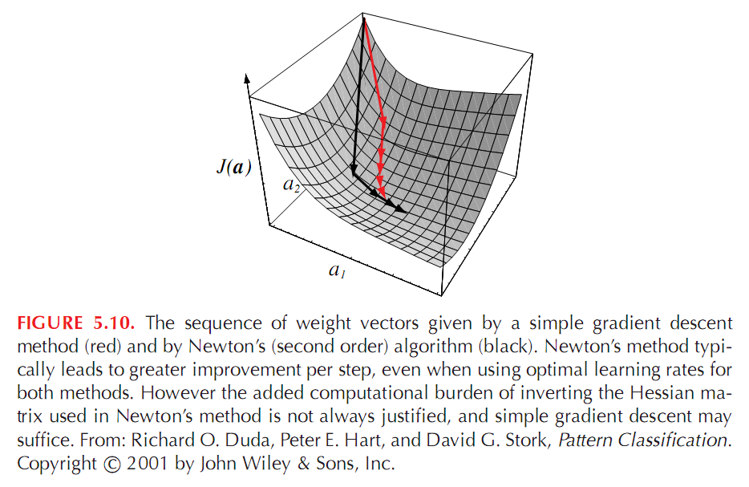
Figure 5.10

Slide 32
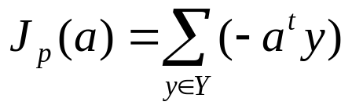
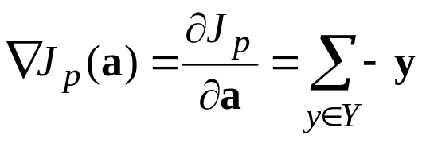
The Perceptron Criterion Function
What could be a good criterion function to solve the following set of inequalities?
a^{t} y_{i} > 0
First choice could be simply the number of misclassified examples.
Second choice is the Perceptron Citerion Function:
Where the summation goes over all examples misclassified using vector a.
Notice that

Slide 33
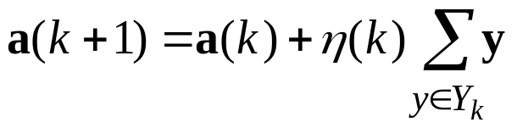
The Perceptron Criterion Function
Notice that ∇J = Σ (- y) and so the update rule becomes:
where the sum goes over the samples misclassified by a(k).
The rule is summarized as follows:
The next weight vector is obtained by adding a multiple of the
sum of misclassified examples to the present weight vector.
Set of samples
misclassified by a_{k}

Slide 34
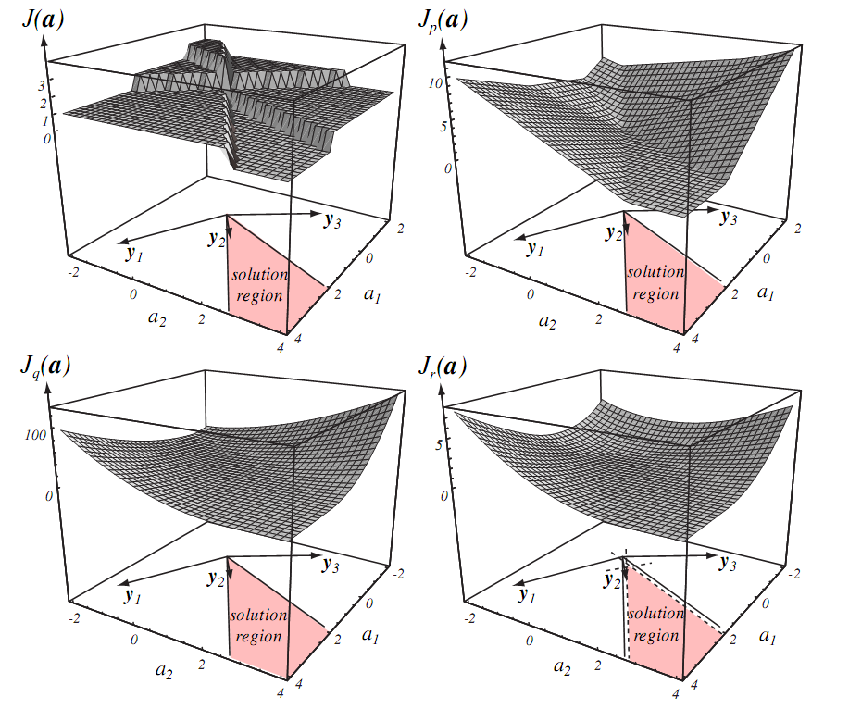
Figure 5.11

Slide 35
Implementation
Since all the criteria functions involve only data points in error (w.r.t. the margin), we can update the weight vector in two different ways:
1.Update every time we see a data point that is in error.
2.Whenever we’ve gotten enough data points in error to
want to update the weight vector we do a batch.

Slide 36
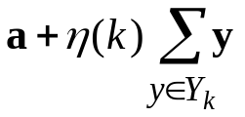

The Batch Perceptron Algorithm
Training data is cycled through until error falls below a threshold. The term “batch” refer to the fact that a group of samples is used when computing each weight update.
Initialize a, threshold θ, learning rate η(.), iteration k=0;
do k←k+1
a ←
until | |< θ
return a
end

Slide 37
Fixed-Increment
Single Sample Perceptron
Fixed Increment
Initialize a, learning rate η=1, iteration k=0;
do k ← k+1 (mod n) n: number of samples
if y^{k} is misclassified by a then a ← a + y^{k}
until all samples are correctly classified
return a
end
Data Sequence: y₁ y₂ y₃ y₄ y₁ y₂ y₃ y₄ y₁ y₂ y₃ y₄
➔ …y¹ y² y³ y⁴ y⁵… = y₂ y₁ y₃ y₂ y₃

Slide 38
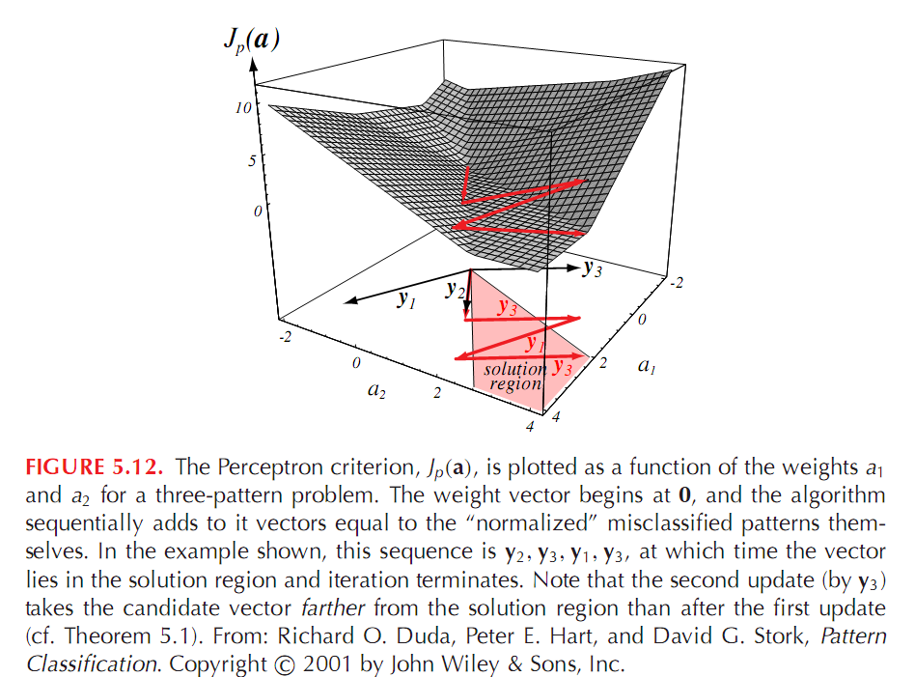
Figure 5.12

