Slide 1
Neural Networks
Overview
Backpropagation
Improving backpropagation
Other techniques

Slide 2
Overview
Artificial Neural Networks are crude attempts to model the
highly massive parallel and distributed processing we believe
takes place in the brain.
Consider: 1) the speed at which the brain recognizes images;
2) the many neurons populating a brain; 3) the speed at which a
single neuron transmits signals.
Notes:
What is machine learning?

Slide 3
Simple step function
The step function is based on a linear combination of real-valued inputs. If the combination is above a threshold it outputs a 1, otherwise it outputs a –1.
x1
w₁
Net function
x2
w₂
Σ
{1 or –1}
Sign function
w₀
xn
w_{n}
X₀=1
Notes:
What is machine learning?

Slide 4
Representational Power
A perceptron can learn only examples that are called “linearly separable”.These are examples that can be perfectly separated by a hyperplane.
+
+
+
+
+
-
+
-
-
-
-
-
Linearly separable
Non-linearly separable
Notes:
What is machine learning?

Slide 5
Limited flexibility
A linear combination of feature values is limited in flexibility.
We could use a functions to map into a larger
dimensional space.
The problem is what functions should we use?
Notes:
What is machine learning?

Slide 6
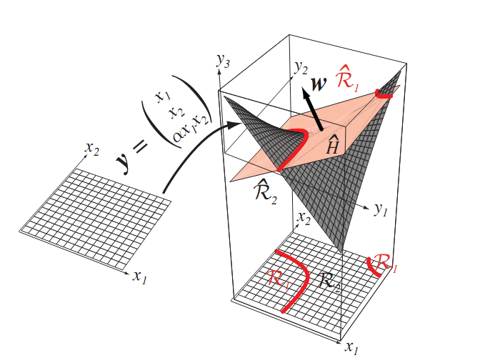
Figure 5.6

Slide 7
Neural Networks
They are made of layers of perceptrons.
Neural networks have high flexibility (representation power)
We will focus on a simple three-layer neural network.
Our architecture consists of an input layer, a hidden layer, and
an output layer.
All nodes are fully connected.
Notes:
What is machine learning?

Slide 8
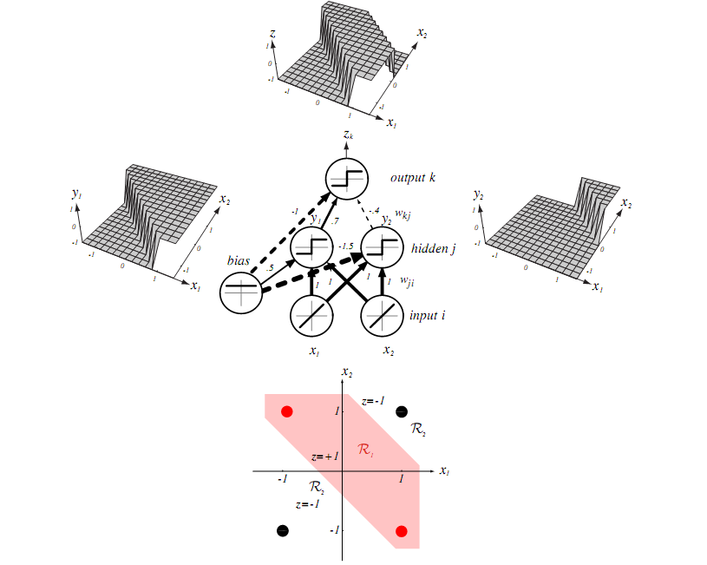
Figure 6.1
Notes:
What is machine learning?

Slide 9
Basics
In contrast to perceptrons, multilayer networks can learn not only
multiple decision boundaries, but the boundaries may be nonlinear.
Output nodes
Internal(hidden)
nodes
Input nodes
Notes:
What is machine learning?

Slide 10
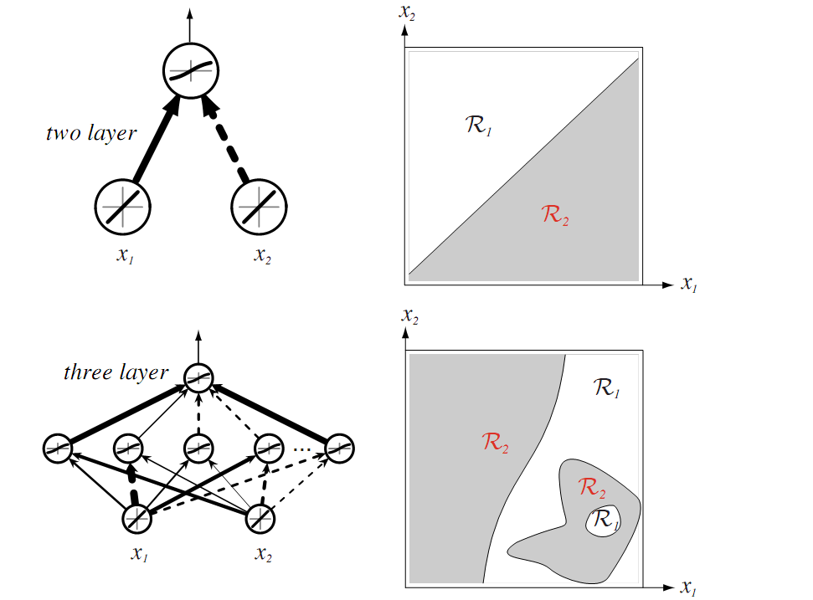
Figure 6.3
Notes:
What is machine learning?

Slide 11
One Single Unit
To make nonlinear partitions on the space we need to define
each unit as a nonlinear function (unlike the perceptron).
One solution is to use the sigmoid unit.
x₁
w_{j1}
x₂
net_{j}
w_{j2}
Σ
O = σ(net_{j}) = 1 / 1 + e ^{-netj}
w_{j0}
x_{d}
w_{jd}
X₀=1
Notes:
What is machine learning?

Slide 12
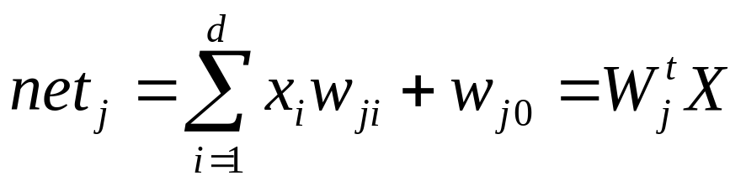
Net Activation
Each hidden unit performs the weighted sum of its inputs to form its (scalar) net activation or simply net.
Notes:
What is machine learning?

Slide 13
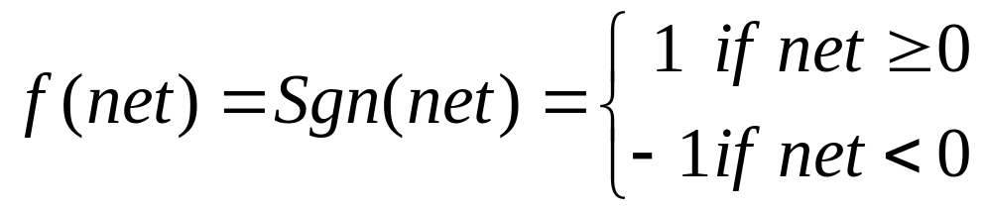
Transfer function
Each hidden unit emits an output that is a nonlinear function of its activation, f(net), i.e.,
y_{j}=f(net_{j})
This f() is sometimes called the transfer function
It may be sign (read "signum") or sigmoid function
Notes:
What is machine learning?

Slide 14
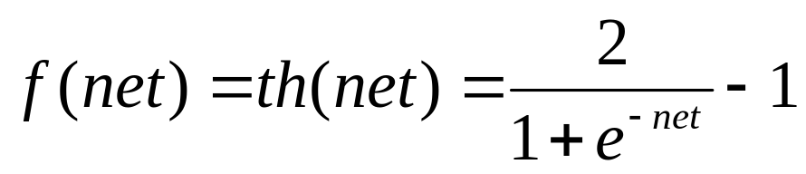
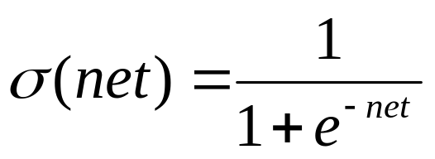
Sigmoid Function
or
Function σ is called the sigmoid or logistic function.
It has the following property:
dσ(x) / dx = σ(x) (1 – σ(x))
Notes:
What is machine learning?

Slide 15
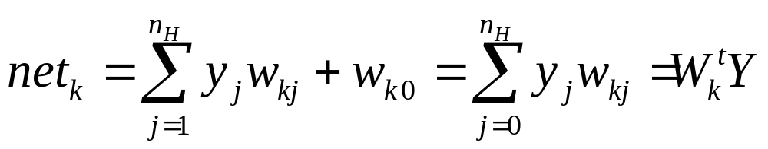
Output Nodes
Each output unit similarly computes its net activation based on the hidden unit signals as
where the subscript k indexes units in the output layer and n_{H} denotes the number of hidden units.
Each output unit then computes the nonlinear function of its net, emitting
z_{k}=f(net_{k})
Notes:
What is machine learning?

Slide 16
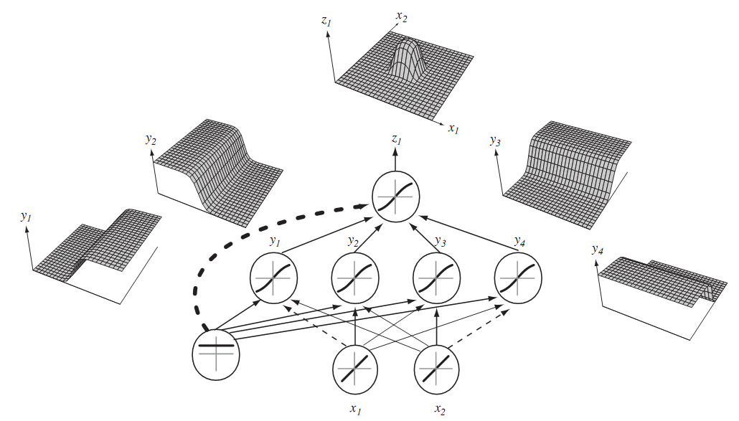
Feedforward Operation And Classification
Notes:
What is machine learning?

Slide 17
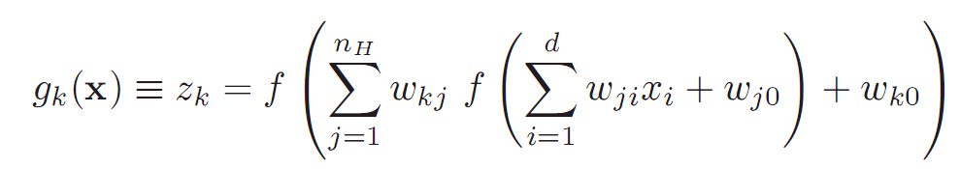
Feedforward Operation And Classification

Slide 18
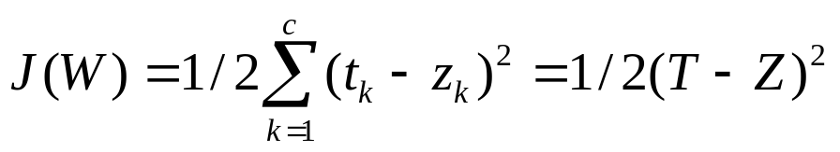
Backpropagation Algorithm
Goal: To learn the weights for all links in an interconnected
multilayer network.
We begin by defining our measure of error:
T and Z are the target and the network output vectors of length c; W represents all the weights in the network.
The idea is to use again a gradient descent over the space of weights to find a global minimum (no guarantee).
Notes:
What is machine learning?

Slide 19
A Function Over the Weight Space
The idea is to find a minimum in the space of weights and
The error function J:
J(W)
w₁
w₂
Notes:
What is machine learning?

Slide 20
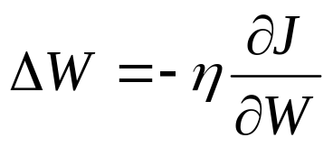

Backpropagation Algorithm
The weights are initialized with random values, and are changed in a direction that will reduce the error:
where η is the learning rate,
at iteration m updating it as:
Notes:
What is machine learning?

Slide 21
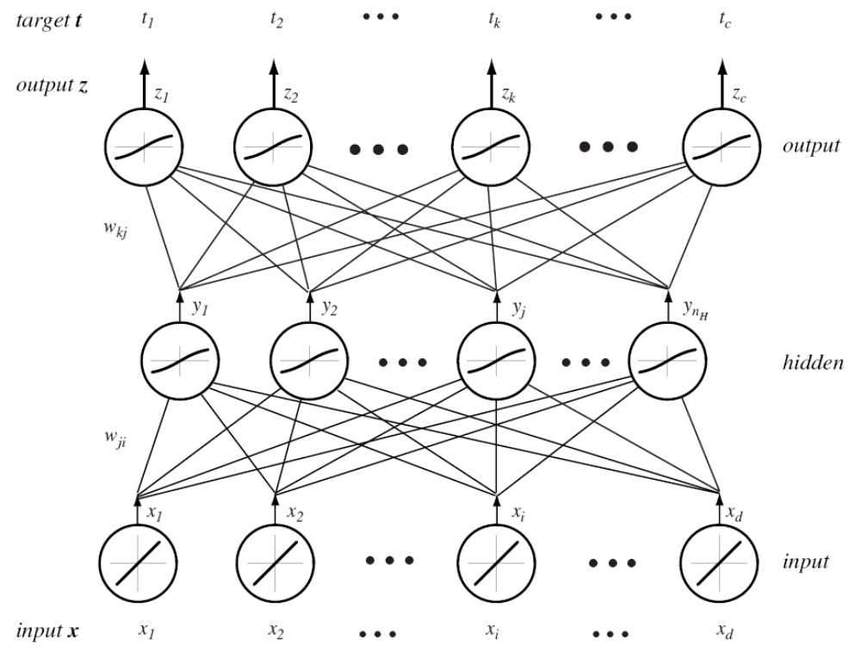

Slide 22
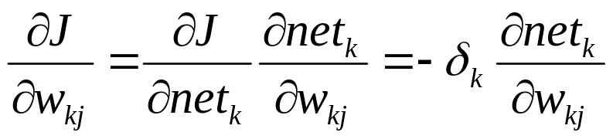
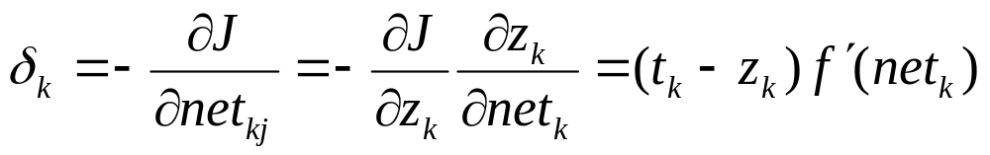
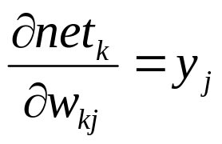
Backpropagation Algorithm
We now turn to the problem for a three-layer net.Consider first the hidden-to-output weights, w_{kj}.
where the sensitivity of unit k is defined to be
and
Notes:
What is machine learning?

Slide 23
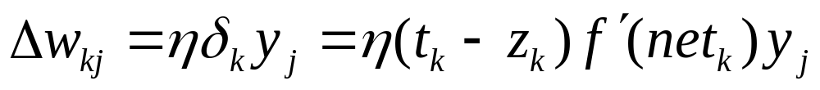
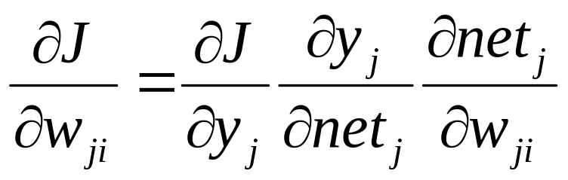
Backpropagation Algorithm
Taken together, these results give the weight update (learning rule) for the hidden-to-output weights:
The learning rule for the input-to-hidden units.
Notes:
What is machine learning?

Slide 24
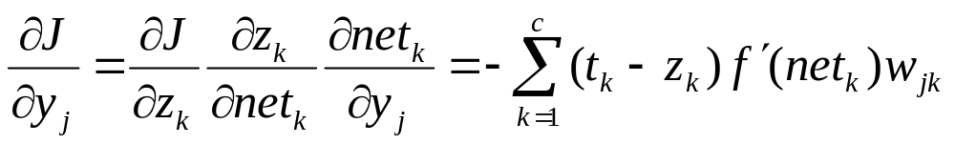
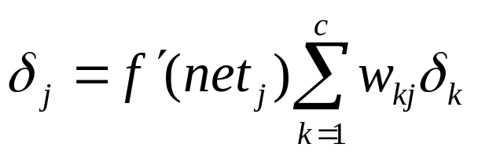
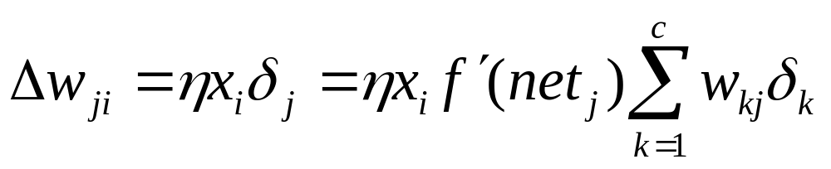
Backpropagation Algorithm
define the sensitivity for a hidden unit as:
Thus the learning rule for the input-to-hidden weights is:
Notes:
What is machine learning?

Slide 25

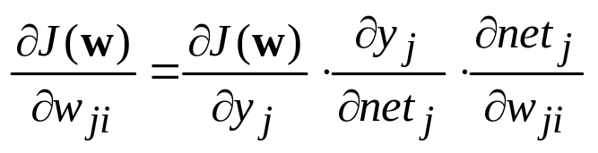
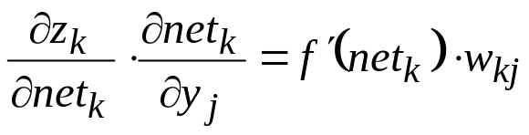
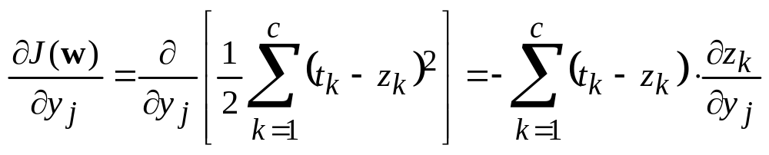
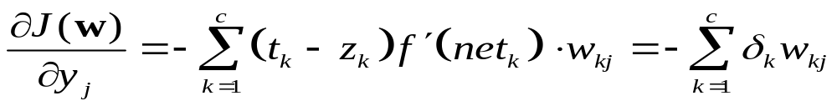
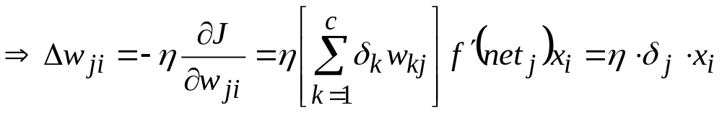
Backpropagation Algorithm
x_{i}
δ_{k}
= δ_{j}

Slide 26
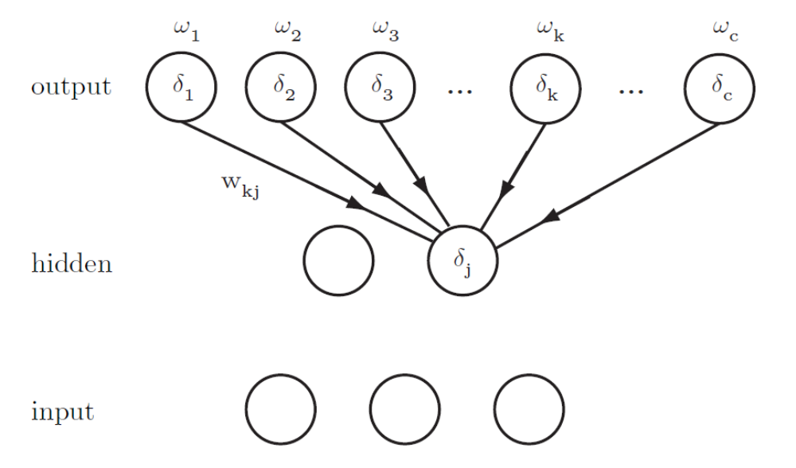

Slide 27
Algorithm
Create a network with n_{in} input nodes, n_{H} internal nodes,
and n_{out} output nodes.
Initialize all weights to small random numbers.
Until error is small do:
  For each example X do
    Propagate example X forward through the network
    Propagate errors backward through the network
Notes:
What is machine learning?

Slide 28
Propagating Forward
Given example X, compute the output of every node until
we reach the output nodes:
Output nodes
Compute sigmoid
function
Internal nodes
Input nodes
Example X
Notes:
What is machine learning?

Slide 29
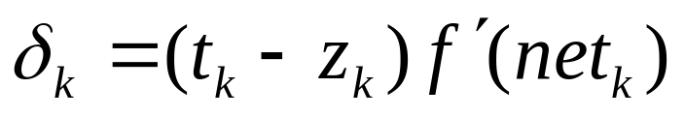
Propagating Error Backward
w_{kj} ← w_{kj} + ηδ_{k}y_{j}
w_{ji} ← w_{ji} + ηδ_{j}x_{i};
Notes:
What is machine learning?

Slide 30
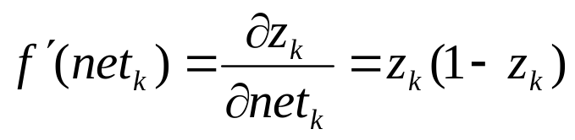
Backpropagation using sigmoid function
For sigmoid fountion
For each output node k compute the error:
δ_{k} = z_{k} (1-z_{k})(t_{k} – z_{k})
B. For each hidden unit h, calculate the error:
δ_{h} = z_{h} (1-z_{h}) Σ_{k} w_{kh} δ_{k}
C. Update each network weight:
w_{ji} = w_{ji} + Δ w_{ji}
where Δ w_{ji} = η δ_{j} x_{ji} (w_{ji} and x_{ji} are the input and weight
of node i to node j)
Notes:
What is machine learning?

Slide 31
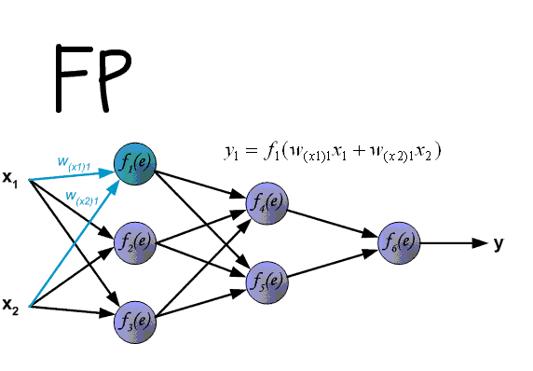
Backpropagation

Slide 32
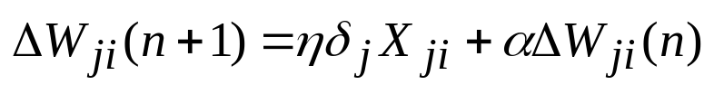

Adding Momentum
The weight update rule can be modified so as to depend
on the last iteration. At iteration n we have the following:
Where is a constant called the momentum.
It increases the speed along a local minimum
It increases the speed along flat regions.
Notes:
What is machine learning?

Slide 33
Remarks on Backpropagation
It implements a gradient descent search over the weight space.
It may become trapped in local minima.
In practice, it is very effective.
The more weights the chances to avoid local minima.
How to avoid local minima?
  Add momentum
  Use stochastic gradient descent
  Use different networks with different initial values
  for weights.
Notes:
What is machine learning?

Slide 34
Training Protocols
Stochastic Training:
Examples are chosen randomly from the training set.
Weights are updated on each example.
Batch Training:
Examples are given to the network before weights are updated
Online Training
Each example is selected once and only once; we do not store
examples in memory.
Notes:
What is machine learning?

Slide 35
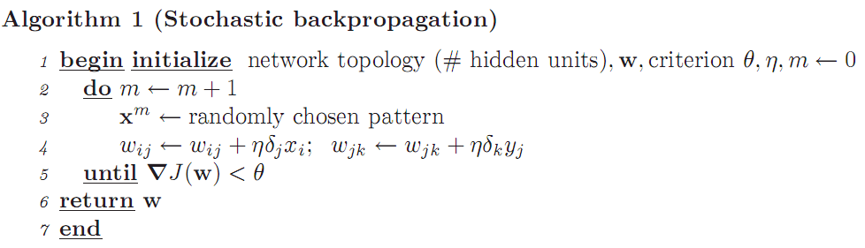
Stochastic Training

Slide 36
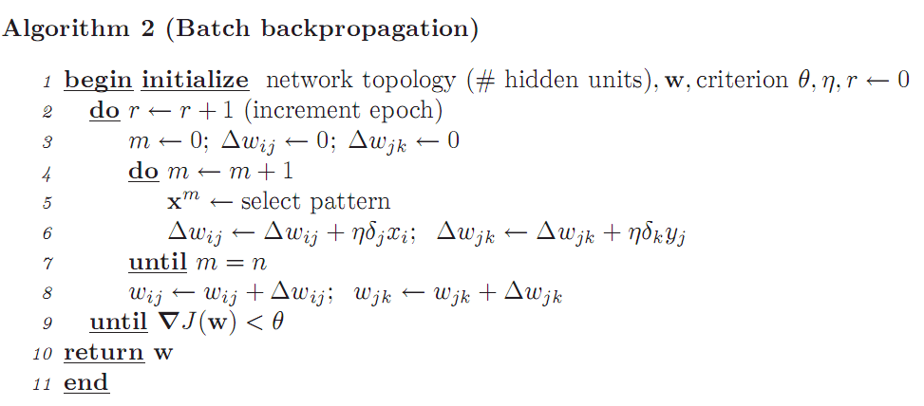
Batch Training

Slide 37
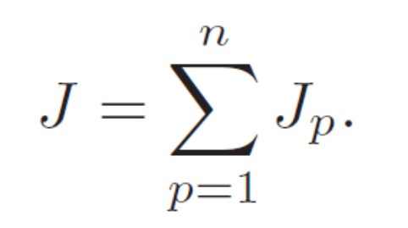
Total training error
Jp -- the error on a single pattern

Slide 38
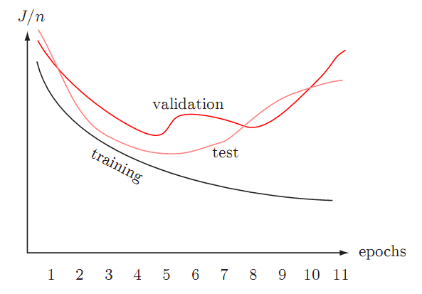
Learning curves
Notes:
Epochs: 训练次数

