Slide 1
Neural Networks
Overview
Backpropagation
Improving backpropagation
Other techniques

Slide 2
Improving Backpropagation
Activation Function.
Remember the sigmoid function:
x1
w1
x2
net
w2
Σ
O = σ(net) = 1 / 1 + e ^{-net}
w0
xn
wn
X0=1
Notes:
What is machine learning?

Slide 3
Other Activation Functions
One may use other activation functions.
Properties:
Function must be nonlinear (to increase the computational power)
Function must saturate (keep the weights and activations bounded)
Continuity and smoothness. f(.) and its derivative f’(.) must be defined.
Monotonicity. (desirable but not necessary).
Notes:
What is machine learning?

Slide 4
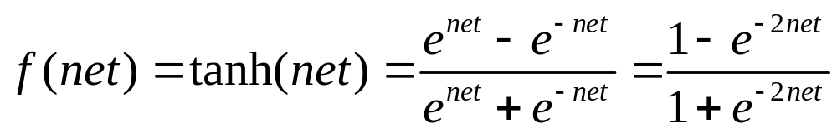
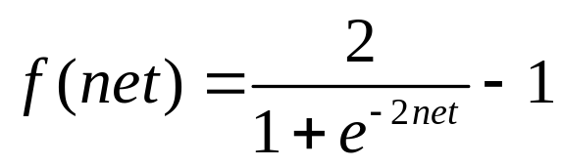

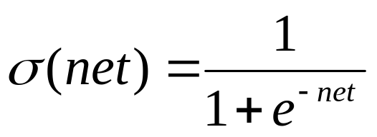
Alternative Sigmoid Functions
hyperbolic tangent:
Sigmoid Function:
σ'(x) = σ(x) (1 – σ(x))
Notes:
经验表明，在隐藏层中使用tanh函数的效果是优于sigmoid函数的，因为其输出更接近零均值。这会使得下一层的学习更加简单

Slide 5
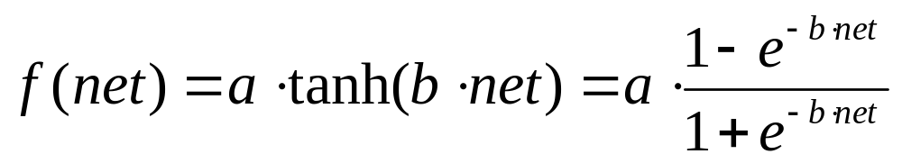
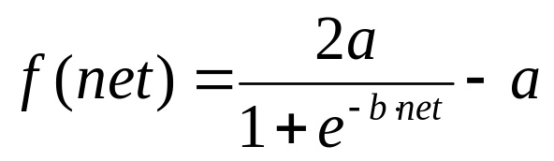
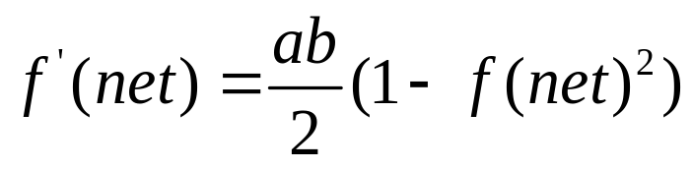
hyperbolic tangent function
Normally we choose a = 1.716 and b = 2/3
f '(0)≈0.5, linear range: -1<net<+1
The extrema of f '' (net) occur roughly at net=±2

Slide 6
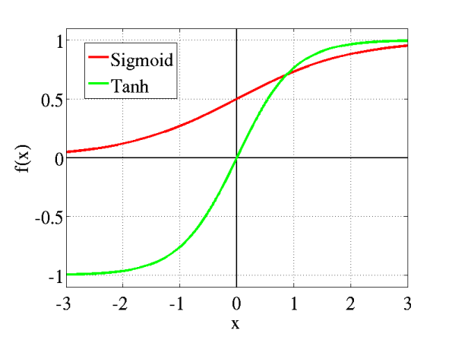
Sigmoid and tanh

Slide 7
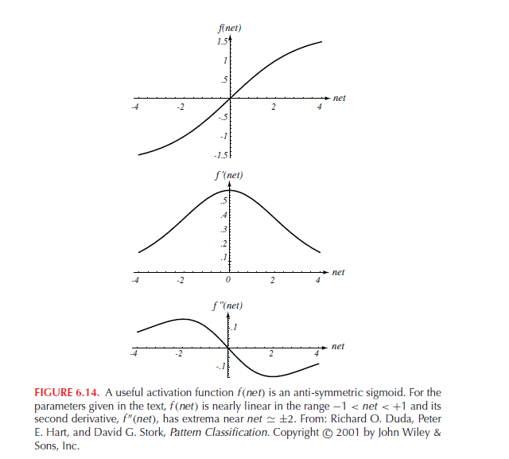

Slide 8
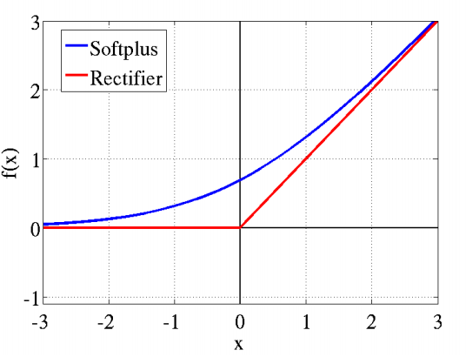
Softplus and ReLU(Rectified Linear Unit)
Softplus: log(1+e^{x})
ReLu: max(0,x)
Notes:
ReLu更多在隐含层使用

Slide 9
Scaling Input
If one attribute is much larger than another attribute, the weights will be adjusted to represent such differences; that is not desirable.
Example: mass and length of a fish.
Solution:
Standardize all features previous to training.
The mean of each feature should be zero.
The variance should be fixed (e.g 1.0 )
Notes:
What is machine learning?

Slide 10
Target Values
Output units saturate at ± 1.716. For any finite value of net_{k}, the output would be less than the saturation values, and thus there would be error.
It is convenient to use values of +1 for the target category and –1 for the non-target category.
Example: for a four-category problem where class 3 is the one assigned,the true output pattern should be (-1, -1, +1, -1).
-1 -1 +1 -1
Notes:
What is machine learning?

Slide 11
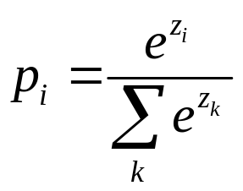
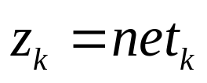
Softmax Function
softmax function is a generalization of the logistic function
p₁ p₂ p₃ p₄
z1 z2 z3 z4

Slide 12
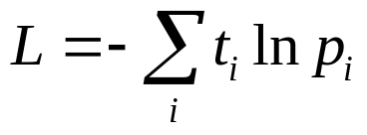

Cross-entropy cost function
t_{i}=0 or 1
If training sample x ∈ ω_{i}
p_{i}
z1 z2 z3 z4
Notes:
每个参数加一个固定值不影响pi或L的值，即参数有无穷多解，通常需要做参数衰减

Slide 13
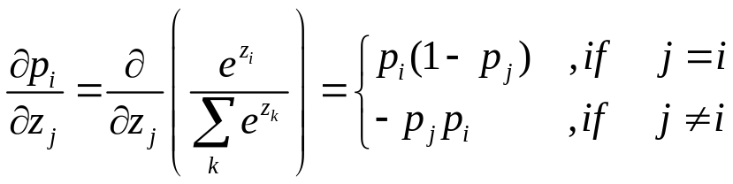
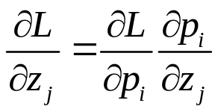
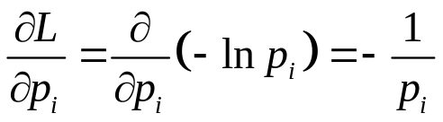
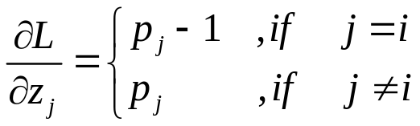
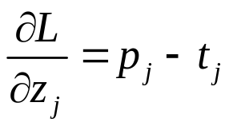
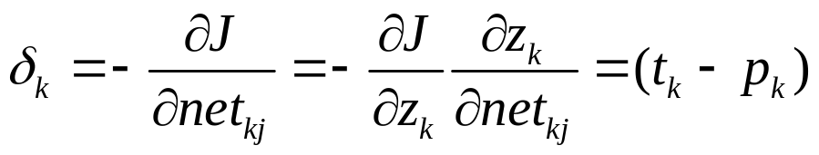
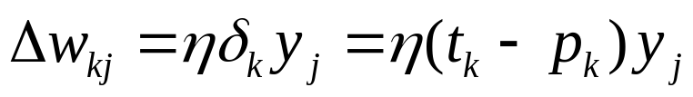
Cross-entropy cost function
or

Slide 14
Feedforward
p₁ p₂ p₃ p₄
z1 z2 z3 z4

Slide 15
Backpropagation
training sample x ∈ ω₂
P₁ P₂ -1 P₃ P₄
z1 z2 z3 z4

Slide 16
Training with Noise
If training set is small, one can “produce” examples and use them as if they were normal examples by generating them from the same distribution.
Assumption: Add d-dimensional Gaussian noise to the true training points.
x2
x1
Notes:
What is machine learning?

Slide 17
Number of Hidden Units
The number of hidden units is related to the “expressiveness” of the neural network (the complexity of the decision boundary).
If examples are easy to discriminate few nodes are necessary.
Conversely complex problems require many internal nodes.
A convenient rule is to choose roughly n / 10 weights, where n is The number of training examples.
Notes:
What is machine learning?

Slide 18
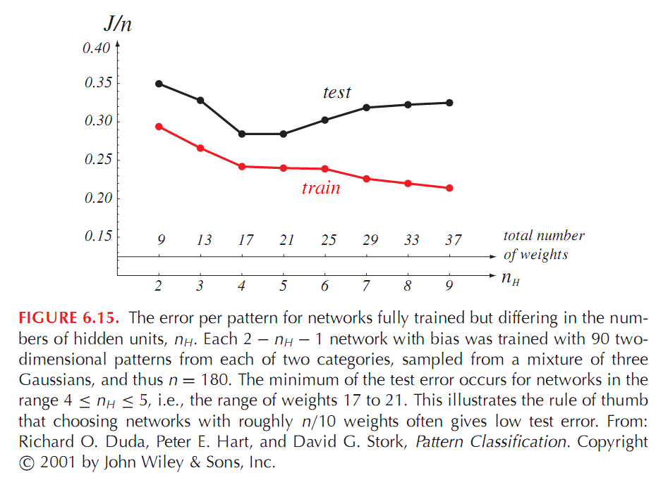
Figure 6.15
Notes:
What is machine learning?

Slide 19
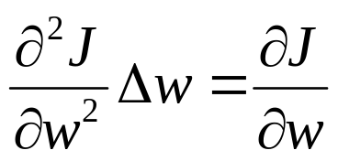
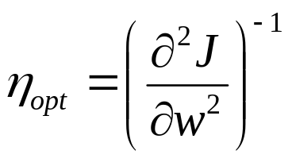
Learning Rates
Different learning rates affect significantly the performance
of a neural network.
Optimal Learning Rate:
Leads to the local error minimum in one learning step.
It’s been found that a principled method to set the learning rate
is to assign a value “separately” for each weight.
If the criterion function is quadratic, then
Notes:
What is machine learning?

Slide 20
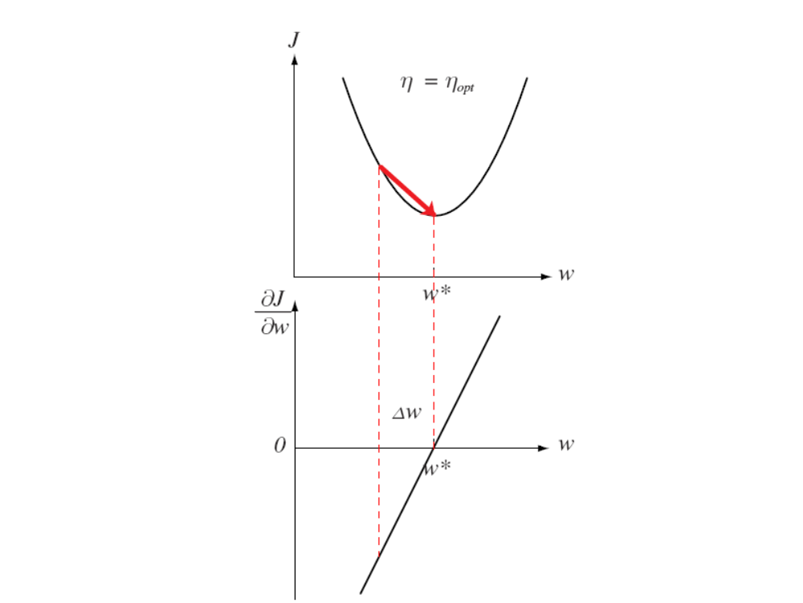

Slide 21
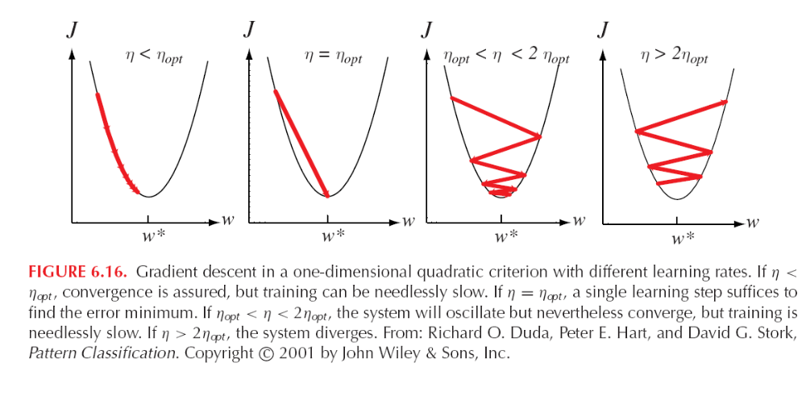
Figure 6.16
Notes:
What is machine learning?

Slide 22
Momentum
Error surfaces may have plateaus.
These are regions where the derivative of the error function is very small.
Points to consider:
Plateaus arise when there are “too many” weights.
Momentum learns more quickly when plateaus exist.
We modify the learning rule to include some fraction α of the
previous weight update:
w(t + 1) = w(t) + (1- α ) Δ W_{bp}(t) + α Δ w(t-1)
If α = 0, the rule is standard backpropagation. If α = 1 backropagation is
ignored and the weight vector moves with constant velocity.
Notes:
What is machine learning?

Slide 23
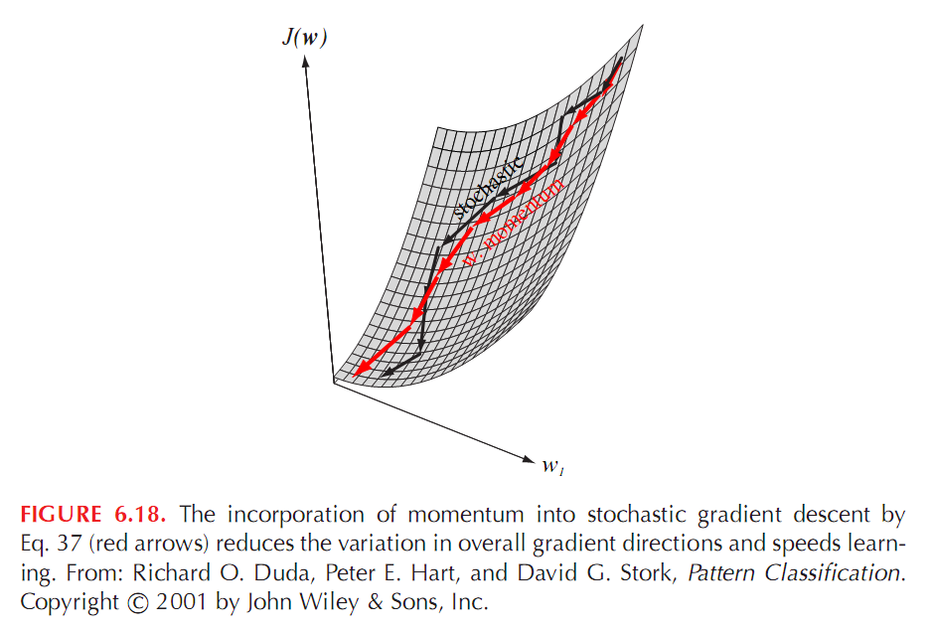
Figure 6.18
Notes:
What is machine learning?

Slide 24
Weight Decay
To avoid overfitting we can impose a method to ensure
the set of weights decay as we approach an optimal solution.
One method is to modify each weight after is been updated
as follows:
W ^{new} = W ^{old} ( 1 – ε )
Where 0 < ε < 1.
The result is that weights that are not needed are reduced as the
criterion function becomes smaller.
Notes:
e.g. softmax

Slide 25
Learning with Hints
The idea is to add output units to help the classification problem.
Example:
Learning to classify c phonemes based on an acoustic input.
Add to outputs for vowels and consonants:
phonemes
vowel consonant
Notes:
What is machine learning?

Slide 26
Adaptive Learning Algorithms
“A Direct Adaptive Method for Faster Backpropagation Learning:
The RPROP algorithm” by Martin Riedmiller and Heinrich Braun.
Proc. of the IEEE Intl. Conf. on Neural Networks, San Francisco, CA
pages = 586-591, 1993.
(http://citeseer.nj.nec.com/riedmiller93direct.html).
Description.
The weight update rule in backpropagation depends on several parameters:
-learning rate
-momentum
How do we adjust them adaptively during training?
Notes:
What is machine learning?

Slide 27
Adaptive Learning Algorithms
Adaptive learning algorithms adjust their parameters automatically.
Parameters are NOT FIXED.
There are two kinds:
Global.
Use information about the whole network to modify
global parameters.
Local.
Use weight-specific information to adapt parameters
related to each weight.
Notes:
What is machine learning?

Slide 28
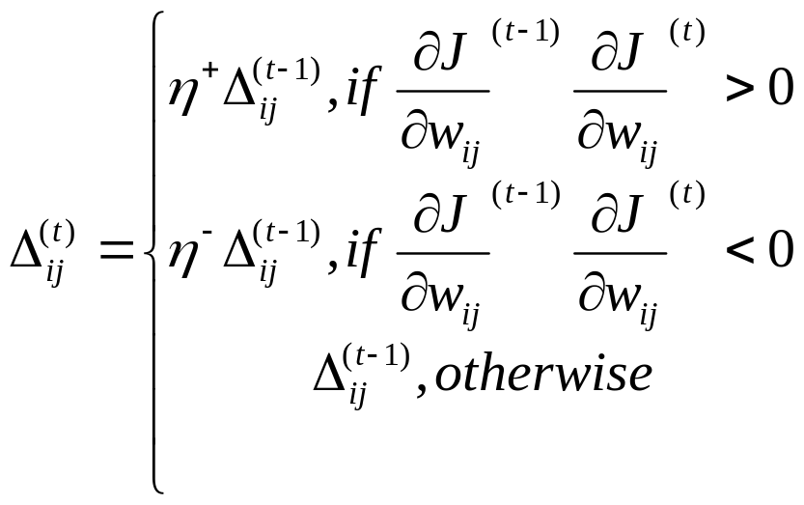
RPROP: Resilient Propagation
The authors propose an approach to modify each weight
that is “local”.
The authors ignore the value of the derivative and consider
only its sign.
Where 0 < η⁻ < 1 < η⁺
Notes:
What is machine learning?

Slide 29
RPROP: Resilient Propagation
Interpretation of the weight update rule:
If the partial derivative of a weight changes sign it means the
last update is too big and we have jumped over a local minimum.
Decrease the update value by η⁻ .
If the partial derivative does not change sign, then increase the
update value by η⁺ to increase convergence.
Error
function
Notes:
What is machine learning?

Slide 30
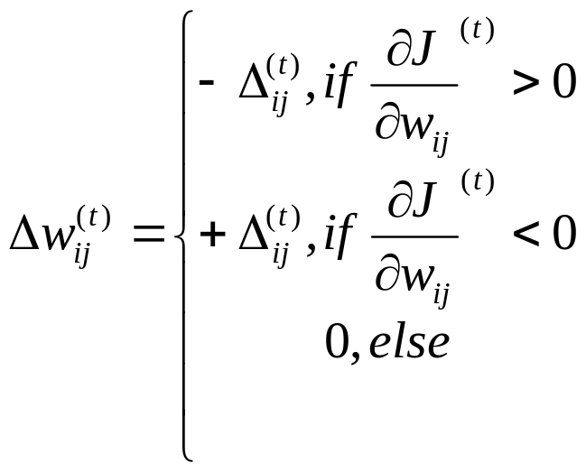
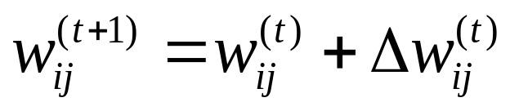
Adaptive Weight Update
The weight is adjusted based only on the the sign of the derivative:
(increasing error)
(decreasing error)
Notes:
What is machine learning?

Slide 31
Other Techniques
Radial basis function networks
Time delay neural networks
Recurrent Networks
Cascade Correlation
Notes:
What is machine learning?

Slide 32
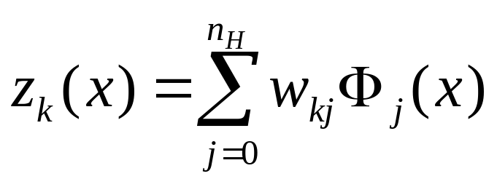
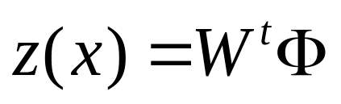
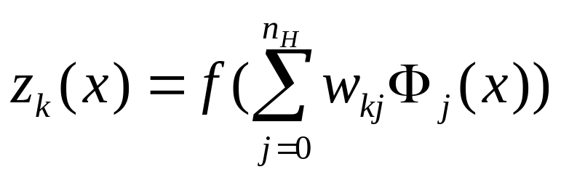
Radial basis function networks (RBF)
A radial basis function network with linear output unit implements
Where Φ_{j}(x) are the hidden unit outputs,
or
Notes:
What is machine learning?

Slide 33
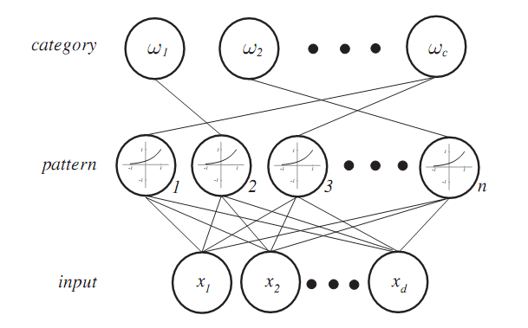
PNN
Φ(x) is Gaussian function

Slide 34
Time Delay Neural Networks(TDNN)
Convolutional Neural Networks(CNN)
How can we incorporate prior knowledge into the network?
For example, assume we wish our classifier to be insensitive to
translations of the pattern.
The solution is similar to a neural network but:
Hidden units accept input from a restricted range of positions.
Weights shifted to right or left must have the same value.
Applications: speech and character recognition.
Notes:
What is machine learning?

Slide 35
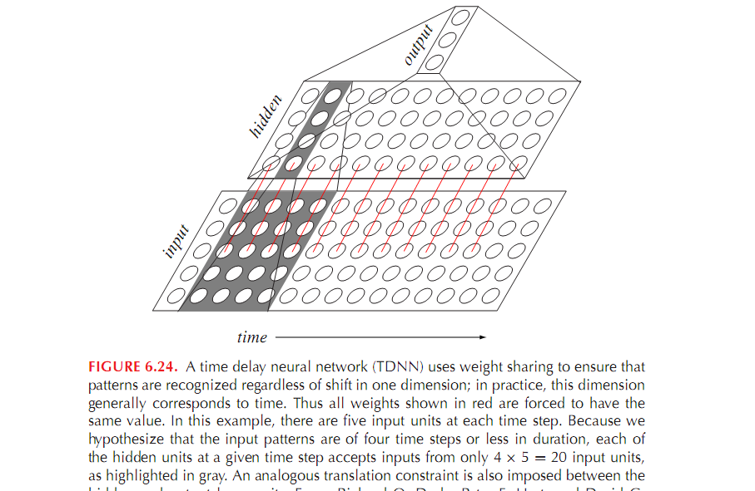
Figure 6.24
Notes:
What is machine learning?

Slide 36
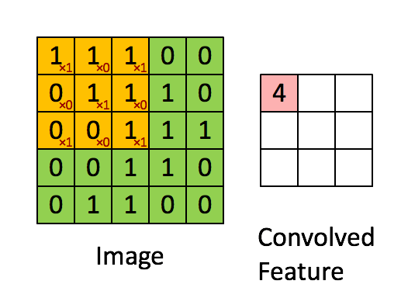
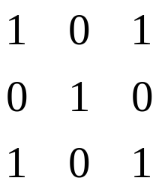
Convolution
convolution kernel

Slide 37
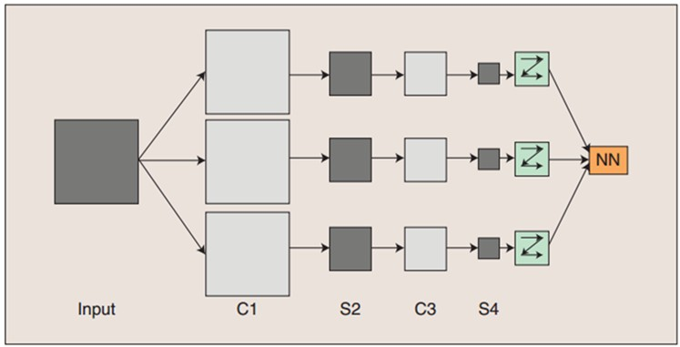
Deep learning

Slide 38
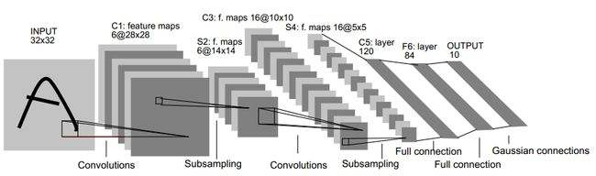
Deep learning
Sub-sampling layer----Pool

Slide 39
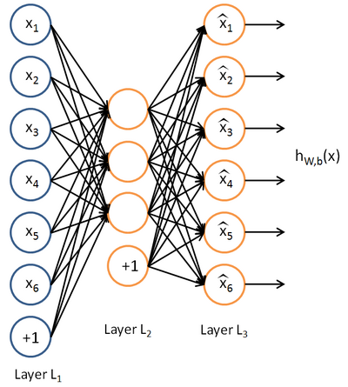
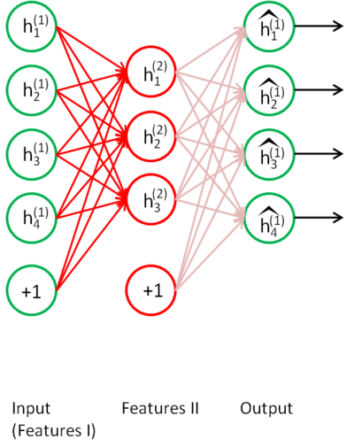
Auto encode

Slide 40
Recurrent Networks
Recurrent networks have found application in time series prediction.
Main ideas:
The output units are “fed back” and duplicated as auxiliary inputs.
During classification a pattern is presented to the input units.
The feedforward flow is done, and the outputs serve as auxiliary
input nodes.
This produces new activations, and new outputs.
Notes:
What is machine learning?

Slide 41
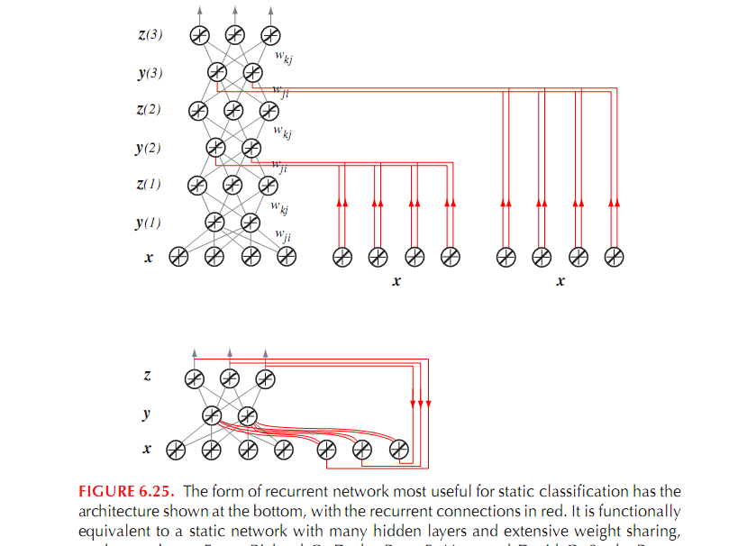
Figure 6.25
Notes:
What is machine learning?

Slide 42
Cascade-Correlation
Main ideas:
Begin with a two-layer network and train it.
If error is low enough stop.
If not do the following:
a. Fix all weights
b. Add one node and connect it to all input and output units.
c. Train the network by adjusting only the weights of the
new node
4. Go to step 2.
Notes:
What is machine learning?

Slide 43
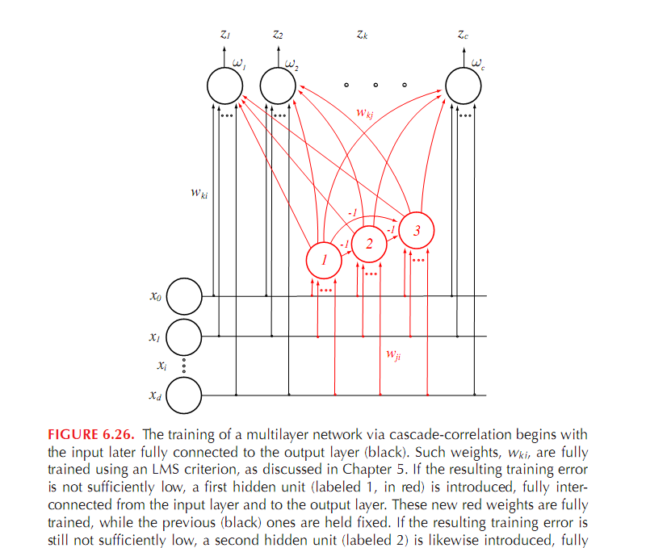
Figure 6.26
Notes:
What is machine learning?

